Slide 1
Uploading on Jupyter Notebook
Salima Khan

Slide 2
Jupyter
Visit Project Jupyter | Home

Slide 3
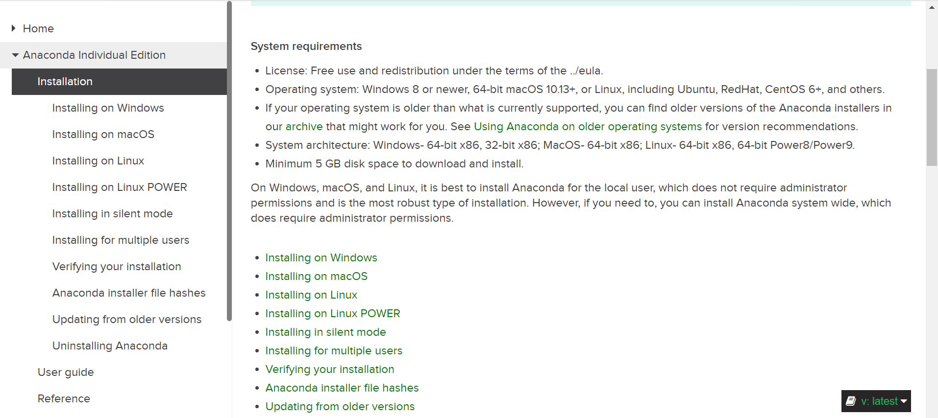
Installing Anaconda Navigator
Visit Installation — Anaconda documentation
Click on the link shown below

Slide 4
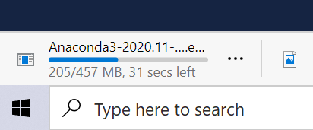
Installing Anaconda Navigator
Click on the link shown in the picture below
It will begin downloading

Slide 5
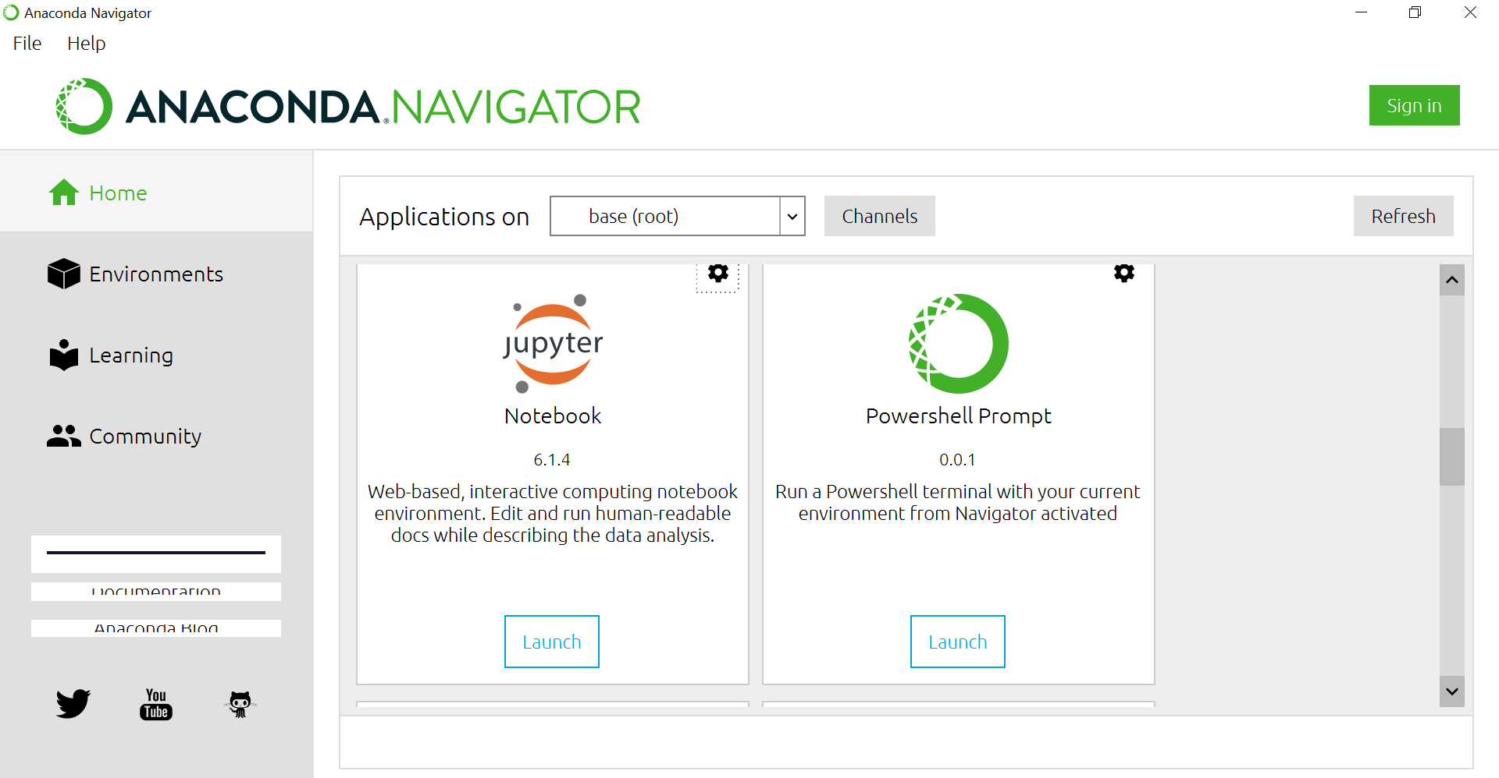
Launch Jupyter Notebook

Slide 6
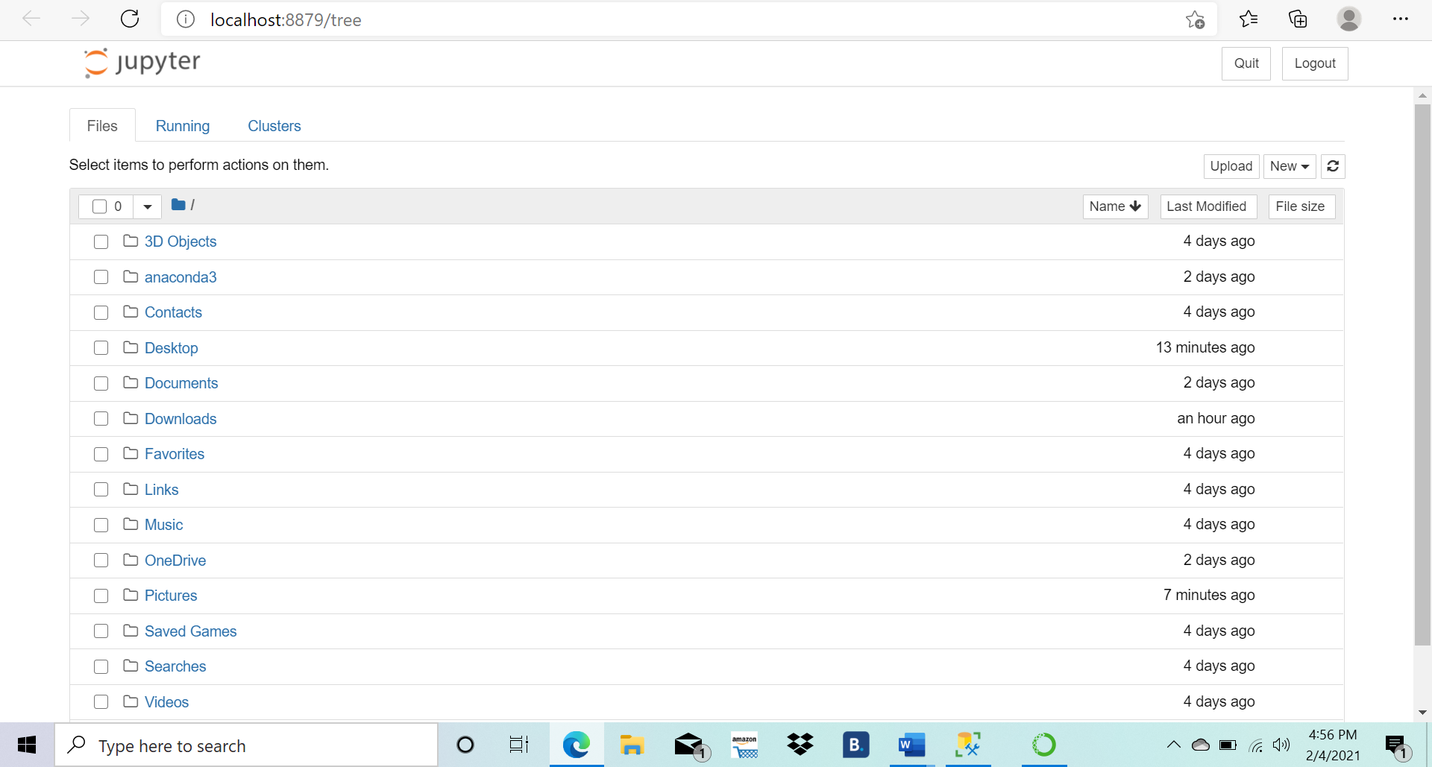
Notes:
Once you launch jupyter notebook it should open in your browser and look something like this. Now you want to click on new in the top right.

Slide 7
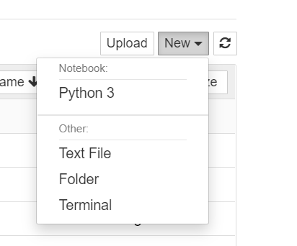
Creating a new Notebook
Click on ‘Python 3’

Slide 8
Rename your Notebook

Slide 9
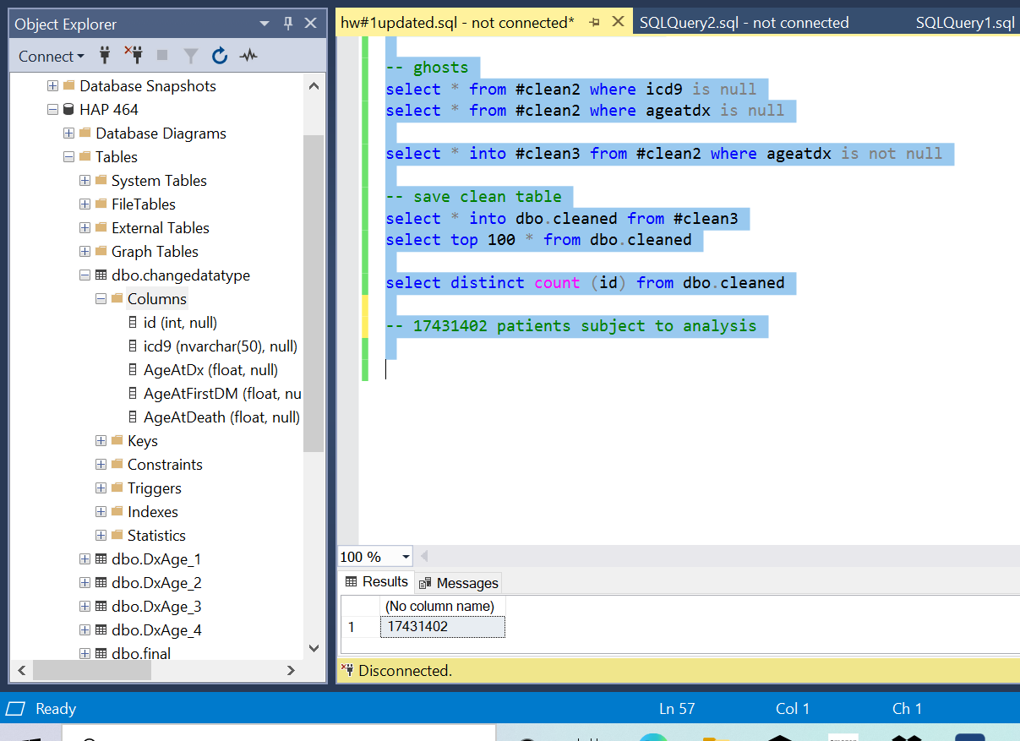
Copy your SQL work

Slide 10
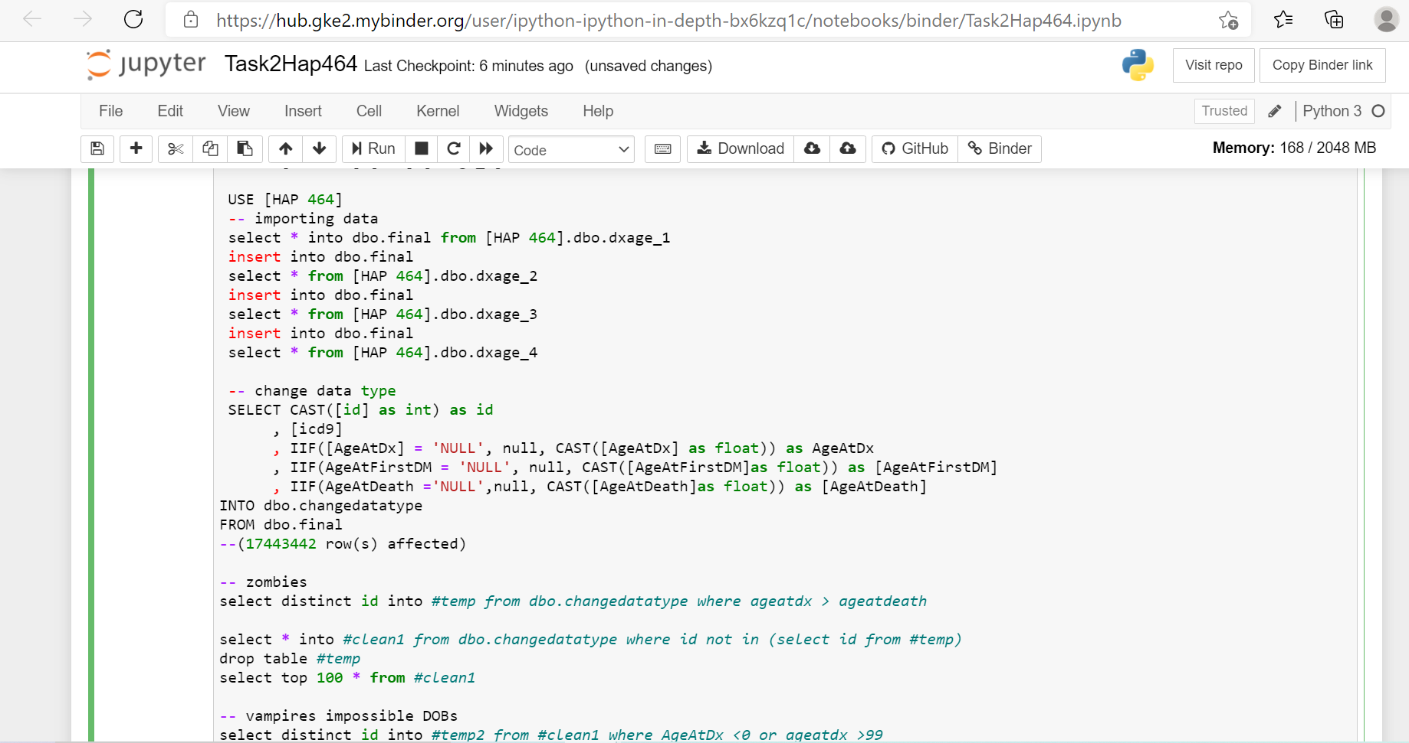
Paste your SQL work into Jupyter Notebook

Slide 11
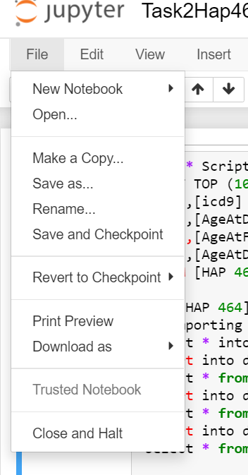
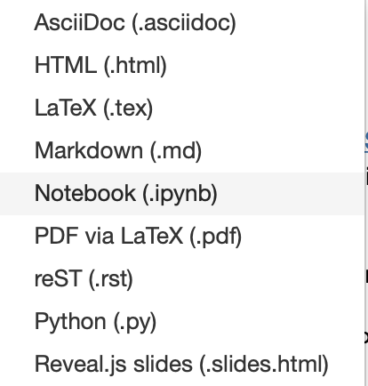
Download Jupyter Notebook as .ipynb file

Slide 12
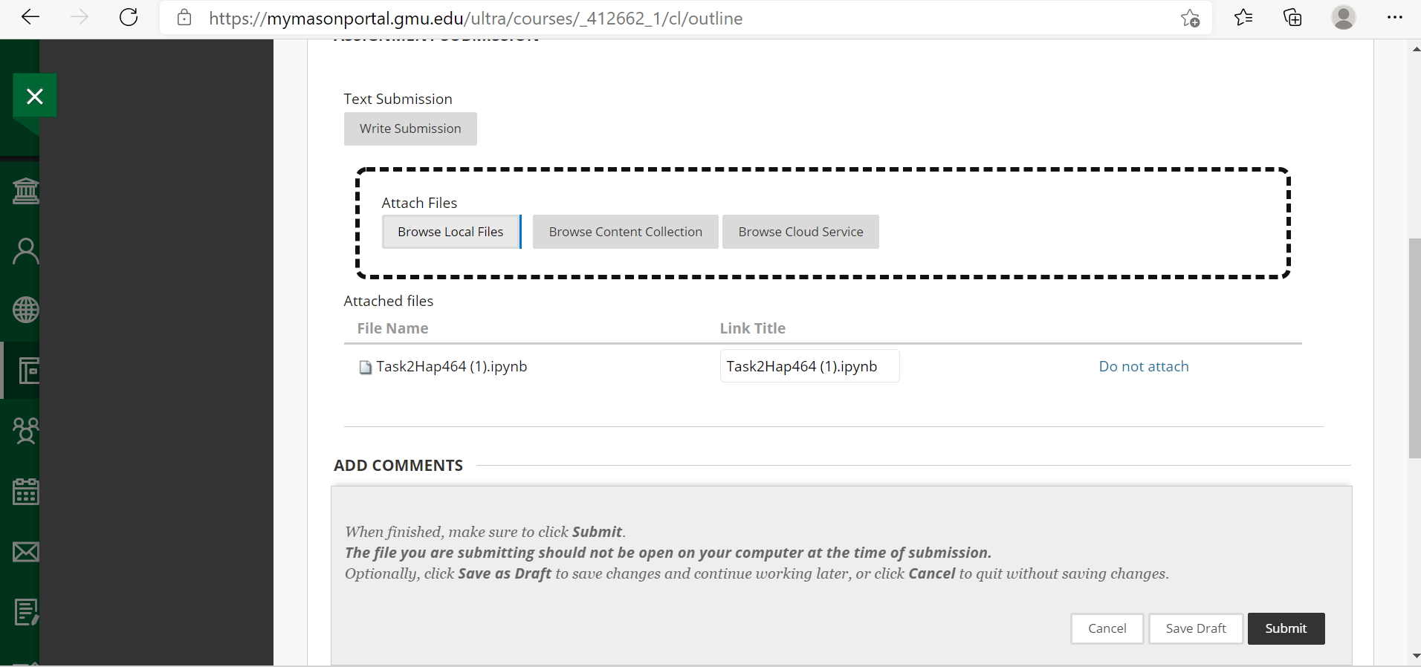
Upload to Blackboard

Slide 13
Questions?

