Slide 1
Multi-Morbidity Ontological Adjustment of Scoring
By: Maira Imran
HAP 464
Professor Alemi

Slide 2
Background
Definition: Ontology adjustment can be utilized to group rare comorbidities into reasonably broad concepts that occur sufficiently in the data to capture the effectiveness of treatment for patients with these conditions.

Slide 3
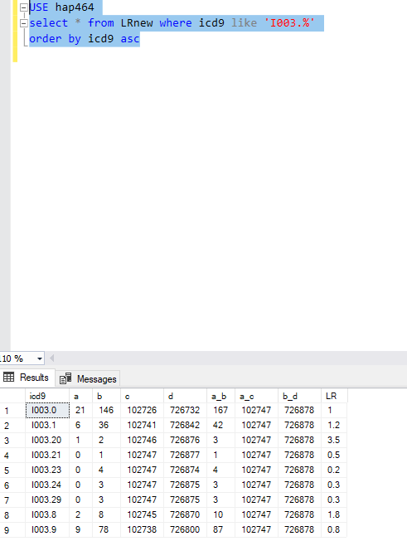
Code
Download and import LR data from Blackboard
Order by icd9 asc

Slide 4
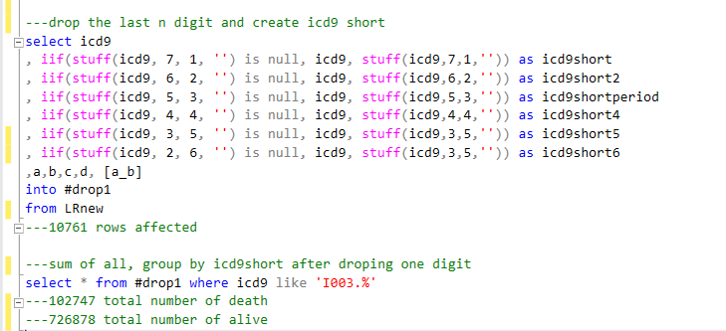
Code

Slide 5
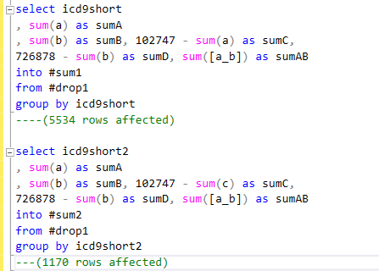
Code

Slide 6
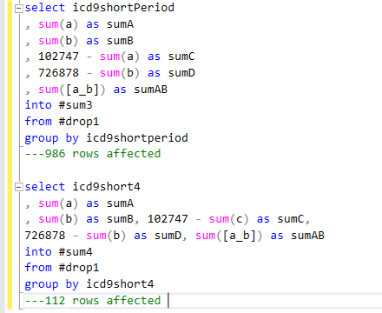
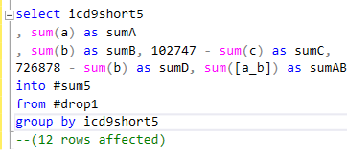
Code

Slide 7
Code

Slide 9
