Slide 1
Teach One
Accuracy of Multimorbidity Index
Ofaq Gul
HAP 464
Professor Alemi

Slide 2
Test the accuracy of the Multimorbidity Index in predicting mortality of patients in 6-months.
Score the Multimorbidity Index using ontological adjustments
Calculate the sensitivity and specificity of the index
Calculate area under receiver operating curve
Plot data using Excel
TASKS:

Slide 3
STEP ONE
Start with Body System Adjustment codes:
Original code
Modify original code

Slide 4
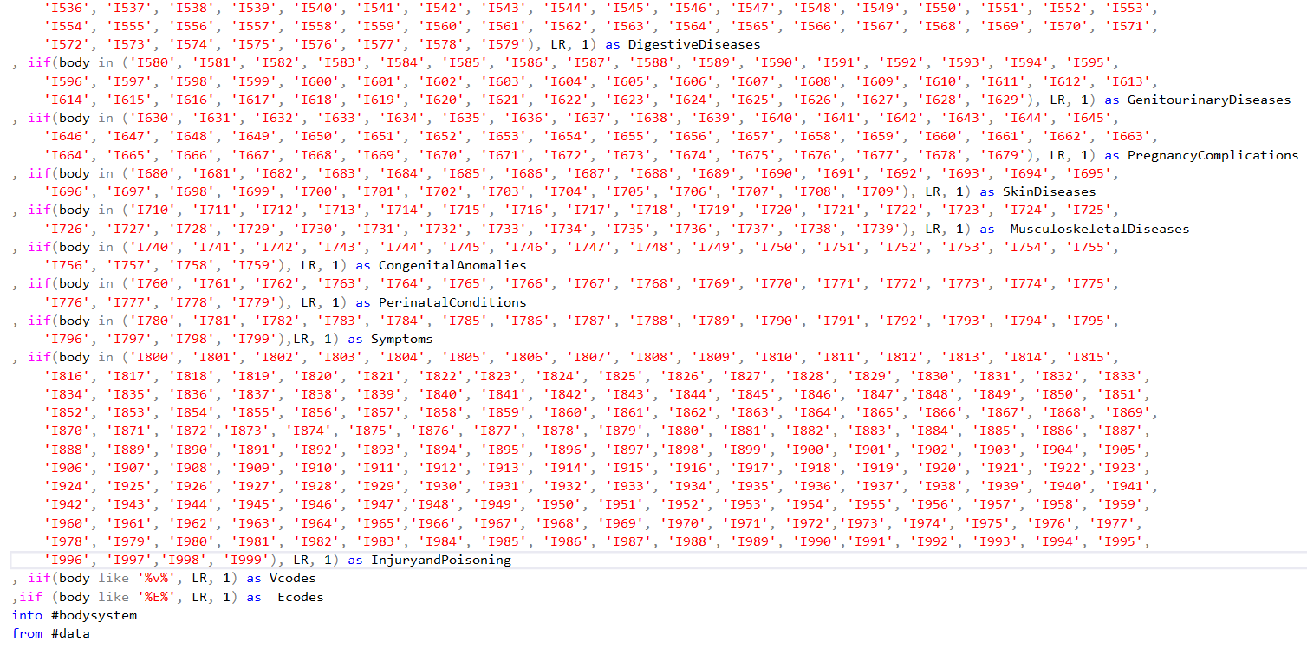
Step two
Keep original code from Body Systems Adjustments

Slide 5
Step three
Make changes to the original code
From Body Ontological Adjustments

Slide 6
Step four
Here we are using the original code from
Charlons Accuracy and modifying it

Slide 7
Step five
Classify predicted scores by comparison to cutoff
*Same code from Charlsons Accuracy
Except I am sampling different cutoff levels

Slide 8
Step six
Classify predicted scores by comparison to cutoff
Calculate sensitivity and specificity
*Same codes from Charlsons Accuracy
Except I am sampling different cutoff levels

Slide 9
Step seven
Calculate area under the receiver operating curve
*Same code from Charlsons Accuracy
Except I am sampling different cutoff levels

Slide 10
excel
Run this code to get your data and insert it into Excel

