Slide 1
Teach One Assignment: Charlson Accuracy
Name: Omar Ali
Class: HAP 464-DL1
Professor: Farrokh Alemi

Slide 2
Table of Contents
Sensitivity
Specificity
Receiving Operating Curve: Calculating the Area Under the Curve
Task 1: Test the accuracy of Charlson index in predicting mortality of patients.
SQL Code
Excel Work

Slide 3
Sensitivity
$$Sensitivity=\frac{True Positives}{True Condition Present}$$

Slide 4
Specificity
$$Specificity=\frac{True Negatives}{True Condition Absent}$$

Slide 5
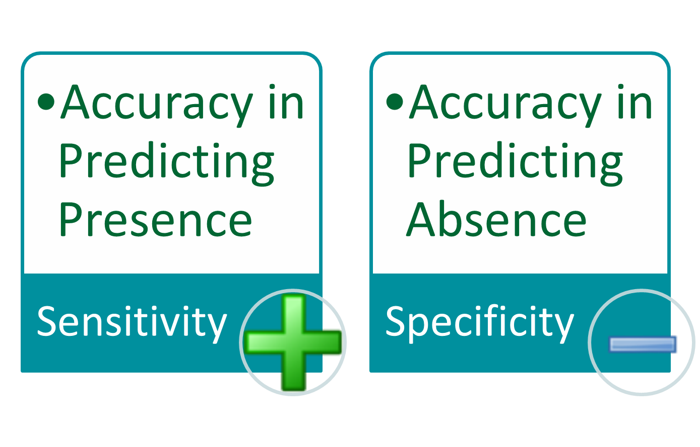

Slide 6
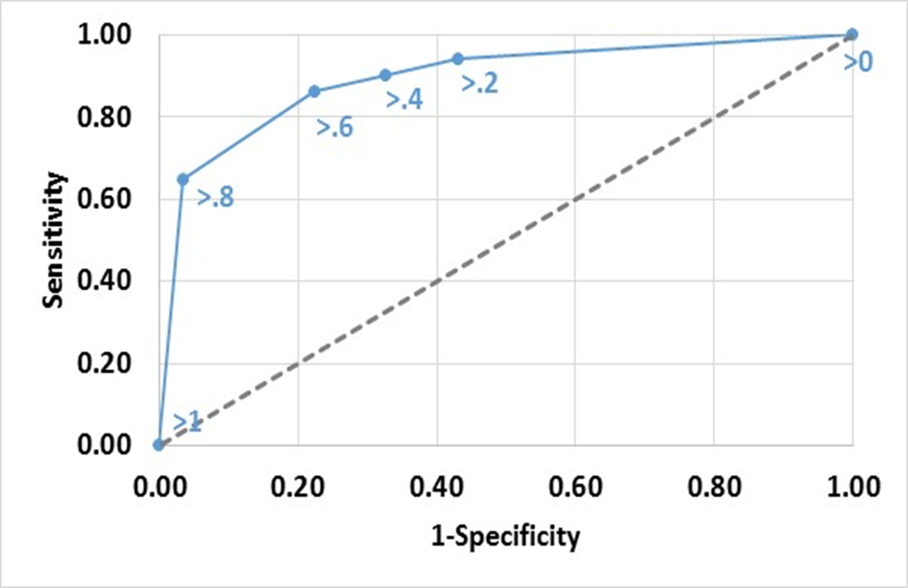
Receiver Operating Curve: Area Under the Curve

Slide 7
SQL Code

Slide 8
Open Previous Charlson Scoring Query

Slide 9
Reformat Charlson Score Accordingly

Slide 10
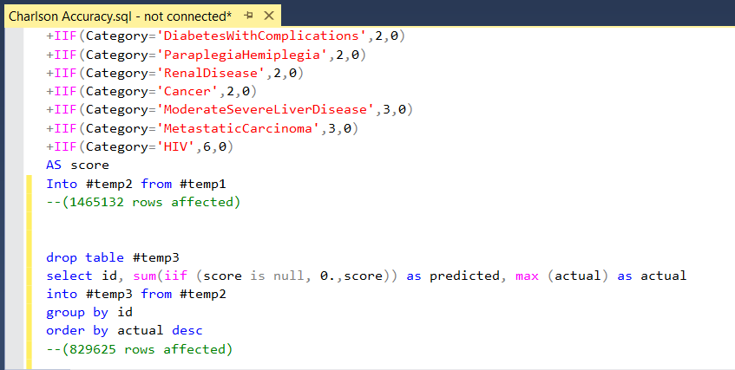
Reformat Chalrson Score Accordingly (cont.)

Slide 11
-- Step 4 calculate area under 2 cutoffs

Slide 12
-- Step 1 decide on a sample of cutoff levels to try ---

Slide 13
-- Step 2 classify predicted scores by comparison to cutoff --

Slide 14
-- Step 3 calculate sensitivity and Specificity ---

Slide 15
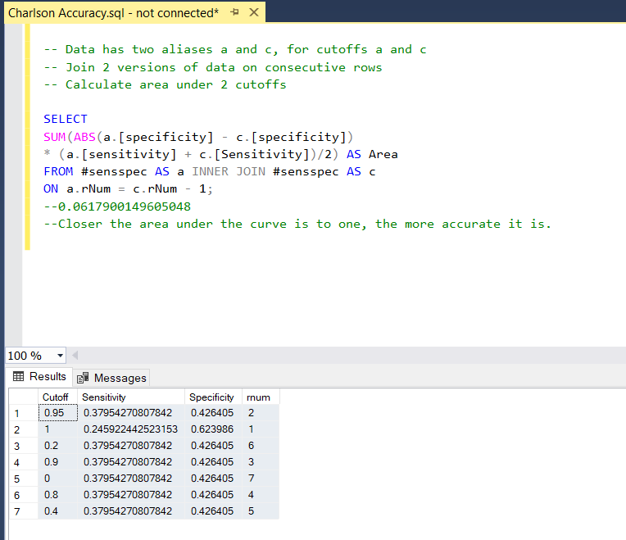
-- Step 4 Calculate area under 2 cutoffs
Copy this into excel for the next step!

Slide 16
Excel

Slide 17
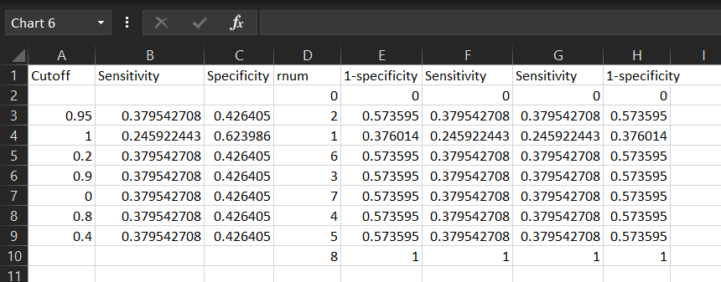
Insert into excel
Add 1-specificity column and Sensitivity column twice

