Slide 1
Likelihood Ratios
Inderveer Saini
HAP 464

Slide 2
Likelihood Ratios
The likelihood ratios tells you how likely a patient has a disease or condition.
The higher the ratio, the more likely they have the disease or condition.

Slide 3
Definition

Slide 4
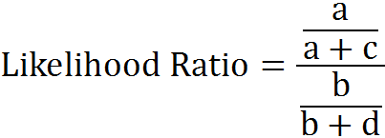
 |  | Status in 6 months
 |  | Dead | Alive | Total
Diagnosis | Present | a | b | a+b
 | Absent | c | d | c+d
 | Total | a+c | b+d | a+b+c+d
Calculating Likelihood Ratios /Contingency Table

Slide 9
Calculating Likelihood Ratios

Slide 10
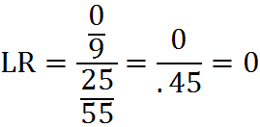
Example:
 |  | Status in 6 months
 |  | Dead | Alive | Total
Diagnosis | Present | 9 | 0 | 9
 | Absent | 30 | 25 | 55
 | Total | 39 | 25 | 64

Slide 11
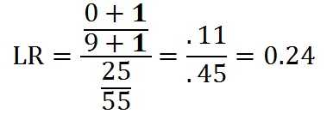
 |  | Status in 6 months
 |  | Dead | Alive | Total
Diagnosis | Present | 9 | 0 +1 | 9+1
 | Absent | 30 | 25 | 55
 | Total | 39 | 25+1 | 64+1

Slide 13
Results

