Slide 1
Multi-Morbidity Ontological Adjustment of Scoring
By:- Shruti Patel
Hap-464
Professor alemi

Slide 2
ONTOLOGICAL PURPOSE
Ontological adjustment allows parameter for rare condition to be replace with the parameters estimated for broader concepts
Improves accuracy of estimates for treatment effectiveness in patient with rare conditions.

Slide 3
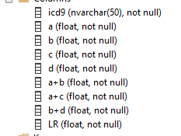
Importing the file Download the file from the online course Right click on database Go to task and select import flat file Change the following a_b =a+b a_c= a+c b_d=b+d

Slide 4
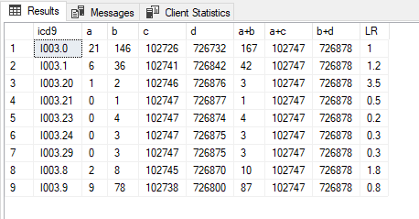

Slide 7
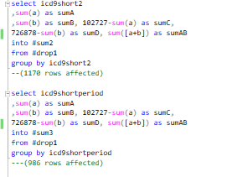
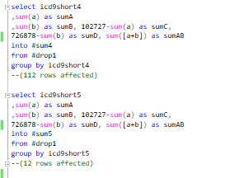

Slide 10
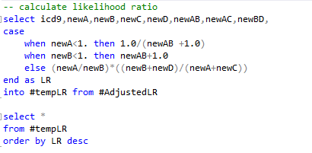
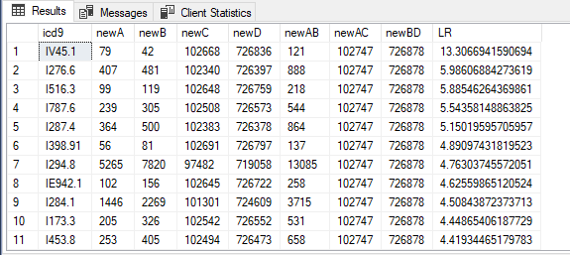
Calculate the Likelihood ratio

