Slide 1
Analysis of Antidepressant History for Missing Values in All of Us
Farrokh Alemi ,PhD ,Vladimir Cardenas &Keerti Reddy
Notes:
These slides show you how to create the database in All of Us for the missing value project,

Slide 2
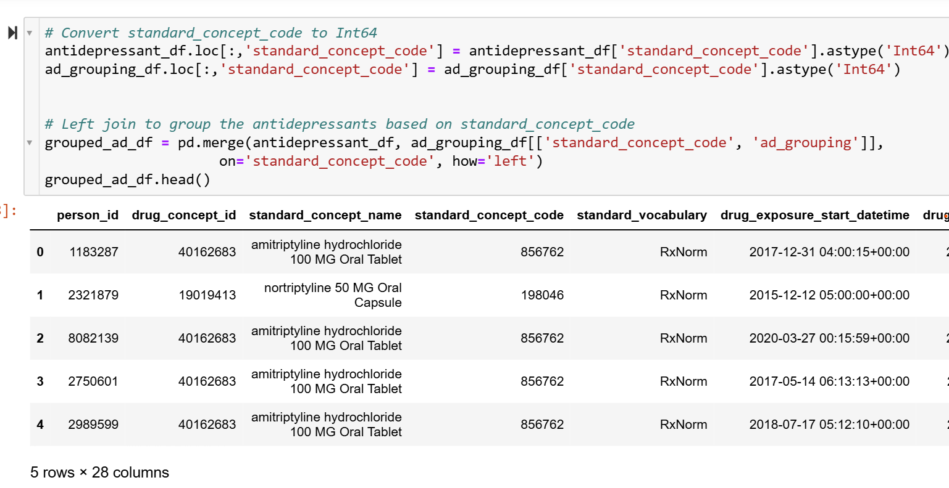
Notes:
This step converts the standard_concept_code column in both antidepressant_df and ad_grouping_df to the Int64 data type to ensure consistency for merging. Then, a left join is performed on standard_concept_code to group the antidepressants based on their corresponding ad_grouping values.

Slide 3
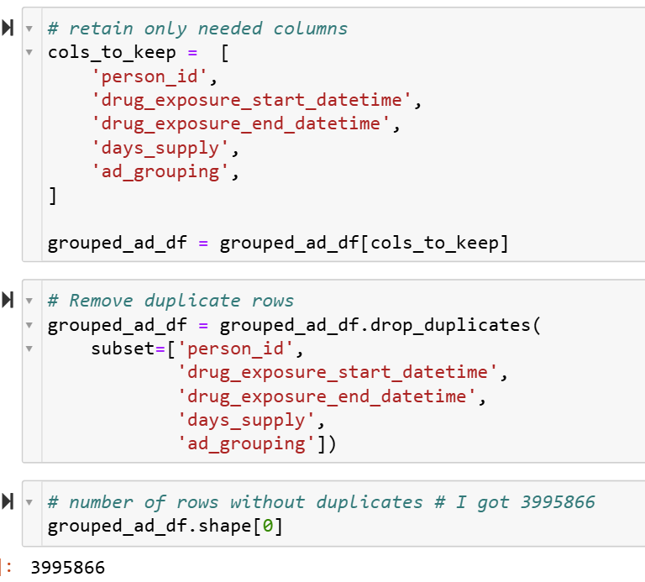
Notes:
This step retains only the necessary columns from grouped_ad_df for analysis, ensuring a more focused dataset. It then removes duplicate rows based on key attributes to eliminate redundant records. The final number of unique rows is displayed.

Slide 4
Notes:
This slide shows the rules for generating antidepressant dates and dosage days.

Slide 5
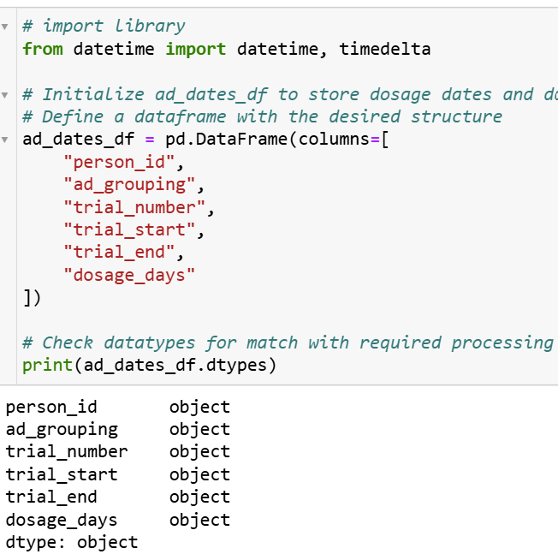
Notes:
This step imports the datetime and timedelta classes from Python's datetime module to handle date and time operations. It then initializes ad_dates_df, with specified columns to store information about each individual's antidepressant trials, including trial numbers, start and end dates, and dosage days. Finally, it prints the data types of the columns in ad_dates_df.

Slide 6
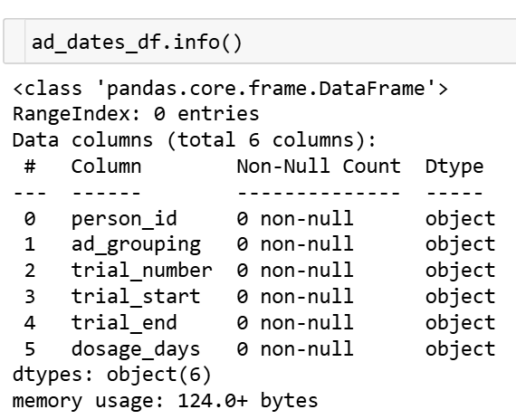
Notes:
This step utilizes the info() method from the pandas library to display a summary of the ad_dates_df DataFrame.

Slide 7
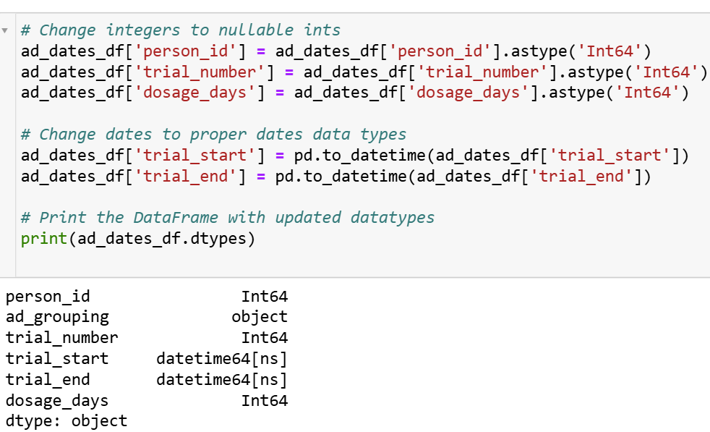
Notes:
In this step, we modify the data types of specific columns in the ad_dates_df DataFrame we convert the 'person_id', 'trial_number', and 'dosage_days' columns to (Int64), which allows these columns to handle missing values (NaN) . Additionally, we convert the 'trial_start' and 'trial_end' columns to the datetime data type using the pd.to_datetime() function.

Slide 8
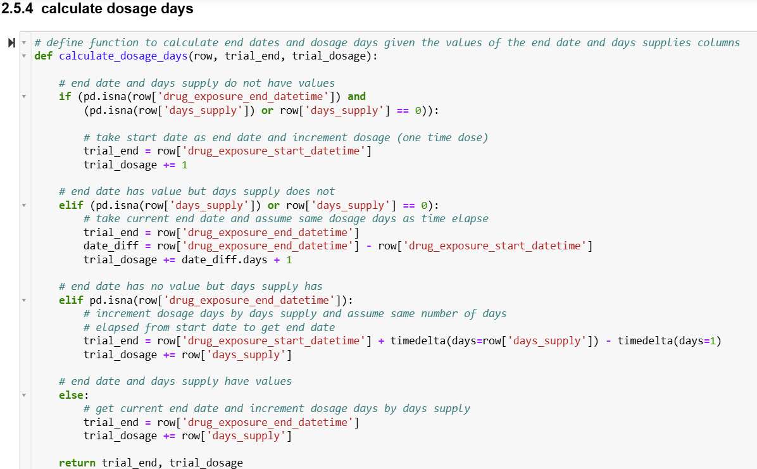
Notes:
This function, calculate_dosage_days, is designed to determine the end date (trial_end) and total dosage days (trial_dosage) for a given anti-depressant exposure record.

Slide 9
Notes:
The provided code defines a function, process_person, which processes antidepressant usage data for each individual in the dataset. The function iterates through each unique antidepressant (ad_grouping) taken by the person, sorts the data by the start date of drug exposure, and initializes variables to track the start and end dates of each treatment trial, as well as the total dosage days.

Slide 10
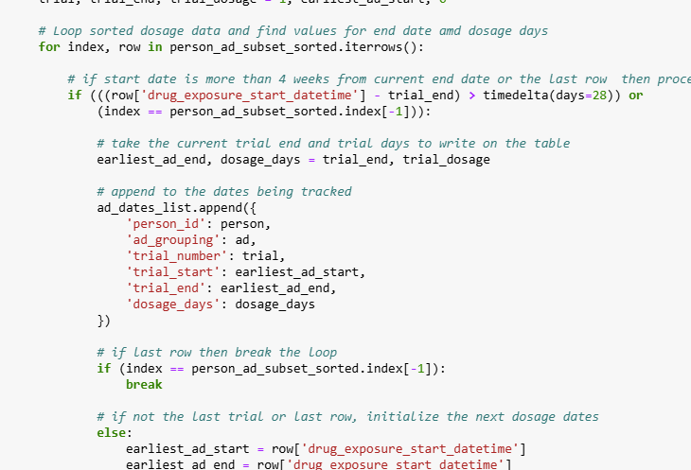
Notes:
It then loops through the sorted data, calculating the end date and dosage days for each period of continuous antidepressant use. If a gap of more than 4 weeks is detected between consecutive doses, it considers the previous period as a completed trial and starts a new trial.

Slide 11
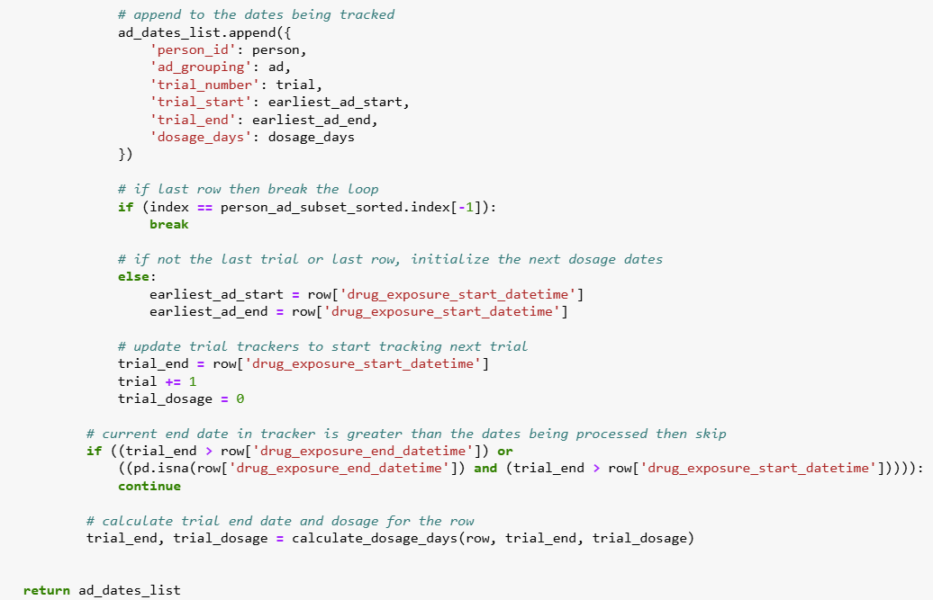
Notes:
For each row, the function calculates the end date and dosage days, updating the trial's end date and total dosage accordingly. The results for each trial are appended to a list, which is returned at the end of the function.

Slide 12
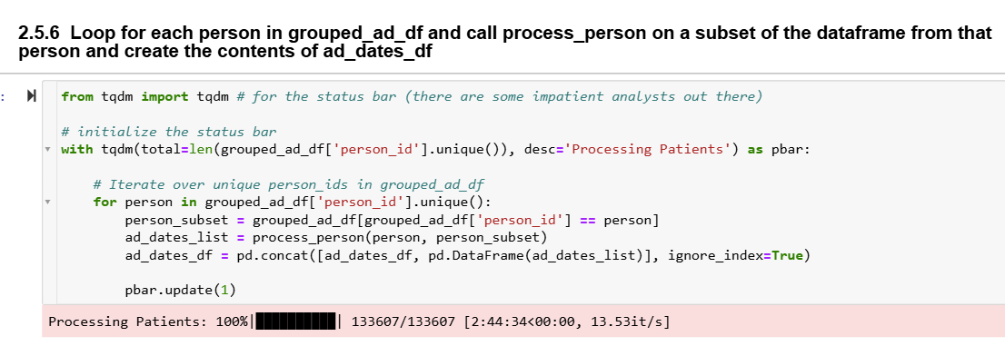
Notes:
This code processes a dataset by iterating over each unique person_id in grouped_ad_df and calling the process_person function to identify and track antidepressant usage periods for each individual. The progress of the loop is visually monitored using a status bar created by tqdm.

Slide 13
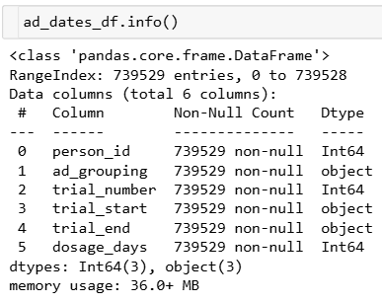
Notes:
This step utilizes the info() method from the pandas library to display a summary of the ad_dates_df DataFrame.

Slide 14
Notes:
In this slide, we aim to identify antidepressant trials that lasted 70 days or more. To achieve this, we create a new column in the ad_dates_df DataFrame called dose_70p.

Slide 15
Notes:
The column dose_70p will be assigned a value of 1 if the dosage_days for a given trial are greater than or equal to 70, or 0 if the dosage_days are less than 70.

Slide 16
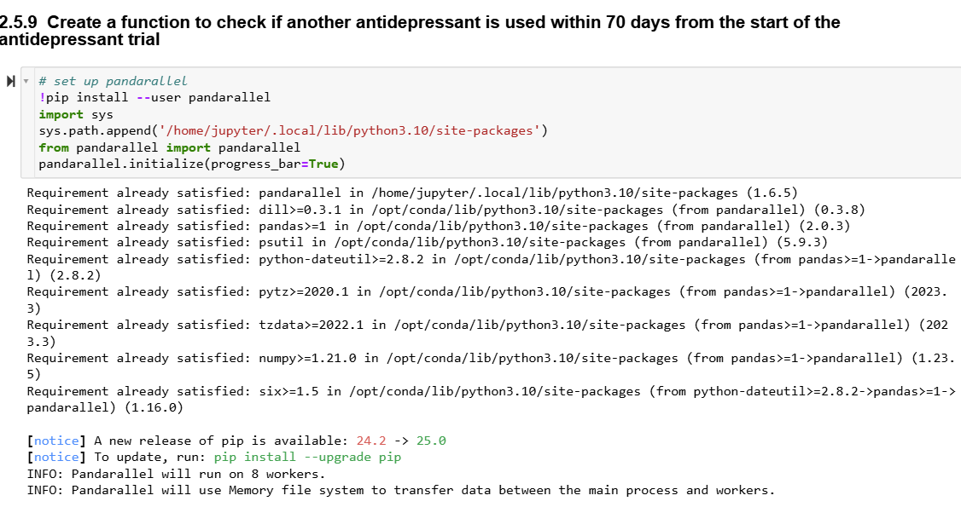
Notes:
This code sets up the pandarallel library to enable parallel processing of Pandas DataFrame operations, thereby enhancing computational efficiency.

Slide 17
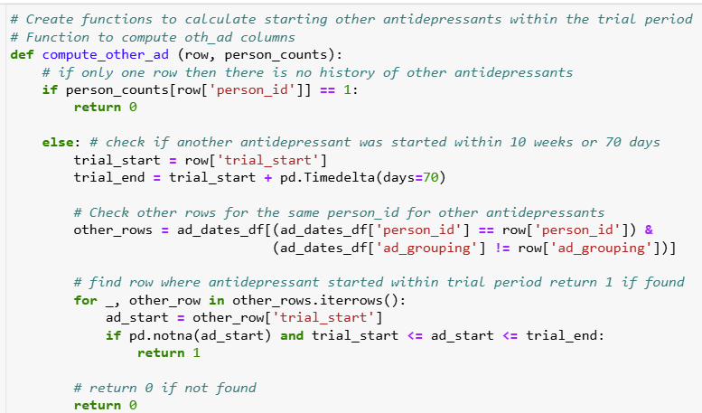
Notes:
The compute_other_ad function checks if another antidepressant was started within 70 days of the current trial's start for the same individual. If such a concurrent treatment exists, it returns 1; otherwise, it returns 0.

Slide 18
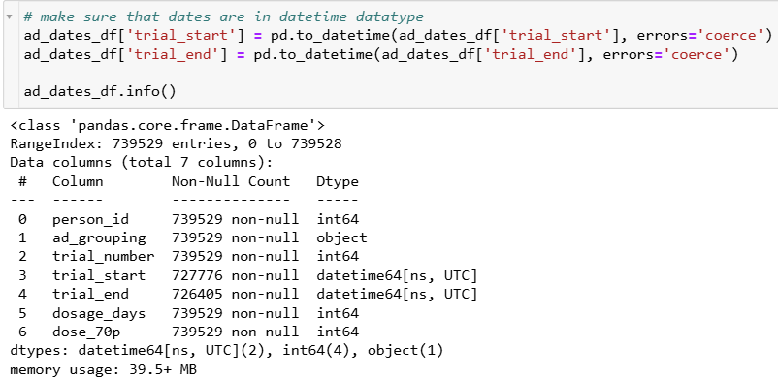
Notes:
The code converts the 'trial_start' and 'trial_end' columns in the ad_dates_df DataFrame to the datetime data type using Pandas' to_datetime function.

Slide 19
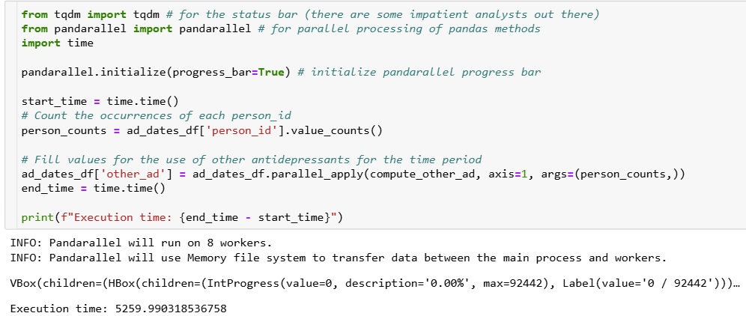
Notes:
The code leverages the pandarallel library to parallelize the computation of the 'other_ad' column in the ad_dates_df DataFrame, indicating whether another antidepressant was used within 70 days from the start of the current trial.
It initializes pandarallel with a progress bar, measures execution time, counts occurrences of each person_id, applies the compute_other_ad function to each row in parallel, and prints the total execution time.

Slide 20
Notes:
The code sets the 'Remission' column in the ad_dates_df DataFrame to 1 when both 'dose_70p' is 1 (indicating the antidepressant trial lasted 70 days or more) and 'other_ad' is 0 (indicating no other antidepressants were started during the trial). In all other cases, the 'Remission' column is assigned a value of 0.

Slide 21
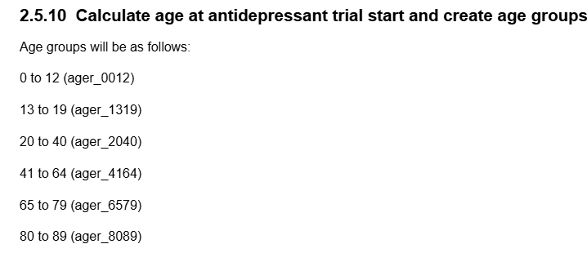
Notes:
This step involves calculating the age of each individual at the start of their antidepressant trial and categorizing them into predefined age groups.

Slide 22
Notes:
This code reads the demographic data and merges it with the antidepressant trial data on the person_id column. It ensures that the dates in both the trial_start and date_of_birth columns are correctly formatted as datetime objects. Then, the code calculates the age of each individual at the start of their antidepressant trial by subtracting the birthdate from the trial start date and converting the result from days to years.

Slide 23
Notes:
This code categorizes individuals into predefined age groups based on their age at the start of an antidepressant trial.

Slide 24
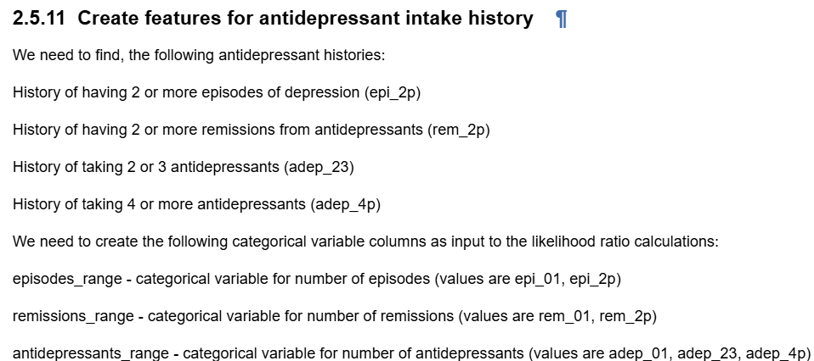
Notes:
This step involves creating categorical features based on individuals' antidepressant intake and depression history.

Slide 25
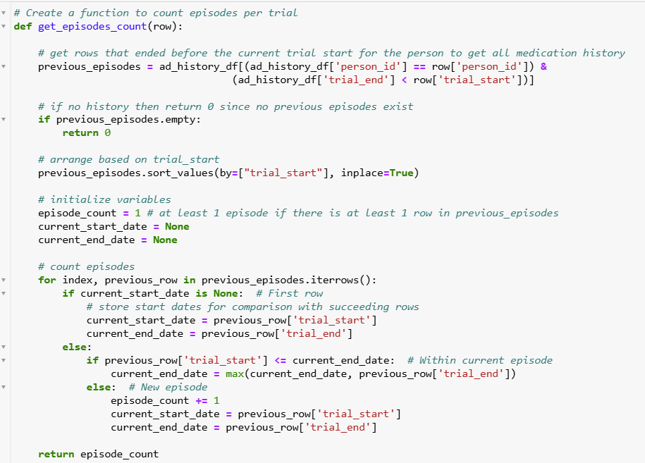
Notes:
This function, get_episodes_count, calculates the number of depression episodes a person has experienced prior to the current trial.

Slide 26
Notes:
This code applies the get_episodes_count function to each row of the ad_history_df DataFrame to calculate the number of depression episodes for each individual.

Slide 27
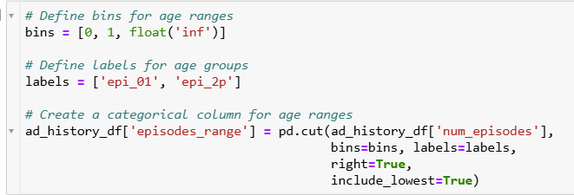
Notes:
This code creates a column episodes_range in the ad_history_df DataFrame to categorize individuals based on the number of depression episodes. The num_episodes is divided into two groups: "epi_01" for individuals with one episode and "epi_2p" for those with two or more episodes. The age ranges are defined by the bins [0, 1, float('inf')], where the first group corresponds to one episode, and the second group corresponds to two or more episodes.

Slide 28
Notes:
This code defines the function get_remission_count, which calculates the number of remissions a patient has experienced prior to each trial. For each row in the ad_history_df, it selects previous episodes for the same patient. If no previous history exists, the function returns a count of 0. It then sums the Remission column in those previous episodes to count how many times the patient achieved remission. The result is the total number of remissions for that individual prior to the current trial.

Slide 29
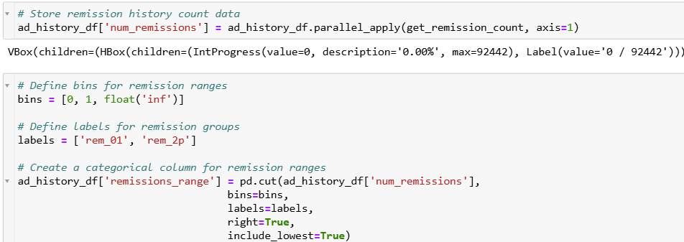
Notes:
This code calculates the remission history for each patient .It then defines bins for categorizing the remission count into two ranges: 'rem_01' for patients with 0 or 1 remission, and 'rem_2p' for those with more than 2 remissions.

Slide 30
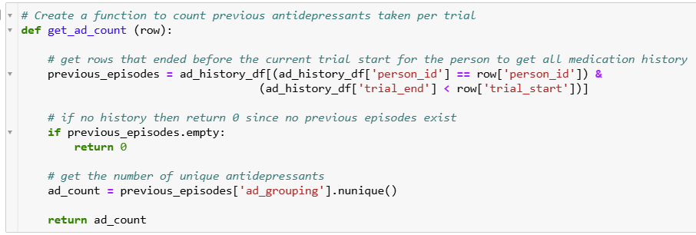
Notes:
This function, get_ad_count, calculates the number of unique antidepressants a patient has taken prior to each trial. It first filters the ad_history_df DataFrame to include only the rows for the patient where the trial ended before the current trial start. If no previous episodes are found, it returns 0.

Slide 31
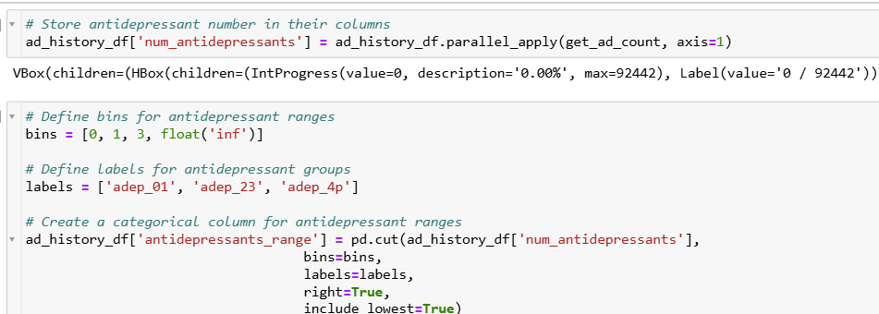
Notes:
This code calculates and categorizes the number of unique antidepressants taken by each patient prior to their current trial. It defines bins to group patients into three categories based on the number of antidepressants they’ve taken: 'adep_01' for 0 to 1 antidepressants, 'adep_23' for 2 to 3 antidepressants, and 'adep_4p' for more than 3 antidepressants.

Slide 32
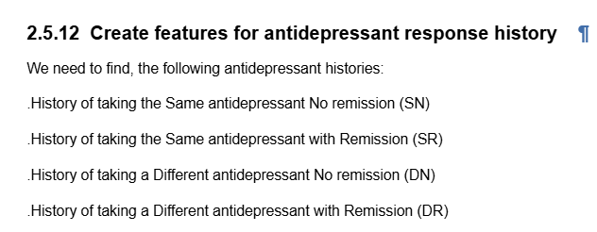
Notes:
This step involves creating features to capture an individual's antidepressant response history based on their treatment and remission outcomes.

Slide 33
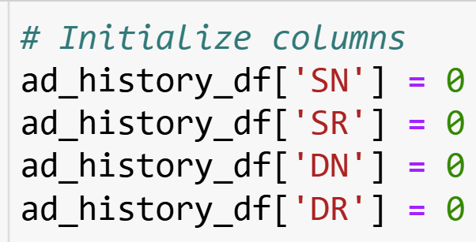
Notes:
This code initializes four new columns in the ad_history_df DataFrame: SN, SR, DN, and DR

Slide 34
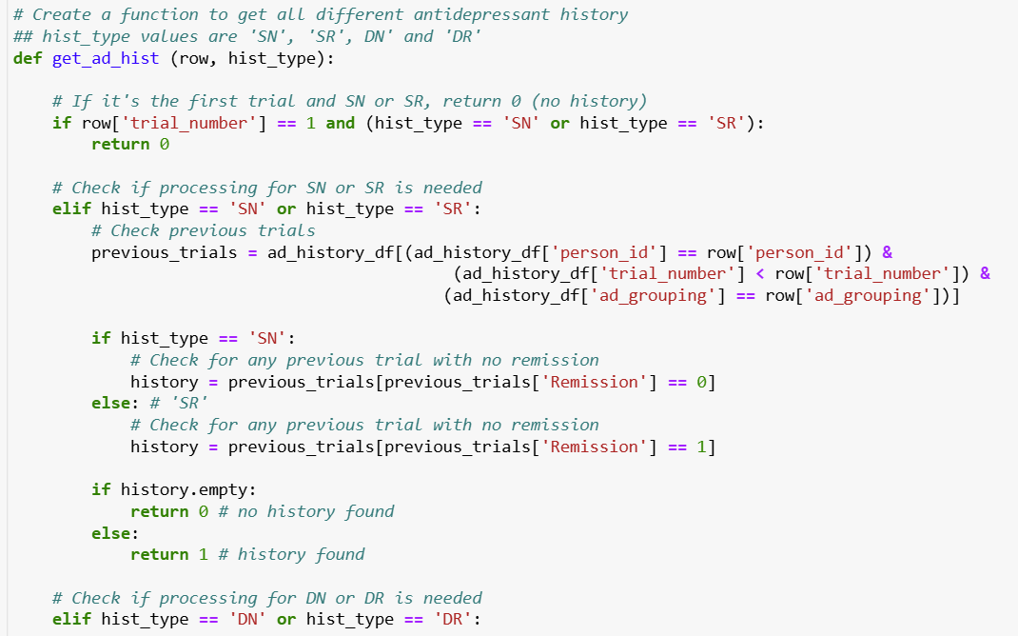
Notes:
The get_ad_hist function tracks antidepressant history based on the requested type (SN, SR, DN, or DR). For SN/SR histories, if it's the patient's first trial, it returns 0, as no prior history exists. For SN, it checks if the patient took the same antidepressant without remission, and for SR, it checks if the patient had remission. If a matching history is found, it returns 1; otherwise, it returns 0.

Slide 35
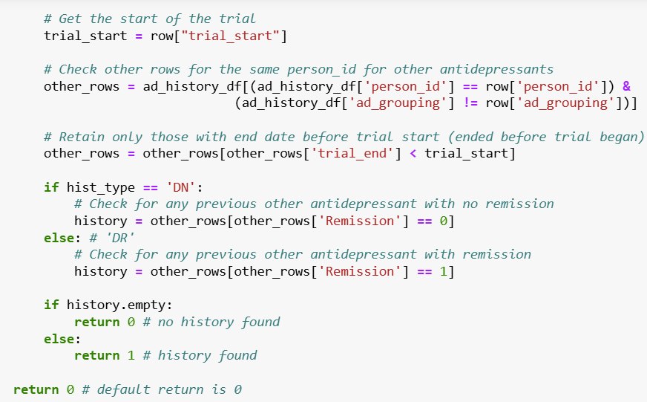
Notes:
The function continues by checking if the history type is DN or DR. For these types, it examines previous trials where the patient used a different antidepressant. It filters out rows where the trial ended after the current trial start. For DN, it looks for cases where the patient took a different antidepressant without remission, and for DR, it checks for remission. If any such history exists, it returns 1; otherwise, it returns 0. If neither SN/SR nor DN/DR conditions are met, the function defaults to returning 0.

Slide 36
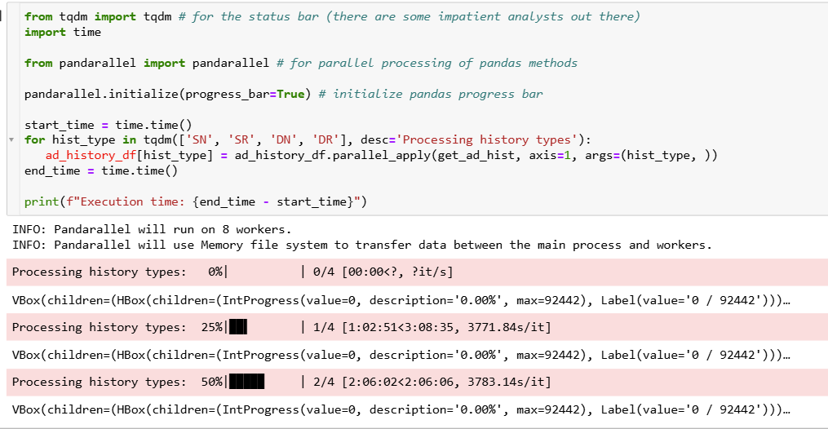
Notes:
This code uses the pandarallel library to parallelize the process of applying the get_ad_hist function across the rows of the ad_history_df DataFrame for different antidepressant history types (SN, SR, DN, DR).

Slide 37
Notes:
This code saves the ad_history_df DataFrame to a CSV file.

Slide 38
This video has demonstrated how to perform Analysis of Anti-depressant History.
Notes:
The take-home message for this presentation is that analyzing antidepressant history and response can be achieved by categorizing antidepressant use, tracking remission patterns, and utilizing parallel processing to efficiently manage and analyze large datasets.

