Slide 1
Annotation Guidelines – Medical History
Evaluating Conversational AI for Depression Management
Annotation Task Assignment
HAP-786
By Md Tanvir Rouf Shawon
Notes:
Welcome to the presentation of the Annotation Guidelines for Medical History, designed to support the evaluation of conversational AI systems for depression management.

Slide 2
Overview
Safe, accurate, and compassionate conversational AI for Major Depressive Disorder (MDD). performance and safety.
Notes:
Our goal is to develop methodologies for the safe, accurate, and compassionate use of conversational AI in managing Major Depressive Disorder.

Slide 3
Overview
Develop methodologies for the safe, accurate, and compassionate use of conversational AI in managing Major Depressive Disorder (MDD).
Collects patient medical histories via natural language
Notes:
We're building an AI Intake System that collects patient medical histories through natural language interactions and provides personalized antidepressant recommendations.

Slide 4
Overview
Develop methodologies for the safe, accurate, and compassionate use of conversational AI in managing Major Depressive Disorder (MDD).
Build an AI Intake System that collects patient medical histories via natural language and provides personalized antidepressant recommendations.
Patient Simulator to generate diverse conversational scenarios
Notes:
Additionally, we're creating a Patient Simulator to produce diverse conversational scenarios to rigorously evaluate the AI's performance and safety.
Both the AI Intake System and Patient Simulator are powered by large language models.

Slide 5
Project Aims
Aim 1 – Bias Correction
Aim 2 – Intake System Refinement
Aim 3 – Patient Impact Evaluation.
Notes:
Our project includes three main aims.
Aim 1 is Bias Correction.
In this aim, we focus on identifying and reducing biases that may exist within the AI Knowledgebase. This is crucial for improving the fairness and generalizability of the AI system across diverse patient populations.

Slide 6
Project Aims
Aim 1 – Bias Correction
Aim 2 – Intake System Refinement
Aim 3 – Patient Impact Evaluation.
Notes:
Aim 2 is Intake System Refinement.
Here, the goal is to develop and evaluate an AI Intake System. We use a comprehensive Patient Simulator to ensure the system can collect conversational medical histories both accurately and safely.

Slide 7
Project Aims
Aim 1 – Bias Correction
Aim 2 – Intake System Refinement
Aim 3 – Patient Impact Evaluation.
Notes:
Aim 3 is Evaluation of impact on patients. This aim involves conducting a randomized controlled trial. We’ll assess how conversational AI affects key human-centered outcomes—specifically, empathy, therapeutic alliance, and the overall quality of the data collected from patients.

Slide 8
Aim 2 – Intake System Refinement
Evaluate the Patient Simulator
Notes:
This annotation task supports technology development under Aim 2.
The goal is to evaluate the Patient Simulator’s ability to generate responses that are both accurate and contextually appropriate, while remaining aligned with the predefined medical personas.

Slide 9
Evaluate Transcripts of Interactions
AI’s question
Simulated list of relevant medical history
Simulator’s answer to the AI’s question
Notes:
You will be evaluating transcripts of interactions between the AI Intake System and the Patient Simulator.
Each transcript consists of multiple conversational turns, and each turn includes three elements: First element is the Question asked.
This is an open-ended medical intake question posed by the AI Intake System.

Slide 10
Evaluate Transcripts of Interactions
AI’s question
List of relevant medical history
Simulator’s answer to the AI’s question
Notes:
Next, is the list of medical history items that are relevant to the medical history of the patient. Each item is marked with a unique reference number, like [2.3].

Slide 11
Evaluate Transcripts of Interactions
AI’s question
Simulated list of relevant medical history
Simulator’s answer to the AI’s question
Notes:
Finally, read the Patient Simulator’s natural language response, intended to answer the questionasked by AI from Relevant Medical History, each marked with corresponding numerical references.

Slide 12
Your Annotation Task
Review the Question
Review the list of Relevant Medical History.
Evaluate each medical history event within the Answer
Notes:
As an annotator, your responsibilities are to first Review the Question posed by the AI Intake System. Then examine the provided Relevant Medical History. And finally to evaluate the presence of each medical history events within the Answer. Each medical history event in the Answer must be assigned exactly one of the labels in the software.

Slide 13
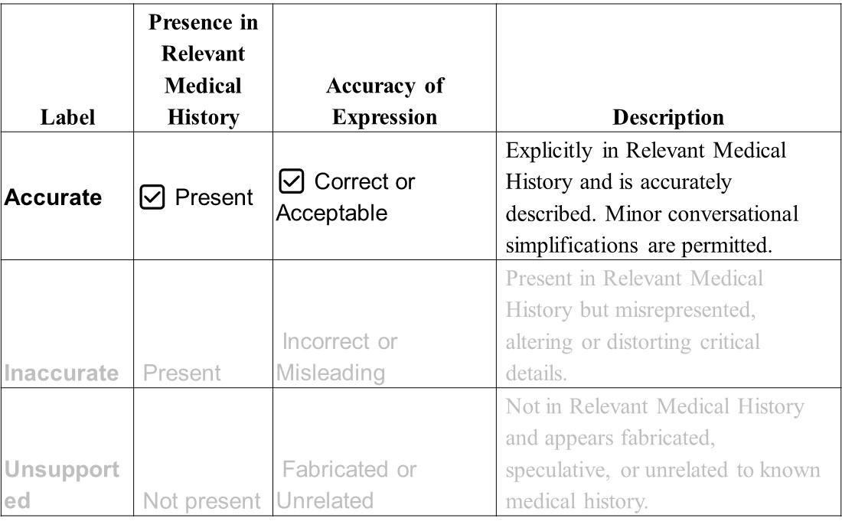
Notes:
Here are the three annotation labels you will be using: First, is the label Accurate.
This means the medical event is present in the Relevant Medical History and is correctly expressed in the answer — including conversational simplifications or synonyms.

Slide 14
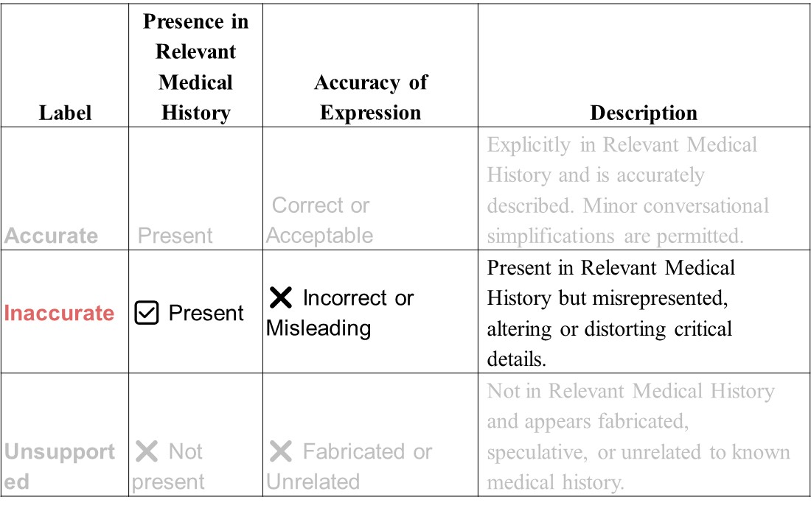
Notes:
The Second label is Inaccurate.
This applies when the medical event is included in the Relevant Medical History but is expressed incorrectly or in a misleading way in the answer.

Slide 15
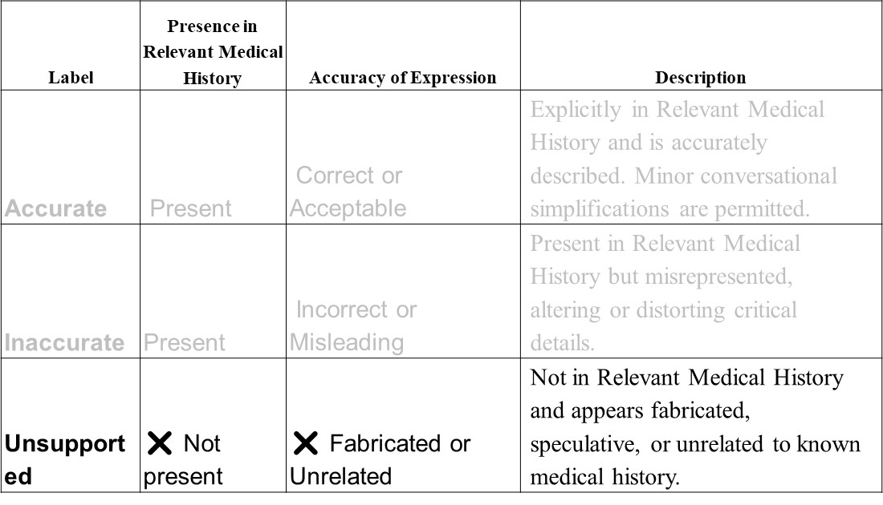
Notes:
Third, is the Unsupported label. This label is used when the medical event mentioned in the answer is not found in the Relevant Medical History — meaning it appears to be fabricated or unrelated.

Slide 16
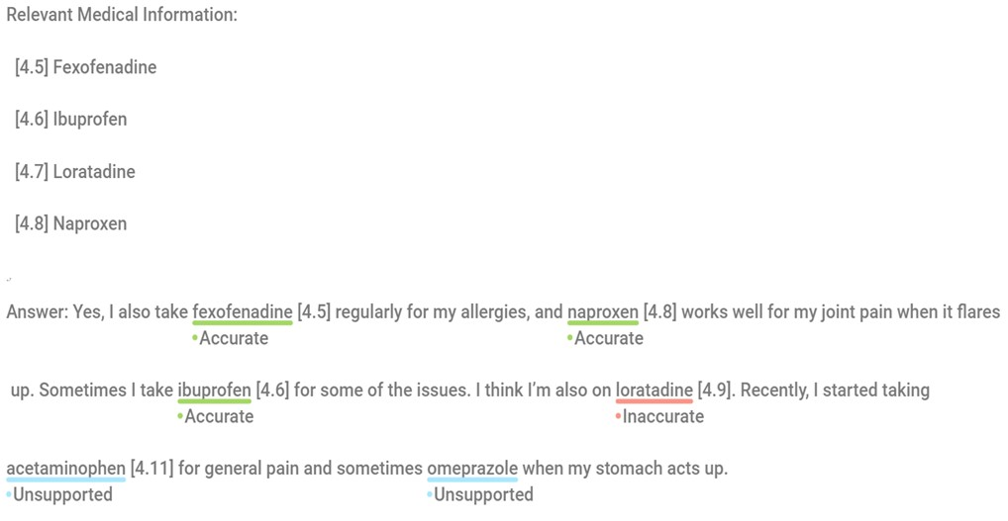
Notes:
Here is an example for the annotation task.
Now, let’s review the annotation tags used in this task.
We begin with the Accurate label. This is used when a medical item is listed in the Relevant Medical History and is correctly described in the patient’s response. For example, “fexofenadine [4.5]” and “naproxen [4.8]” are both accurate—they are present in the profile and described appropriately in context.

Slide 17
Notes:
Next is Inaccurate. This label applies when the medical item is indeed part of the profile, but it is expressed incorrectly or referenced misleadingly. In the example, “loratadine [4.9]” is tagged as inaccurate—not because the medication is wrong, but because the reference number does not match the one listed in the Relevant Medical History, which was actually [4.7].

Slide 18
Notes:
Finally, we have Unsupported. This is for medical items that are completely absent from the Relevant Medical History. These entries appear fabricated or unrelated. In our example, both “acetaminophen [4.11]” and “omeprazole” are unsupported. Neither is listed in the provided history, so they should not have been included or referenced.
As always, remember to focus solely on the referenced medical content. General dialogue or unreferenced statements do not require annotation.

Slide 19
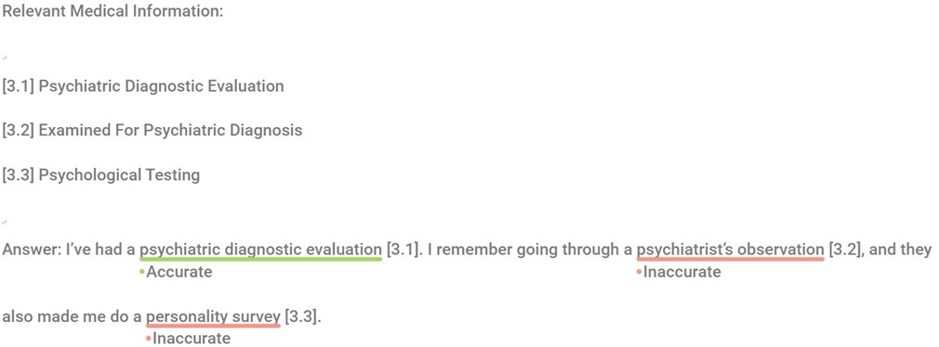
Notes:
Now let’s review the annotation tags in the context of a response about medical procedures in another example.
We begin with the Accurate label. This is assigned when a referenced medical procedure is clearly listed in the Relevant Medical History and described appropriately. In this case, “psychiatric diagnostic evaluation [3.1]” is labeled Accurate, as it is both present and accurately expressed.

Slide 20
Notes:
Next, we see Inaccurate labels. These are applied when the reference number is correct but the way the item is described misrepresents its intended meaning. For example “psychiatrist’s observation [3.2]” is marked Inaccurate. Although [3.2] is indeed part of the Relevant Medical History, the expression is vague and doesn't precisely reflect the standardized label “Examined for Psychiatric Diagnosis.” Similarly, “personality survey [3.3]” is marked Inaccurate because it distorts the term “Psychological Testing” [3.3]. .

Slide 21
Notes:
A “survey” suggests a much more informal, non-clinical procedure, which could mislead evaluators.
This illustrates the importance of accurate terminology even when referencing valid medical codes. The names used must reflect the intended clinical procedure without distortion or oversimplification.

Slide 22
Doccano Webapp
https://ai-intake-system-dev-81e104b353a8.herokuapp.com/
Login using the following credentials:
  Username: Your net ID (net_ID@gmu.edu)
  Password: largelanguagemodel
Notes:
Doccano is an open-source annotation tool for text-based datasets. We’ll be using it to label simulated patient responses with reference tags.
To access the assigned annotation files, go to the Doccano web app at this link.
Then log in with your GMU Net ID.
Username is your Net ID which is the first part of your gmu email.
Password is largelanguagemodel which is same for all students.

Slide 23
Doccano Annotation Process
Log in.
Click Annotate
Read through each of the turns of the conversations
Select the phrase you want to annotate
Click on the chosen label.
You don’t need to submit anything. When you are done, all the annotations will be collected through the admin panel. You will find detailed description of the project in the Annotation Guideline.
Notes:
Once you log in, you’ll see a list of datasets assigned to you for annotation.
Click on ‘Annotate’ and read through each conversational turn. Select the phrase you want to label and then click on the appropriate annotation tag.
You don’t need to hit submit—your work is saved automatically. When you're finished, all your annotations will be collected directly through the admin panel.
And remember, for a more detailed explanation of the task, please refer to the Annotation Guideline.

