Slide 1
Annotation Guidelines – Medical History
Evaluating Conversational AI for Depression Management
Annotation Task Assignment
HAP-786
Notes:
Welcome to the presentation of the Annotation Guidelines for Medical History, designed to support the evaluation of conversational AI systems for depression management.

Slide 2
Task Description
Your annotation involves:
Reviewing the Question posed by the AI Intake System.
Reviewing the Relevant Medical History provided.
Evaluating each medical history event within the Answer, recognizing that the Answer may include zero or more of these events. Each medical history event in the Answer must be assigned exactly one of the labels from
Notes:
As an annotator, your responsibilities are to:
Review the Question posed by the AI Intake System.
Examine the provided Relevant Medical History.
Evaluating each medical history event within the Answer, recognizing that the Answer may include zero or more of these events. Each medical history event in the Answer must be assigned exactly one of the labels from

Slide 3
Task Description
Label​ | Presence in Relevant Medical History​ | Accuracy of Expression​ | Description​
Accurate​ | ✅ Present​ | ✅ Correct or Acceptable​ | Explicitly in Relevant Medical History and is accurately described. Minor conversational simplifications are permitted.​
Inaccurate​ | ✅ Present​ | ❌ Incorrect or Misleading​ | Present in Relevant Medical History but misrepresented, altering or distorting critical details.​
Unsupported​ | ❌ Not present​ | ❌ Fabricated or Unrelated​ | Not in Relevant Medical History and appears fabricated, speculative, or unrelated to known medical history.​
Notes:
Here are the three annotation labels you will be using:”
First, Accurate.
This means the medical event is present in the Relevant Medical History and is correctly expressed in the answer — including conversational simplifications or synonyms.
Second, Inaccurate.
This applies when the medical event is included in the Relevant Medical History but is expressed incorrectly or in a misleading way in the answer.
Third, Unsupported.
This label is used when the medical event mentioned in the answer is not found in the Relevant Medical History — meaning it appears to be fabricated or unrelated.

Slide 4
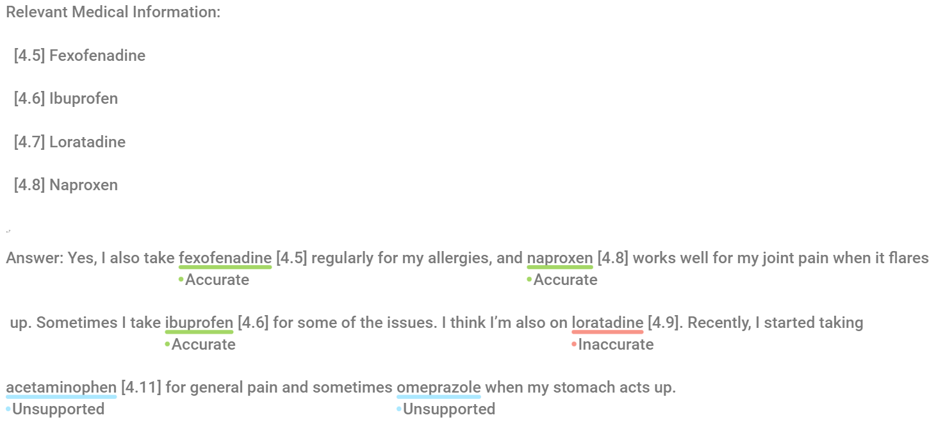
Examples
AI Intake System Question: At this phase I will collect your current medication history, Can you tell me about any medications you're currently taking, including both prescription and over-the-counter drugs?
Notes:
Here is an example for the annotation task.
Now, let’s review the annotation tags used in this task.
We begin with the Accurate label. This is used when a medical item is listed in the Relevant Medical History and is correctly described in the patient’s response. For example, “fexofenadine [4.5]” and “naproxen [4.8]” are both accurate—they are present in the profile and described appropriately in context.
Next is Inaccurate. This label applies when the medical item is indeed part of the profile, but it is expressed incorrectly or referenced misleadingly. In the example, “loratadine [4.9]” is tagged as inaccurate—not because the medication is wrong, but because the reference number does not match the one listed in the Relevant Medical History, which was actually [4.7].
Finally, we have Unsupported. This is for medical items that are completely absent from the Relevant Medical History. These entries appear fabricated or unrelated. In our example, both “acetaminophen [4.11]” and “omeprazole” are unsupported. Neither is listed in the provided history, so they should not have been included or referenced.
As always, remember to focus solely on the referenced medical content. General dialogue or unreferenced statements do not require annotation.

Slide 5
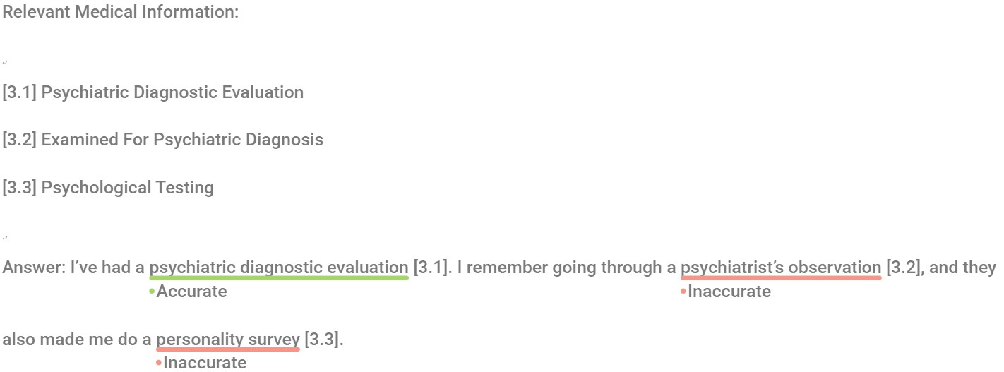
Examples
AI Intake System Question: At this phase, can you tell me about any medical procedures you've undergone, especially those related to psychiatric or mental health, such as psychotherapy or hospitalization assessments?
Notes:
Now let’s review the annotation tags in the context of a response about medical procedures in another example.
We begin with the Accurate label. This is assigned when a referenced medical procedure is clearly listed in the Relevant Medical History and described appropriately. In this case, “psychiatric diagnostic evaluation [3.1]” is labeled Accurate, as it is both present and accurately expressed.
Next, we see Inaccurate labels. These are applied when the reference number is correct but the way the item is described misrepresents its intended meaning. For example:
“psychiatrist’s observation [3.2]” is marked Inaccurate. Although [3.2] is indeed part of the Relevant Medical History, the expression is vague and doesn't precisely reflect the standardized label “Examined for Psychiatric Diagnosis.”
Similarly, “personality survey [3.3]” is marked Inaccurate because it distorts the term “Psychological Testing” [3.3]. A “survey” suggests a much more informal, non-clinical procedure, which could mislead evaluators.
This illustrates the importance of accurate terminology even when referencing valid medical codes. The names used must reflect the intended clinical procedure without distortion or oversimplification.

Slide 6
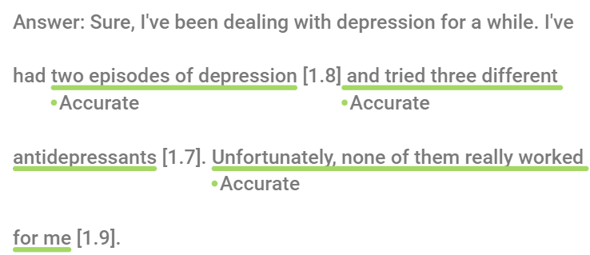
Examples (Not To Do)

Slide 7
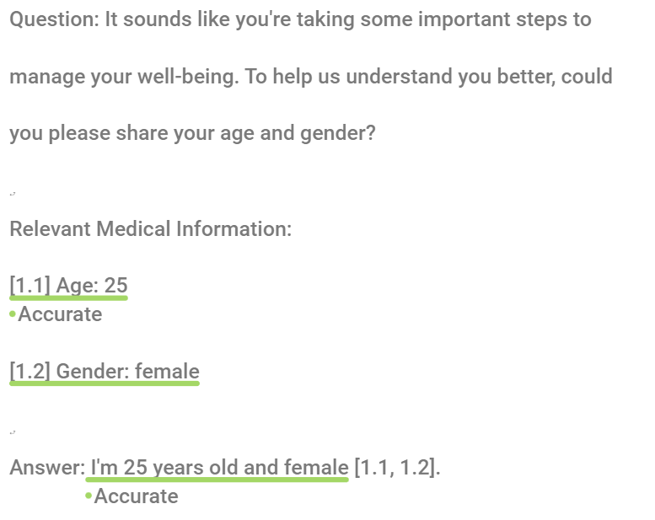
Examples (Not To Do)

Slide 8
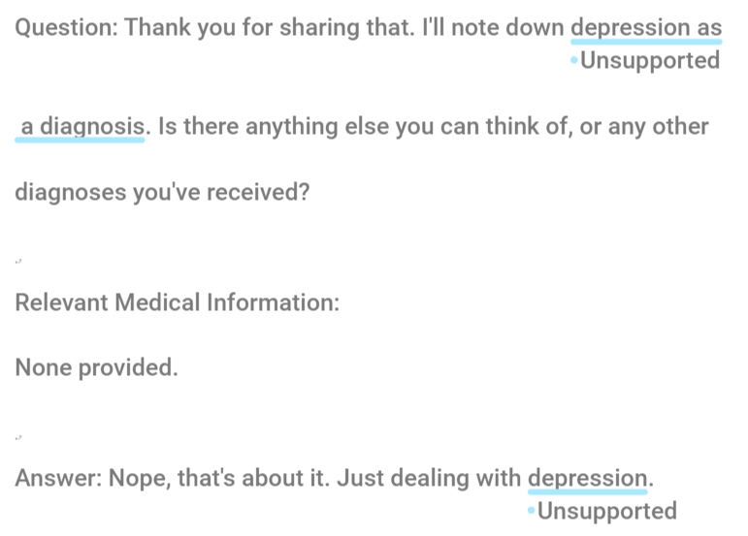
Examples (Not To Do)

Slide 9
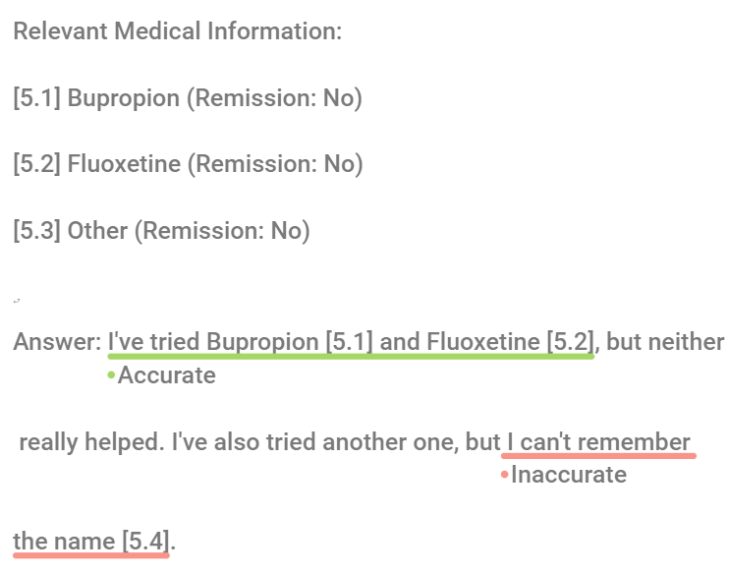
Examples (Not To Do)

Slide 10
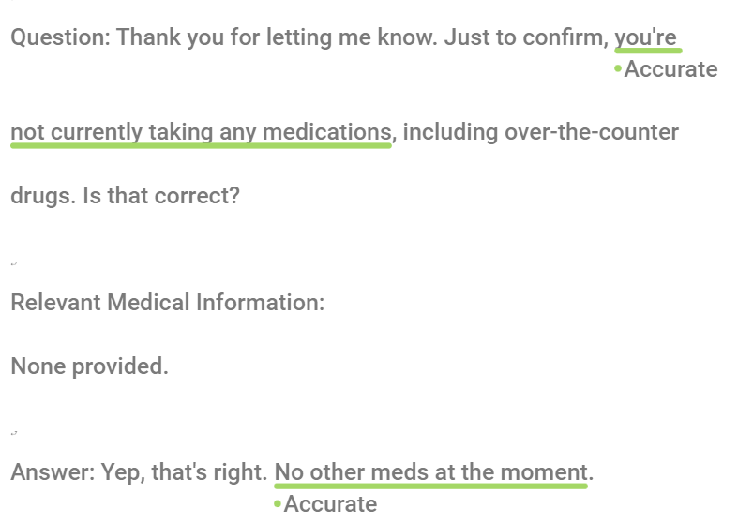
Examples (Not To Do)

Slide 11
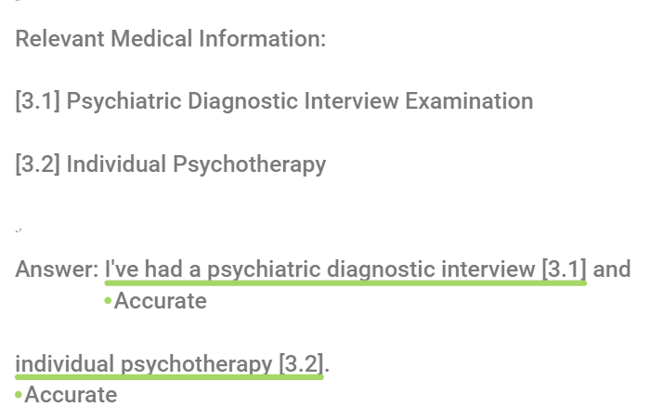
Examples (Not To Do)

Slide 12
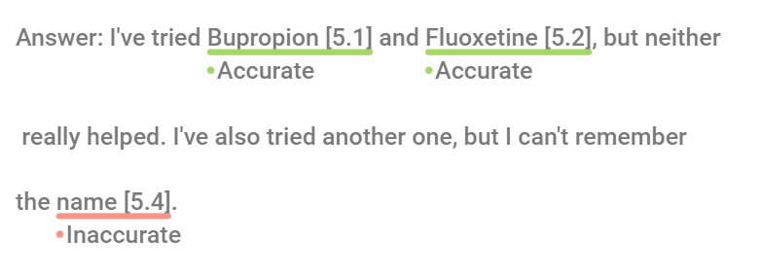
Examples (Not To Do)

Slide 13
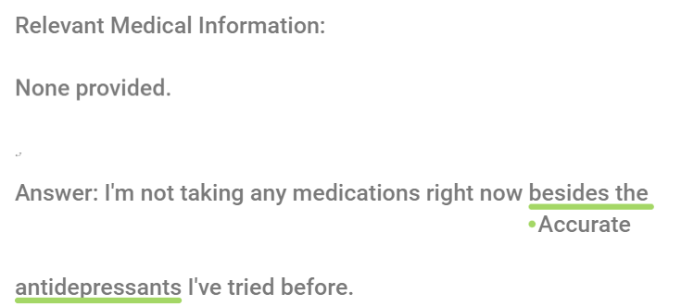
Examples (Not To Do)

Slide 14
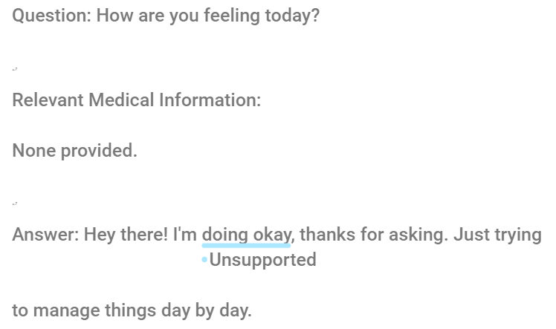
Examples (Not To Do)

Slide 15
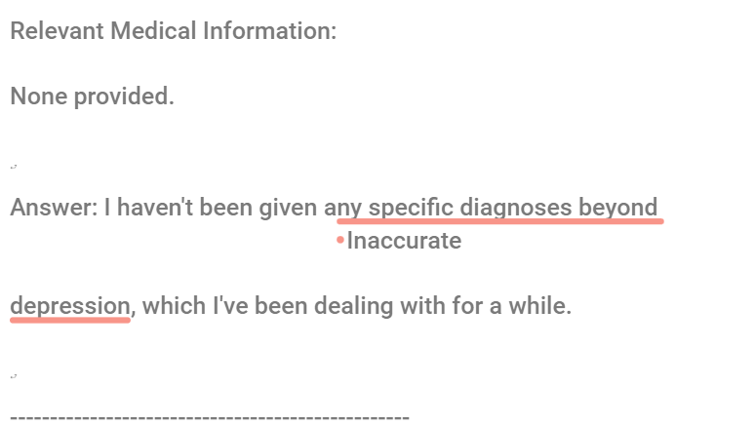
Examples (Not To Do)

Slide 16
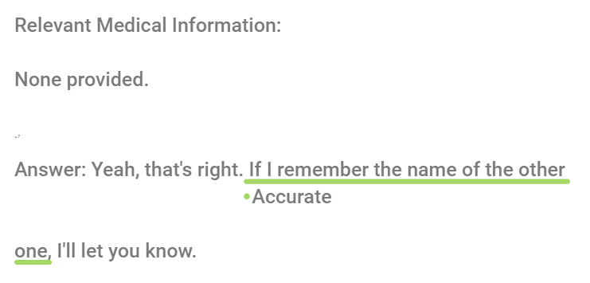
Examples (Not To Do)

Slide 17
Doccano
Access to the Assigned Files:
Go to the Doccano webapp at: https://ai-intake-system-dev-81e104b353a8.herokuapp.com/
Login using the following credentials:
Username: Your net ID (net_ID@gmu.edu)
Password: largelanguagemodel
Notes:
Doccano is an open-source annotation tool for text-based datasets. We’ll be using it to label simulated patient responses with reference tags.
To access the assigned annotation files, go to the Doccano web app at this link.
Then log in with your GMU Net ID.
Username is your Net ID which is the first part of your gmu email.
Password is largelanguagemodel which is same for all.

Slide 18
Doccano
Annotation Process:
After logging in you will see some datasets which you need to annotate.
Click Annotate and Read through each of the turns of the conversations and select the phrase you want to provide an annotation and click on the chosen label.
You don’t need to submit anything in Docanno. When you are done, all the annotations will be collected through the admin panel.
You will find detailed description of the project in the Annotation Guideline.
Notes:
Once you log in, you’ll see a list of datasets assigned to you for annotation.
Click on ‘Annotate’ and read through each conversational turn. Select the phrase you want to label and then click on the appropriate annotation tag.
You don’t need to hit submit—your work is saved automatically. When you're finished, all your annotations will be collected directly through the admin panel.
And remember, for a more detailed explanation of the task, please refer to the Annotation Guideline.

