Slide 1
Creating Antidepressant Datasets for Missing Values in All of Us
Farrokh Alemi ,PhD ,Vladimir Cardenas &Keerti Reddy
Notes:
These slides show you how to create antidepressant database in All of Us for the missing value project,

Slide 2
Notes:
Go to create database in open online courses and you can see all the files in adding antidepressant history to the database

Slide 3
Notes:
The first step is to create an antidepressant history dataset. To create it, click on the plus sign.

Slide 4
Notes:
The next step is to create a concept set.

Slide 5
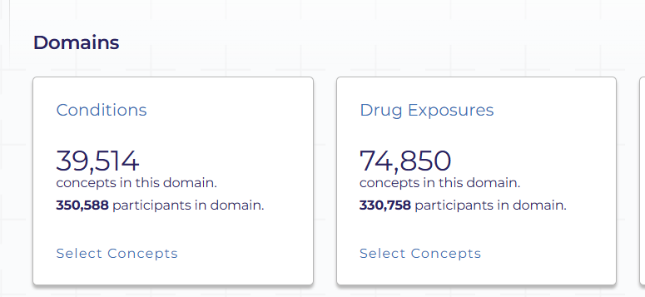
Notes:
Select drug exposures to create the antidepressant dataset.

Slide 6
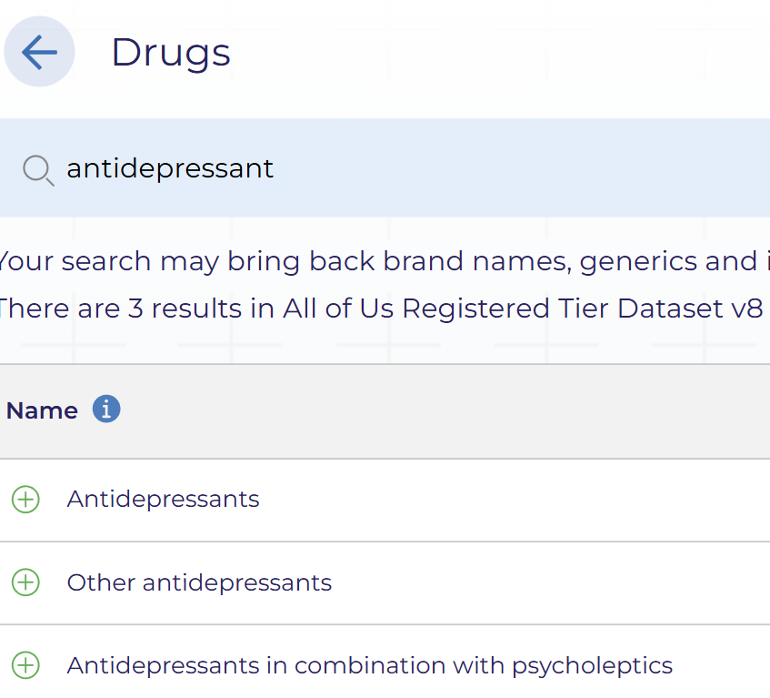
Notes:
Type "antidepressant" to see three options, then select all the concepts.

Slide 7
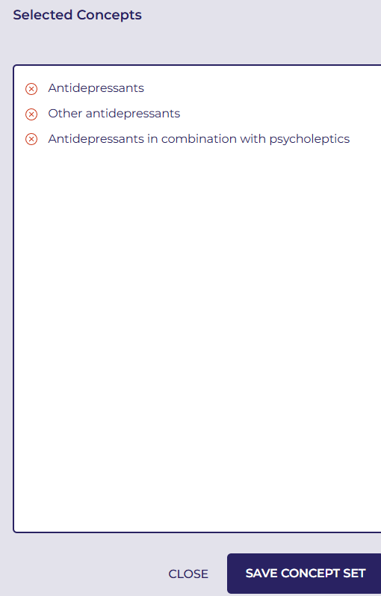
Notes:
Click "Finish and Review" to ensure all three are in the concept set, then click "Save Concept Set."

Slide 8
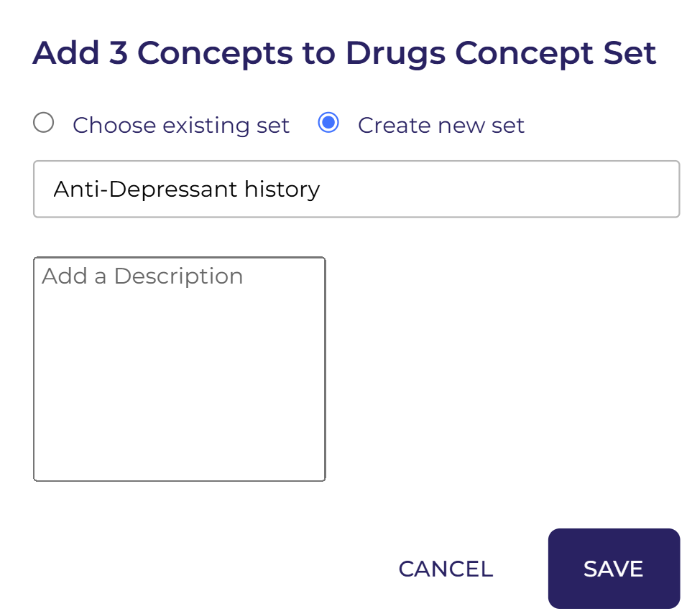
Notes:
Select "Create new Set," type "Anti-depressant History," and then click "Save."

Slide 9
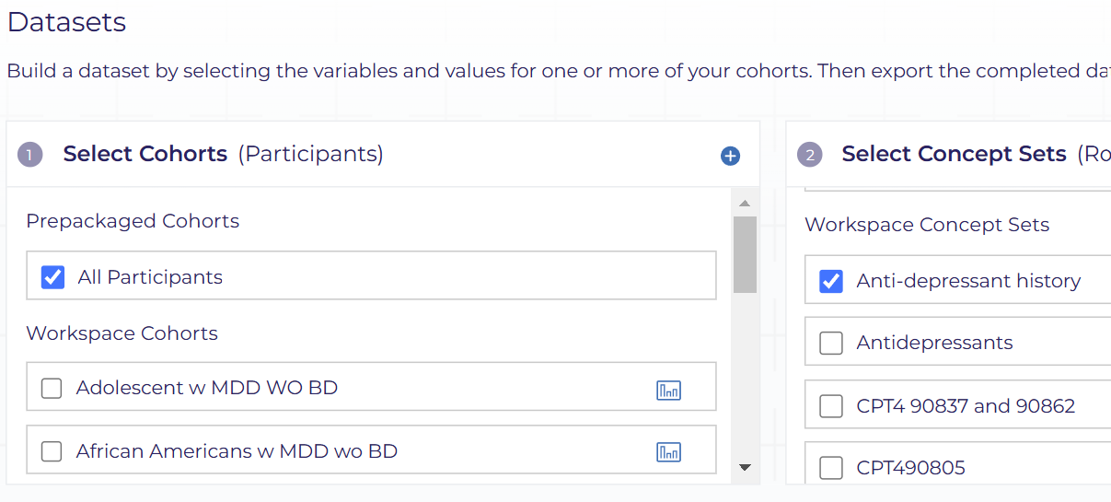
Notes:
To create the antidepressant dataset, select the cohort as "All Participants" and then select the "Anti-depressant History" concept set.

Slide 10
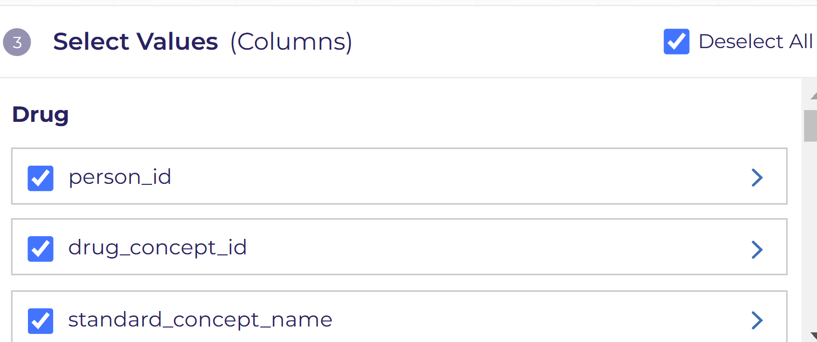
Notes:
Select all the columns.

Slide 11
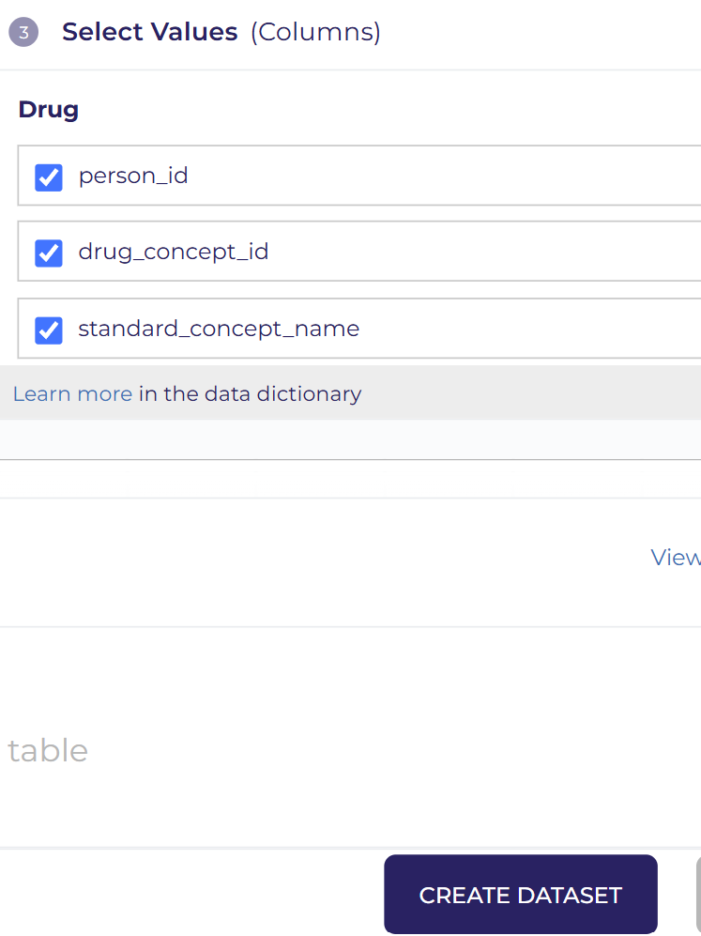
Notes:
click on create dataset

Slide 12
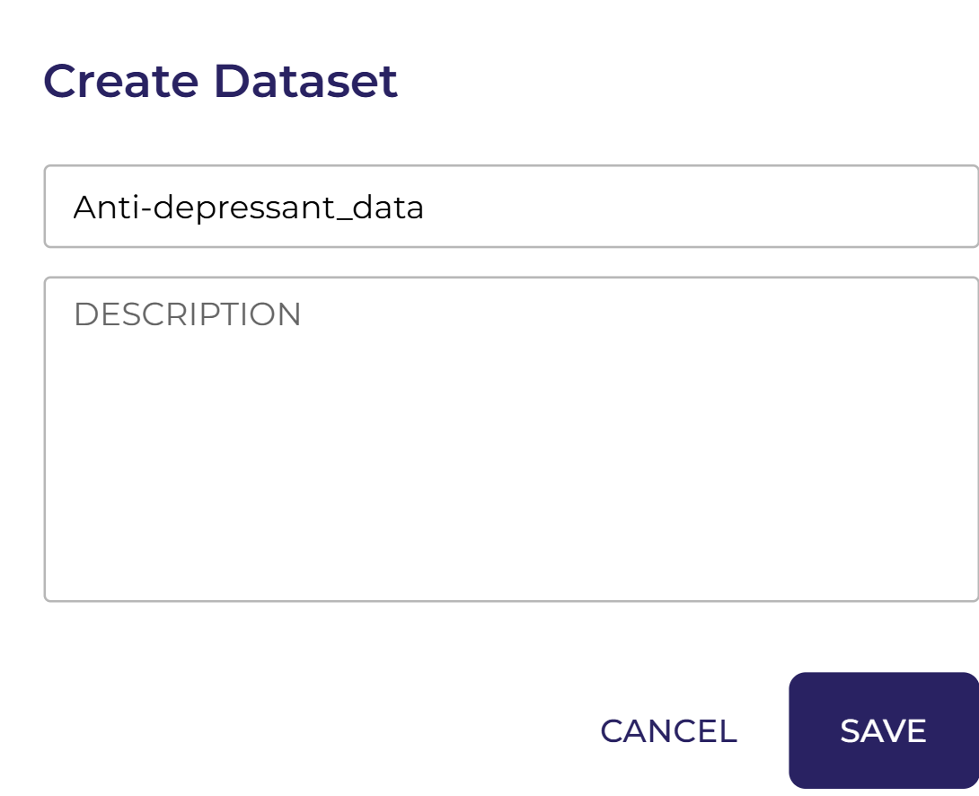
Notes:
Name the dataset "Antidepressant-data" and click "Save."

Slide 13
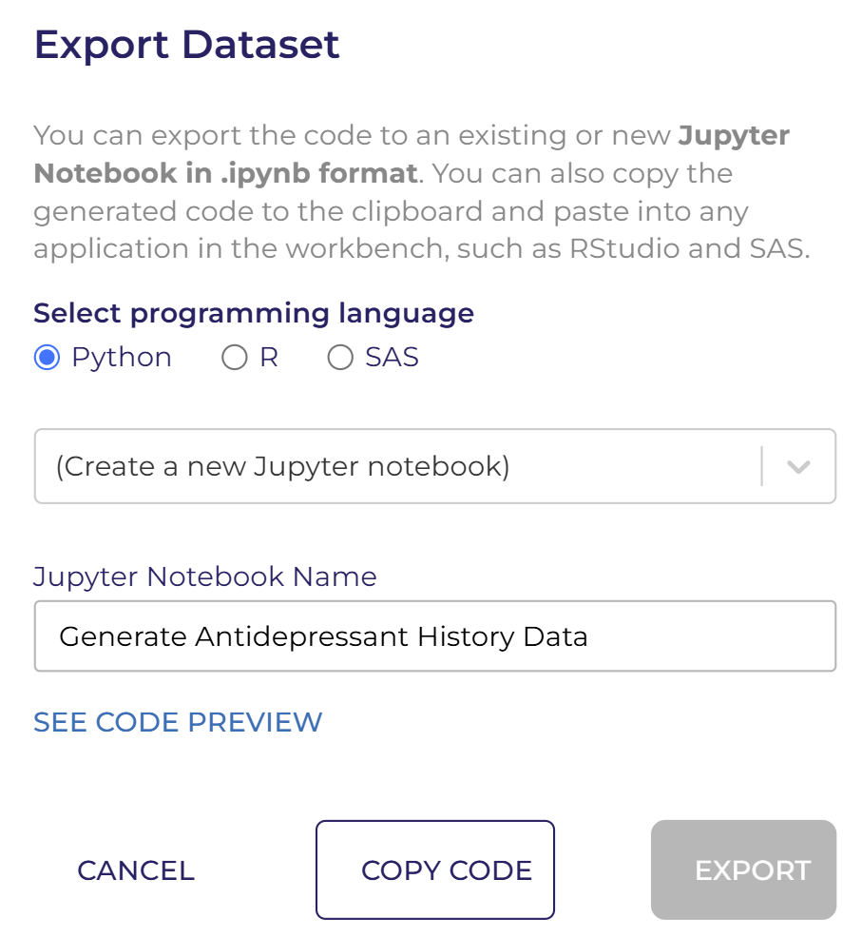
Notes:
Click on "Analyze,“after that select Python, then choose the notebook created earlier: "Analyze Missing Values," and click "Export."

Slide 14
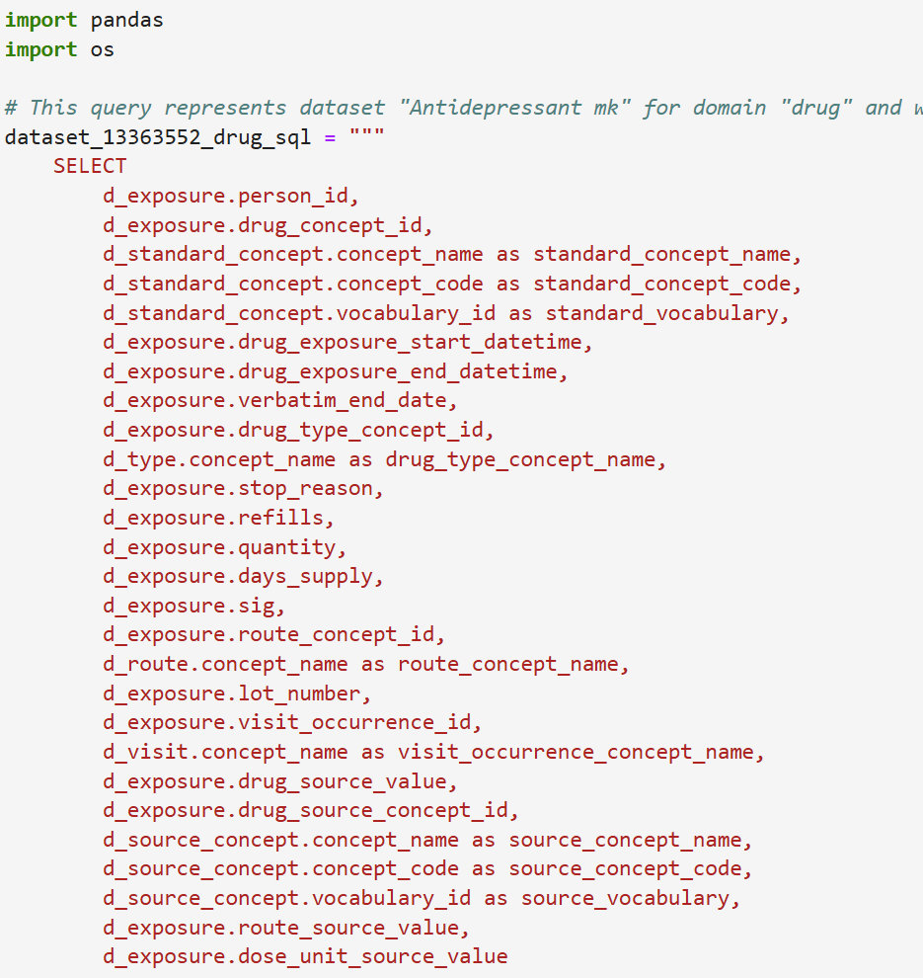
Notes:
This code queries the "Antidepressant_data" dataset for drug exposure information in the All of Us.

Slide 15
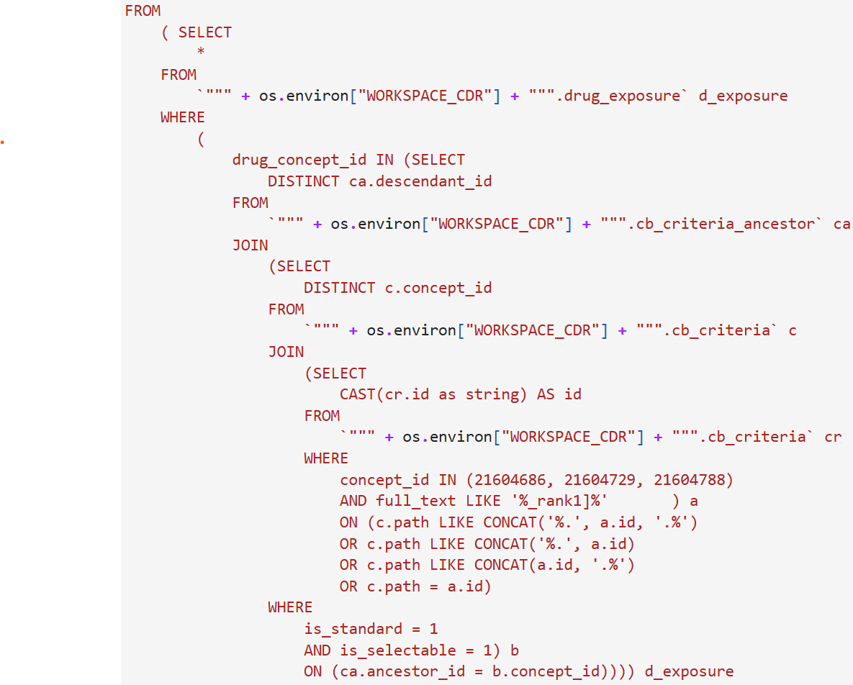
Notes:
This code joins multiple tables to retrieve detailed drug exposure.

Slide 16
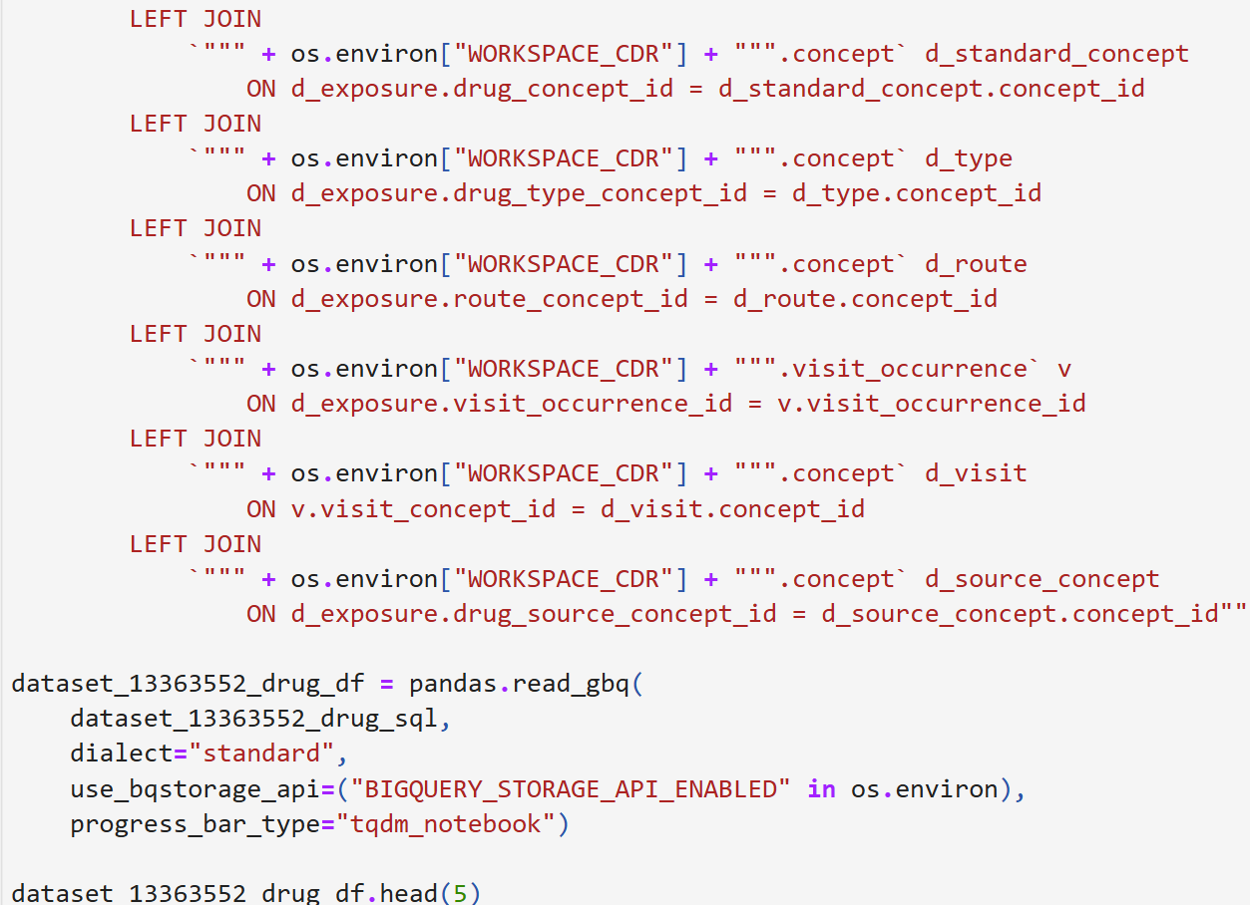
Notes:
The query is executed using pandas to load the result into a DataFrame for analysis.

Slide 17
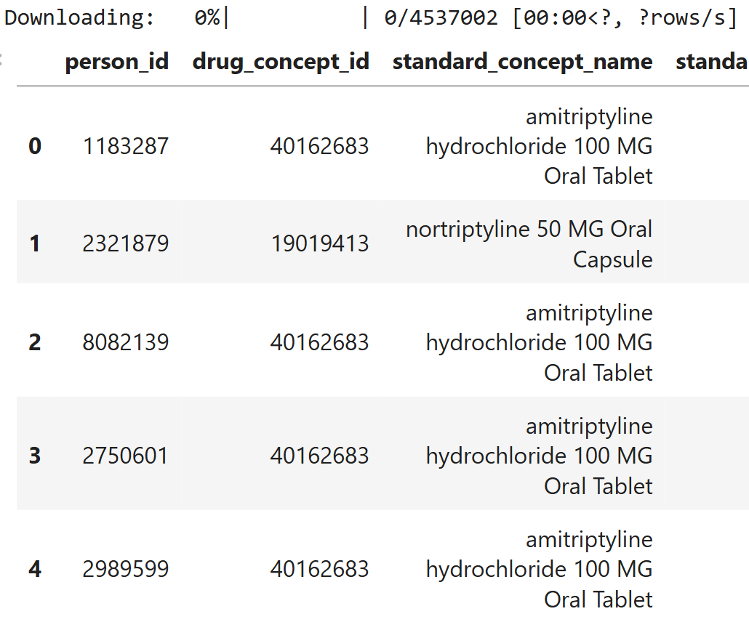
Notes:
Check your results after the execution of the code.

Slide 18
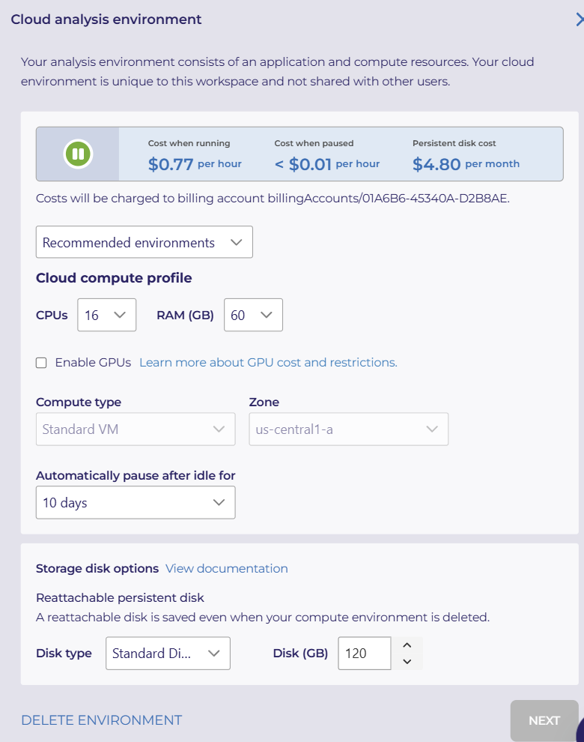
Notes:
Select 16 CPUs and 60 GB RAM, then set the system to automatically pause after 10 days of idle time. Finally, click "Next."

Slide 19
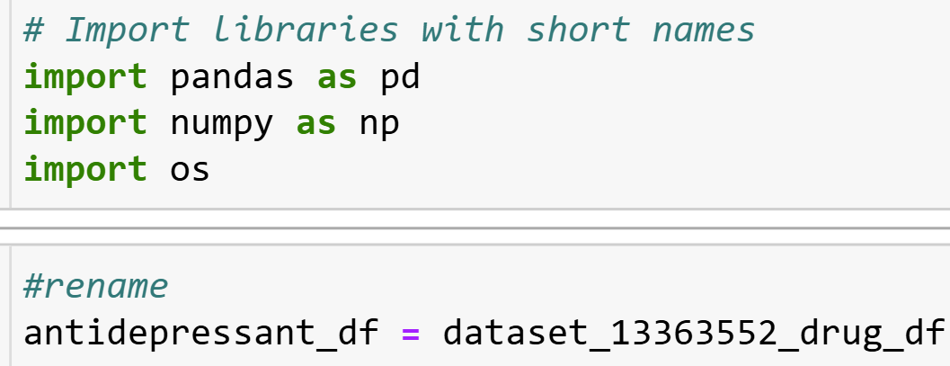
Notes:
This code imports the necessary libraries (pandas, numpy, and os) and renames the dataset to antidepressant_df

Slide 20
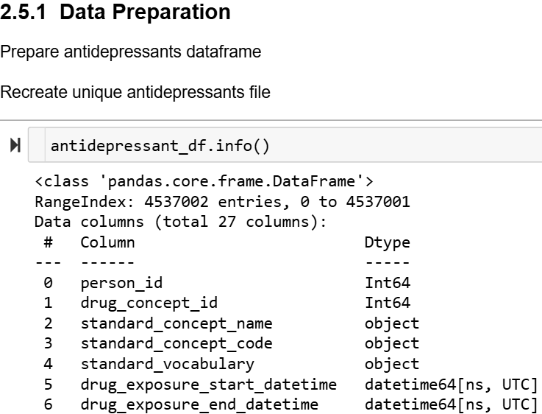
Notes:
The antidepressant_df.info() function provides a summary of the DataFrame. This is helpful for understanding the dataset's structure.

Slide 21
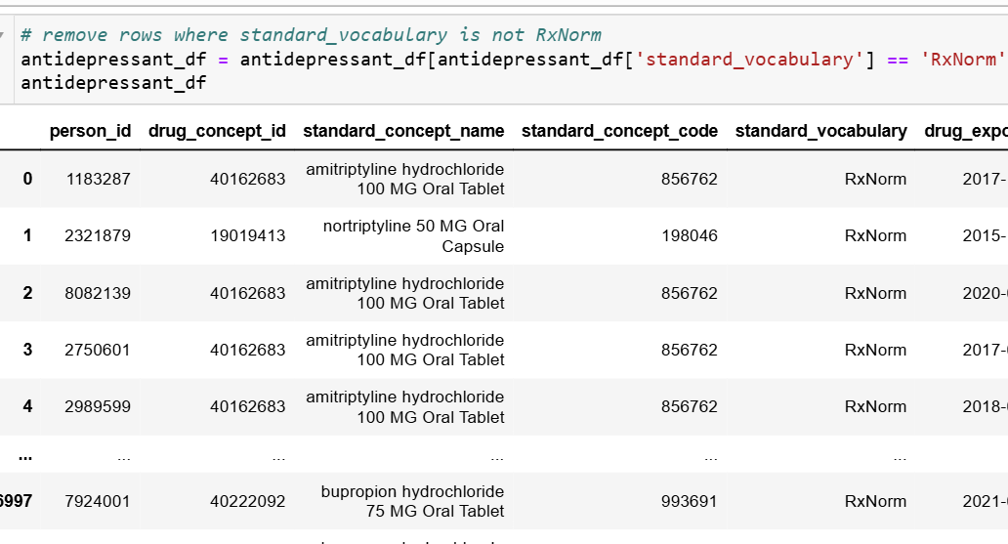
Notes:
This step filters the antidepressant_df DataFrame to retain only the rows where the standard_vocabulary is 'RxNorm', ensuring that the dataset contains only data related to drug concepts.

Slide 22
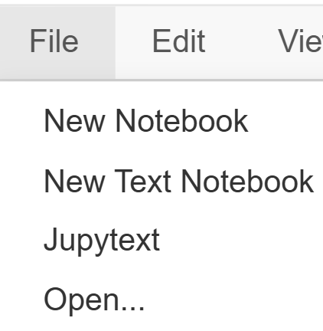
Notes:
select file and click open

Slide 23
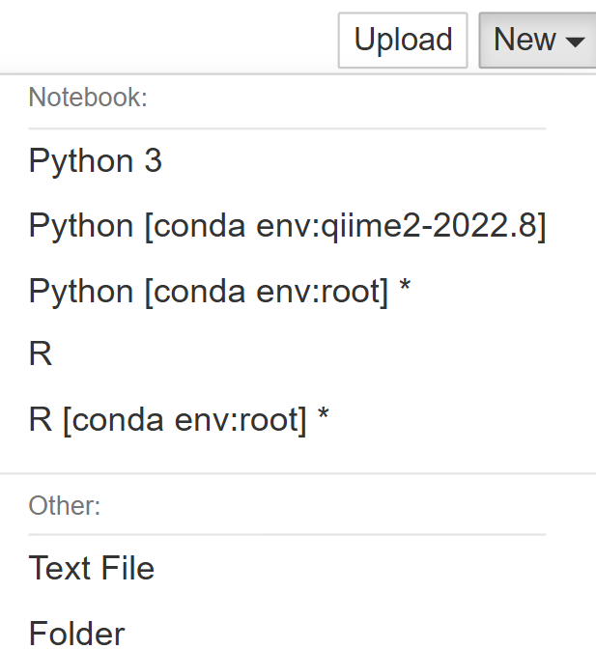
Notes:
Select New and then click folder

Slide 24
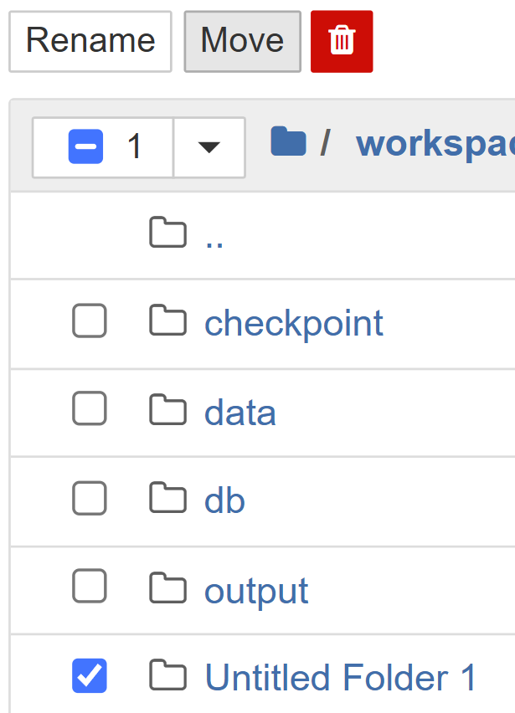
Notes:
Select untitled folder and click on rename.

Slide 25
Notes:
Rename the directory to data and click rename.

Slide 26
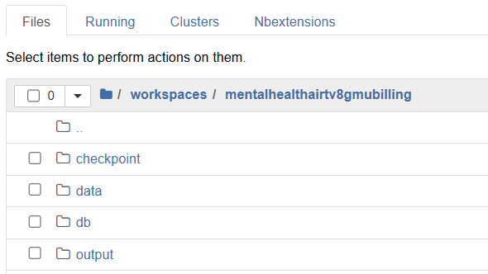
Notes:
Open the data folder

Slide 27
Notes:
click upload and ok to upload the unique_ad_grouped.csv .

Slide 28
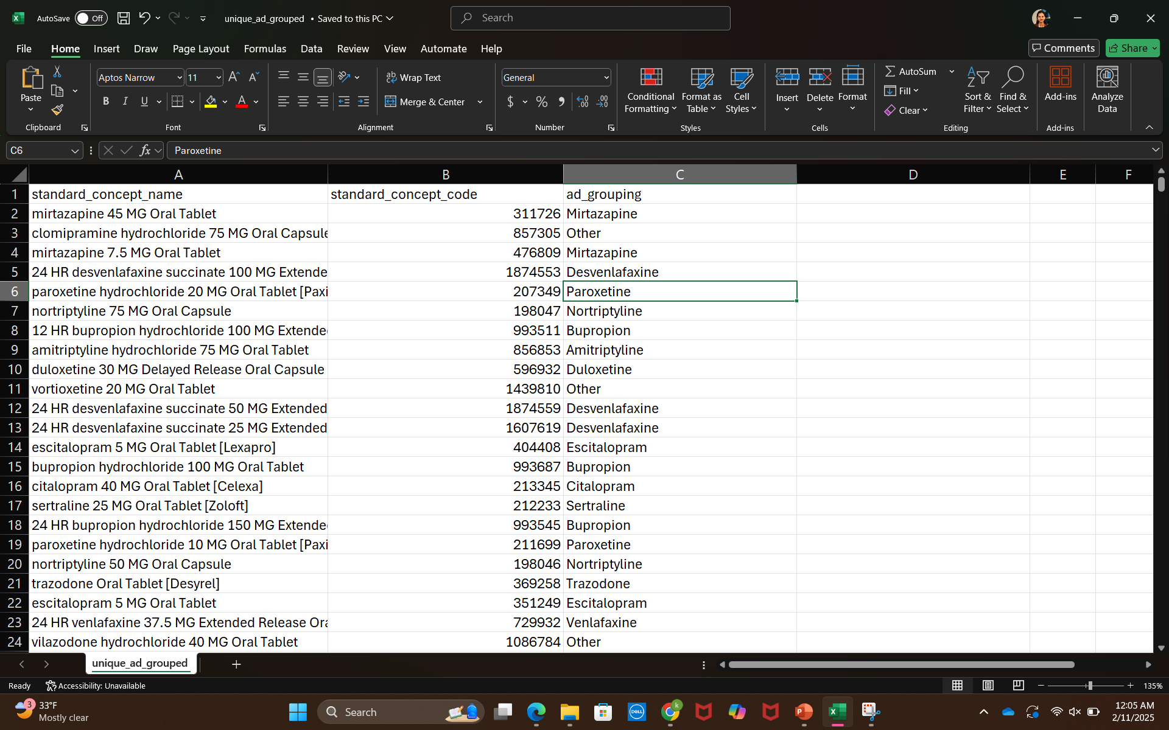
Notes:
This is unique_ad_grouped.csv file upload this file into the data folder.

Slide 29
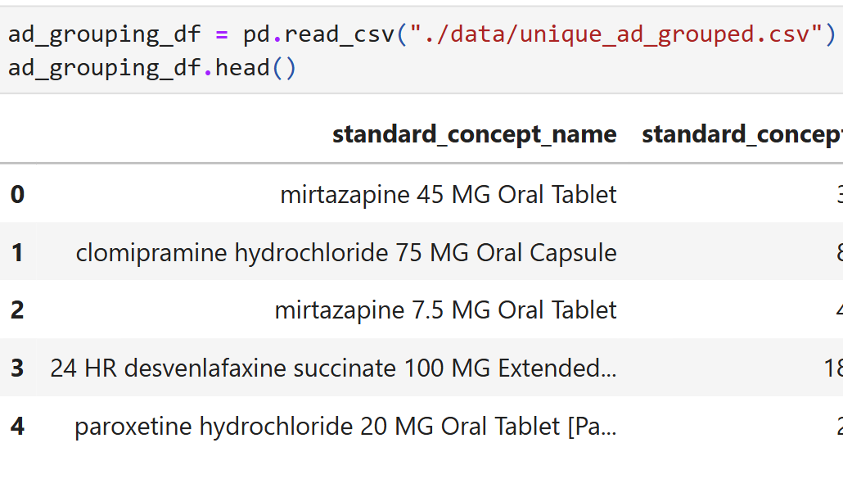
Notes:
This step reads the CSV file unique_ad_grouped.csv into a pandas DataFrame called ad_grouping_df and displays the first few rows using ad_grouping_df.head()

Slide 30
Notes:
This step retrieves and displays the unique values in the ad_grouping column of the ad_grouping_df DataFrame.

Slide 31
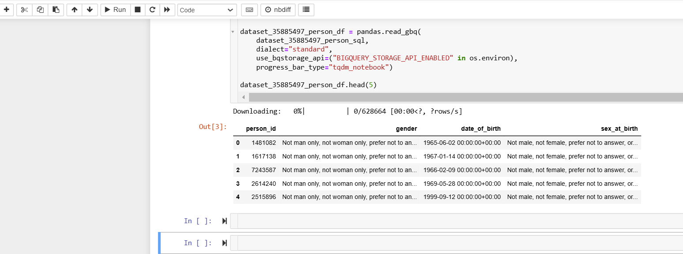
Notes:
Copy the demographics code into this Generate antidepressant history note book and Add two new cells by clicking plus after the demographics dataset code.

Slide 32
Notes:
Save the previously executed demographics_ dataset into a csv. Rename the dataset_35885497_person_df to demographics_df and then the code to_csv saves the demographics_df DataFrame to a CSV file.

Slide 33
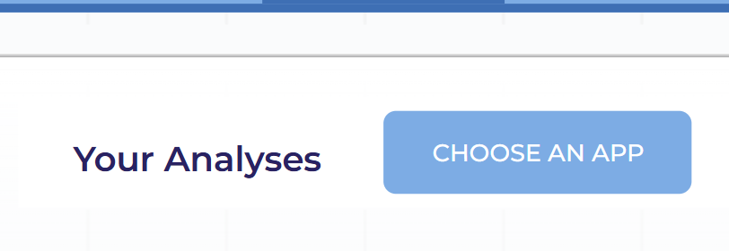
Notes:
Next step is to select choose an app

Slide 34
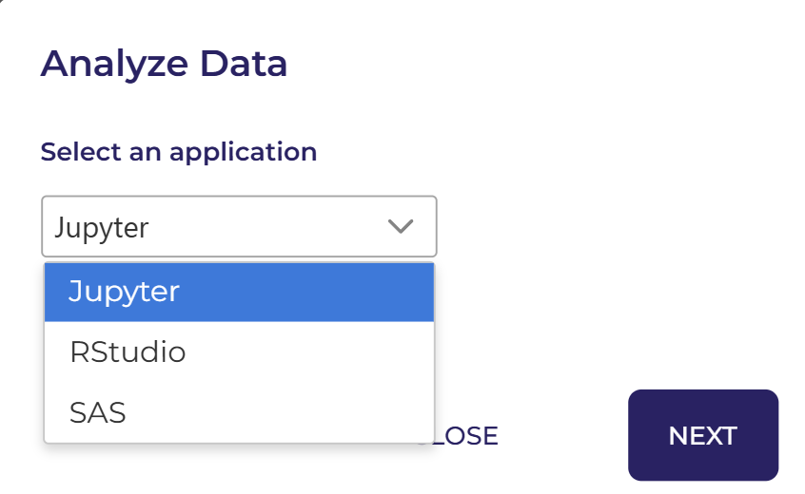
Notes:
Select application jupyter

Slide 35
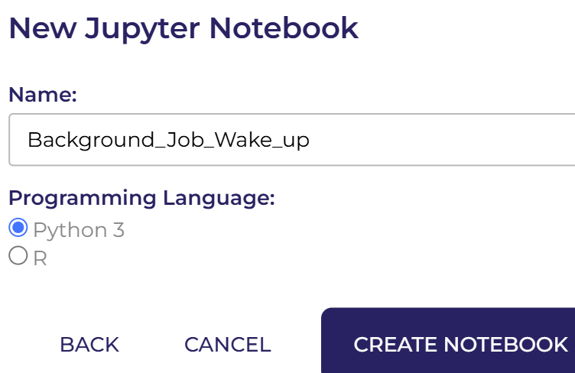
Notes:
Name it as Background_job_wake_Up and click on create notebook.

Slide 36
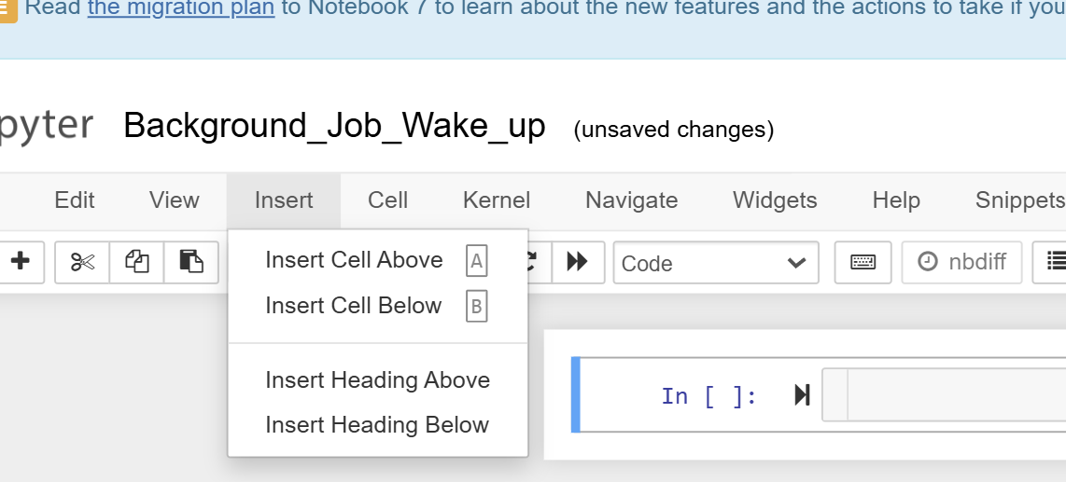
Notes:
Now click on insert heading above

Slide 37
Notes:
And insert the given text

Slide 38
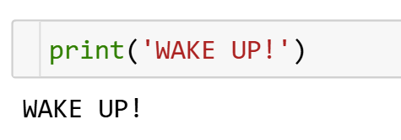
Notes:
Run the python code after 12-15 hrs copy this code again in the next cell and run the code

Slide 39
Notes:
Click on this link to learn how to run the code in the background. This is crucial because processing antidepressant history data can take up to 15 to 20 hours, which may lead to issues such as automatic sign-outs or even account restrictions. Following these steps will help you prevent such problems.

Slide 40
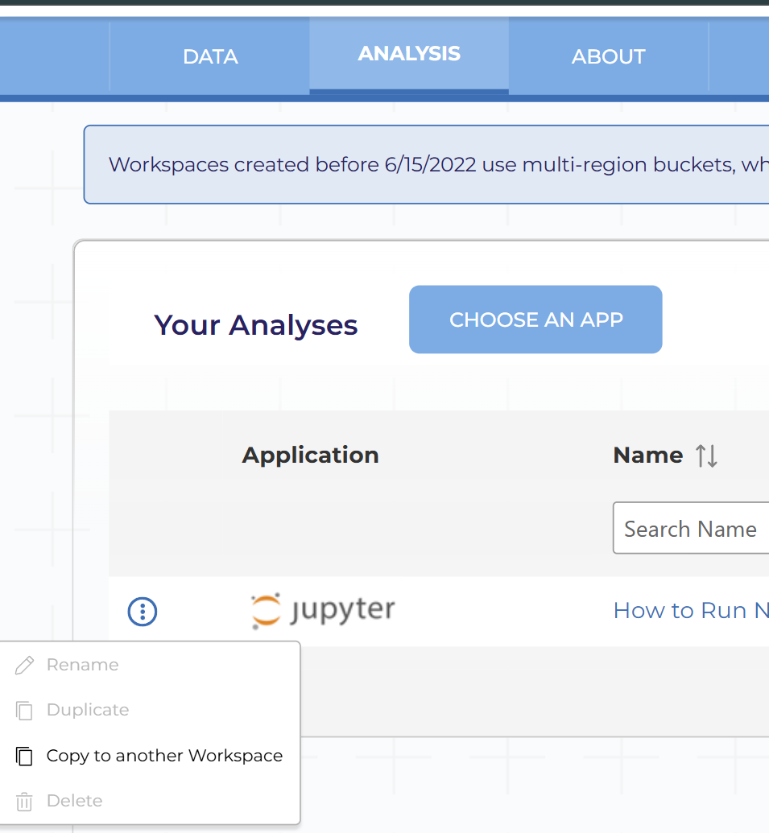
Notes:
After opening the link, navigate to "Analysis," click on the three dots, and select "Copy to Another Workspace.

Slide 41
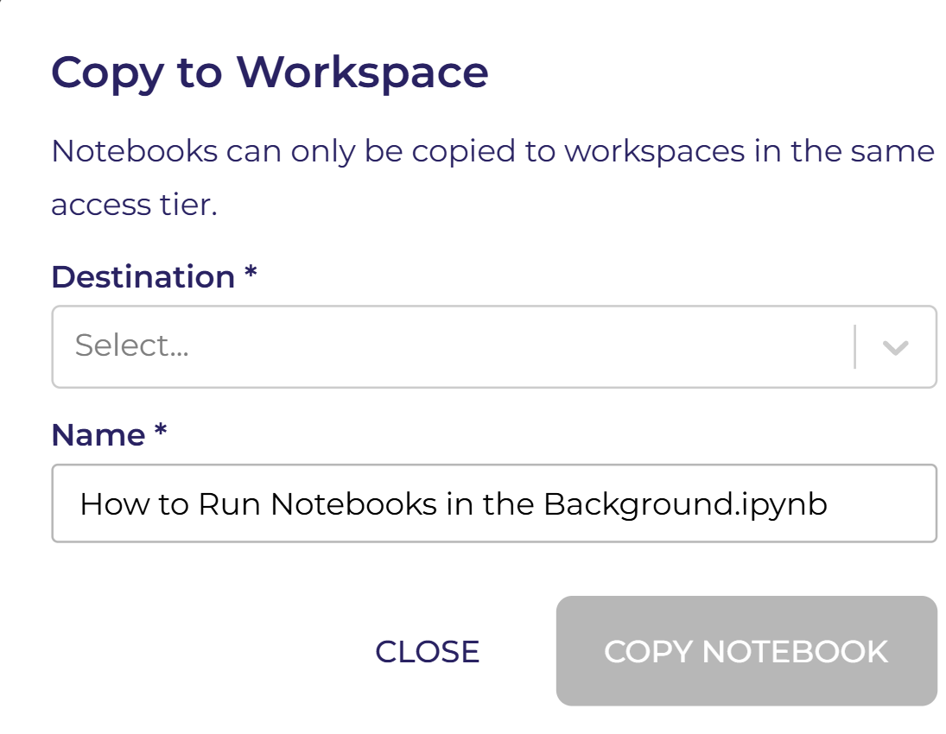
Notes:
In the destination section, select your workspace.

Slide 42
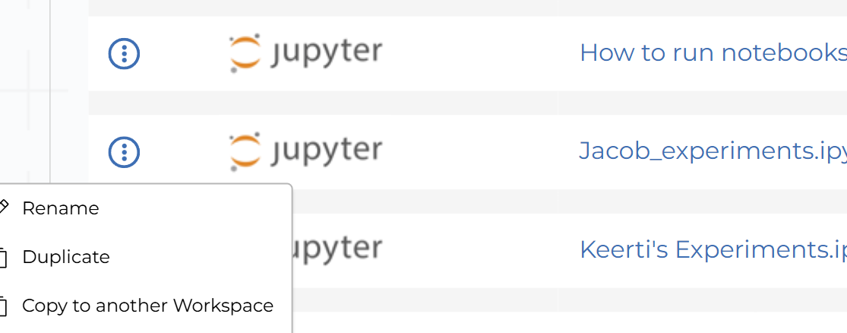
After that, you should see the notebook in the "Analysis" section of your workspace. Then,uplicate the notebook.
Notes:
After that, you should see the notebook in the "Analysis" section of your workspace. Then, duplicate the notebook.

Slide 43
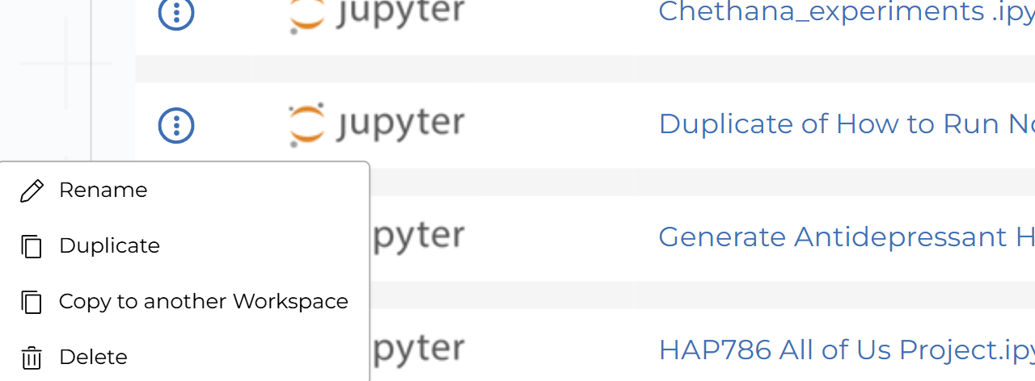
Notes:
Rename the duplicate notebook

Slide 44
Notes:
Rename it to Notebook_to_run

Slide 45
Notes:
This slide demonstrates how to run a notebook in the background, which is particularly useful for handling long-running notebooks in your workspace.

Slide 46
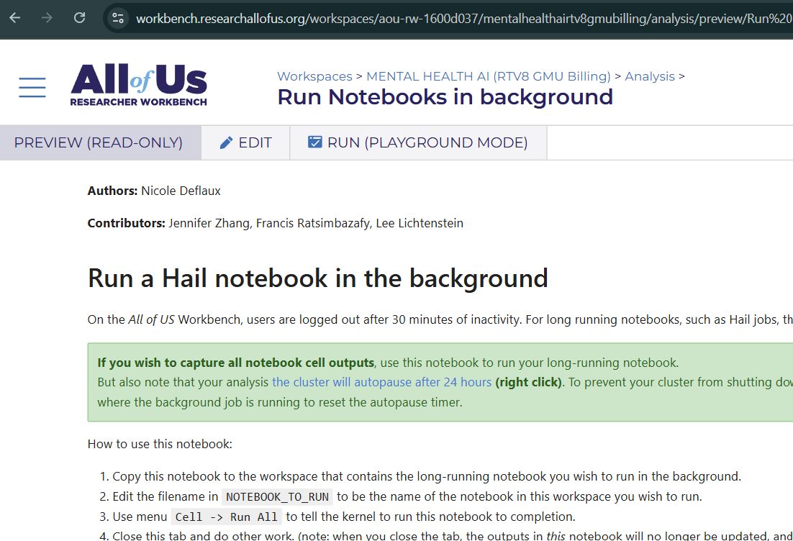
Notes:
Click edit to run the program

Slide 47
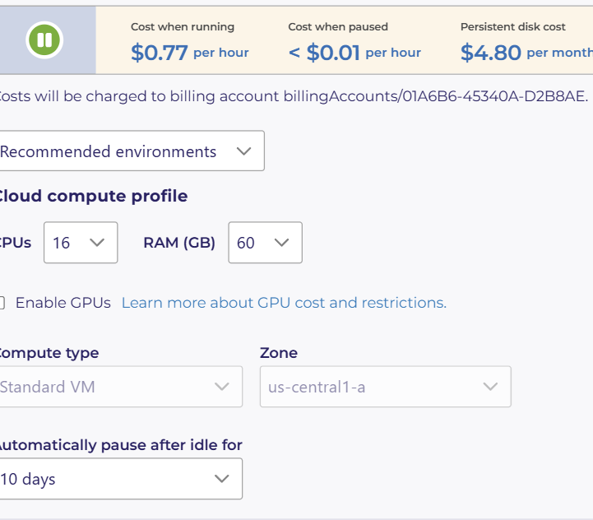
Notes:
Make sure to set the CPUs to 16, allocate 60 GB of RAM, and configure the session to automatically pause after 10 days of inactivity. Also, update the cloud analysis environment similarly for the "Generate Antidepressant History Data" notebook.

Slide 48
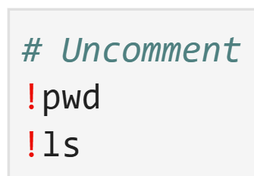
Notes:
Remove the comment lines to see list of notebooks in the current working directory.

Slide 49
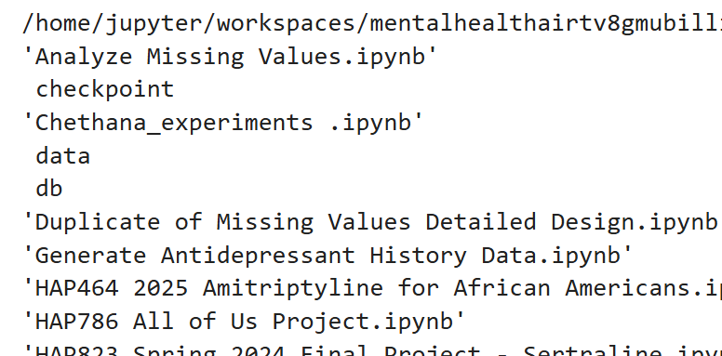
Notes:
Copy the notebook name from the results and paste it in the next line of the code

Slide 50
Notes:
Replace your_notebook to Generate Antidepressant History Data and kernel to python

Slide 51
Notes:
Now, you should be able to see the executed notebook name. This is crucial because you need to run this file Notebook_to_run and wait for it to complete, which may take anywhere from 15 to 25 hours. Once the process is finished, a new notebook with the name given here will appear in your workspace.

Slide 52
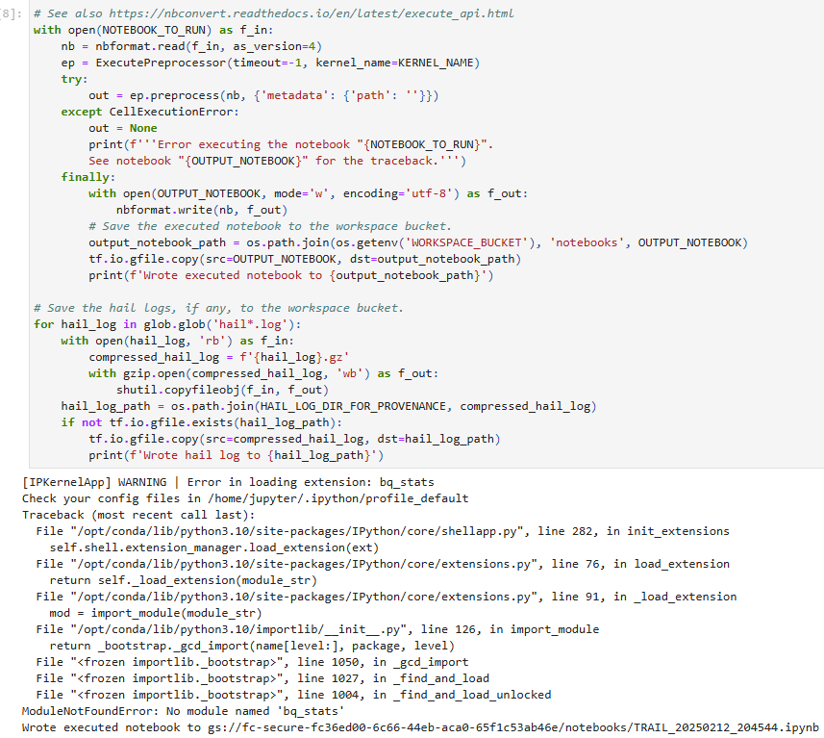
Notes:
Wait till this code run it will take 15-24 hrs

Slide 53
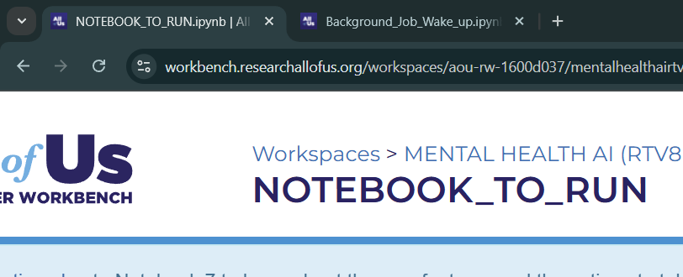
Notes:
Keep these two notebooks open

Slide 54
Step 1: Understand the Process:
Watch the reference videos to understand the entire process of generating antidepressant history data. Familiarize yourself with how the data should be structured.
Step 2: Create the Code:
Create a new notebook.(Generate Antidepressant History Data)
Reference the code provided in the open online course, and start writing code to generate the antidepressant history data and demographics data.
Be sure to organize your code properly and create a data folder to store the generated data files.
Step 3: Save the Code:
Once the code is ready, save the notebook .Dont run the code in this notebook
Begin working on the second notebook titled background_job_wake_up.
Step 4: Copy and Rename Notebook:
Find the notebook “How to Run Large Files in Background” via the provided link.
Copy this notebook to your workspace and rename it to NOTEBOOK_TO_RUN
Step 5: Run the Entire Code:
Execute the code in NOTEBOOK_TO_RUN:
Wait for the kernel to run for approximately 20-25 hours. The process may take a significant amount of time, so be patient.
Step 6: Ensure Both Notebooks are Open:
Keep both notebooks background_job_wake_up AND NOTEBOOK_TO_RUN ,open in your browser during the execution process. This ensures you can monitor the progress and troubleshoot if necessary.
Step 7: Completion:
Once the code runs completely, check for a new notebook file with the name: Generate Antidepressant History Data_20250212_173824.ipynb.
If you see this notebook, the process is complete, and you are done!
Notes:
Review these steps before working.

Slide 55
This video has demonstrated how to Create the Antidepressant Dataset
Notes:
The takeaway from this presentation is to outline the steps in creating an antidepressant dataset for effective analysis and demonstrate how to run large code by executing the notebook in the background.

