Slide 1
Calculating Likelihood Ratio’s
for Missing Values in All of Us
Farrokh Alemi ,PhD &Keerti Reddy
Notes:
These slides show you how to calculate the likelihood ratios for feature selection in missing values project.

Slide 2
Notes:
Go to datasets

Slide 3
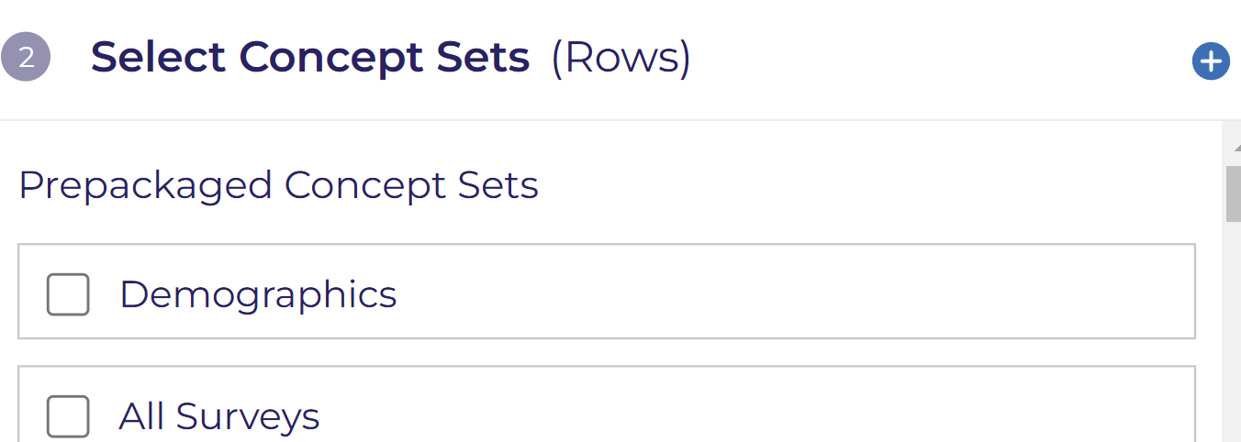
Notes:
select plus symbol to create a new concept set

Slide 4
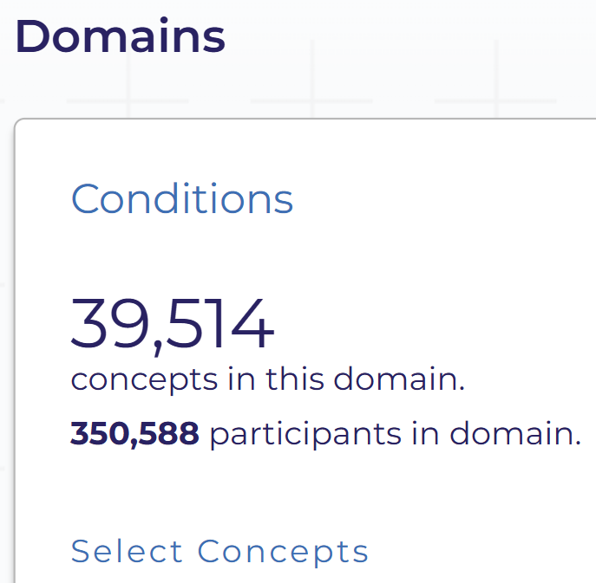
Notes:
Click on conditions

Slide 5
Notes:
Enable this to see the results as source concepts

Slide 6
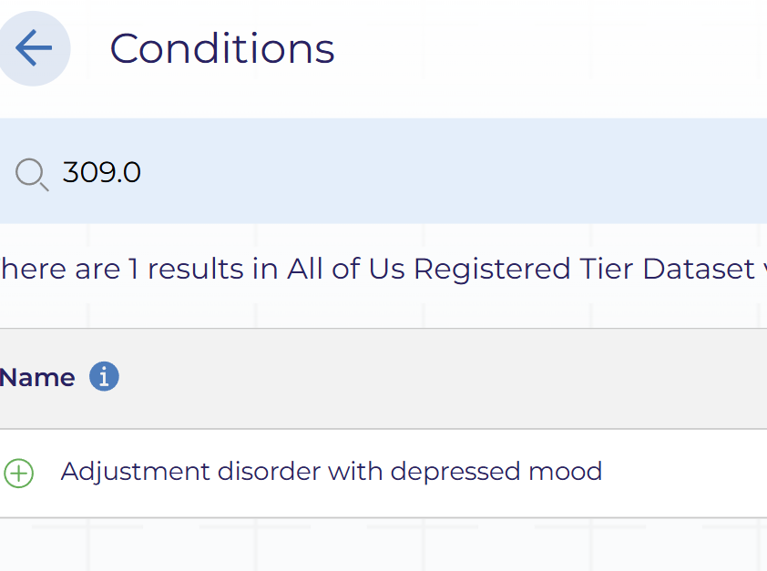
Notes:
Select a condition for example I choose ICD9 309.0

Slide 7
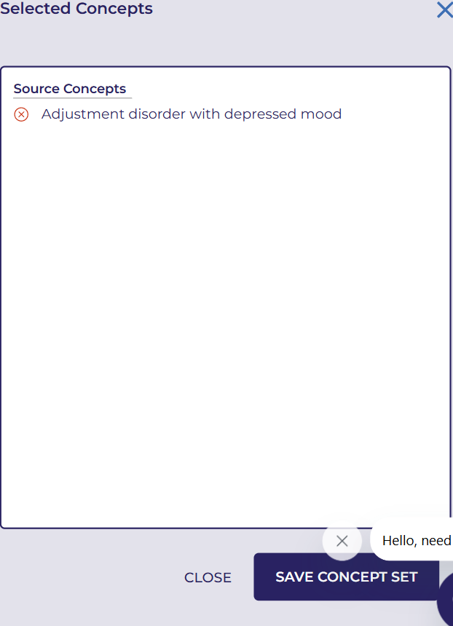
Notes:
Save the concept set

Slide 8
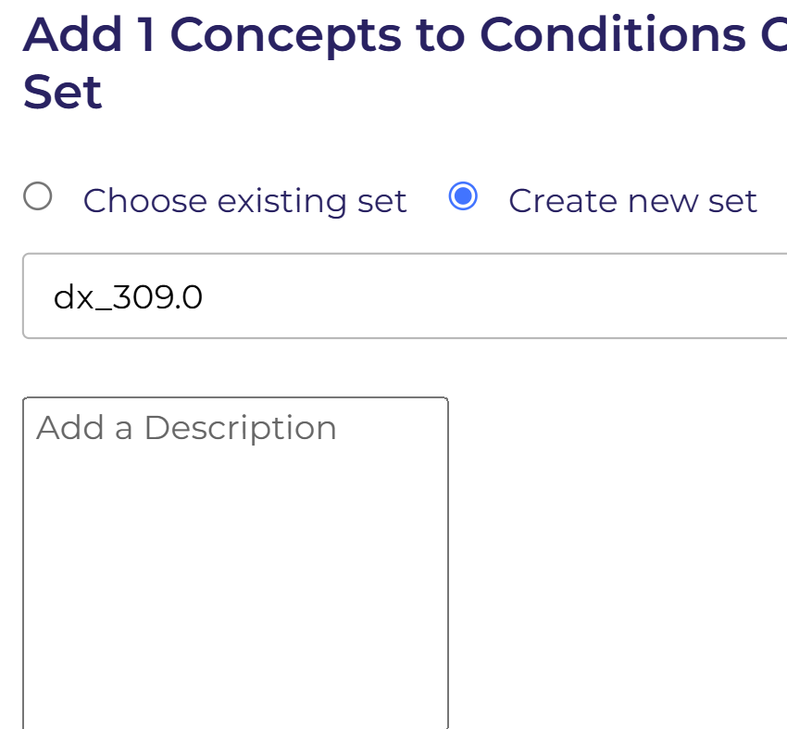
Notes:
create a new concept set by name dx_309.0 and click save

Slide 9
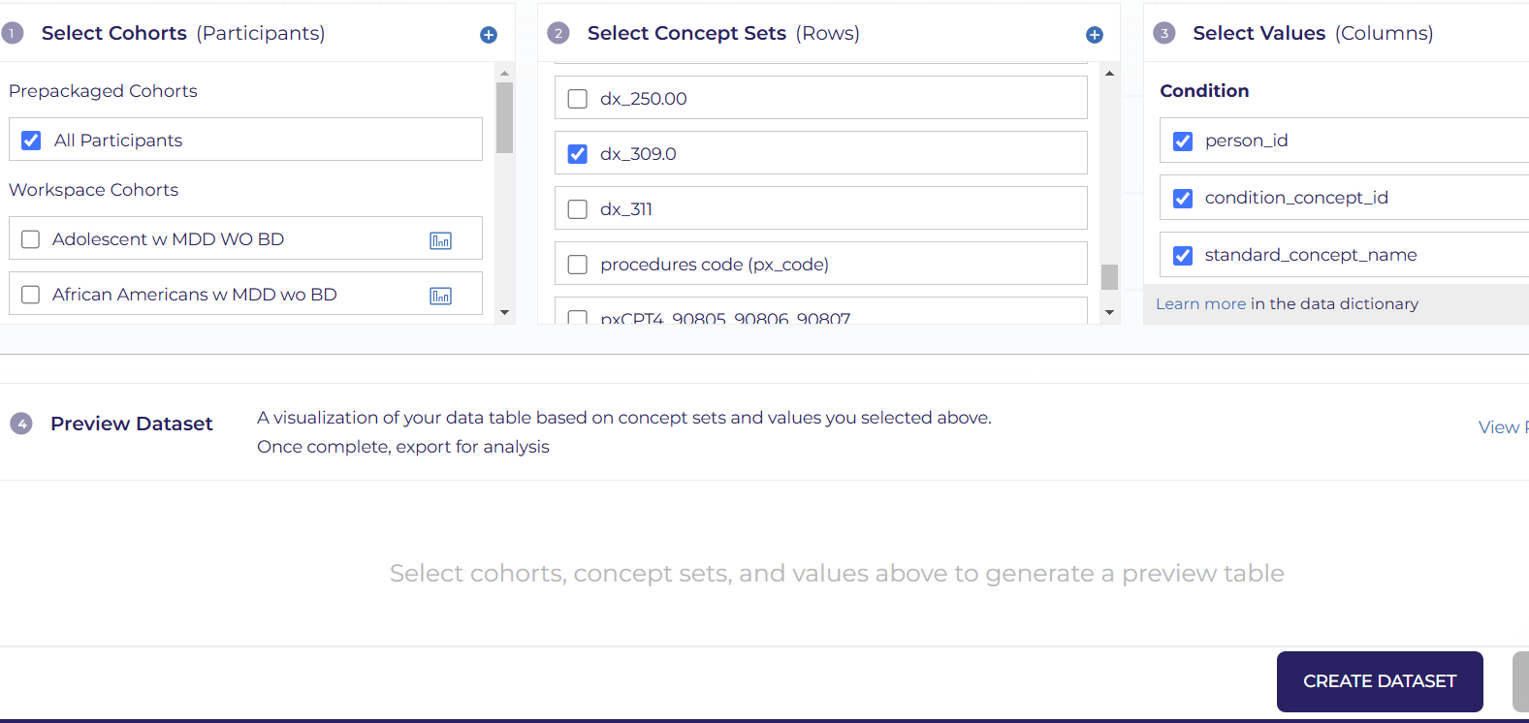
Notes:
Select Cohort as "All Participants", choose the Concept Set as "dx_309.0", select all columns, and then click "Create Dataset".

Slide 10
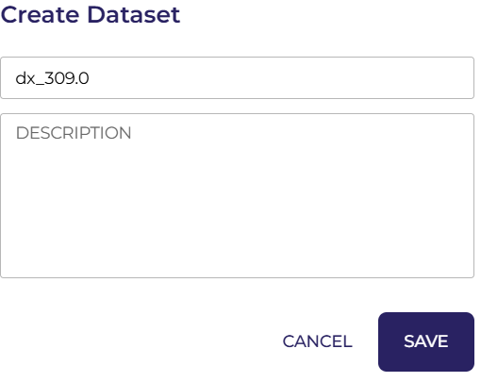
Notes:
Create dataset dx_309.0 and click save

Slide 11
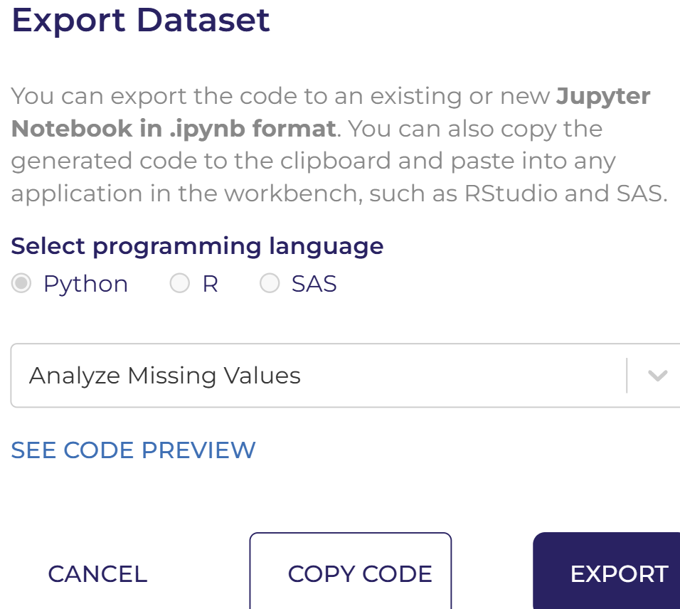
Notes:
Select analyze missing values and click export

Slide 12
Notes:
This Python script extracts specific disease data from the All of Us Registered Dataset

Slide 13
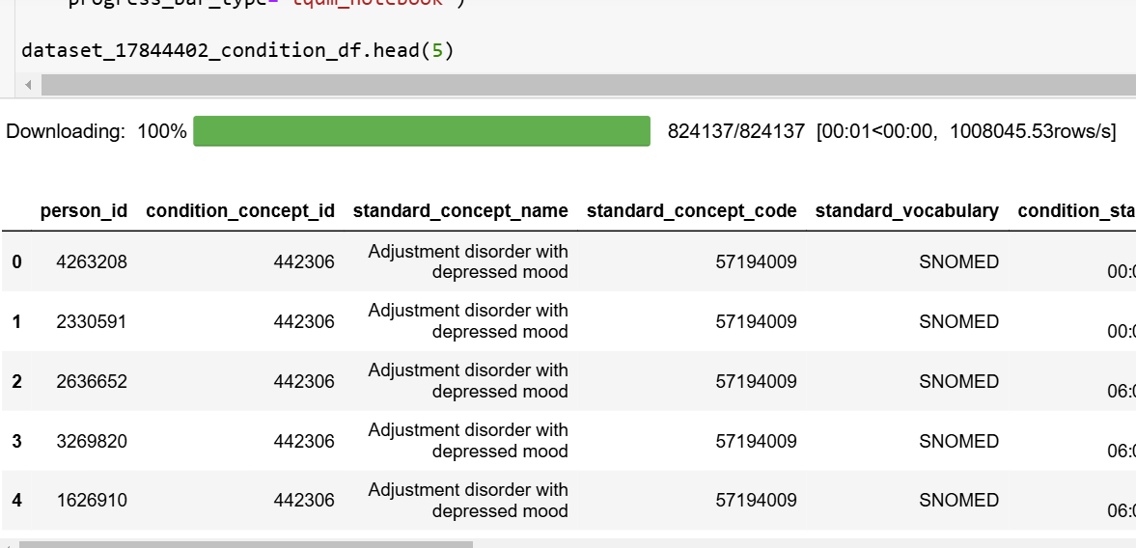
Notes:
Check your results

Slide 14
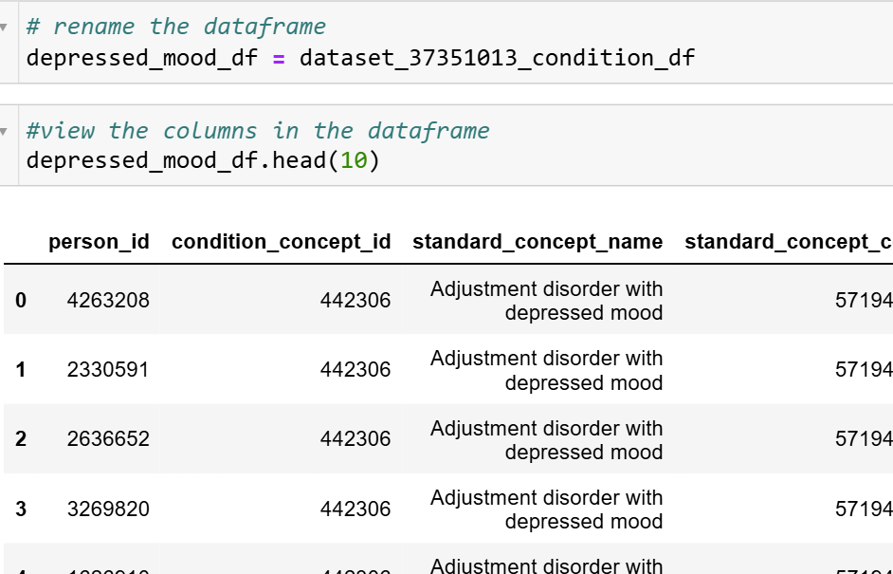
Notes:
check your results and rename the dataframe

Slide 15
Notes:
This slide shows the number of rows with duplicates

Slide 16
Notes:
Go to datasets to create concept set for all diseases

Slide 17
Notes:
select plus symbol to create a new concept set

Slide 18
Notes:
Click on conditions

Slide 19
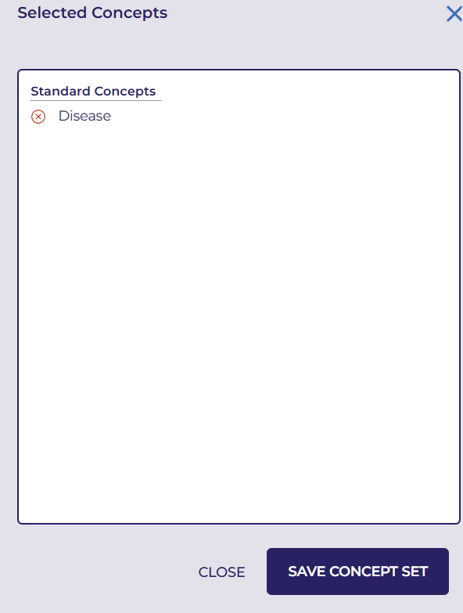
Notes:
Save the concept set

Slide 20
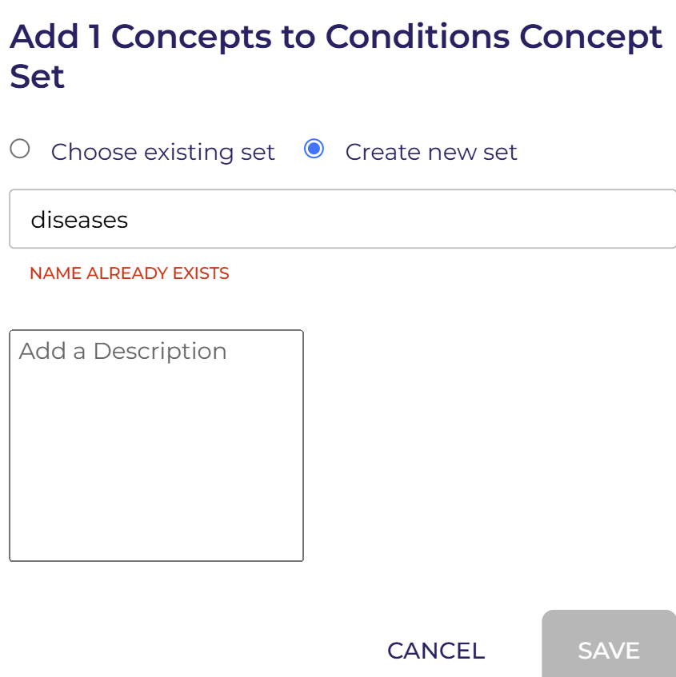
Notes:
Create a new set and name it as diseases.

Slide 21
Notes:
Select Cohort as "All Participants", choose the Concept Set as “diseases", select all columns, and then click "Create Dataset".

Slide 22
Notes:
Select analyze missing values and click export

Slide 23
Notes:
This Python script extracts all disease data from the All of Us Registered Dataset.

Slide 24
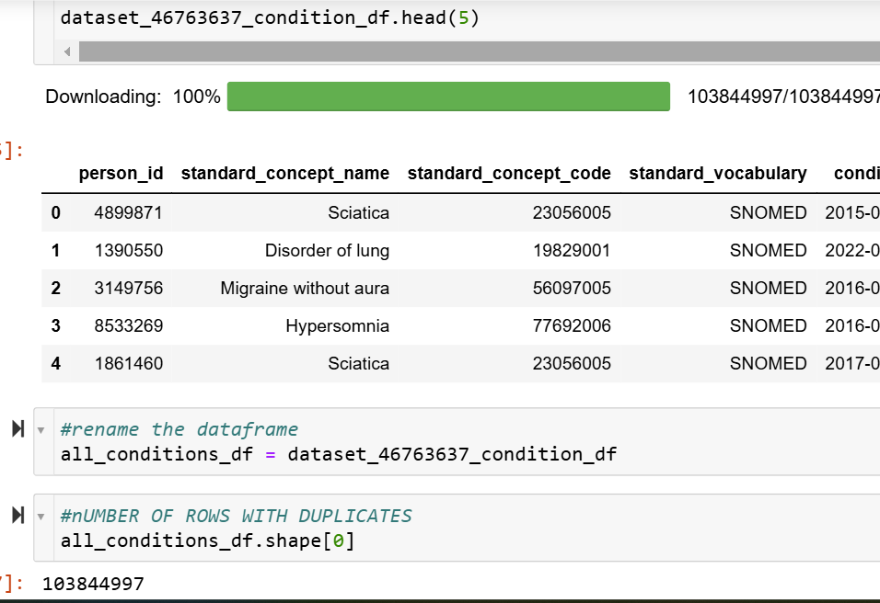
Notes:
Check your results and also rename the dataframe. and count the number of rows with duplicates

Slide 25
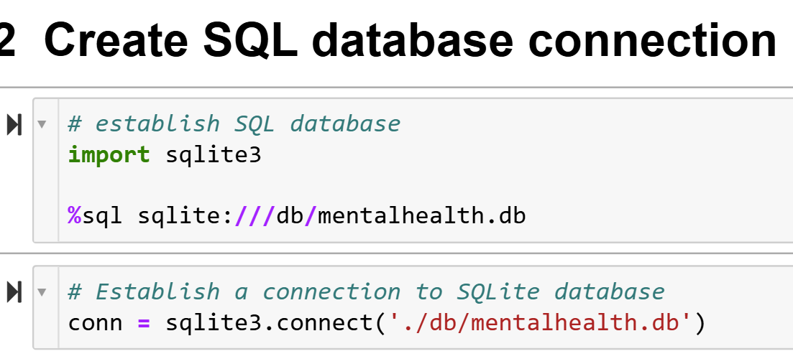
Notes:
Create a new folder db and set up the SQL database connection

Slide 26
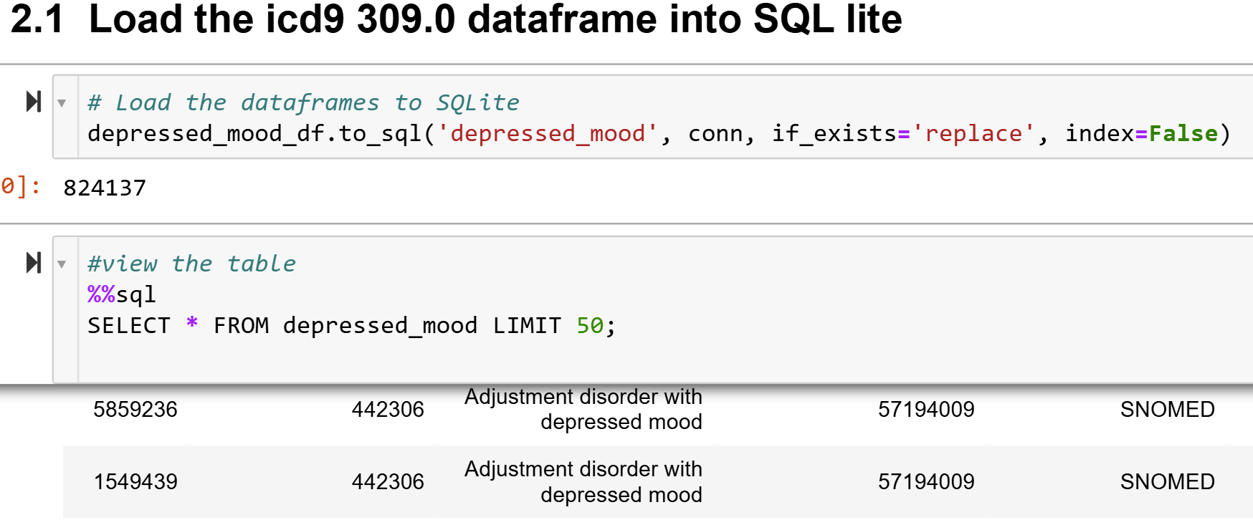
Notes:
Load the depressed_mood_dataframe to sqlite and view the table.

Slide 27
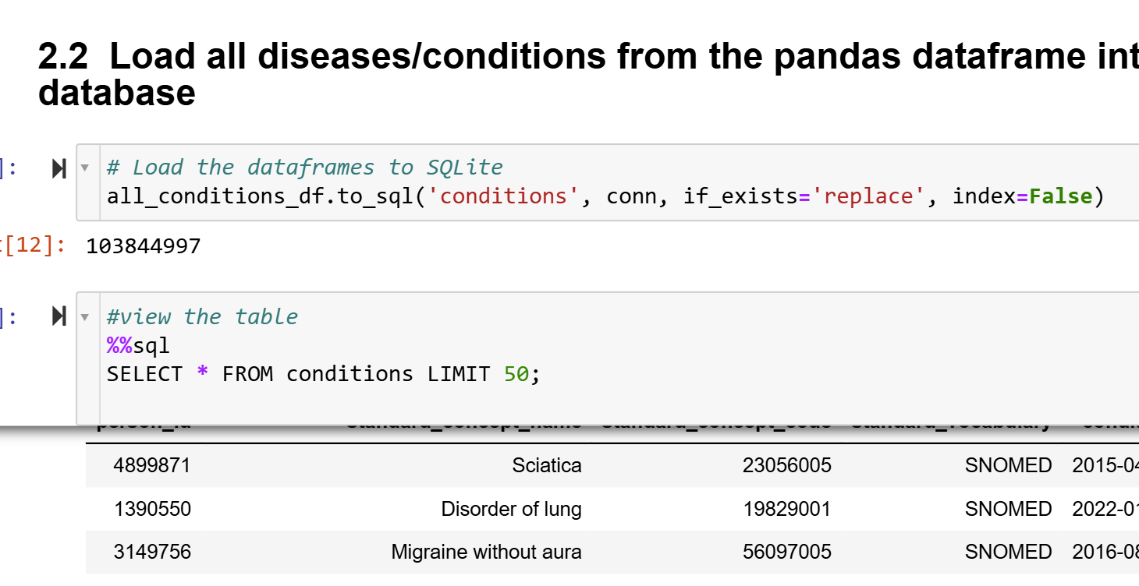
Notes:
Load all the conditions and view the table

Slide 28
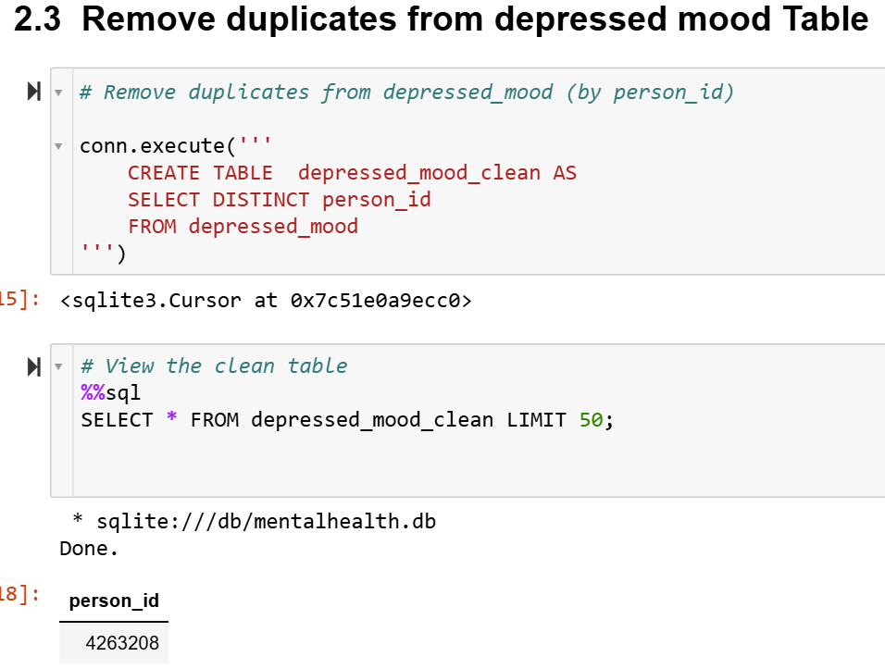
Notes:
Remove the duplicates and view the clean table.

Slide 29
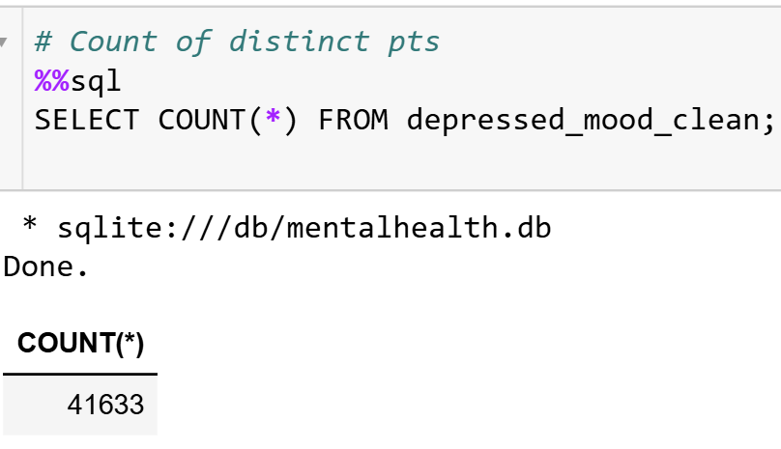
Notes:
This slide shows the count of distinct patients from the cleaned table.

Slide 30
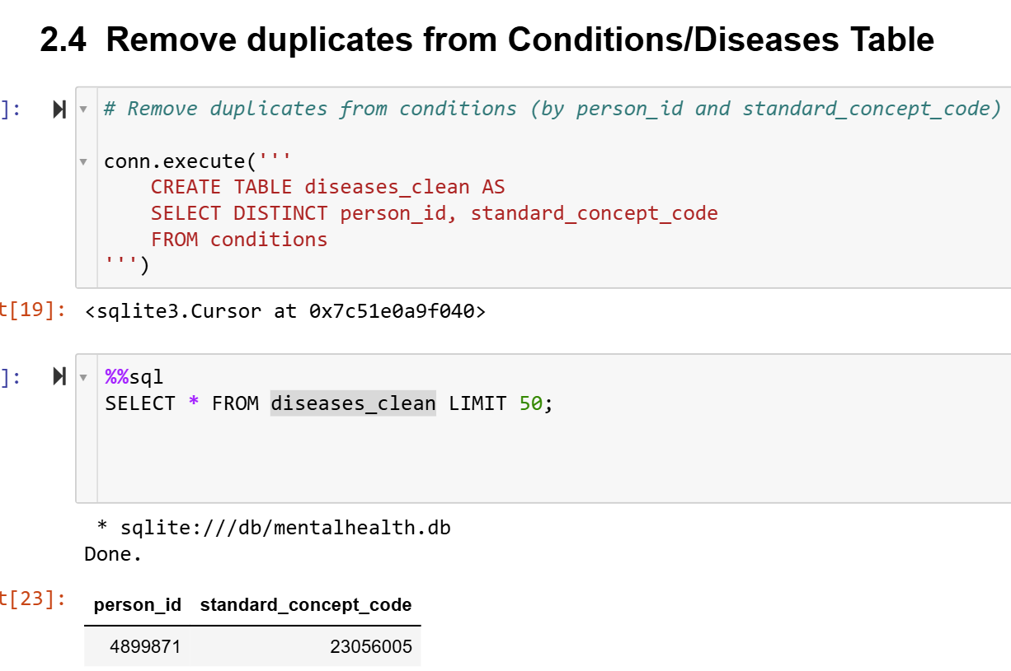
Notes:
This slide presents the code used to eliminate duplicate records based on person_id and standard_concept_code from the conditions table, then save the resulting dataset as diseases_clean."

Slide 31
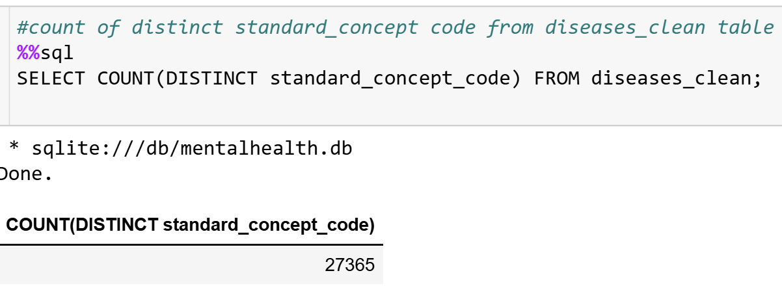
Notes:
"This slide displays the count of distinct rows from the diseases_clean table."

Slide 32
Notes:
This slide shows the target column creation

Slide 33
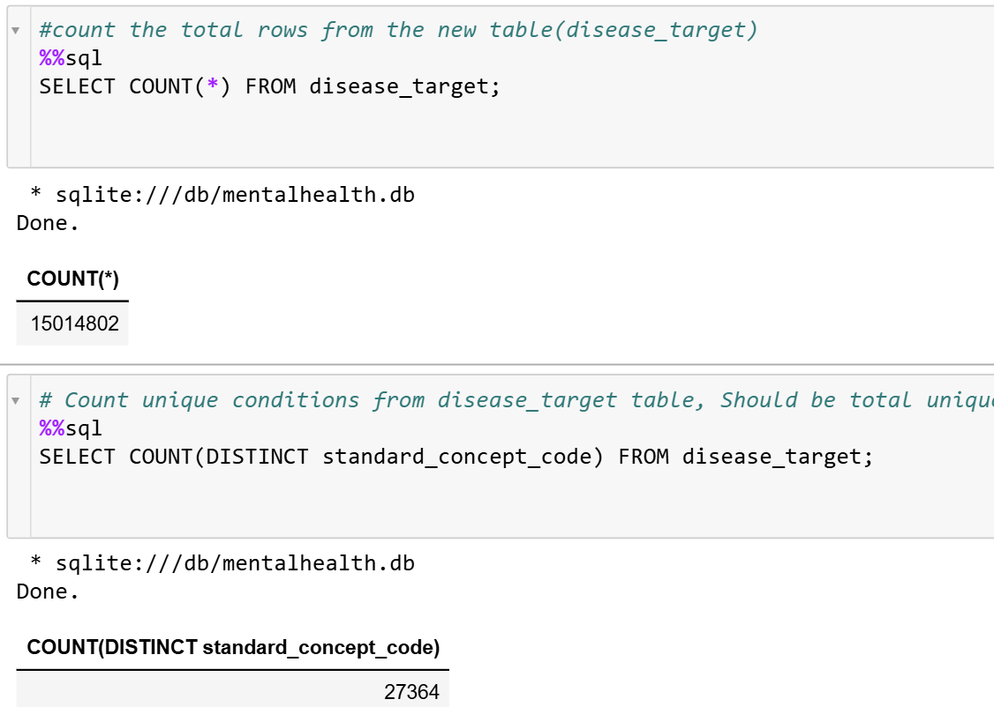
Notes:
This slide shows the count of total rows and unique conditions from the disease_target

Slide 34
Notes:
"Check if depressed_mood is present in the disease_target table by using the standard_concept_code in the WHERE condition."

Slide 35
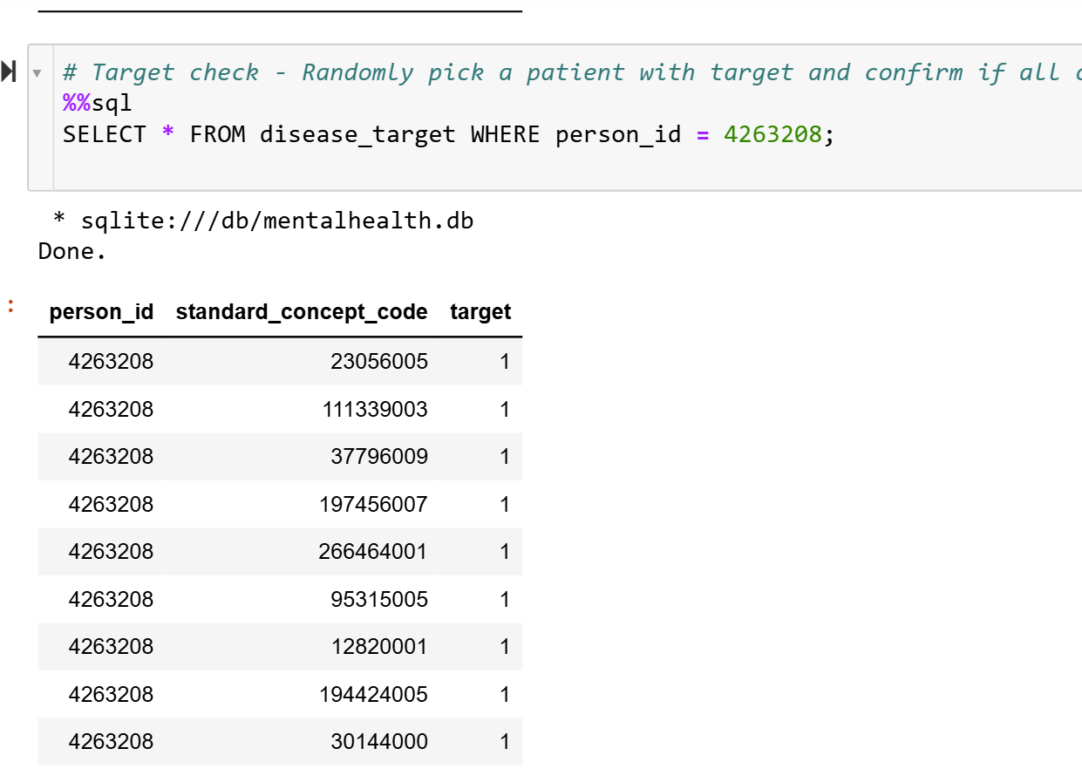
Notes:
This slide shows how to do the Target Verification first Randomly select a patient with in disease_target table and confirm that all recorded instances included target.

Slide 36
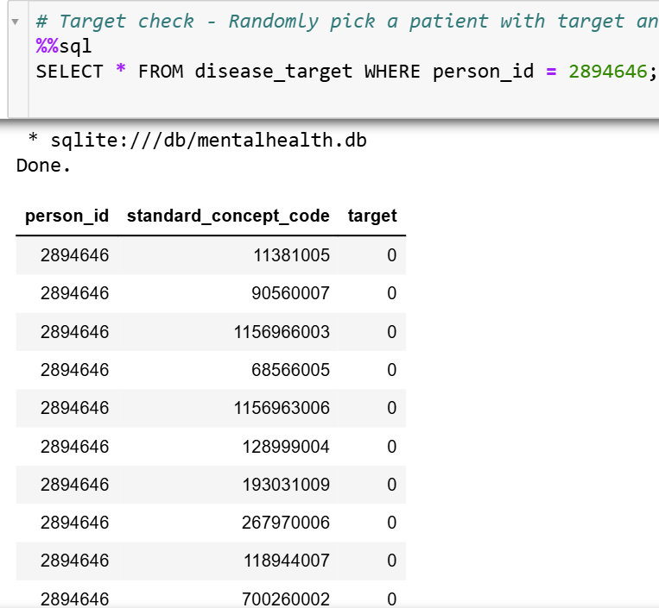
Notes:
Target Verification: Randomly select a patient with in disease_target table and confirm that none of their recorded instances include the target label.

Slide 37
Notes:
Create a likelihood ratio results table by calculating CodeTarget, CodeNoTarget, TotalTarget, TotalNoTarget, TotalCount. Filter CodeTarget and Code NoTarget <=0 and total record count for each disease/condition <10.

Slide 38
Notes:
Calculate Likelihood Ratio's based on these values for each disease/condition in All of Us database for the likelihood of ICD 9 309.0

Slide 39
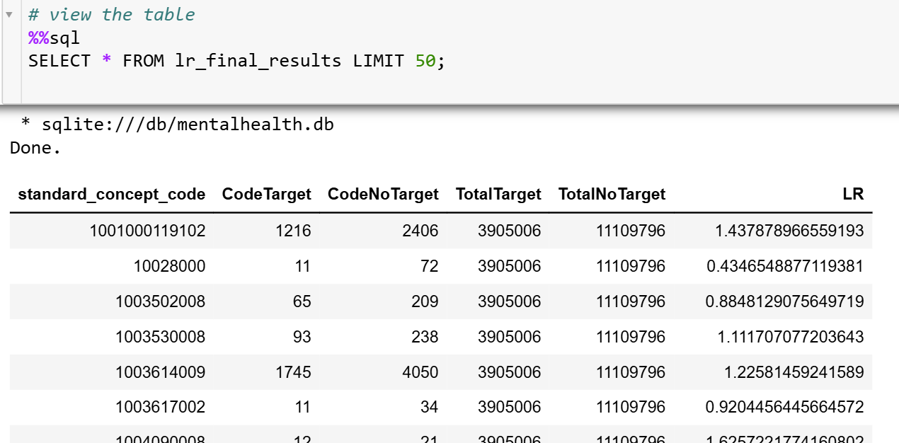
Notes:
View the results

Slide 40
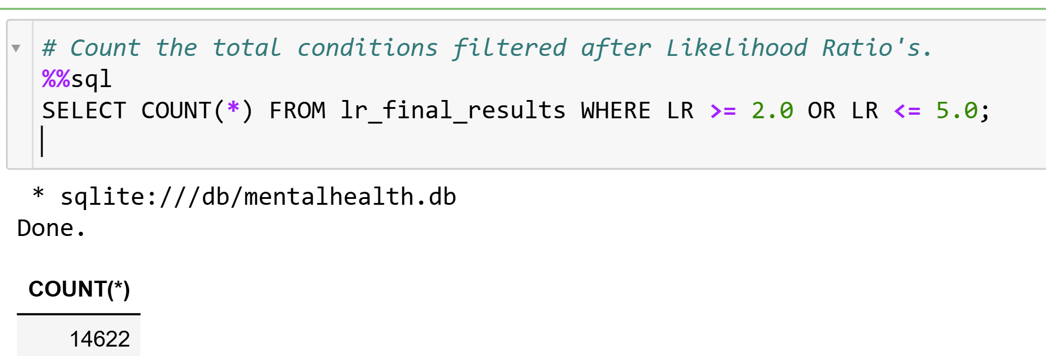
Notes:
Count the total conditions filtered after Likelihood Ratio's.

Slide 41
This video has demonstrated how to calculate the likelihood ratios
Notes:
The takeaway message from this presentation is that Likelihood ratios help quantify the predictive power of features, enabling data-driven selection of the most relevant features.

