Slide 1
Merging Data and dropping duplicates in All of Us
Vladimir Cardenas, Keerti Reddy & Farrokh Alemi, PhD
Notes:
These slides show you how to set up the datasets in All of Us for the missing value project,

Slide 2
Notes:
"To minimize processing costs, we will use SQL in this workspace for initial data dimensionality reduction. Once we have the target and independent variables, we will standardize the datasets."

Slide 3
Notes:
"This slide presents the structure of the target dataset, and we will be working with all the target dataframes mentioned here."

Slide 4
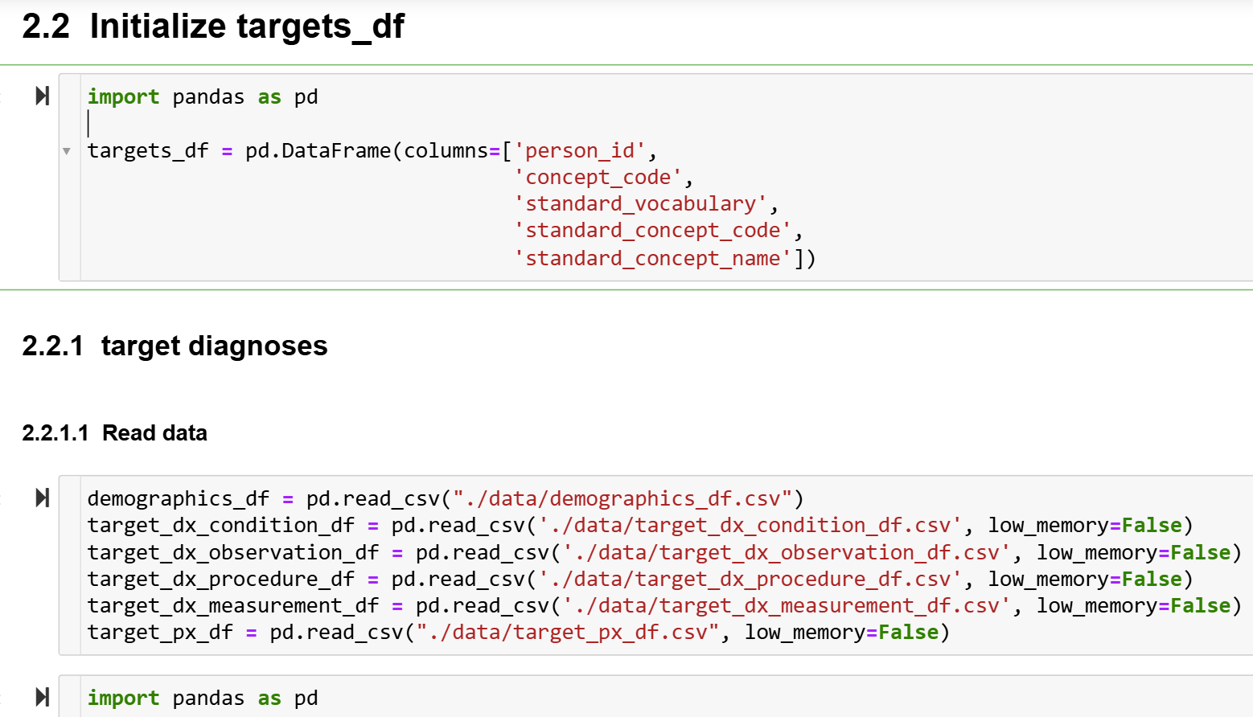
Notes:
"This slide outlines the columns required for the standardization of the target dataframe, along with the process of reading all the target files."

Slide 5
Notes:
The next step demonstrates how to define the function for structuring the diagnoses table, including which rows to retain, how to remove duplicates, and the process of renaming the source_concept_code to concept_code. Additionally, it covers how to convert these values to reflect the strata codes."

Slide 6
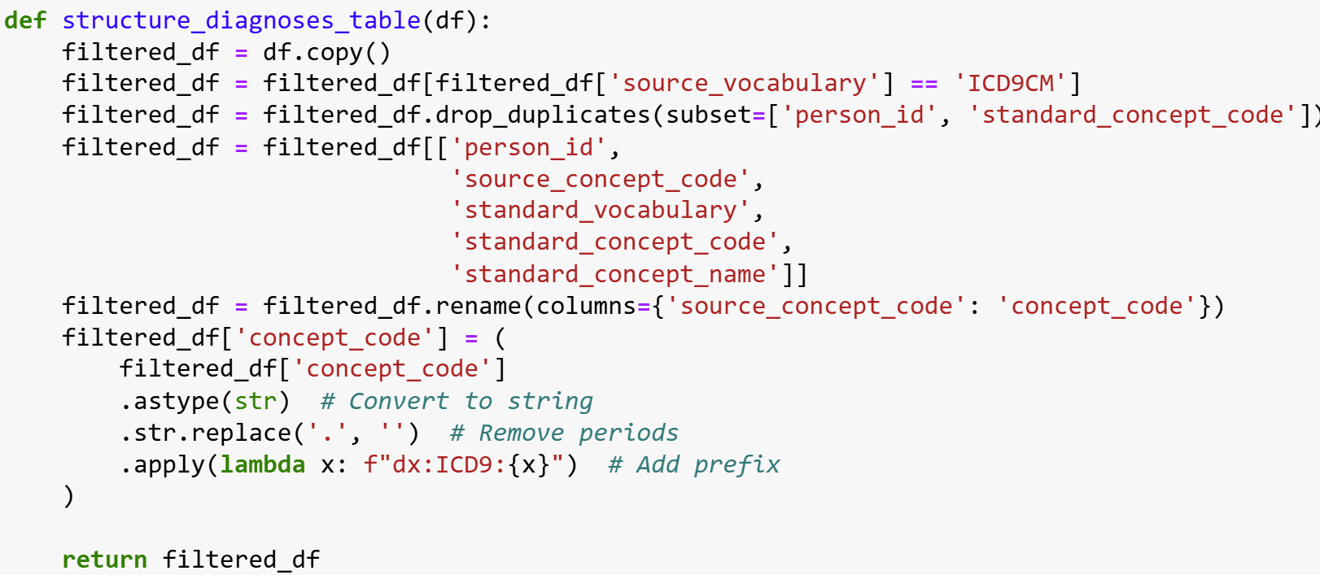
Notes:
This slide shows the code

Slide 7
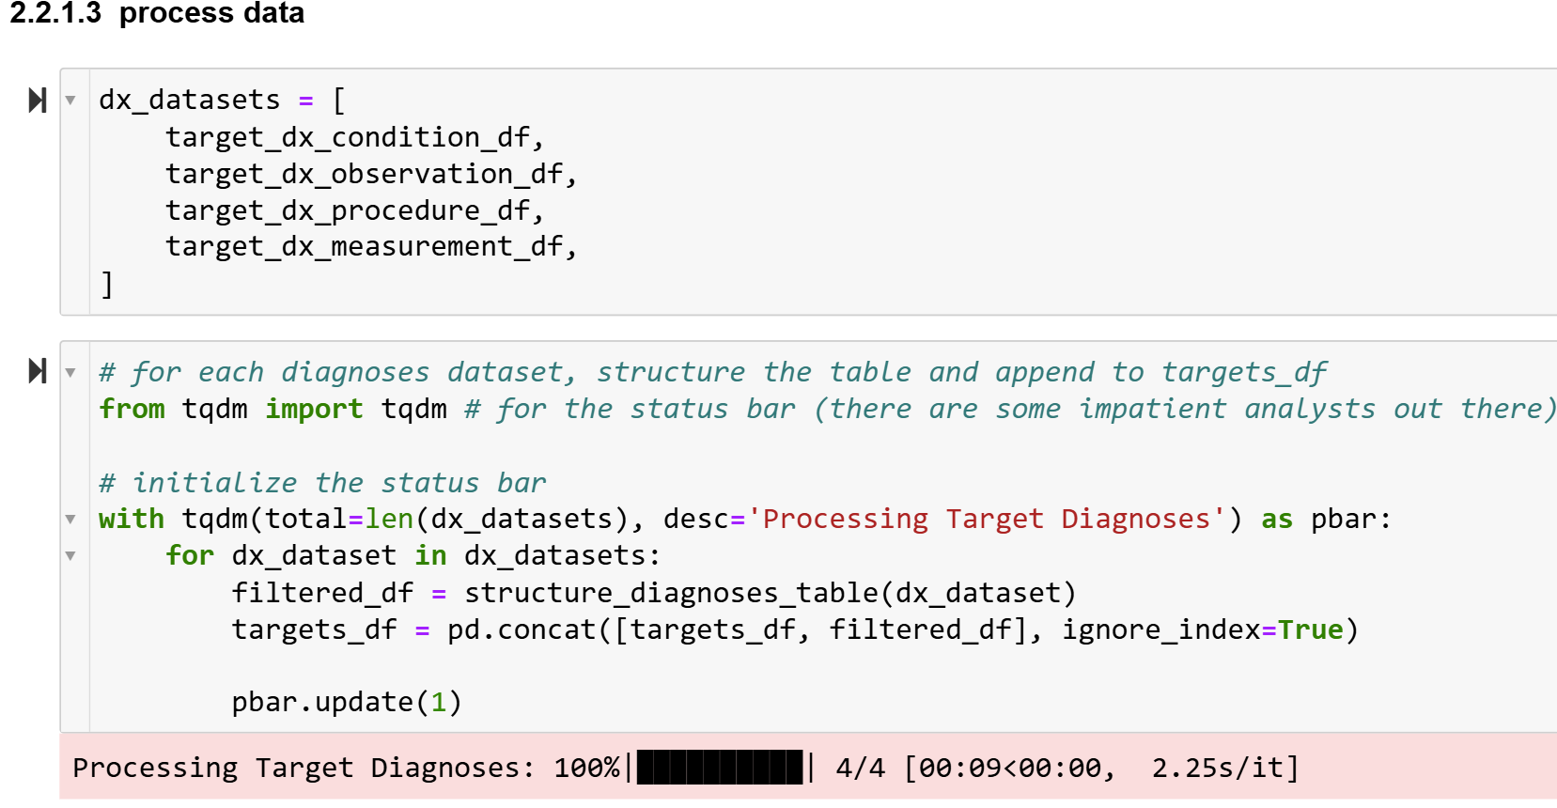
Notes:
"The next step illustrates how to process the data, structure the table, and append the results to the targets_df."

Slide 8
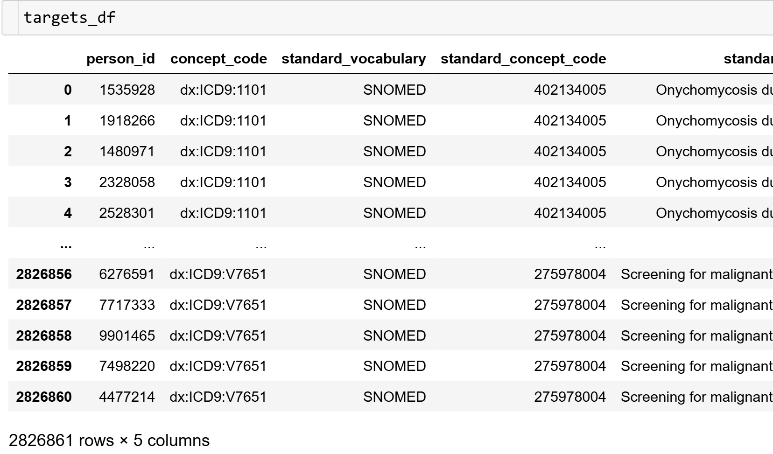
Notes:
Check your results

Slide 9
Notes:
"Now that we have standardized the diagnosis table, we will proceed by reading the procedures dataset, which is stored in a CSV file."

Slide 10
Notes:
This slide demonstrates how to define the function to structure the procedures table. It also highlights how to retain rows where the source_vocabulary is CPT4, remove duplicates, keep the necessary columns, and rename the source_concept_code to concept_code."

Slide 11
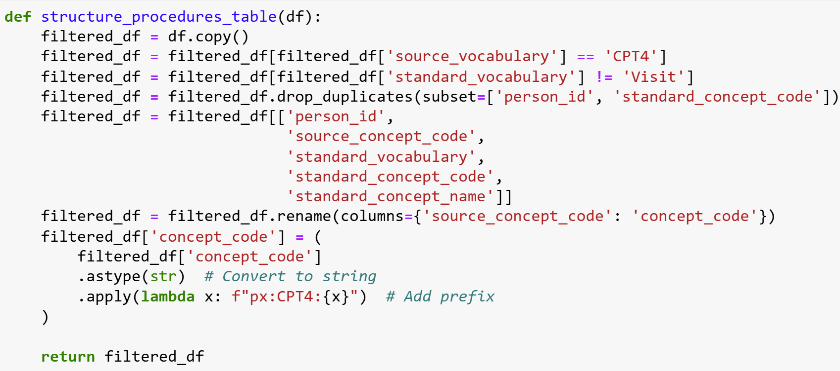
Notes:
This slide shows the code

Slide 12
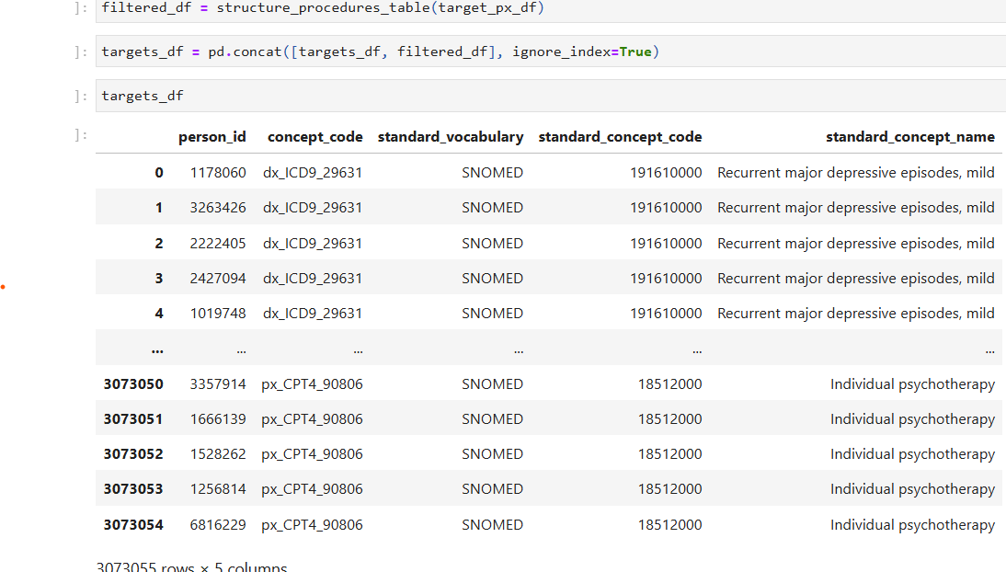
Notes:
The code combines the (filtered_df) with the existing targets_df. This process helps in expanding the targets_df dataframe with the newly processed target data from various sources.

Slide 13
Notes:
Next, we will read the demographics dataset into our environment.

Slide 14
Notes:
Now, in the demographics dataset, we will filter the rows to retain only those where 'sex_at_birth' is labeled as 'female'. We'll also rename the 'sex_at_birth' column to 'concept_code' for consistency with our other datasets. Additionally, we will remove any duplicate entries to ensure the dataset is clean and ready for further analysis.

Slide 15
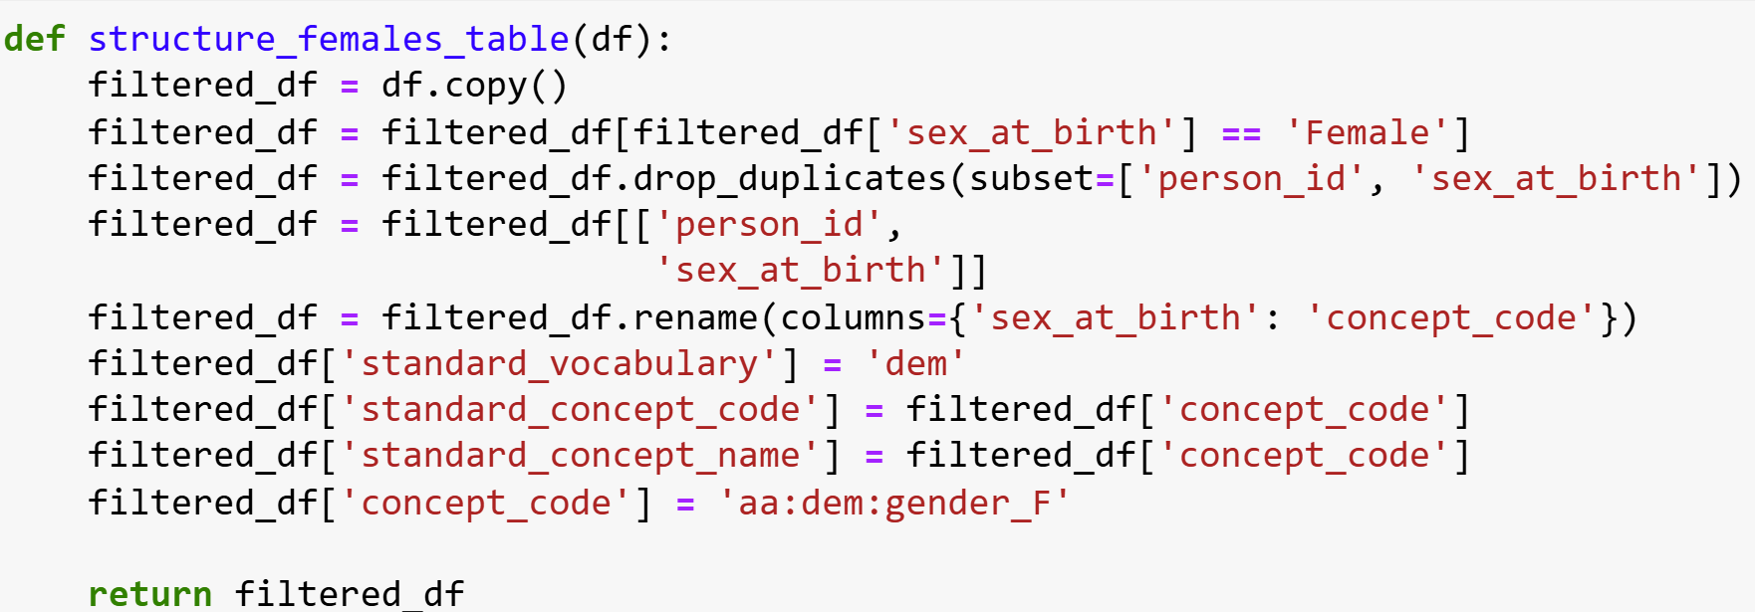
Notes:
This step shows the code

Slide 16
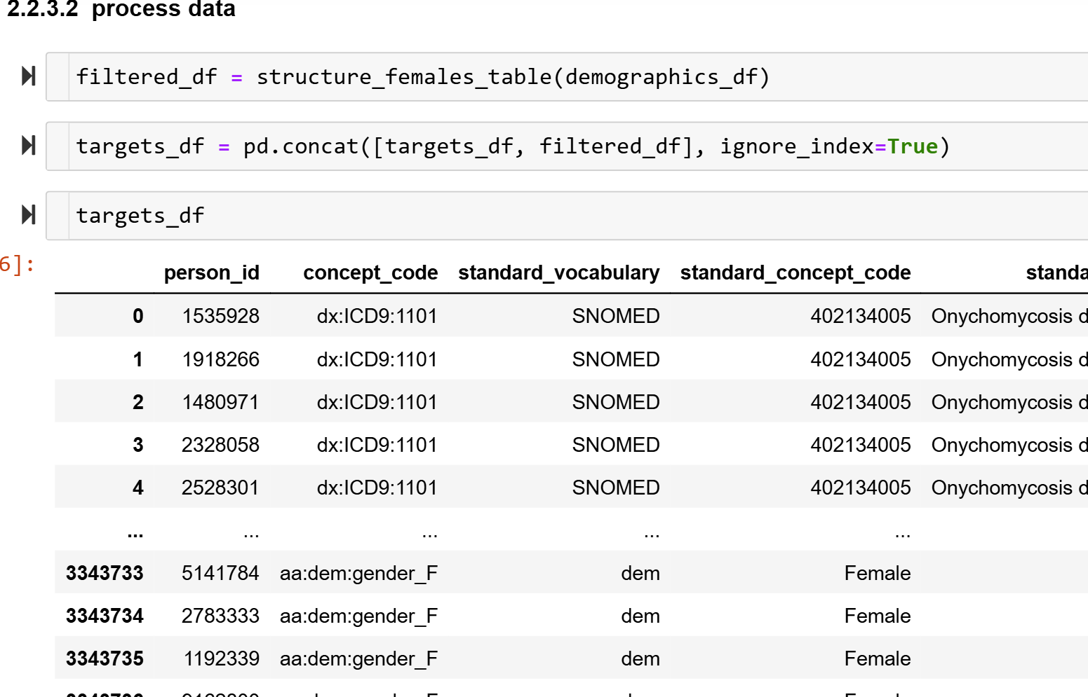
Notes:
In this step, we use pd.concat to concatenate the targets_df DataFrame with the filtered_df DataFrame. This operation appends the filtered and processed data from filtered_df to the existing targets_df, ensuring that all necessary data is combined into one unified DataFrame. Afterward, we can view the results.

Slide 17
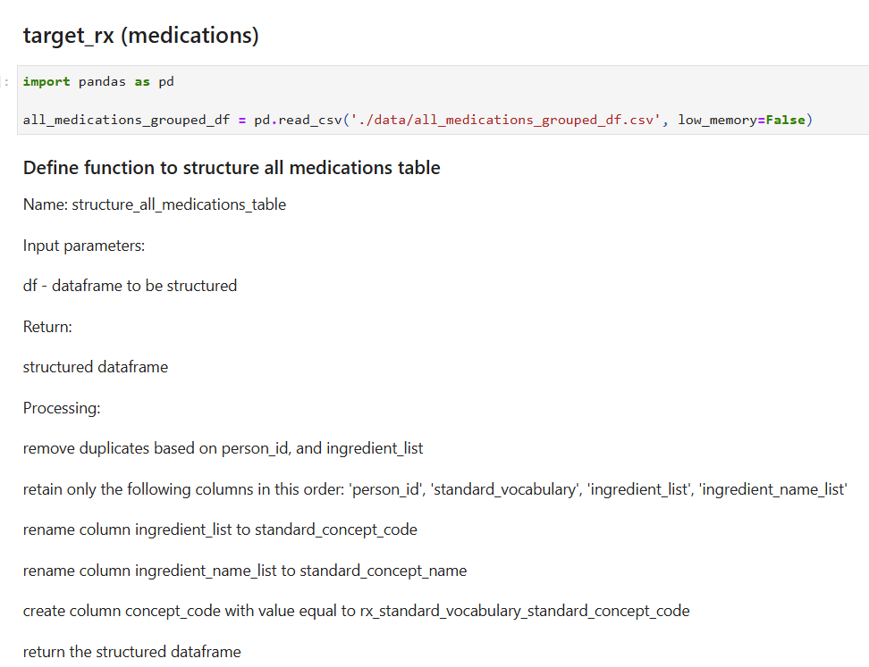
Notes:
Read the medications file

Slide 18
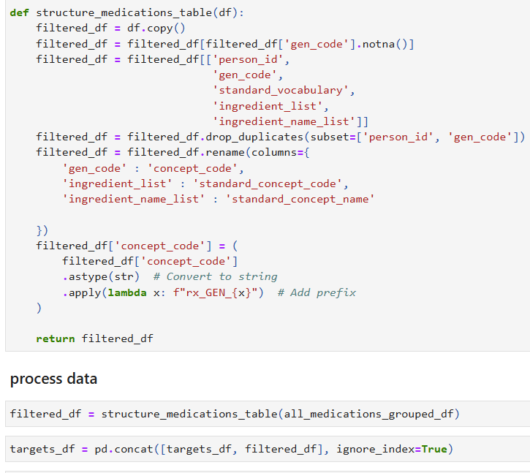
Notes:
This code shows how to structure the medications data.

Slide 19
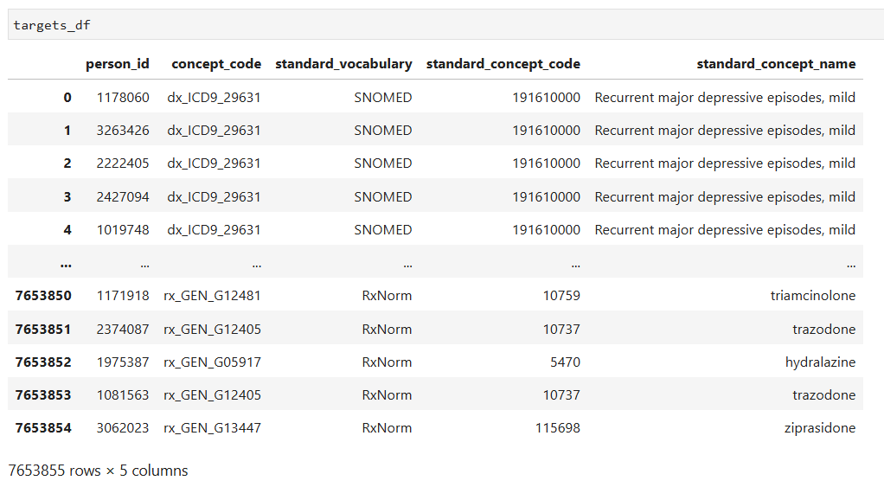
Notes:
Check your reuslts

Slide 20
Notes:
"Next, we read the antidepressant history data. Following this, we will reference an additional file that maps the concept_code for antidepressant history. This mapping file provides the necessary codes to ensure that the dataset aligns with standardized concepts, helping in the accurate categorization and analysis of the antidepressant-related data.
Link: https://gmuedu-my.sharepoint.com/:x:/r/personal/klybarge_gmu_edu/Documents/Research/PCORI%20AD/Documentation%20Regression%20Models/Files%20for%20upload%20to%20notebook/data/antidepressant_range_definitions.csv?d=wd14359db516b4f4b9e557960b6ebbe85&csf=1&web=1&e=xrhI7Y

Slide 21
Notes:
This slides helps us to understand how to define the function to structure antidepressants history.

Slide 22
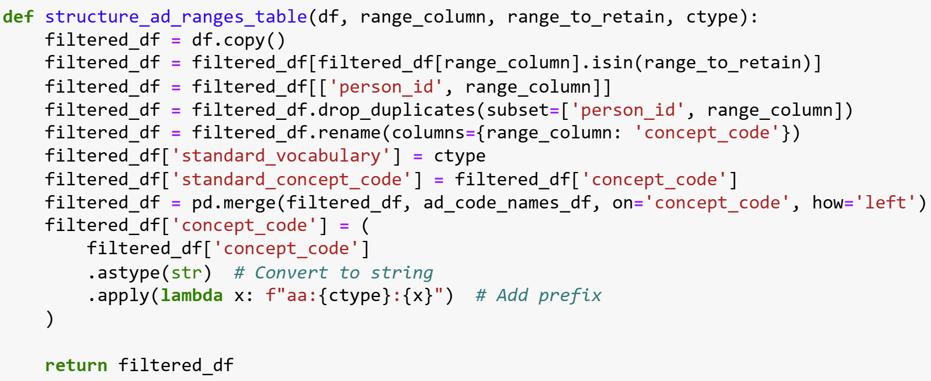
Notes:
This slide shows the code

Slide 23
Notes:
This slide defines the function structure_ad_hist_table to process antidepressant history data. It creates a standardized concept_code, and retains necessary columns ('person_id', 'concept_code'). The function removes duplicates, adds new columns (standard_vocabulary, standard_concept_code, standard_concept_name), and updates concept_code to reflect strata codes.

Slide 24
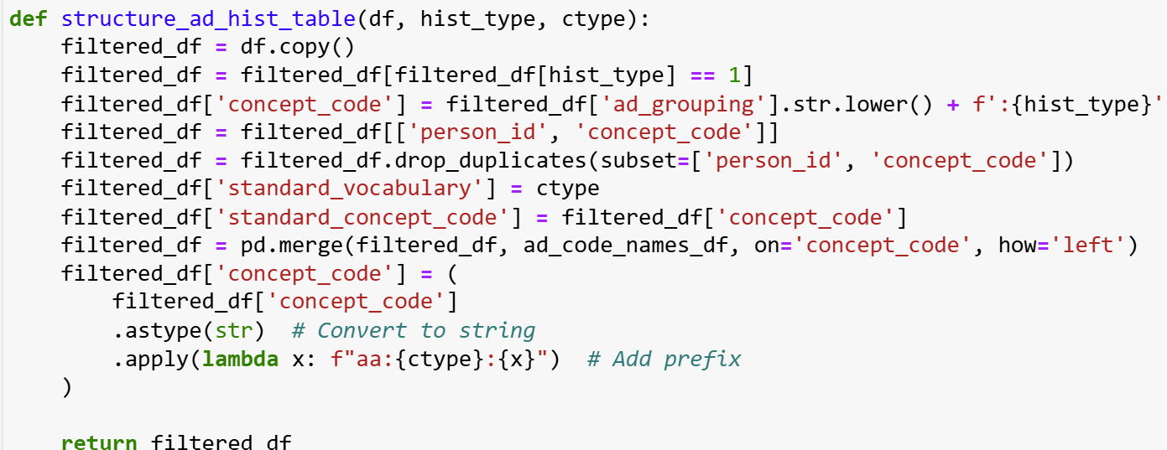
Notes:
This slide shows the code

Slide 25
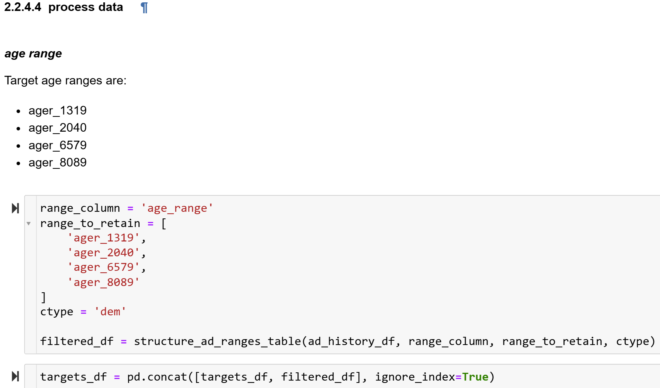
Notes:
This step processes the antidepressant history data by filtering based on specified age ranges: 'ager_1319', 'ager_2040', 'ager_6579', and 'ager_8089’. The resulting filtered data is appended to targets_df using pd.concat."

Slide 26
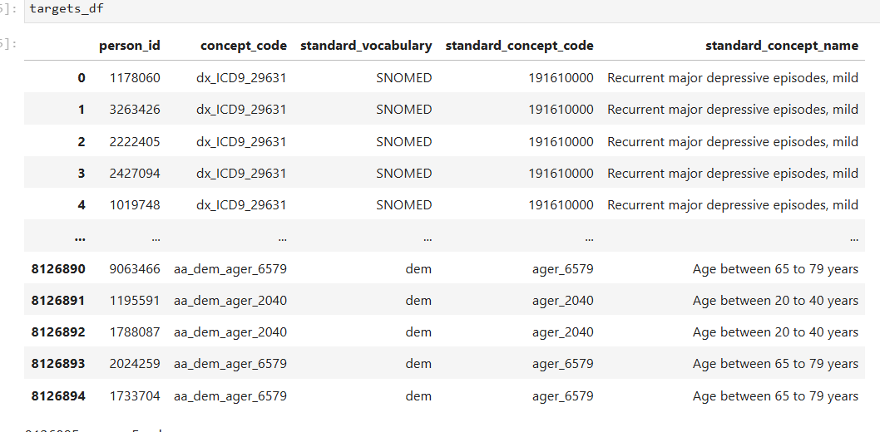
Notes:
Check your results

Slide 27
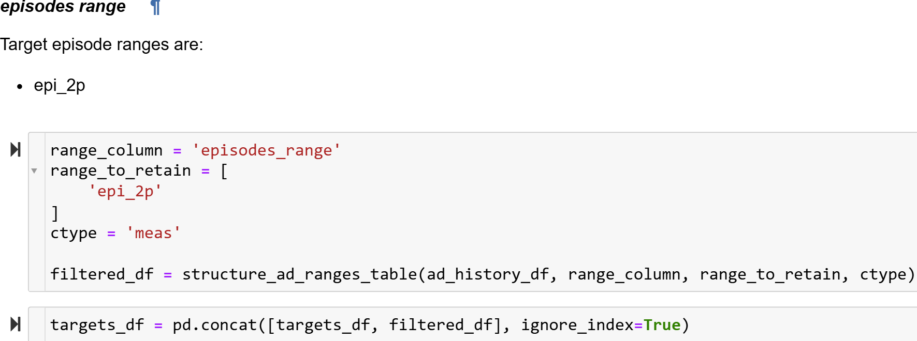
Notes:
This step focuses on processing the antidepressant data by filtering for the target episode range 'epi_2p'.

Slide 28
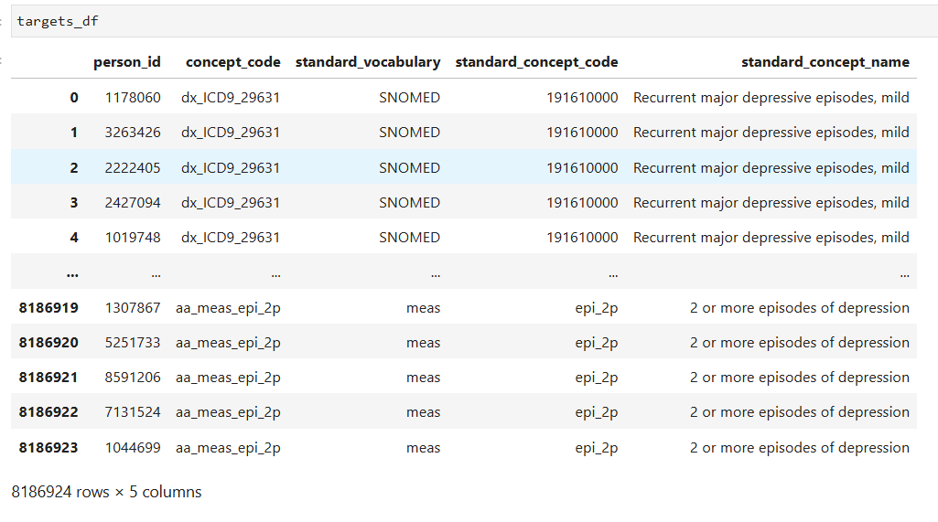
Notes:
Check your results

Slide 29
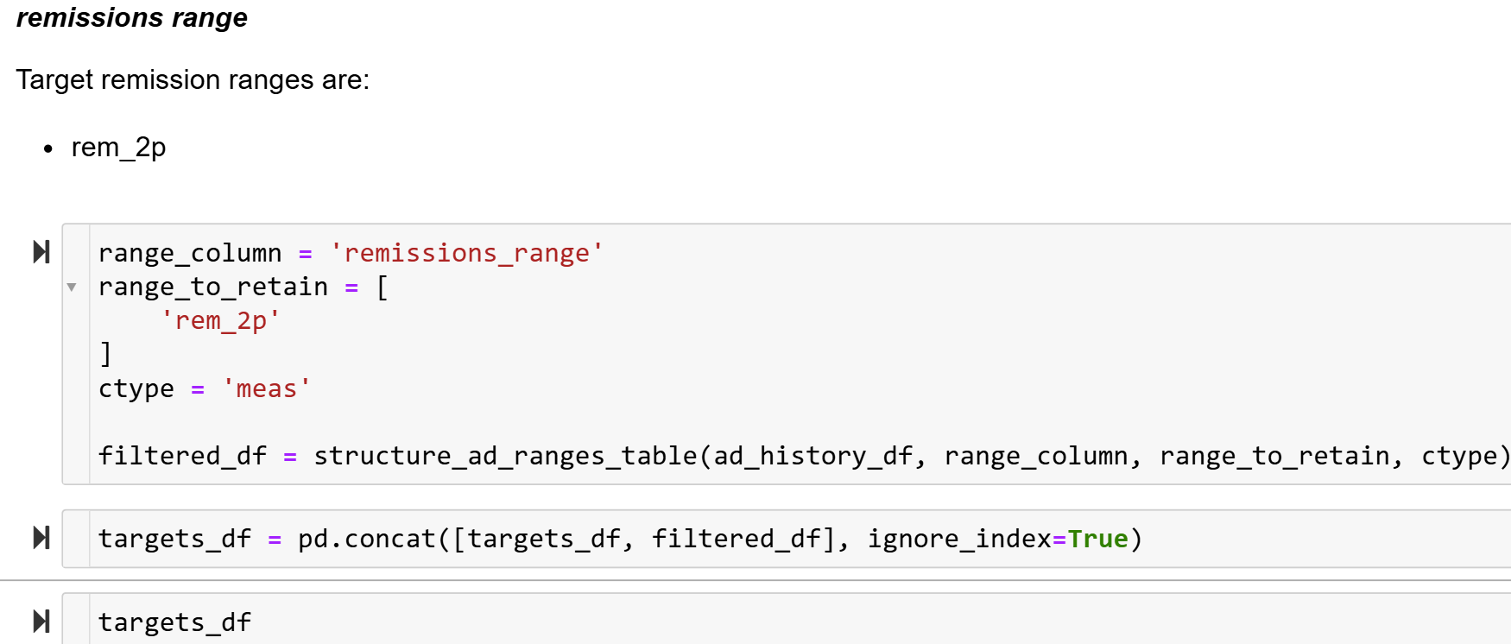
Notes:
This step filters the antidepressant data for the target remission range 'rem_2p'.

Slide 30
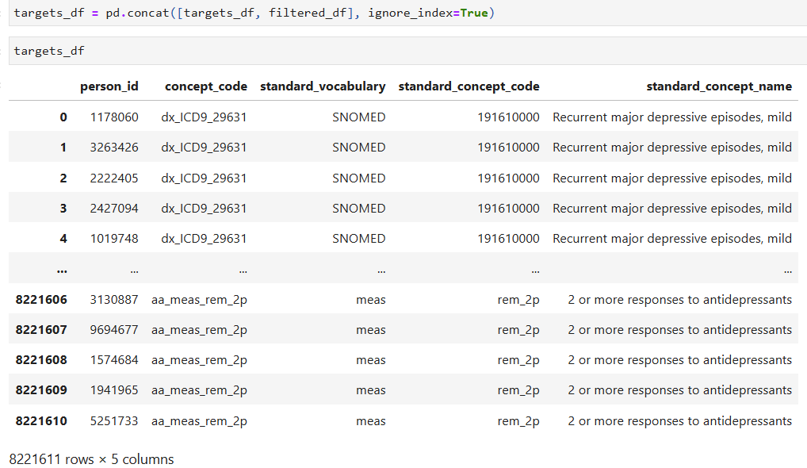
Notes:
Check your results

Slide 31
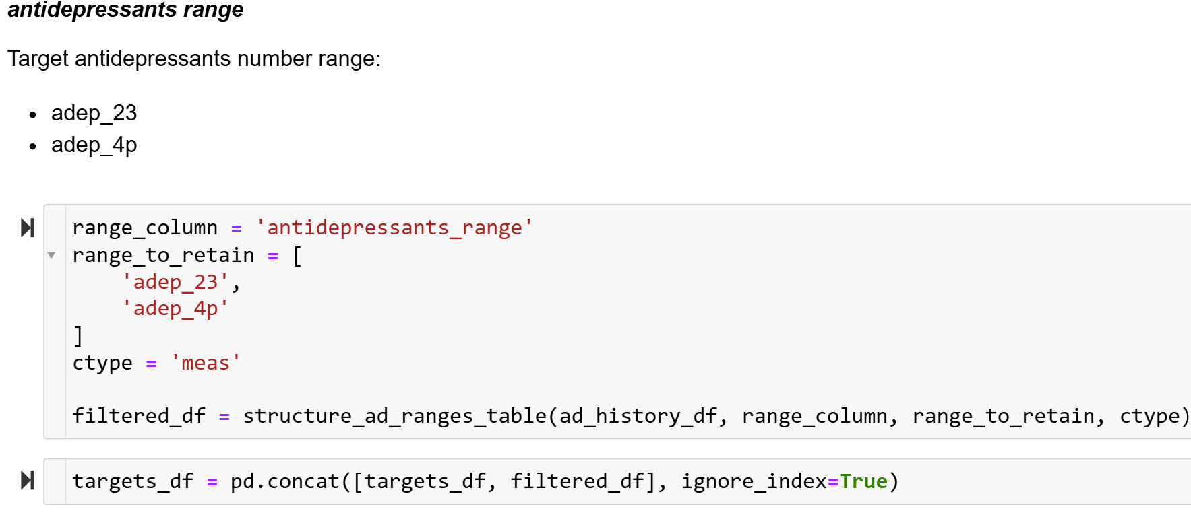
Notes:
This step focuses on filtering antidepressant data based on the target antidepressants number range, which includes 'adep_23' and 'adep_4p’.

Slide 32
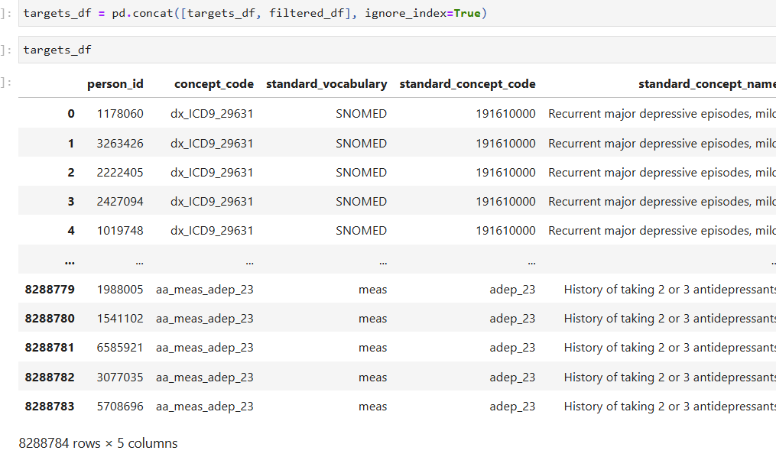
Notes:
Check your results

Slide 33
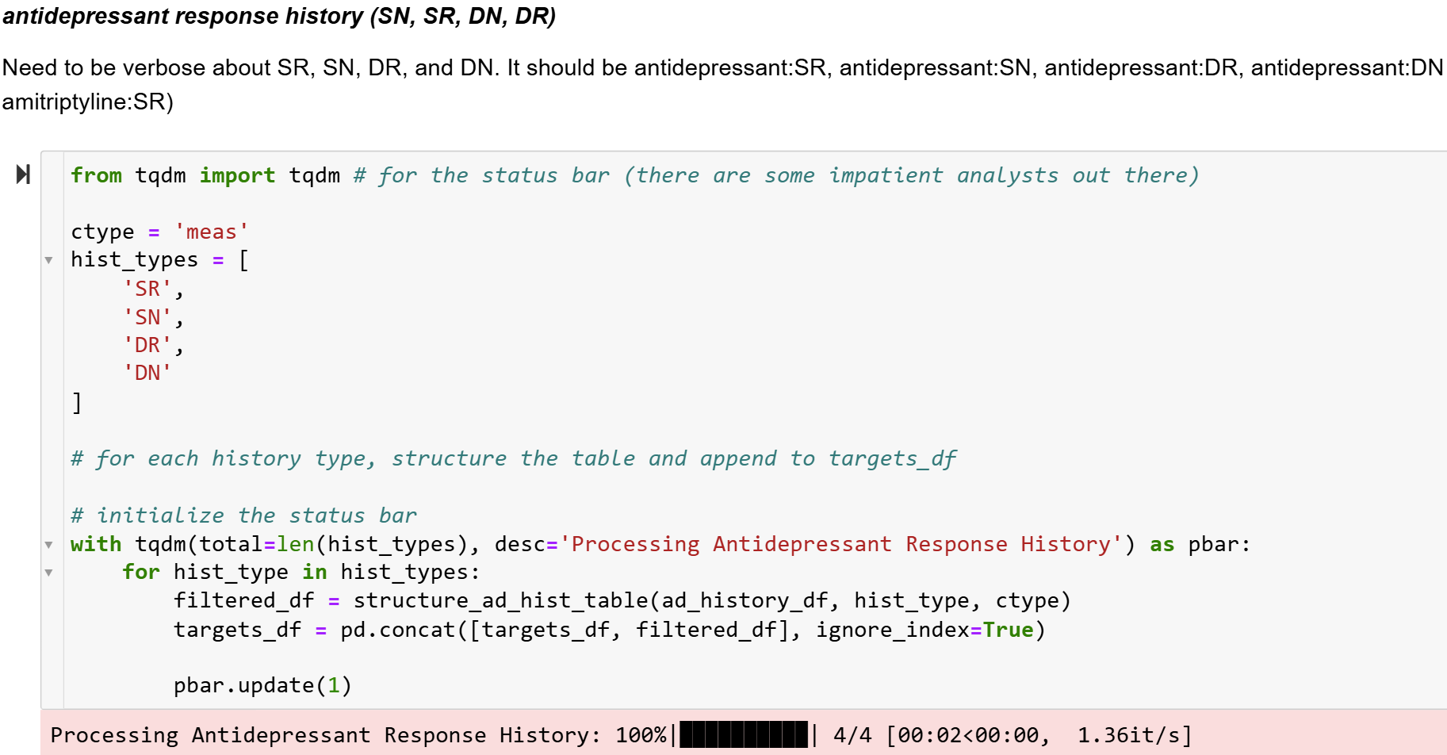
Notes:
In this step, we process the antidepressant data for the four history types: SN,SR,DN,DR

Slide 34
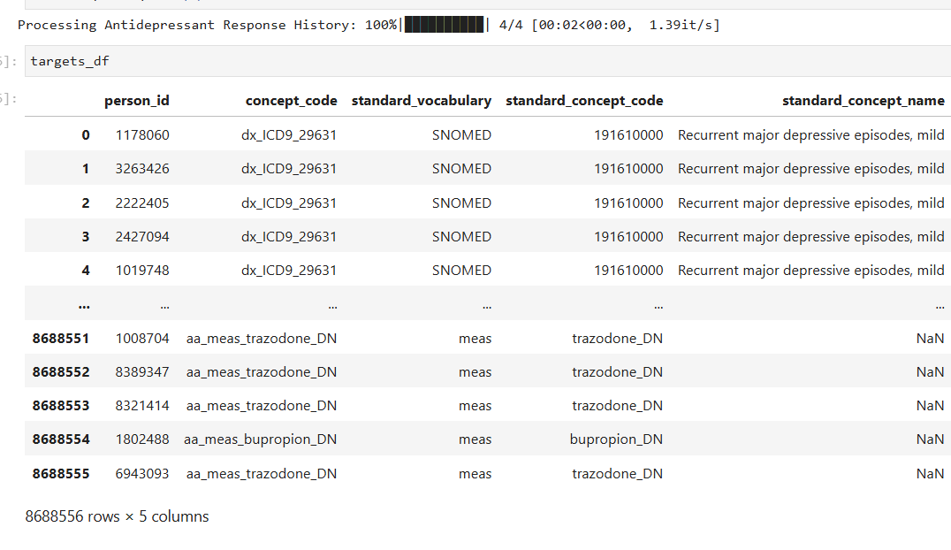
Notes:
Check your results

Slide 35
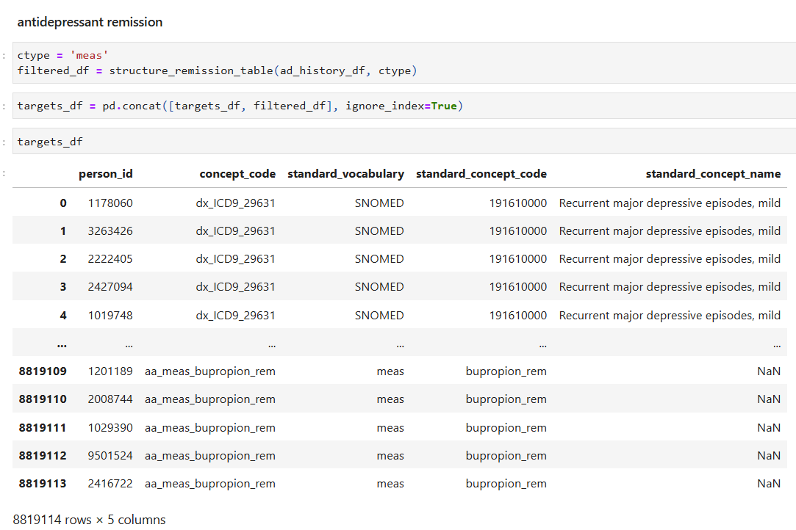

Slide 36
Notes:
This step saves the final targets_df dataframe to a CSV file, ensuring that the processed data is stored and can be accessed for future steps without needing to re-run the data processing.

Slide 37
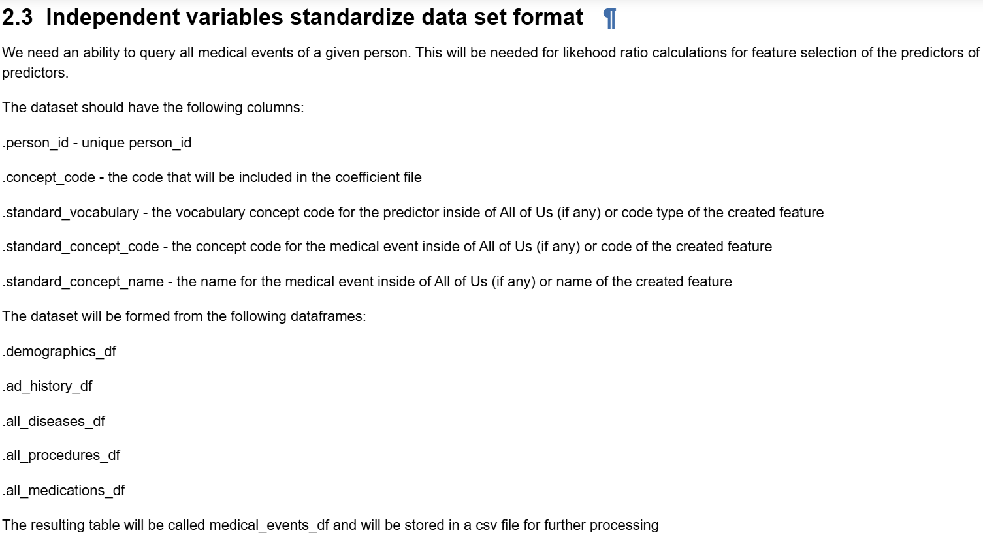
Notes:
This step outlines the process for standardizing independent variables.

Slide 38
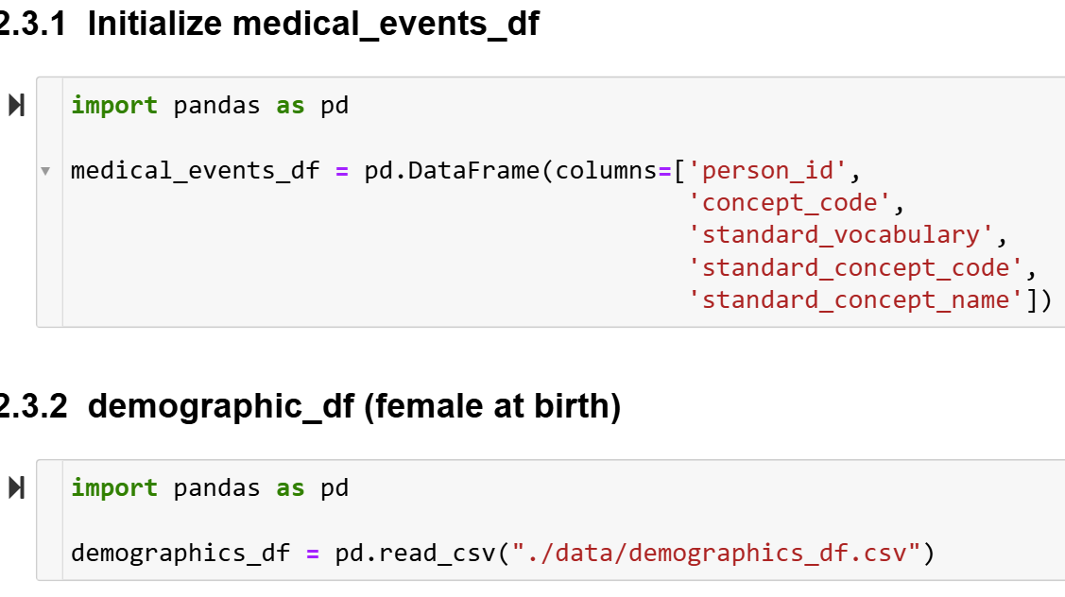
Notes:
In this step, we initialize medical_events_df, which will have the needed columns.

Slide 39
Notes:
This step involves defining the function structure_females_table.

Slide 40
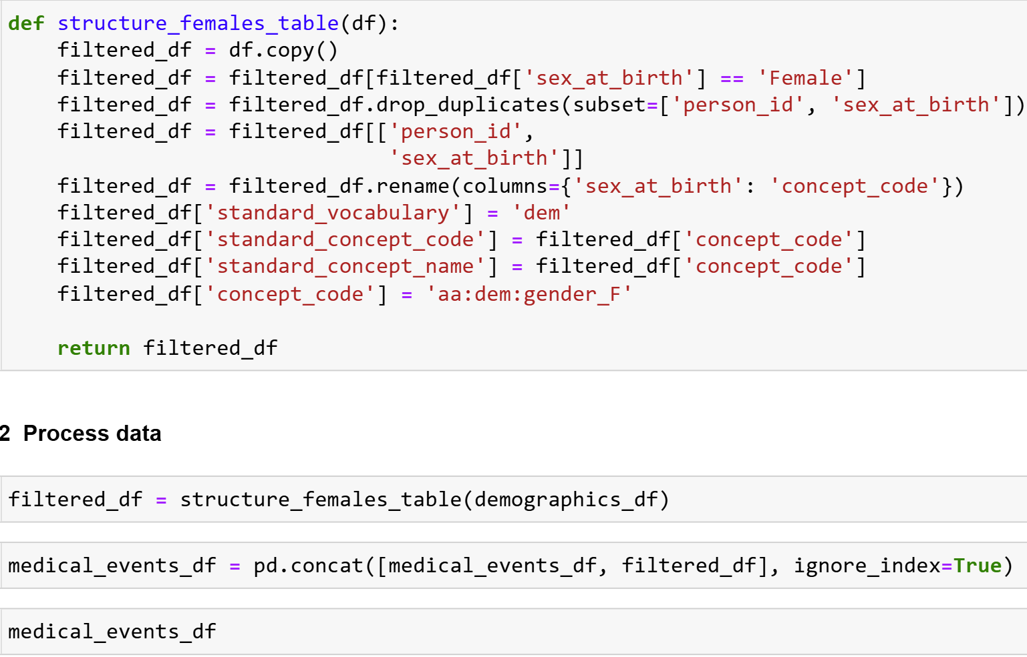
Notes:
This slide shows the code

Slide 41
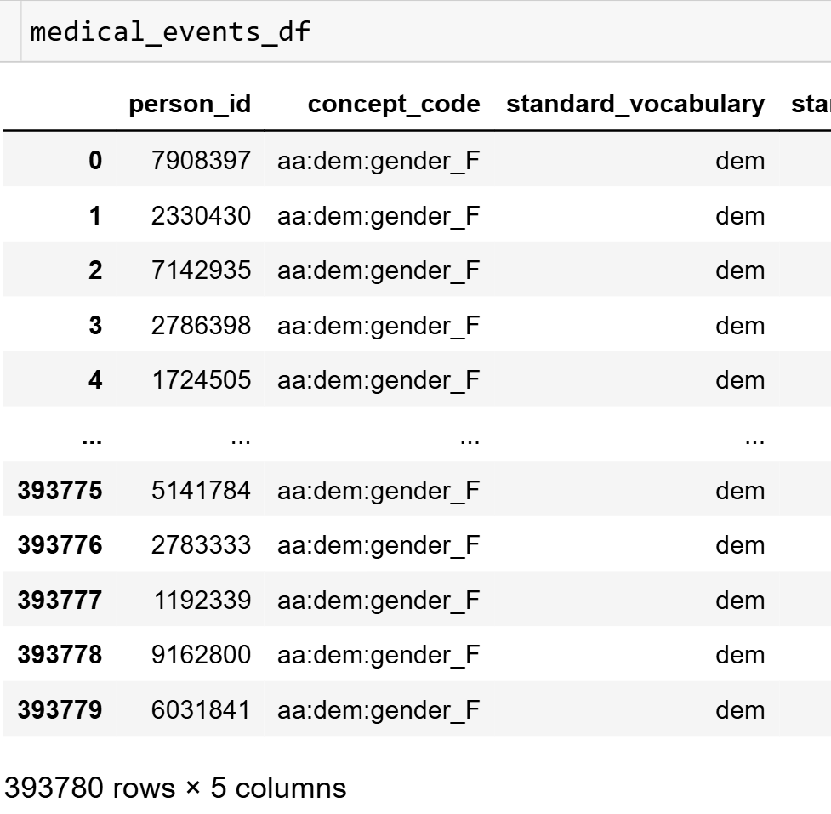
Notes:
Check the results

Slide 42
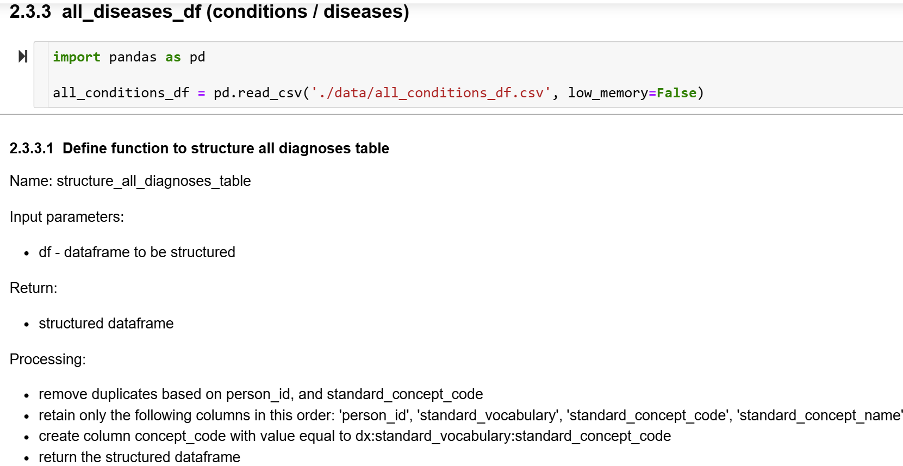
Notes:
Read all_conditions_df csv file, and then we define the function structure_all_diagnoses table.

Slide 43
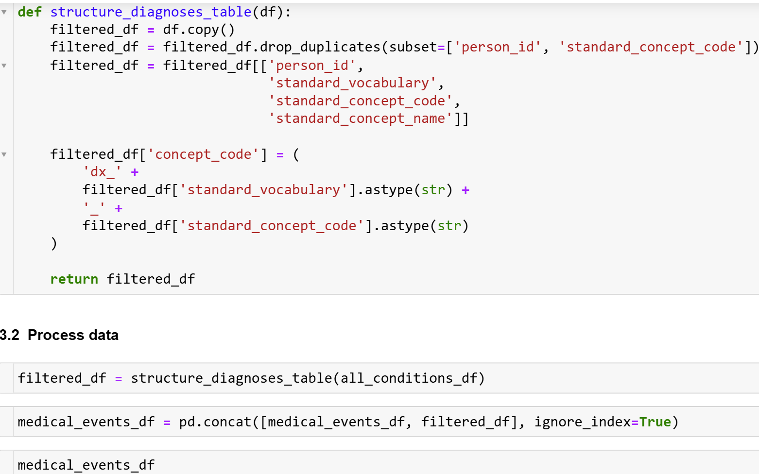
Notes:
This slide shows the code

Slide 44
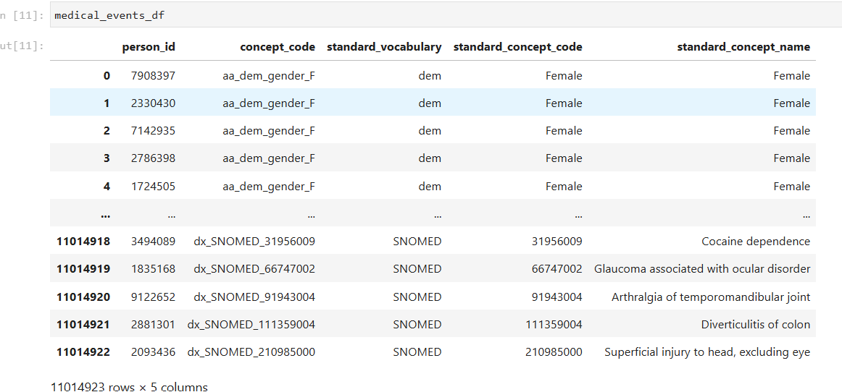
Notes:
Check your results

Slide 45
Notes:
In this step, we define the function structure_all_procedures_table to process and structure the procedures data.

Slide 46
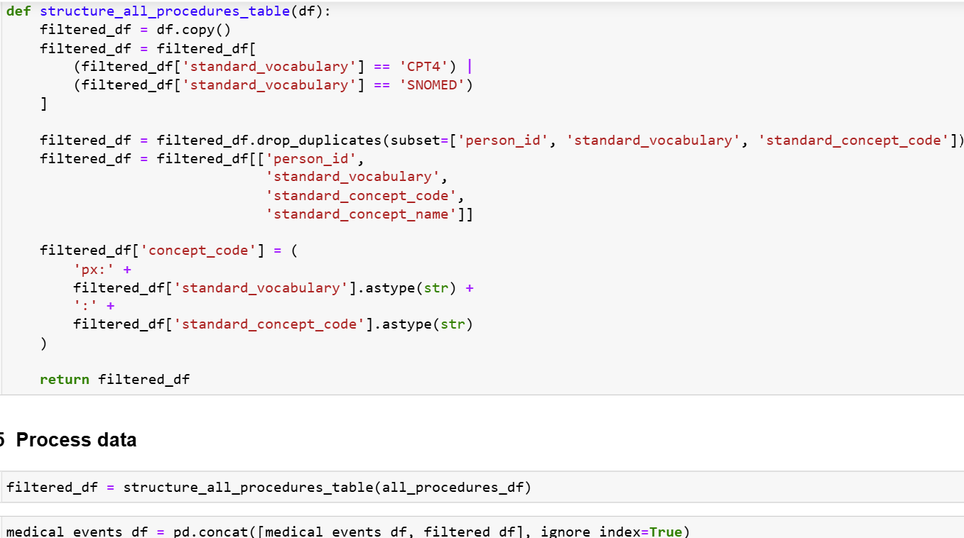
Notes:
This slide shows the code

Slide 47
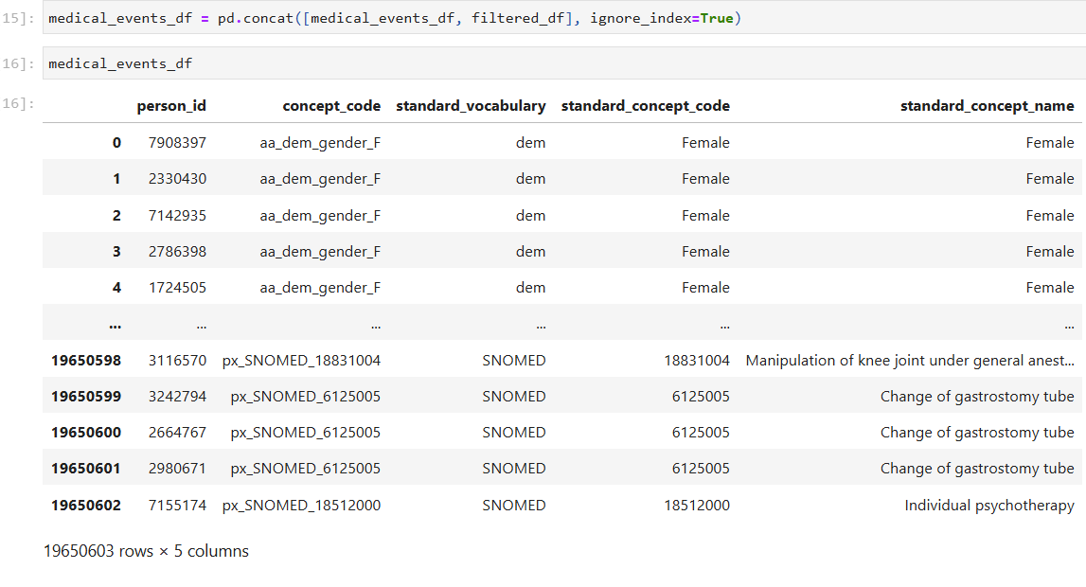
Notes:
Check your results

Slide 48
Notes:
Read the medications file

Slide 49
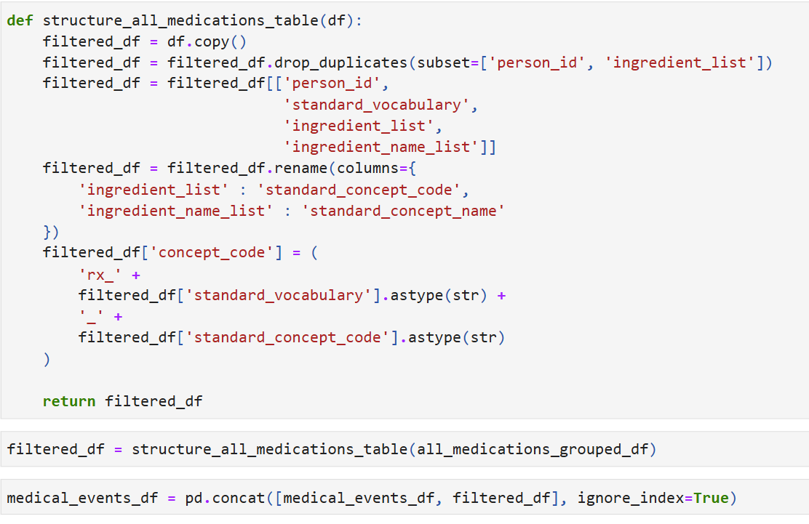
Notes:
This slide shows the code on how to structure the medications data.

Slide 50
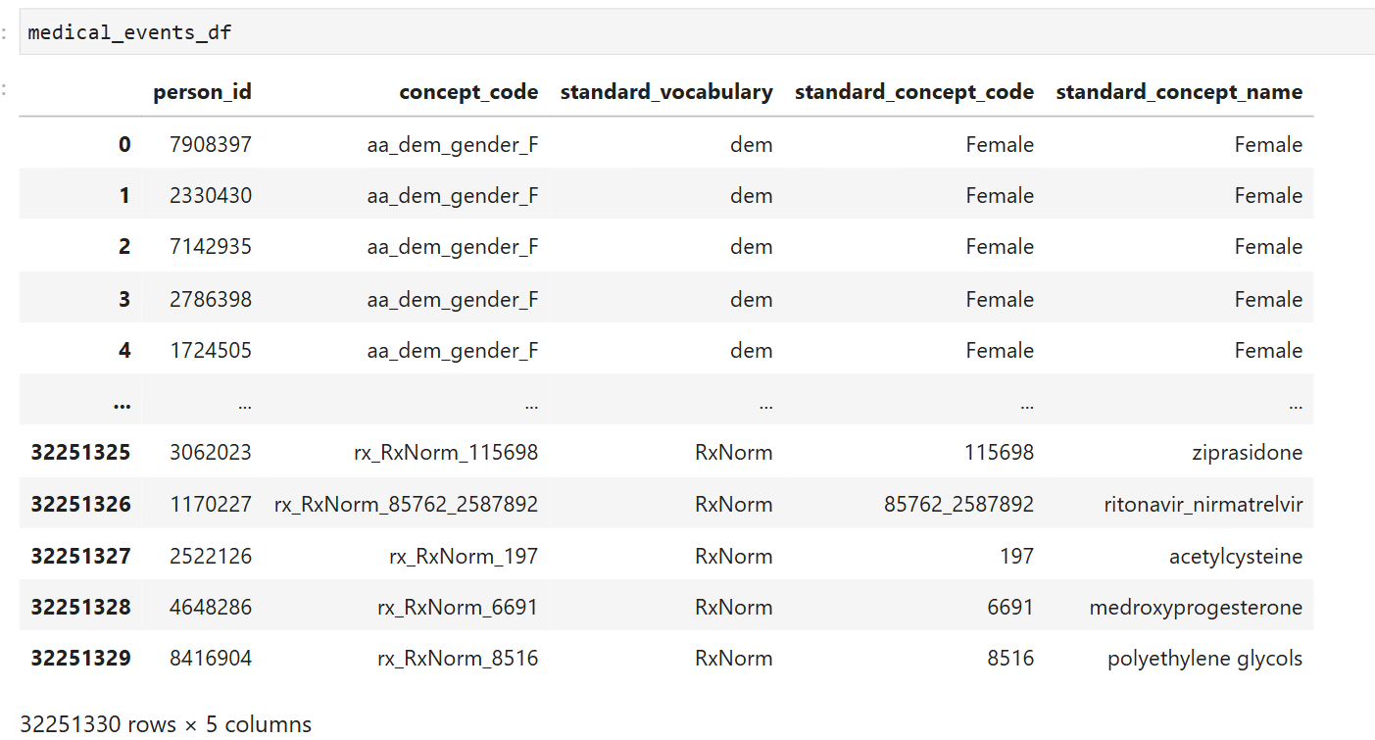
Notes:
Check the results

Slide 52
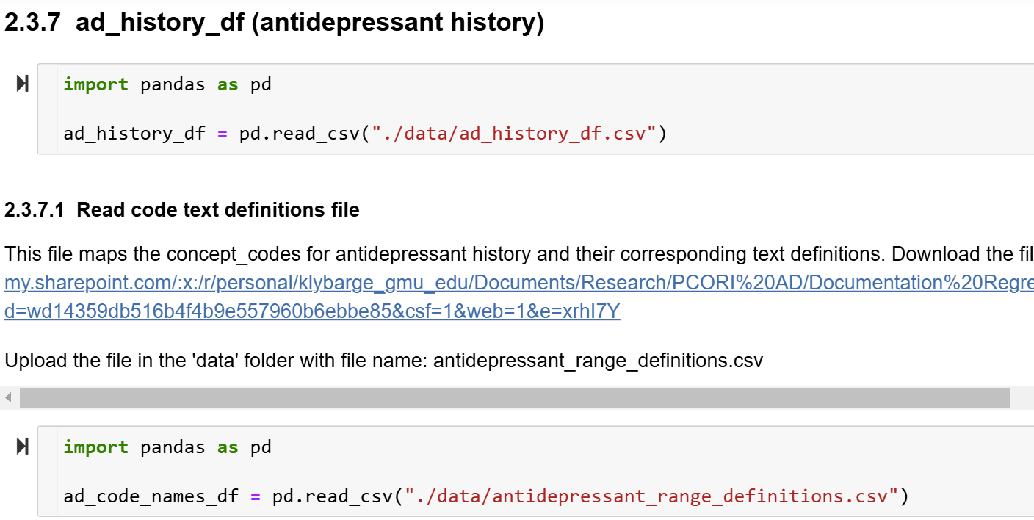
Notes:
In this step, we read in the ad_history_df.csv file.
Link : https://gmuedu-my.sharepoint.com/:x:/r/personal/klybarge_gmu_edu/Documents/Research/PCORI%20AD/Documentation%20Regression%20Models/Files%20for%20upload%20to%20notebook/data/antidepressant_range_definitions.csv?d=wd14359db516b4f4b9e557960b6ebbe85&csf=1&web=1&e=xrhI7Y

Slide 53
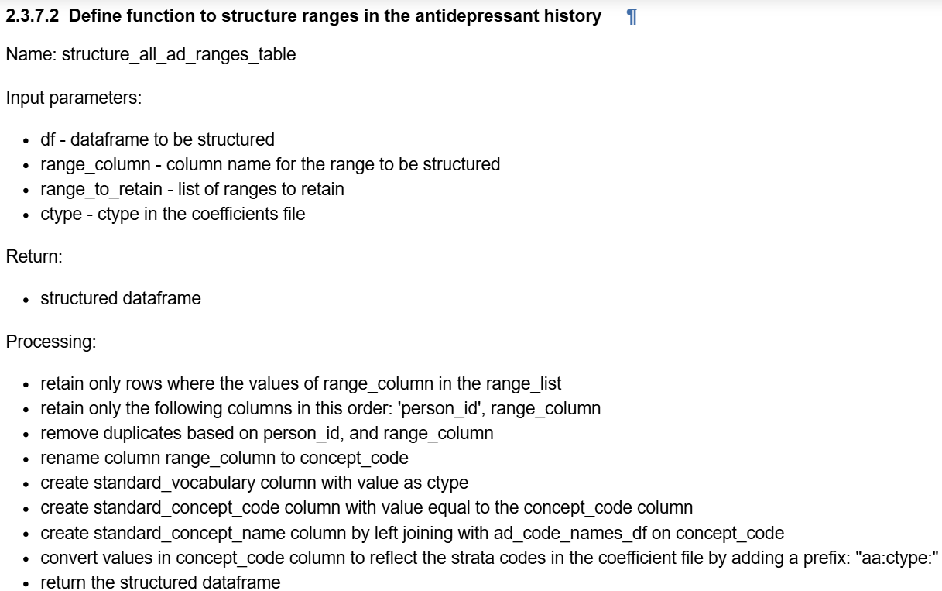
Notes:
The structure_all_ad_ranges_table function processes antidepressant history data.

Slide 54
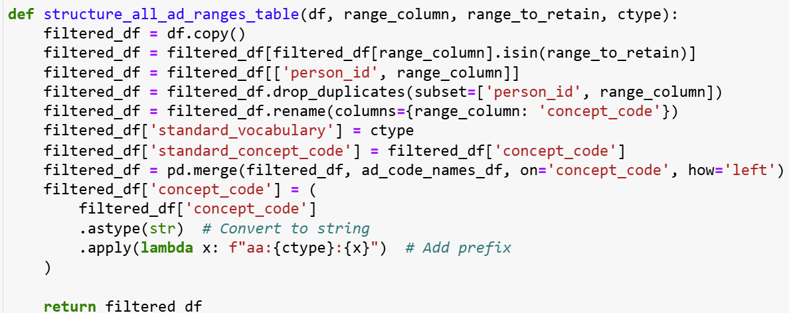
Notes:
This slide shows the code

Slide 55
Notes:
The structure_ad_hist_table function processes antidepressant data by:
Filtering rows where hist_type is 1, Retaining person_id and concept_code columns, Removing duplicates based on person_id and concept_code.

Slide 56
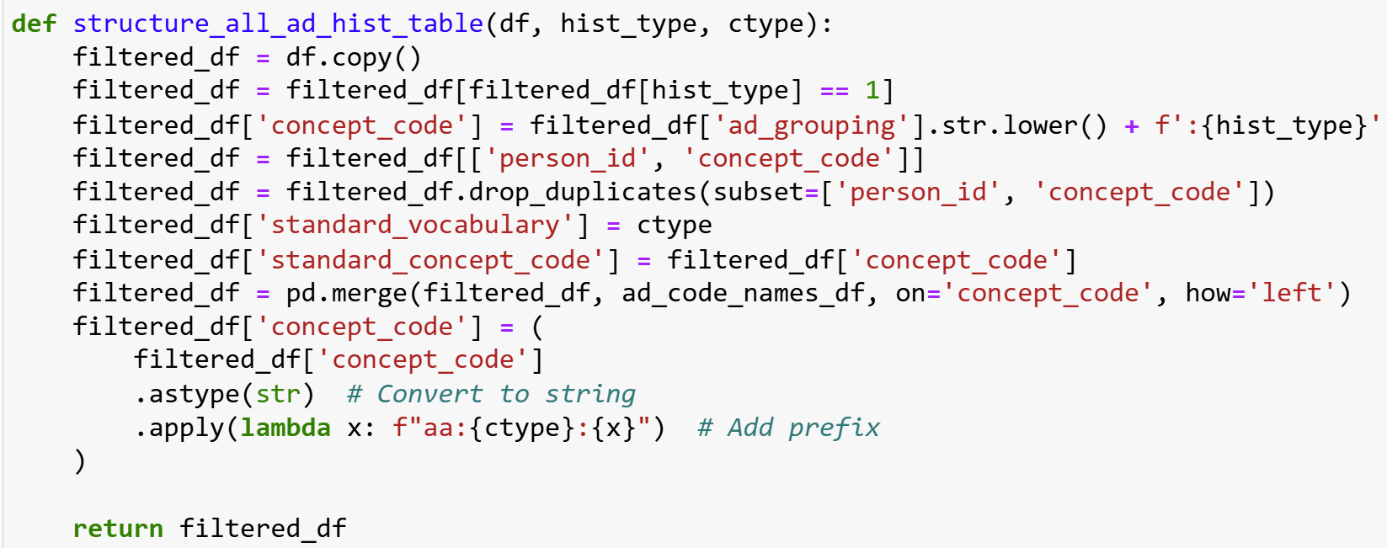
Notes:
This slide shows the code

Slide 57
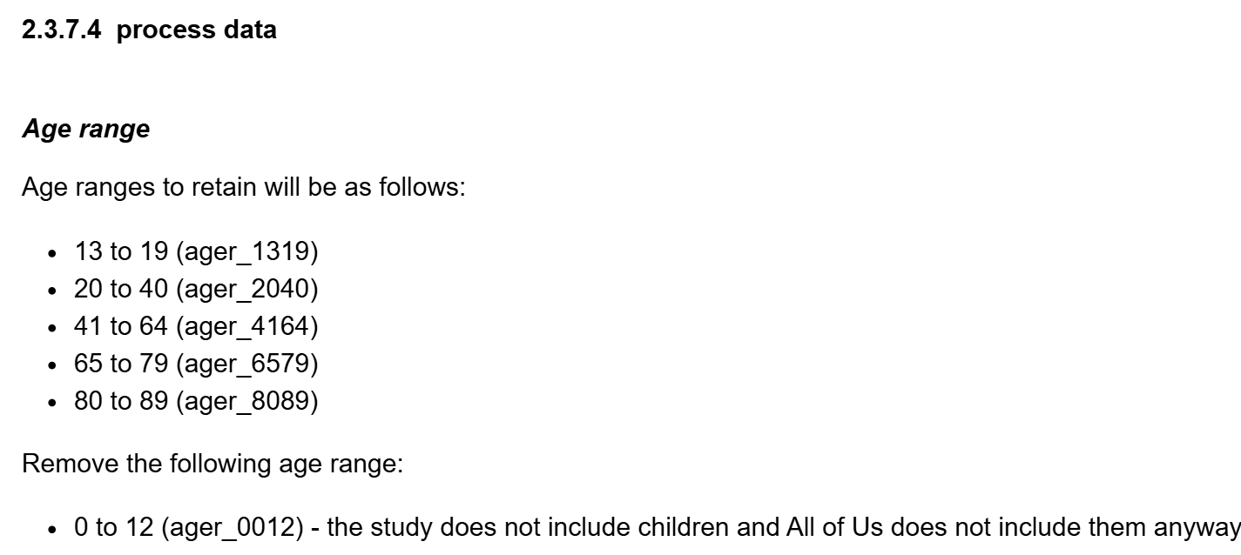
Notes:
This slide shows the age ranges

Slide 58
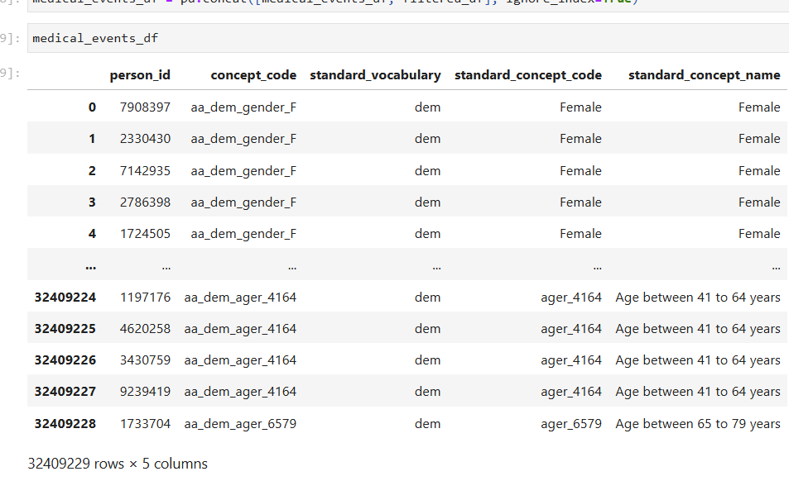
Notes:
This code filters the ad_history_df for the specified age ranges structures the dataframe using structure_all_ad_ranges_table(), and appends the result to medical_events_df.

Slide 59
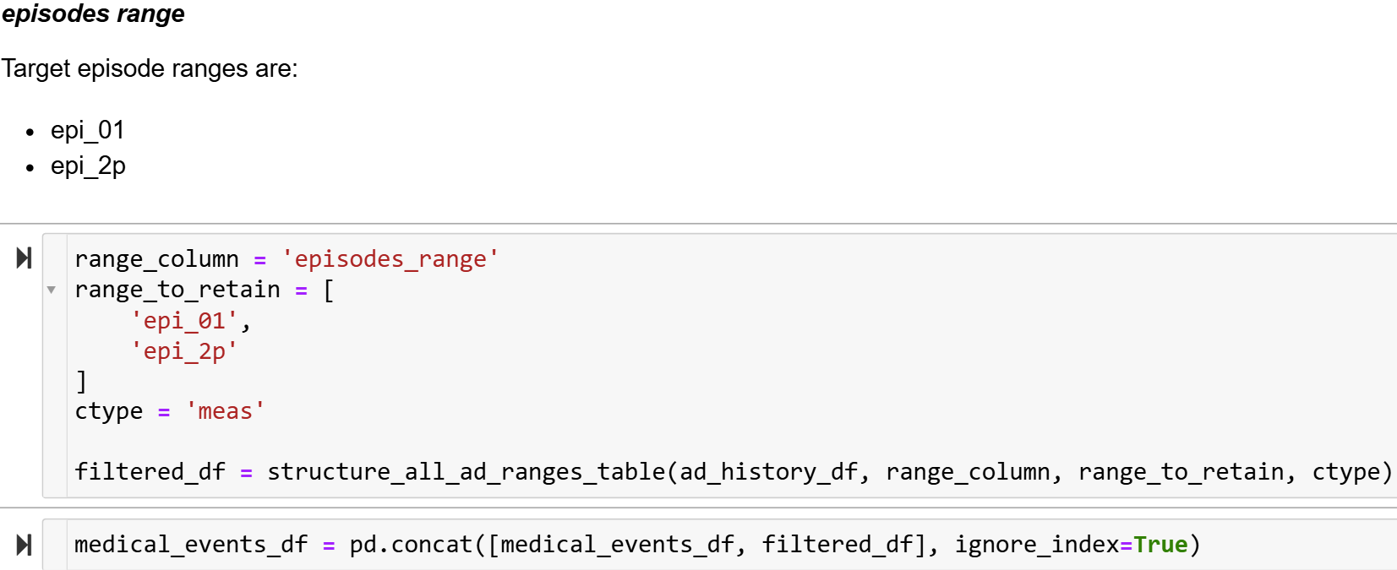
Notes:
This code filters the ad_history_df for the specified episode ranges.

Slide 60
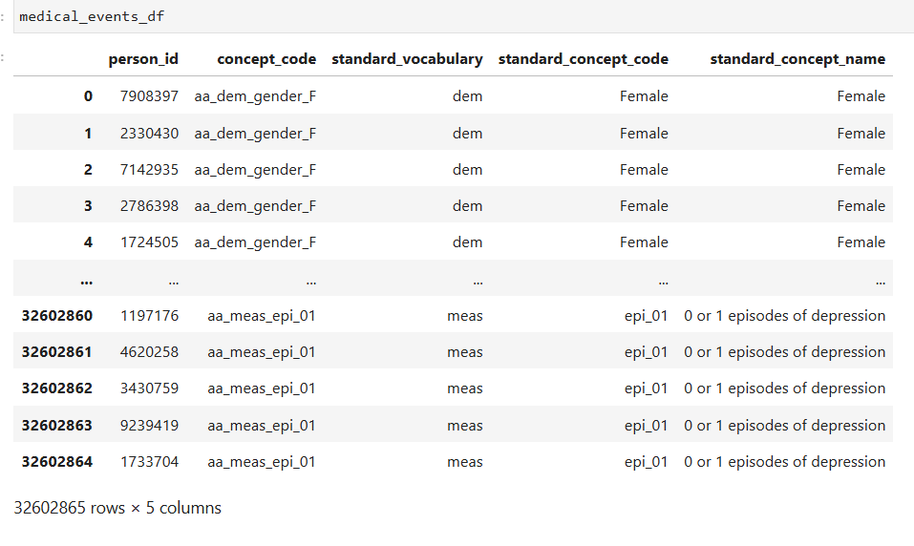
Notes:
Check your results

Slide 61
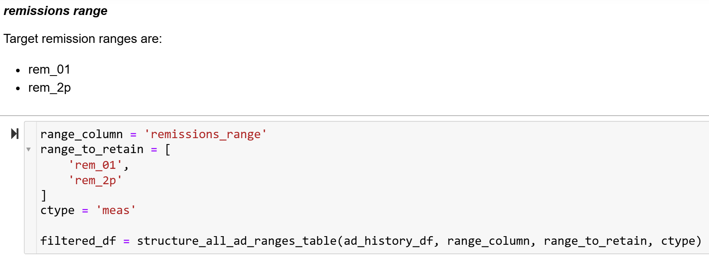
Notes:
This code filters the ad_history_df for the specified remission ranges (rem_01, rem_2p).

Slide 62
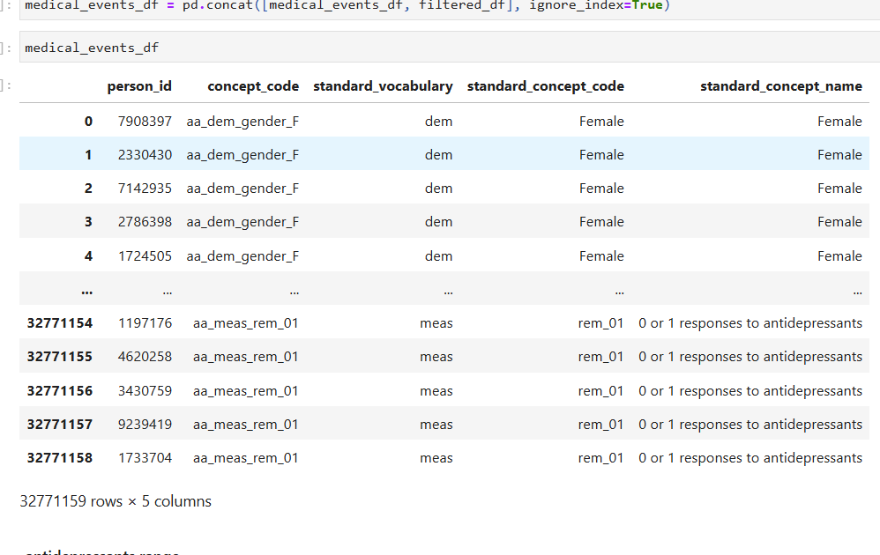
Notes:
Check your results

Slide 63
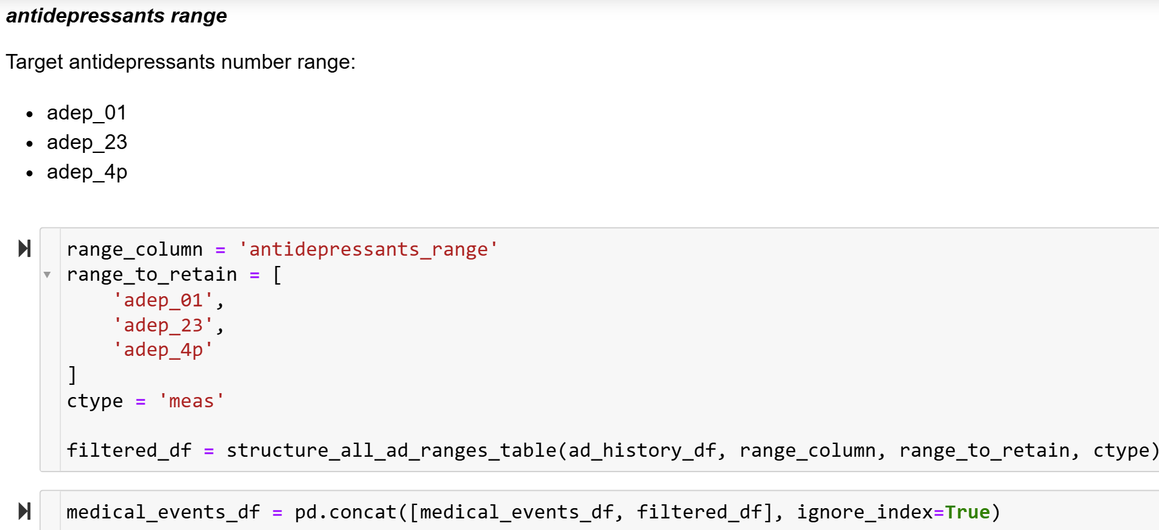
Notes:
This code filters the ad_history_df for the specified antidepressant ranges.

Slide 64
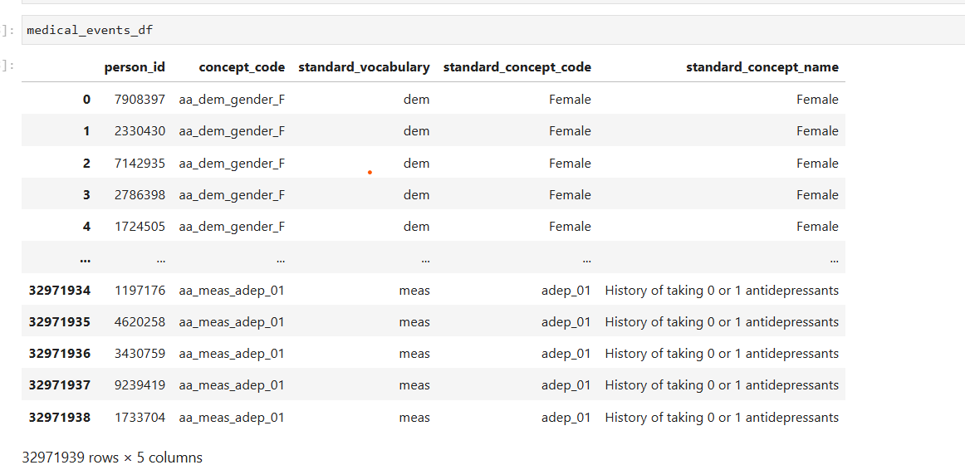
Notes:
Check your results

Slide 65
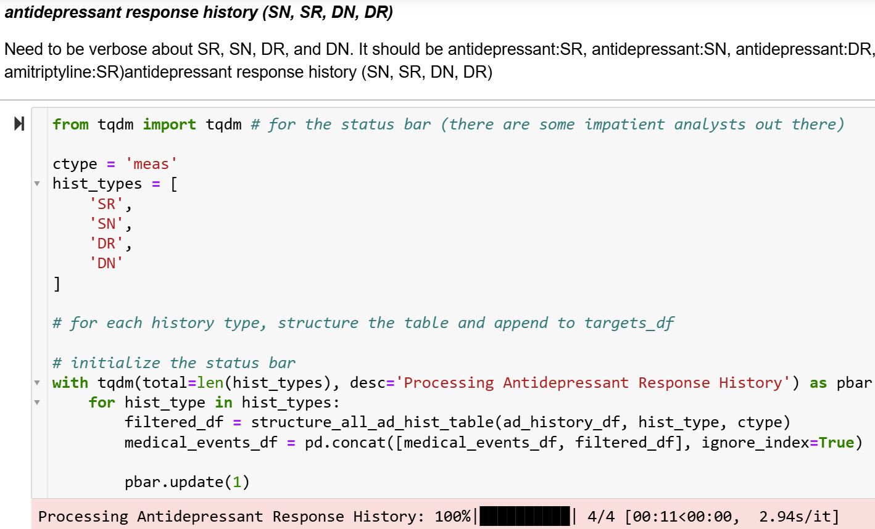
Notes:
This code processes antidepressant data for the specified history types (SR, SN, DR, DN) by calling the structure_all_ad_hist_table() function for each type. The response history is structured into the appropriate format (antidepressant:SR, antidepressant:SN, etc.) and then appended to the medical_events_df. The tqdm library is used to display a progress bar as the history types are processed.

Slide 66
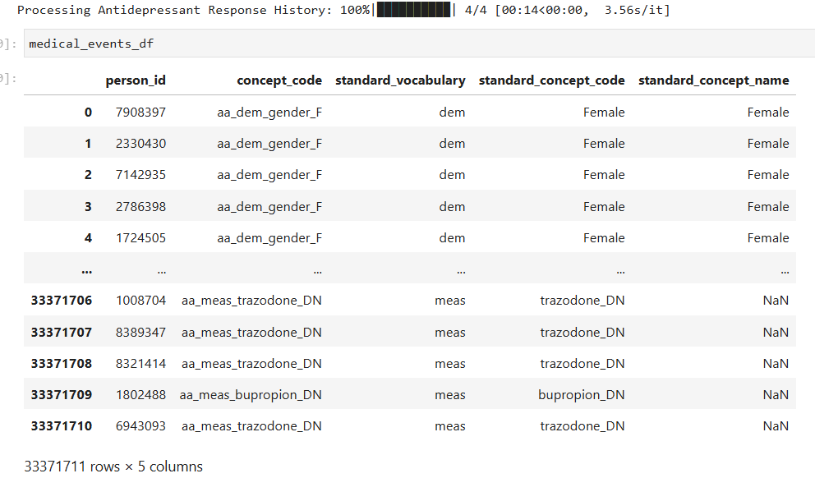
Notes:
Check your results

Slide 67
Notes:
This step saves the medical_events_df dataframe to a CSV file

Slide 68
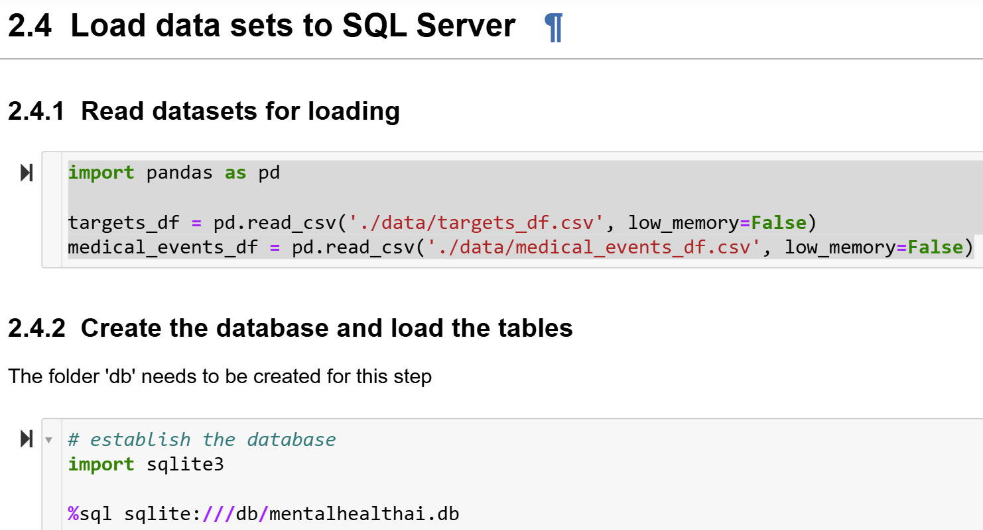
Notes:
This step ensures that the processed data is stored in SQL Server

Slide 69
Notes:
This slide shows how to write the dataframes to SQL lite.

Slide 71
Notes:
This slide checks whether the data has been successfully loaded .

Slide 72
Notes:
Close the connection

Slide 73
This video has demonstrated how to Merge the data and drop duplicates
Notes:
The take home message is successful transfer of processed data into SQL Server. Testing the targets and medical_events tables, ensures that the data is properly structured and accessible for further analysis.

