Slide 1
AI Systems for Depression Management 5/6/2025
Notes:
This presentation provides an overview of a standalone, direct to consumers, online, conversational, safe and accurate AI system for management of patients with depression symptoms or diagnosis

Slide 2
Notes:
I am an avatar design by Dr. Alemi to deliver this talk.

Slide 3
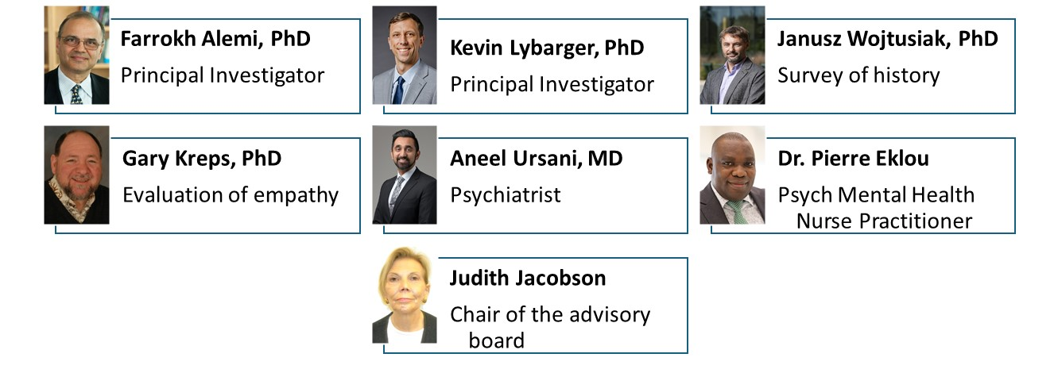
Notes:
The project includes a diverse group of researchers

Slide 4
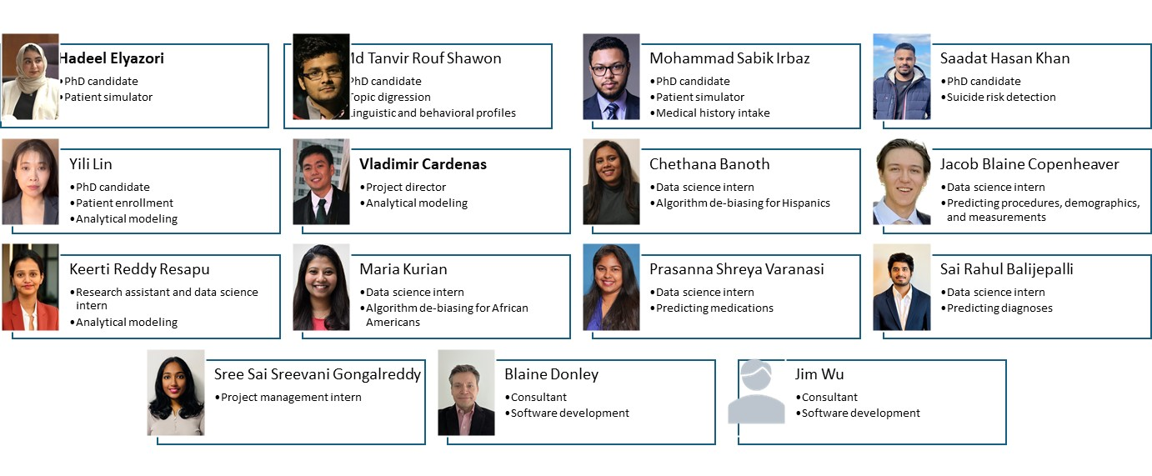
Programmers and Analysis Team
Notes:
In addition, the analysis and coding is being done by a large group of our students and contractors that I would like to acknowledge

Slide 5
Most primary clinicians do not assess risk of suicide for depressed patients
Leavey G, Mallon S, Rondon-Sulbaran J, Galway K, Rosato M, Hughes L. The failure of suicide prevention in primary care: family and GP perspectives - a qualitative study. BMC Psychiatry. 2017 Nov 21;17(1):369. doi: 10.1186/s12888-017-1508-7. PMID: 29157221; PMCID: PMC5697339.
Notes:
Primary and general practitioners prescribing antidepressants do not assess risk of suicide, even though depression is one of the most important risk factors for suicide.

Slide 6
Often bipolar depression is misdiagnosed as major depressive disorder
Leavey G, Mallon S, Rondon-Sulbaran J, Galway K, Rosato M, Hughes L. The failure of suicide prevention in primary care: family and GP perspectives - a qualitative study. BMC Psychiatry. 2017 Nov 21;17(1):369. doi: 10.1186/s12888-017-1508-7. PMID: 29157221; PMCID: PMC5697339.
Notes:
Clinicians often diagnose bipolar patients as having major depressive disorder.

Slide 7
Substance use is often not explored as cause of depression
Campopiano von Klimo M, Nolan L, Corbin M, Farinelli L, Pytell JD, Simon C, Weiss ST, Compton WM. Physician Reluctance to Intervene in Addiction: A Systematic Review. JAMA Netw Open. 2024 Jul 1;7(7):e2420837. doi: 10.1001/jamanetworkopen.2024.20837. PMID: 39018077; PMCID: PMC11255913
Notes:
Few clinicians ask about substance use even though it contributes to depression.

Slide 8
Min H, Alemi F. Insights into prescribing patterns for antidepressants: an evidence-based analysis. BMC Med Inform Decis Mak. 2025 Jan 27;25(1):42. doi: 10.1186/s12911-025-02886-z. PMID: 39871264; PMCID: PMC11773954.
Notes:
Clinicians do not agree with each other or with consensus guidelines regarding what should be prescribed.

Slide 9
Only 22 to 40% benefit from their antidepressants
Mendlewicz J. Towards achieving remission in the treatment of depression. Dialogues Clin Neurosci. 2008;10(4):371-5. Doi: 10.31887/DCNS.2008.10.4/jmendlewicz. PMID: 19170394; PMCID: PMC3181889
Notes:
In the current system of care, only 22% to 40% of patients benefit from their antidepressant. The majority do not benefit. Think about it.

Slide 10
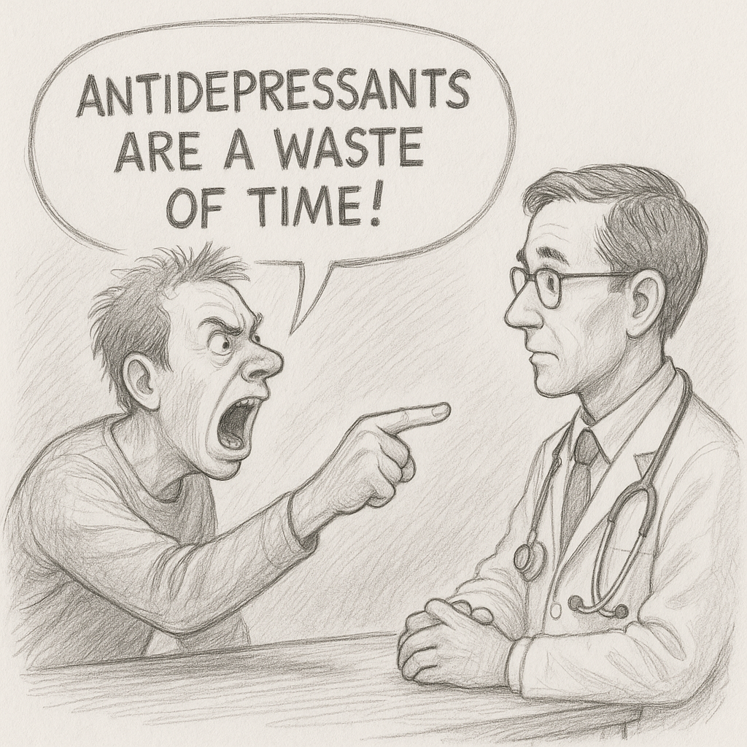
Notes:
Some patients say it is a waste of time and are angry.

Slide 11
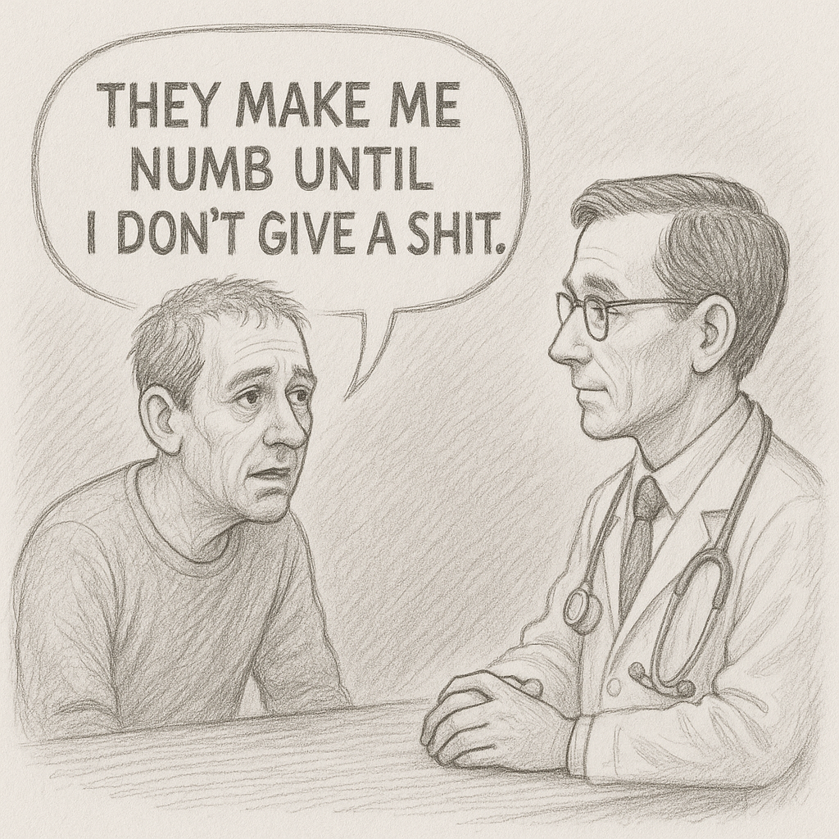
Notes:
Some complain about its side effects

Slide 12
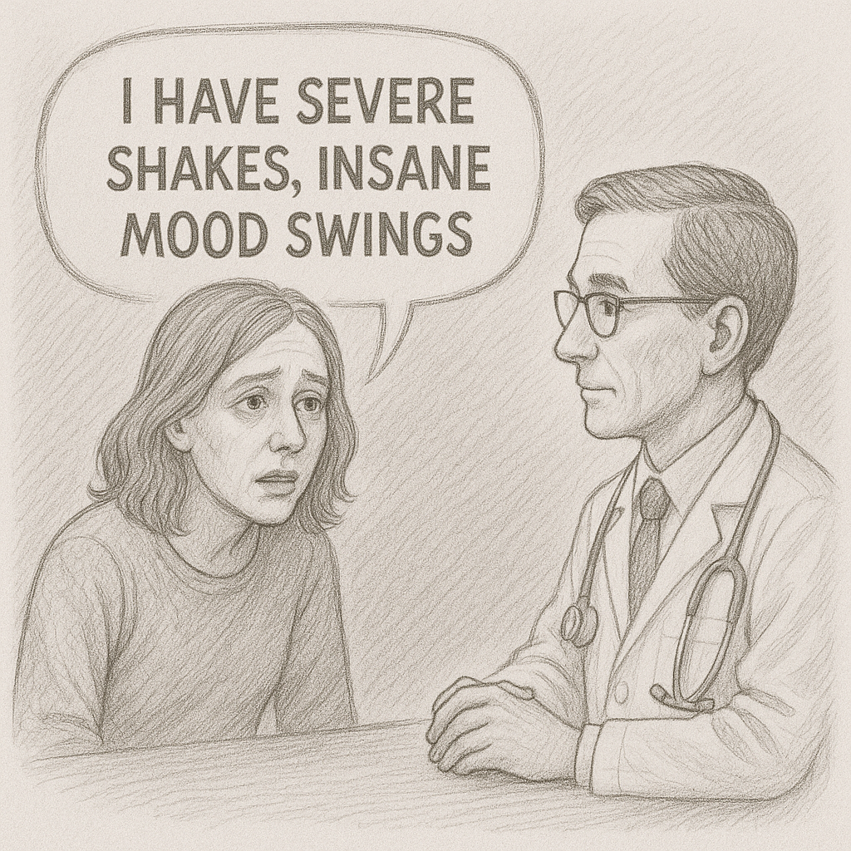
Notes:
Patients say antidepressants make them suicidal. Not only the prescription is not helping, it is harming some.

Slide 13
Notes:
We have designed an AI system to help solve the current poor outcomes

Slide 14
Notes:
We use ChatGPT to interact with the patients in natural language. The patient receives open questions. The interaction is empathetic. It adjusts if the patient is angry, non-compliant, withdrawn, confused, talkative, and so on.

Slide 15
Notes:
A dialogue manager guides the AI system in the long intake conversation. It recenters conversations when there is digression. It assesses if sufficient information has been collected.

Slide 16
Notes:
A human in the loop monitors interactions for safety.

Slide 17
Notes:
A monitoring AI works in the background, analyzes patient responses, and screens for suicide, substance use, mild depression, and bipolar depression.

Slide 18
Notes:
An advice system predicts likely probability of response to 15 common antidepressants in real time. The advice system is based on objective data. The system explains its logic.

Slide 19
No Hullicinations
Notes:
The advice is scripted and not generative. No chance for hullicination.

Slide 20
Knowledgebase Augmented with Medical Record Data
Notes:
We have added to the ChatGPT’s knowledge additional data that describes the relationship between diagnoses, treatment and outcomes in medical records.

Slide 21
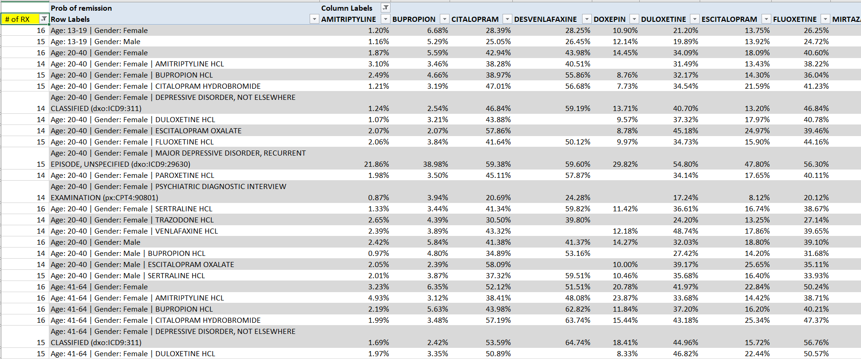
Optum Health
3.6 Million Depressed Patients
10.2 Million Treatment Episodes
16,700 Patient Subgroups
Notes:
These data includes data from Optum Health databases, more than 10 million antidepressant treatment episodes. Our advice is based on patient experiences.

Slide 22
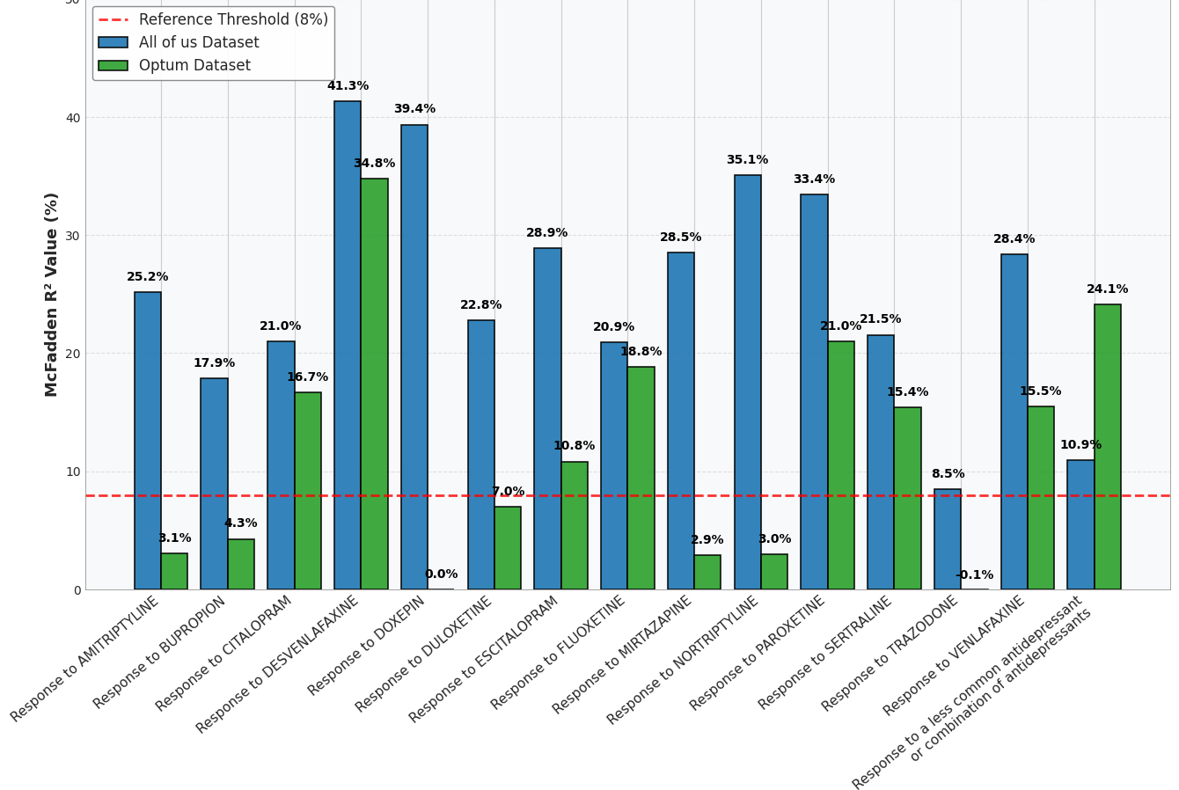
Notes:
Using All of Us data of 600,000 patients, we find out that for African Americans some, but not all, of our models have a bias. We corrected our models.

Slide 23
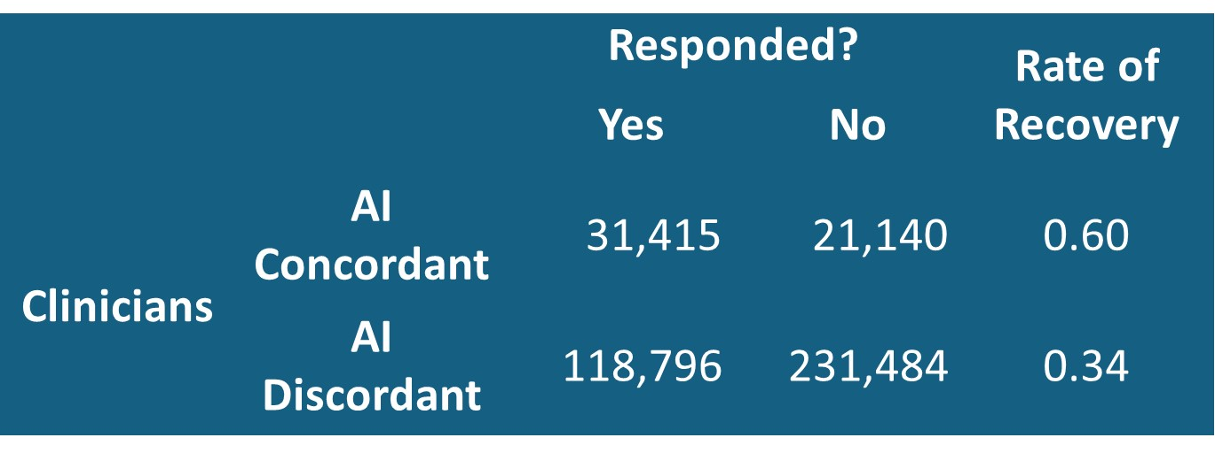
Notes:
Perhaps the most surprise finding so far has been that patients of clinicians who prescribe the same as our advice, what we call concordant clinicians, are 26% more likely to experience remission than patients of discordant clinicians.

Slide 24
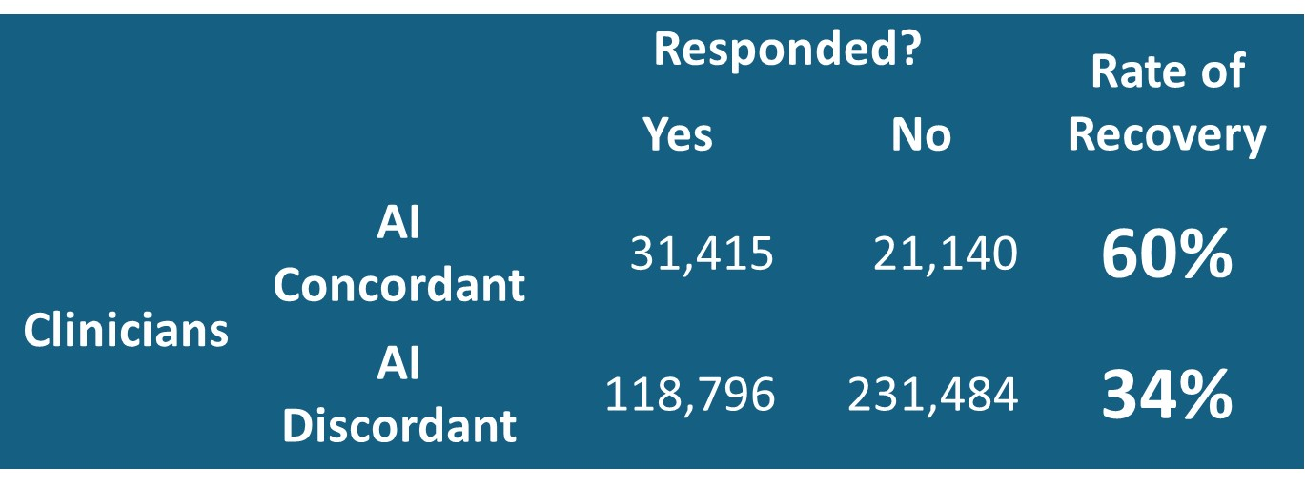
Notes:
The point is that following our advice can nearly double the recovery rate for patients. Who do you want to see, an artificial clinician that can help you recover or a real clinician that can try different things hoping that something will work.

Slide 25
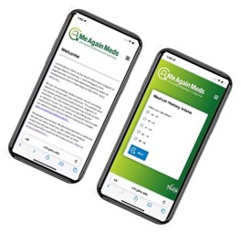
Notes:
An experimental system ,that is undergoing change, is available at rapid improvement dot ai

Slide 26
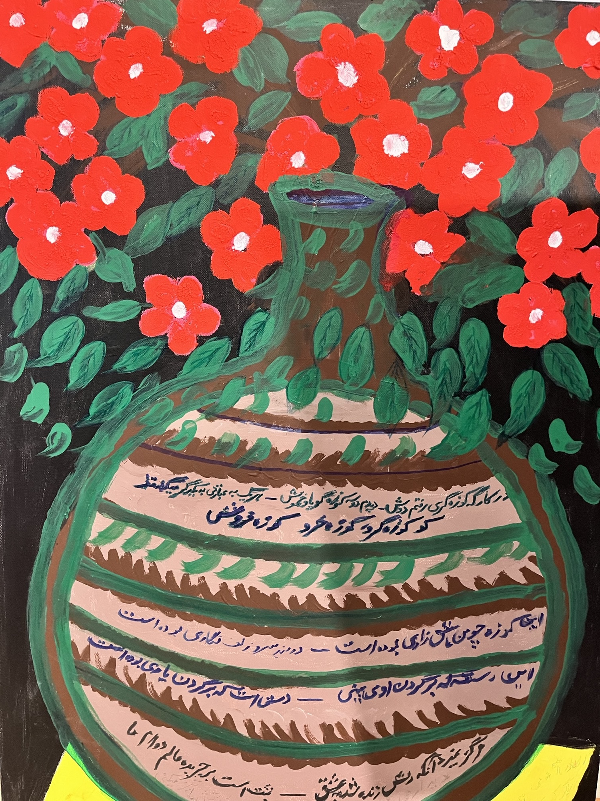
Thank You
Notes:
We are working on an AI system that can radically improve care of depressed patients. Thank you for listening to me.

