Slide 1
Database for Missing Values in All of Us
Keerti Reddy & Farrokh Alemi, PhD
Notes:
These slides show you how to create the database in All of Us for the missing value project,

Slide 2
Missing Value Project:
Language Output →
Input to Machine Learning
Notes:
a project in which we try to link output of language models to input needed by the machine learning models

Slide 3
Unit of Analysis: Individuals.
Notes:
The unit of analysis is individuals.

Slide 4
Dependent Variables:
Predictors of Response to Antidepressants (Target Concepts)
Notes:
The dependent variables are approximately 300 variables that predict responses to antidepressants. These are also called target concepts

Slide 5
Independent Variables:
All Medications, All Diagnoses, Select Procedures, & Antidepressant History
Notes:
The independent variables are approximately 25000 conditions, 30000 medications, select 50 procedures and 20 antidepressant history variables.

Slide 6
Cohort Construction
Initial Database
Adding Target Concepts
Notes:
Th e creation of the database for missing value problems is done in three steps. The first step is cohort construction.

Slide 7
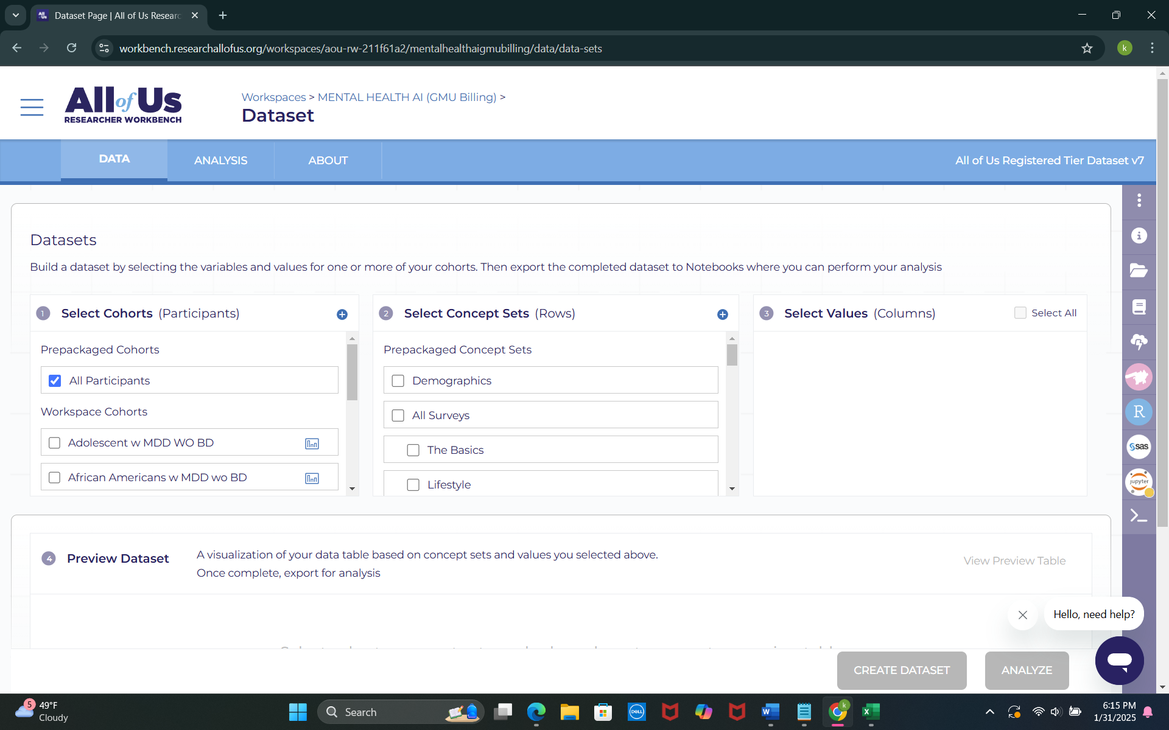
Notes:
Select to work with all of the participants. You do not need to restrict to any specific cohort.

Slide 8
Cohort Construction
Initial Database
Adding Target Concepts
Notes:
The second step in construction of the missing value database is to create the initial database.

Slide 9
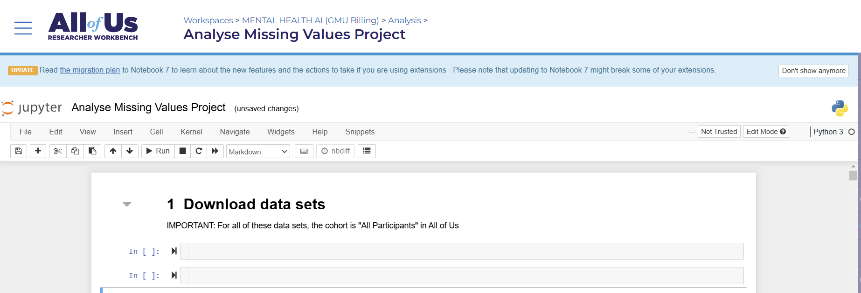
Notes:
Create new Jupyter notebook with the name Analyze Missing Values project

Slide 10
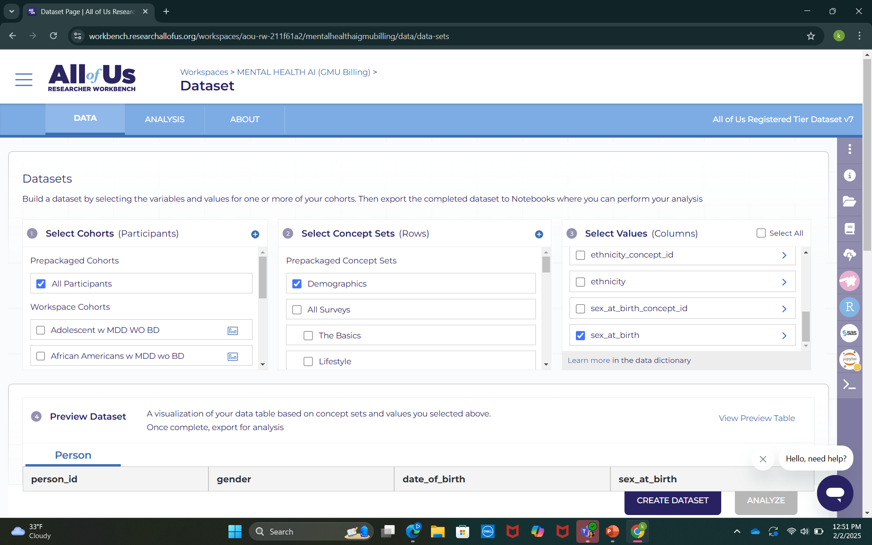
Creating Demographics Dataset
Notes:
Select all participants from the cohort and include key demographics such as date of birth for age calculation and sex at birth.

Slide 11
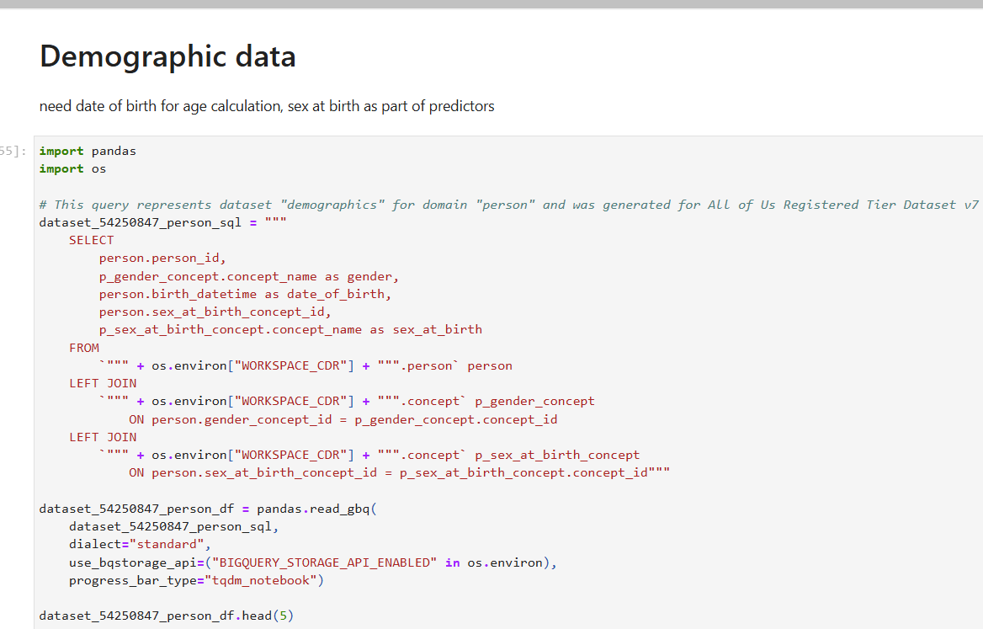
Notes:
This Python script extracts demographic data from the All of Us Registered Tier Dataset.

Slide 12
Notes:
It selects person id, gender, date of birth, and sex at birth from the dataset.

Slide 13
Notes:
The script performs LEFT JOINs to map gender and sex-at-birth concept names to their respective concept IDs.

Slide 14
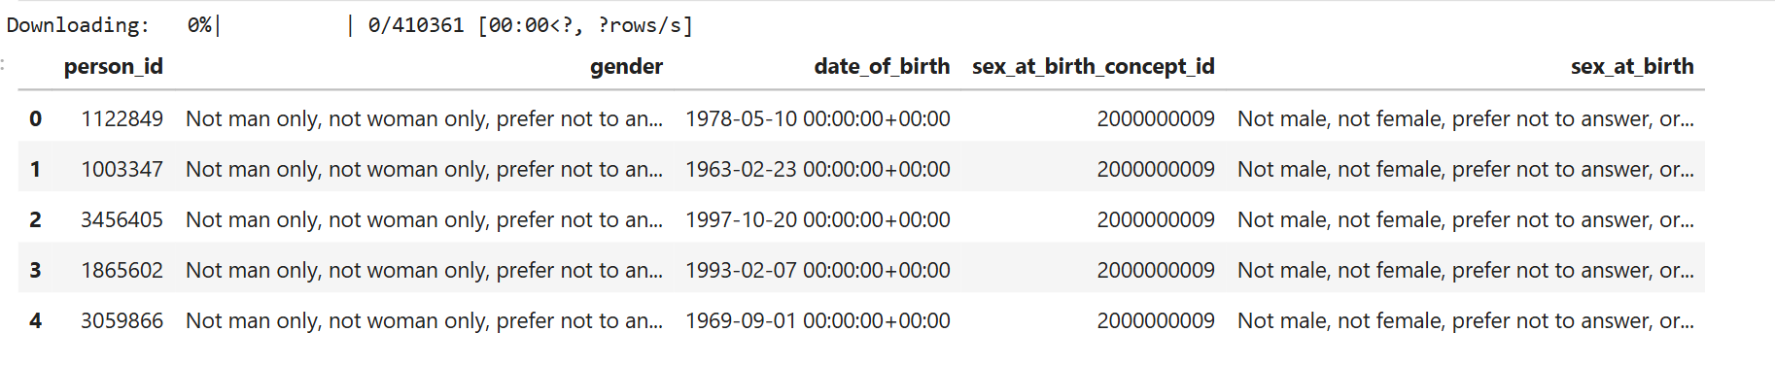
Notes:
Results from Demographics Dataset Analysis

Slide 15
Cohort Construction
Initial Database
Adding Target Concepts
Notes:
The third step in construction of the database is to add target concepts. Recall that these are variables that predict response to antidepressants.

Slide 16
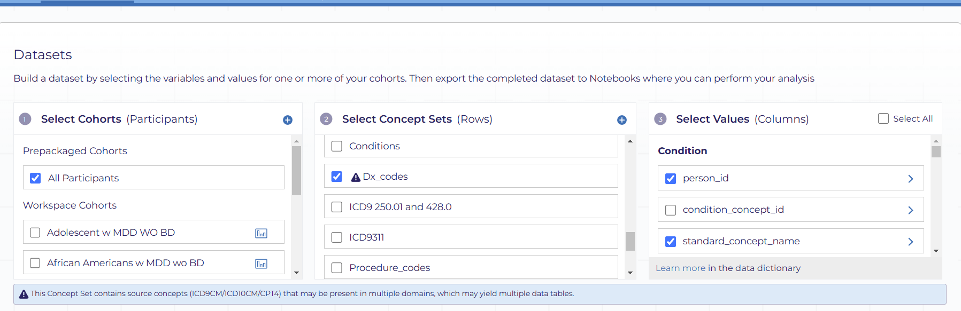
Creating Diagnoses Dataset
Notes:
This slide outlines the process of creating a diagnoses dataset

Slide 17
Creating Diagnoses Dataset
Insert here the next screen that will give them access to Jupyter
Notes:
This slide outlines the process of creating a diagnoses dataset

Slide 18
Creating Diagnoses Dataset
Show the empty Jupyter then show where they copy the code into the Jupyter. Then show the pasted document
Notes:
In the empty Jupyter copy paste the following attached code also available in the course page.

Slide 19
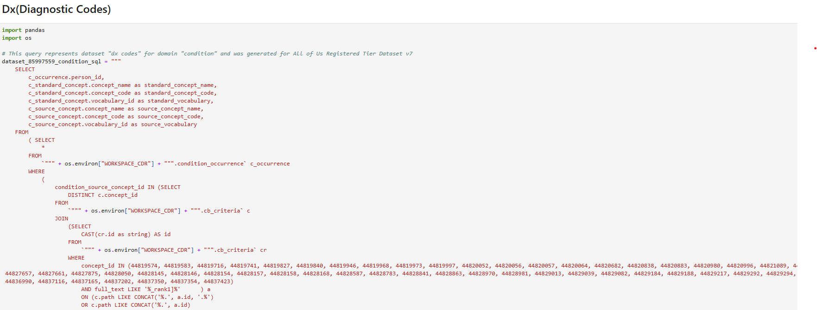
Notes:
This Python script retrieves the concepts that need to be added as target variables

Slide 20
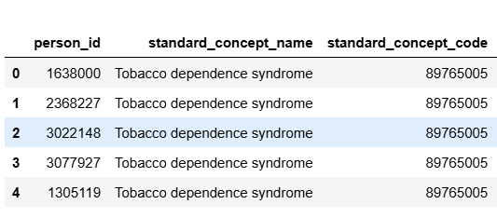
Notes:
Please check your results against this output

Slide 21
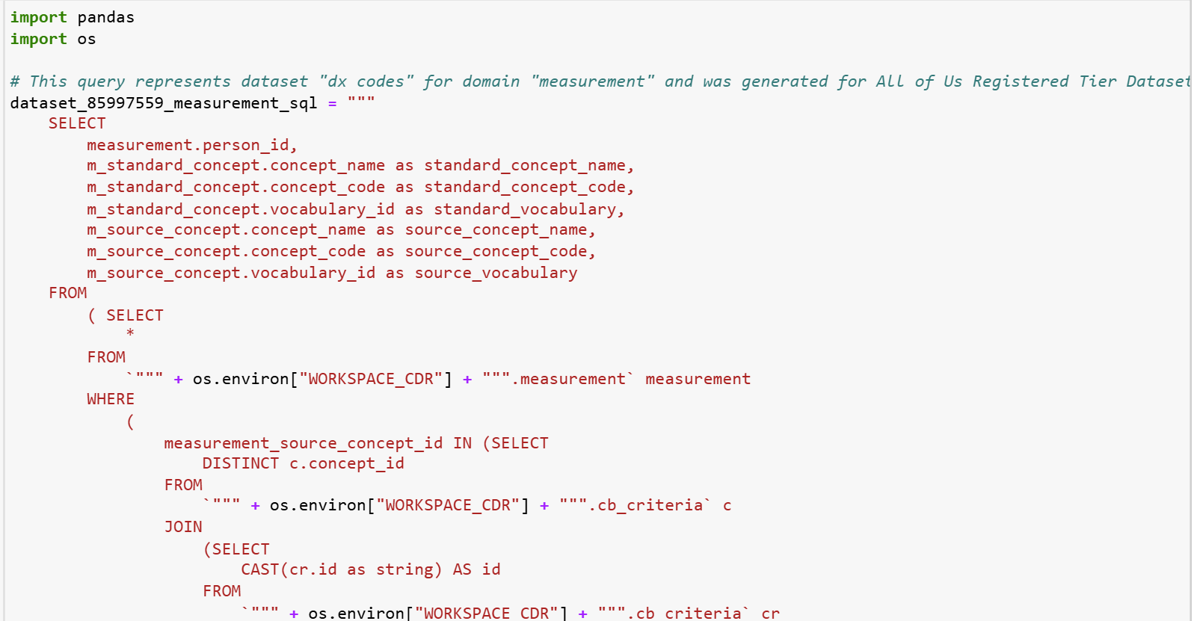
Notes:
This Python script extracts measurement-related data from the All of Us Registered Tier Dataset v7 using SQL and Google BigQuery. It retrieves key details such as person ID, standard and source concept names, concept codes, and vocabulary IDs for selected medical measurements.

Slide 22
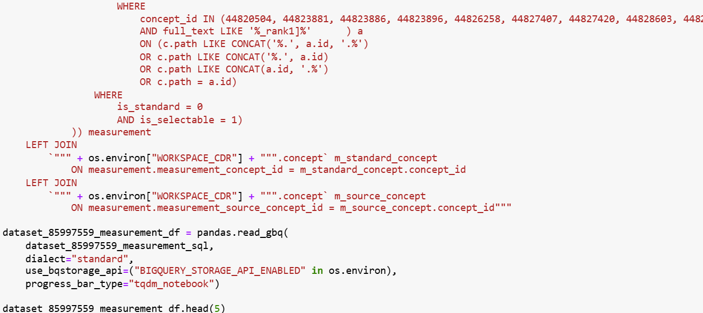
Notes:
The query filters specific measurement concept IDs to ensure relevant data is captured. The dataset is then loaded into a Pandas DataFrame for further analysis, with head(5) displaying the first five rows.

Slide 23
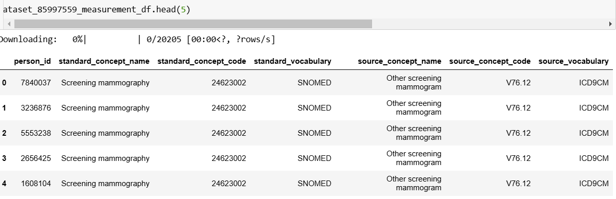
Notes:
Results from Diagnoses (Measurement) Dataset Analysis

Slide 24
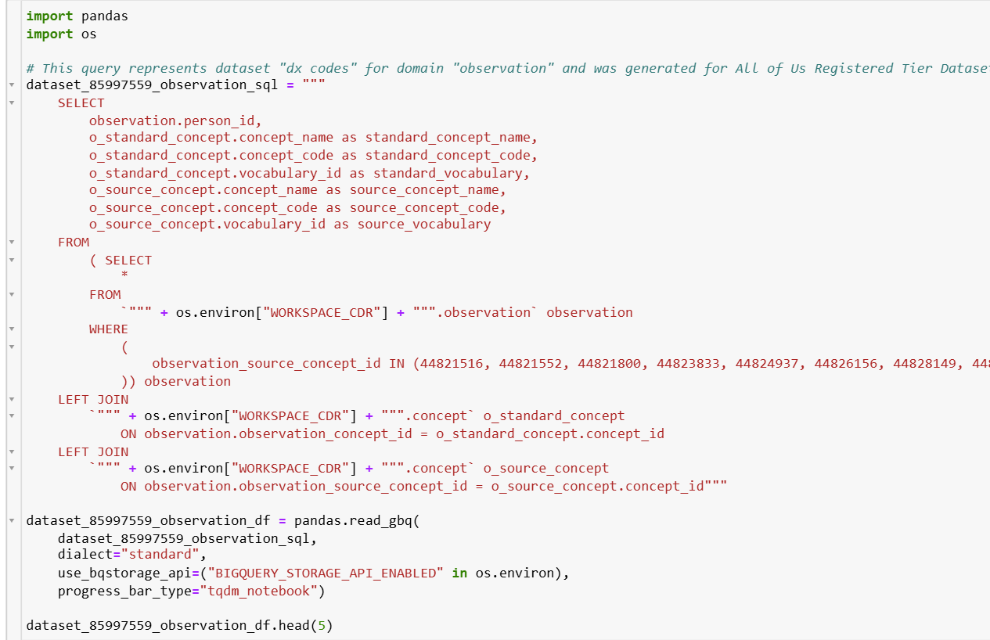
Notes:
This Python script retrieves observation-related data from the All of Us Registered Tier Dataset v7 using SQL and Google BigQuery. It extracts details such as person ID, standard and source concept names, concept codes, and vocabulary IDs for selected observations. The query filters specific observation concept IDs to focus on relevant clinical observations.

Slide 25
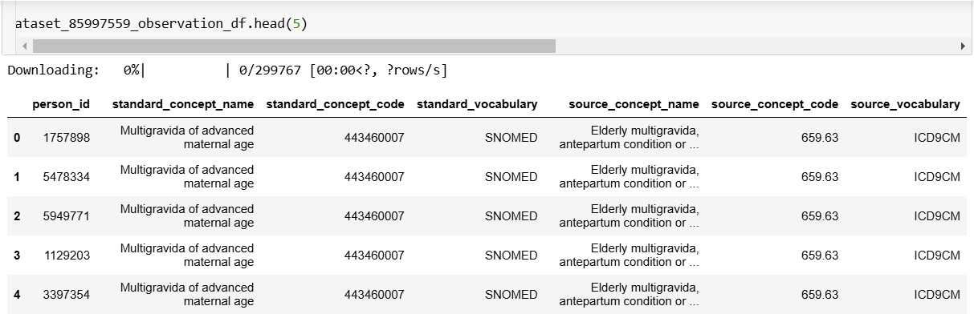
Notes:
Results from Diagnoses (Observation) Dataset Analysis

Slide 26
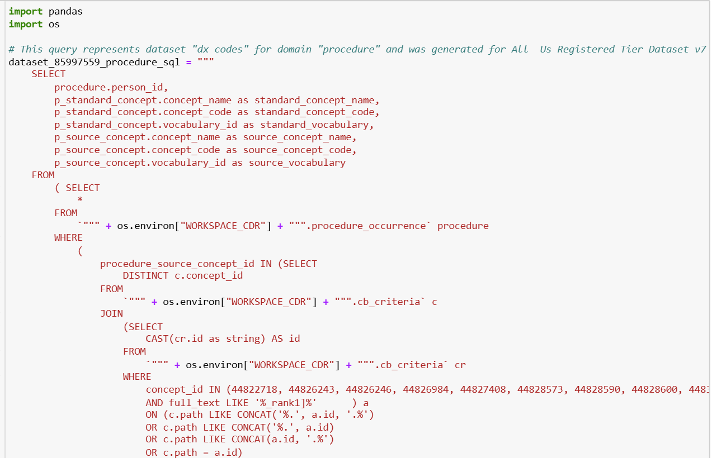
Notes:
This Python script queries the procedure-related data from the All of Us Registered Tier Dataset v7, focusing on retrieving procedure-related concepts such as standard concept names, codes, and vocabulary IDs.

Slide 27
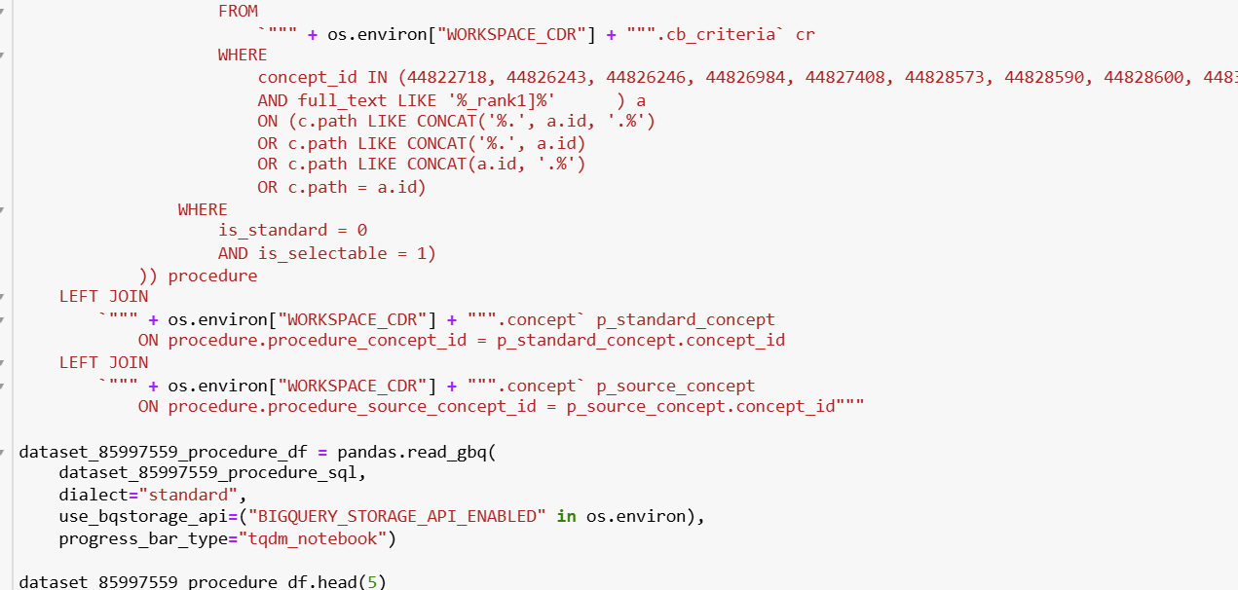
Notes:
The SQL query filters the results based on selected procedure source concept IDs and joins the relevant tables to get both standard and source concept details. The data is loaded into a Pandas DataFrame, and the first five rows are displayed using head(5) for a preview of the dataset.

Slide 28
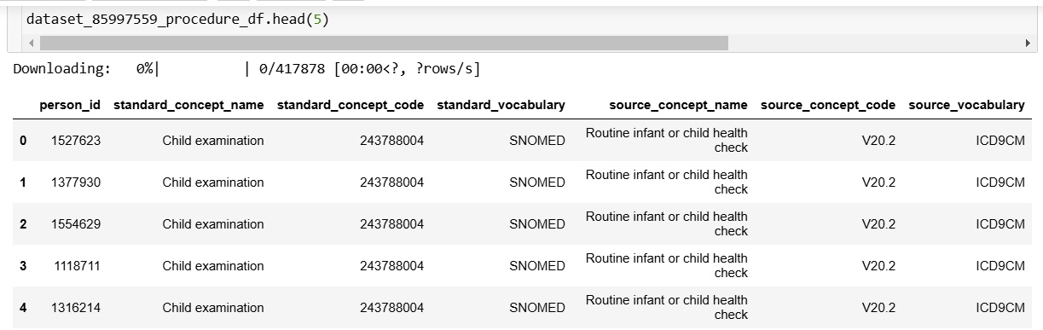
Notes:
Results from Diagnoses (Procedure) Dataset Analysis

Slide 29
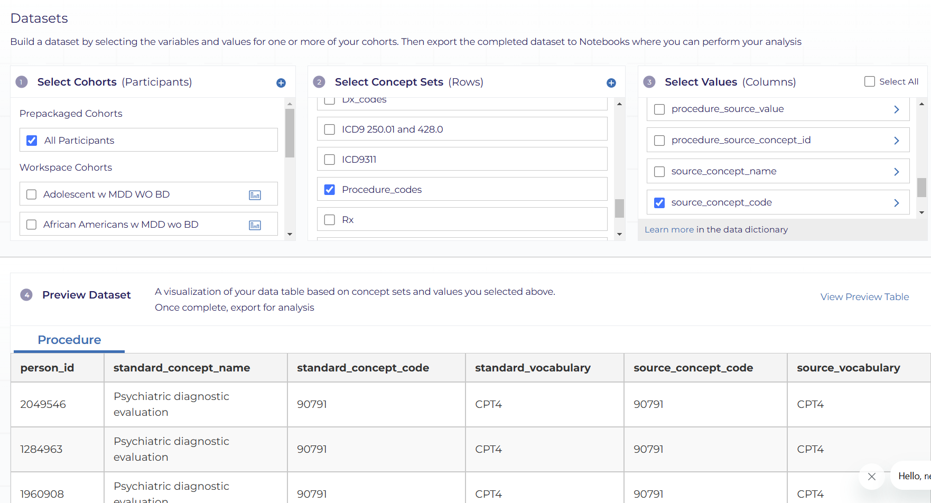
Creating Procedure Dataset
Notes:
This slide outlines the process of creating a procedures dataset

Slide 30
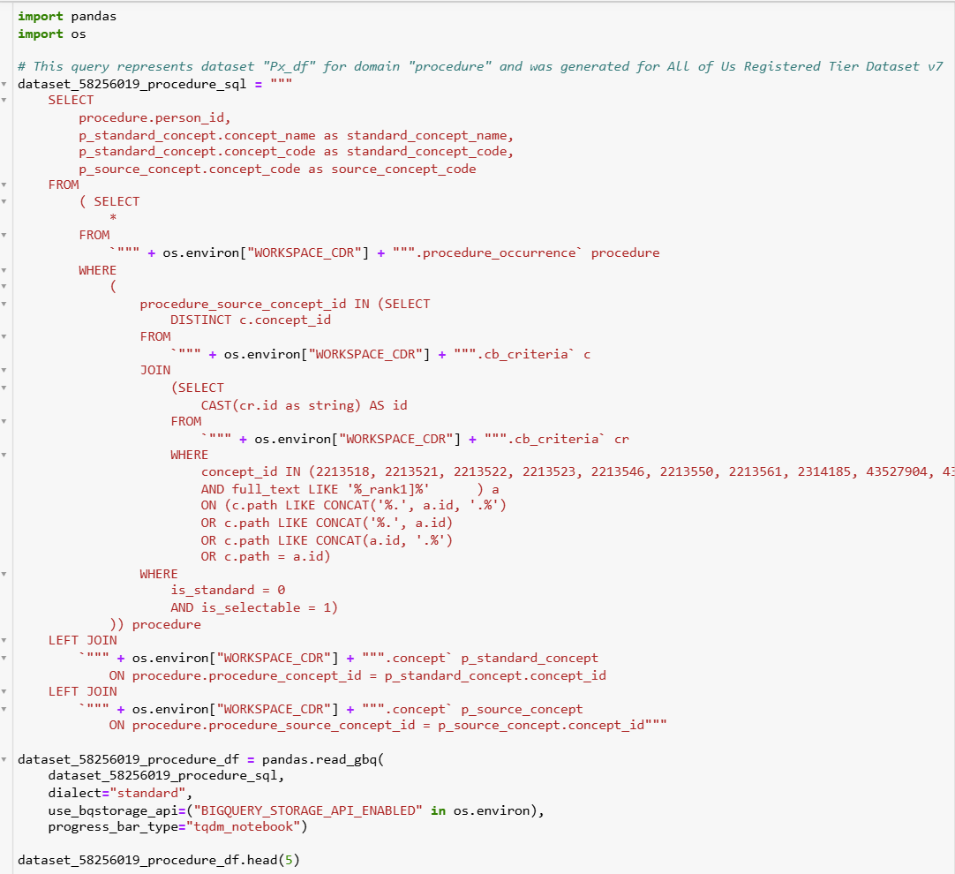
Notes:
This Python script extracts a procedure dataset from the All of Us Registered Tier Dataset v7 using SQL within a BigQuery environment. It retrieves key procedure-related details, including person ID, standard procedure names, standard and source concept codes.

Slide 31
Notes:
The query filters procedures based on specific concept IDs, ensuring relevant medical procedures are included. The dataset is then loaded into a Pandas DataFrame using Google BigQuery (GBQ) storage API for further analysis. The head(5) function previews the first five rows of the extracted dataset.

Slide 32
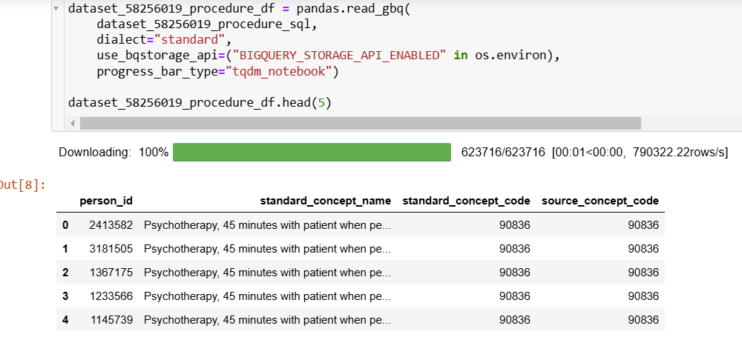
Notes:
Results from Procedures Dataset Analysis

Slide 33
This video has demonstrated how the database is created in 3 steps
Notes:
The take home message for this presentation is that all of us database can be created by defining the cohort, creating an initial database and adding target concepts.

