Slide 1
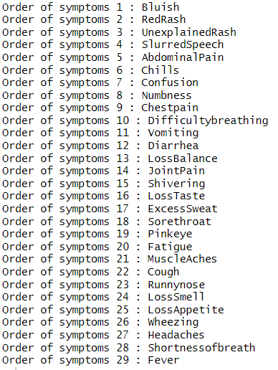
Describe the occurrence of variables
Order of Symptoms:
The order of occurrence of the variables are as follows:
Gender and Age occur first since they occur at birth
The symptoms occur in the order displayed on the right
At home test comes next
PCR test comes last

Slide 2
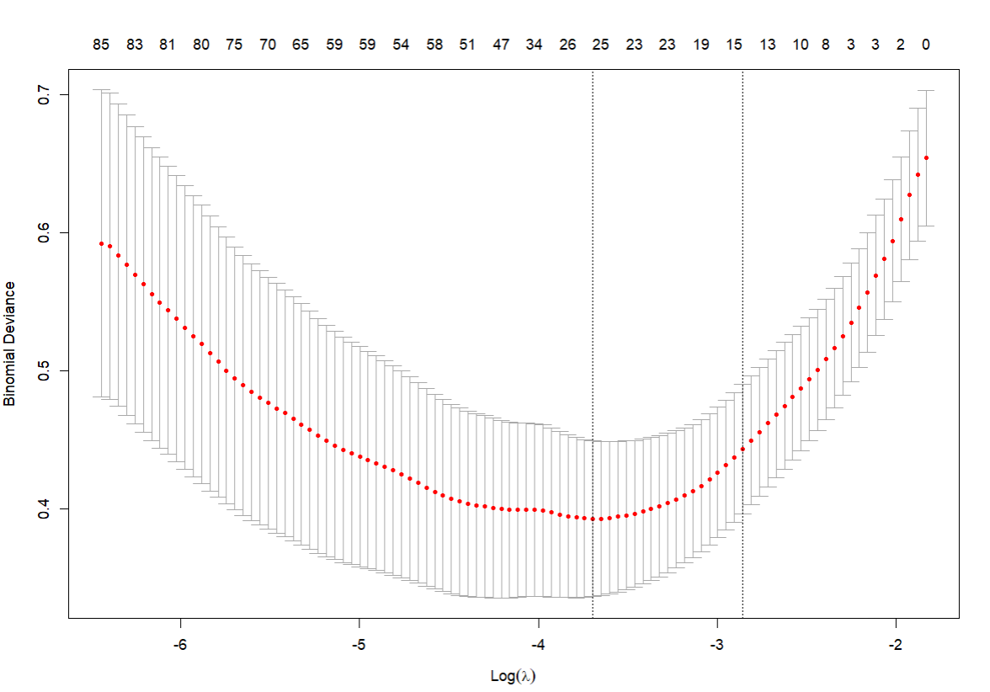
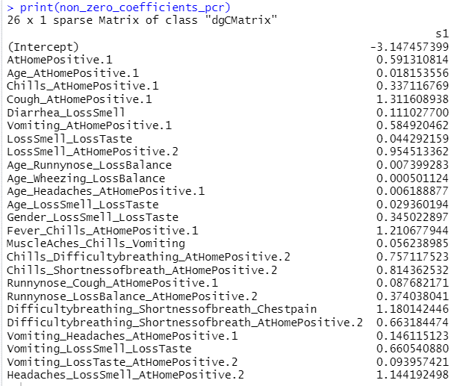
Using logistic LASSO, regress the PCR test results on all variables, including pairwise or triple variables that precede PCR test.
Model Inspection
Attributes with Non-Zero Coefficients
Percentage Deviance Explained: 33.70839%
McFadden Psuedo R-Squared: 0.5343493
AUC-ROC: 0.8915

Slide 3
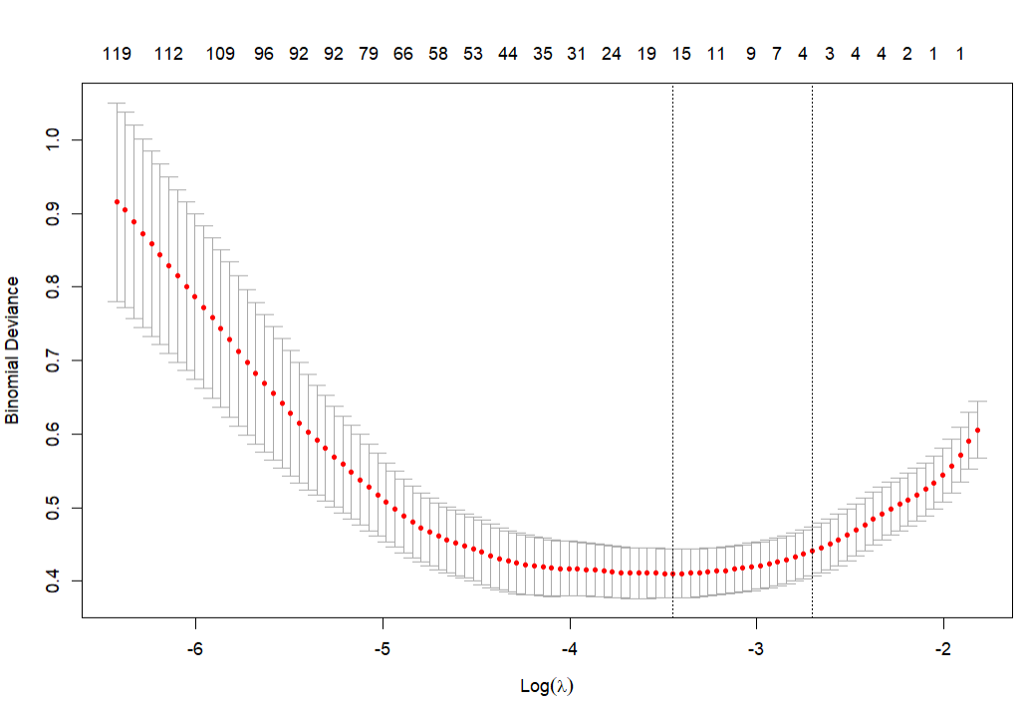
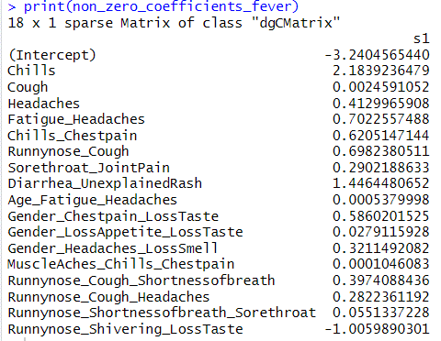
Using logistic LASSO, regress Fever on all variables that precede it, including pairwise or triple variable.
Model Inspection
Attributes with Non-Zero Coefficients
Percentage Deviance Explained: 55.18205%
McFadden Psuedo R-Squared: 0.4261133
AUC-ROC: 0.9389

