Slide 1
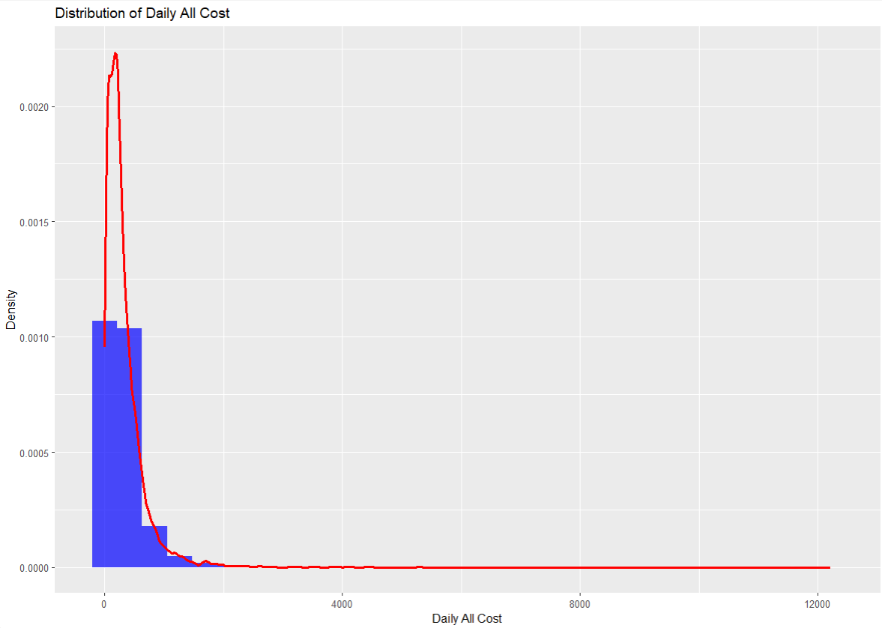
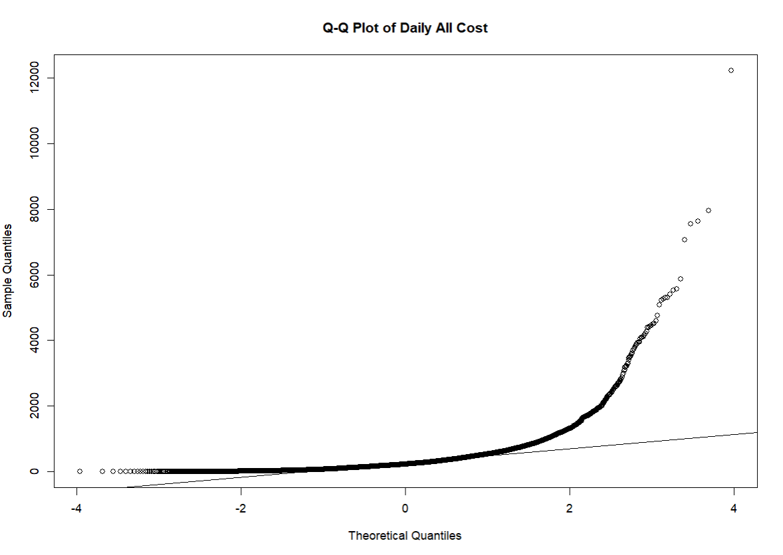
Check if cost is normally distributed (It is not normally distributed)

Slide 2
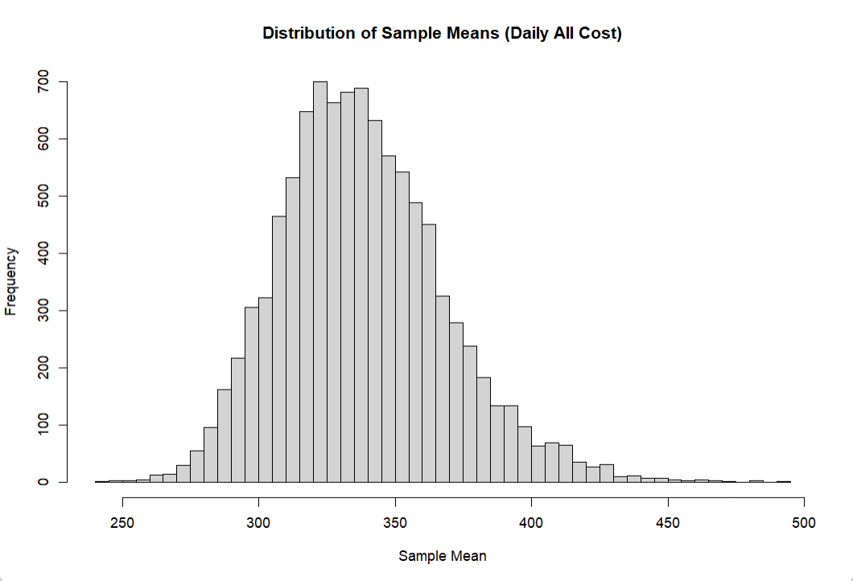
Check if the average of the variable is normally distributied (It is normally distributed)

Slide 3
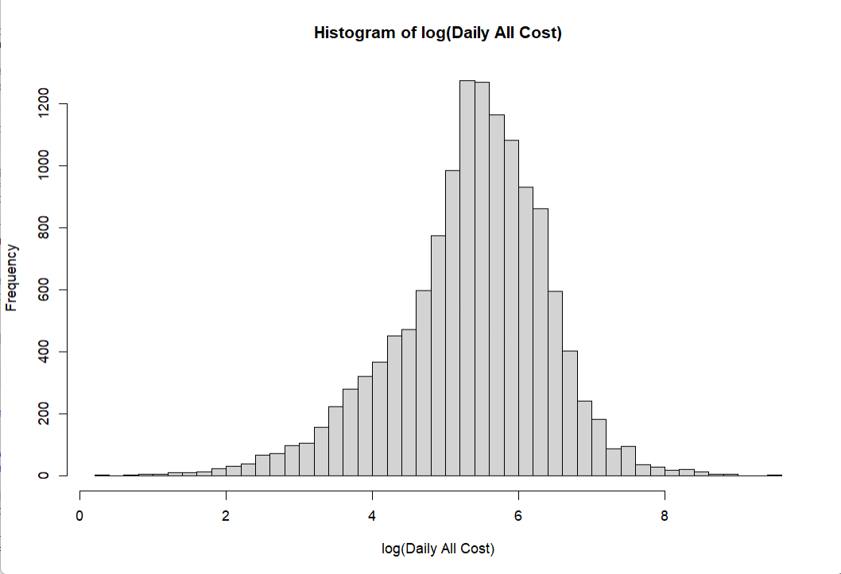
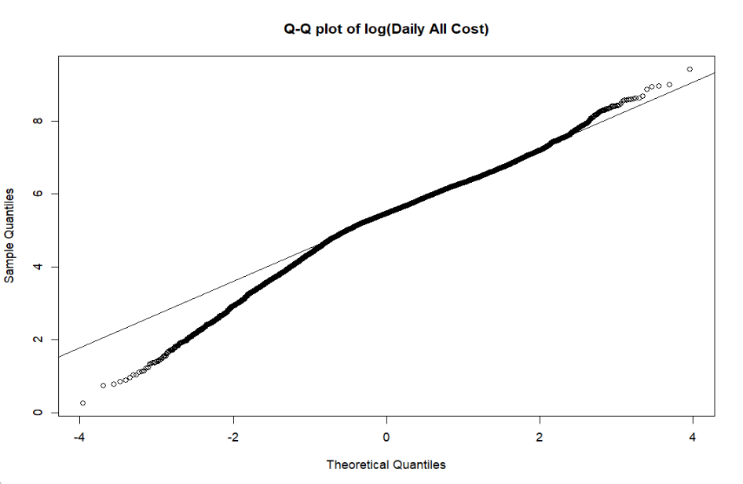
Check if log of cost is more normally distributed (It is more normally distributed)

Slide 4
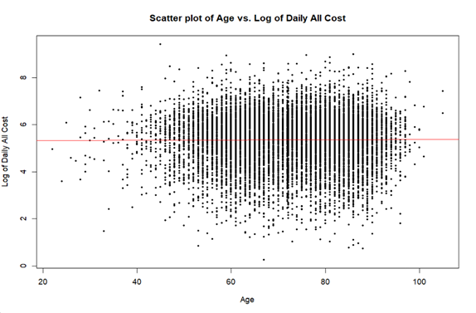
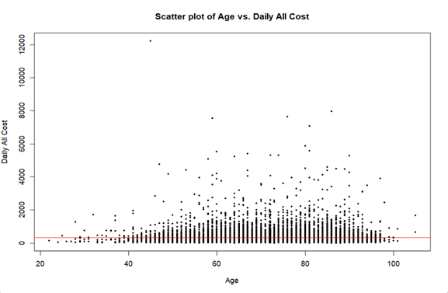
Check that age and cost have a linear relationship (There is no linear relationship)
Correlation value: 0.03
Correlation value: 0.01

Slide 5
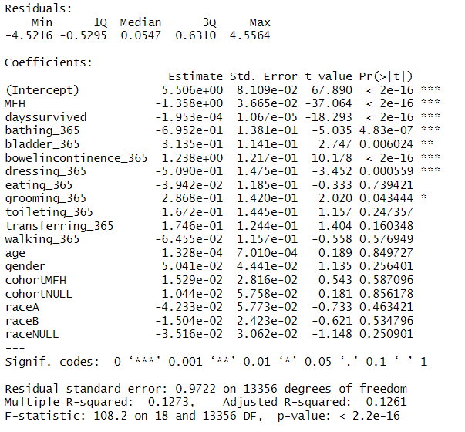
Regression Results

Slide 6
Percent of variation explained (R-squared and Adjusted R-squared)
Based on the R-squared value: 12.73% of the variation in costs is explained by the model
Based on the Adjusted R-squared value: 12.61% of the variation in cost is explained by the model

Slide 7
F-Statistic
The F-statistic of the model is 108.21 with a p-value of 0. This shows that the model is statistically significant predictor, as a group, of cost of care.

Slide 8
Show variables that are statistically significant (alpha = 0.05)
Does age affect cost? No, age does not have a statistically significant effect on cost
Does MFH reduce cost of care? Yes, MFH reduces the cost of care because it has a negative coefficient equal to (-1.358).

