Slide 1
Regression Q2

Slide 2
Data Preprocessing and Imputing:
Zero Imputation Method has the highest r_squared value

Slide 3
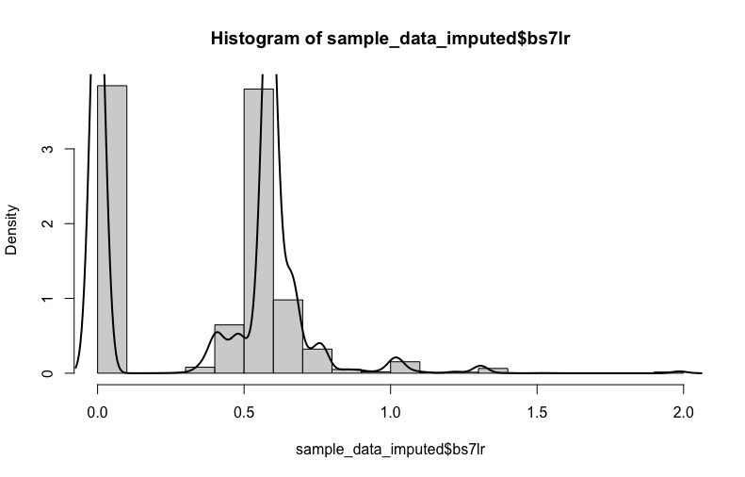
Check the normal distribution assumption of the response variable
The response variable was not normally distributed, performed cube root transformation
and normalized the data

Slide 4
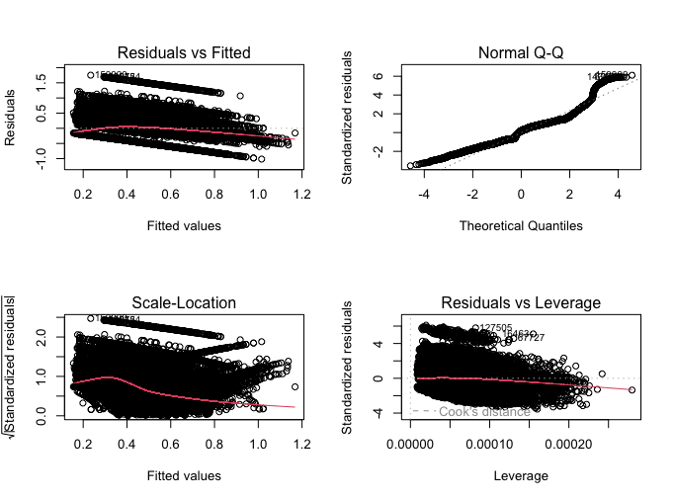
Check the assumption of linearity

Slide 5
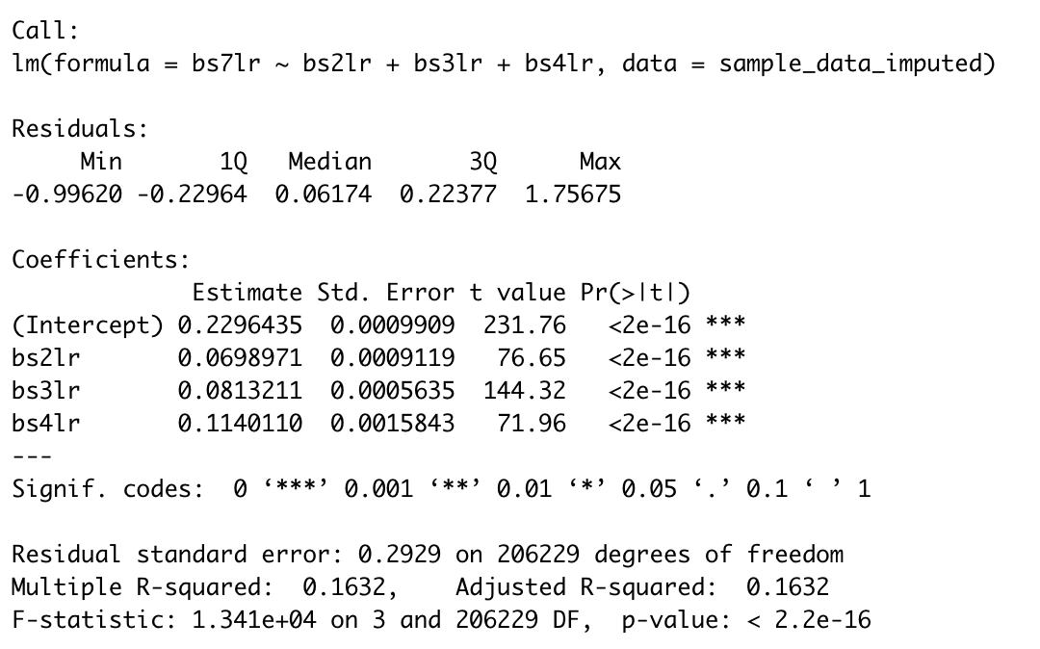
Variables that are predictors at 0.01
1. Endocrine, metabolic & Immunity
Pairs of Variables: Neoplasms ,
Endocrine, metabolic & Immunity
3. Triplets : Incidence of Diabetics,
Endocrine, metabolic & Immunity
Blood System

Slide 6
e. Evaluate the R-square (percent of variation in circulatory diseases explained by other variables that occur prior to it.

Slide 7
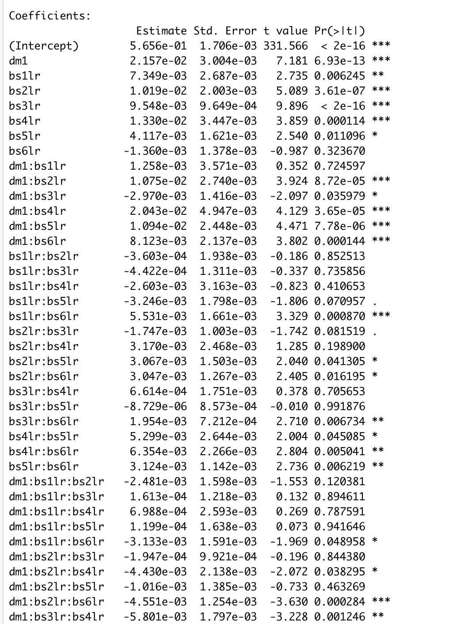
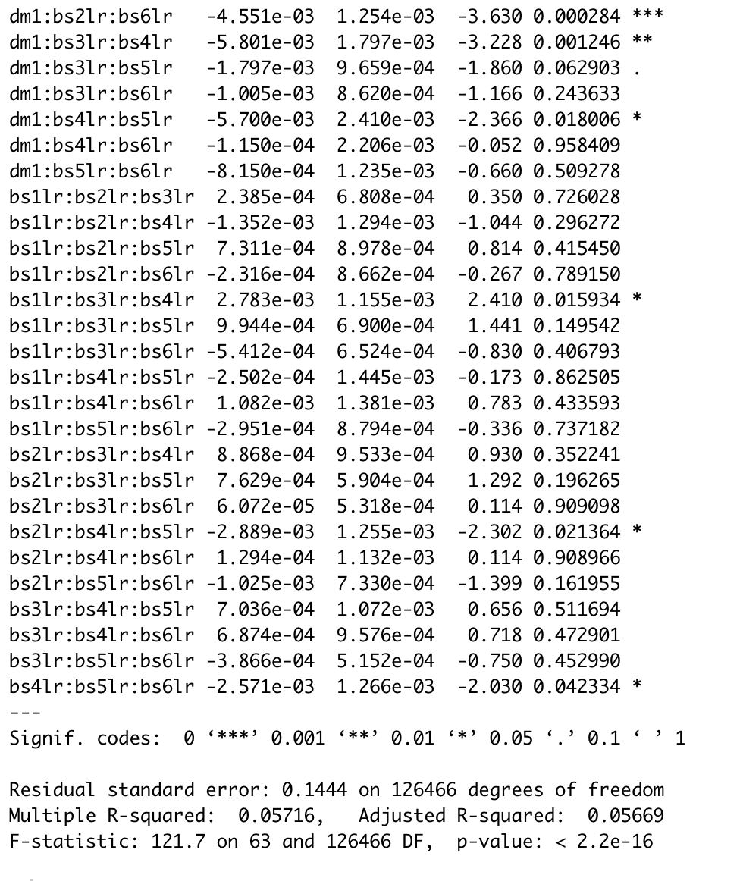
List the variables, pairs of variables, or triplets of variables that are significant predictors at 0.01.:

Slide 8
List of Variables that are significant predictors at 0.01
bs5lr
bs2lr:bs6lr
dm1:bs4lr:bs5lr
bs1lr:bs3lr:bs4lr

