Slide 1
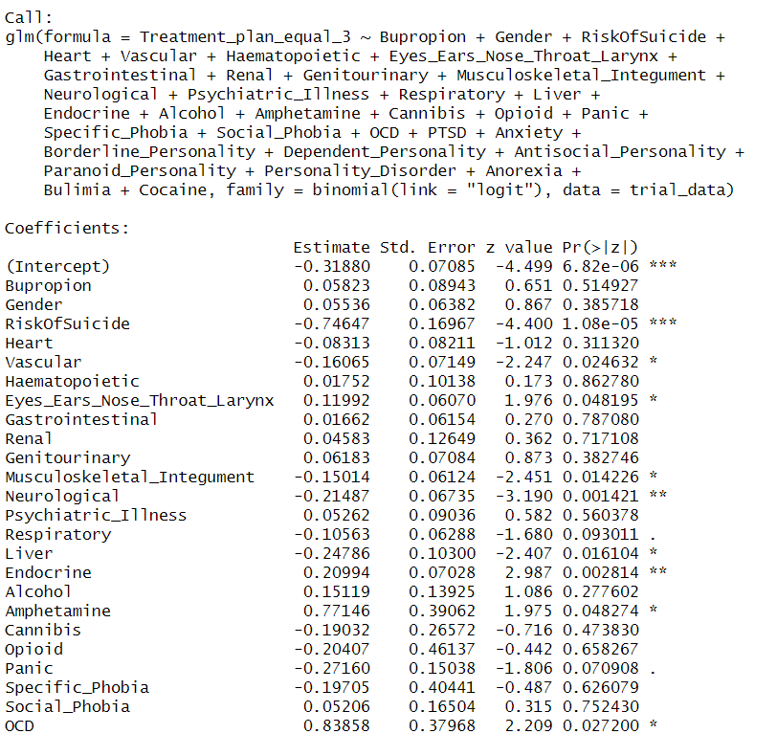
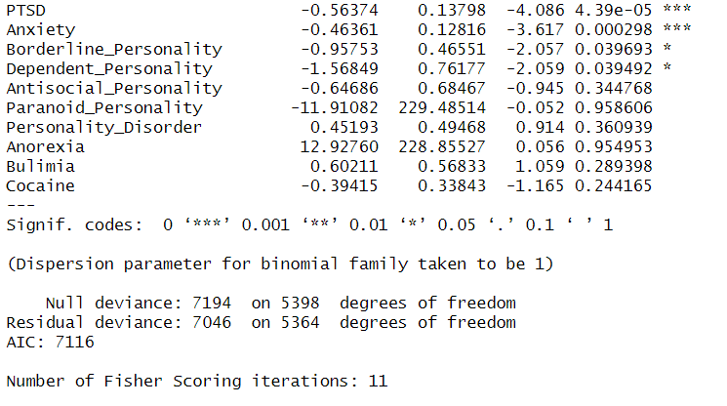
Baseline: Ordinary Outcome Analysis w/o Propensity Score

Slide 2
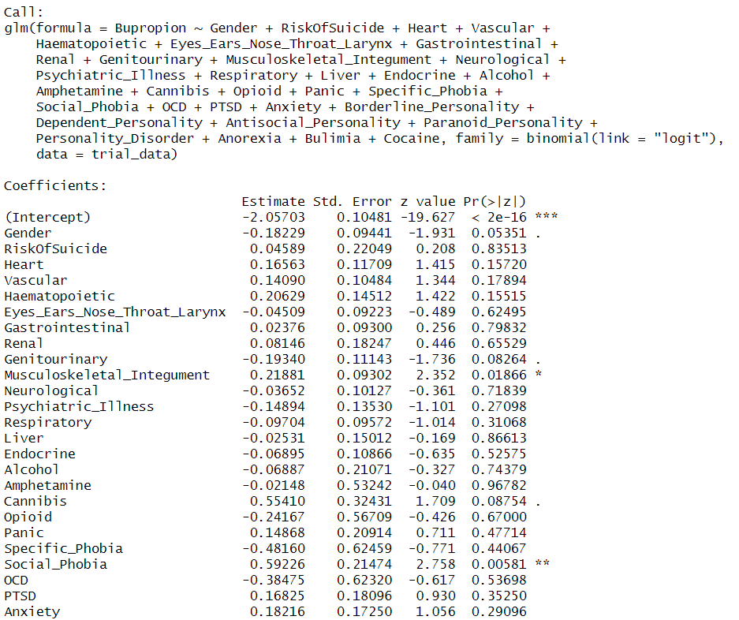
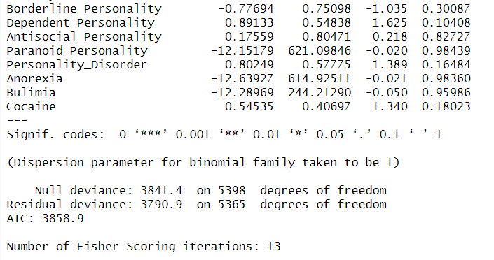
Calculate the propensity of taking the antidepressant

Slide 3
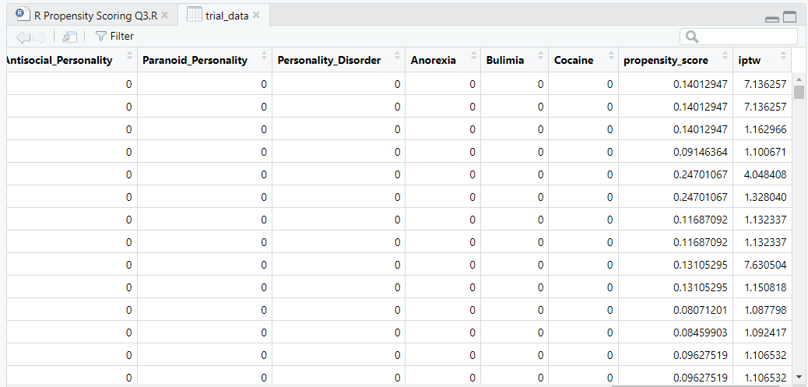
Calculate the Inverse Propensity Weights
Propensity scores and weights for selected observations

Slide 4
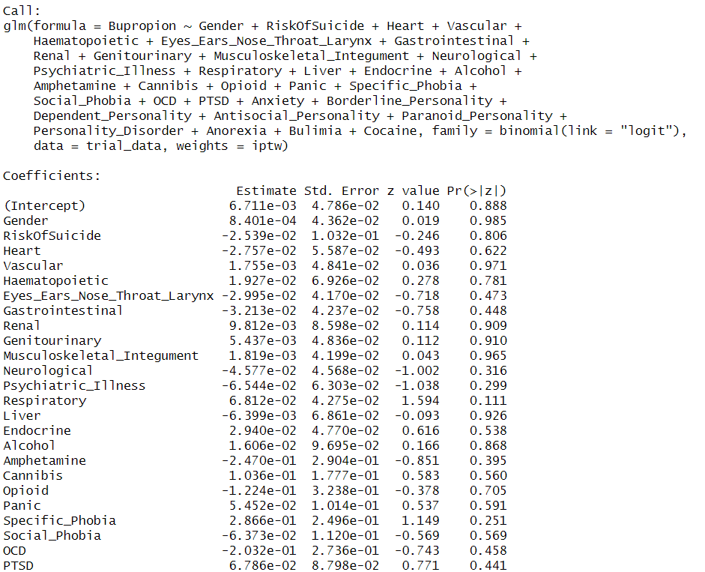
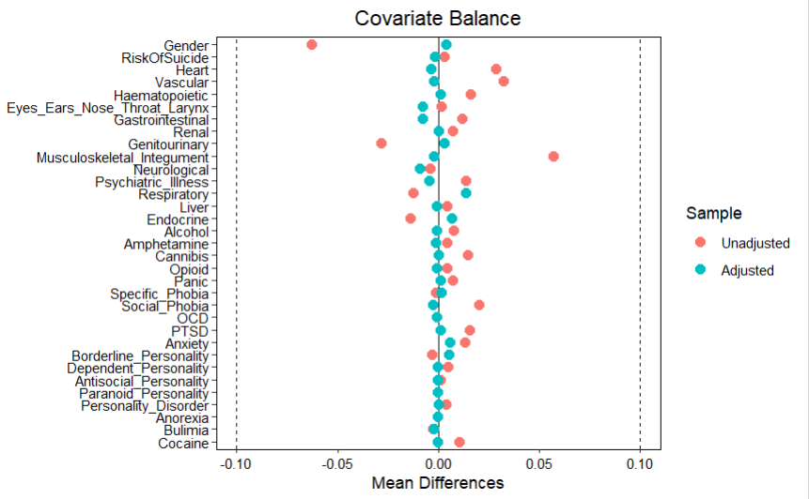
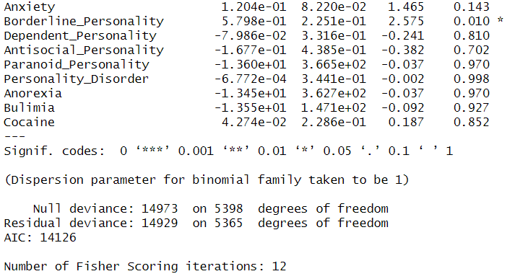
Verify that weighted regression removes the effect of all covariates (Note: There is still an attribute that has statistically significant impact on Bupropion even after applying propensity scores. But Standard Mean Difference (SMD) plot shows balancing has occurred. Even for the statistically significant attribute)

Slide 5
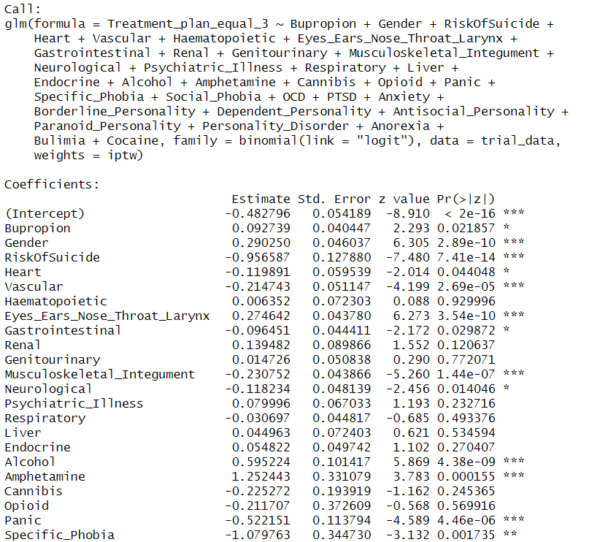
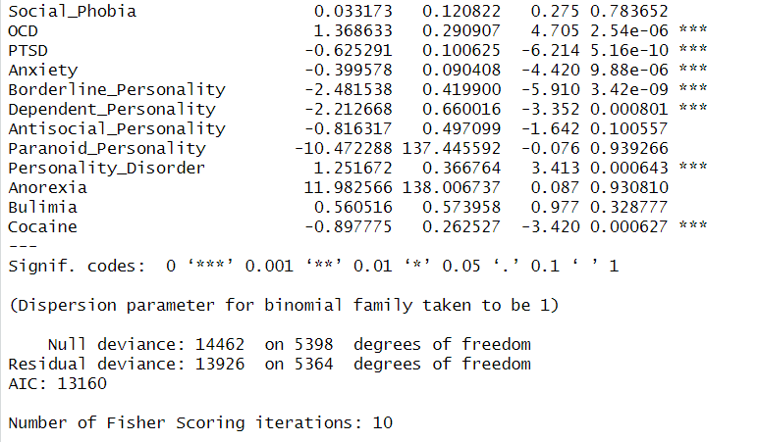
Estimate the Impact on Response. Describe how well the model was balanced and how well the impact of the antidepressant was estimated.
How well the model was balanced: The Standard Mean Difference chart show that the balancing made all adjusted values have mean difference than the non-adjusted values. The regression results also show a decrease on the number of covariates with significant impact to Bupropion, from 6 to 1.
How well the impact of antidepressant was estimated: Before balancing the effect of the covariates on Bupropion, the baseline outcome analysis model showed that Bupropion does not have a statistically significant impact on remission. However, after balancing the effects of the covariates, the resulting weighted model show that Bupropion actually has a statistically significant impact on remission.

