Slide 1
Multilevel Regression Q2
Comparing Medical centers

Slide 2
Processes
The Assignment is done is SQLight in R:
SQLite is a serverless database, you don't need to set up a dedicated database server.
R has packages like RSQLite that provide easy integration with SQLite databases. You can execute SQL queries, import/export data, and work with SQLite databases seamlessly from R
Nulls in the dataset are replaced with group-wise mean ( by Medical center) for accuracy.

Slide 3
Database “Hospital.db” and Tables Created
Lung_Cancer_Comorbodity_table
satisfaction_data_table
Survival_Probability_Per_PatientsConditions
Average_Survival_Rate_By_Medical_Center

Slide 4
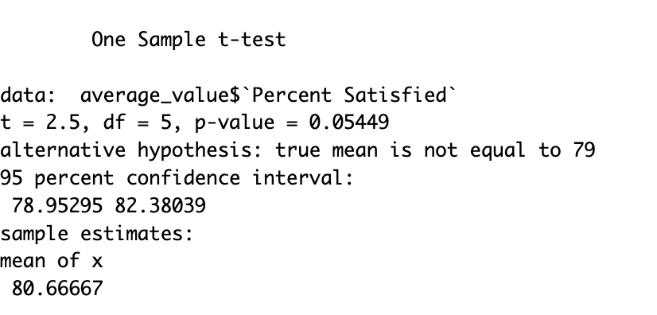
Select patient satisfaction form medical center 1 and contrast it to the average of other medical centers
Medical center patient satisfaction is being tested in this one-sample t-test.
Conclusion: at a p-value of 0.05449
We have strong evidence that there is no significant difference between medical center 1 patient satisfaction and the average of other medical center's patient satisfaction.

Slide 5
SQL to calculate survival rate for the hospital and the average of other hospitals across strata. Each stratum is a combination of patient conditions.
Interpretation.
For a patient from medical center 1 who has a lung cancer and have condition as represented by the stratum have a probability of survival =1 .
Survival is calculated Sum of Death in 6 months divided by total observation per medical center.

Slide 6
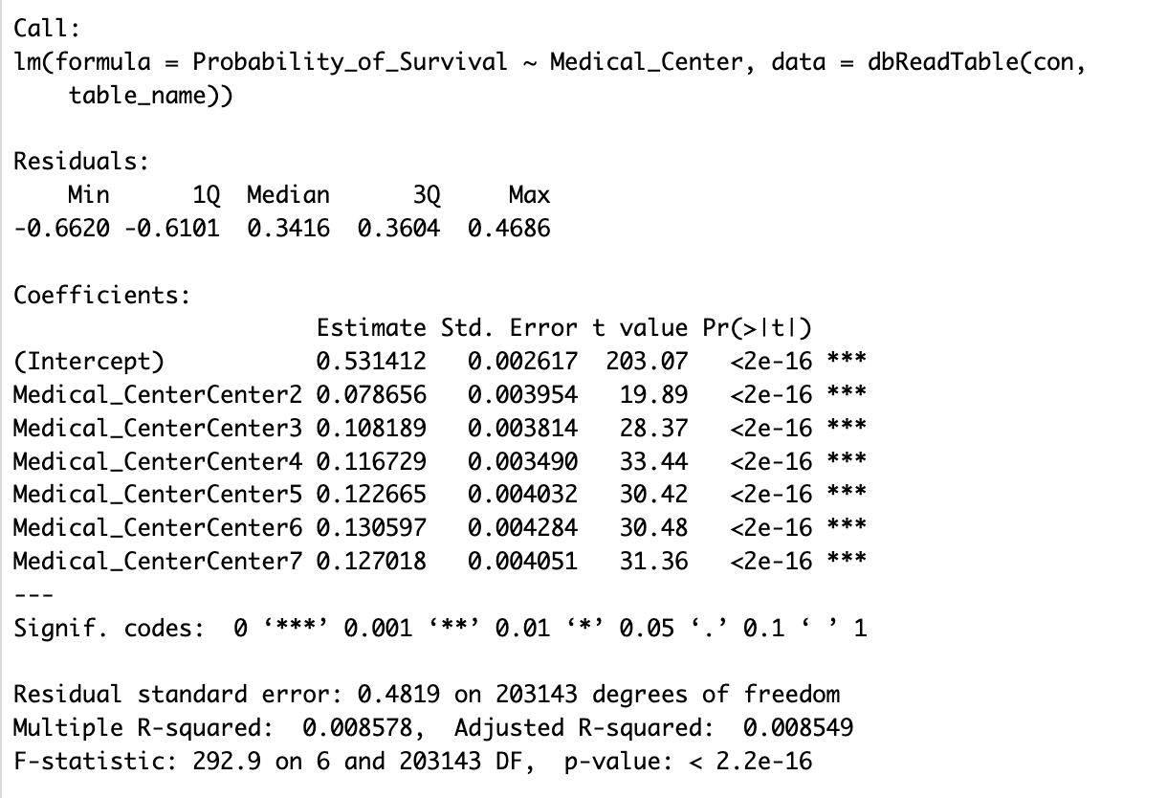
The estimated intercept (0.0531412) of the regression model represents the baseline survival rate for that medical center 1, assuming no differences in patient conditions.
Each of these coefficients represents the difference in "Probability of Survival" compared to medical center 1.
The "Estimate" column shows the numerical value of the estimated coefficient. For instance, for "Medical Center2," the estimate is 0.0787. This means that, on average, when a patient is at Center2 (compared to medical center1), the estimated "Probability of Survival" is higher by 0.0787.

Slide 7
Regress survival rates at different hospitals on distance and percent satisfied at the hospital.

Slide 8
Intercept: Estimated value of "AverageSurvivalRate" when both Average travel distance ans Percent Satisfaction are zero. In this case, the estimate is 0.258633, and the p-value (0.7462) suggests that it's not statistically significant. Average_Travel_Distance: The coefficient for "Average_Travel_Distance" is 0.003275. This means that, for each unit increase in "Average_Travel_Distance," you would expect an increase of approximately 0.003275 units in "Average Survival Rate." The p-value (0.0881) suggests that it's not statistically significant at conventional significance levels (e.g., 0.05), but it's worth noting that it's close to the threshold. Percent_Satisfied: The coefficient for "Percent_Satisfied" is 0.001698. This suggests that, for each unit increase in "Percent_Satisfied," you would expect an increase of approximately 0.001698 units in "AverageSurvivalRate." The p-value (0.8687) indicates that it's not statistically significant.

