Slide 1
Propensity Score Matching Question 4

Slide 2
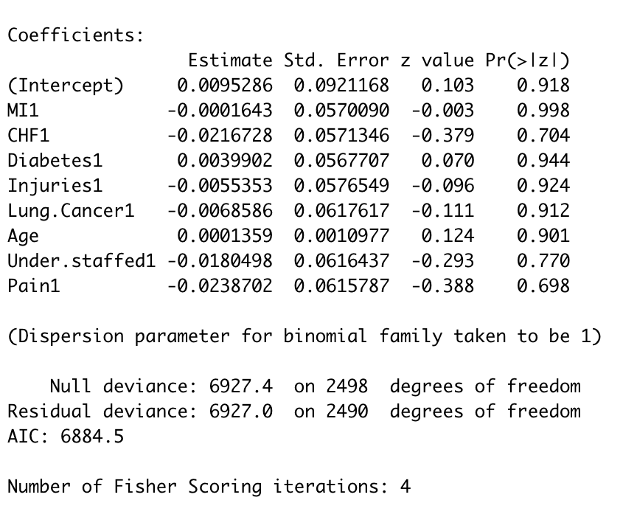
Create a New Column Binary with values 1 or 0 based on the condition:
Here we calculate the mean and add values 1 if values are greater that mean and
0 if values are less than mean.
Balancing the analysis after implementing propensity score and weights

Slide 3
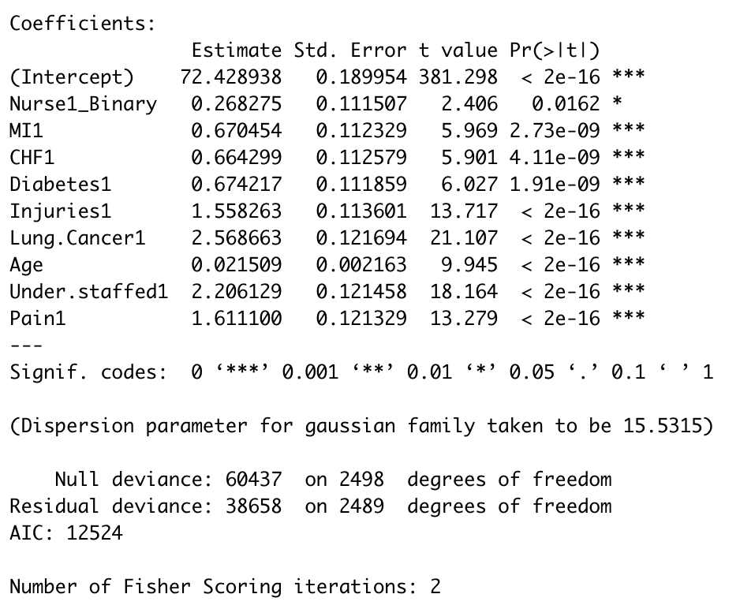
p value of nurse1_binary is less that alpha value(0.05) which shows that Nurse1 has significant effect on outcome
variable satisfaction.

Slide 4
Summary:
Nurse1:
Balance Analysis prior to Propensity score matching:
MI, Injuries are more significant on Nurse1
Balance Analysis after using pscore as weights
Pvalue of Nurse1 is 2e-16 which is less than alpha value(0.05) which means that Nurse1 has significant impact on satisfaction of the unit.

