Slide 1
Propensity Scoring
Farrokh Alemi, Ph.D.
Notes:
This presentation reviews ordinary regression. This brief presentation was organized by Dr. Alemi.

Slide 2
Remove Confounding
Comparing clinicians performance in Non-random
Observational data
“I have bad outcomes because I treat sicker patients”

Slide 3
1
Predict Propensity for Treatment
2
Balance Covariates across treated and untreated
3
Calculate Impact of Treatment in Balanced Data

Slide 4
Risk Group | Number of Patients |  | Propensity in Sample |  | LOS of Real Patients
 | Peer | Clinician | Peer | Clinician | Peer | Clinician
Low | 140 | 4 | 97% | 3% | 2 | 4
Medium | 60 | 8 | 88% | 12% | 6 | 8
High | 20 | 10 | 67% | 33% | 14 | 10
Total/Avg | 220 | 22 |  |  | 16.57 | 4.39

Slide 5
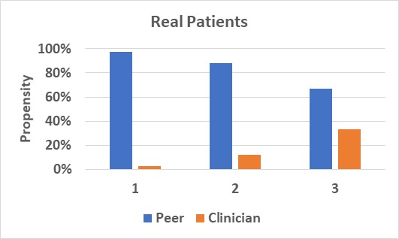
Risk Group | Number of Patients |  | Propensity in Sample |  | LOS of Real Patients
 | Peer | Clinician | Peer | Clinician | Peer | Clinician
Low | 140 | 4 | 97% | 3% | 2 | 4
Medium | 60 | 8 | 88% | 12% | 6 | 8
High | 20 | 10 | 67% | 33% | 14 | 10
Total/Avg | 220 | 22 |  |  | 16.57 | 4.39

Slide 6

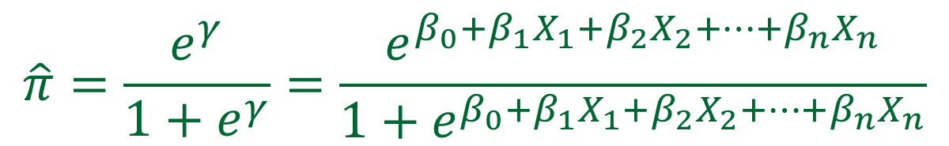
1
Predict Propensity for Treatment
Probability
$$Odds=\frac{π}{1−π}$$
$$\hat{π}=\frac{e^{γ}}{1+e^{γ}}=\frac{e^{β_{0}+β_{1}X_{1}+β_{2}X_{2}+…+β_{n}X_{n}}}{1+e^{β_{0}+β_{1}X_{1}+β_{2}X_{2}+…+β_{n}X_{n}}}$$
$$\ln\left(\frac{π}{1−π}\right)=logit(π)=β_{0}+β_{1}X_{1}+β_{2}X_{2}+…+β_{n}X_{n}$$
Been There
Done That

Slide 7
Risk Group | Number of Patients |  | Propensity in Sample |  | LOS of Real Patients
 | Peer | Clinician | Peer | Clinician | Peer | Clinician
Low | 140 | 4 | 97% | 3% | 2 | 4
Medium | 60 | 8 | 88% | 12% | 6 | 8
High | 20 | 10 | 67% | 33% | 14 | 10
Total/Avg | 220 | 22 |  |  | 16.57 | 4.39
Propensity for treatment is the probability of being treated by the clinician given the case mix of the patient, e.g., p(Clinician | Low)

Slide 8
Two Methods of Balancing Covariates
2

Slide 9

Inverse Weights
1
$$w=\frac{T}{\hat{π}}+\frac{1−T}{1−\hat{π}}$$

Slide 10
Stratify & Match
Stratification
2
Severity
Low
Severity
Med
Severity
High

Slide 11
Risk Group | Number of Patients |  | Propensity in Sample |  | LOS of Real Patients |  | Sample Weights |  | Weighted Patients |  | Weighted Rate |  | LOS of Weighted Patients
 | Peer | Clinician | Peer | Clinician | Peer | Clinician | Peer | Clinician | Peer | Clinician | Peer | Clinician | Peer | Clinician
Low | 140 | 4 | 97% | 3% | 2 | 4 | 1.03 | 36.00 | 144 | 144 | 60% | 60% | 2.06 | 144.00
Medium | 60 | 8 | 88% | 12% | 6 | 8 | 1.13 | 8.50 | 68 | 68 | 28% | 28% | 6.80 | 68.00
High | 20 | 10 | 67% | 33% | 14 | 10 | 1.50 | 3.00 | 30 | 30 | 12% | 12% | 21.00 | 30.00
Total/Avg | 220 | 22 |  |  | 16.57 | 4.39 |  |  | 242 | 242 | 1 | 1 | 5.74 | 108.51

Slide 12
Risk Group | Number of Patients |  | Propensity in Sample |  | LOS of Real Patients |  | Sample Weights |  | Weighted Patients |  | Weighted Rate |  | LOS of Weighted Patients
 | Peer | Clinician | Peer | Clinician | Peer | Clinician | Peer | Clinician | Peer | Clinician | Peer | Clinician | Peer | Clinician
Low | 140 | 4 | 97% | 3% | 2 | 4 | 1.03 | 36.00 | 144 | 144 | 60% | 60% | 2.06 | 144.00
Medium | 60 | 8 | 88% | 12% | 6 | 8 | 1.13 | 8.50 | 68 | 68 | 28% | 28% | 6.80 | 68.00
High | 20 | 10 | 67% | 33% | 14 | 10 | 1.50 | 3.00 | 30 | 30 | 12% | 12% | 21.00 | 30.00
Total/Avg | 220 | 22 |  |  | 16.57 | 4.39 |  |  | 242 | 242 | 1 | 1 | 5.74 | 108.51

Slide 13
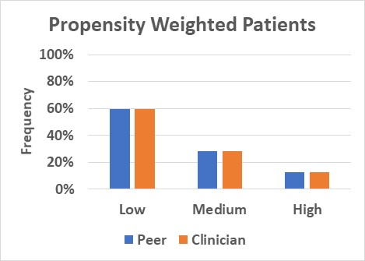
Risk Group | Number of Patients |  | Propensity in Sample |  | LOS of Real Patients |  | Sample Weights |  | Weighted Patients |  | Weighted Rate |  | LOS of Weighted Patients
 | Peer | Clinician | Peer | Clinician | Peer | Clinician | Peer | Clinician | Peer | Clinician | Peer | Clinician | Peer | Clinician
Low | 140 | 4 | 97% | 3% | 2 | 4 | 1.03 | 36.00 | 144 | 144 | 60% | 60% | 2.06 | 144.00
Medium | 60 | 8 | 88% | 12% | 6 | 8 | 1.13 | 8.50 | 68 | 68 | 28% | 28% | 6.80 | 68.00
High | 20 | 10 | 67% | 33% | 14 | 10 | 1.50 | 3.00 | 30 | 30 | 12% | 12% | 21.00 | 30.00
Total/Avg | 220 | 22 |  |  | 16.57 | 4.39 |  |  | 242 | 242 | 1 | 1 | 5.74 | 108.51

Slide 14
Risk Group | Number of Patients |  | Propensity in Sample |  | LOS of Real Patients |  | Sample Weights |  | Weighted Patients |  | Weighted Rate |  | LOS of Weighted Patients
 | Peer | Clinician | Peer | Clinician | Peer | Clinician | Peer | Clinician | Peer | Clinician | Peer | Clinician | Peer | Clinician
Low | 140 | 4 | 97% | 3% | 2 | 4 | 1.03 | 36.00 | 144 | 144 | 60% | 60% | 2.06 | 144.00
Medium | 60 | 8 | 88% | 12% | 6 | 8 | 1.13 | 8.50 | 68 | 68 | 28% | 28% | 6.80 | 68.00
High | 20 | 10 | 67% | 33% | 14 | 10 | 1.50 | 3.00 | 30 | 30 | 12% | 12% | 21.00 | 30.00
Total/Avg | 220 | 22 |  |  | 16.57 | 4.39 |  |  | 242 | 242 | 1 | 1 | 5.74 | 108.51
Reversed Impact

Slide 15
In observational data, remove confounding: Compare apples to apples, oranges to oranges

