Slide 1
Propensity score matching
HAP 819: Advanced Statistics in Health Services Research II
Presenter:
Shaan Muberra Khan, Doctoral student
George Mason University

Slide 2
Propensity score
Covariates
Propensity score methods allow investigators to minimize the effects of observed confounding when estimating treatment effects using observational data
Patient History
Received treatment
Risk factors
Outcome
Treatment
No treatment
No treatment
Co-morbidity

Slide 3
Propensity score: Assignment
Data source: National Institute of Mental Health, there are 22,254 records for about 4,000 patients
Treatment: Either patients received bupropion antidepressant OR patients did not receive bupropion (are assumed to have received an alternative antidepressant)
Outcome: Remission of depression symptoms
Patients’ age, gender and medical history can affect the use of antidepressant and remission of depression symptoms

Slide 4
Steps in propensity score matching
Step 1: Select and list the covariates/variables
Step 2: Create propensity score
Step 3: Inverse probability of treatment weighting
Step 4: Assess propensity score
Step 5: Create graphical presentation
Step 6: Outcome analysis with matched data

Slide 5
Step 1: Select and list the covariates/variables
Treatment:
Use of antidepressants
Including covariates that are related to:
- Treatment
- Outcome
Reviewing previous research to identify these variables/covariates
Excluding important variables may lead to biased results
Variables selected for PSM
Outcome: Remission of depression symptoms

Slide 6
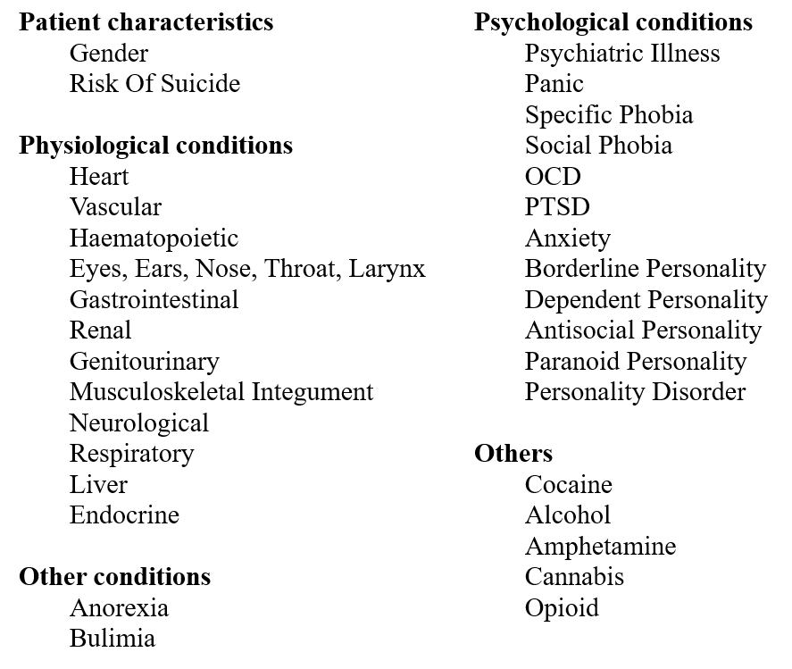
Table 1: Variables selected for PSM

Slide 7
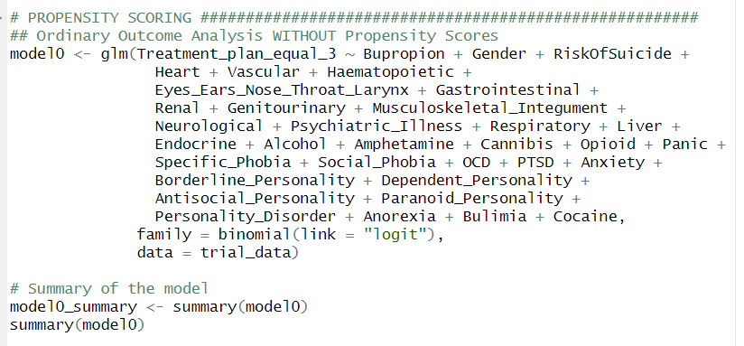
An experiment!
Let us conduct ordinary outcome analysis without propensity scores:
Treatment: Use of antidepressant
Outcome: Remission rate

Slide 8
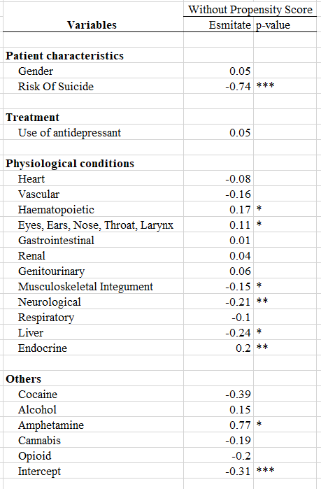
An experiment!
No significant effect of Treatment (Use of antidepressant) on Outcome: Remission rates!!!
Many variables are confounded!!!
Propensity score is necessary to remove the confounding

Slide 9
Steps in propensity score matching
Step 1: Select and list the covariates/variables
Step 2: Create propensity score
Step 3: Inverse probability of treatment weighting
Step 4: Assess propensity score
Step 5: Create graphical presentation
Step 6: Outcome analysis with matched data

Slide 10
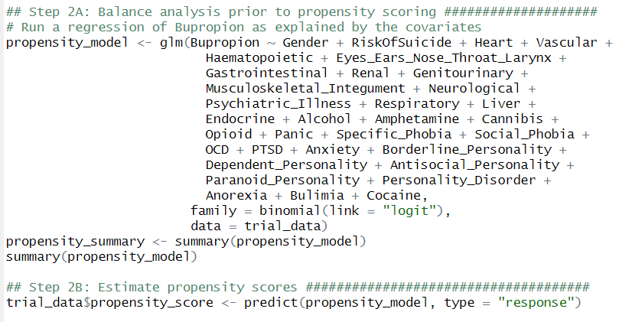
Step 2: Create propensity score
Patients used bupropion antidepressants
Using logistic regression to predict propensity scores
Patients did not use bupropion antidepressants

Slide 11
Step 2: Create propensity score
Patients used bupropion antidepressants
Using logistic regression to predict propensity scores
0.52
0.78
0.06
0.22
0.12
0.46
0.39
0.82
0.90
0.78
Patients did not use bupropion antidepressants

Slide 12
Step 2: Create propensity score
Patients used bupropion antidepressants
Using logistic regression to predict propensity scores
0.52
0.78
0.06
0.22
0.12
0.46
0.39
0.82
0.90
0.78
Patients did not use bupropion antidepressants

Slide 13
Step 2: Create propensity score
Patients used bupropion antidepressants
Using logistic regression to predict propensity scores
0.52
0.78
0.06
0.22
0.12
➔ Caliper
0.46
0.39
0.77
0.90
0.50
Patients did not use bupropion antidepressants

Slide 14
Steps in propensity score matching
Step 1: Select and list the covariates/variables
Step 2: Create propensity score
Step 3: Inverse probability of treatment weighting
Step 4: Assess propensity score
Step 5: Create graphical presentation
Step 6: Outcome analysis with matched data

Slide 15
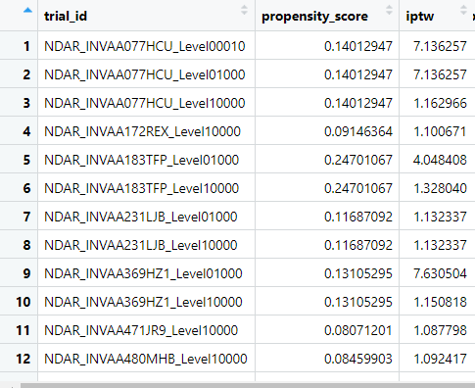
Step 3: Inverse probability of treatment weighting
We will weight the entire study sample by inverse probability of treatment weights
Where,
Z denote treatment status
Z = 1 denotes treated
Z = 0 denotes untreated)
e denote the estimated propensity score

Slide 16
Steps in propensity score matching
Step 1: Select and list the covariates/variables
Step 2: Create propensity score
Step 3: Inverse probability of treatment weighting
Step 4: Assess propensity score
Step 5: Create graphical presentation
Step 6: Outcome analysis with matched data

Slide 17
Step 4: Assess propensity score
Patients used bupropion antidepressants
Balance diagnostics
Assessing whether patients had the same distribution of covariates/variables
Assessing whether the propensity score model has been adequately specified
Using standardized difference to quantify the differences in means or prevalence between two group
0.52
0.78
0.06
0.22
0.12
Are we on the right track?
0.46
0.39
0.76
0.90
0.03
Patients did not use bupropion antidepressants

Slide 18
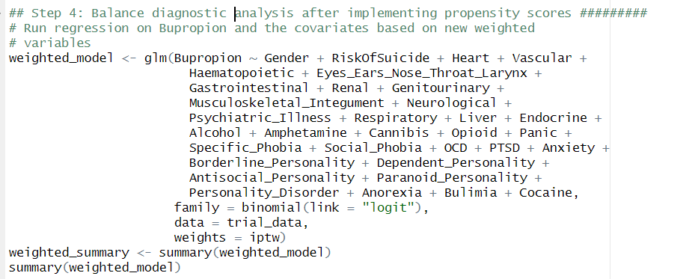
Step 4: Assess propensity score

Slide 19
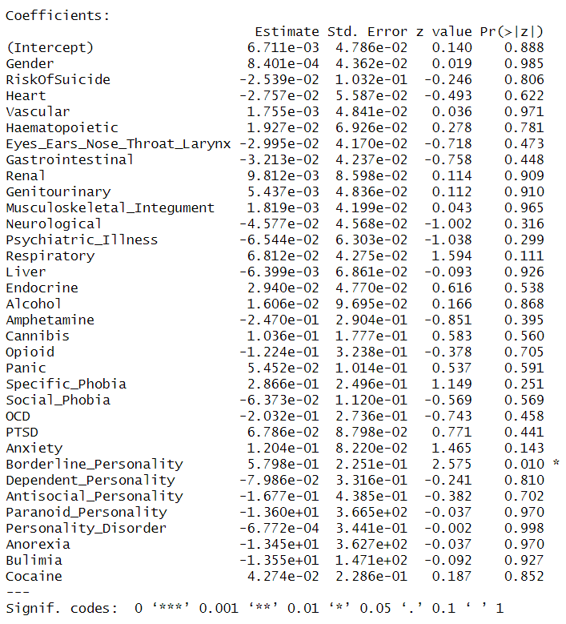
Step 4: Assess propensity score
The weighted regression removes the effects of all covariates on treatment

Slide 20
Steps in propensity score matching
Step 1: Select and list the covariates/variables
Step 2: Create propensity score
Step 3: Inverse probability of treatment weighting
Step 4: Assess propensity score
Step 5: Create graphical presentation
Step 6: Outcome analysis with matched data

Slide 21
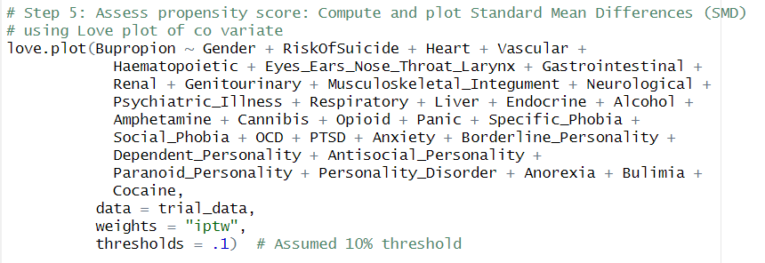
Step 5: Create graphical presentation
Graphical presentation showing that the data have been balanced

Slide 22
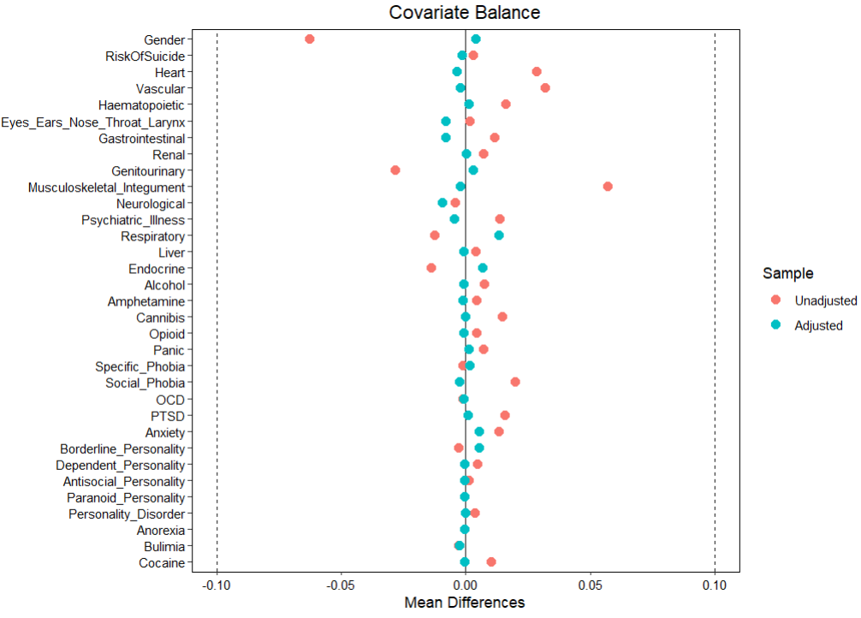
There is still an attribute that has statistically significant impact on use of Bupropion antidepressant, even after applying propensity scores.

Slide 23
Steps in propensity score matching
Step 1: Select and list the covariates/variables
Step 2: Create propensity score
Step 3: Inverse probability of treatment weighting
Step 4: Assess propensity score
Step 5: Create graphical presentation
Step 6: Outcome analysis with matched data

Slide 24
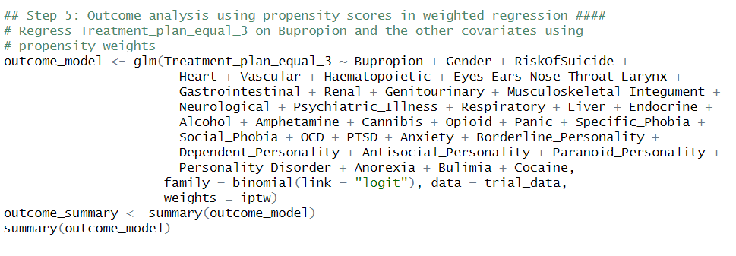
Step 6: Outcome analysis with matched data
Weighted regression of remission rates on various covariates/variables and use of antidepressant
- Dependent variable: Remission rates
- Independent variable: Use of Buspirone antidepressant

Slide 25
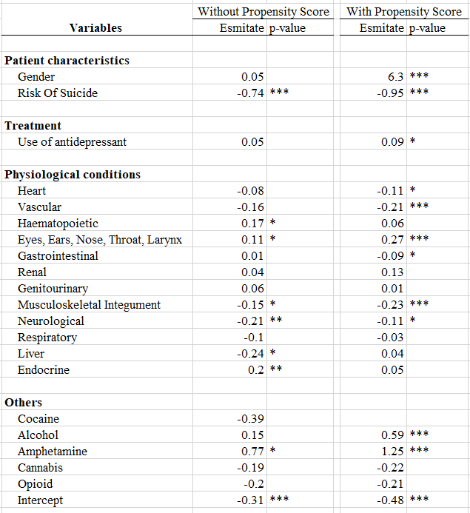
Step 6: Outcome analysis with matched data
Before balancing vs after balancing with propensity score: changed the impact
There is a statistically significant relationship between Treatment (Use of Buspirone antidepressant) on Outcome: Remission rate of depressive symptoms, after balancing the effect of covariates

Slide 26
Final remarks
Can we calculate propensity score if we have missing values for treatment and outcome?
- Drop those observations with missing values, cleaning is important before analysis
If we have more that two treatment groups, can we calculate propensity score?
- Of course, with a multinomial regression

Slide 27
References
Austin PC. A tutorial and case study in propensity score analysis: an application to estimating the effect of in-hospital smoking cessation counseling on mortality. Multivariate behavioral research. 2011 Feb 7;46(1):119-51.
Alemi F. Big Data in Healthcare: Statistical Analysis of the Electronic Health Record. Health Administration Press; 2020.

