Slide 1
Logistic Regression Q3

Slide 2
What is the probability of patients being seen by Dr. Smith?
Probability of Patients being seen by Dr. Smith is 0.6019

Slide 3
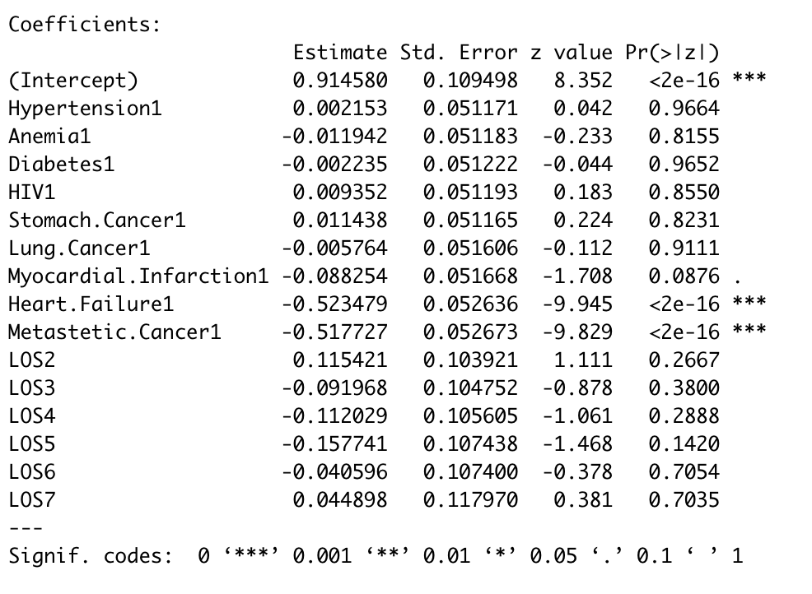
Regress the choice of provider on the 9 diagnoses provided.
Heart Failure1 and Metastetic Cancer1
are the most significant values.
Estimate value is negative value, which indicates
that as the value increases, the probability that
Dr. Smith diagnosis decreases.

