Slide 1
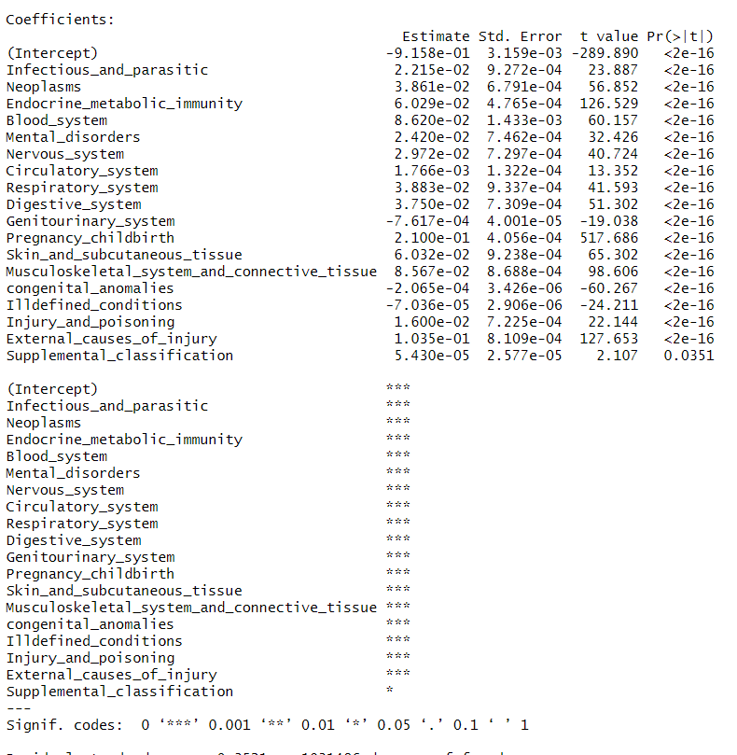
Replace missing values with multiple imputations
Percent of variation explained after multiple imputations: 31.62 %

Slide 2
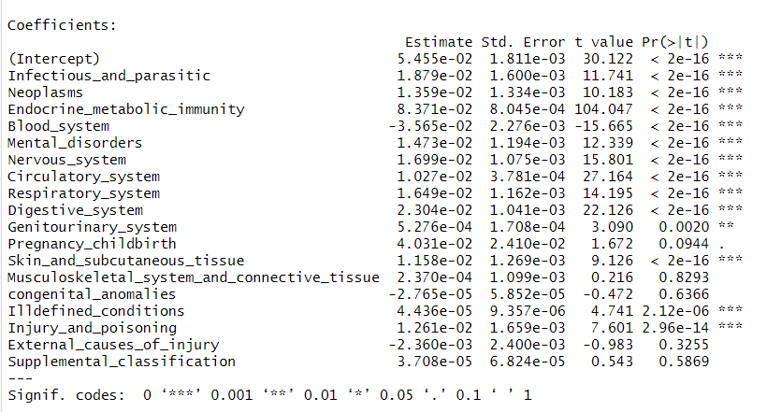
Replace missing values with 0
Percent of variation explained after replacing missing independent variables with 0: 8.85 %

Slide 3
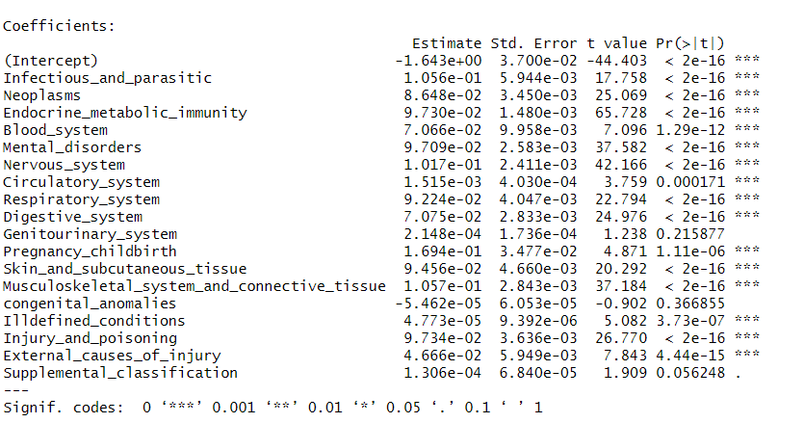
Replace missing values with mean
Percent of variation explained after replacing missing independent variables with mean: 8.47 %

