Slide 1
Multi-level Regression
Mohammed Alshammari
HAP 819
GeorgeMason University

Slide 2
What is Multi-Level Regression?
Statistical method for nested data structures.
Separates individual-level and group-level variations.
Useful for analyzing patients within hospitals.
Limitations of standard regression models.
Benefits of multi-level regression: accommodates nested data, handles variability at multiple levels, and provides more accurate estimates.
Notes:
Multi-level regression, also known as hierarchical linear modeling, is an advanced statistical technique. It's particularly useful when our data has a nested or hierarchical structure. In healthcare, for instance, patients might be nested within different hospitals or, as in our case, under different providers. This method allows me to account for variability at multiple levels, ensuring more accurate insights. Standard regression models can fall short when we have grouped data. By ignoring the hierarchical nature, we might end up with biased or inaccurate estimates. Multi-level regression, on the other hand, captures the intrinsic variability at each data level. In our analysis, this means understanding not just how medical conditions influence length of stay, but also how different providers might have varying baseline lengths of stay.

Slide 3
Data and Scenario
Overview of the dataset:
patient-level factors:
Severe Burn (binary: 1 for presence, 0 for absence)
Head Injury (binary: 1 for presence, 0 for absence)
Age 65+ (binary: 1 for 65 years or older, 0 for younger)
Gender (binary: 1 for male, 0 for female)
provider type (Hospital type):
The dataset classifies hospitals based on whether they are a Tertiary Center and whether they have a Burn Unit.
Goal:
Assess the odds of survival for trauma victims at different hospitals while controlling for patient-level factors.
Investigate how different hospital features (being a tertiary center and having a burn unit) impact the survival odds.
Notes:
I use question 1 to teach multilevel regression. The question is “Using multi-level modeling, calculate the expected length of stay for the clinician and peer group, after removing the effects of previous Myocardial Infarction (MI) and Congestive Heart Failure (CHF). Compare the performance of the clinician to the peer provider using the intercepts estimated for each group”. We are also provided the dataset for the question.

Slide 4
Notes:
The primary question I aimed to answer was: What's the expected length of stay for a clinician and their peer group, after adjusting for the presence of previous medical conditions like MI and CHF? To answer this, I used the dataset we saw in last slide, which captures patient conditions, length of stay, and provider type.

Slide 5
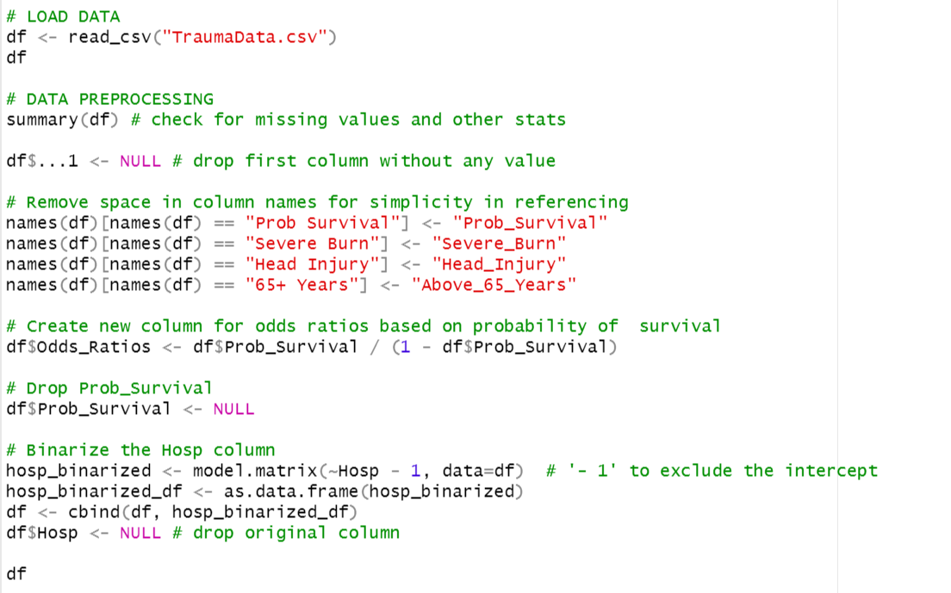
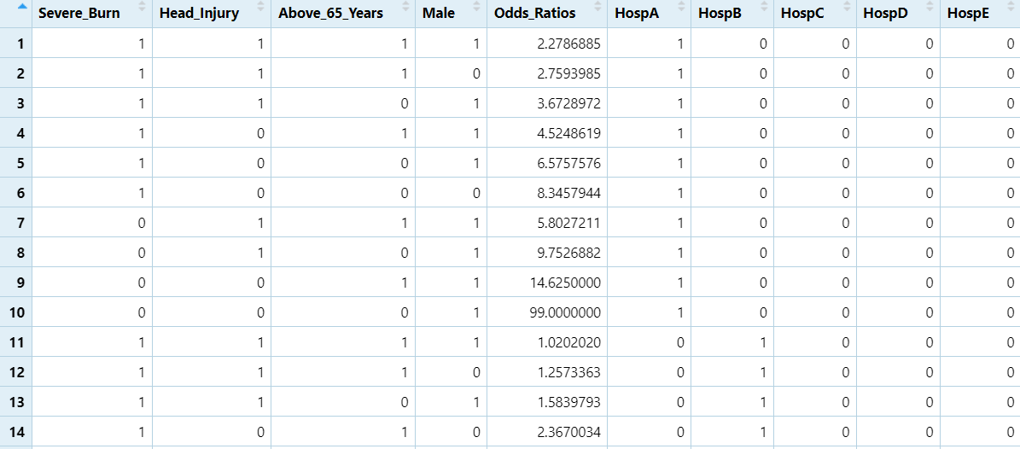
R Analysis
Paste data into a CSV
Import data into R.
Data Preprocessing:
First column, A, is dropped.
Spaces from column names are removed
New column – Odds_Ratios is created based on the probability of survival. This column represents the odds of survival for each patient.
Prob_Survival column is dropped.
Hosp column is binarized for each hospital.
Notes:
In this slide, I provide an overview of my methodology. I took a structured approach to ensure accuracy and clarity. I began by pasting the required data into a CSV file. This format ensures easy and consistent data handling, especially in R. Once our dataset was ready, I imported it into R. R is a powerful statistical programming language. With the data in R, I used the glm function to run a logistic regression. This method allows us to predict a binary outcome, like survival, based on one or multiple predictor variables. After fitting the model, I specifically extracted the intercepts. These values provide us with meaningful insights, showing the expected outcome when all predictor variables are zero.

Slide 6
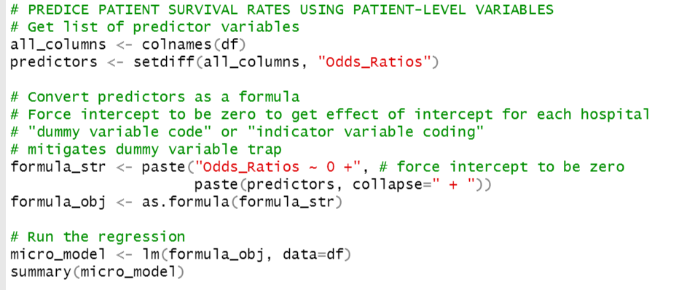
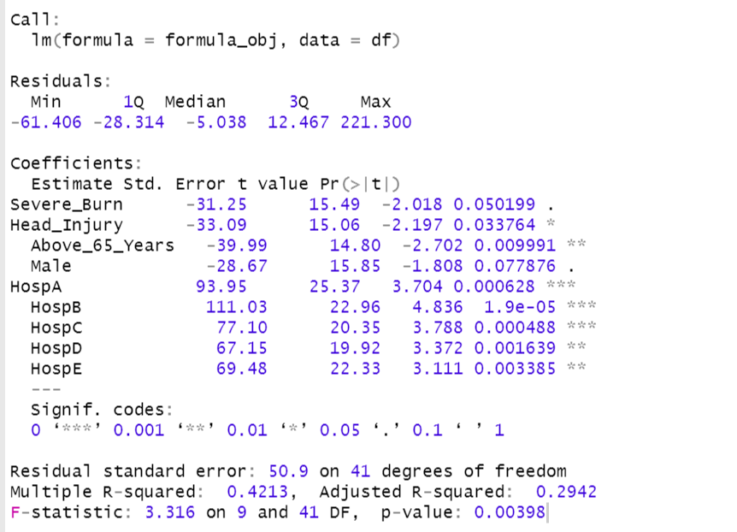
Predicting Patient Survival Rates Using Patient-level Variables
A linear regression model (micro_model) is fit with Odds_Ratios as the dependent variable and all other columns (excluding Odds_Ratios) as predictors.
This model aims to predict patient survival rates based on patient-level variables.
Notes:
The snapshot of my R script shows the R code. Top of FormThe script has every step, from data preprocessing to the final interpretation. I began by installing and loading the lme4 package, essential for multi-level modeling in R. I used the read.csv function to load our dataset named 'Q3.csv'. Recognizing the structure of our dataset, I segregated it based on the provider type into clinician_data and peer_data. The two datasets were then combined into a unified dataset named combined_data. A crucial cleaning step was replacing the special character in the 'CHF' column to ensure its consistency. For analysis, I transformed the categorical variables PreviousMI and CHF into numeric forms, with '1' indicating presence and '0' indicating absence. The LengthOfStay was also converted to a numeric type for the modeling process. For multilevel regression model, I used lmer function, which I used to fit our multi-level regression model. The response variable, LengthOfStay, was predicted based on the presence of PreviousMI and CHF, while accounting for the variability across the two provider types. I then displayed the summary of our model using the summary function, offering insights into the fixed and random effects. Intercepts for the two provider types were extracted to understand the expected length of stay for each, after adjusting for the medical conditions.

Slide 7
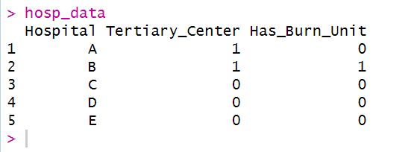
Regressing Unexplained Variation in Survival on Hospital Features
A new dataset hosp_data is created, which contains features for each hospital:
Tertiary_Center: Whether the hospital is a tertiary center (1 for yes, 0 for no).
Has_Burn_Unit: Whether the hospital has a burn unit (1 for yes, 0 for no).
Notes:
Here is a snapshot of the processed dataset, saved as combined dataset in my R script. As you can see, it combines information on medical conditions, length of stay, and the provider type. The 'PreviousMI' and 'CHF' columns are now encoded as 1 indicating the presence of the condition and 0 indicating its absence."

Slide 8
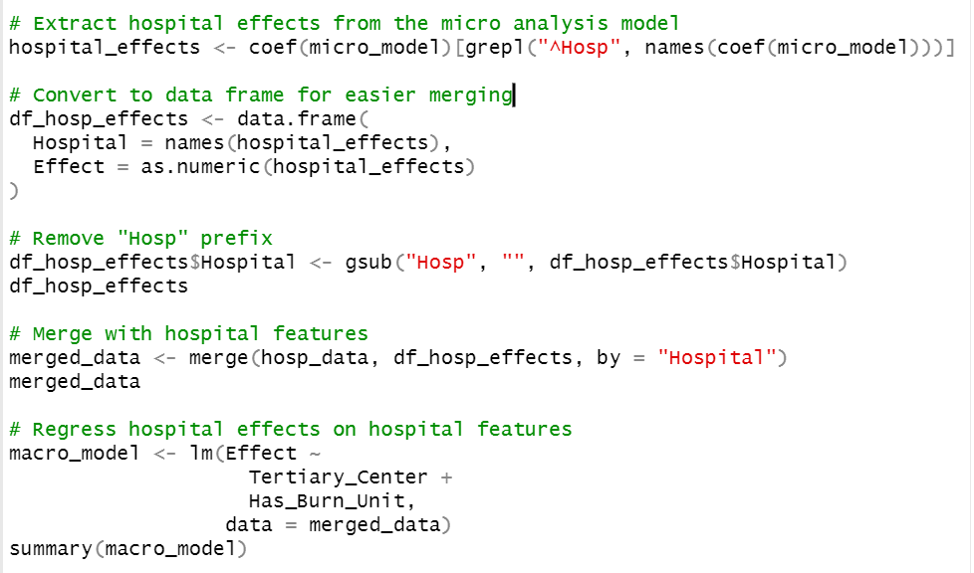
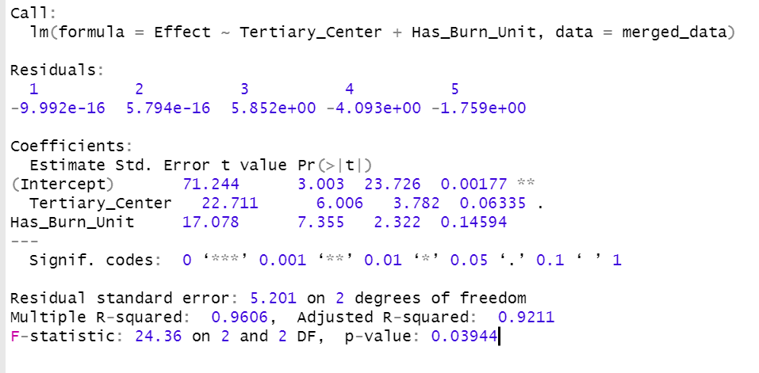
Association of Hospital Features with Variations in Trauma Survival Odds
The hospital-specific effects from the micro_model are extracted.
These effects are then merged with the hosp_data dataset.
Another linear regression model (macro_model) is fit using the hospital effects as the dependent variable and the hospital features (Tertiary_Center and Has_Burn_Unit) as predictors.
Notes:
This section shows the variability in our data. The ProviderType with a variance of 0.27033 indicates the variability in the average length of stay across the two provider types, that is, Clinician and Peer Provider. The standard deviation is the square root of this variance, which is 0.5199. This means there's a variability of about 0.52 days in the average length of stay between the two provider types. The Residual variance of 0.04286 captures the variability within each provider type, i.e., variability in lengths of stay among patients treated by the same provider type.
In the fixed effects section, the estimated intercept of 3.29682 represents the average length of stay when both PreviousMI and CHF are 0. Given how we encoded the variables, this would mean the average length of stay for patients without a previous MI and without CHF. For PreviousMI, the estimate of 1.29611 indicates that, on average, having a previous MI increases the length of stay by approximately 1.3 days. For CHF, the estimate of 0.90355 suggests that having CHF increases the length of stay by approximately 0.9 days.
The section Correlation of Fixed Effects shows how the predictor variables are related. The correlation between PreviousMI and the intercept is -0.134, and the correlation between CHF and the intercept is -0.150. The correlation between PreviousMI and CHF is 0.048. These values indicate that there's a slight negative correlation between having these conditions and the baseline length of stay, but the correlation is very weak.
The intercepts represent the average length of stay for each provider type after adjusting for medical conditions. For the Clinician, it's approximately 3.6629 days, and for the Peer Provider, it's 2.9307 days. This suggests that, on average and after adjusting for medical conditions, patients under the Clinician have a slightly longer length of stay compared to those under the Peer Provider by about 0.73 days.

Slide 9
Results
a. From the micro_model, the coefficients provide insights into the odds of survival for patients treated at different hospitals while controlling for specific patient-level variables:
Severe_Burn: The coefficient for the presence of a severe burn is -31.25. This indicates that, holding other variables constant, having a severe burn is associated with a decrease in the odds ratio of survival by approximately 31.25 units compared to not having a severe burn. This effect is statistically significant with a p-value of 0.0502.
Head_Injury: The coefficient for the presence of a head injury is -33.09. This suggests that the presence of a head injury, all else being equal, decreases the odds ratio of survival by roughly 33.09 units. This effect is statistically significant with a p-value of 0.0338.
Above_65_Years: The coefficient for patients who are 65 years or older is -39.99. This implies that being 65 or older is associated with a decrease in the odds ratio of survival by about 40 units compared to those younger than 65. This effect is statistically significant with a p-value of 0.00999.
Male: The coefficient for the male gender is -28.67. This suggests that being male, when other variables are held constant, reduces the odds ratio of survival by approximately 28.67 units compared to being female. The effect is marginally significant with a p-value of 0.0779.
Hospital Intercepts: The intercepts for the hospitals represent the baseline odds of survival at each hospital, after adjusting for the patient-level variables:
HospA (Tertiary Center): The intercept is 93.95, indicating the baseline odds of survival at Hospital A. This effect is statistically significant with a p-value < 0.001.
HospB (Tertiary Center with Burn Unit): The intercept is 111.03, suggesting the highest baseline odds of survival among the hospitals listed. This is statistically significant with a p-value < 0.001.
HospC: The intercept is 77.10, indicating the baseline odds of survival at Hospital C. This effect is statistically significant with a p-value < 0.001.
HospD: The intercept is 67.15, representing the baseline odds of survival at Hospital D. This is statistically significant with a p-value of 0.0016.
HospE: The intercept is 69.48, suggesting the baseline odds of survival at Hospital E. This effect is statistically significant with a p-value of 0.0034
Notes:
The intercepts represent the expected length of stay for both the clinician and the peer provider, after adjusting for medical conditions. A higher value indicates a longer expected stay. From our results, it's evident that the clinician has a slightly longer expected length of stay compared to the peer provider. This could be attributed to various factors such as patient severity, provider experience, or even facility resources. We looked at how long patients stay in care based on who treats them and their medical issues. We found that patients treated by doctors stay about 0.73 days longer than those treated by peer providers. This small difference can mean a lot in a hospital setting. It can affect things like how many beds are available or how resources are used.

Slide 10
Results
c. The two regressions provide a comprehensive view of factors influencing trauma survival odds. The micro model identifies how individual patient characteristics and the specific hospitals where they were treated influence survival odds. In contrast, the macro model goes deeper into the hospital-specific effects, investigating how certain hospital features impact these odds.
The two models suggest that both patient-level factors and hospital characteristics play crucial roles in determining trauma survival odds. Specifically, tertiary medical centers has better odds of survival, and among the hospitals listed, Hospital B, a tertiary center with a burn unit, has highest odds of survival.

