Slide 1
HAP819 Logistic Regression
Sravya Vunnam (G01347220)
Teach one

Slide 2
Logistic Regression
Why choose Logistic regression?
When predicted values of dependent variable with the given values of independent variables is >1, the probabilities become invalid as probability is not </=1.
For this reason, a log of odds ratio is calculated through logistic regression to predict probability of the event.

Slide 3
Assignment (Q1.1)
In the following, calculate predicted value of a logistic regression using the following formula:
Regress the classification labels in the training set on the words, pair of consecutive words, and triplets of consecutive words in the target sentence: "He loves his patients and I can tell it's about us and not the money." Use the predicted probability of complaint to classify the target sentence. Values above 0.5 should be classified as complaints.

Slide 4
Dataset explanation:

Slide 5
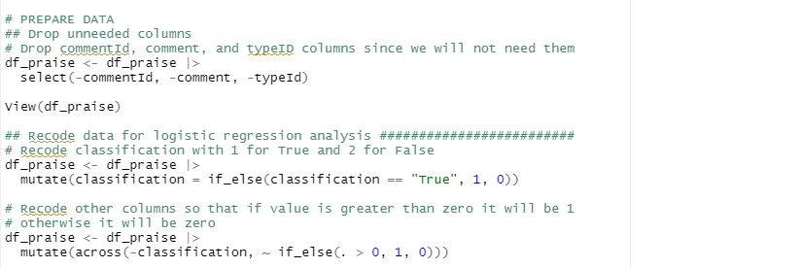
Preparing the data:
Remove columns we do not need (commentID, Comment, typeId).
The classification column is binarized as 1(True) & 0(False)

Slide 6
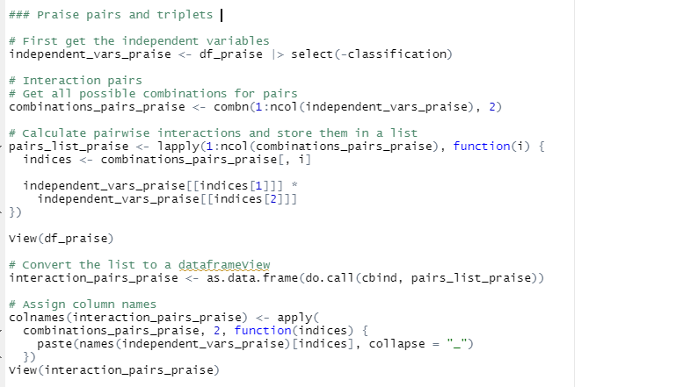
Creating pair of consecutive words, and triplets of consecutive words in the target “He loves his patients, and I can tell it's about us and not the money” sentence
Here independent variable is Classification
We make pairwise interaction of the remaining columns
Repeat the same to create triplets interactions.
The using Rbind we attach these to the original data frame to get the data frame.

Slide 7
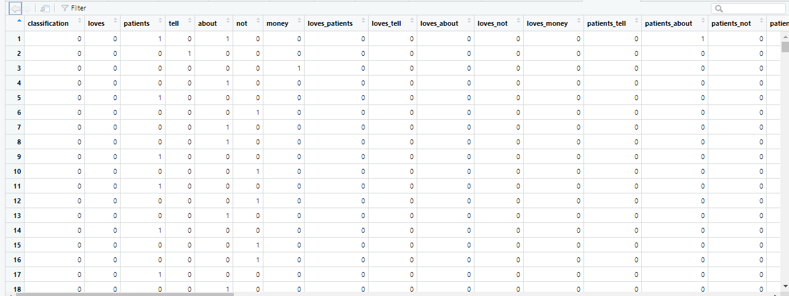
Data frame used for regression:

Slide 8
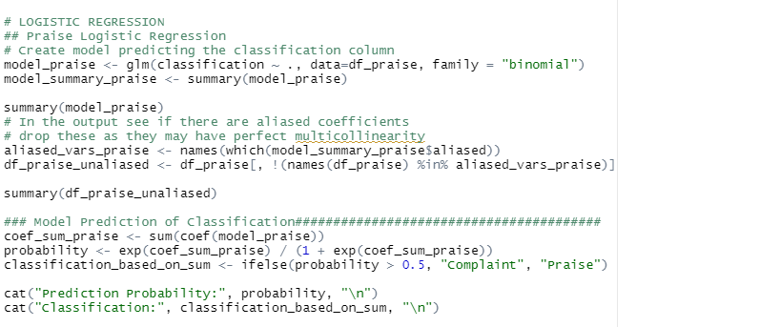
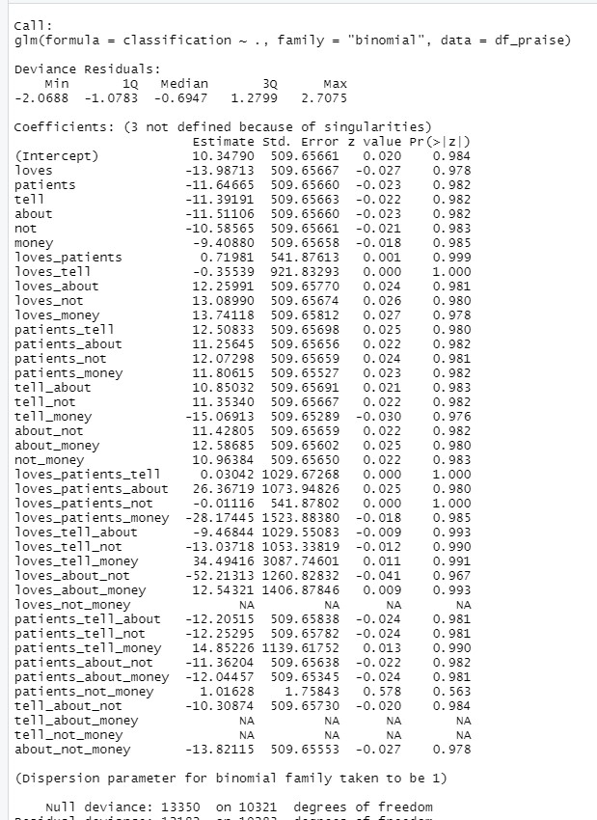
Regression Model for praise dataset:
When we run the model, we see that loves_not_money, tell_about_not, tell_not_money are N/A due to multi collaterality, 23 remove them
Aliased coefficients which should be removed

Slide 9
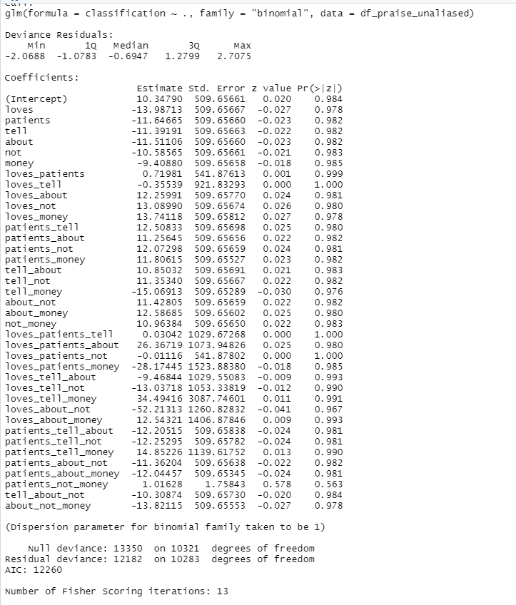
Unaliased dataset:
We run regression with unaliased dataset.
We remove loves_not_money, tell_about_not, tell_not_money from the model.
We run the model to see:

Slide 10
McFadded R-squared: 1−LLmod/LL0, where LLmod is the log likelihood value for the fitted model and LL0 is the log likelihood for the null model

Slide 11
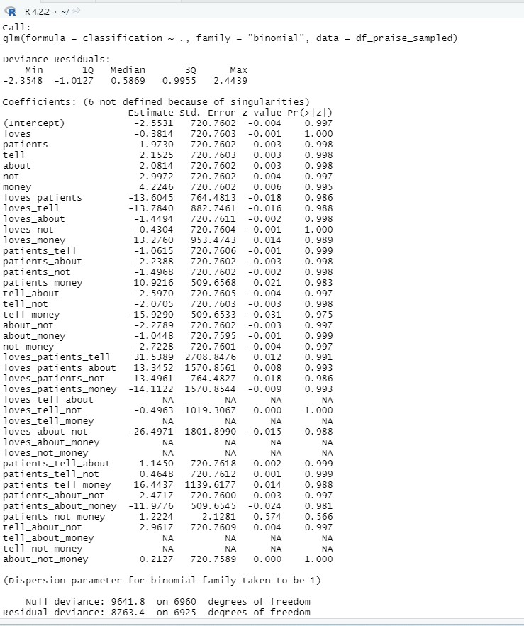
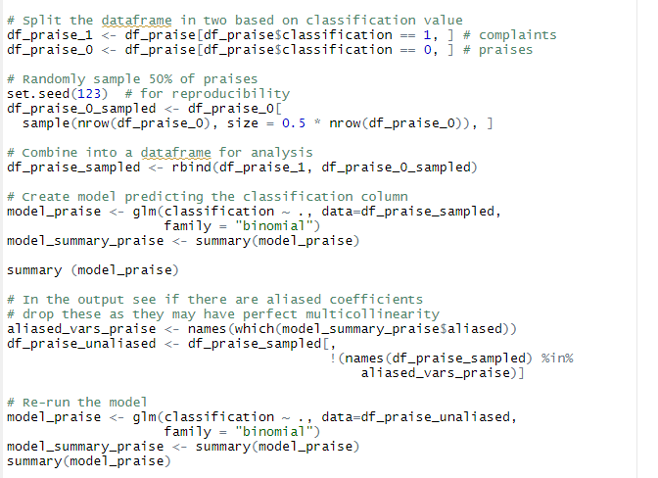
1.3: Repeat the analysis but this time include all of the complaints and 50% random sample of praises in the training data set. How did the sampling procedure affect the McFadden R-square

Slide 12
The prediction probability for the model with 50% praise is 0.98 , so the model is correct

Slide 13
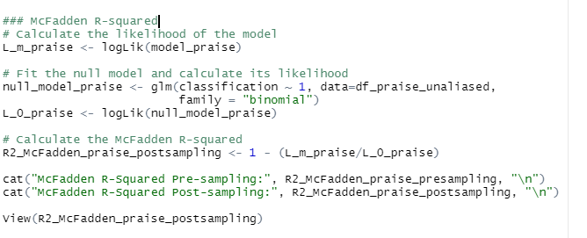
McFadded Rsquared Value:
McFadded Rsquared value increased from pre sampling to post sampling from 0.088 to 0.091

