Slide 1
Missing Values
Farrokh Alemi, Ph.D.
Notes:
This presentation reviews treatment of missing values in regression analysis. This brief presentation was organized by Dr. Alemi.

Slide 2
Purpose of Missing Values
Notes:
When a value is missing, typically the case cannot be processed by regression methods that require full matrix format data. The purpose of missing values is to replace the missing value with an estimated value that improves the accuracy of the fit of the model to the data

Slide 3
Variables: Missing at
Random
Notes:
If information is missing at random, there are less concerns about how the missing variable is treated.

Slide 4
Variables: Not Missing at
Random
Notes:
Often variables are not missing at random. What can be done in these situations is a lot more complex.

Slide 5
BP in ER increase risk of
mortality (e.g., Shock, Arrest)
Notes:
Why would missing BP in ER indicate increased risk of mortality?

Slide 6
Not Missing at Random
Why would missing BP in ER
increase risk of mortality?
Notes:
Why would missing BP in ER indicate increased risk of mortality?

Slide 7
How would you estimate
missing values? What are
your ideas or what you have
seen in literature?
Notes:
Why would missing BP in ER indicate increased risk of mortality?

Slide 8
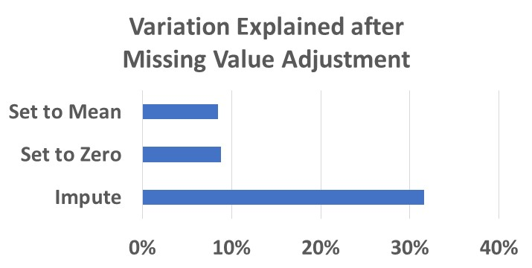

Slide 9
Pattern of Missingness
Create Indicators
Set missing values to 0
Regress on indicators
Adjust regression by using indicators
Use combination of indicators to adjust for pattern

Slide 10
Question 1 Demo of Reasoning through Patterns of Missing Values: Regress incidence of diabetes on all other variables indicating progression of diseases in body systems. Data Download► Dictionary►

Slide 11
Set to 1 when X is missing and 0, otherwise. Regress Y on binary Xs.

Slide 12
Singularity means that X is always absent or always present.

Slide 13
Statistically significant indicators means not missing at random

Slide 14
Infection
Age
Infection
Blood
Cancers
Other
Gender
Cardiovascular
Hormones
Social

Slide 15
Combinations of indicators show patterns of missing
Infection
Age
Infection
Blood
Cancers
Other
Gender
Cardiovascular
Hormones
Social

Slide 16
5.65% of variation of diabetes explained by missing information

Slide 17
Patterns of missing information is informative
Notes:
To use ordinary regression, verify assumptions, transform data, then interpret the results.

