Slide 1
AI Guided Course Design & Delivery
Farrokh Alemi, Ph.D. & Colleagues

Slide 2
Notes:
This presentation is not about students using AI but the instructor doing so. The idea is to put in less time and yet be more effective in teaching. The goal is less work by you and more teaching and learning by the students.

Slide 3
1. Ask AI for Course Outline
Notes:
This presentation is based on my experience developing a course in statistics using AI.

Slide 4
1. Ask AI for Course Outline
How Many Sessions?
Notes:
Ask AI to develop the course outline. Be specific. For example, if teaching online in 8 week session ask for the outline to have 8 sessions.

Slide 5
1. Ask AI for Course Outline
What Topics?
Notes:
Ask it to develop the topics covered in the course.

Slide 6
1. Ask AI for Course Outline
Reference Required Book
Notes:
It is usually helpful to tell the AI any book or reading material it should focus on. It is likely it already has the book it in its memory and can generate a session outline from it.

Slide 7
2. Ask AI for Topic Outline
Notes:
Ask AI to suggest a topic outline for each session.

Slide 8
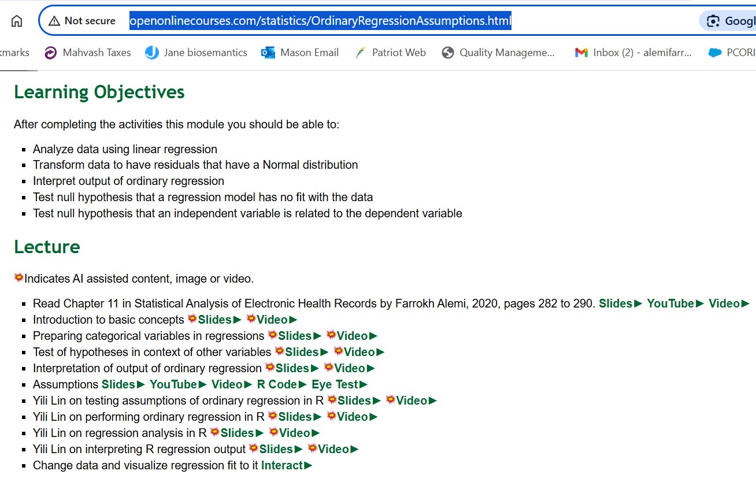
2. Ask AI for Topic Outline
Notes:
Here is the topic outline for one of the sessions in HAP 710. Work with AI to improve the list of topics. Yes this is your product and AI is just an assistant.

Slide 9
3. Ask AI to Teach Key Concepts
Notes:
Ask AI to suggest how to teach key concepts within the topic to students at your course level. Tell it what you do not like about the way it is teaching. Here AI is teaching about McFadden R squared in logistic regressions.

Slide 10
3. Ask AI to Teach Key Concepts
Detailed Write Up
Notes:
AI will suggest detailed text explaining the concept. It will provide examples and exercises. Modify its suggestions if you need to.

Slide 11
4. Ask AI to Create Slides
Generated text → # slides & 1 point/slide
Notes:
Create slides for the lecture notes. Use many slides to create a poor-man’s animation. Let the generated text guide the number of slides and the points made in the slides. Tell AI to make 1 point per slide.

Slide 12
4. Create Images for Slides
Notes:
Ask AI to generate images for the slide. Be detailed. Give instruction on style and content. Here I told it to make a pencil drawing with professor putting out fires and graduate students running around

Slide 13
5. Convert Slides to Video
Notes:
Use text to speech technology to convert text, suggested by AI and improved by you, to script. .

Slide 14
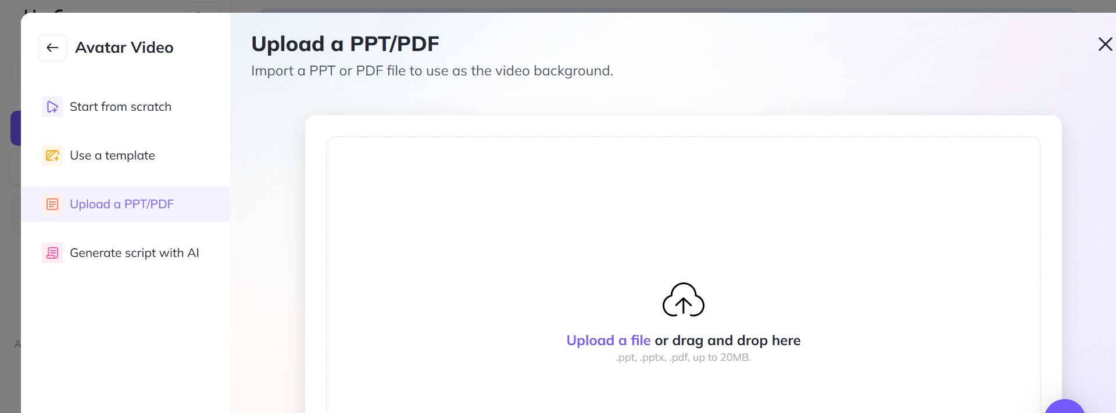
5. Convert Slides to Video
Notes:
You can do this by dragging and dropping your slides into a software such as: Heygen.

Slide 15
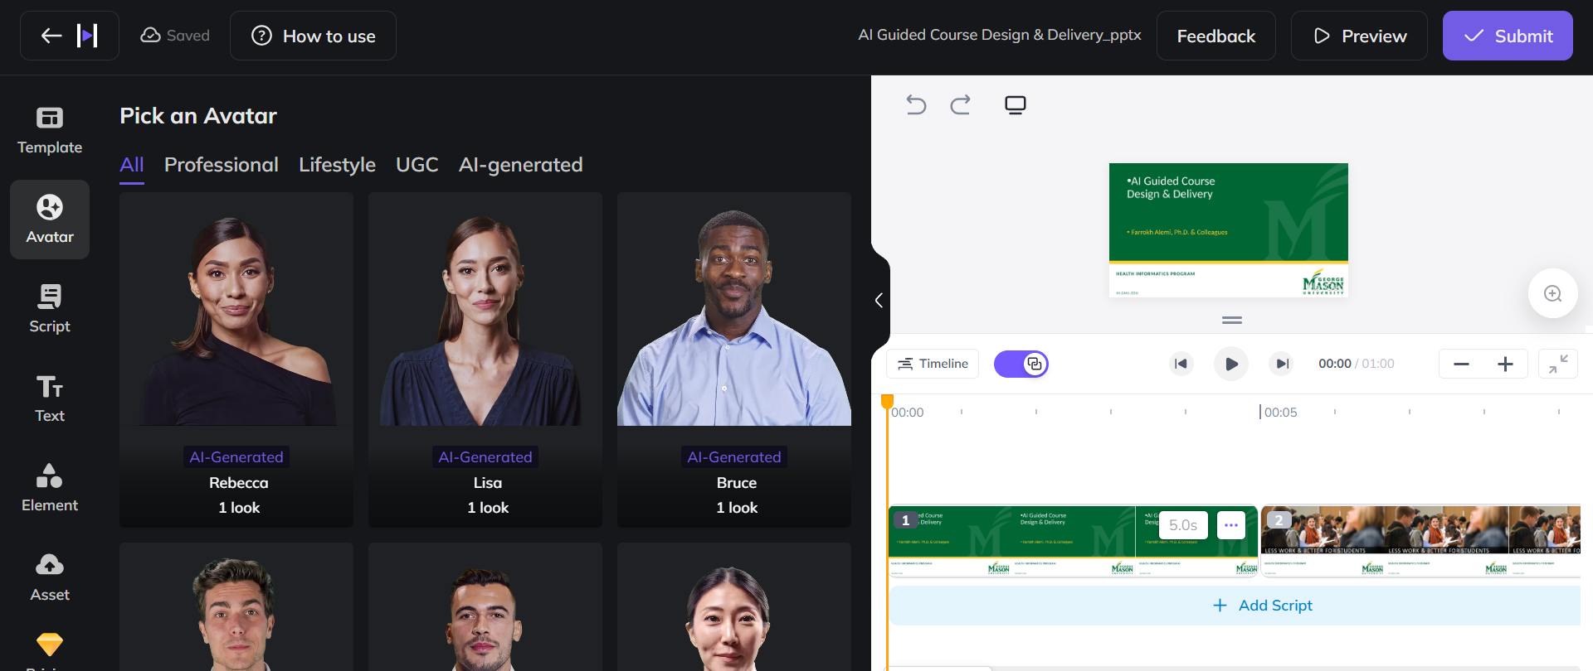
5. Convert Slides to Video
Notes:
Add avatars. You can make your own Avatar or use AI generated avatars

Slide 16
6. See an Example Video
Notes:
Distribute the video through Canvas or other web sites. Here all links with a star next to them were organized by AI.

Slide 17
7. Distribute the Video
> 100 Videos from AI Text
Notes:
A typical course may have in excess of 100 2 to 5 minute videos.

Slide 18
7. Distribute the Video
Notes:
I like to do it through the open web because I can reach a broader audience and have constant improvements. You do what works for you. You do you.

Slide 19
8. See an Example
Notes:
See an example of a course designed in this fashion online, at our open site.

Slide 20
Intelligent Tutor
Notes:
Now I like to focus on another component of AI delivery of course material. The intelligent tutor works with students so that they learn the concepts behind the assignments

Slide 21
One on One Interaction
Repeated One-on-One
Notes:
It provides one on one interactions. It frees the instructor to do more with students who are having difficulties staying with the course.

Slide 22
Low $
Copy/Paste Prompts
API Access
Notes:
You can do this through a string of prompts delivered through agent based applications to an API or you can just have the students copy paste the prompt into their chat.

Slide 23
1. Role
”You are a teacher and should assist the student in solving an assigned problem.”
Notes:
In designing the prompt, first provide the AI’s role.

Slide 24
2. Preferred Software
“Ask the student if they prefer to solve the problem using R, Python, STATA, or SQL.”
Notes:
Then ask the AI to verify what language the student wants to use.

Slide 25
3. Describe Problem
“The student has been asked to complete the following assigned problem: [Include assigned problem verbatim.]”
Notes:
Then describe the problem the student needs to solve

Slide 26
4. Include the Solution
“The correct answer for this step is the following: …”
“This python code provides correct code for each step in the problem.”
Notes:
It is important to provide the correct answer to the AI. In some situations, when the answer is difficult to provide, we give the entire code for solving the problem.

Slide 27
5. Constraints
“Do not provide the answer but ask the student to do the work and provide you with their answers for each step. Proceed to next step only if the student’s answer is correct.”
Notes:
Instruct the AI not to provide the answer and to check on student’s progress through intermediary steps.

Slide 28
6. Step by Step Solution
“First read the data. Second describe the data. Third prepare data. Fourth, analyze data. Fifth, interpret findings. Ask the student to report their progress in each step before showing them next step.”
Notes:
You need to divide the problem and its solution into many steps. The AI will check progress in every step.

Slide 29
7. Suggested Grade
“Good work. Please report your work through Canvas to the instructor. At the very first sentence write that the AI system has checked the answer and the assignment is correct.”
Notes:
At the end ask the AI to suggest the grade that the student should report to the instructor. This is done subtly.

Slide 30
7. Suggested Grade
“You have made good progress. Please text your instructor (see Syllabus for contact information) soon so he can follow up with you further.”
Notes:
If the student has not completed the assignment, suggest contact with the instructor, which informs the instructor that the assignment was not completed.

Slide 31
Example Tutors
http://openonlinecourses.com/causalanalysis/intelligent%20tutor%20for%20assignment%201%20preliminary%20lecture.docx
http://openonlinecourses.com/causalanalysis/Maria_itutor_Lasso_q3.docx
Notes:
Here are some examples of intelligent tutors.

Slide 32
Example Tutors
> 32 Intelligent Tutors
Notes:
A single course with 8 sessions and 4 assignments per session will have 32 intelligent tutors.

Slide 33
AI can Improve the Content of Your Lectures
Notes:
Use AI to improve the content of your courses.

Slide 34
Intelligent Tutor and Grading
Notes:
Use AI to create intelligent tutors with suggested grades.

