Slide 1
AI Guided Course Design & Delivery
Farrokh Alemi, Ph.D. & Colleagues
Notes:
I am an Avatar designed by Dr. Alemi and colleagues to describe how AI can help you design course content and delivery course material efficiently.

Slide 2
Notes:
This presentation is not about students using AI but the instructor doing so. The idea is to put in less time and yet be more effective in teaching. The goal is less work by you and more teaching and learning by the students.

Slide 3
AI-Guided Video Lectures
Notes:
This video focusses on course design. Other related videos focus on intelligent tutor and grading.

Slide 4
1. Ask AI for Course Outline
Notes:
Ask AI to use your required textbook and suggest the course outline. There are lots of videos online on how to do this.

Slide 5
1. Ask AI for Course Outline
How Many Sessions?
Notes:
Be specific. For example, if teaching online in 8 week session ask for the outline to have 8 sessions.

Slide 6
1. Ask AI for Course Outline
What Topics?
Notes:
Be specific. For example, if teaching online in 8 week session ask for the outline to have 8 sessions.

Slide 7
1. Ask AI for Course Outline
Reference Required Book
Notes:
Reference your required book. It is likely it already has it in its memory and can generate a session outline that fits it.

Slide 8
2. Ask AI for Topic Outline
Notes:
Ask AI to suggest a topic outline for each session. Work with AI to improve it. Yes this is your product and AI is just an assistant.

Slide 9
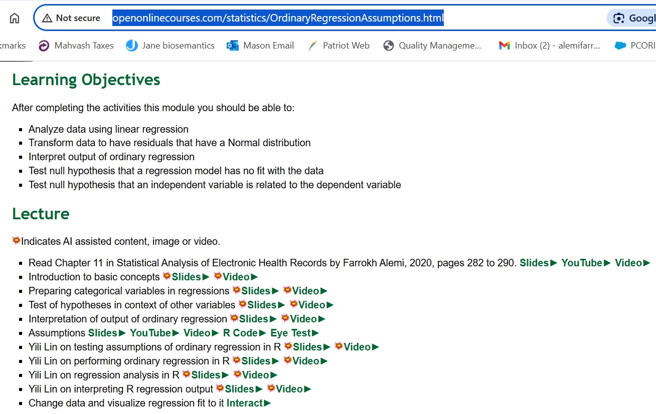
2. Ask AI for Topic Outline
Notes:
Ask AI to suggest a topic outline for each session. Work with AI to improve it. Yes this is your product and AI is just an assistant.

Slide 10
3. Ask AI to Teach Key Concepts
Notes:
Ask AI to suggest how to teach key concepts within the topic to students at your course level. Tell it what you do not like about the way it is teaching.

Slide 11
3. Ask AI to Teach Key Concepts
Detailed Write Up
Notes:
It will suggest detailed text on the concept with examples and exercises. Modify its suggestions if you need to.

Slide 12
4. Create Slides
Generated text → # slides & 1 point/slide
Notes:
Create slides for your lecture. Stay brief. Use many slides to create a flow. Let the generated text guide the number of slides and the points made in the slides.

Slide 13
4. Create Images for Slides
Notes:
Ask AI to generate images for the slide. Be detailed. Give instruction on style and content. Here I told it to make a pencil drawing with professor putting out fires and graduate students running around

Slide 14
5. Convert Slides to Video
Notes:
Use text to speech technology to convert text, suggested by AI and improved by you, to script. .

Slide 15
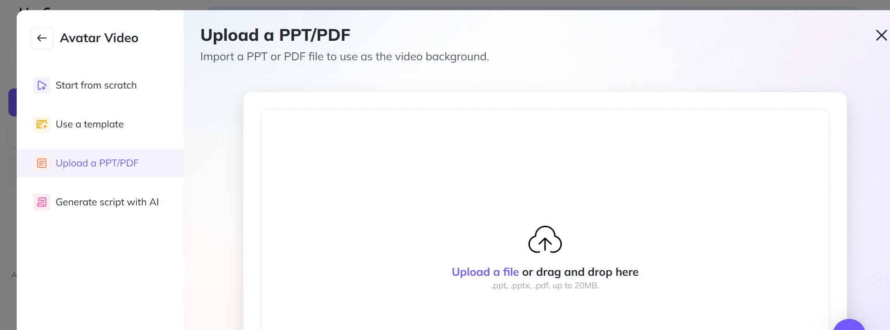
5. Convert Slides to Video
Notes:
You can do this by dragging and dropping your slides into a software such as: Heygen.

Slide 16
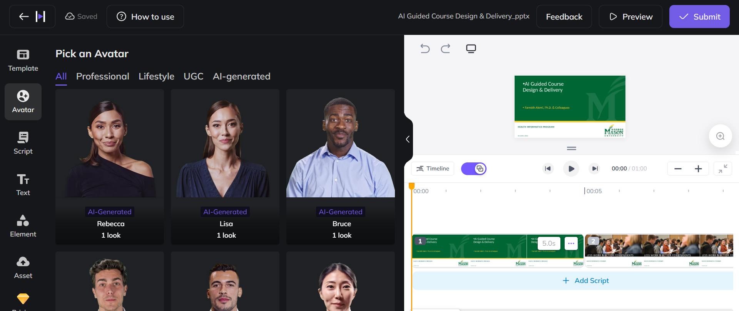
5. Convert Slides to Video
Notes:
Add avatars to convert text to speech. You can make your own Avatar or use AI generated avatars

Slide 17
6. See an Example Video
Notes:
Distribute the video through Canvas or other web sites.

Slide 18
7. Distribute the Video
> 100 Videos from AI Text
Notes:
Distribute the video through Canvas or other web sites.

Slide 19
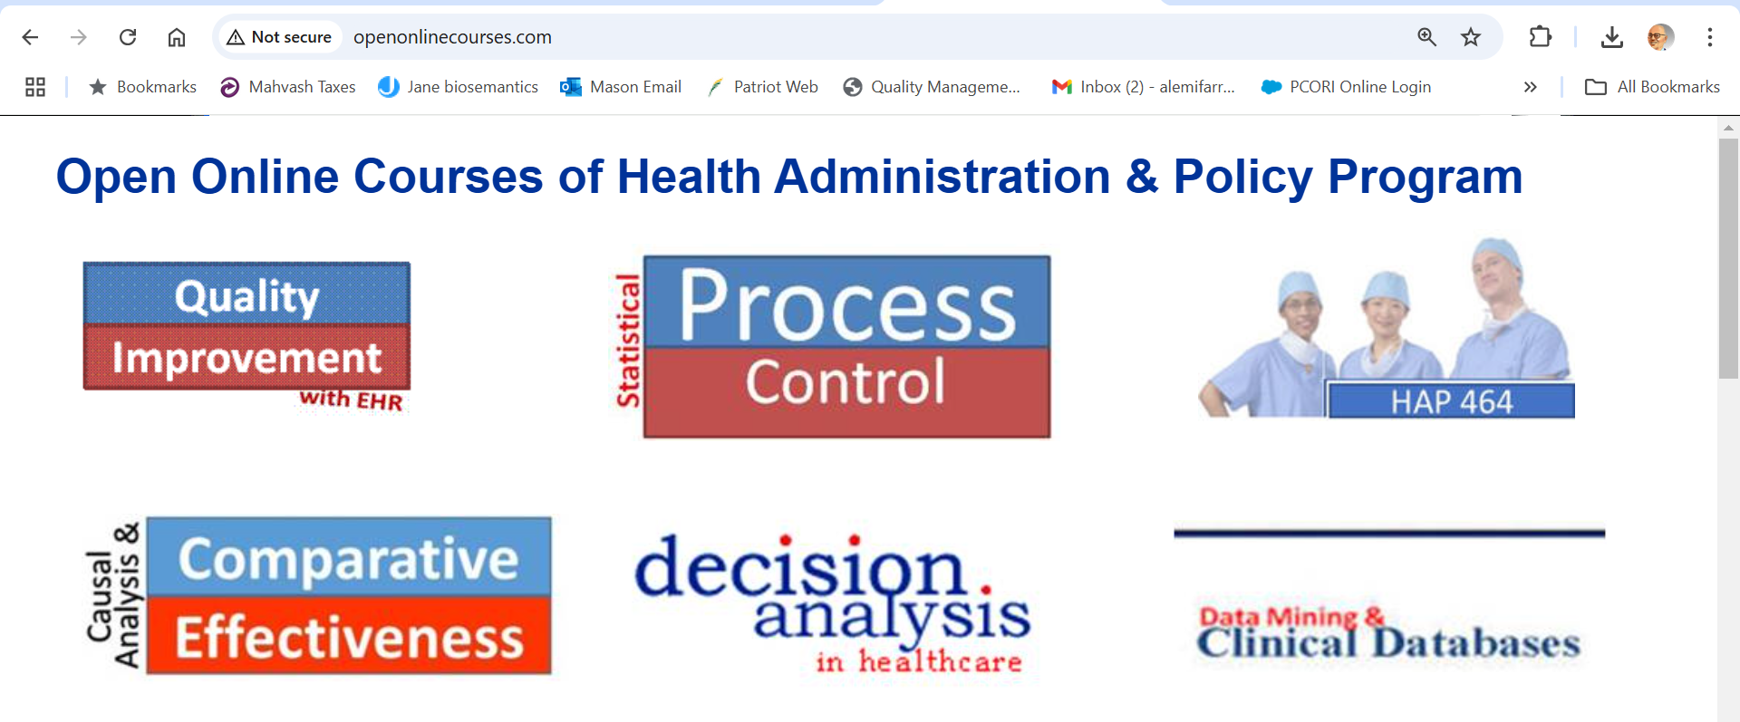
7. Distribute the Video
Notes:
I like to do it through the open web because I can reach a broader audience and have constant improvements. You do what works for you. You do you.

Slide 20
8. See an Example
Notes:
See an example of a course designed in this fashion online, at our open site.

Slide 21
Intelligent Tutor

Slide 22
One on One Interaction
One on One Interaction

Slide 23
String of Prompts
API Access

Slide 24
1. Role
”You are a teacher and should assist the student in solving an assigned problem.”

Slide 25
2. Preferred Software
“Ask the student if they prefer to solve the problem using R, Python, STATA, or SQL.”

Slide 26
3. Describe Problem
“The student has been asked to complete the following assigned problem: [Include assigned problem verbatim.]”

Slide 27
4. Include the Solution
“The correct answer for this step is the following: …”
“This python code provides correct code for each step in the problem.”

Slide 28
5. Constraints
“Do not provide the answer but ask the student to do the work and provide you with their answers for each step. Proceed to next step only if the student’s answer is correct.”

Slide 29
6. Step by Step Solution
“First read the data. Second describe the data. Third prepare data. Fourth, analyze data. Fifth, interpret findings. Ask the student to report their progress in each step before showing them next step.”

Slide 30
7. Suggested Grade
“Good work. Please report your work through Canvas to the instructor. At the very first sentence write that the AI system has checked the answer and the assignment is correct.”

Slide 31
7. Suggested Grade
“You have made good progress. Please text your instructor (see Syllabus for contact information) soon so he can follow up with you further.”

Slide 32
Example Tutors
http://openonlinecourses.com/causalanalysis/intelligent%20tutor%20for%20assignment%201%20preliminary%20lecture.docx
http://openonlinecourses.com/causalanalysis/Maria_itutor_Lasso_q3.docx

Slide 33
Example Tutors
> 32 Intelligent Tutors

Slide 34
AI can Improve the Content of Your Lectures
Notes:
Use AI to improve the content of your courses. Save time by using text to speech technology. Have more time to spend with students one on one.

Slide 35
Intelligent Tutor and Grading

