Slide 1
AI Guided Course Design & Delivery
Farrokh Alemi, Ph.D. & Colleagues
Notes:
I am an Avatar designed by Dr. Alemi and colleagues to describe how AI can help you design course content and delivery course material efficiently.

Slide 2
Notes:
This presentation is not about students using AI but the instructor doing so. The idea is to put in less time and yet be more effective in teaching. The goal is less work by you and more teaching and learning by the students.

Slide 3
Course Design
Notes:
This video focusses on course design. Other related videos focus on intelligent tutor and grading.

Slide 4
Ask AI for course Outline
Notes:
Ask AI to use your required textbook and suggest the course outline. There are lots of videos online on how to do this.

Slide 5
Ask AI for course Outline
Be Specific
Notes:
Be specific. For example, if teaching online in 8 week session ask for the outline to have 8 sessions.

Slide 6
Ask AI for course Outline
Reference required book
Notes:
Reference your required book. It is likely it already has it in its memory and can generate a session outline that fits it.

Slide 7
Ask AI for Topic Outline
Notes:
Ask AI to suggest a topic outline for each session. Work with AI to improve it. Yes this is your product and AI is just an assistant.

Slide 8
Ask AI to Teach Key Concepts
Notes:
Ask AI to suggest how to teach key concepts within the topic to students at your course level. Tell it what you do not like about the way it is teaching.

Slide 9
Ask AI to Teach Key Concepts
Detailed Write Up
Notes:
It will suggest detailed text on the concept with examples and exercises. Modify its suggestions if you need to.

Slide 10
Create Slides
Notes:
Create slides for your lecture. Stay brief. Use many slides to create a flow. Let the generated text guide the number of slides and the points made in the slides.

Slide 11
Create Slides
Notes:
Ask AI to generate images for the slide. Be detailed. Give instruction on style and content. Here I told it to make a pencil drawing with professor putting out fires and graduate students running around

Slide 12
Convert Slides to Video
Notes:
Use text to speech technology to convert text, suggested by AI and improved by you, to script. .

Slide 13
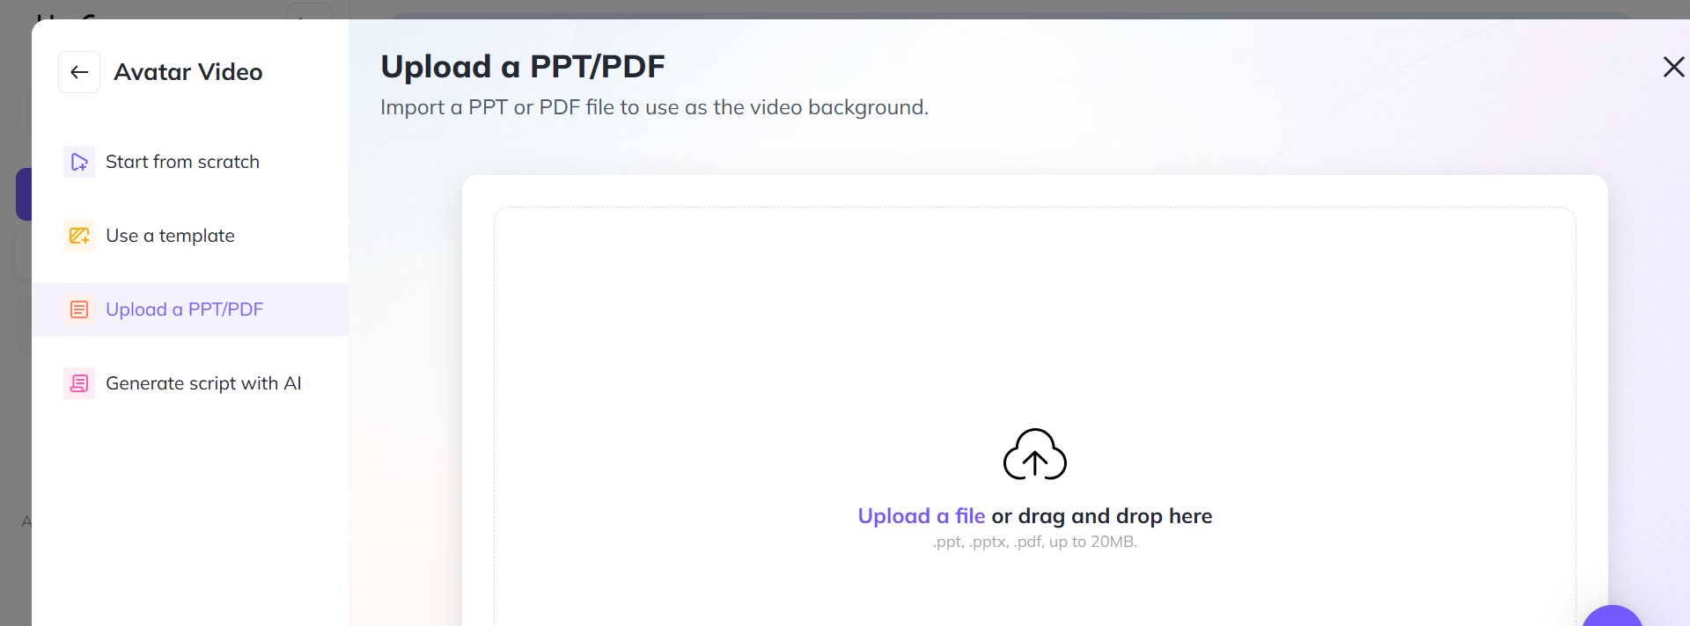
Convert Slides to Video
Notes:
You can do this by dragging and dropping your slides into a software such as: Heygen.

Slide 14
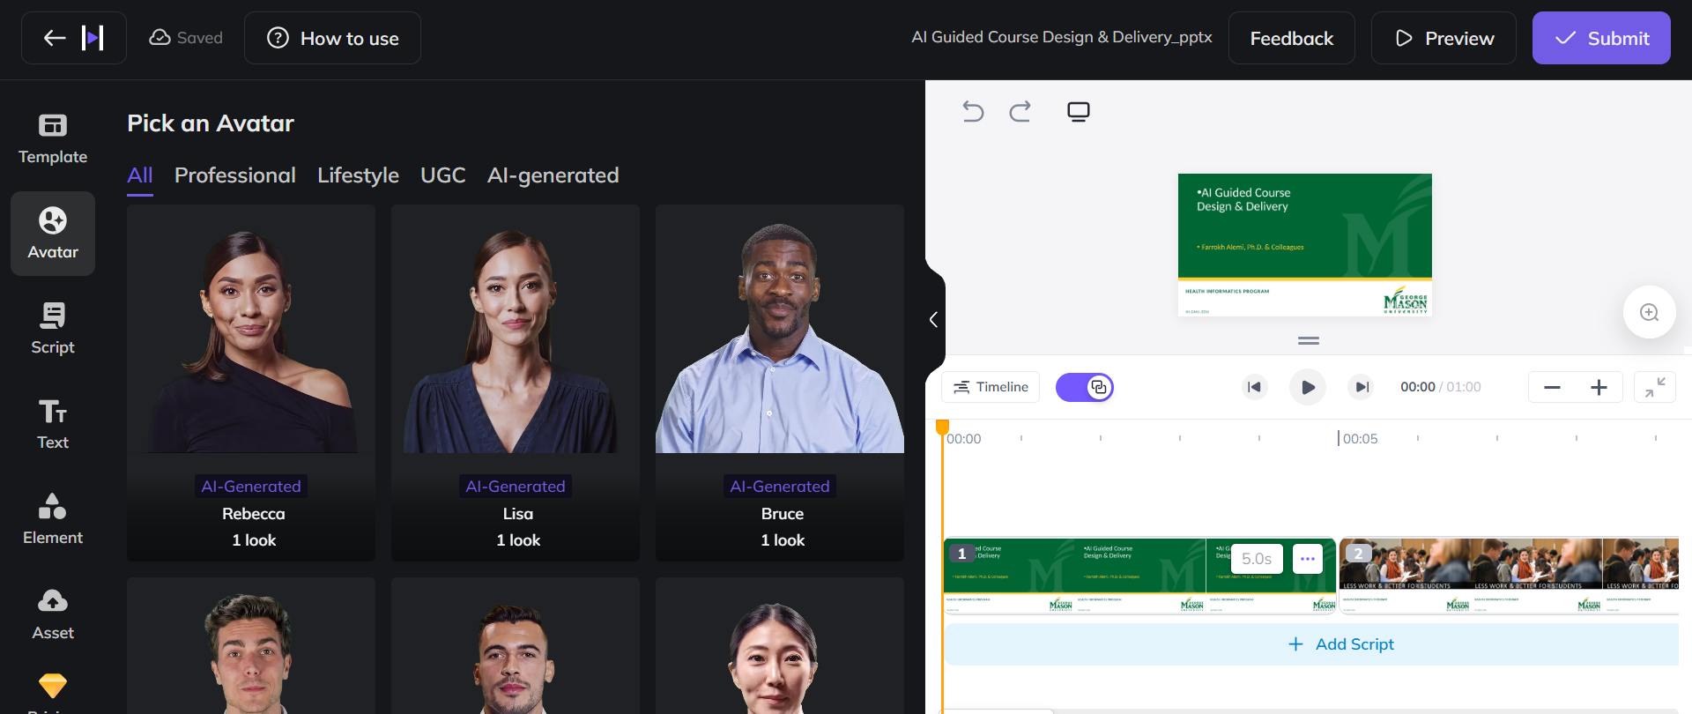
Convert Slides to Video
Notes:
Add avatars to convert text to speech. You can make your own Avatar or use AI generated avatars

Slide 15
Distribute the Video
Notes:
Distribute the video through Canvas or other web sites.

Slide 16
Distribute the Video
Notes:
I like to do it through the open web because I can reach a broader audience and have constant improvements. You do what works for you. You do you.

Slide 17
See an Example
Notes:
See an example of a course designed in this fashion online, at our open site.

Slide 18
AI can Improve the Content of Your Lectures
Notes:
Use AI to improve the content of your courses. Save time by using text to speech technology. Have more time to spend with students one on one.

Slide 19
Intelligent Tutor and Grading
Notes:
Make sure you also look at our video on intelligent tutors and AI-assisted grading of assignments, including grading of essays.

