Slide 1


HAP 823: Teach One
Alanoud Alturki
HAP 823
Prof. Farrokh Alemi
FEB 25, 2023

Slide 2
First step, we must Clean and Prepare the data

Slide 3
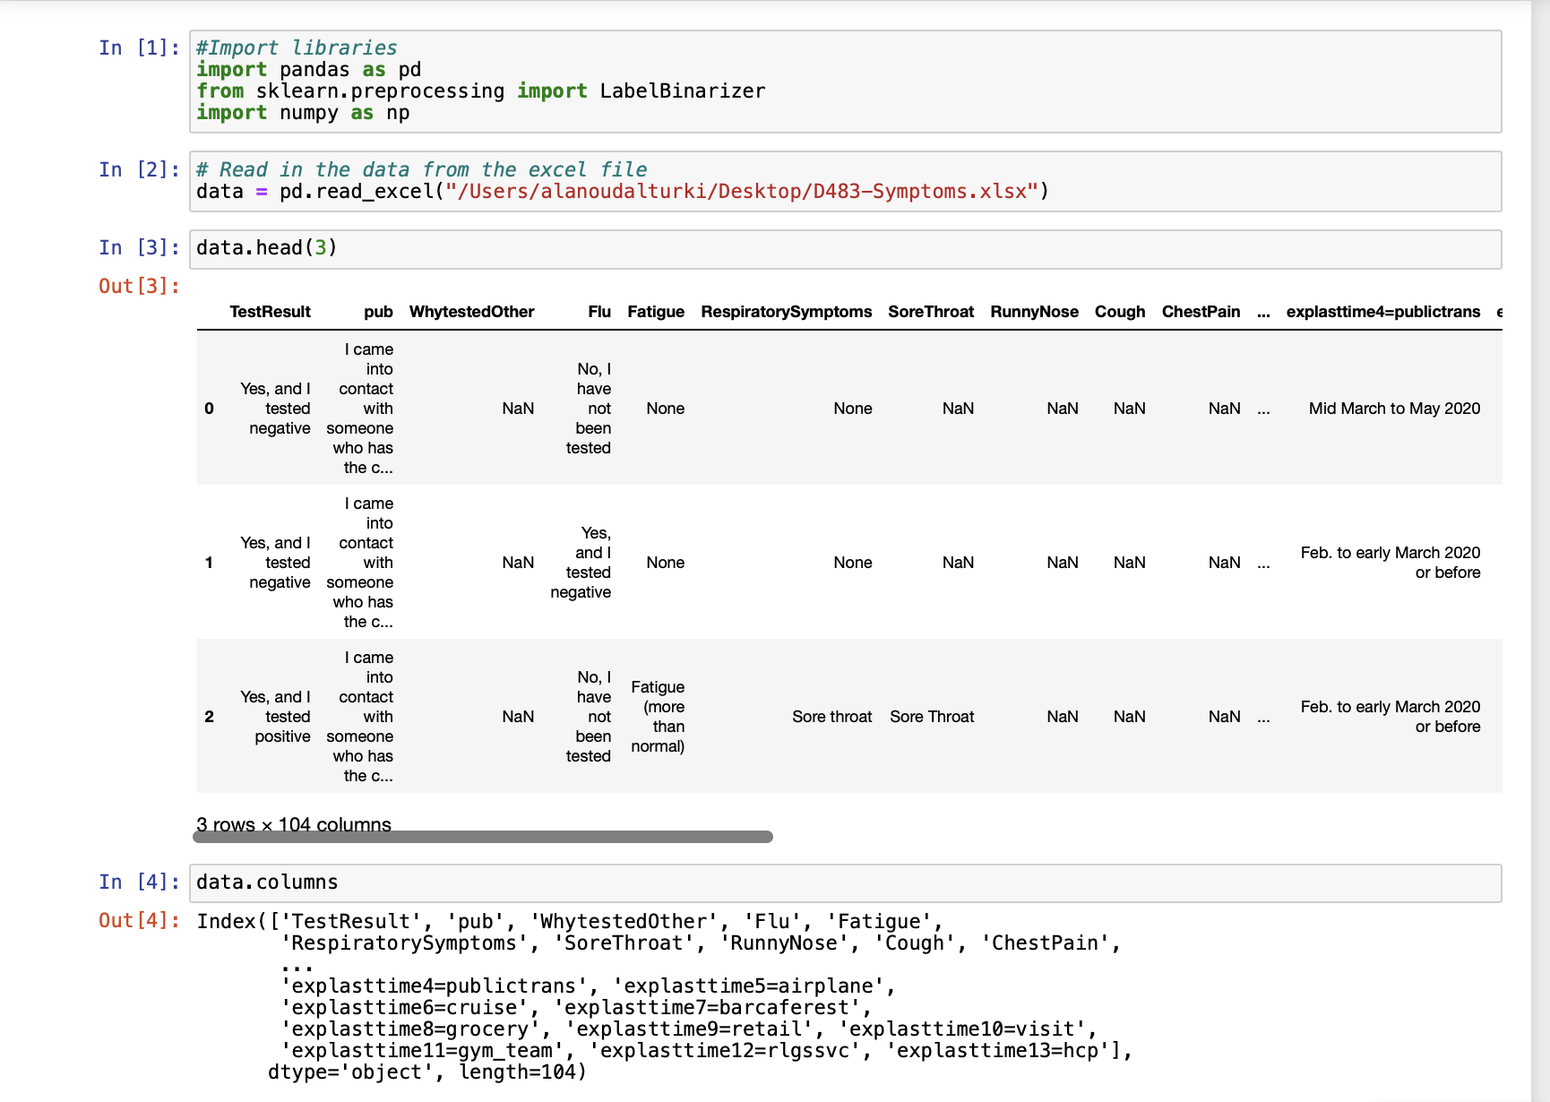
Import necessary libraries, then examine the data

Slide 4
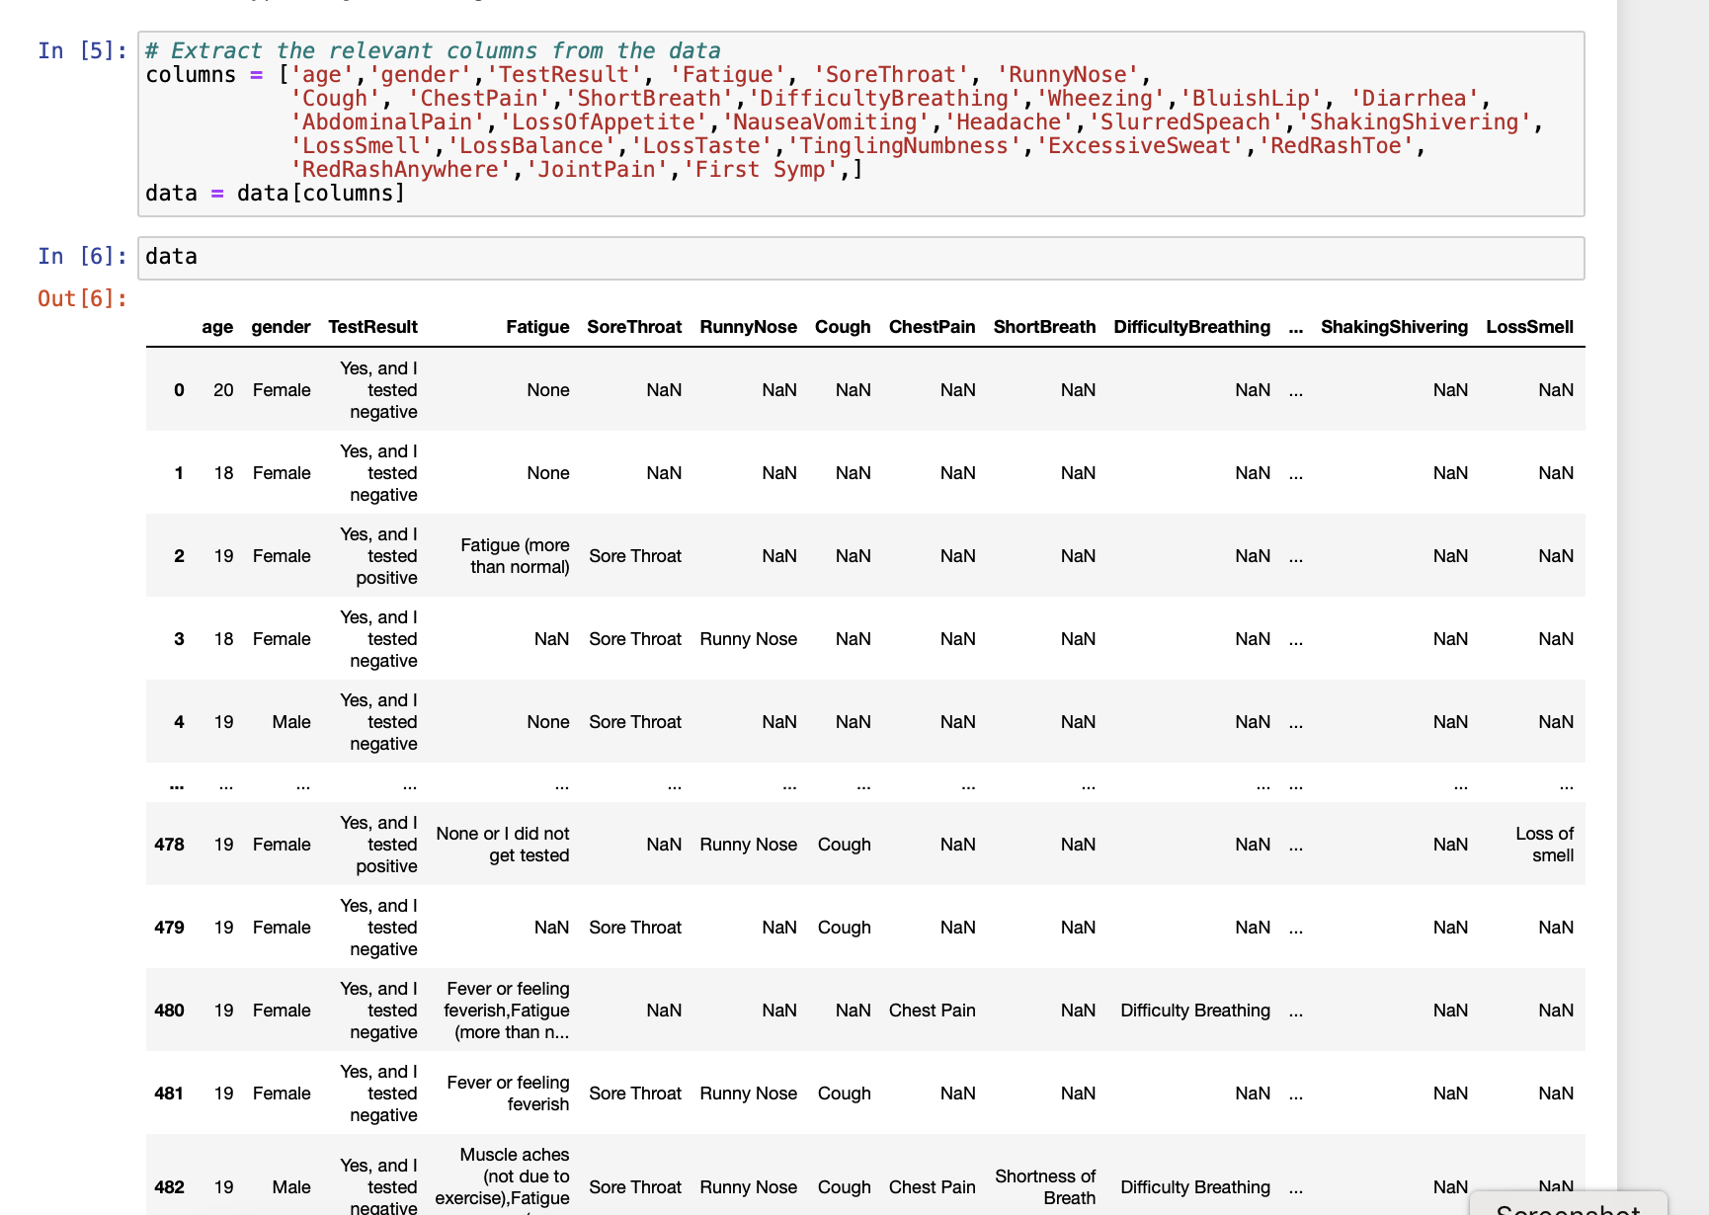
Extract the relevant columns from the data

Slide 5
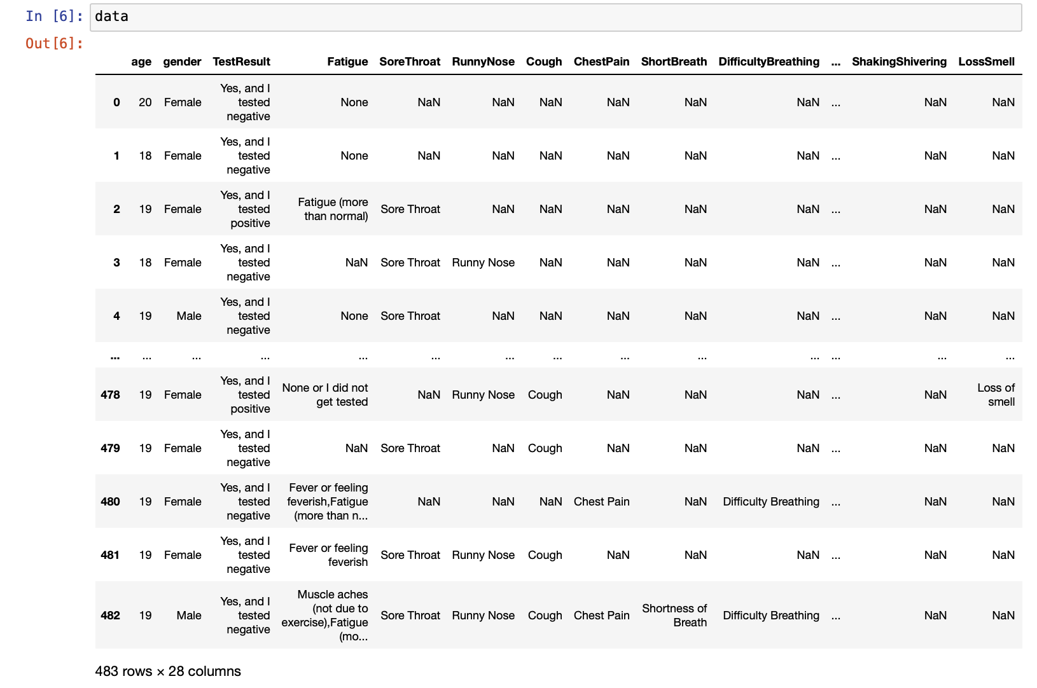
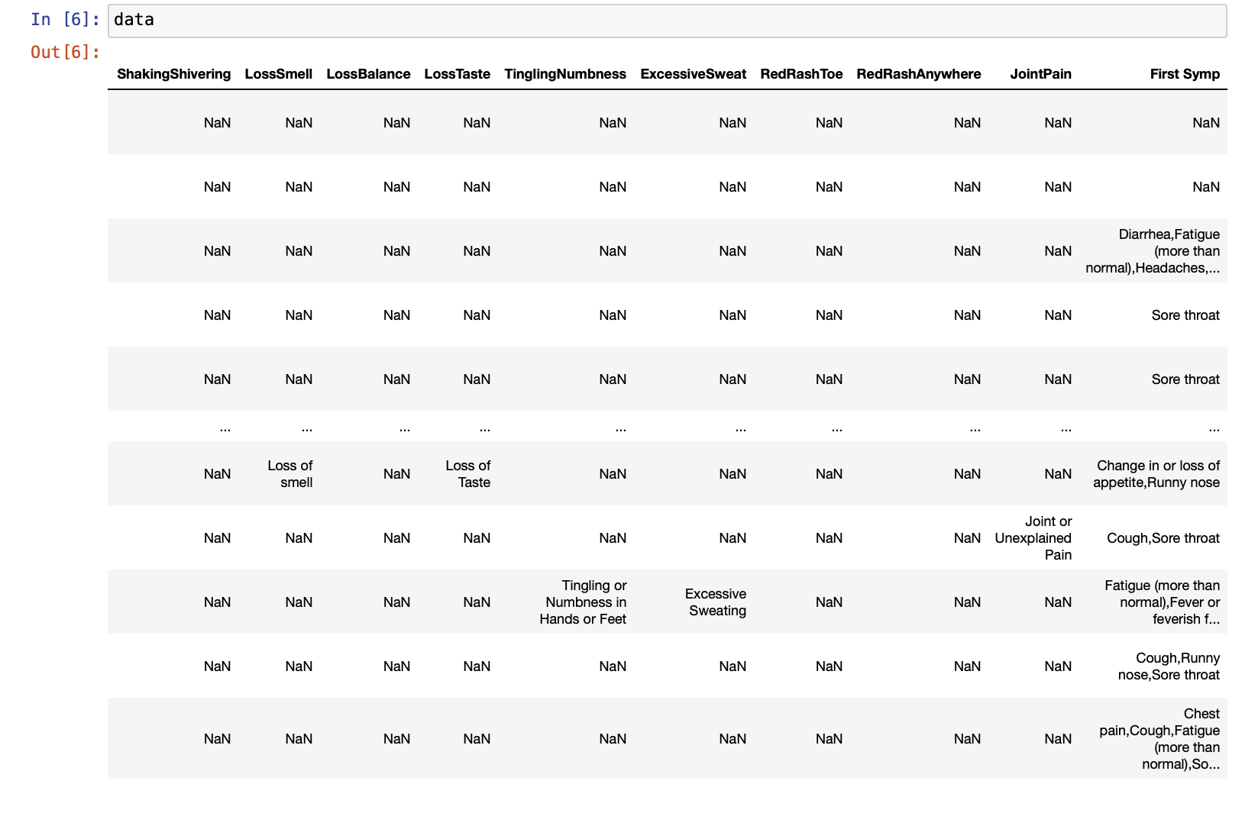

Slide 6
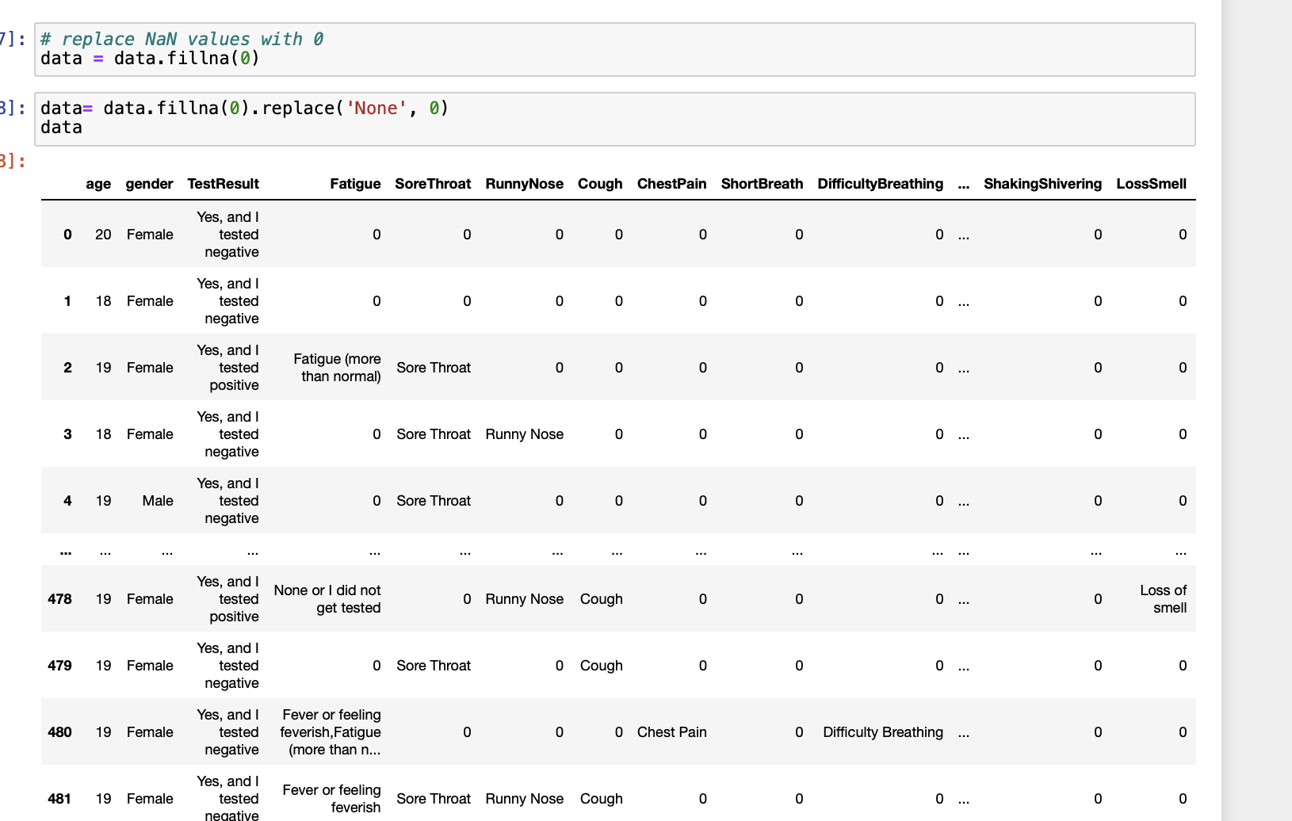
Replace None & NaN values with 0

Slide 7
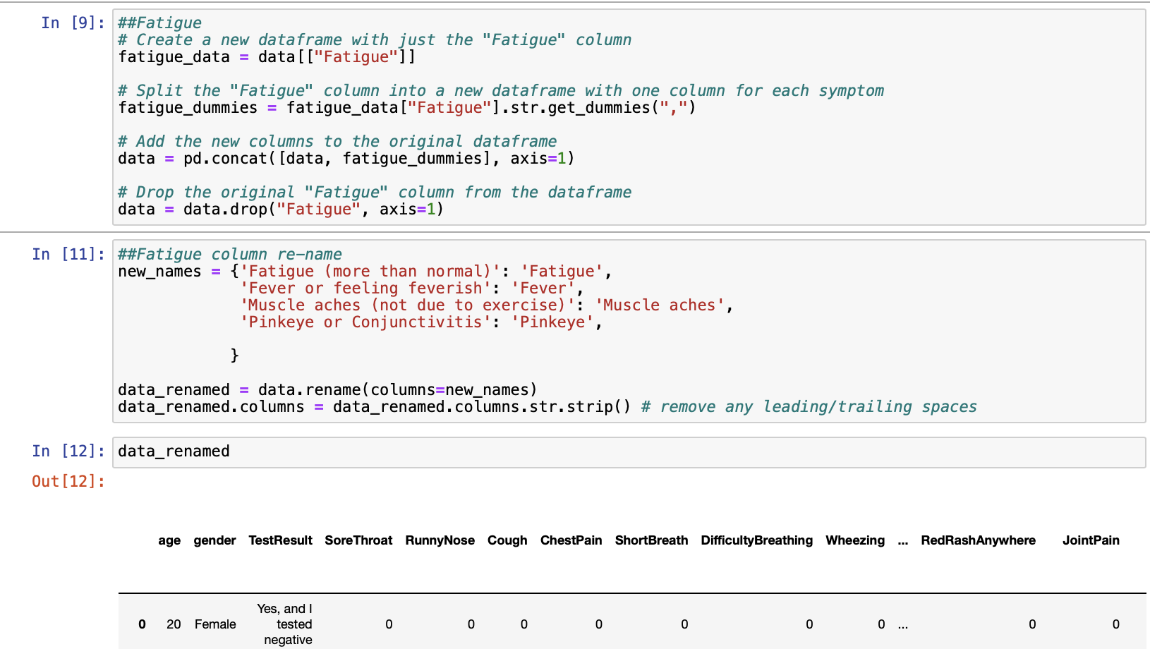
[‘Fatigue’]

Slide 8
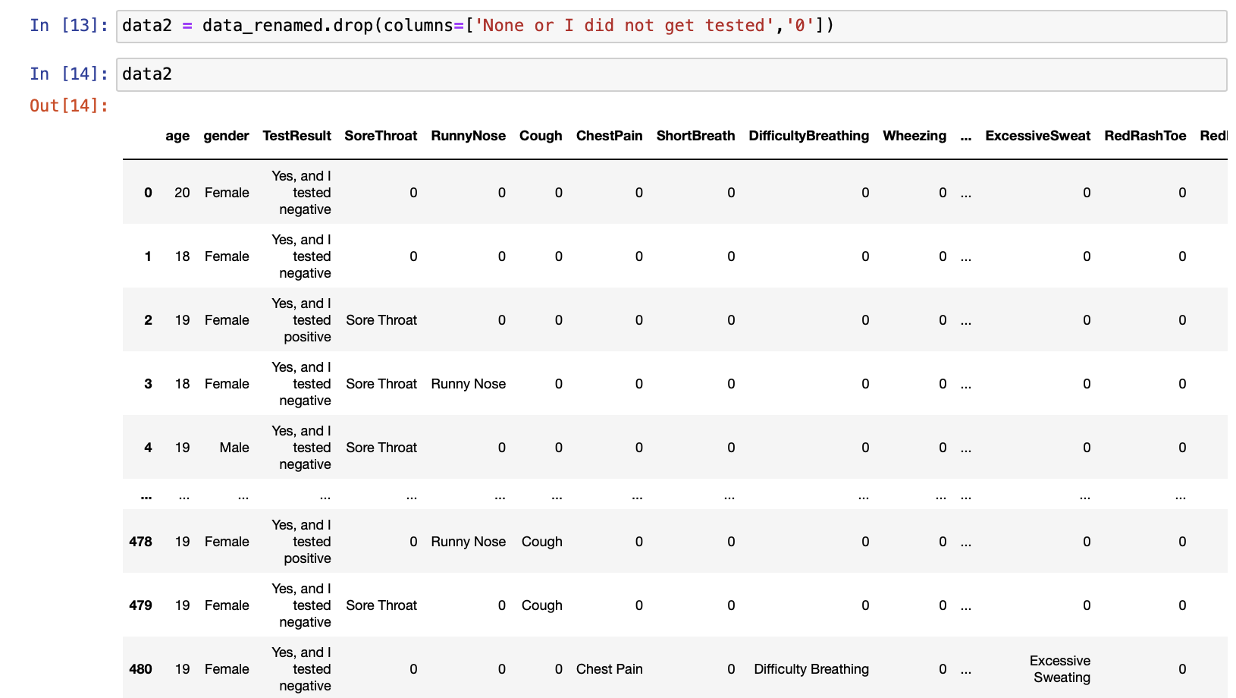
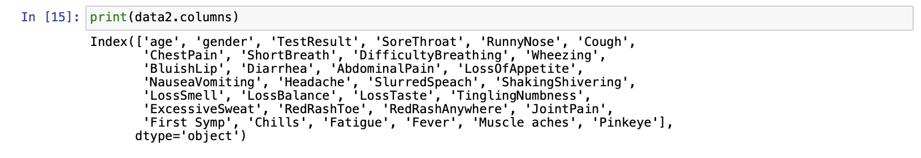
[‘Fatigue’]

Slide 9
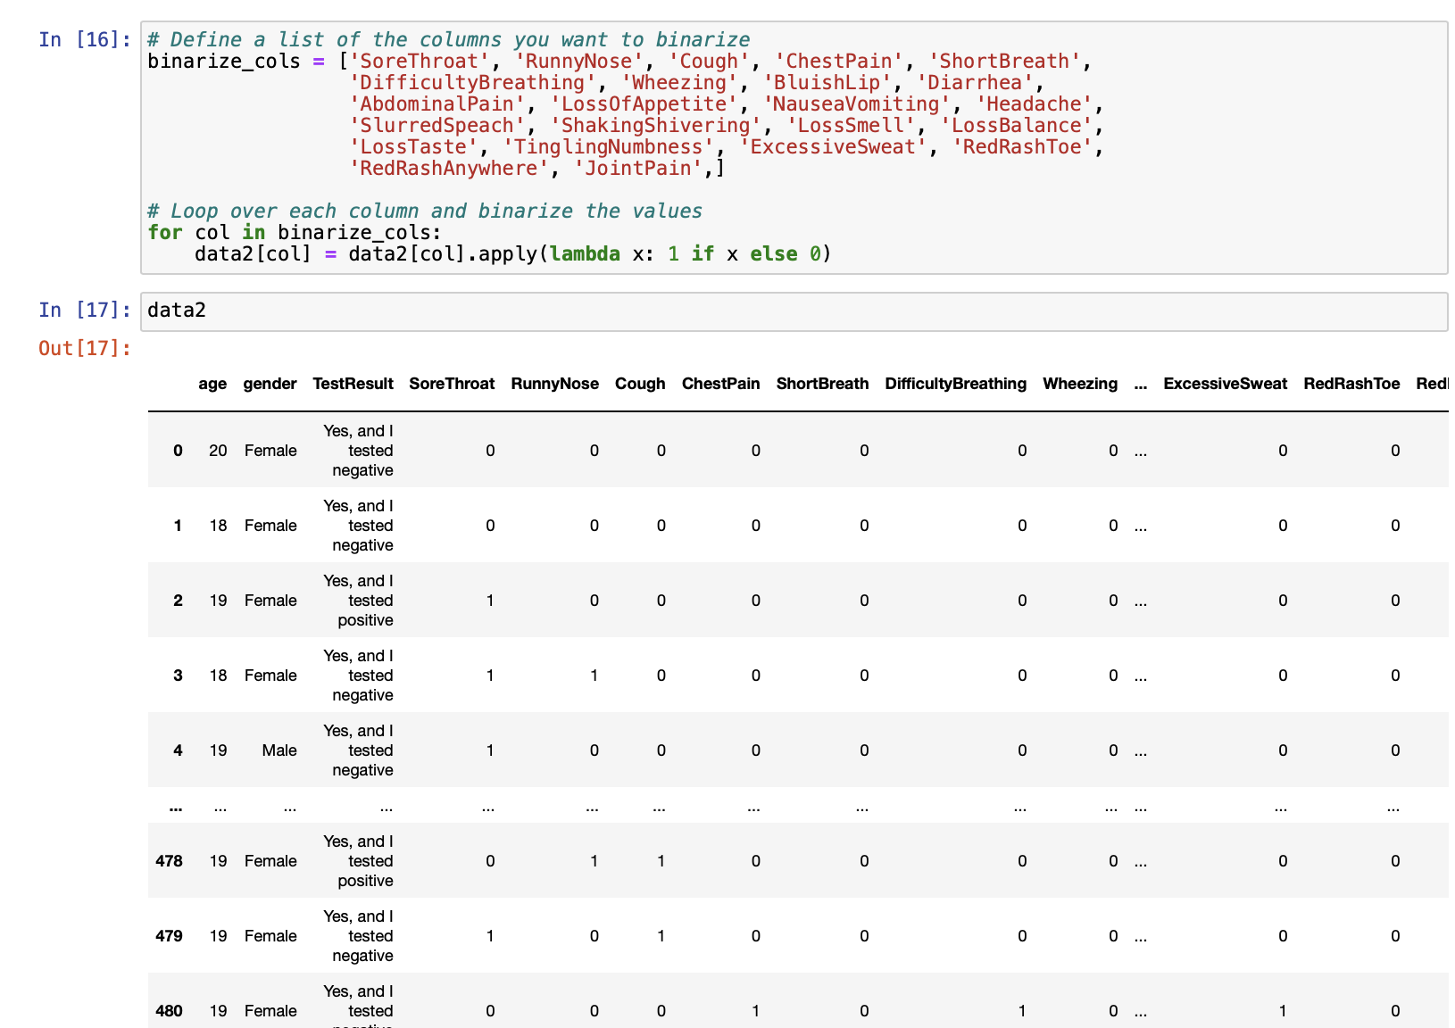
Define a list of the columns you want to binarize

Slide 10
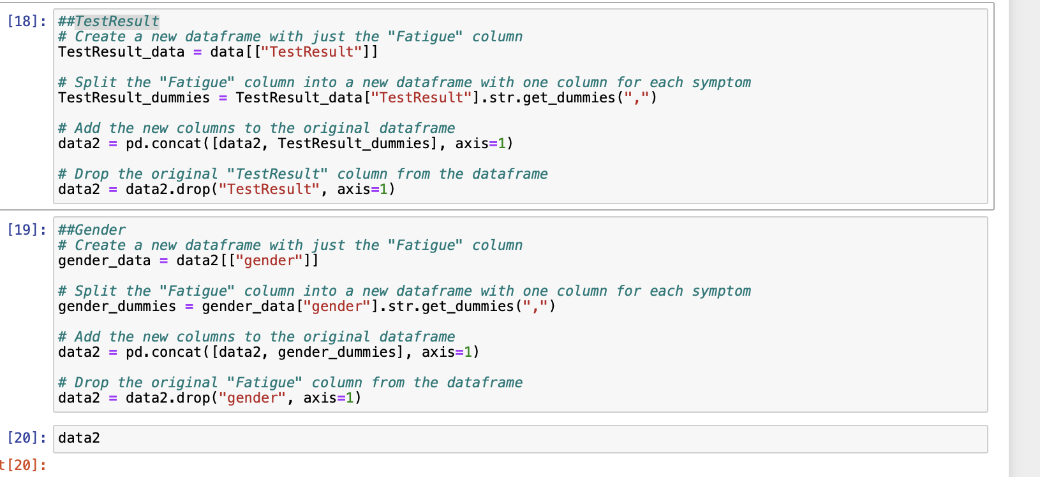
[‘TestResult’] &[‘Gender’]

Slide 11
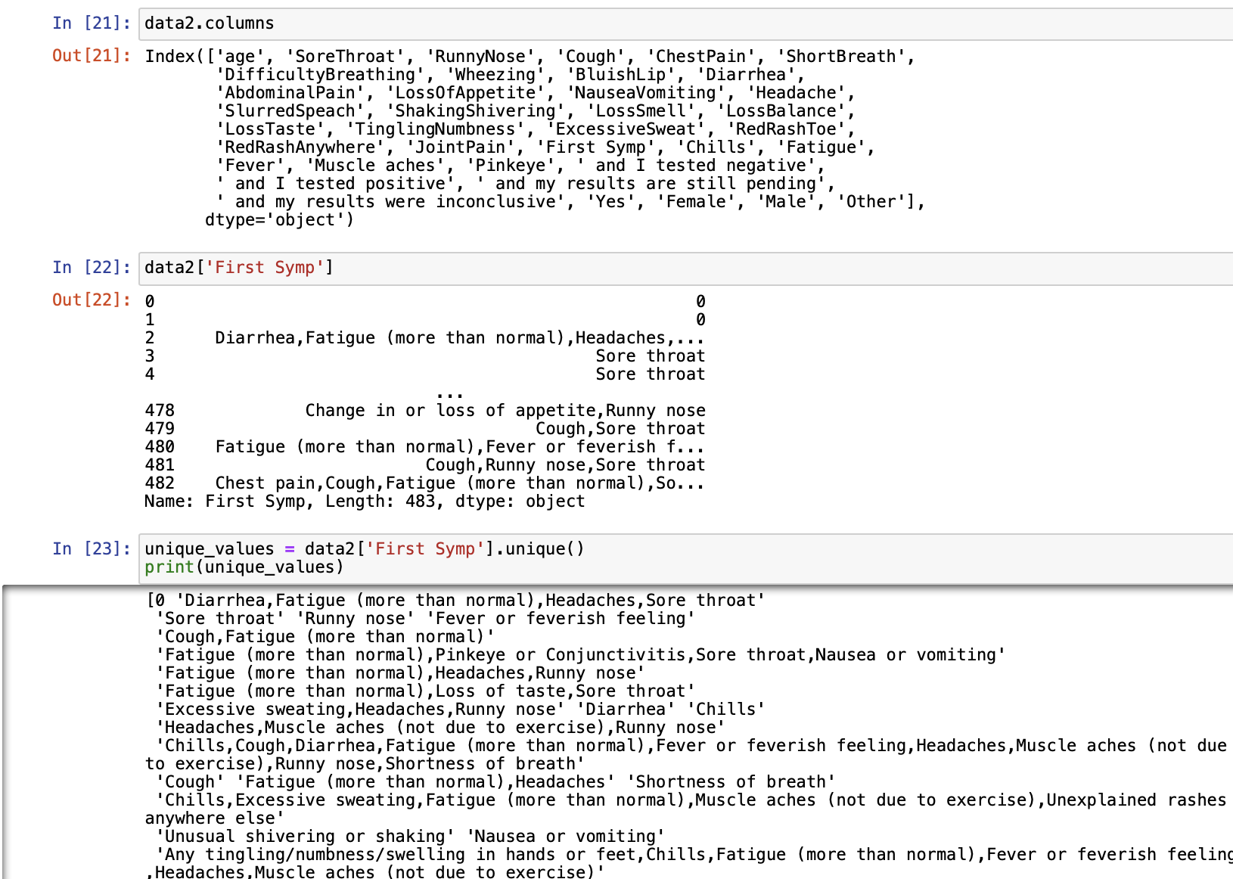
['First Symp']

Slide 12
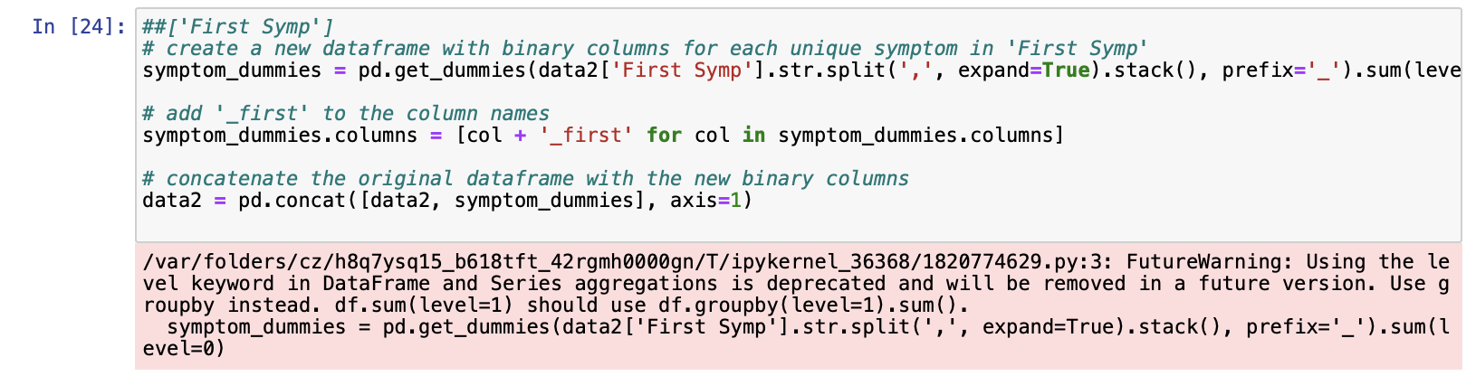
['First Symp']

Slide 13
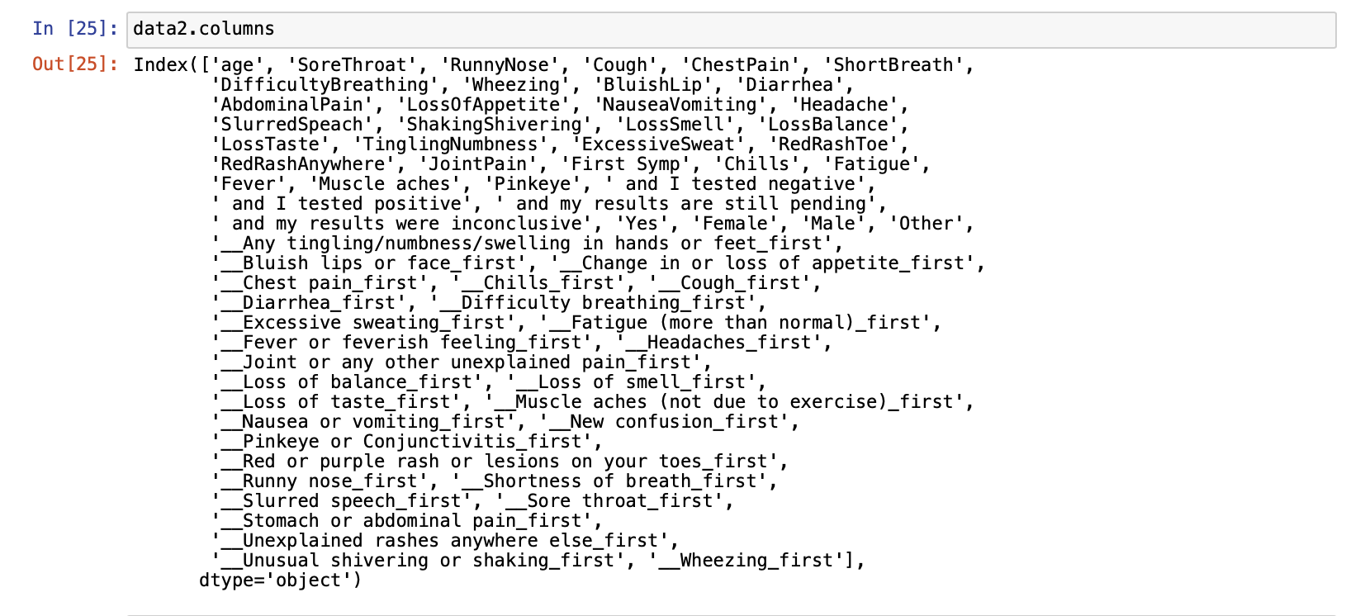
Check columns

Slide 14
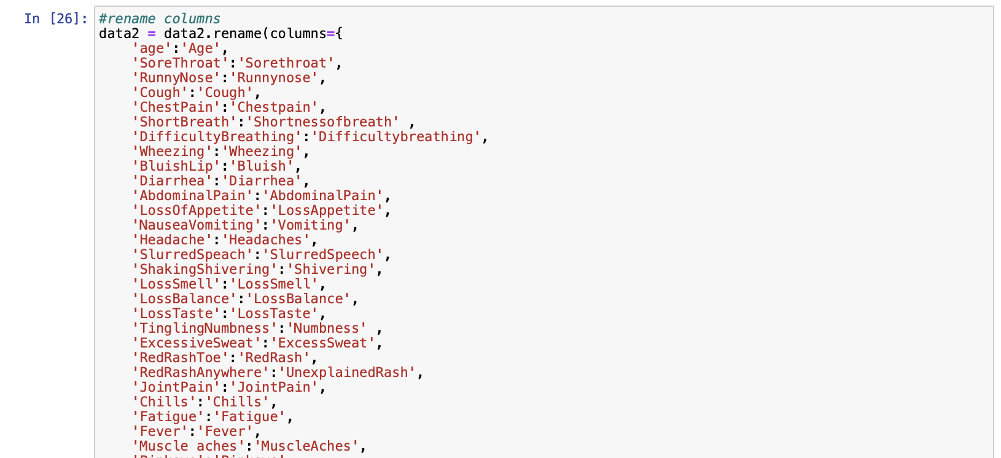

Slide 15
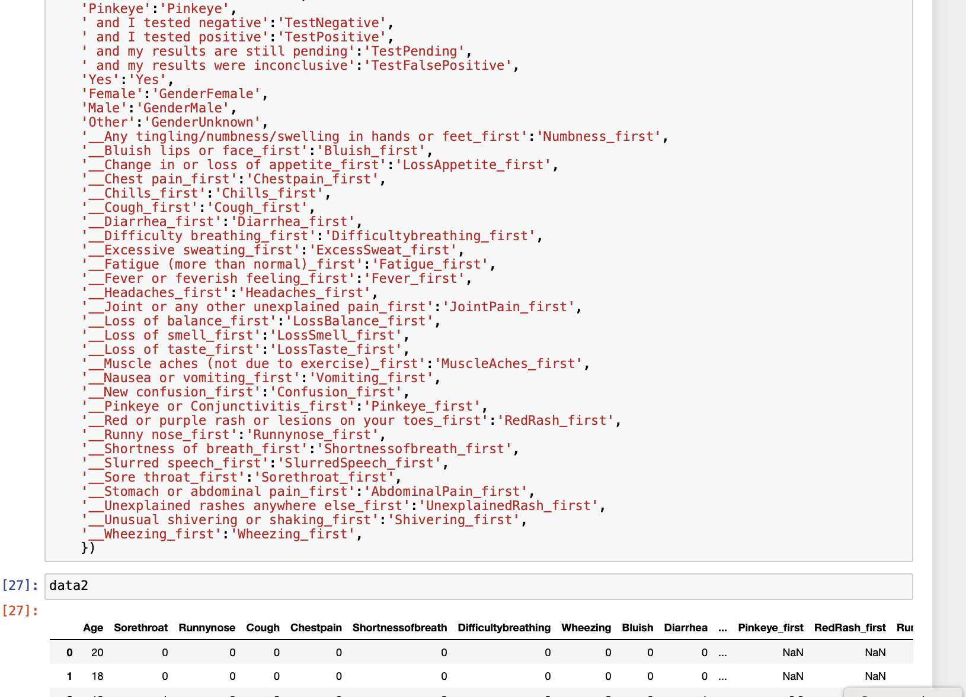

Slide 16
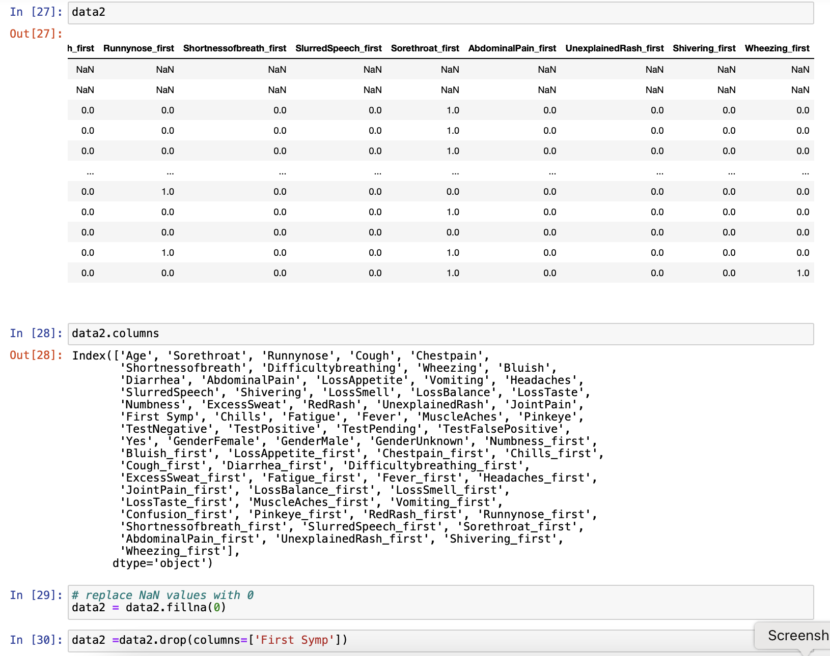

Slide 17
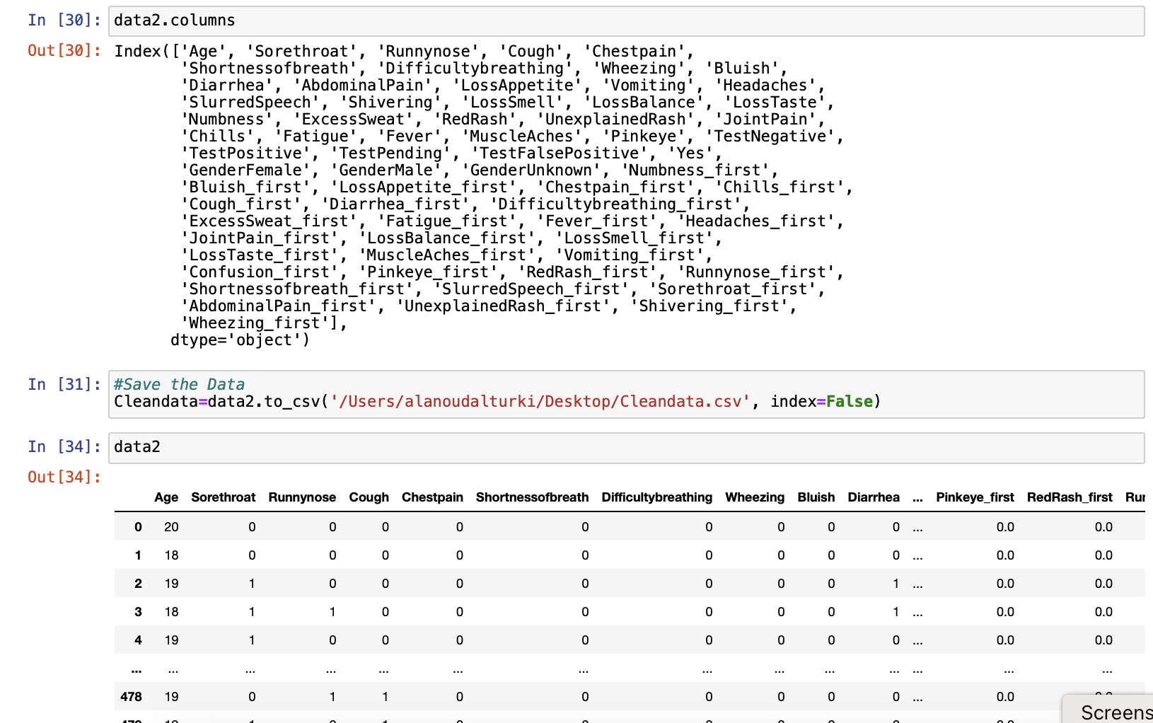
Data Ready to Use for Question 1

Slide 18
Question No. 1– Part 1
Question 1: Classify COVID-19 based on its symptoms.
Describe the order of occurrence of the variables:
      Assume that age and gender occur at birth. Assume that vaccination information occurs before the onset of symptoms. Assume home tests occurs after the onset of symptoms. Assume that the laboratory PCR test occurs after the home test.
      Establish the order in which symptoms occur
        Count for each pair of symptoms, the number of times one symptom occurs before another. Use column AK in the database to identify if one symptom has occurred before another.
        Use the pairwise count of one symptom occurring before another to establish a sequence of occurrence of symptoms.
Notes:
Find the order of occurrence of symptoms, we must count the number of times one symptom appears before another, utilizing column AK [Frist symp ] in the database to determine if one symptom happened before another.
Determine how often one symptom follows another for each set of occurred.
Using Pairwise numbers to determine the order in which the symptoms appeared.
By analyzing all possible pairwise combinations of symptoms. We can find the timeline of symptoms that occur

Slide 19
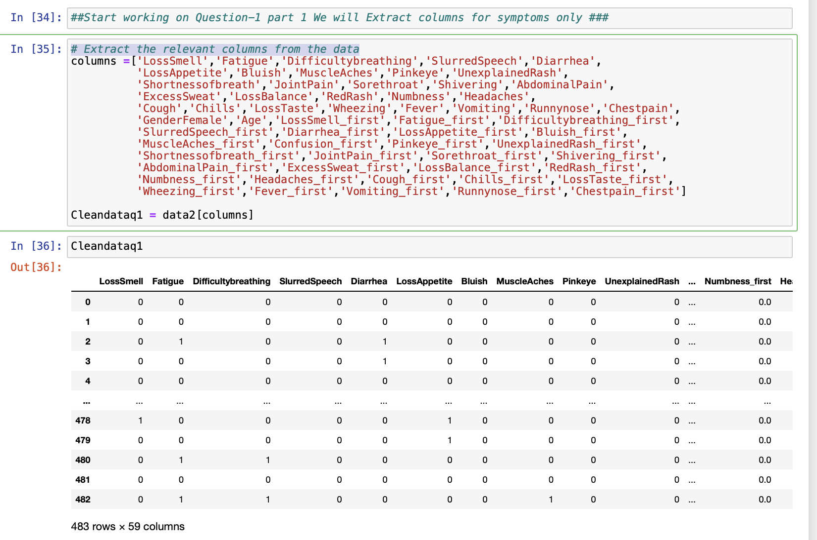
Extract the relevant symptoms columns only

Slide 20
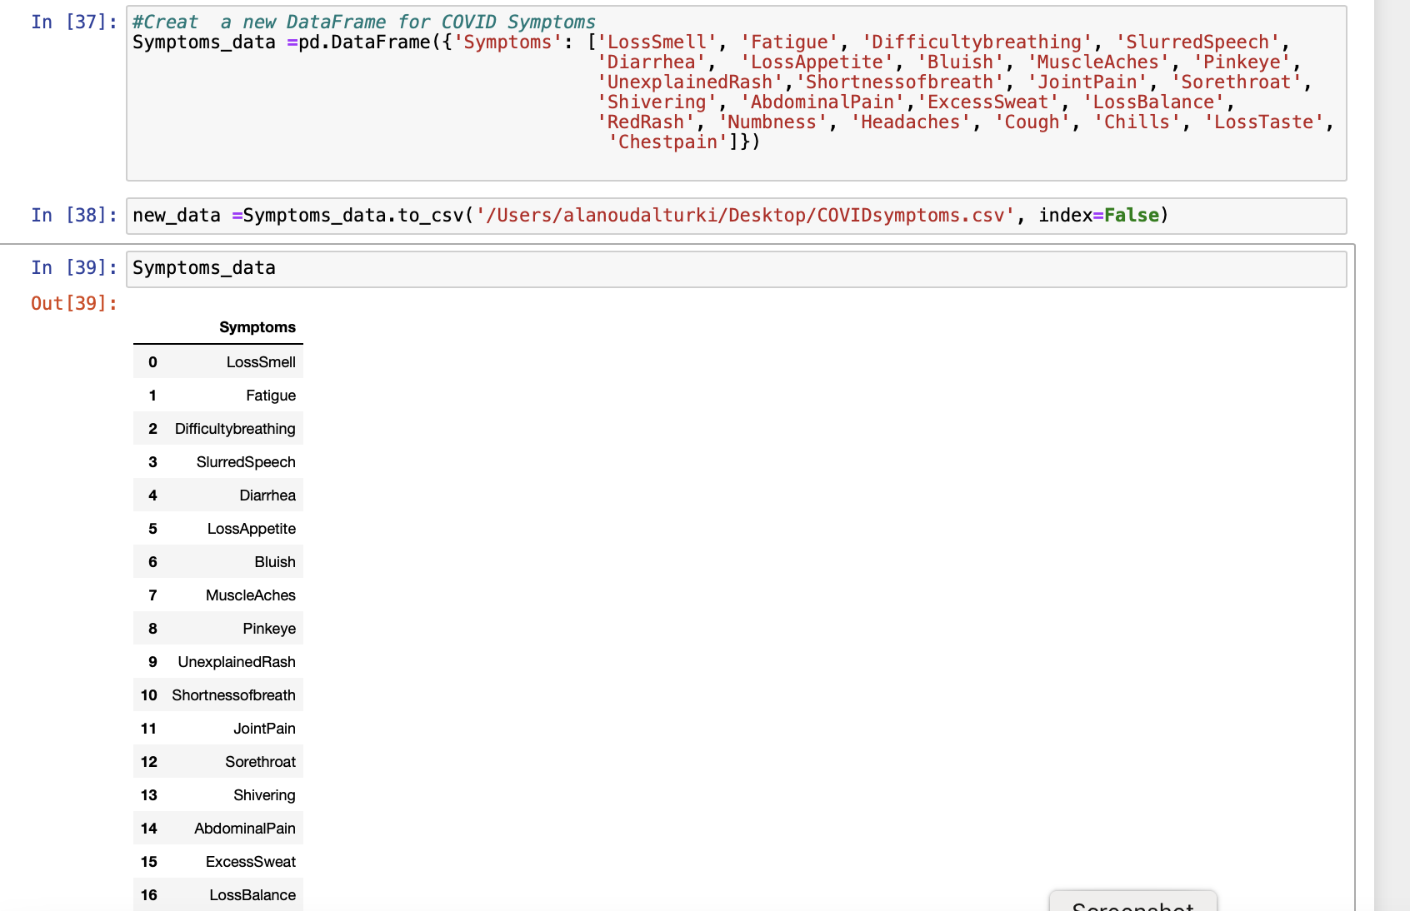
Create a new DataFrame (Symptoms_data)

Slide 21
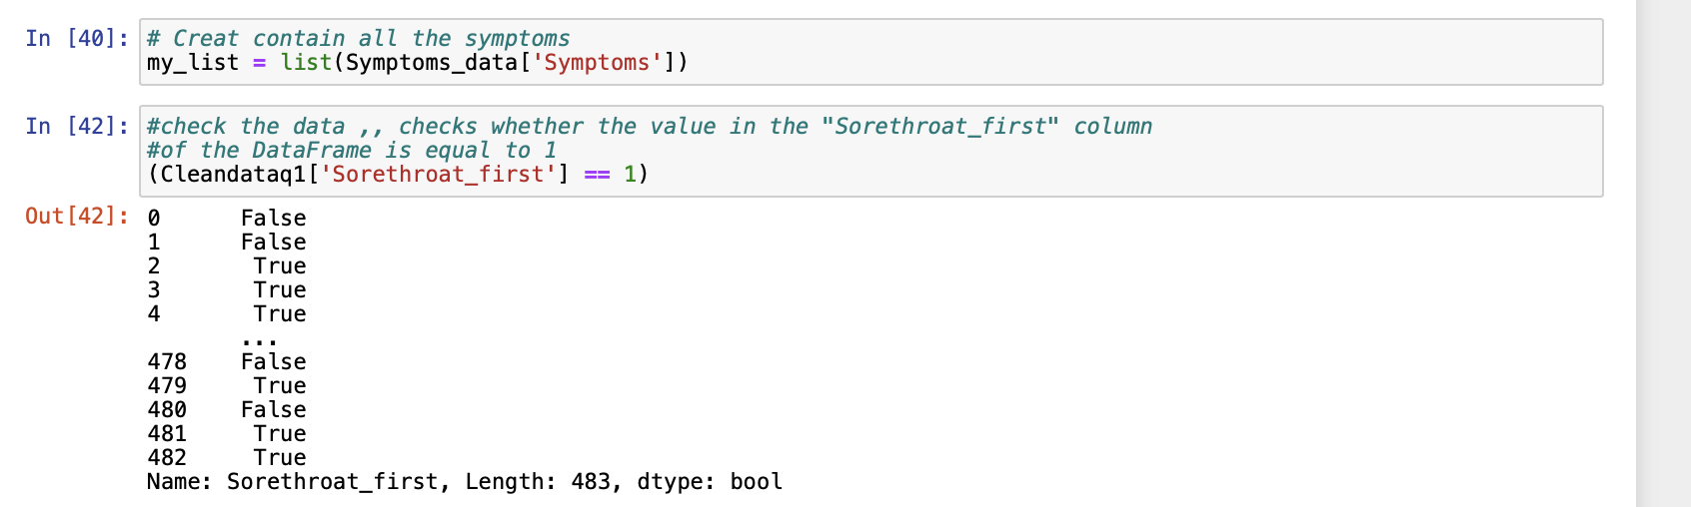

Slide 22
Example:
'Shortnessofbreath'
'Fatigue '

Slide 23
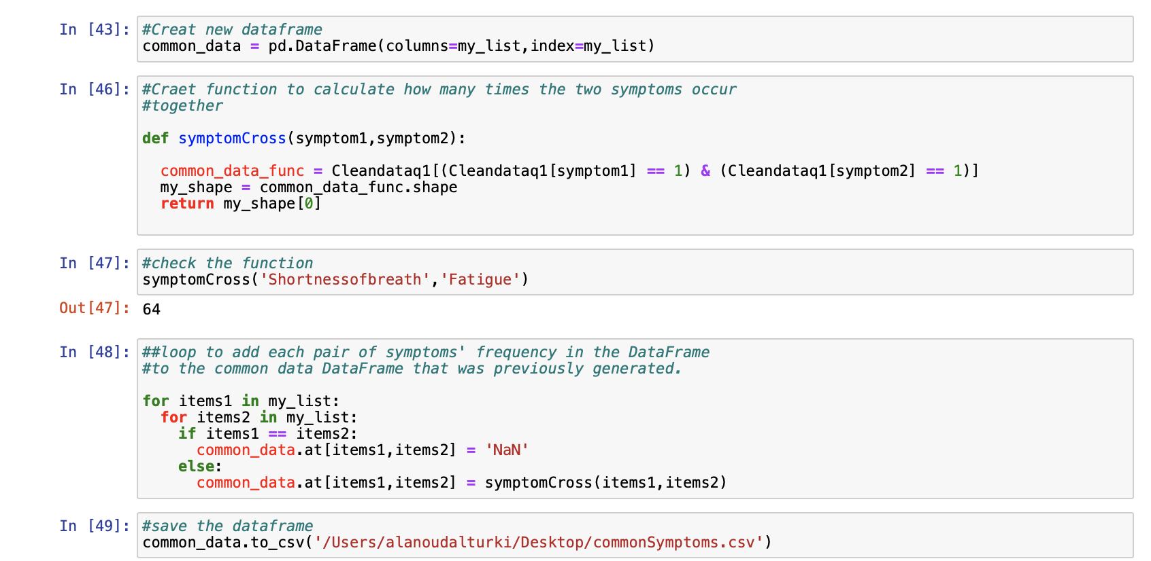
Create a new DataFrame (Common_Data )

Slide 24
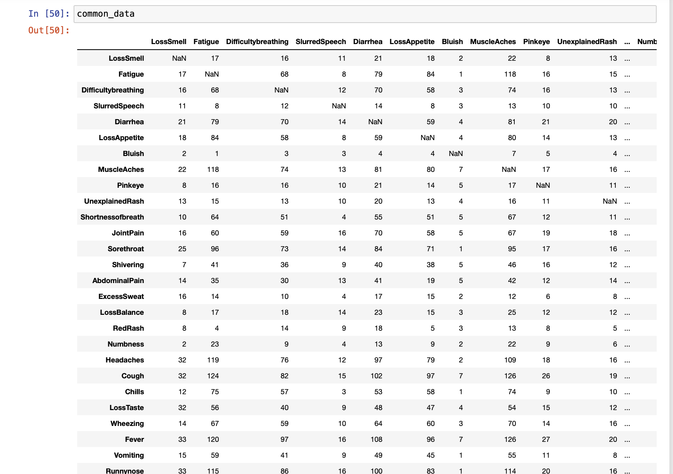
Notes:
for common data, the table shows the Number of Times the Column Variable and Row Variable occur together

Slide 25
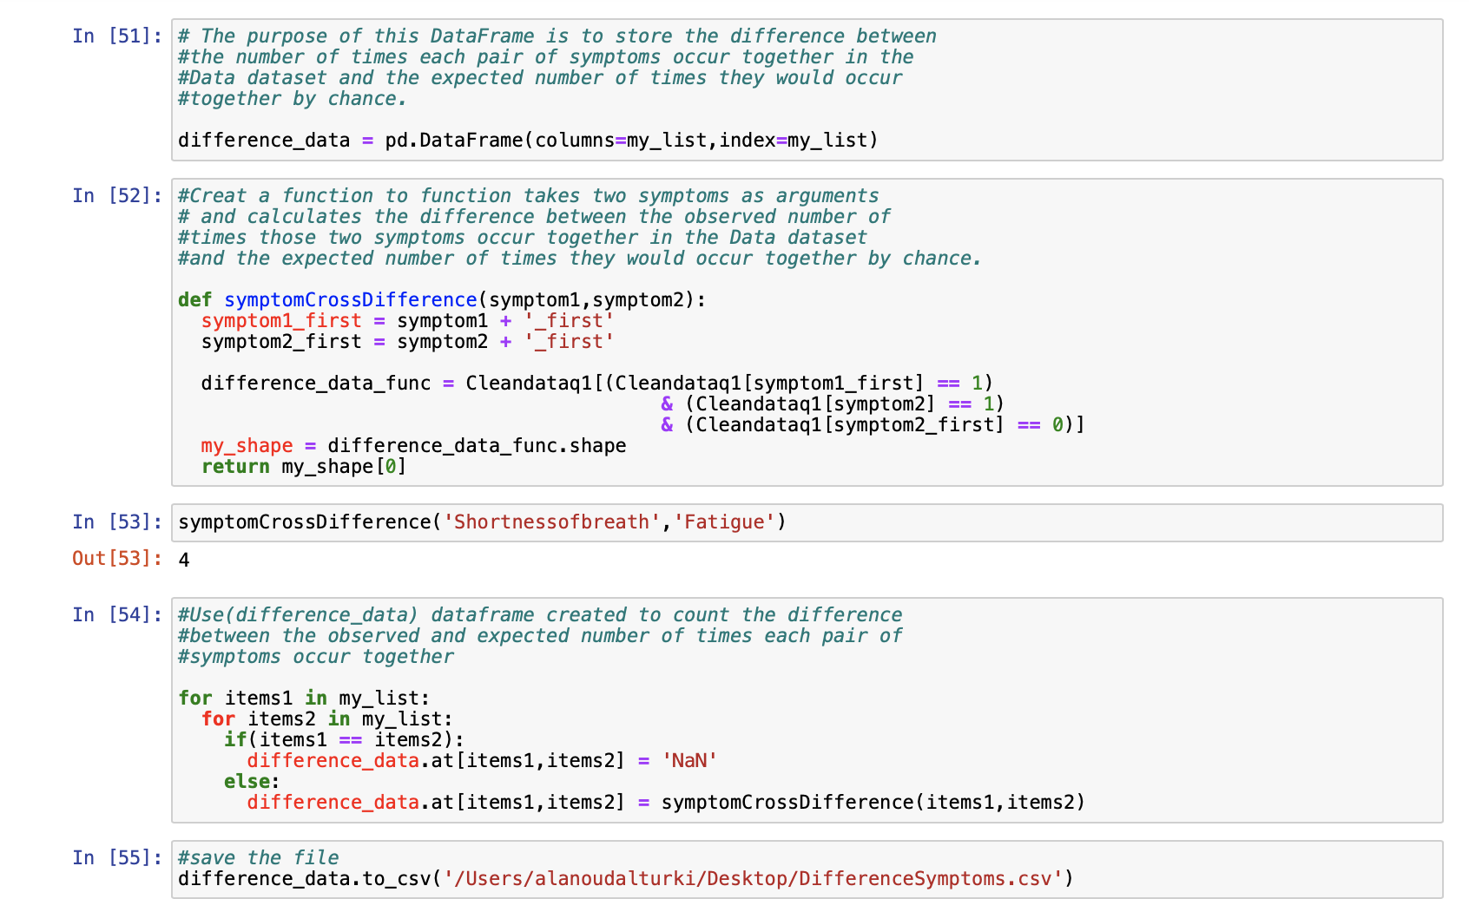
Create a new DataFrame (Difference_Data )

Slide 26
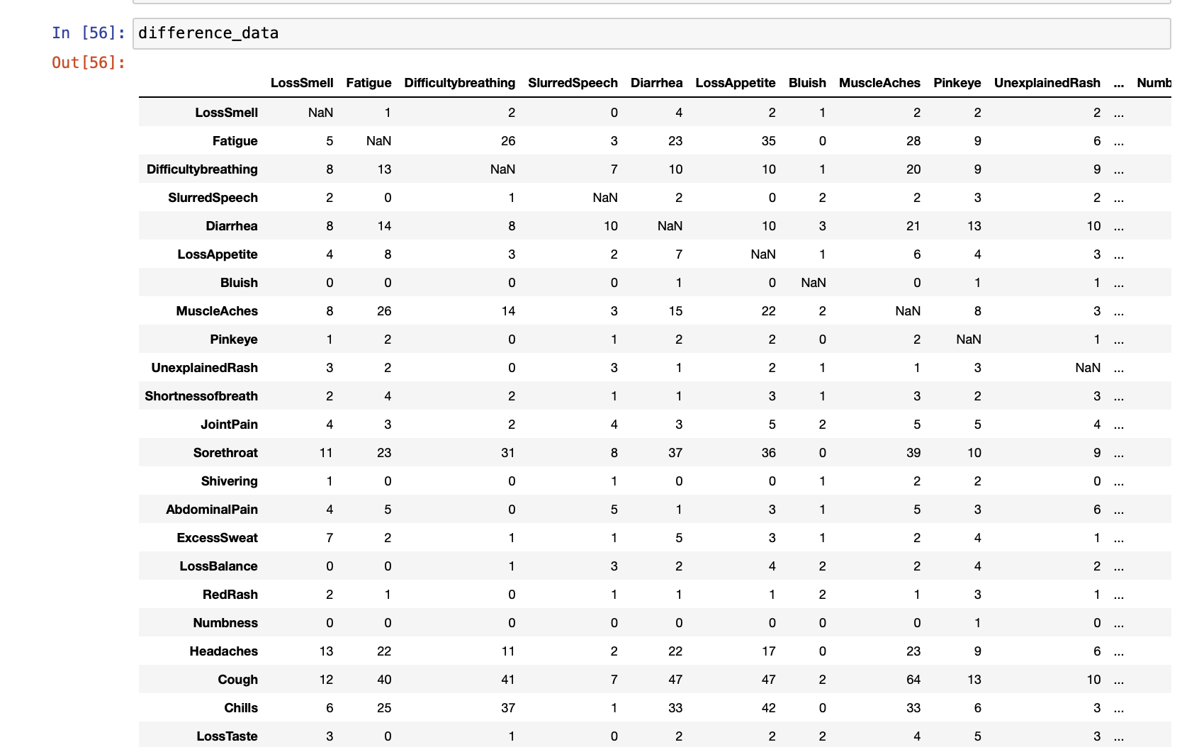
Notes:
for different data, the table shows the Number of Times the Column Variable Occurs after Row Variable

Slide 27
Create New DataFrame (Combined_Data )
(Difference_Data )
(Common_Data )

Slide 28
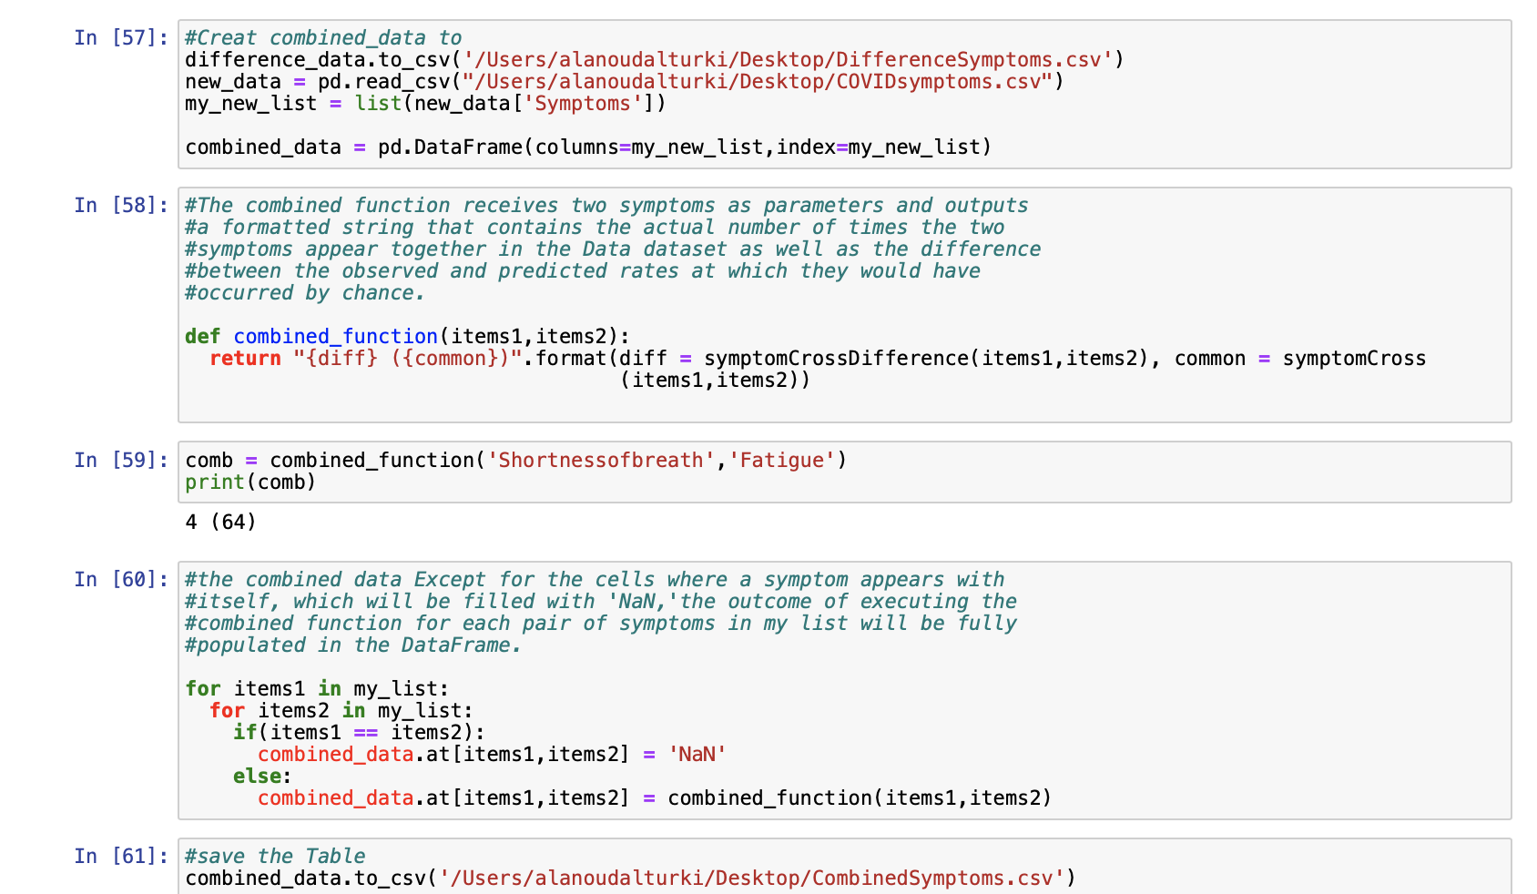

Slide 29
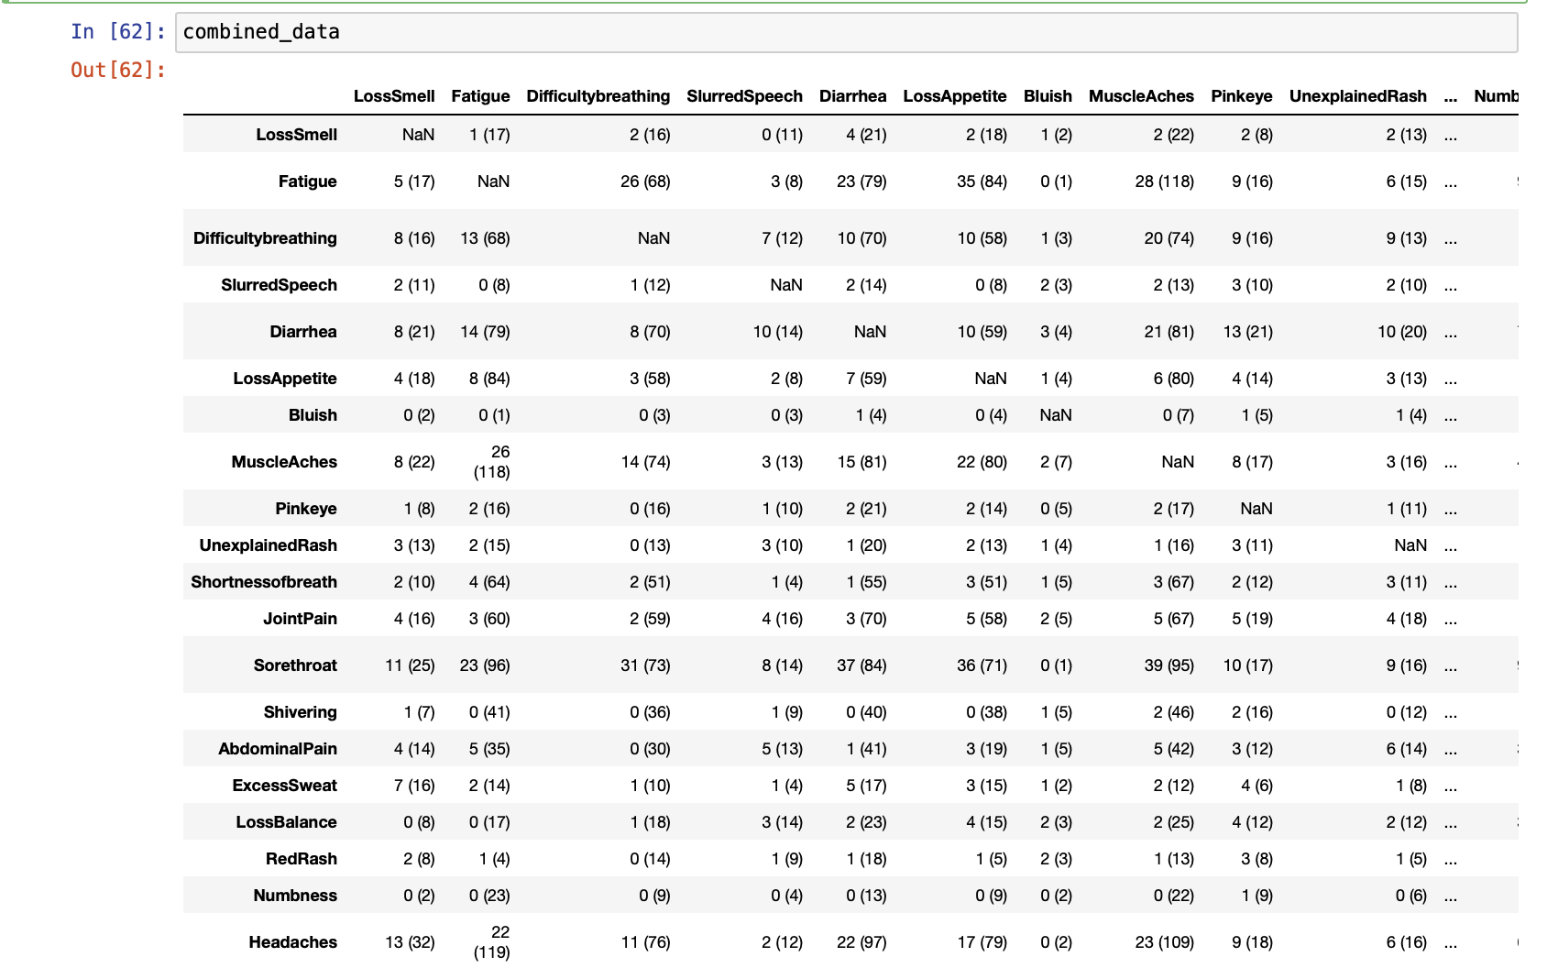

Slide 30
64 patients have both Fatigue and Shortness of breath. In 4 patients, Fatigue occurs after Shortness of breath
Notes:
the table shows the Number of Times the Column Variable Occurs after Row Variable and how many times two symptoms occur togather
64 patients have both Fatigue and Shortness of breath. In 4 patients, Fatigue occurs after Shortness of breath

Slide 31
Thank you

