Slide 1
Analysis of Temporal Order Using Timestamped Date of Events
Farrokh Alemi, Ph.D.
Notes:
This presentation focusses on definition of types of nodes in causal networks. It is presented by Dr. Alemi.

Slide 2
Recorded Time of Event (Available in EHRs)
Notes:
Recorded Time. This method is the gold standard for defining sequence among variables. These data are widely available in electronic health records, where events are time-stamped and therefore it is easy to examine which event has occurred before another.

Slide 3
Both events must occur in the same person

Slide 4
Diseases can occur for different patients in different order

Slide 5
Count the number of patients for whom one disease occurs before another

Slide 6
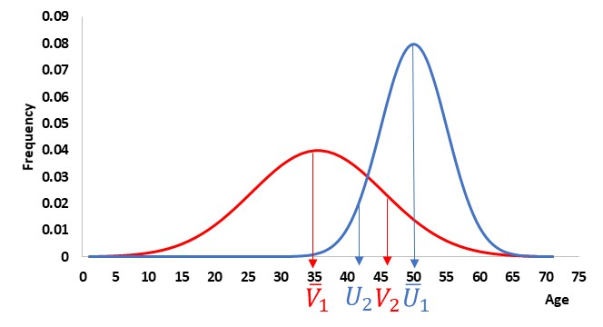
Notes:
For any patient diseases can occur in a different order than the average across the population.

Slide 7
A method is needed to examine variability in order of presentation of pairs of diseases & establish sequence of events

Slide 8
Step 1: Count the number of times event i occurs before event j for same person

Slide 9
Step 2: Sum the number of times event i occurs before all other events

Slide 10
Step 3: Rank in reverse order of the sum

Slide 11

Notes:
Consider 4 events A, B, C, and D.

Slide 12
Notes:
Event A occurs 70 time before B.

Slide 13
Notes:
Event B occurs 30 times before event A.

Slide 14
215
Notes:
Event A occurs 215 times before other events.

Slide 15
165
Notes:
Event B occurs 165 times before other events.

Slide 16
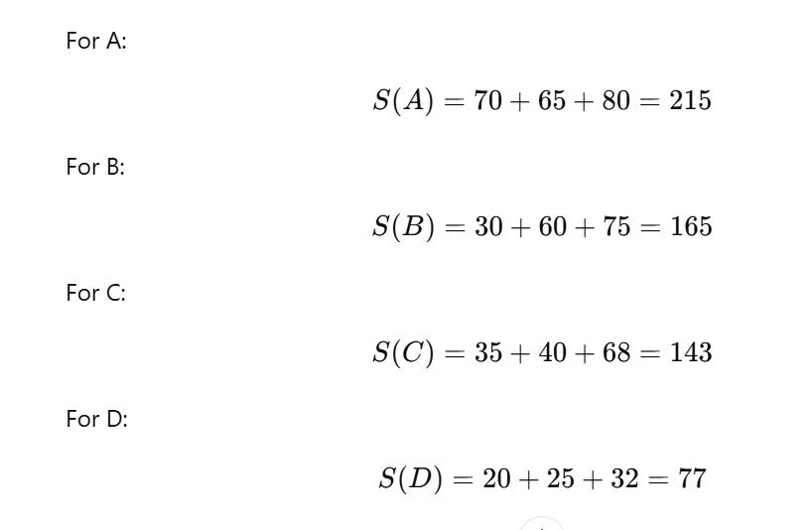
Notes:
Here is how many times each event occurs before other events.

Slide 17
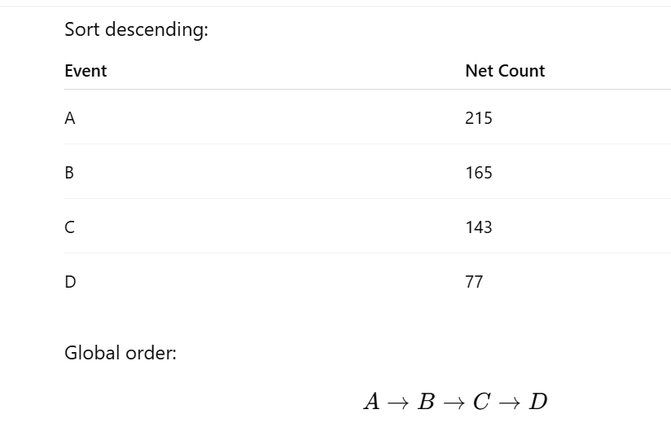
Notes:
Sort descending and you have the global order of occurrence of the events in the population.

Slide 18
Global Order Can be Estimated from Pairwise occurrences of Medical Events in Same Person

