Slide 1
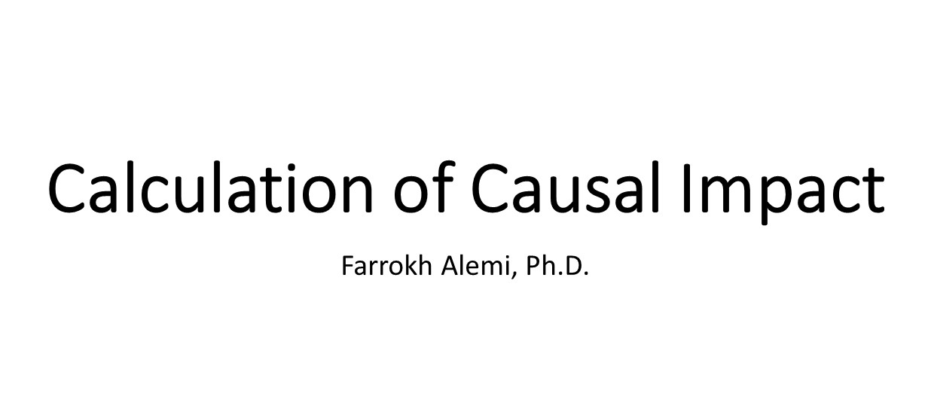

Slide 2
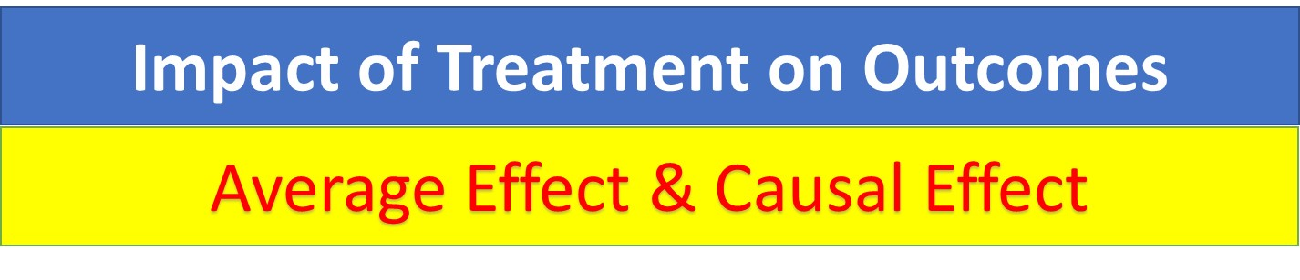
Notes:
This presentation shows how you can calculate the average treatment effect or the causal treatment effect.

Slide 3
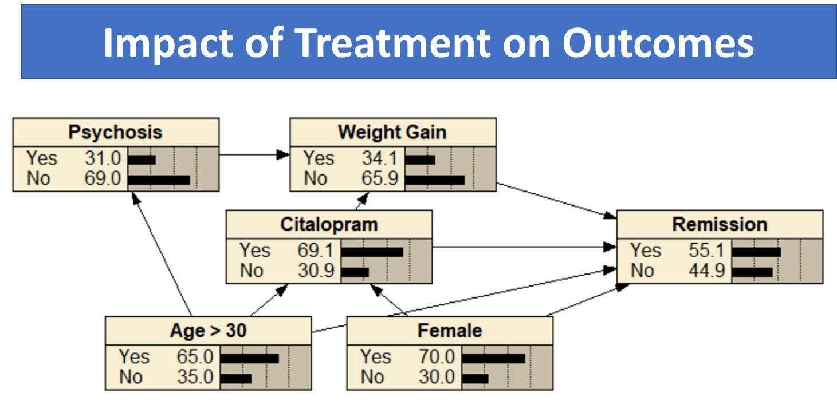
Notes:
We show the calculations using this network model.

Slide 4
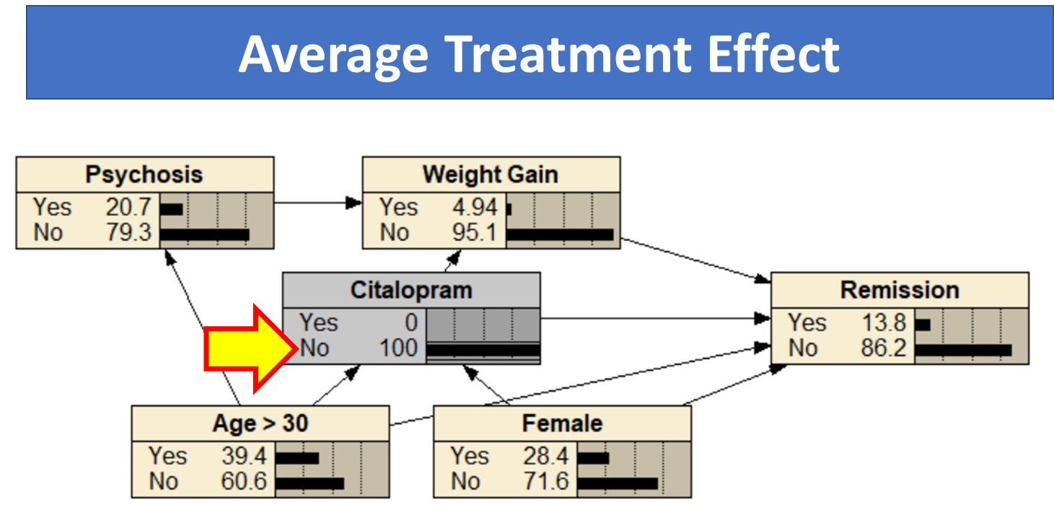
Notes:
Average treatment effect is the change in outcome for change in treatment. Of the patients who did not receive citalopram,

Slide 5
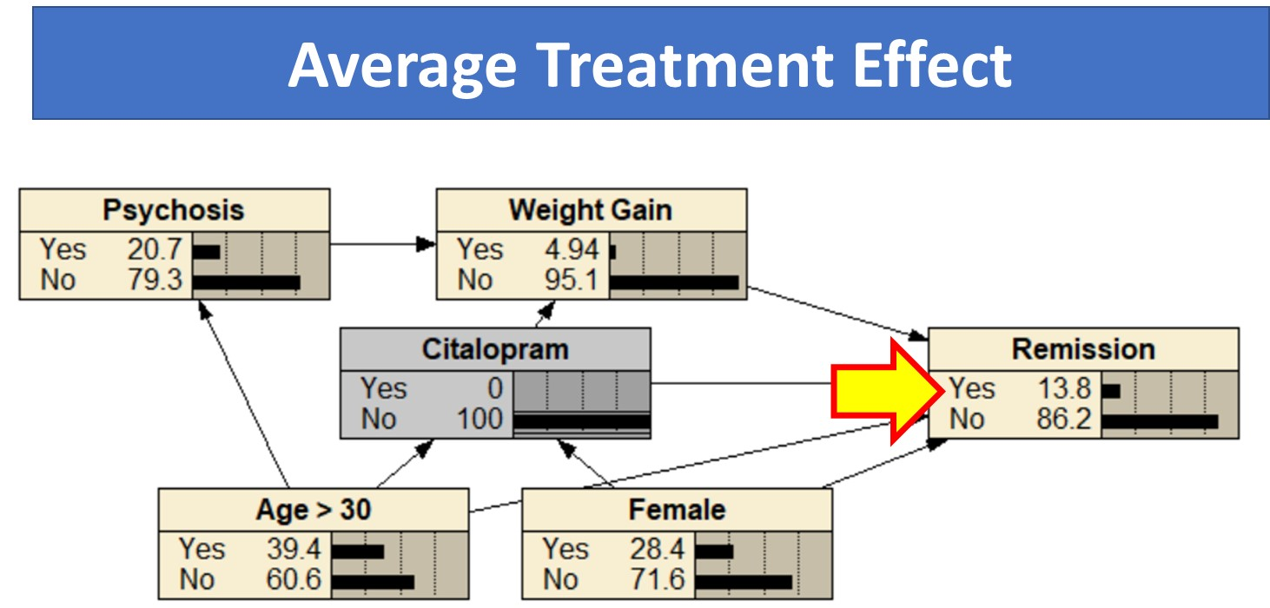
Notes:
13.8% experienced remission.

Slide 6
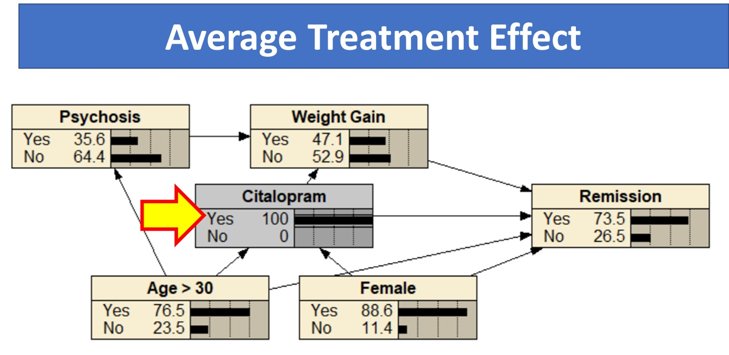
Notes:
Of the patients who took citalopram,

Slide 7
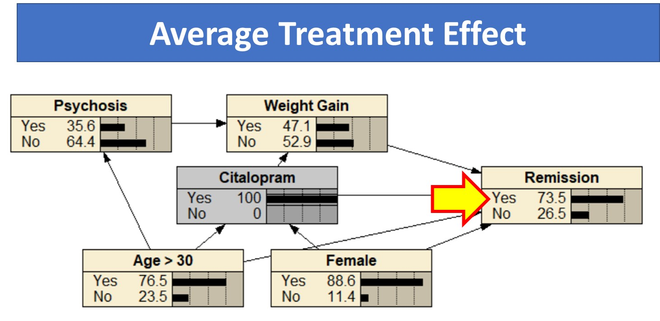
Notes:
73.5% experienced remission.

Slide 8
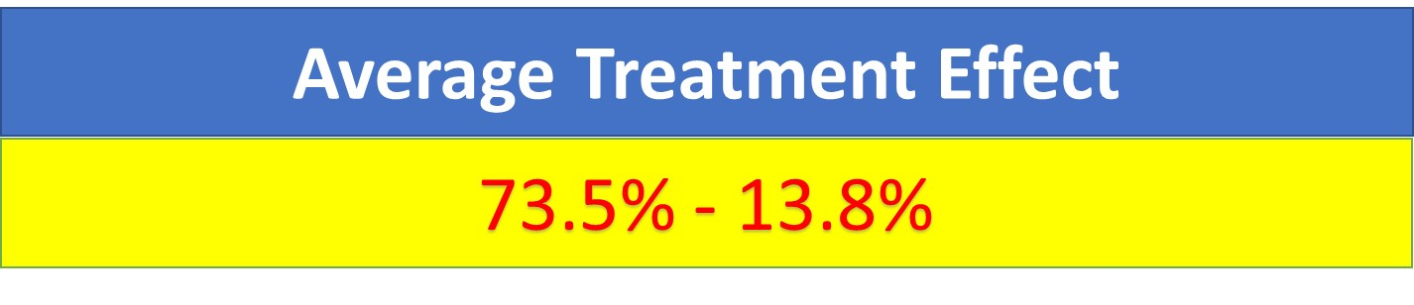
Notes:
The average treatment effect is the change in remission rate after you take citalopram. It is 73.5% minus 13.8%

Slide 9
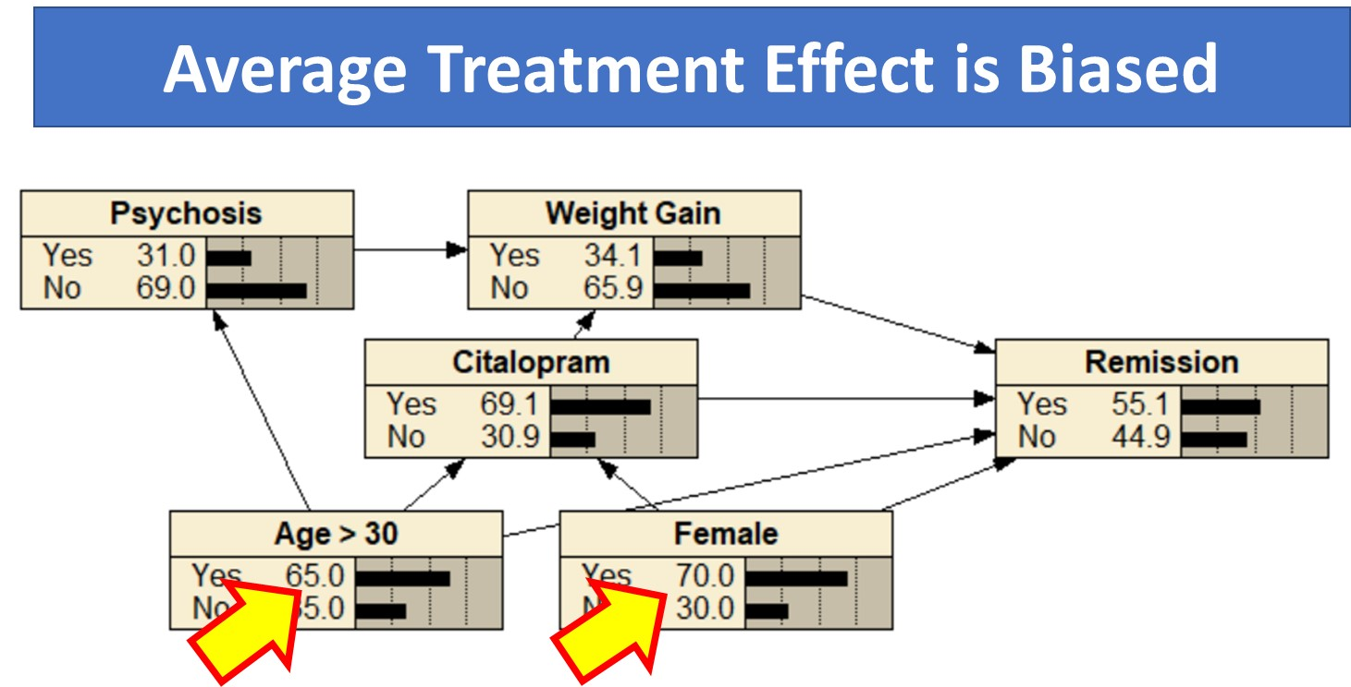
Notes:
The average treatment effect is biased by the fact that more women take citalopram and more patients over 30 years take citalopram.

Slide 10
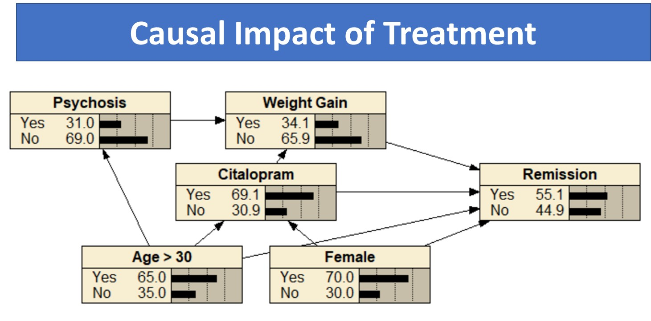
Notes:
Causal effect controls for selection bias. Let us look at how causal effect is calculated.

Slide 11
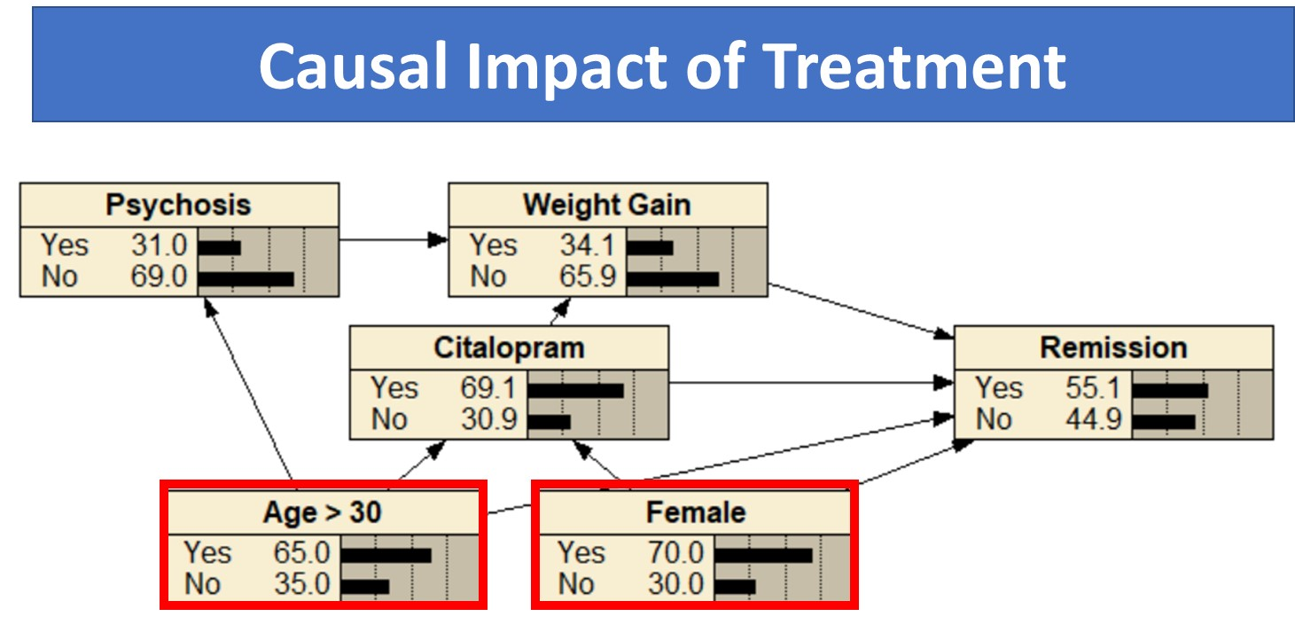
Notes:
To calculate causal effect, we need to block parents in the Markov blanket of treatment. This will block every backdoor from remission to citalopram that does not involve the descendants of citalopram.

Slide 12
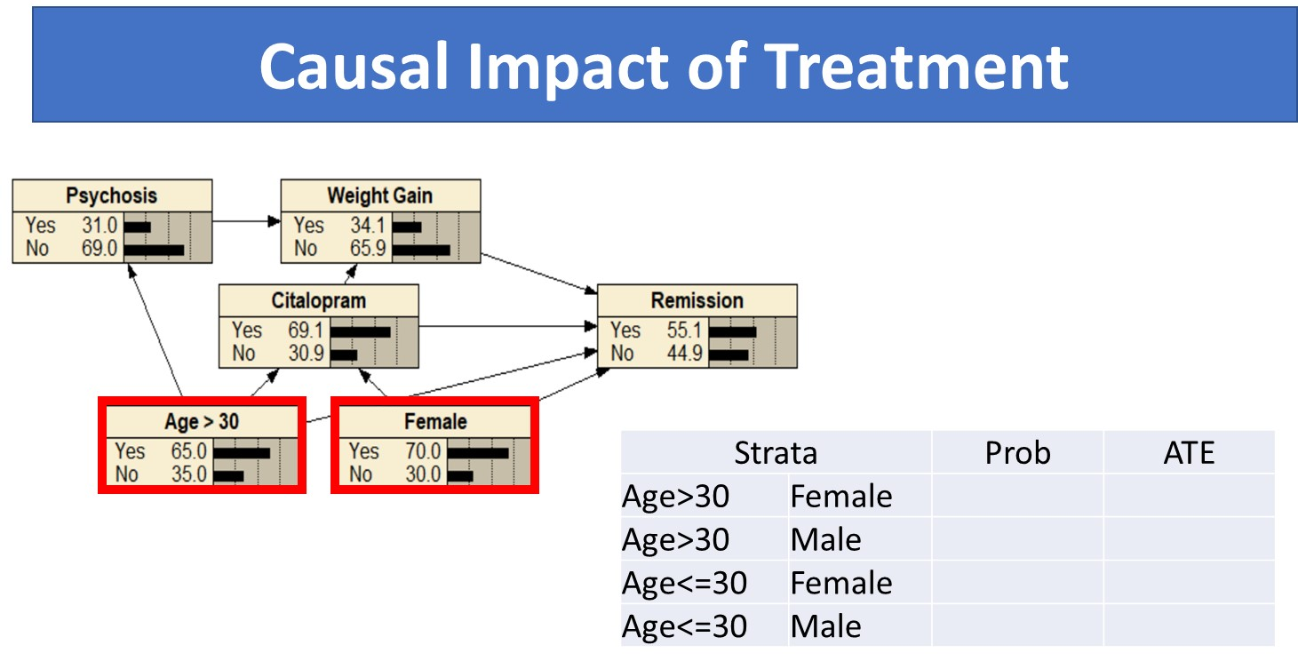
Notes:
To block the parents in Markov blanket, calculate the average treatment effect for every combination of the parents. Every combination of age and gender.

Slide 13
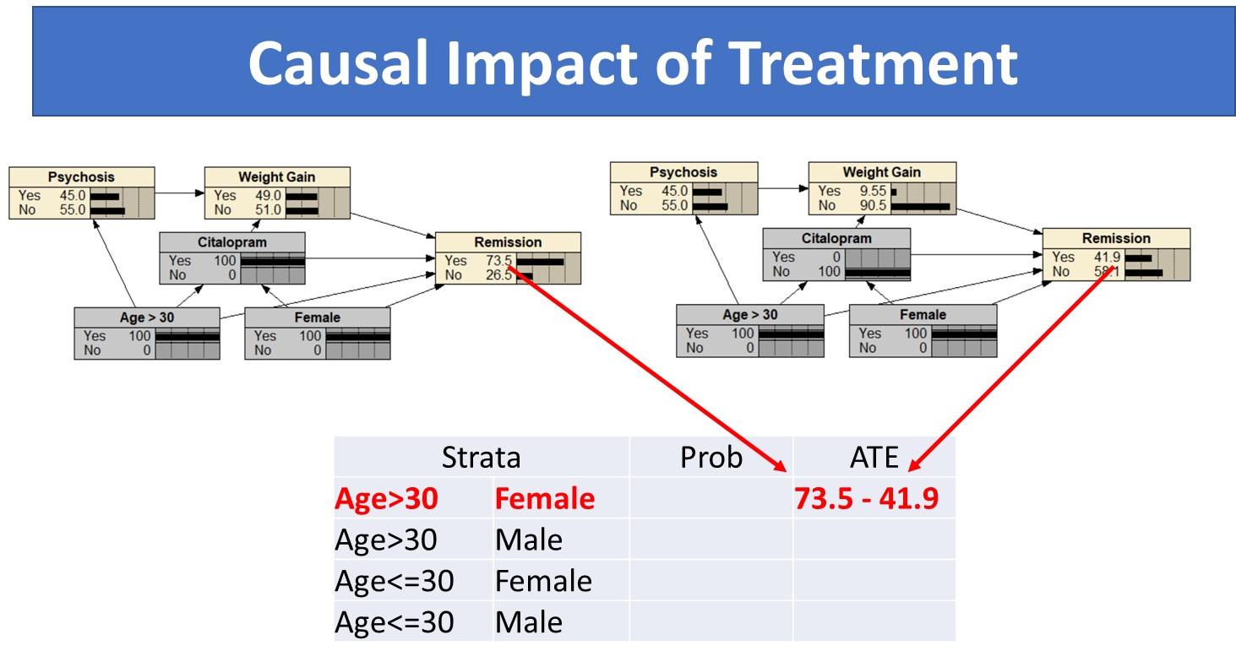
Notes:
For female patients over 30 years, citalopram users had 73.5% and patients not treated with citalopram had 41.9% remission rate.

Slide 14
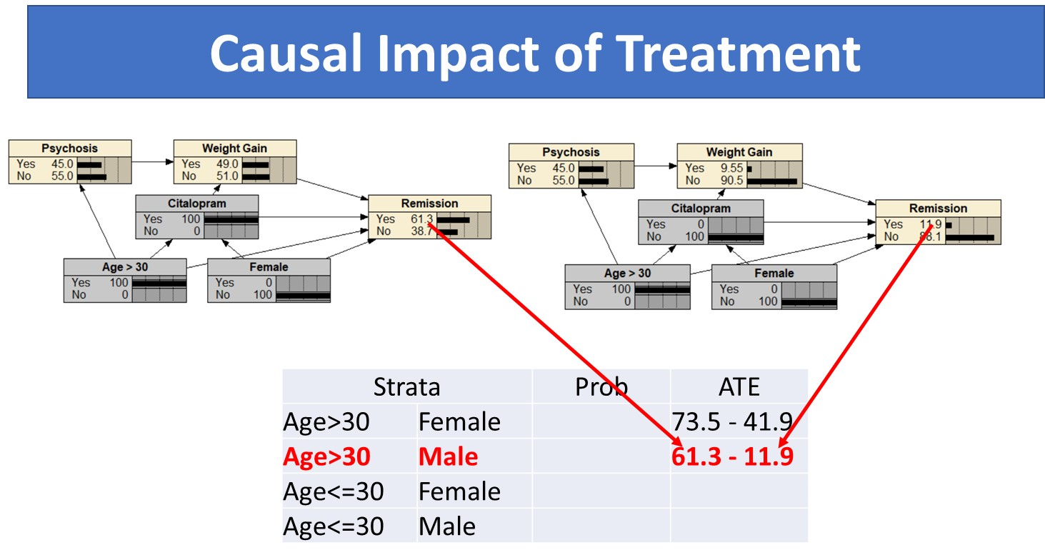
Notes:
For male patients over 30 years, patients treated had 61.3% remission rate and untreated patients had 11.9% remission rate.

Slide 15
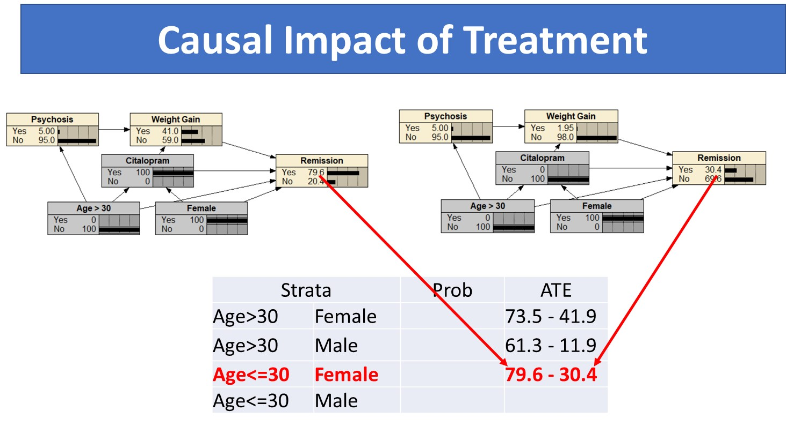
Notes:
For young females and young males, the treatment effect is also calculated.

Slide 16
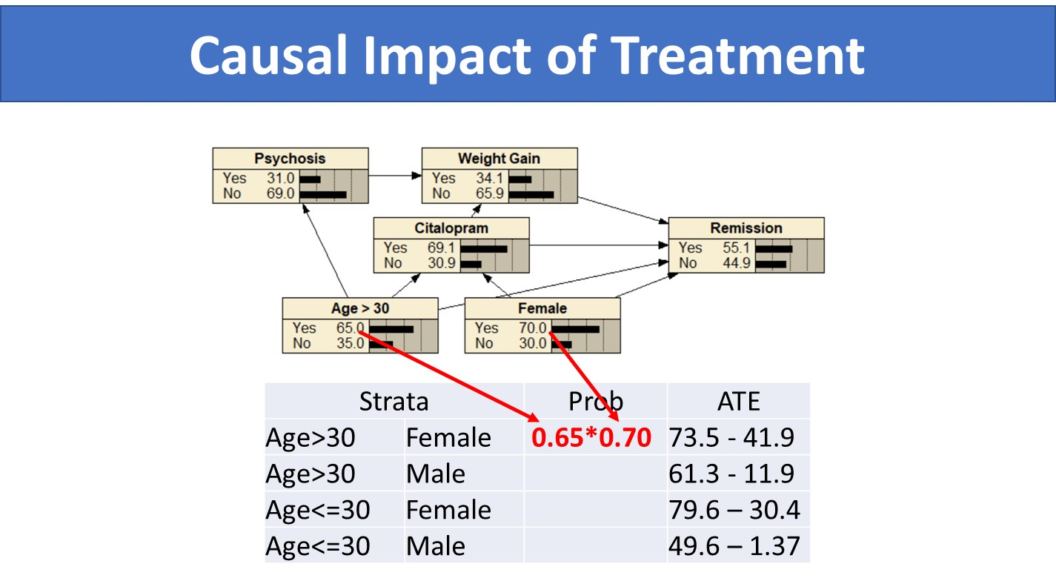
Notes:
Assuming independence of age and gender, the probability of a female patient being above 30 years old is product of the probability of each of these patient characteristics.

Slide 17
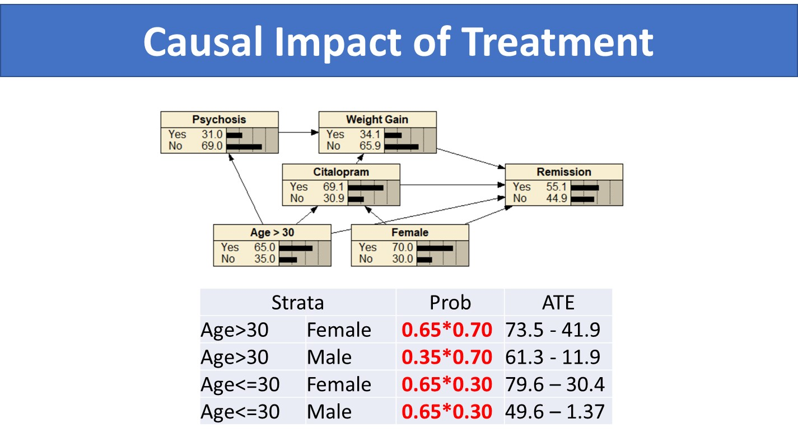
Notes:
Similarly, the joint probabilities of the other combinations of age and gender can be calculated.

Slide 18
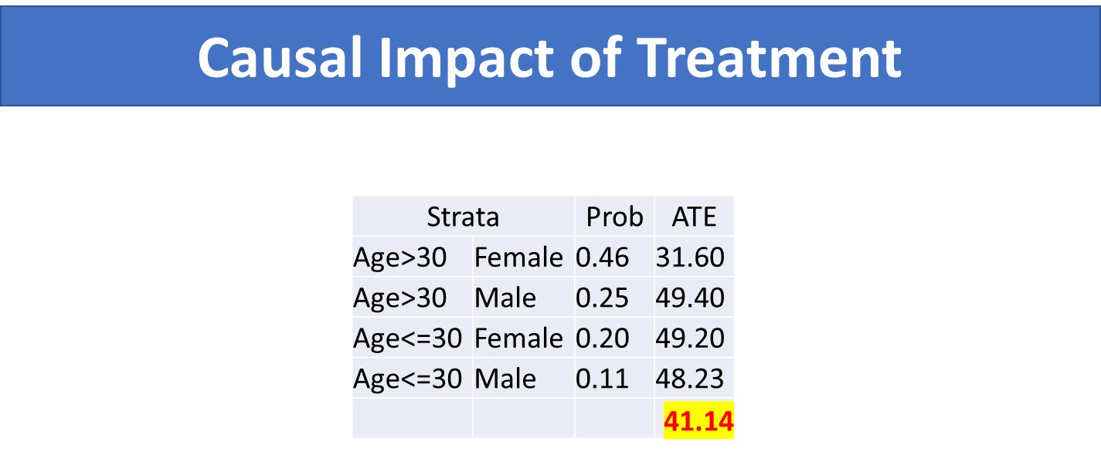
Notes:
The weighted average of the causal impact can now be calculated and it is 41.14%

Slide 19
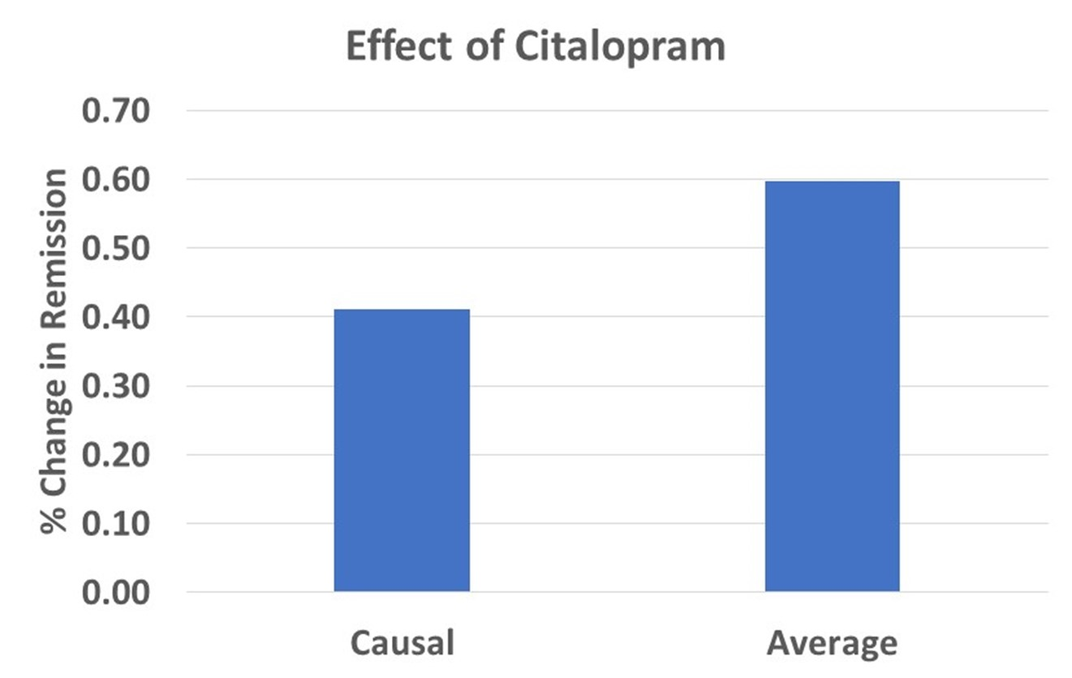
Notes:
This presentation has shown how causal and average treatment effects are calculated in Network models.

