Slide 1
Outcome Based Prescribing of Citalopram
Farrokh Alemi, PhD falemi@gmu.edu 703 893 3799
Aryan Mazloum

Slide 2
Personalized Analysis
Right Medication from Start

Slide 3
My Antidepressants Doesn’t Work
TRY & TRY ANOTHER
Picture taken from http://www.time.com/time/health/article/0,8599,1905083,00.html#ixzz0kWKdxlNH

Slide 4
False Start for Majority of Patients

Slide 5
Source of Data: STAR*D

Slide 6
4,041 major depression from 41 Clinics
Star*D

Slide 7
STAR*D
Demographic data (gender, age, race)
Medical History (cardiovascular, vascular, hematopoietic, eyes, gastrointestinal, renal, genitourinary, musculoskeletal, neurological, psychiatric, respiratory, liver, and endocrine diagnostic disorders)

Slide 8
STAR*D
Demographic data (gender, age, race)
Medical History (cardiovascular, vascular, hematopoietic, eyes, gastrointestinal, renal, genitourinary, musculoskeletal, neurological, psychiatric, respiratory, liver, and endocrine diagnostic disorders)
Comorbidities (Alcohol, Cannabis, Panic, Post-traumatic Stress, and Generalized Anxiety disorders)

Slide 9
50% reduction in Hamilton Depression Rating Scale
Who will respond to citalopram?

Slide 10
Confounding with Neurological Disorders
 |  | Cases | Controls
Age 41+ |  | 395 | 1102
Age 18-41 |  | 345 | 1061
Gender Female |  | 491* | 1299*
Gender Male |  | 249* | 864*
Race White |  | 557 | 1726
Race Not-White |  | 183 | 437
 | No comorbidities | 24** | 300**
 | Heart | 145** | 595**
 | Vascular | 218** | 482**
 | Hematopoietic | 81* | 160*
 | Eyes | 442** | 841**
 | Gastrointestinal | 397** | 694**
 | Renal | 65** | 89**
 | Genitourinary | 268** | 417**
 | Musculoskeletal | 417** | 850**
 | Cases | Controls
Psychiatric Illness | 171** | 389**
Respiratory | 319** | 595**
Liver | 102** | 149**
Endocrine | 245** | 452**
Alcohol Abuse | 43 | 110
Cannabis | 12 | 31
Panic | 38 | 86
Generalized Anxiety | 51 | 114
Total | 740 | 2,163

Slide 11
Method of Data Analysis: Sequenced Causal Networks

Slide 12
Average Age of Occurrence of Comorbidities

Slide 13
Average Age of Occurrence of Comorbidities
Later Events Do Not Influence Earlier Events

Slide 14
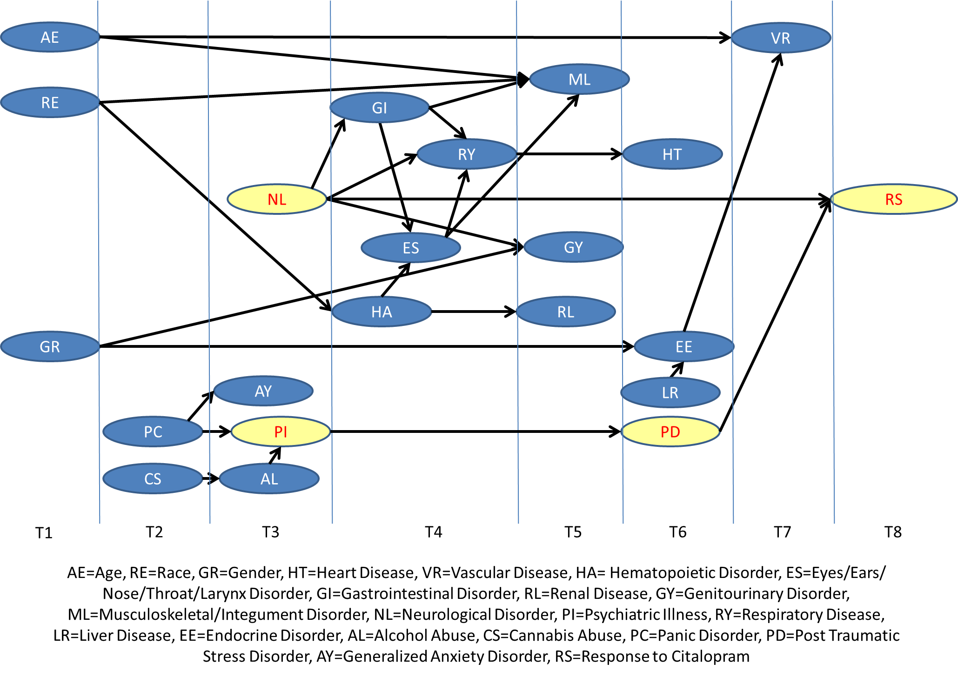
Network Predictive of Remission

Slide 15
Example Conclusion
Citalopram Is Not Helpful for Patients with PTSD or Neurological Disorders

Slide 16
Impact of Neurological Disorders & PTSD on Response
Disorders | Cases | Remission | X² | Common Odds Ratio
Neurological Disorder | 740 | 332 | 11.80* | 0.74
Post-Traumatic Stress Disorder | 158 | 56 | 8.31* | 0.53
* Significant at alpha 0.05

Slide 17
You?
Could we help

