Slide 1
Creating Bipolar Datasets in All of Us
Farrokh Alemi ,PhD , Abdul Hafeez, PhD, & Ledo Thankachan
Notes:
These slides show you how to create Bipolar database in All of Us,

Slide 2
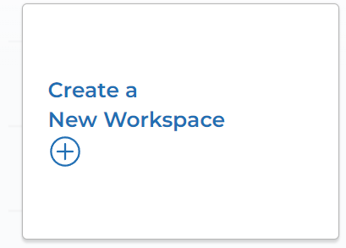
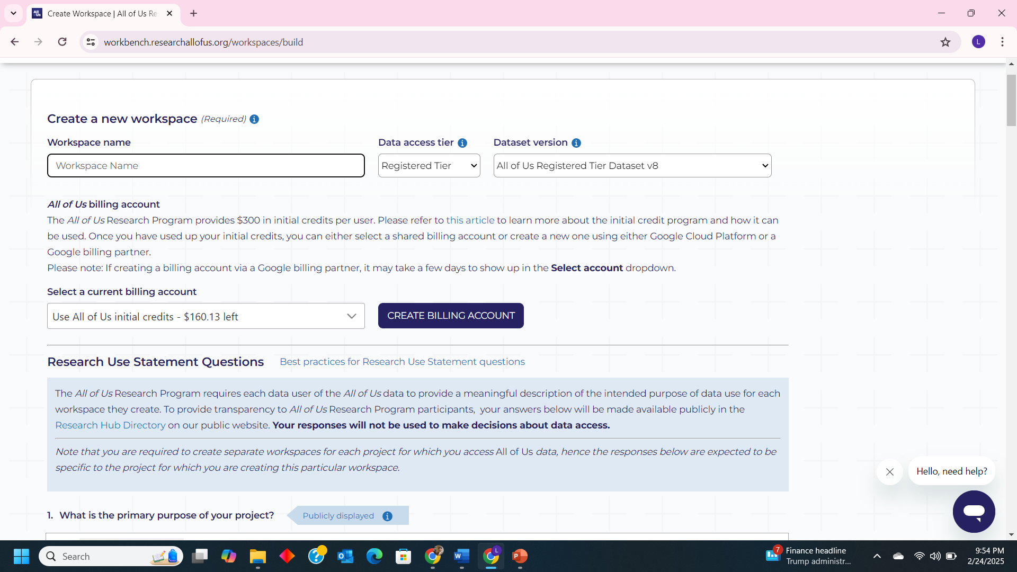
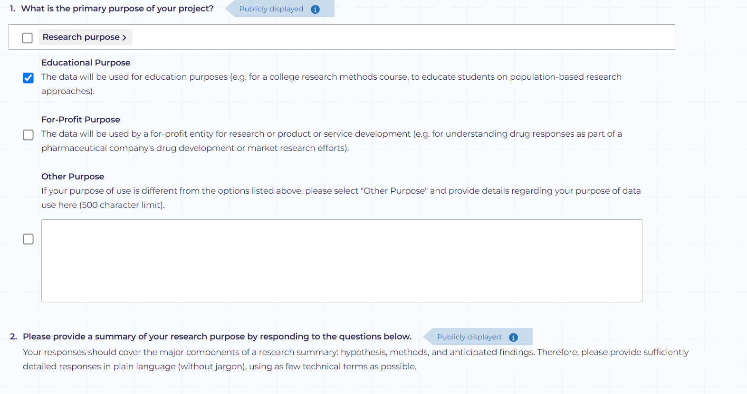
Notes:
Give a name and keep rest of the information as it is.

Slide 3
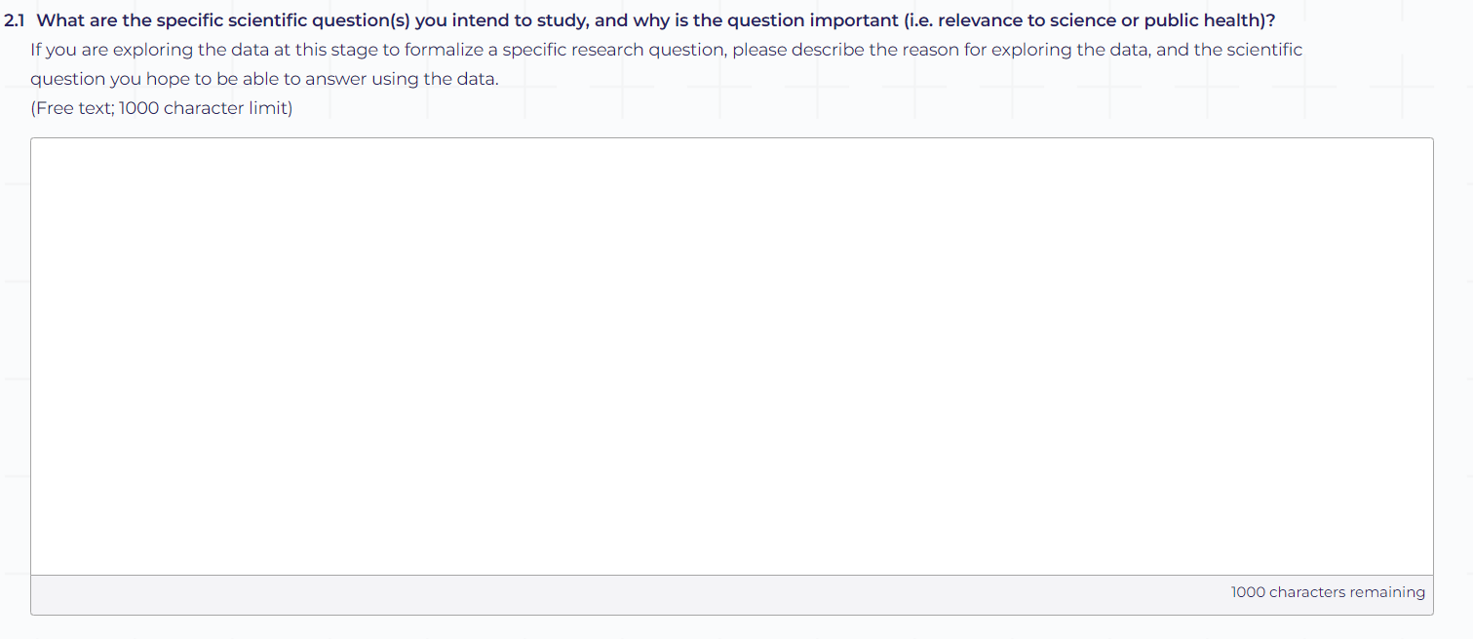
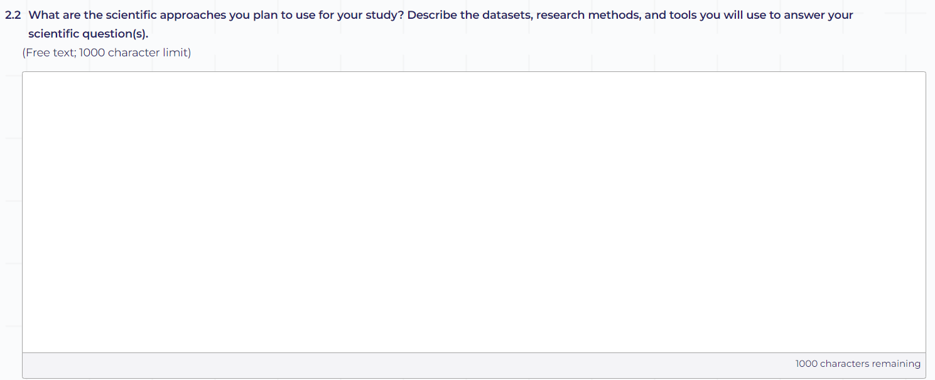
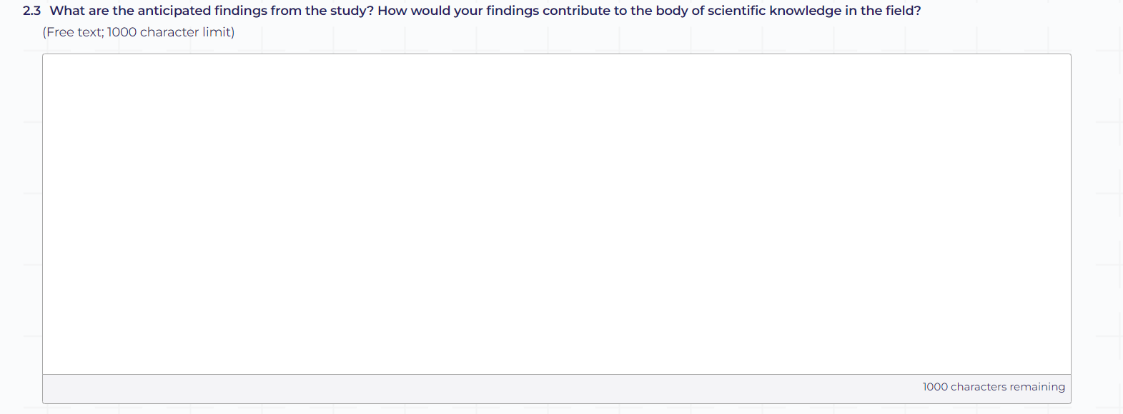
Notes:
Write about 2 lines regarding our project on your won words.

Slide 4
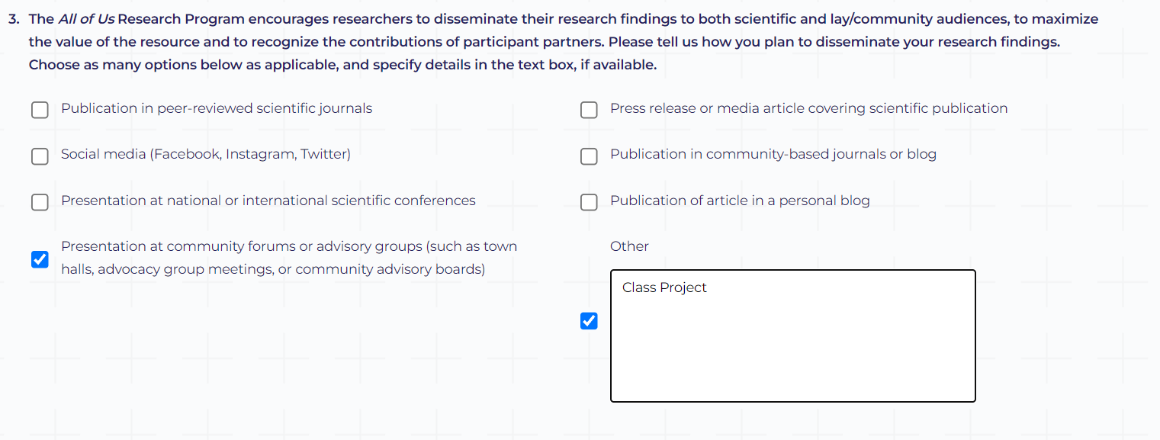
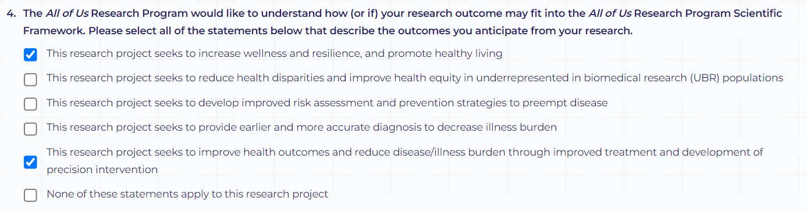
Notes:
Select these as we are trying to find the effect of drugs on Bipolar disorder

Slide 5
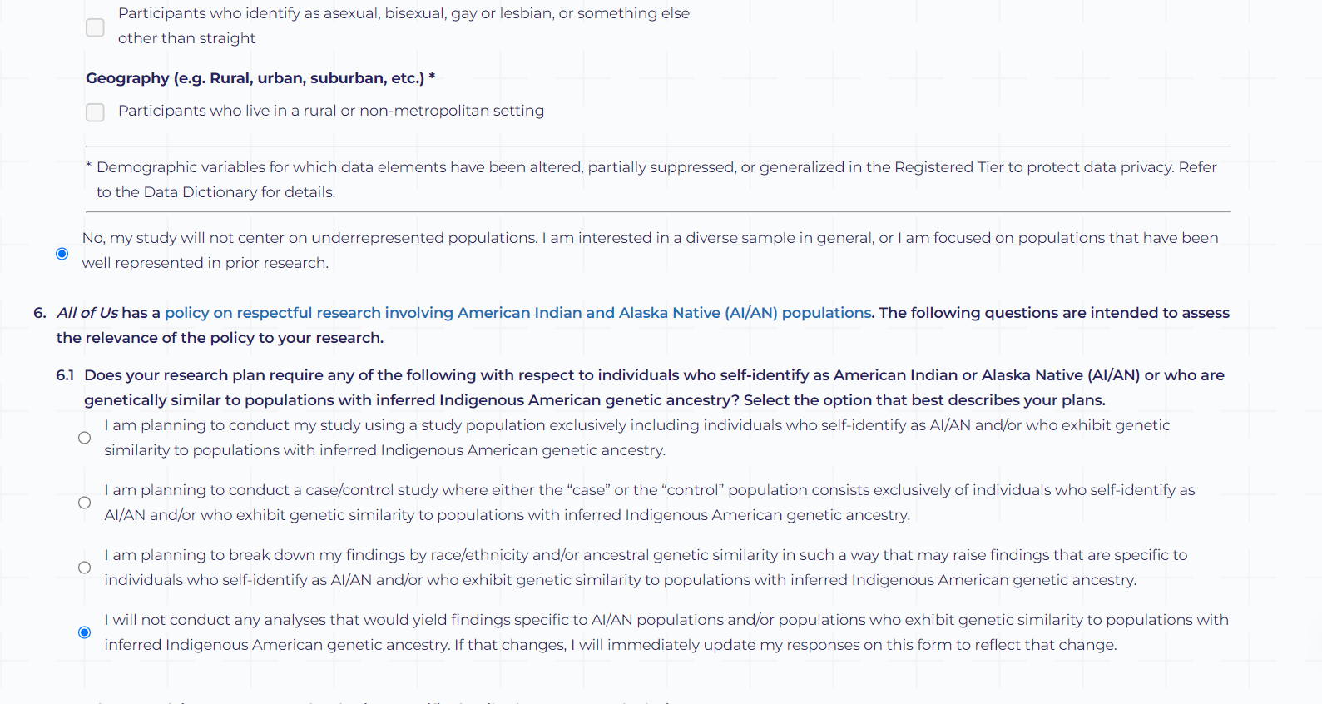
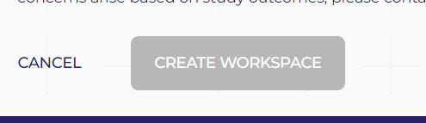
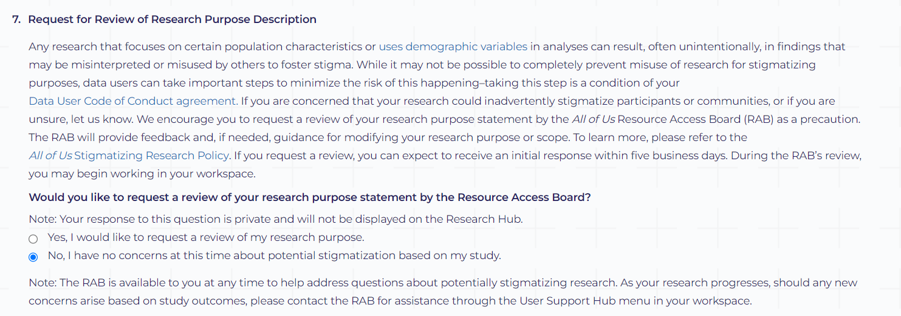
Notes:
We are interested in all races, adults, all genders who have bipolar disorder

Slide 6
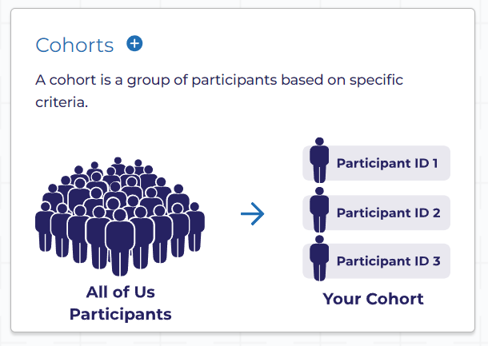
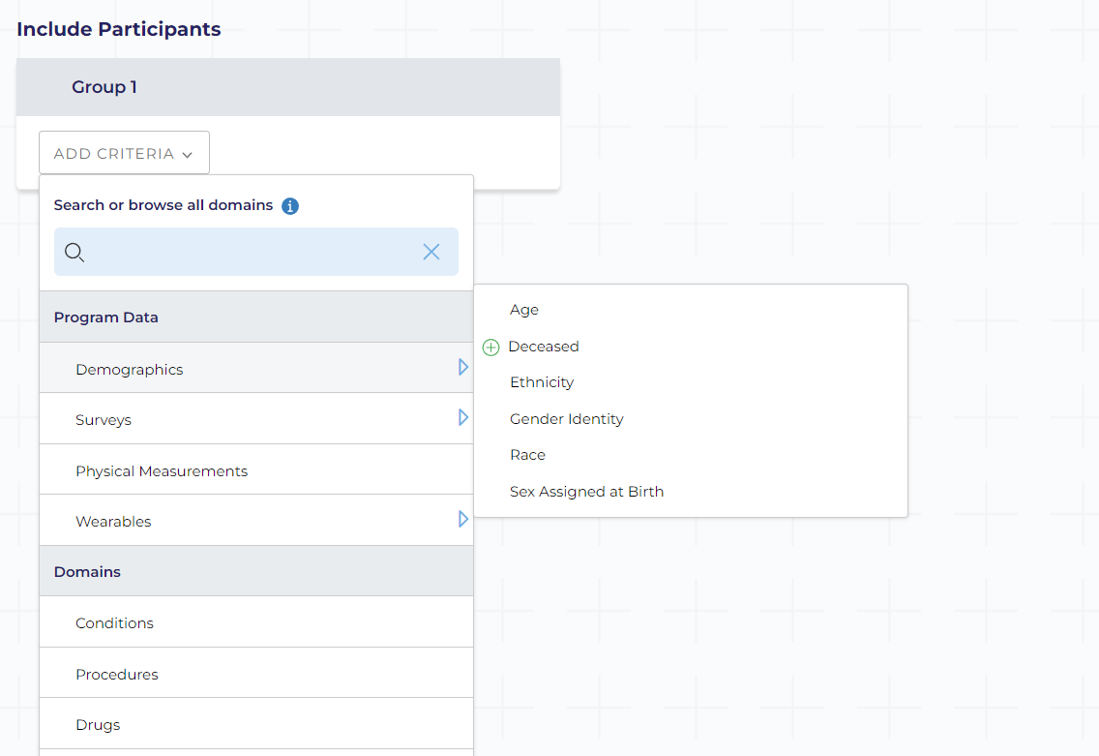
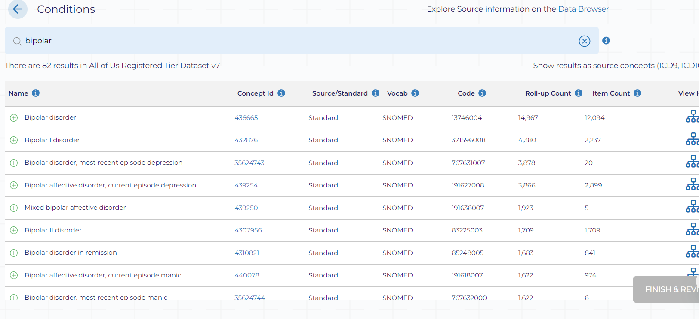
Notes:
Select cohort then add criteria condition

Slide 7
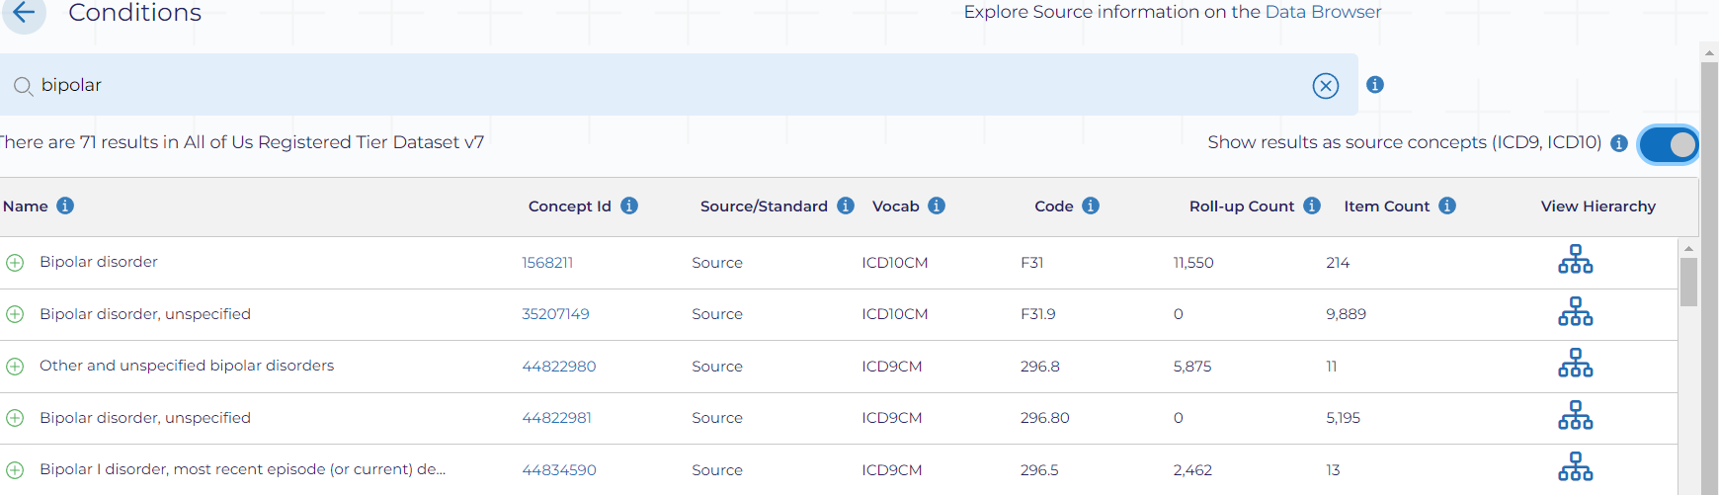
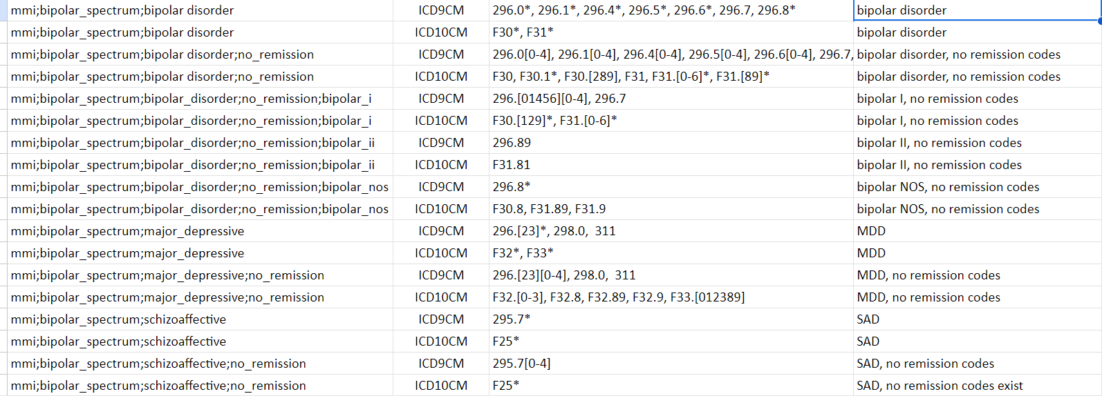
Notes:
Select Show results as source concepts (ICD9, ICD10) and use all the codes below to build data set

Slide 8
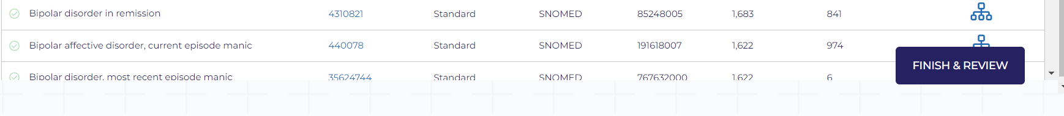
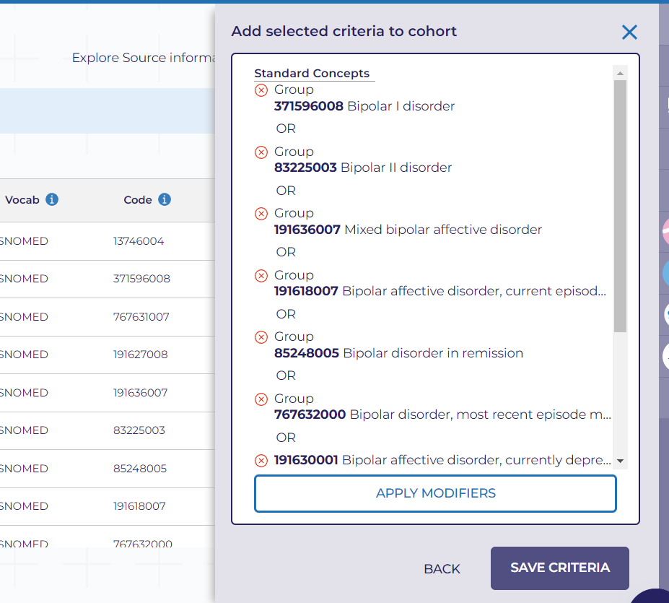
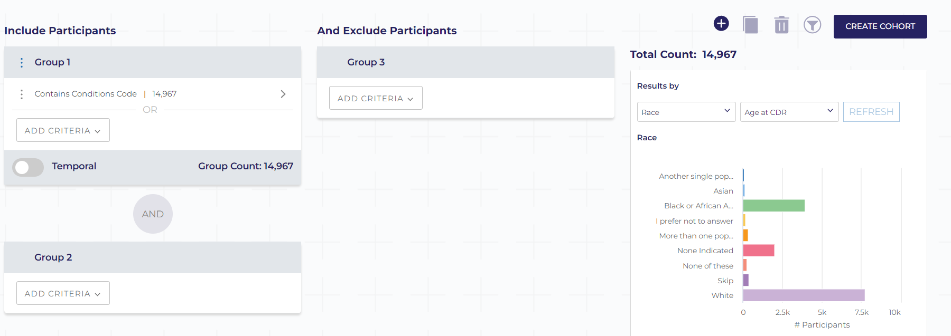

Slide 9
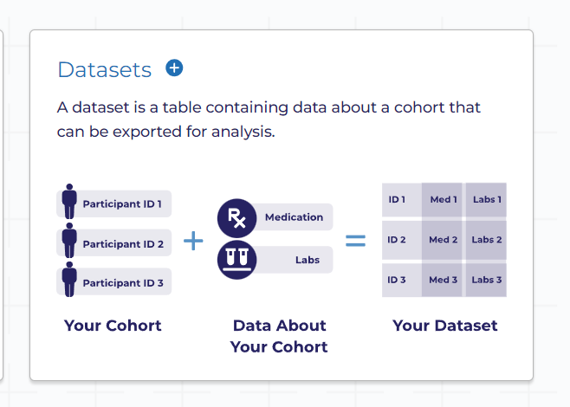
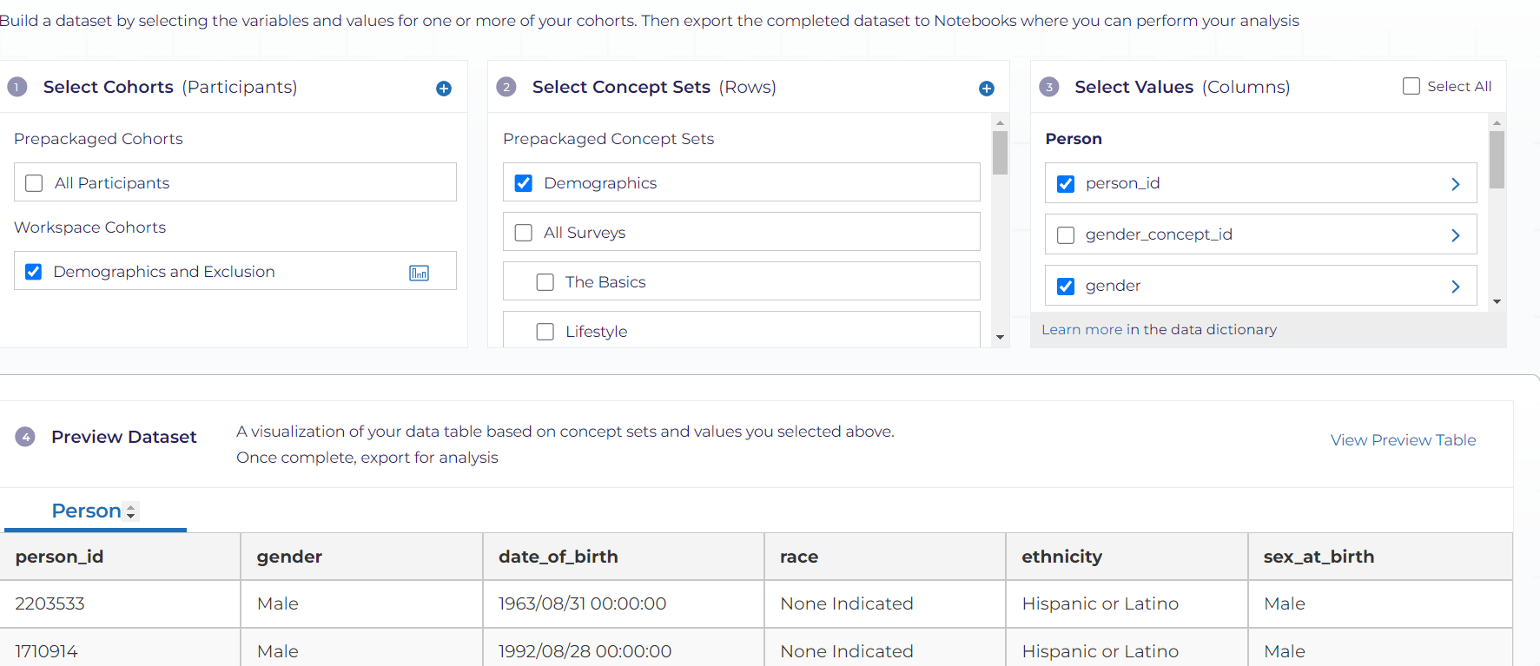
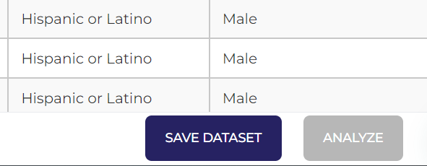
Notes:
Save and give a name as demographics

Slide 10
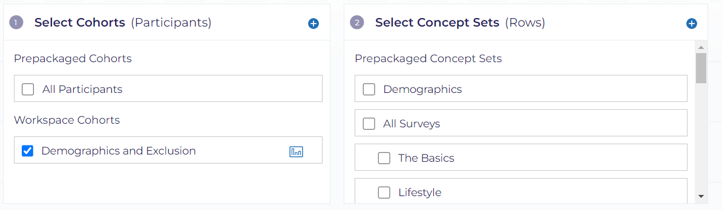
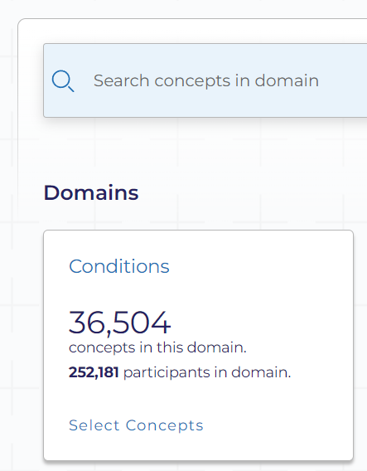
Notes:
Select demographics and select + sign on concept set and select condition

Slide 11
Notes:
Select Show results as source concepts (ICD9, ICD10) and use all the codes below to build data set

Slide 12
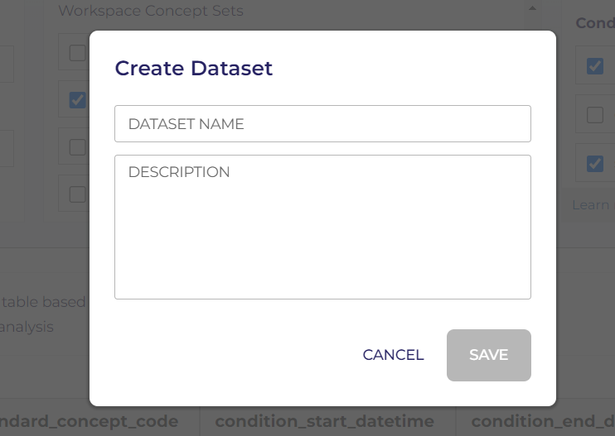
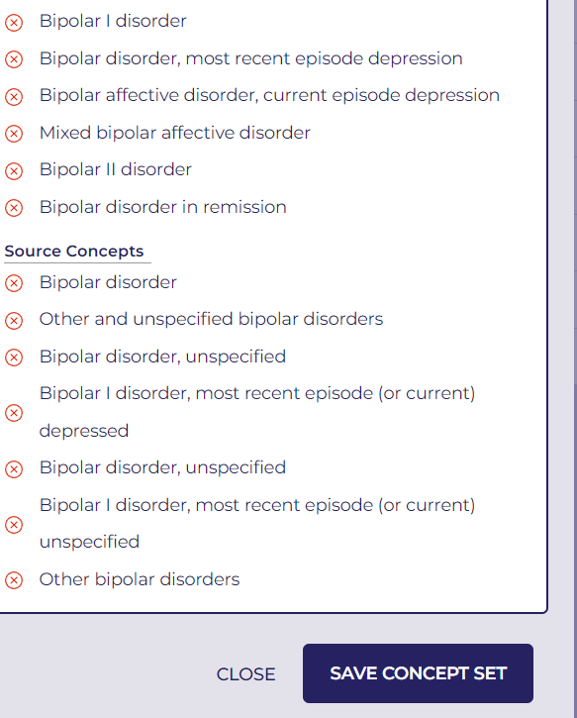

Slide 13
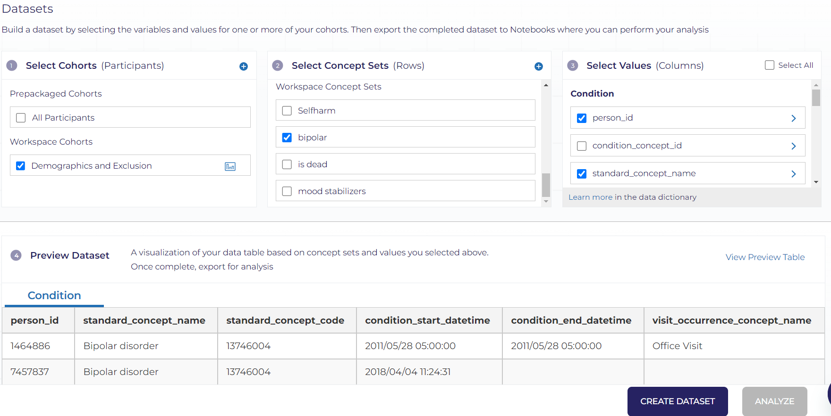

Slide 14
Notes:
Select demographics and select + sign on concept set and select condition

Slide 15
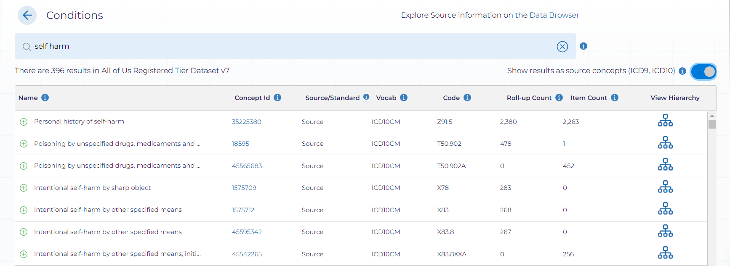

Slide 17
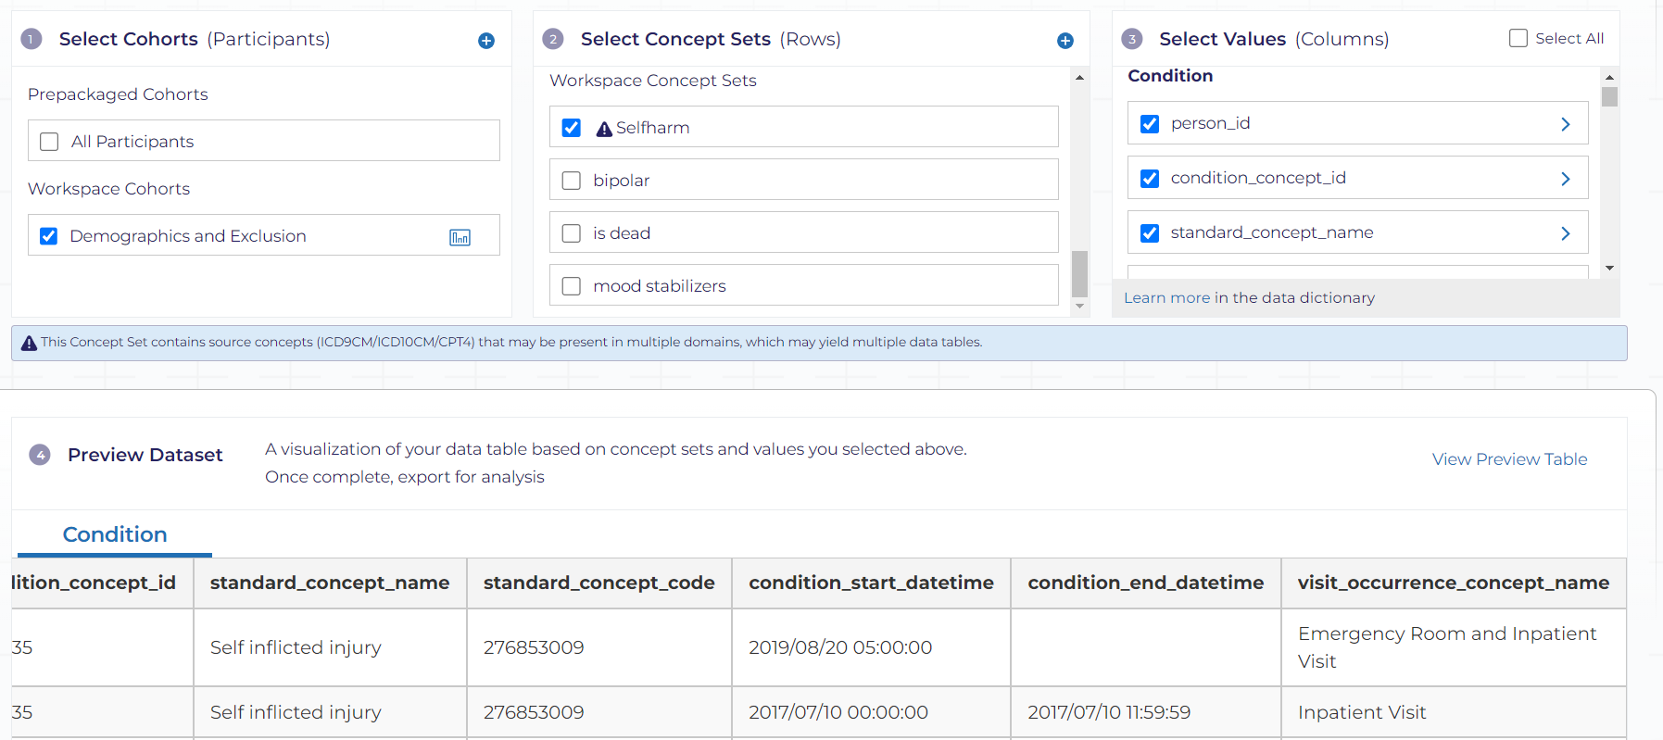
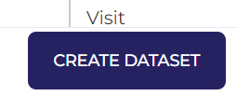
Notes:
Select only the columns required those are the ones that I am showing

Slide 18
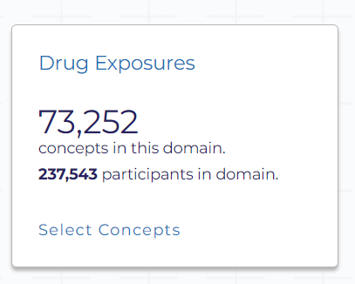
Notes:
Select demographics and select + sign on concept set and select drugs

Slide 19
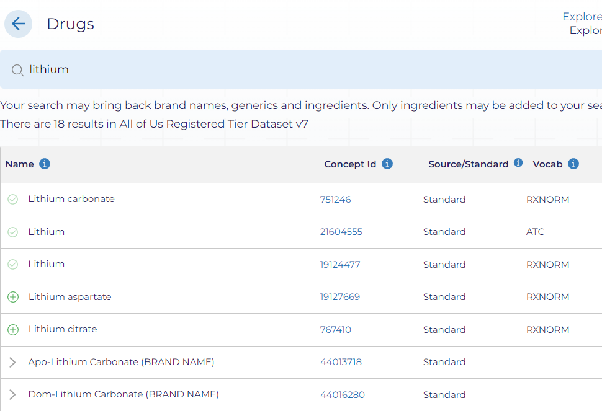
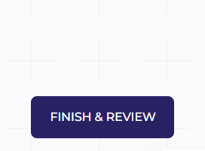
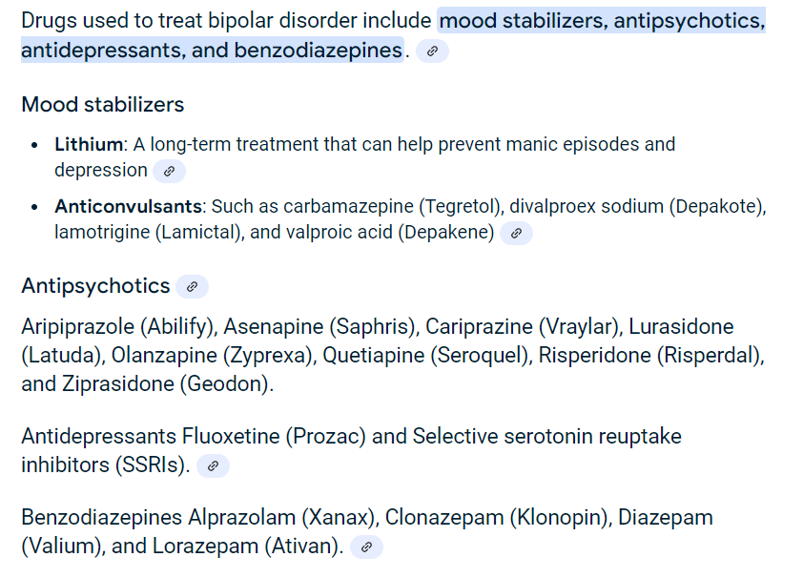

Notes:
We will select all these drugs along with antidepressants has we are doing drug level analysis

Slide 20
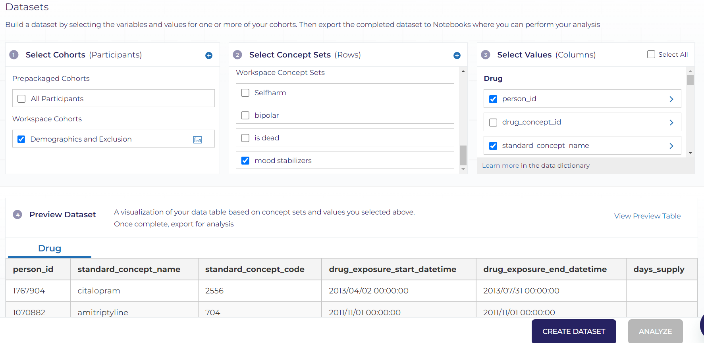

Slide 21
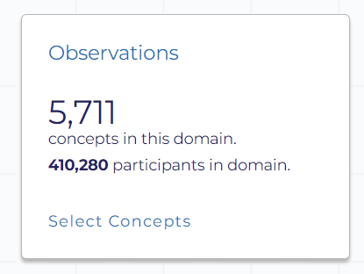

Slide 22
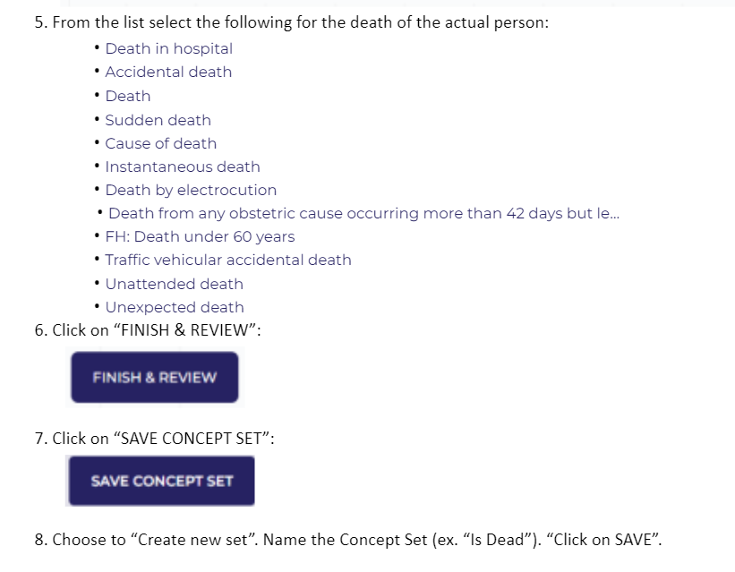

Slide 23
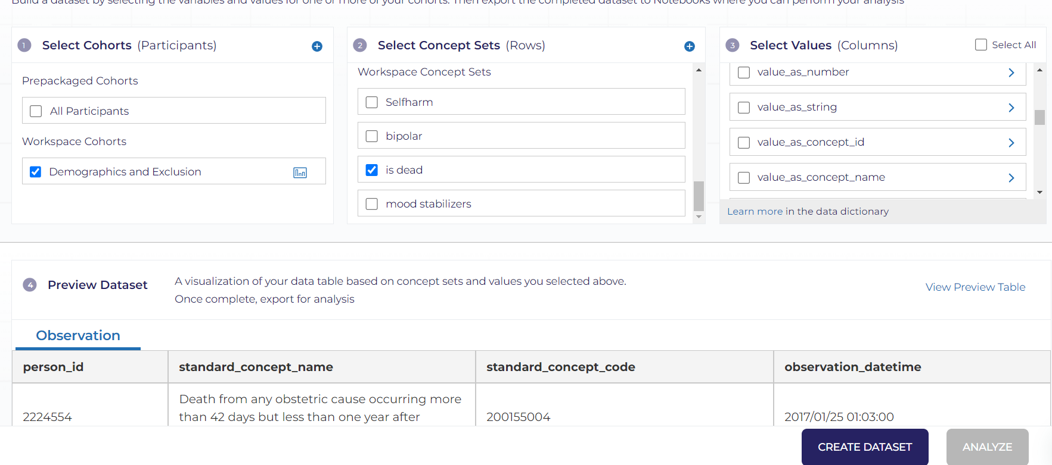

Slide 24
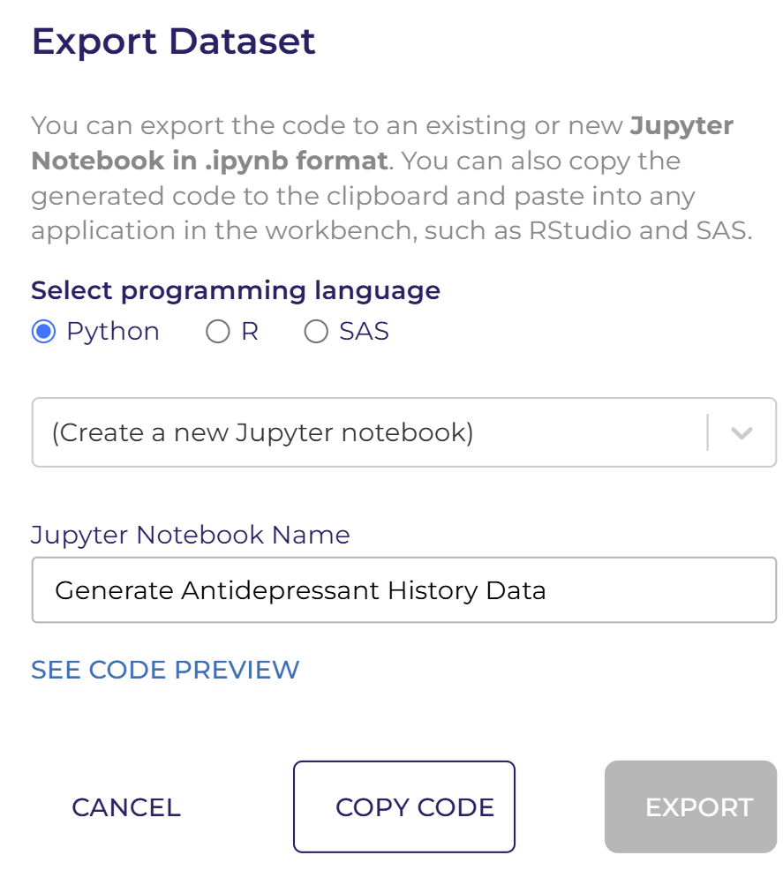
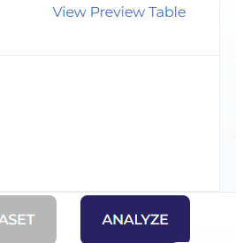
Notes:
Click on "Analyze,“after that select Python, then choose the notebook created earlier: and click "Export.“ Repeat fo

Slide 25
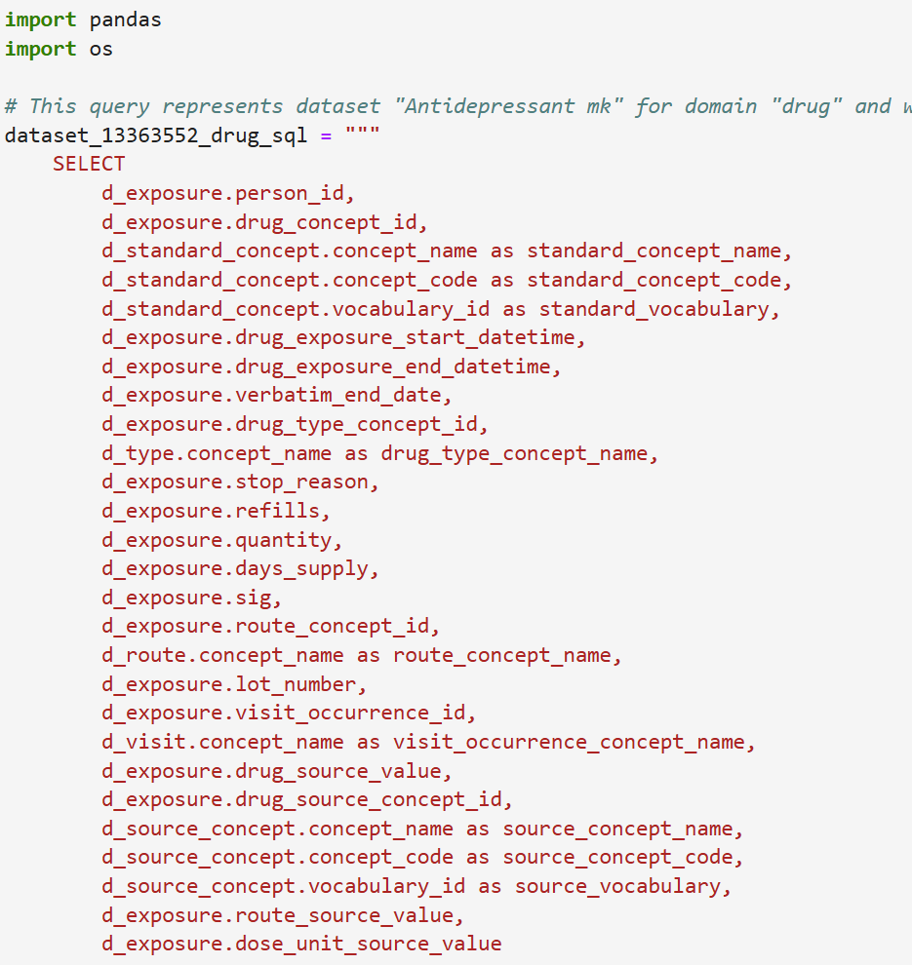
Notes:
This code queries the “bipolar_drug_data" dataset for drug exposure information in the All of Us.

Slide 26
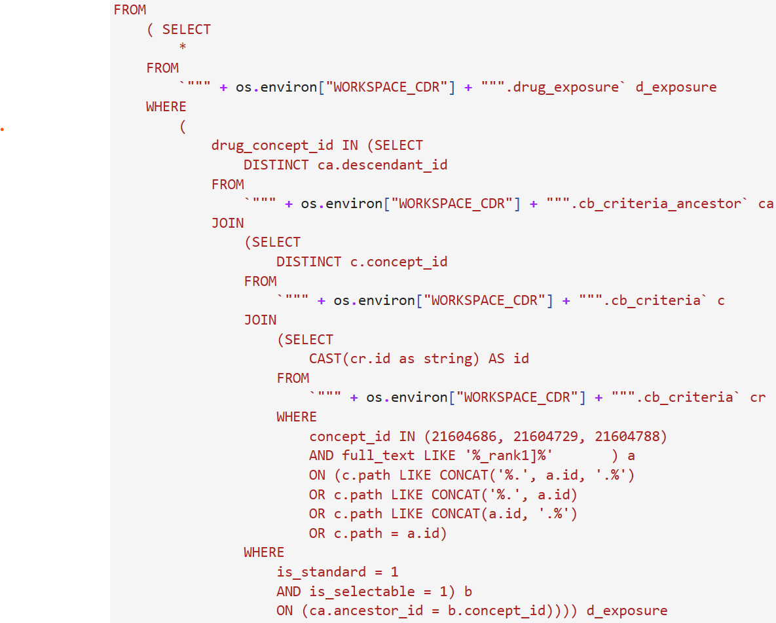
Notes:
This code joins multiple tables to retrieve detailed drug exposure.

Slide 27
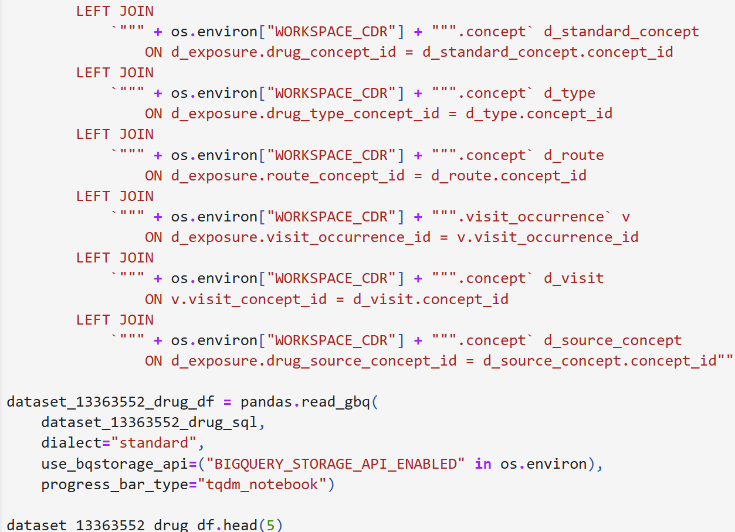
Notes:
The query is executed using pandas to load the result into a DataFrame for analysis.

Slide 28
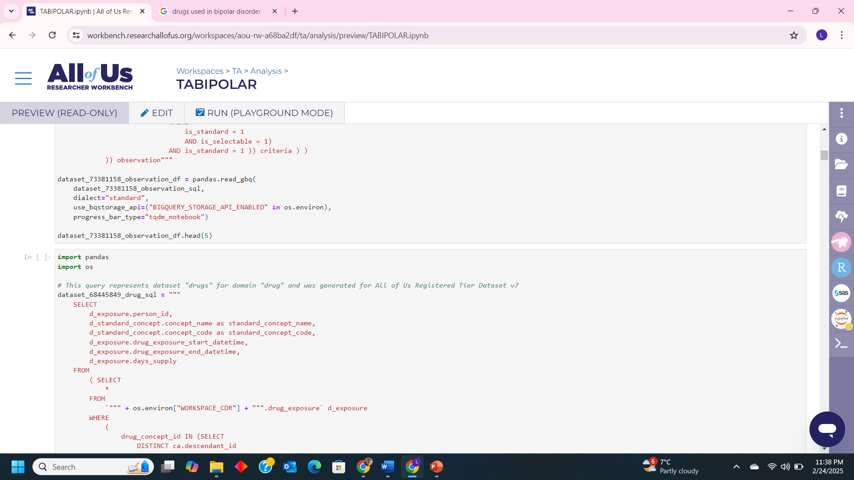
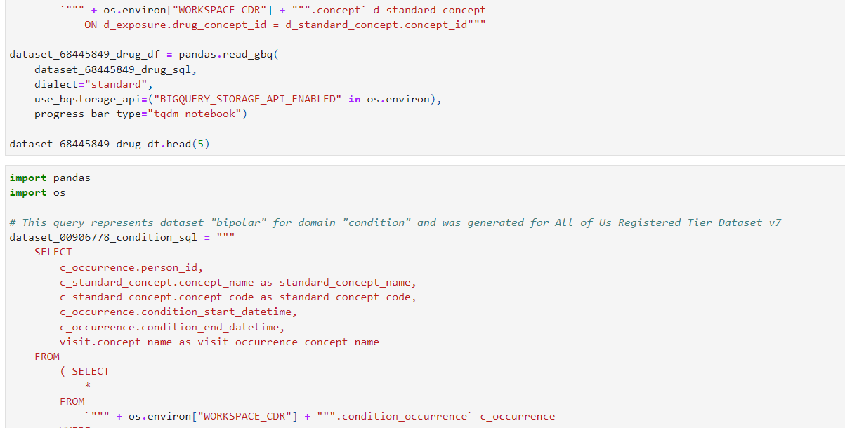

Slide 29
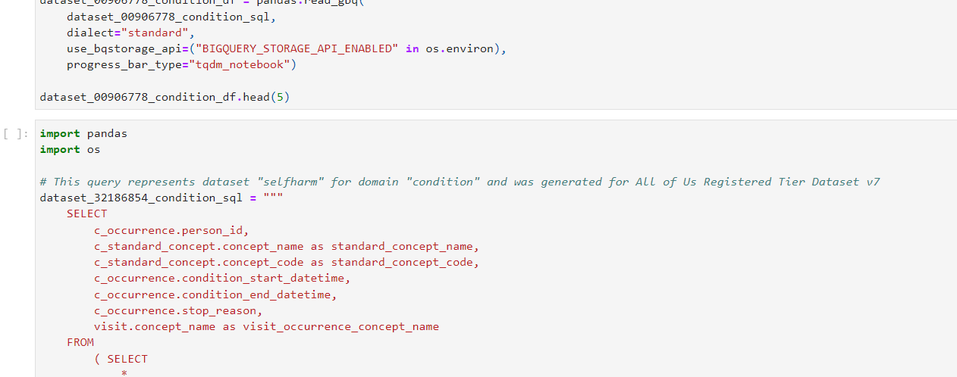
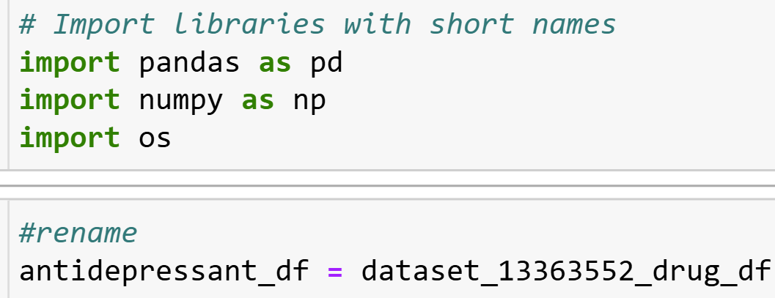
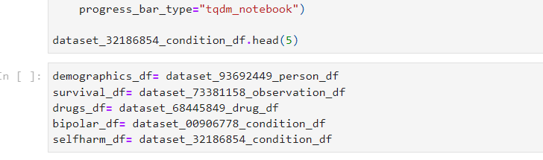
Notes:
Import Libraires and rename datasets for our ease

Slide 30
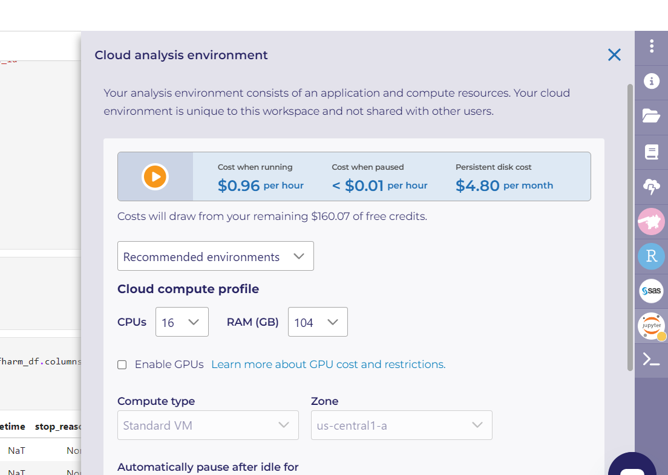
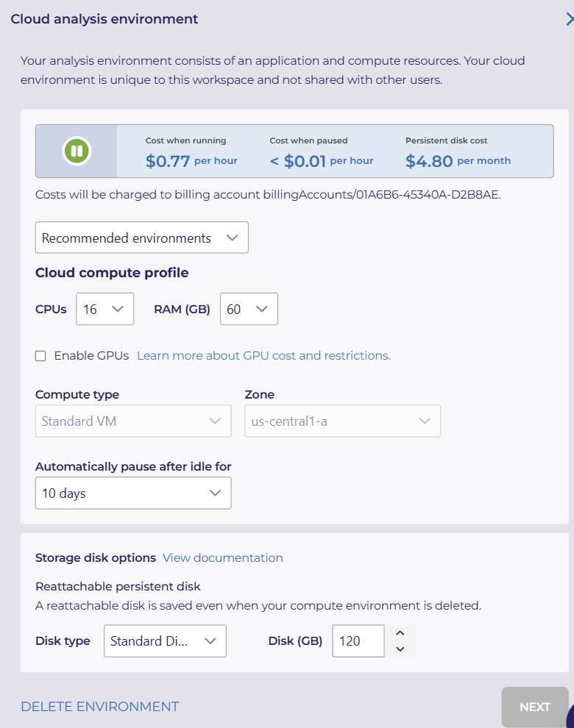
Notes:
Select 16 CPUs and 60 GB RAM, then set the system to automatically pause after 10 days of idle time. Finally, click "Next."

Slide 31
Thank you
Notes:
The takeaway from this presentation is to outline the steps in creating All Of Us Bipolar dataset for effective analysis

