Slide 1
Do Operation, Adjustment Formula & Backdoor Criterion
Farrokh Alemi, PhD.
2/8/2024
Morgan SL, Winship C. Counterfactual and causal inference. Cambridge University Press 2007
Notes:
This lecture introduce the do operation, backdoor blocking through conditioning and stratification. The lecture is based on work of Pearl on causality and articles and book written by Morgan and Winship on counterfactual and causal inference.

Slide 2

Observational Data
Misleading Comparisons
Notes:
People argue that in observational data there are many reasons why an outcome has occurred and comparing the outcomes of two patients is like comparing apples with oranges: an unequal and misleading comparison. We do not really know if the observed differences are due to the cause or to some alternative explanation. Here we do not know if the observed outcome is due to color differences or to the fact that one is an apple and the other an orange.

Slide 3
Model Away Some Observed Correlations
Common Effect Subgroup Correlations
Common Cause Correlations
Notes:
Observed data also contain many correlations that are due to confounding. Common causes produce a correlation in their effect. This correlation should not be modelled as an association between the variables but as a common cause. Common effects are correlated when the effect is held constant. This correlation too should not be modelled as an observed association in the variables but as subgroup anomality of common effect. These correlations occur in data but should be modelled as their underlying causal structure and not as real associations. If we get the structure right we have already modelled these correlations.

Slide 4
Observational Data
Misleading Comparisons
Selection Bias
Vanishing Association
Sicker Patients
Notes:
These observed correlations are described in different ways. Clinicians often use the observed association between covariates, a common cause of outcome and treatment, as reason to discard the analysis as not adjusting for their patients. Statisticians refer to these associations as selection bias. A vanishing correlation that exists in treatment and outcome but disappears when covariates are controlled statistically.

Slide 5

Adjustment Formula
Misleading Comparisons
Potential Outcomes
Notes:
Adjustments and statistical controls remove the effects of selection bias, reduces parsimonious correlations in observational data, and allows us to compare treatment for the same set of patients.

Slide 6

Adjustment Formula
Misleading Comparisons
$$p\left(Y | X\right)$$
Potential Outcomes
Notes:
The conditional probability of outcome Y given treatment X is the average treatment effect. This conditional probability is distorted by the common causes of both X and Y, what statistician call covariates of treatment and outcome. These distortions must be removed before examining the effect of X on Y.

Slide 7
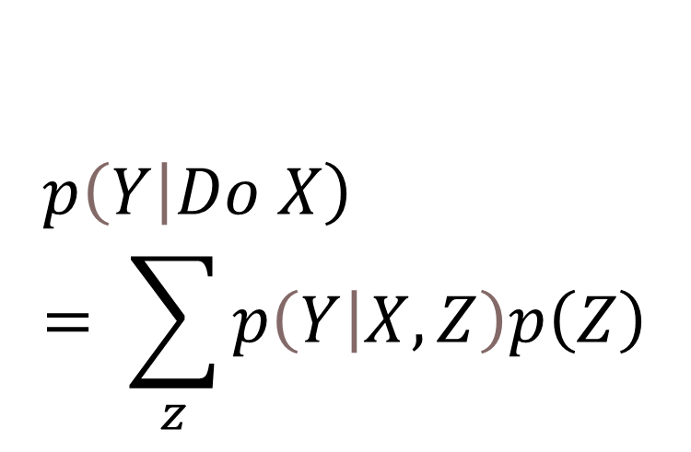
Adjustment Formula
Misleading Comparisons
$$p\left(Y | X\right)$$
Potential Outcomes
$$\left.p\left(Y\right|Do X\right)= \sum_{z}{p\left(Y | X,Z\right)p\left(Z\right)}$$
Notes:
Adjustments Remove the effects of selection bias, reduces parsimonious correlations due to common causes in observational data, and allow us to compare treatment for same set of patients. Here the variables Z is the set of adjustment variables.

Slide 8



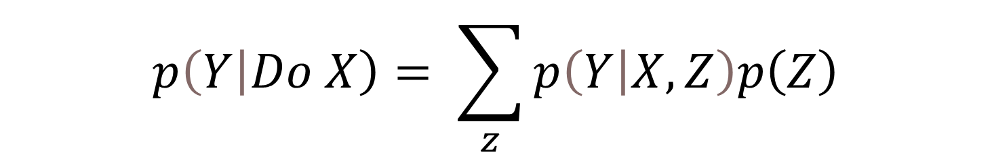
$$\left.p\left(Y\right|Do X\right)= \sum_{z}{p\left(Y | X,Z\right)p\left(Z\right)}$$
Treated
Untreated
X
Ceteris Paribus on Z
Strata
Notes:
Stratification is a process of comparing two situations with one difference. In one situation, the treatment X is present and in the other it is absent. In stratification of observational data cases are matched on all relevant aspects except one. These matches are not only on several conditions but all combinations of these conditions. Then comparing the two strata allows us to detect difference that the treatment makes. Stratification allows us to set up the environment so that we are not comparing apples to oranges but apples to apples and oranges to oranges. Here we see two situations. We match every fruit within the first basket with every fruit in the second situation. These matches are made on the set of variables in Z by weighting them so that treated and untreated group have the same weighted variables. Then the difference in outcomes in the two situations is attributed to the cause, present in the first but absent in the second situation. Economists refer to this as holding all other things constant or “ceteris paribus.”

Slide 9
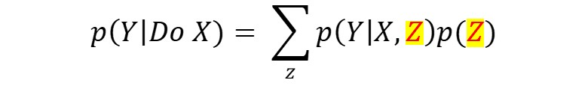
What Do We Adjust For?
Notes:
But what are the adjustment variables and how do we find me in observational data?

Slide 10
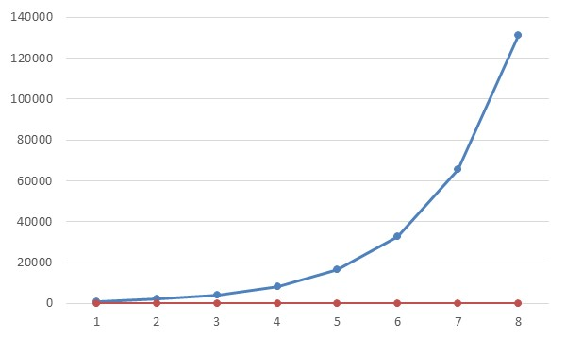
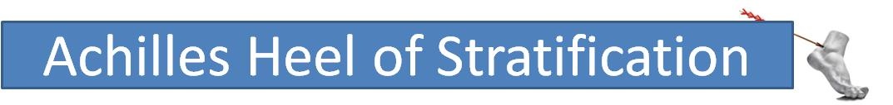
Explosion
Impractical
Many
Few
Ouch
Notes:
A bit of history. Stratification was around in 1950s, before the creation of potential outcome methods. Some scientists abandoned stratification. The main reason was because stratification or conditioning was problematic. In most realistic problems, there were too many covariates and combinations of covariates. Stratification was not practical in these situations. Sufficient data may not be available to accurately assess the impact of the cause within each strata. The situation changed with directed networks came about and concepts of d-separation and Back-door were clarified. In this lecture, we define these concepts and see how networks help make stratification more practical.

Slide 11
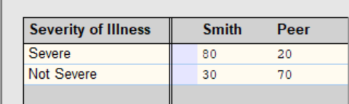
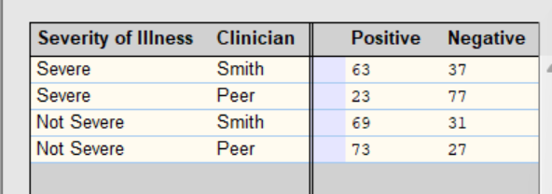
Distortions Caused by Common Causes
Notes:
Lets examine a simple network of 3 variables. We have three nodes, one describing the severity of illness of the patient. The other if clinician smith took care of the patient or his peer. The third the outcome of care. Severity of illness is a common cause of both visits to smith and outcome of care. The clinician node is our treatment node. We are interested in the effect of this node on outcomes. The tables provide conditional probabilities of Dr. Smith seeing severe patients and the conditional probability of observing outcomes.

Slide 12
Distortions Caused by Common Causes
Sicker patients visit Smith
Notes:
Dr. Smith points out that he is seeing sicker patients than his peer and we should not blame him for poor outcomes because that is really not his care but the reflection of type of patients he is seeing.

Slide 13
Distortions Caused by Common Causes
Notes:
Note that 67.7% of patients who visit Smith have positive outcomes. In contrast, 71.6% of patients who visit his peer have positive outcome. These are average treatment effects and these conditional probabilities are distorted by covariate. We need to control for severity of illness of patients before reporting these conditional probabilities.

Slide 14
Distortions Caused by Common Causes
Blaming firemen for the fire
Notes:
Otherwise, we would be blaming fireman for the fire. We would be blaming Smith for caring for sicker patients.

Slide 15
In Severe Strata, Smith is Better
Notes:
In the top network we are controlling for both severity of illness and whether the patient is seen by Dr. Smith. We see that in severe patients, 63% of patients seen by Dr. Smith have a positive outcome. Next in the bottom network we control for severe patients and visiting peer clinicians. We see that in only 23% of severe patients, peer clinicians have positive outcomes. So in severe patients, Dr. Smith is way better than his peer.

Slide 16
In Not Severe Strata, Smith Is Worse
Notes:
Now we examine the performance of Dr. Smith and his peer in not severely ill patients. The value of the node on severity of illness is set to not severe in both of the two networks. In one network the value of clinician is set to Smith and in the other set to Peer. Now we see that 73% of peer clinicians have positive outcome versus 69% of patients that visit Dr. Smith. Dr. Smith has a worse performance than his peer clinicians in patients who are not severely ill.

Slide 17
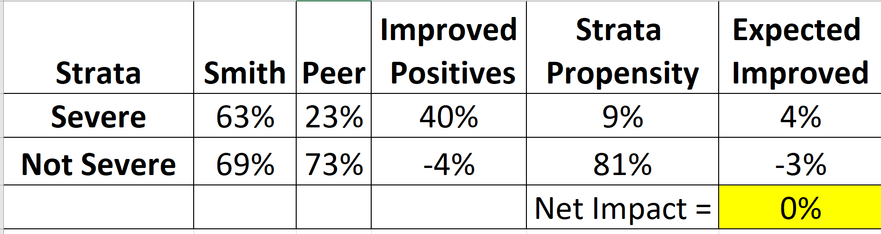
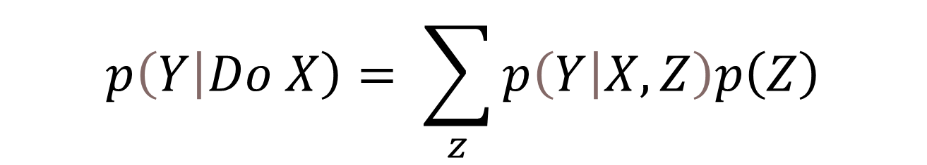
Adjustment Formula is Expected Strata Impact
$$\left.p\left(Y\right|Do X\right)= \sum_{z}{p\left(Y | X,Z\right)p\left(Z\right)}$$
Notes:
Here we have weighted the extent of improvement in each strata by the probability of strata occurring, in this case the probability of severe patients occurring is 9%. The net impact across the strata is 0% and there is negligible difference between quality of care by Dr. Smith and his peers.

Slide 18
What if we have more
complicated networks?
How do we know what to adjust?
Notes:
What if we have more
complicated networks?
How do we know what to adjust?

Slide 19
Block all backdoors from
outcome to treatment
How do we know what to adjust?
Notes:
We need a concept called backdoors to find the adjustment variables. We need to trace backdoor pathways from outcome to treatment and block them and the nodes that block the backdoor pathways are the nodes that remove the effect of the covariates.

Slide 20
Definition of Backward Path
Backdoors are arcs that start from outcome and at last node point to treatment. Include arcs between variables and in subgroups of common effects.
Notes:
In measuring the causal impact of two variables, a backdoor path is any path from the effect to the cause. Not from cause the effect that we are interested in but the reverse from the effect to the cause. Note that movement along the backdoor path does not depend on causal direction. If a path exists, then variables on the path are associated with both the cause and its effect and therefore confound the calculation of causal effect.

Slide 21
Backdoors are blocked if all nodes that point to treatment are stratified
Blocking backdoors remove selection bias
Notes:
An easy way to block all backdoors is to stratify all nodes that point to treatment. This is not necessarily the optimal way of doing so but a simplified way.

Slide 22
Obesogenic Anti-Depressant
Obesity
Infection
Antibiotic Treatment
Diabetes
?
Does Antibiotic Use
Increase Diabetes
Notes:
Let us look at a more complex example. This network shows 6 relationships or arcs. The question we want to figure out is whether antibiotic treatment leads to diabetes. We know that obesogenic antidepressants affects the emergence of diabetes as well as obesity. We also know that infections alter micro-biome and eventually could lead to weight gain and obesity. So we have a complex set of relationships. To examine the effect of antibiotics on diabetes we have to close any path from diabetes to antibiotics, from the effect back to the cause. A possible candidate is obesity, as it blocks both the causal chains from antidepressants and from infection. But obesity is the common effect of two causes and therefore it may open a back door.

Slide 23

Obesogenic Anti-Depressant
Obesity
Infection
Antibiotic Treatment
Diabetes
?
Does Antibiotic Use
Increase Diabetes
Notes:
Here we see a backdoor that starts from diabetes and goes to antidepressant type, then goes to obesity and later to infection and later to antibiotic treatment. This is one path. We need to block it so that we can see the effect of antibiotic on diabetes without the distortions caused by other covariates such as antidepressant use.

Slide 24
Obesogenic Anti-Depressant
Obese Patients
Infection
Antibiotic Treatment
Diabetes
?
Notes:
If we condition on obesity, we look at only subgroup of patients who are obese or not obese. Here we show the relationships among obese patients. Among obese patients, there is a backdoor from antidepressants to or from infections. We have blocked a common effect. Now there is a path from diabetes to antidepressants, to infection, and back to antibiotics.

Slide 25
Obesogenic Anti-Depressant
Obese Patients
Infection
Antibiotic Treatment
Diabetes
?
Notes:
Now there is a path from diabetes to antidepressants, to infection, and back to antibiotics. So there is a back door and the effect of antibiotics on diabetes continues to remain distorted. Blocking obesity opened new paths that we had not anticipated. A better place to block the backdoors is to block infections. This is a node that points to antibiotics.

Slide 26
Reduce Combinatorial Explosion
Block All Backward Paths by Stratifying All Variables that Point to Treatment/Exposure
Notes:
One way is to condition on the minimum set of nodes that block all backward paths. If all backward paths are blocked then the impact of the cause on the outcome can be assessed accurately without needing the stratification of other events in the network. This reduces the size of combinatorial events that should be examined since the focus is on events that block the backward path and not all possible events. This strategy makes the stratification more practical without losing accuracy.

Slide 27
Can You Find the Backdoor Paths?
V
A
U
F
B
G
C
D
?
Y
What is causal
impact of D on Y
Notes:
Suppose we are interested in the relationship between D and Y in this network. We want to estimate the causal effect of D on Y. In this network there are two hidden nodes, U and V, which are not measured or observed but are hypothesized to affect the observed variables. Both U and V are common causes. The observed variables include several common effects. G and F have the common effect on Y. A, B, and C have common effects on D. There are also a number of causal chains such as A to D to Y. Or from B to D to Y. To effectively stratify these data to discover the relationship between D to Y, we need to find and block all the back doors.

Slide 28

First Backdoor Path
V
A
U
F
B
G
C
D
?
Y
Notes:
There are two backdoor paths between Y and D. The first path is shown here. Note that the path connects to Y and ends in D. Thus the two condition for a path are met. There is a backward association path between Y and D and the path is pointed to the cause. If we stratify A then the path is blocked, as A is not part of a collider in this path. Within this path it is a mediator. If we stratify F this path is blocked, as F is also a mediator in this path.

Slide 29
Second Backdoor Path
V
A
U
F
B
G
C
D
?
Y
Notes:
This is the second pathway. It goes through both the hidden events. Now conditioning on A is not sufficient because it is a common effect in this path. Thus conditioning on A is not productive and does not block the path. But conditioning on F does. It is a mediator that blocks both the first back door path and the current back door. Therefore, this is the most reasonable event to condition on.

Slide 30
Minimal Block Set
V
A
U
F
B
G
C
D
?
Y
Notes:
Stratifying F is sufficient to close both backward paths. Instead of conditioning on 5 possible covariates of D and Y, we have found one event, i.e. F, that is a sufficient block to all backward paths. Therefore we can use just 1 variable for stratification. In this network, controlling for F is sufficient to remove all distortions of causal impact of D on Y. After F is stratified, then no node is associated with both D and Y. There is no longer any confounding. The two hidden nodes, even though not measured, are still controlled for as they cannot affect both D and Y.

Slide 31
Blocking at Treatment
V
A
U
F
B
G
C
D
?
Y
Notes:
We can also break the backdoors at all the nodes that point to D, the treatment variable. A and B are covariates as they are related to both D and Y and distort the effect. C is not. Including C as adjustment variable will make the analysis less efficient but this is a reasonable set if we cannot see the entire network. We are not sure about U and V so we do not know how the three nodes that point to D affect the outcomes. We can examine the correlations between A, B, C and D and Y. Then select variables that point to D, or in other words predict D but are also correlated with Y. These are adjustment variables.

Slide 32
Stratifying Several Variables
Set values for all possible combinations of variables
Notes:
We should stratify all adjustment variables that predict treatment and are correlated with outcome. What does it mean to stratify. It means that we can set the values of combination of adjustment variables and look at treatment effect in these fixed situations.

Slide 33
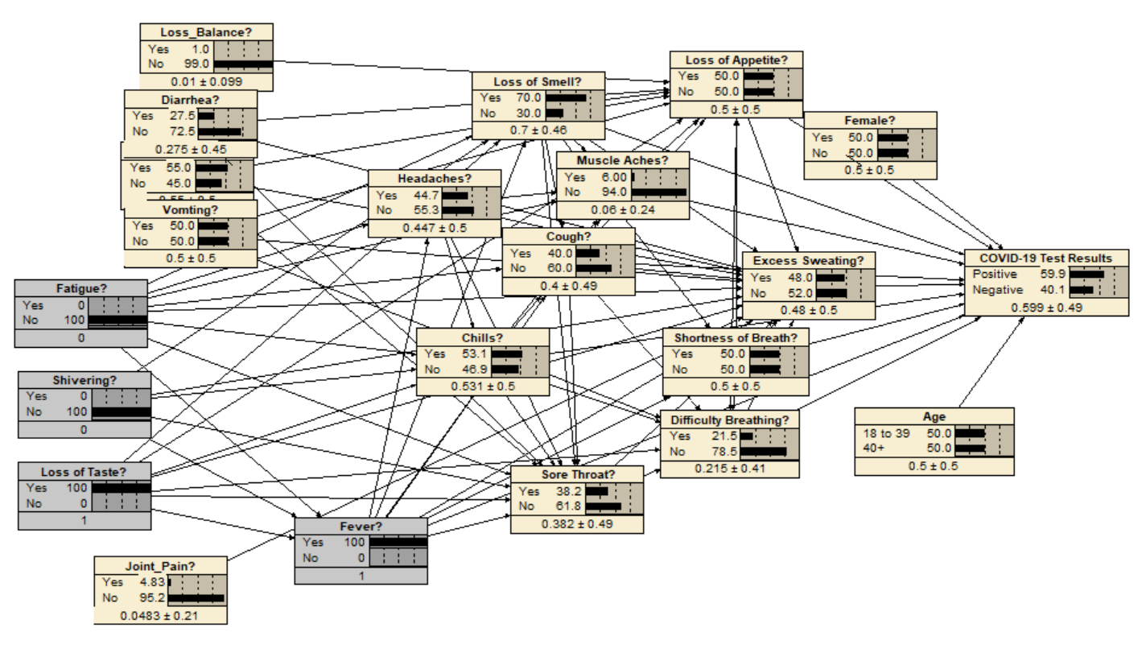
Stratifying Several Variables
Notes:
Let us look at a more complex situation. Here we are trying to understand the effect fever on diagnosis of COVID. We have three variables that predict fever and are correlated with COVID diagnosis. These are fatigue, shivering and loss of taste.

Slide 34
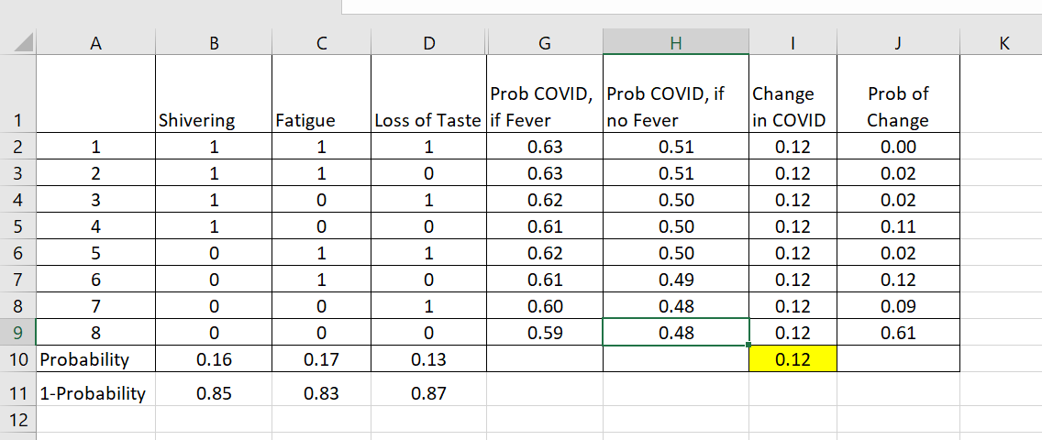
Stratifying Several Variables
Notes:
To stratify these three variables, we set the values of the combination of these three variables and then look at the effect of fever on diagnosis of COVID.

Slide 35
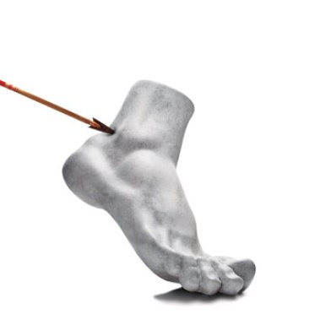

Take Home Lessons
Block Back Door Path
Notes:
This lecture has shown how blocking backdoor path could remove confounding and provide a way of thinking about which exogenous variable, whether observed or hidden. Blocking backdoors provides a clear criterion for making stratification computationally practical. It solves the Achilles' heel of stratification by reducing the explosion of combinations of covariates.

