Slide 1
Using Regression to Estimate Joint Distributions
Farrokh Alemi, PhD
Notes:
This lecture describes how to create a network model through repeated use of regressions.

Slide 2
Chain of Regressions
 | Outcome Y | Covariate C1 | Covariate C2 | Exposure X | Mediator Z
Intercept | 0.3 | 0.6 | 0.85 | 0.12 | 0.45
Covariate C1 | 0.12 |  |  | 0.85
Covariate C2 | 0.22 |  |  | 0.35
Exposure X | 0.15 |  |  |  | 0.82
Mediator, Z | 0.4
McFadden R2 | 0.18 | 0.12 | 0.13 | 0.23 | 0.34
Notes:
This table shows key findings from a chain of 5 regressions. Previously we used these regressions to construct the network structure.

Slide 3
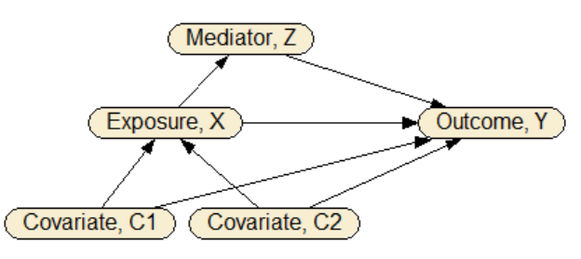
Network Structure
Notes:
Our analysis led to this network. This describes the structure of the network. We now show how the same regressions that brought us to this structure also lead us to the discovery of the underlying joint distribution of the variables

Slide 4
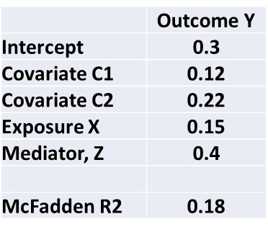
Estimating Distribution of Y
Notes:
Each regression represents a table within the network. Lets start with the regression of Y on prior events.

Slide 5
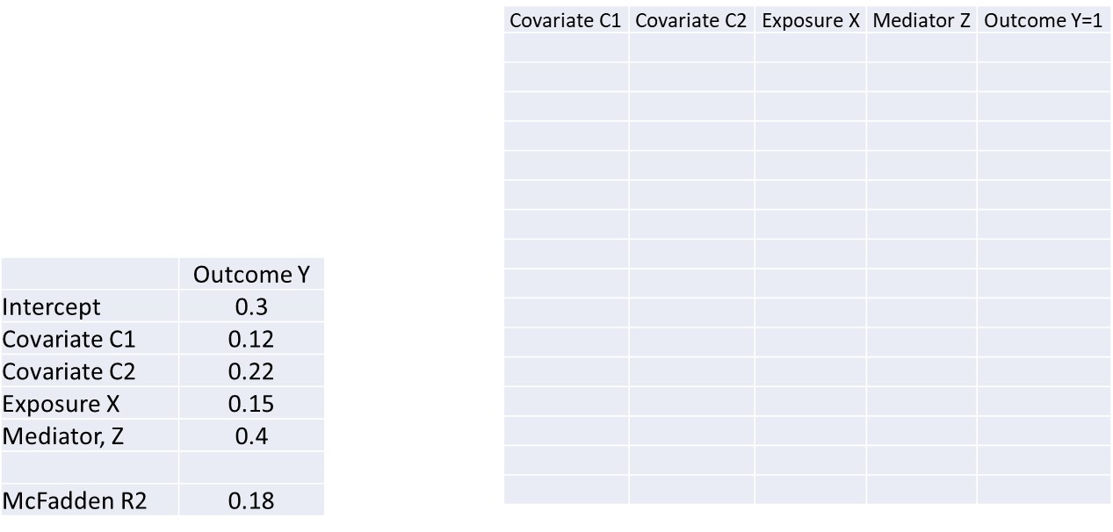
Estimating Distribution of Y
Notes:
First we create a factorial combination of direct predictors of Y. To generate the factorial combination of 4 variables we will need a table that has 2 to the power of 4 rows, that is 16 rows.

Slide 6
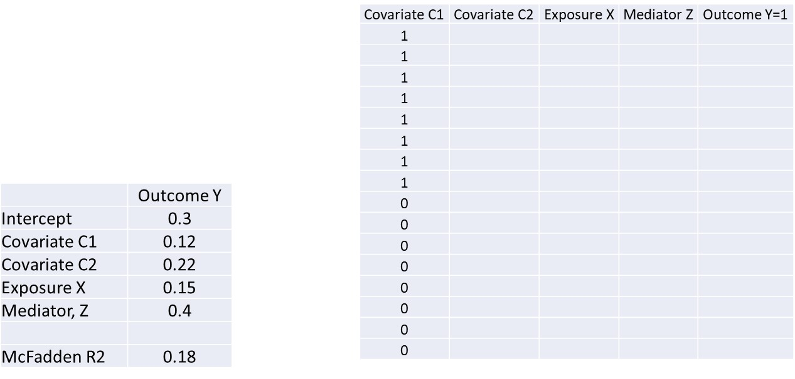
Estimating Distribution of Y
Notes:
In half of the 16 rows covariate C1 is present and in half it is absent.

Slide 7
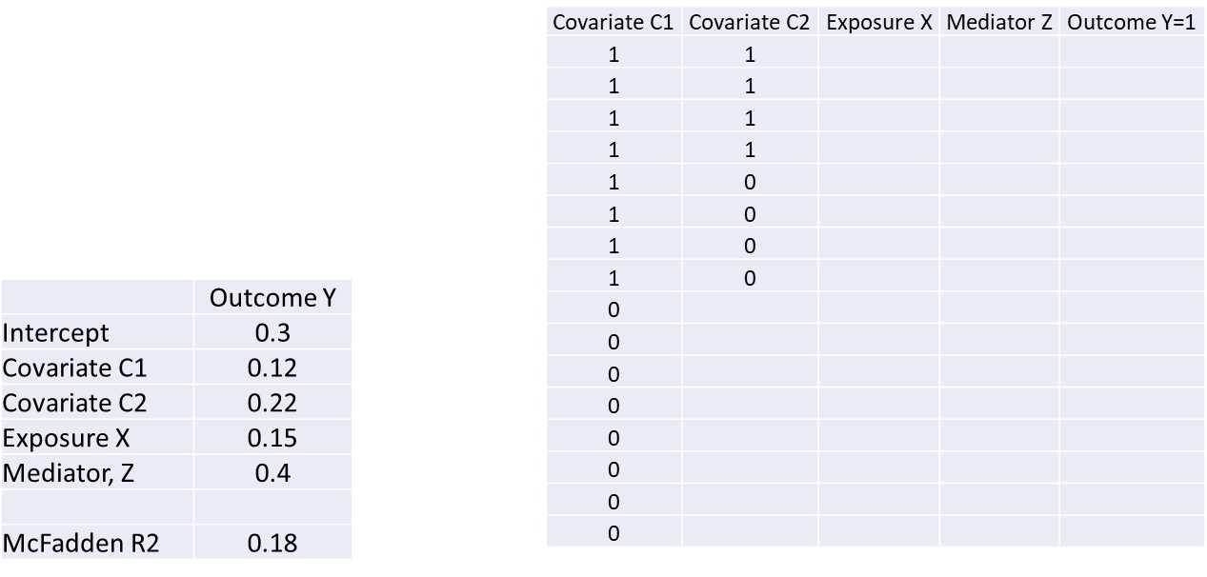
Estimating Distribution of Y
Notes:
Covariate C2 is present in half of the times when covariate C1 is present and absent in the rest.

Slide 8
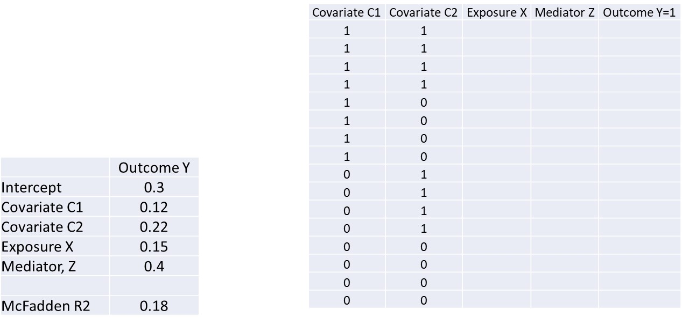
Estimating Distribution of Y
Notes:
Similarly, covariate C2 is present in half of the times when covariate C1 is absent and C2 is absent in the rest.

Slide 9

Estimating Distribution of Y
Notes:
The same procedure is followed for exposure variable. It is present in half of the situations where both C1 and C2 are present. And absent in half the situations where both C1 and C2 are present.

Slide 10
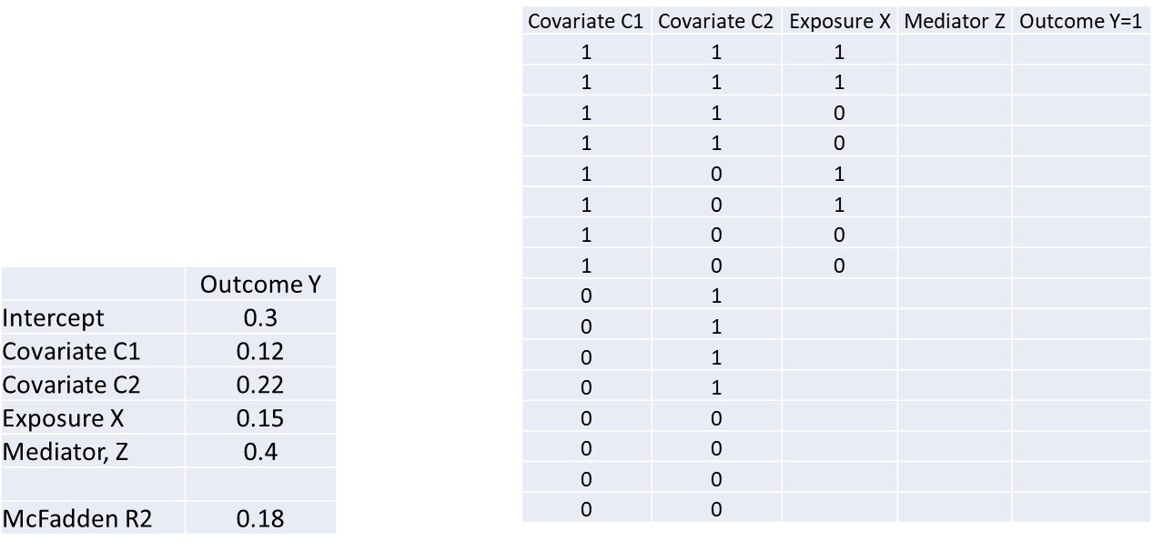
Estimating Distribution of Y
Notes:
The same procedure is followed for the situation where C1 is present but C2 is absent.

Slide 11
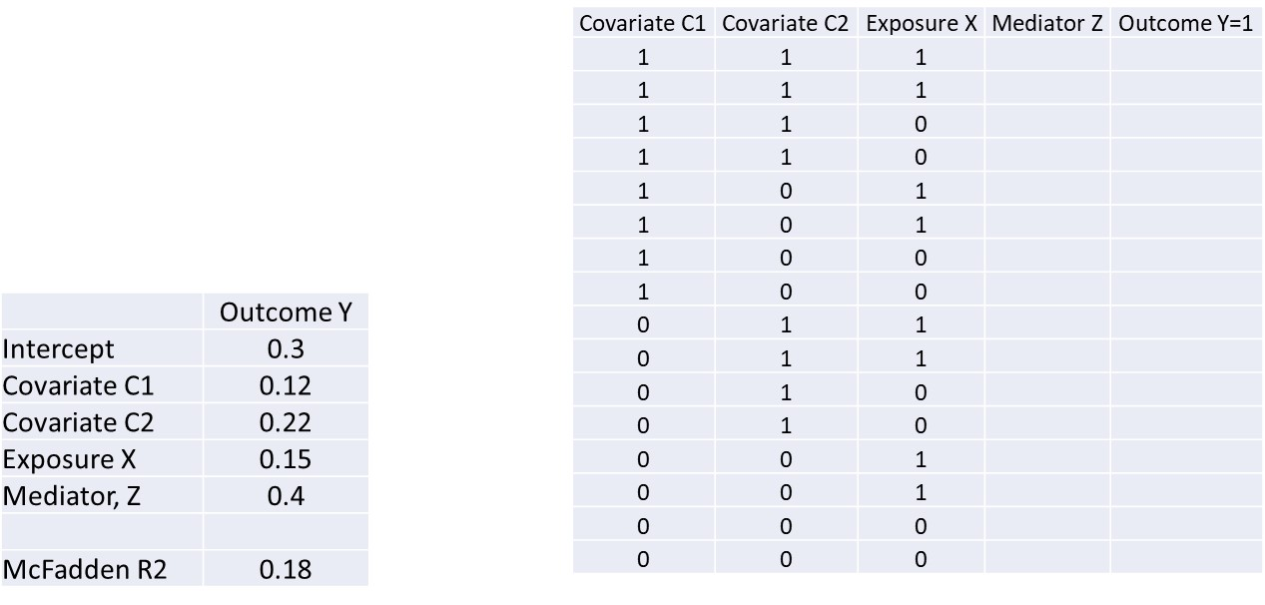
Estimating Distribution of Y
Notes:
And so on until all combination of C1 and C2 have corresponding absent and presence of X variable.

Slide 12

Estimating Distribution of Y
Notes:
The procedure is continued until a factorial combination is created by examining all possible combination of the 4 direct predictors of Y. This table shows 16 combination of these 4 factors. Each row corresponds to one combination.

Slide 13
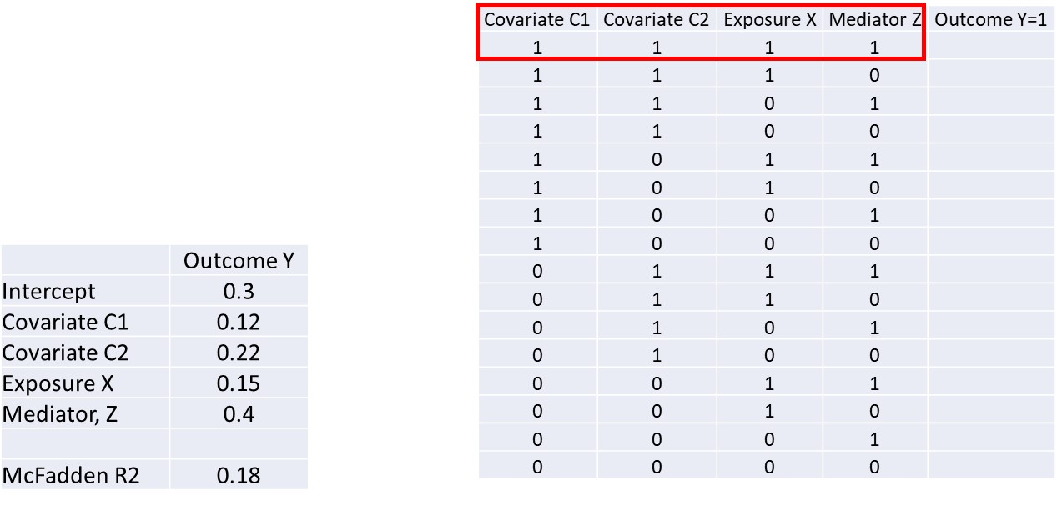
Estimating Distribution of Y
Notes:
The first row shows the combination where all 4 predictors are present.

Slide 14
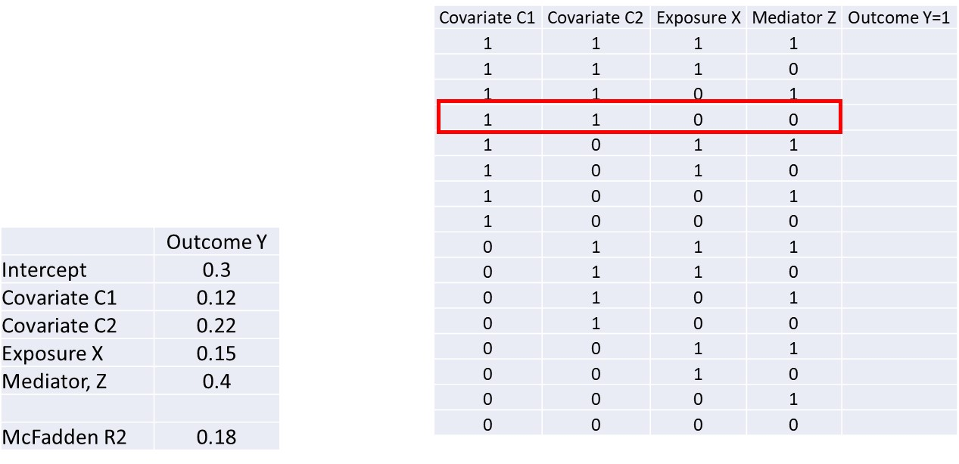
Estimating Distribution of Y
Notes:
The 4th row shows situations where the two covariates are present but exposure and mediator are absent.

Slide 15
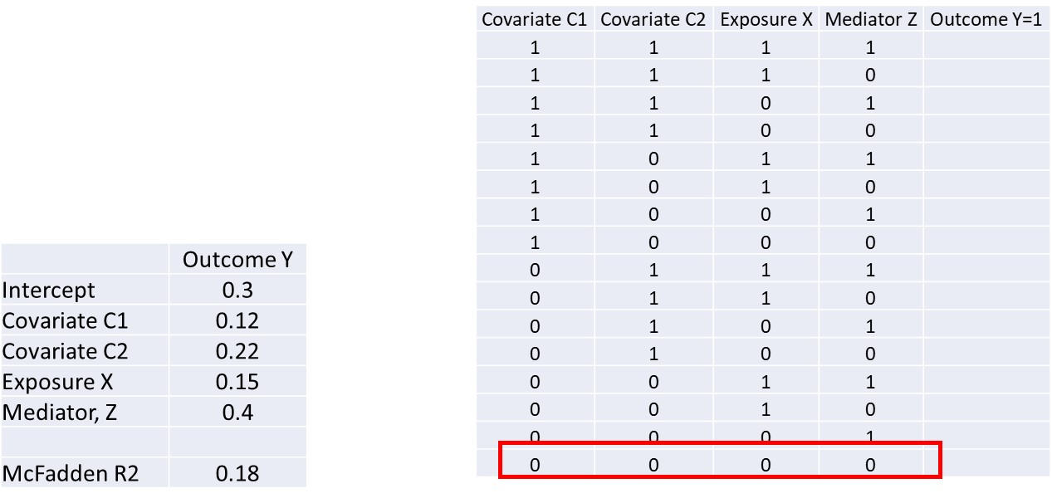
Estimating Distribution of Y
Notes:
The last row shows the situation where none of the predictors are present.

Slide 16
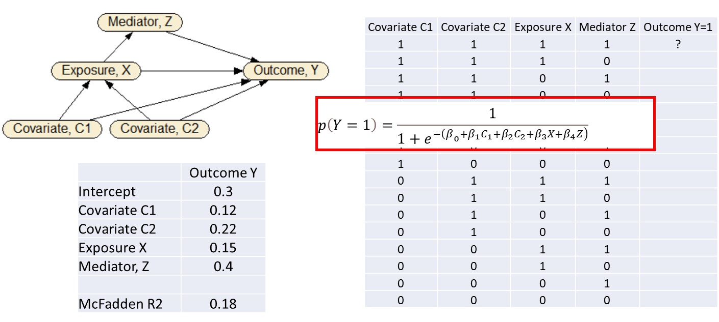
Estimating Distribution of Y
Notes:
The regression equation is used to calculate the probability of the outcome. In logistic regression this is done as 1 divided by e to the inverse power of regression equation.

Slide 17
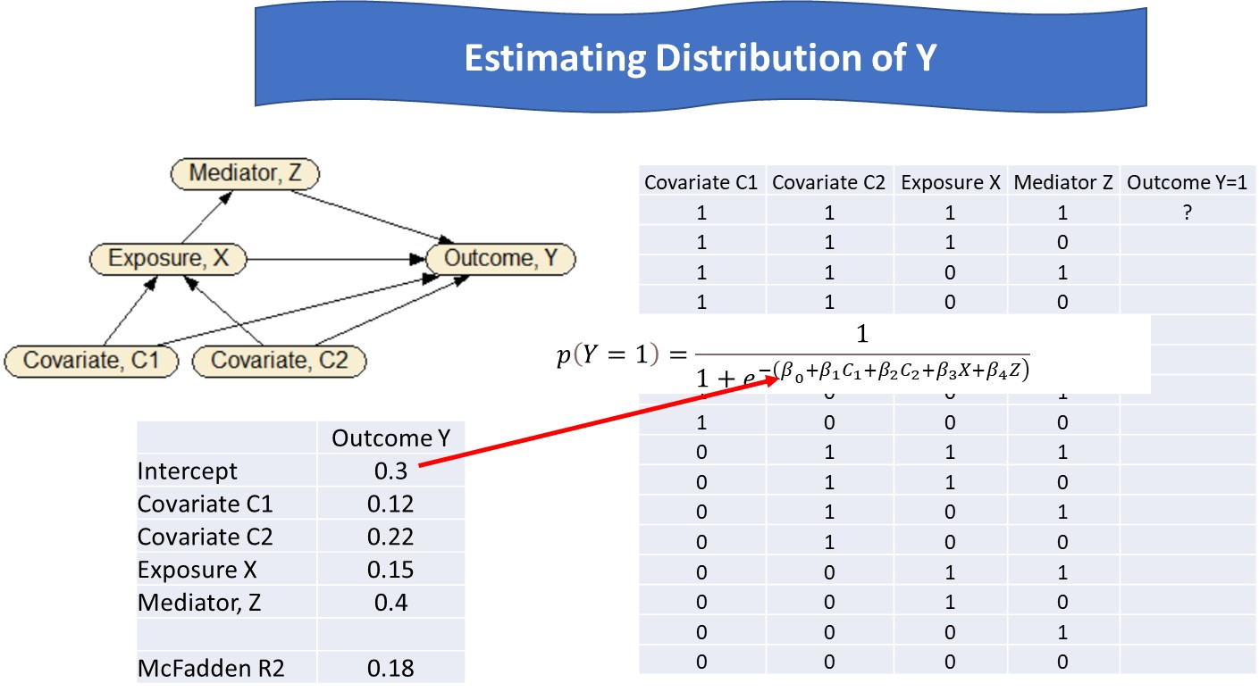
Notes:
The intercept is 0.3.

Slide 18
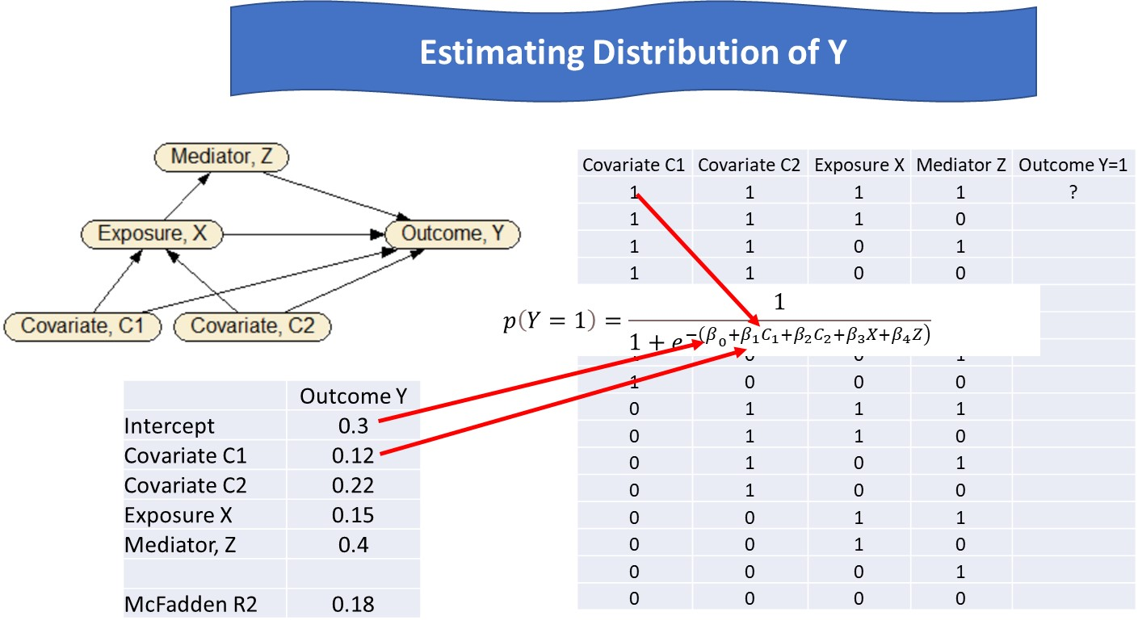
Notes:
The coefficient for C1 is 0.12. If we evaluating the regression for the first row where C1 is present, then it has the value of 1.

Slide 19
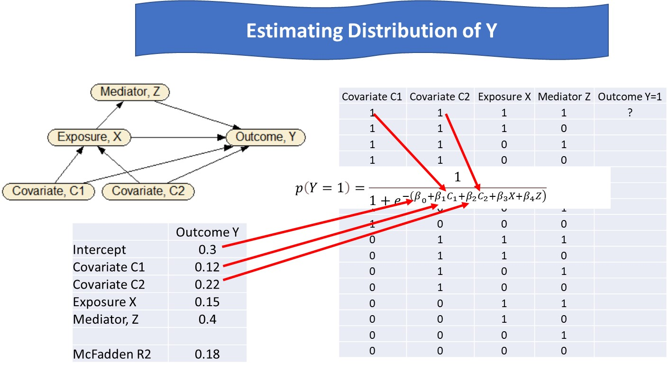
Notes:
The coefficient for C2 is 0.22. Since we are evaluating the regression for the first row, C2 is present and has the value of 1.

Slide 20
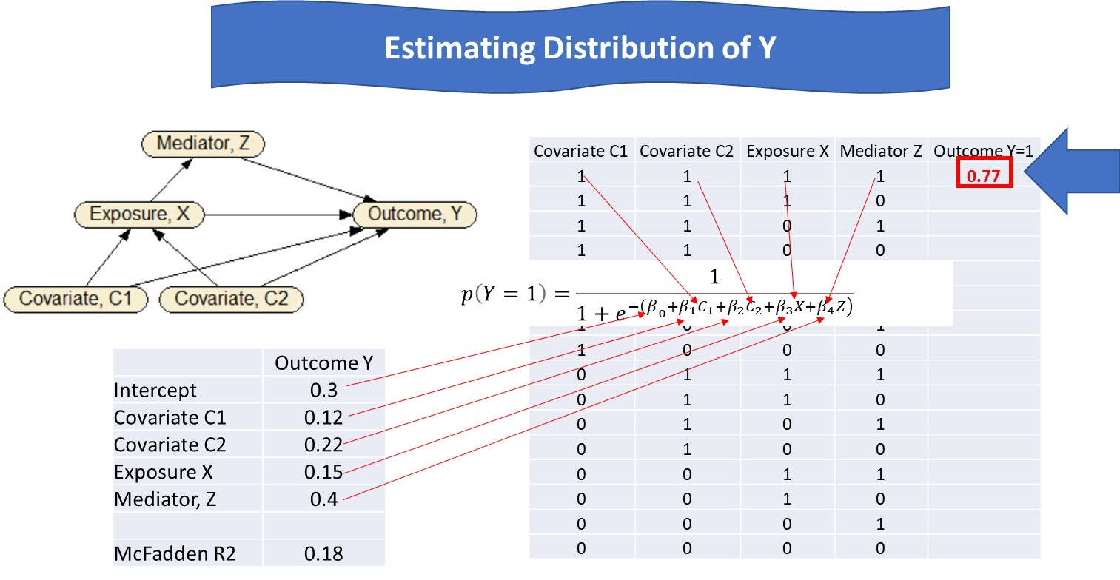
Notes:
The regression is evaluated for all the values in row one, yielding a probability of 0.77.

Slide 21
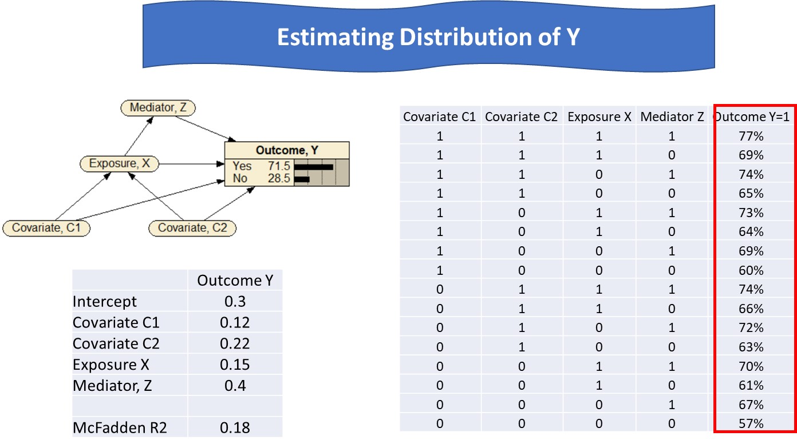
Notes:
The regression equation is used to calculate the probability of the outcome at every row. This provides the joint distribution of Y for different values of covariates, exposure, and mediator variables.

Slide 22
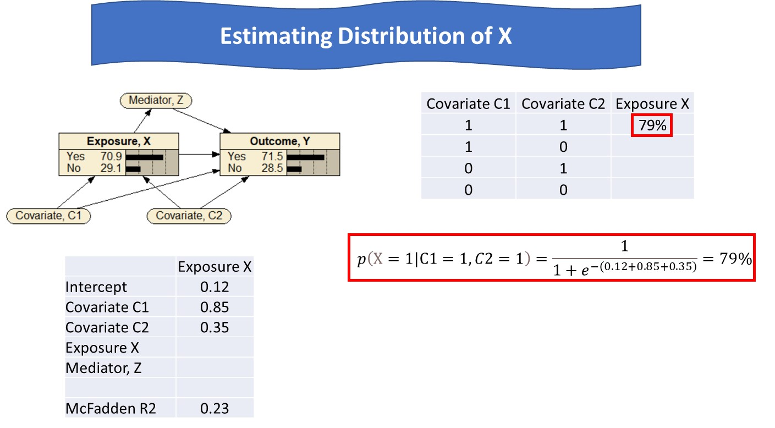
Notes:
The regression equation for exposure X is used to calculate the probability of the exposure variable X as a function of the two direct predictors C1 and C2. When both covariates are present, the conditional probability is 0.79.

Slide 23
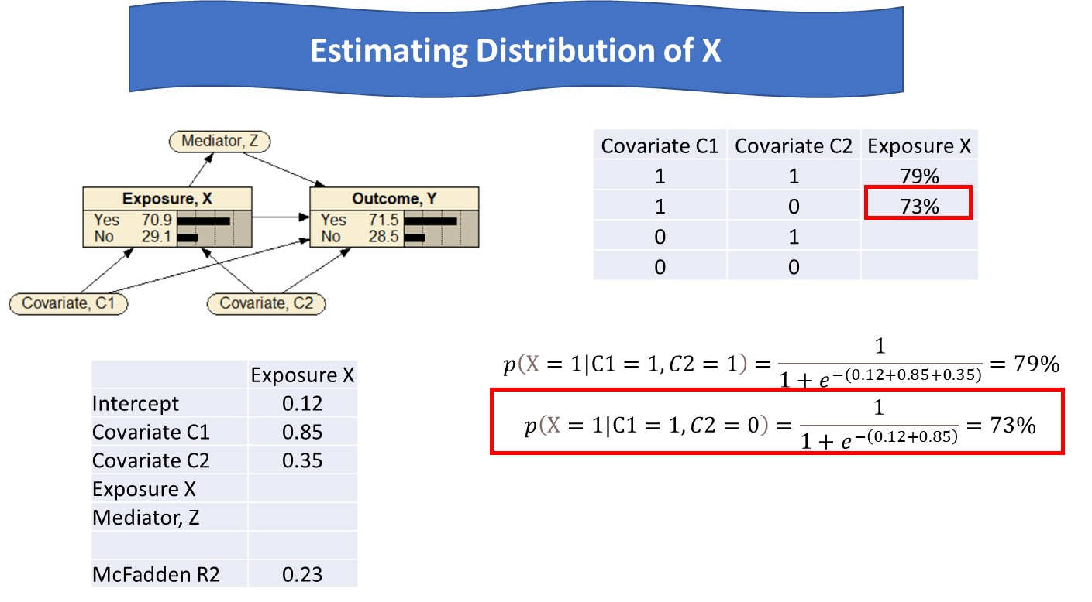
Notes:
The conditional probability of exposure given presence of C1 but absence of C2 is calculated as 73%.

Slide 24
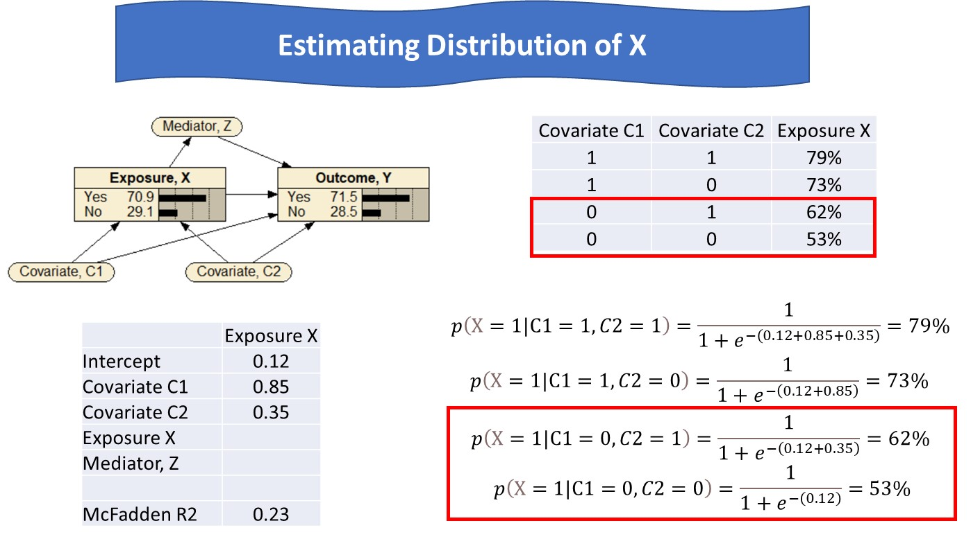
Notes:
Similarly, evaluating the regression equation for each row gives us the values of 62% and 53%.

Slide 25
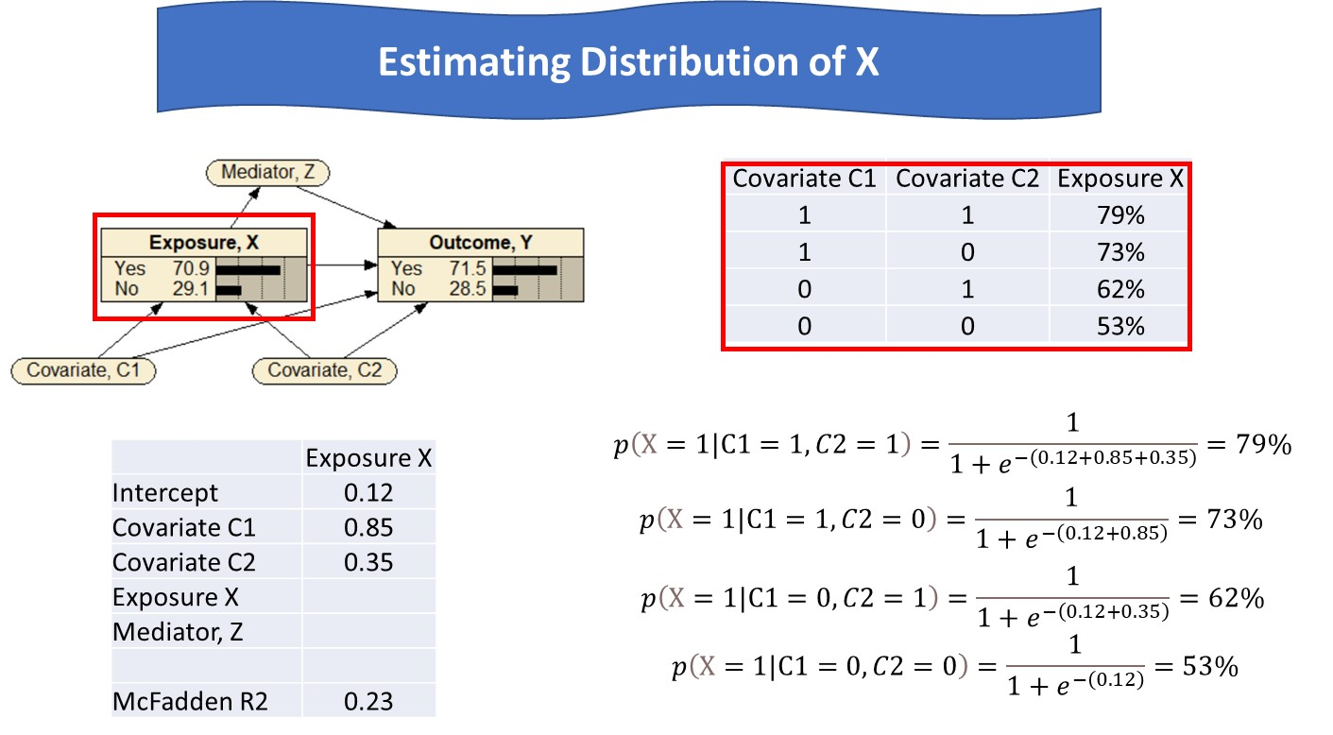
Notes:
This completes the joint distribution of exposure variable x as a function of its direct predictors.

Slide 26
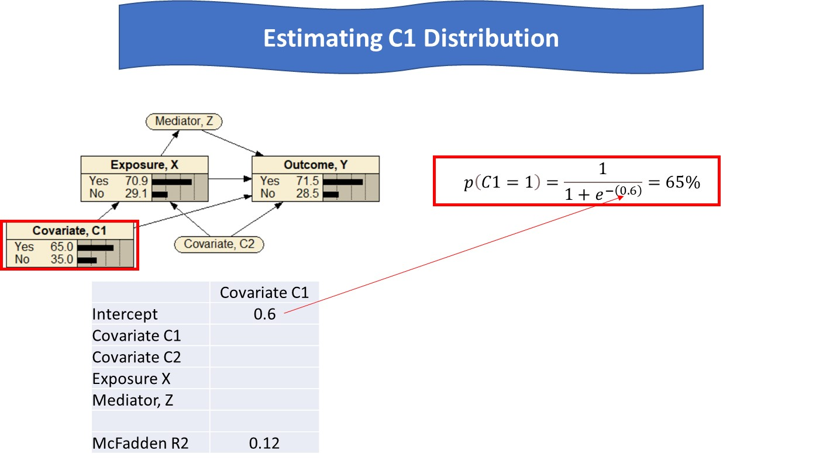
Notes:
The regression equation is used to also calculate the probability of the Covariate C1. There are no direct predictors for this variable and just the intercept in the regression is used.

Slide 27
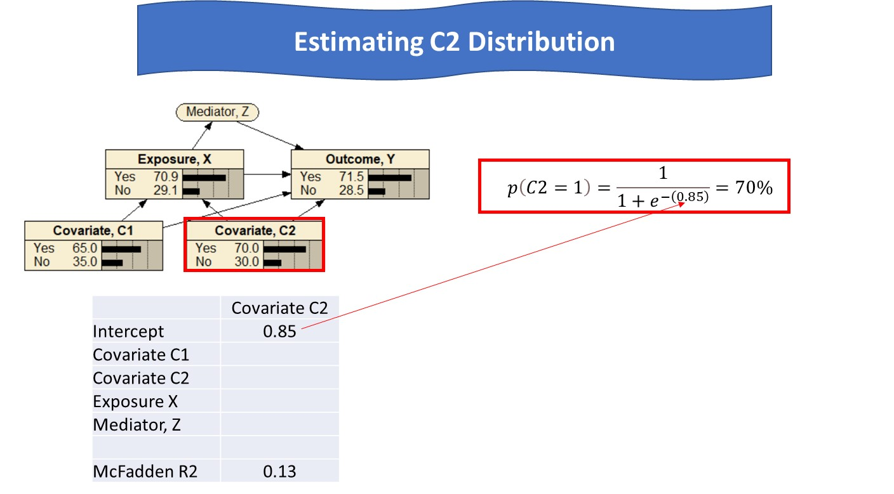
Notes:
The regression equation is also used to calculate the probability of the occurrence of covariate C2.

Slide 28
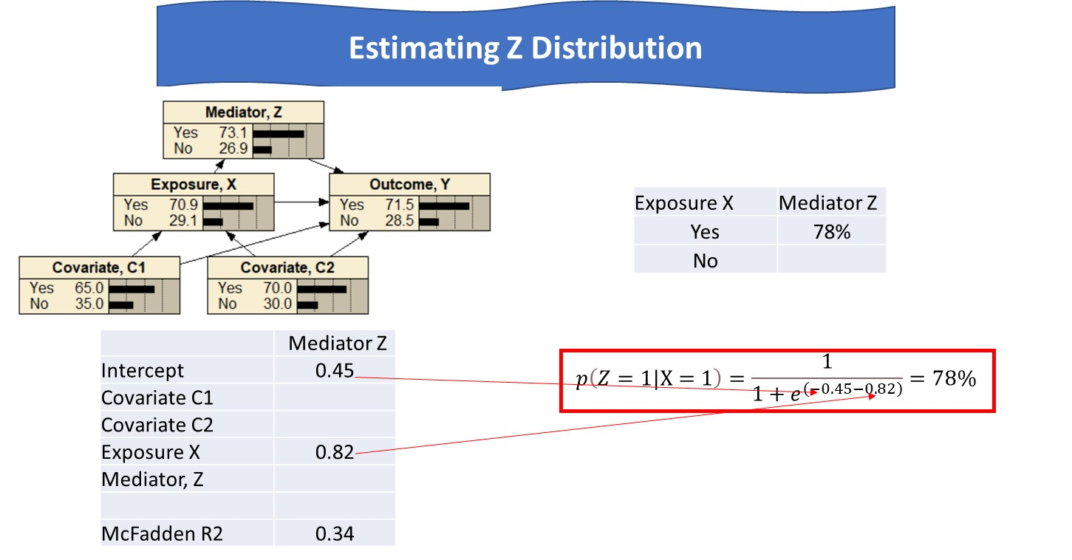
Notes:
The regression equation is also used to calculate the joint distribution of the mediator Z. When X is present, this probability is calculated from the regression equation to be 0.78.

Slide 29
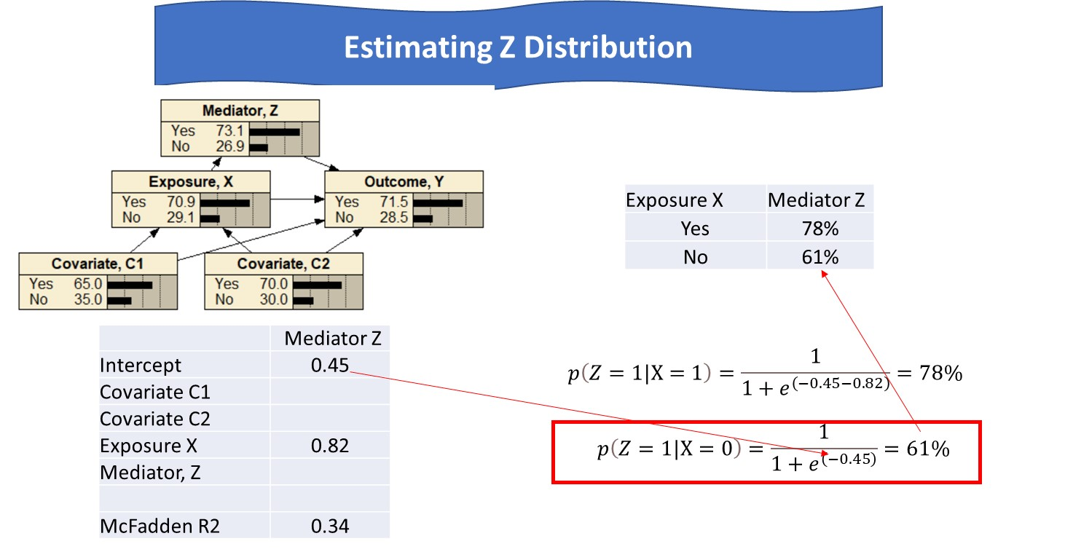
Notes:
When X is absent, the coefficient of X is multiplied by zero and thus does not affect the regression. The probability is calculated as 61%.

Slide 30
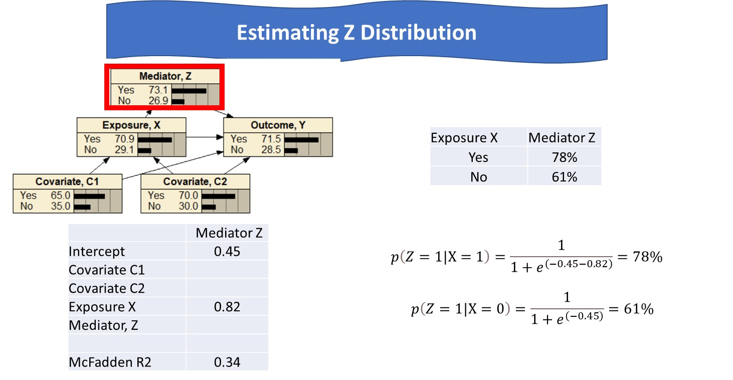
Notes:
This completes the specification of the joint distribution of the mediator variable and on average the mediator variable is present in 73.1% of occasions.

Slide 31
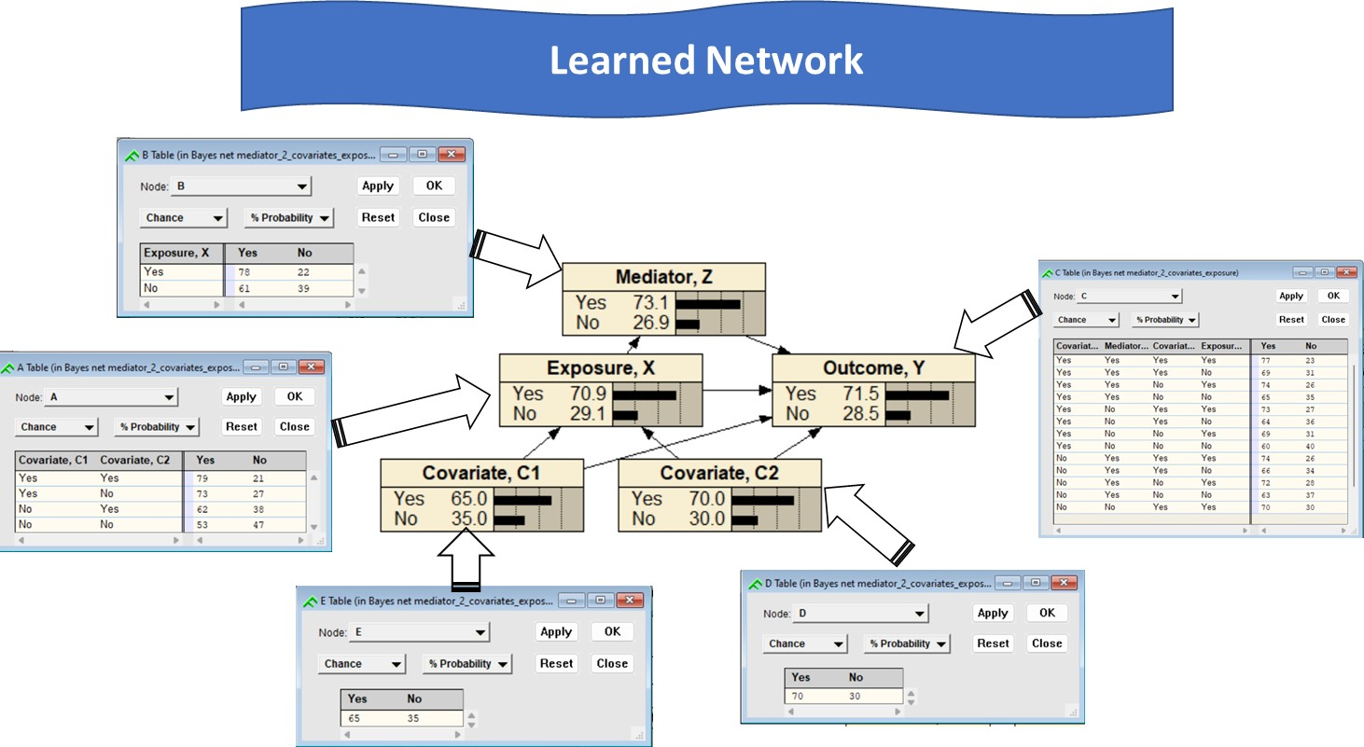
Notes:
We have learned both the structure and parameters of the network from its associated regressions. We can now use this network model to make inferences about a variety of situations in which different combination of variables are present.

