Slide 1
LASSO Regression
Farrokh Alemi, Ph.D.
Abdul Hafeez, Ph.D.
Notes:
This presentation reviews LASSO regression. I am an Avtar was organized by Dr. Alemi and Dr. Hafeez.

Slide 2
Purpose of LASSO
Regression: Feature Selection
Notes:
The purpose of LASSO regression is to select a minimum set of variables that would explain most of the variance in the response variable

Slide 3
Ordinary Regression: Regress Y on independent
variables X₁ … X_{n}
Notes:
In an ordinary regression you regress the dependent variable y on a set of independent variables X one through X n

Slide 4
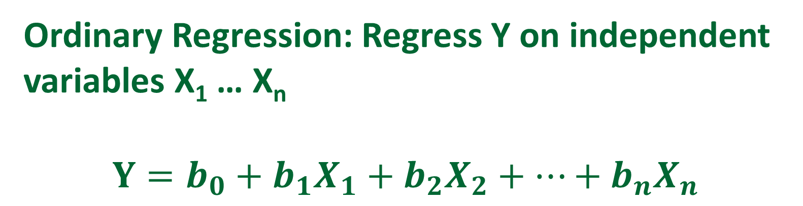
Ordinary Regression: Regress Y on independent
variables X₁ … X_{n}
$$Y=b_{0}+b_{1}X_{1}+b_{2}X_{2}+…+b_{n}X_{n}$$
Notes:
Y is the output or the variable we want to predict. X1, X2, ….., Xn are the features. B 0, b 1, b 2, are the coefficient weights estimated from the data.

Slide 5
Ordinary Regression: Regress Y on independent
variables X₁ … X_{n}
LASSO Regression: Regress Y on independent
variables X₁ … X_{n} but minimize sum of the
estimated coefficients for X₁ … X_{n} forcing many
variables to have zero coefficients
Notes:
LASSO regression minimizes the sum of the coefficients forcing many variables to have zero coefficient.

Slide 6
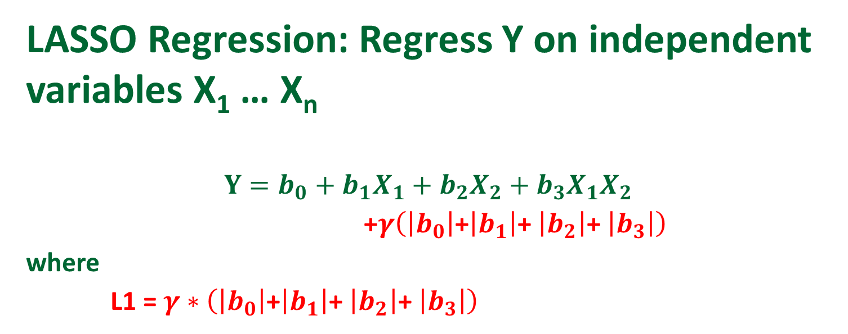
LASSO Regression: Regress Y on independent
variables X₁ … X_{n}
$$Y=b_{0}+b_{1}X_{1}+b_{2}X_{2}+b_{3}X_{1}X_{2}$$
$\text{+}γ\left(\left|b_{0}\right|\text{+}\left|b_{1}\right|\text{+} \left|b_{2}\right|\text{+} \left|b_{3}\right|\right)$
where
L1 = $γ∗\left(\left|b_{0}\right|\text{+}\left|b_{1}\right|\text{+} \left|b_{2}\right|\text{+} \left|b_{3}\right|\right)$
Notes:
L1 is the sum of the absolute value of the coefficients multiplied by a tuning parameters i.e., lambda.

Slide 7
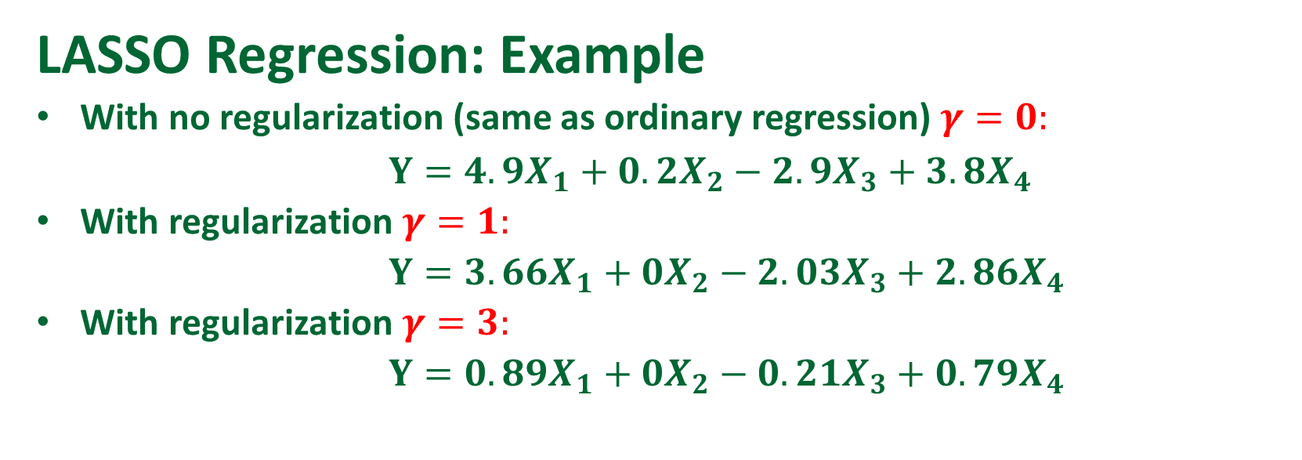
LASSO Regression: Example
With no regularization (same as ordinary regression) $γ=0:$
$Y=4.9X_{1}+0.2X_{2}−2.9X_{3}+3.8X_{4}$
With regularization $γ=1:$
$Y=3.66X_{1}+0X_{2}−2.03X_{3}+2.86X_{4}$
With regularization $γ=3:$
$Y=0.89X_{1}+0X_{2}−0.21X_{3}+0.79X_{4}$
Notes:
Here we see that with lambda zero the regression includes x2 but with lambda 1, then X2 drops out

Slide 8
Meaning of Hyperparameter
Larger lambda = fewer
variables selected
Notes:
Larger lambda gives us fewer variables selected. Smaller lambda allows us to pick up more variables.

Slide 9
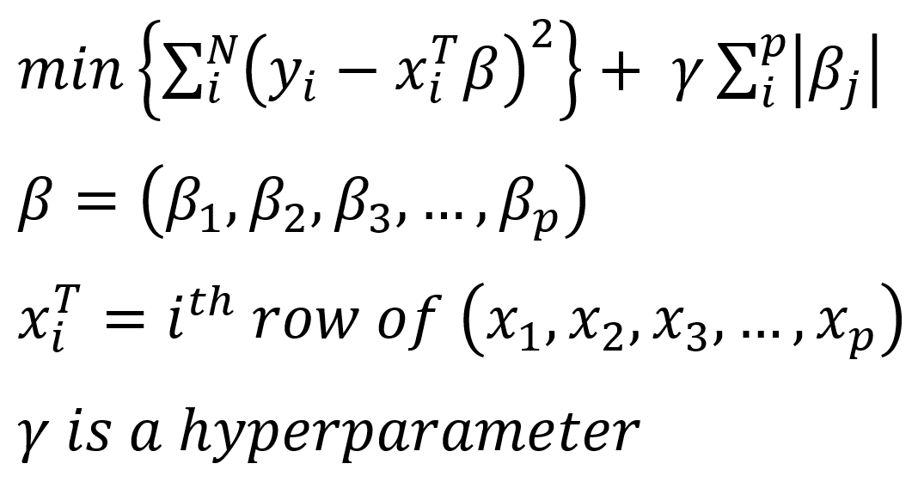
Multiple Regression
Residual Sum of Squares (RSS)
Notes:
Ordinary regression is minimizing the sum of squares of residuals.

Slide 10
LASSO Regression
Residual Sum of Squares (RSS)
Regularized Term
Notes:
In LASSO, we add the regularized term in addition to minimize the number of features allowed.

Slide 11
Meaning of Hyperparameter
When lambda is zero LASSO is the same as ordinary multiple regression
Notes:
When lambda is 0 lasso is the same as ordinary multiple regression.

Slide 12
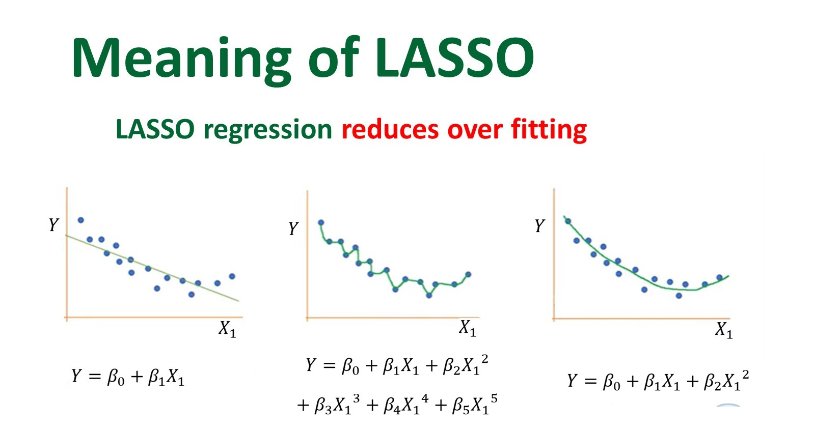
Notes:
To get an intuition about Lasso let us look at an ordinary regression with 1 variable. Here we see that the fit between the regression equation and X is not very good. The line is linear but the data are not.

Slide 13
Notes:
We can add in more variables by taking x to different powers. With 5 variables we can perfectly fit the data. But we are modeling noise and this kind of perfect fits may not be reasonable. Typically this kind of over fitting occurs when the number of cases is less than number of features.

Slide 14
Notes:
Lasso can help us model the data with fewer variables and thus avoid overfitting. Lasso drops x to power 3, x to power 4 and x to power 5. It only keeps x and x to power of 2. It selects a set of feature that does not do over fitting and can explain most of the data..

Slide 15
Meaning of LASSO
LASSO: Regress Y on independent
variables X₁ … X_{n} keeping only
direct predictors of Y and dropping all
other associations
Notes:
So what does lasso do for us. It helps us select a set of direct predictors of Y. The ignored variables can still be correlated to Y but not when the selected variables are present.

Slide 16
Meaning of LASSO
LASSO: Regress Y on independent
variables X₁ … X_{n} keeping only
direct predictors of Y
Non-zero LASSO variables make all other variables irrelevant
Notes:
Lasso keeps only the direct predictors of Y. These direct predictors, also called non-zero predictors, make all other variables irrelevant.

Slide 17
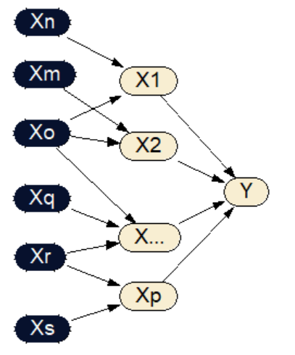

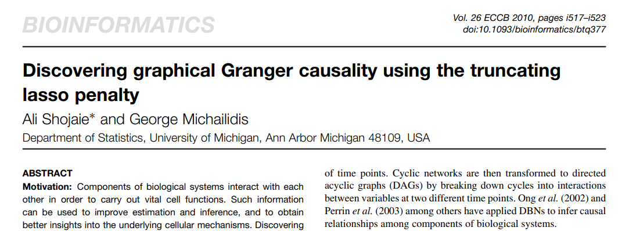
Meaning of LASSO
Outcome
Notes:
Recent work has shown that we can use lasso to organize a network. First we look at outcome Y. Find all of its direct predictors.

Slide 18
Meaning of LASSO
D
Notes:
Here we see that X1 through Xp are the direct predictors of Y.

Slide 19
Meaning of LASSO
D
I
Notes:
The predictor of direct predictors of Y are called indirect predictors of Y. Here we see that Xr and Xs are predictors of Xp, which itself is a predictor of Y. Indirect predictors are associated with Y, only when the mediating direct predictor is not present.

Slide 20
Meaning of LASSO
Given a temporal order, not all associations are the same. Some don’t matter
D
I
Notes:
Lasso and the temporal order of variables can tell us a great deal about what associations matter and correlations can be ignored.

Slide 21
Meaning of LASSO
LASSO identifies direct predictors & ignores indirect associations
D
I
Notes:
In identifies direct predictors and ignores indirect associations thus it tells what correlations can be ignored

Slide 22
LASSO Uncomplicates Life
It Selects Variables that Make other Variables irrelevant
Notes:
Lasso uncomplicates our lives by selecting direct associations and ignoring many other associations in the data.

