Slide 1
Using Ordinary Regression for Logit Transformed Data
Farrokh Alemi, Ph.D.
Notes:
This presentation reviews ordinary regression. This brief presentation was organized by Dr. Alemi.

Slide 2
Binary
MFH | Bathe | Urine | Bowel | Dress | Eat | Groom | Toilet | Transfer | Walk | Gender | Race | Age
0 | Yes | No | Yes | Yes | Yes | Yes | Yes | Yes | Yes | Female | NULL | 70
0 | No | Yes | Yes | Yes | Yes | Yes | Yes | Yes | Yes | Female | NULL | 70
0 | Yes | No | Yes | Yes | Yes | Yes | Yes | Yes | No | Male | NULL | 70
0 | Yes | Yes | Yes | Yes | Yes | Yes | No | Yes | No | Male | NULL | 70
1 | Yes | Yes | No | Yes | Yes | Yes | Yes | Yes | Yes | Male | White | 82
1 | Yes | Yes | No | Yes | Yes | No | Yes | Yes | Yes | Male | NULL | 70
0 | Yes | Yes | Yes | Yes | Yes | Yes | Yes | Yes | Yes | Female | NULL | 70
1 | Yes | Yes | Yes | Yes | No | Yes | Yes | Yes | No | Male | Black | 91
0 | Yes | Yes | Yes | No | Yes | Yes | Yes | Yes | Yes | Male | Black | 91
0 | Yes | Yes | Yes | Yes | Yes | Yes | Yes | Yes | No | Male | Other | 91
Notes:
Suppose you need to analyze data such as this. Here the dependent variable is participation in the medical foster home program, shown in the first column. It is either 0 or 1. We want to know if patients with different functional abilities are more likely to participate in the program. We can regress the MFH variable on the remaining independent variables. The problem is that we cannot use multiple variable regression as this method of data analysis requires a continuous response or dependent variable.

Slide 3
Probability
$$Odds=\frac{π}{1−π}$$
Notes:
So we set out to create a continuous response variable. We group the data and calculate the probability of the event within each combination of independent variables. Then we calculate the odds of participating in medical foster home from the probability.

Slide 4
Zero to infinity
$$Response Variable=\log_{e}\left(\frac{π}{1−π}\right)$$
Notes:
The response or dependent variable is log of the odds.

Slide 5
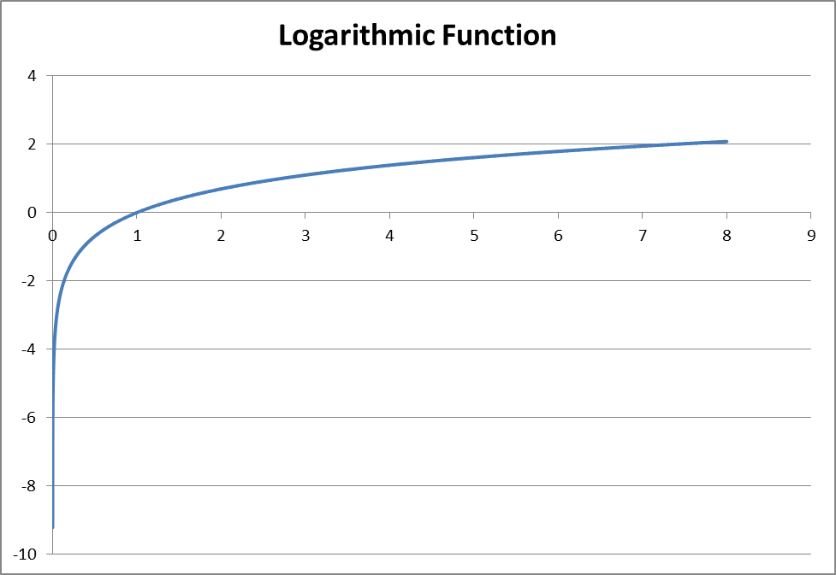
$$Odds=\frac{π}{1−π}$$
$$Response Variable=\log_{e}\left(\frac{π}{1−π}\right)$$
Notes:
The logarithm function is a number between zero and infinity. When it is negative it means that the odds are against the response. When positive it means that it increases the response variables. At odds of 1 to 1, the logarithm is zero.

Slide 6
Ordinary Regression
Logit
$$\ln\left(\frac{π}{1−π}\right)=logit(π)=β_{0}+β_{1}X_{1}+β_{2}X_{2}+…+β_{n}X_{n}$$
Notes:
The natural log of the odds is called the logit function. It is a transformation that allows us to deal with probabilities without the awkward hard limit at 1. The logit transformation can be regressed on the linear or nonlinear combination of predictors. If we were going to regress the probability on the same set of predictors we may have had a predicted probability that was more than 1, which makes no sense. The logit function does not have this hard limit so it does not make predictions that cannot be interpreted.

Slide 7
Undo Logit
$$γ=β_{0}+β_{1}X_{1}+β_{2}X_{2}+…+β_{n}X_{n}$$
$$\hat{π}=\frac{e^{γ}}{1+e^{γ}}=\frac{e^{β_{0}+β_{1}X_{1}+β_{2}X_{2}+…+β_{n}X_{n}}}{1+e^{β_{0}+β_{1}X_{1}+β_{2}X_{2}+…+β_{n}X_{n}}}$$
Notes:
Since the regression was done using a logit transformation of the probability, you may wonder how can this function be used to retrieve the probability of the dependent variable. If lambda is the predicted logit response, the e to the power of lambda divided by 1 plus lambda allows us to get the predicted probability, here shown as pi with a hat to emphasize the it is a predicted value. The logit transformation allows us to learn the relationship between the dependent variable and the predictors. The inverse of this transformation allows us to retrieve the probability of the binary response variable.

Slide 8
Drop Table #Data
Declare @AvgAge as Float
Set @AvgAge = (SELECT avg(age) FROM [MFH].[dbo].[DailyCost$])
SELECT distinct [MFH]
, iif([bathing_365]>.5,1,0) AS Bathing
,iif([bladder_365]>.5, 1,0) as Bladder
,iif([bowelincontinence_365]>.5, 1,0) as Bowel
,iif([dressing_365]>.5, 1, 0) as Dressing
,iif([eating_365]>.5, 1, 0) as Eating
,iif([grooming_365]>.5, 1, 0) as Grooming
,iif([toileting_365]>.5, 1, 0) as Toileting
,iif([transferring_365]>.5, 1, 0) as Transferring
,iif([walking_365]>.5, 1, 0) as Walking
,iif([gender] ='F', 0, 1) AS Male
,iif([race] ='B', 1,0) as Black
,iif(race='W', 1, 0) AS White
,iif(race='NULL', 1,0) AS RaceNull
,iif(age is null, @avgAge, age) as Age
, ID
INTO #Data
FROM [MFH].[dbo].[DailyCost$]
-- (39139 row(s) affected)
Prepare Data
Notes:
Ok lets see how this is done. First prepare your data. All predictors have to be discrete variables. First we break the independent variables into binary variables. Later we will break the continuous variables into several categories, perhaps quintiles.

Slide 9
MFH | Bathing | Bladder | Bowel | Dressing | Eating | Grooming | Toileting | Transferring | Walking | Male | Black | White | RaceNull | Age | ID
0 | 0 | 0 | 0 | 0 | 0 | 0 | 0 | 0 | 0 | 1 | 0 | 0 | 1 | 72.15989 | 35572
0 | 0 | 0 | 0 | 0 | 0 | 0 | 0 | 0 | 0 | 1 | 0 | 0 | 1 | 72.15989 | 35573
0 | 0 | 0 | 0 | 0 | 0 | 0 | 0 | 0 | 0 | 1 | 0 | 0 | 1 | 72.15989 | 35574
0 | 0 | 0 | 0 | 0 | 0 | 0 | 0 | 0 | 0 | 1 | 0 | 0 | 1 | 72.15989 | 35575
0 | 0 | 0 | 0 | 0 | 0 | 0 | 0 | 0 | 0 | 1 | 0 | 0 | 1 | 72.15989 | 35618
Notes:
This is how our initial data looks like now. Each predictor is now a binary variable.

Slide 10
DROP TABLE #Prob
SELECT CAST(Sum(MFH) as Float)/Cast(Count(distinct ID) as float) AS Prob
, count(distinct id) as n
, Bathing, Bladder, Bowel, Dressing, Eating, Grooming, Toileting
, Transferring, Walking, Male, Black, White, RaceNull, Floor([age]/10)*10 AS Decade
INTO #Prob
FROM #DATA
GROUP BY Bathing, Bladder, Bowel, Dressing, Eating, Grooming, Toileting
, Transferring, Walking, Male, Black, White, RaceNull, Floor([age]/10)*10
Having Count(distinct ID)>9
-- (405 row(s) affected)
Probabilities in Groups
Notes:
Next we group by the binary predictor variables. This gives us several combination of functional disabilities, age and gender. For each combination we calculate the probability. This is the pi in our earlier equations.

Slide 11
Prob | n | Bathe | Bladder | Bowel | Dress | Eating | Groom | Toilet | Transfer | Walk | Male | Black | White | Race Null | Decade
0.00 | 10 | 0 | 0 | 0 | 0 | 0 | 0 | 0 | 0 | 0 | 0 | 0 | 1 | 0 | 40
0.06 | 16 | 0 | 0 | 0 | 0 | 0 | 0 | 0 | 0 | 0 | 0 | 0 | 1 | 0 | 50
0.42 | 19 | 0 | 0 | 0 | 0 | 0 | 0 | 0 | 0 | 0 | 0 | 0 | 1 | 0 | 60
0.00 | 10 | 0 | 0 | 0 | 0 | 0 | 0 | 0 | 0 | 0 | 0 | 1 | 0 | 0 | 40
0.00 | 13 | 0 | 0 | 0 | 0 | 0 | 0 | 0 | 0 | 0 | 1 | 0 | 0 | 0 | 60
Notes:
So in the first row of these data we see the situation of a white female in her 40s without any functional disabilities. There were 10 such combination in the data and none of them were in the medical foster home program and this shows up with probability of zero. In contrast, there were 16 White females in their50s and 6% of them participated in the program.

Slide 12
Logit | Probability | n
-2.3026 | 0 | 10
-2.7081 | 0.0625 | 16
-0.3185 | 0.42105 | 19
-2.3026 | 0 | 10
-2.5649 | 0 | 13
-2.3979 | 0 | 11
Notes:
Here we see the logit transformation of the probabilities. It is these set of numbers that are regressed on the functional disabilities, age, and gender

Slide 13
 | Coefficients | Standard Error | t Stat | P-value | Lower 95% | Upper 95%
Intercept | -1.977 | 0.562 | -3.517 | 0.000 | -3.083 | -0.872
Bathe | -0.691 | 0.228 | -3.031 | 0.003 | -1.139 | -0.243
Bladder | 0.341 | 0.178 | 1.917 | 0.056 | -0.009 | 0.691
Bowel | 0.046 | 0.188 | 0.245 | 0.806 | -0.324 | 0.416
Dress | -0.239 | 0.186 | -1.285 | 0.200 | -0.605 | 0.127
Eating | 0.097 | 0.153 | 0.637 | 0.525 | -0.203 | 0.398
Groom | 0.090 | 0.164 | 0.546 | 0.586 | -0.233 | 0.412
Toilet | 0.070 | 0.168 | 0.418 | 0.676 | -0.260 | 0.401
Transfer | 0.646 | 0.148 | 4.364 | 0.000 | 0.355 | 0.937
Walk | -0.183 | 0.200 | -0.917 | 0.360 | -0.575 | 0.209
Male | -0.230 | 0.326 | -0.707 | 0.480 | -0.871 | 0.410
Black | 0.325 | 0.351 | 0.928 | 0.354 | -0.364 | 1.015
White | 0.157 | 0.334 | 0.470 | 0.638 | -0.499 | 0.813
Race Null | -0.095 | 0.362 | -0.263 | 0.793 | -0.807 | 0.617
Decade | 0.005 | 0.005 | 0.977 | 0.329 | -0.005 | 0.016
Notes:
Here is the result of the regression. We can now see that participants in the medical foster program did not differ in many ways from non-participants. There were two differences that were significant. Participants were less likely to have bathing disability and more likely to have transfer disability.

Slide 14
Group the data, calculate probability, transform using logit & regress
Notes:
So to do a regression with a binary response variable, group the data by the independent variables, calculate the probability of the response within the combination of the variables, transform the probability and then do the regression.

