Slide 1
D-separation & Markov Blanket
Farrokh Alemi, Ph.D.
Notes:
These slides show you how to create a causal network through LASSO regressions

Slide 2
Meaning of Markov Blanket:
Shows which variables are
relevant to our analysis

Slide 3
Meaning of Markov Blanket:
Shows which variables are
relevant to our analysis
Similar to Statistical Significance in Regression

Slide 4
Parents in Markov Blankets:
Building blocks of networks
Notes:
A causal network is a collection of nodes, where parents in Markov blanket of the node point to and are connected to the node.

Slide 5
To learn Markov Blankets:
First learn d-separation

Slide 6
Directed-Separation:
Two variables are
independent, if starting
from one you cannot reach
the other following arc
directions (one exception)

Slide 7
Exception:
If information is available on
a common effect, then
causes have an unreported
arc

Slide 8
Examples:
Look for common effects
common causes, and chains

Slide 9
Common Effect: Is P Independent from CL?

Slide 10
Common Effect: Is P Independent from CL?
H

Slide 11
Chain: Is DME Independent from LTH, observing H?
H

Slide 12
Chain: P Independent from OT, if we observe RF?
RF

Slide 13
Common Cause: Is HO independent from OT, if we observe PBD?
PBD

Slide 14
Markov Blanket of a node
d-separates a node from
the rest of the network

Slide 15
Markov Blanket of a node
d-separates a node from
the rest of the network
Makes the rest of network irrelevant

Slide 16
Causal Network
Notes:
This graph shows a causal network. Variables are related by arcs. There are no cycles in the network. You can start from causes and see its effects.

Slide 17
Markov Blanket
Notes:
The Markov blanket of variable X6 is shown here inside the dashed line.

Slide 18
Markov Blanket
Parent
Parent
Notes:
This includes parents of X6 which are X2 and X3, the variables that immediately precede X6 and are connected to it.

Slide 19
Markov Blanket
Child
Child
Notes:
Markov blanket also includes children of X6, in this case X8 and X9.

Slide 20
Markov Blanket
Co-parents
Co-parents
Notes:
Finally Markov blanket includes co-parents. These are other parents of children of X6. In this network these are X5 and X7.

Slide 21
An Example
Notes:
Let us go through an example

Slide 22
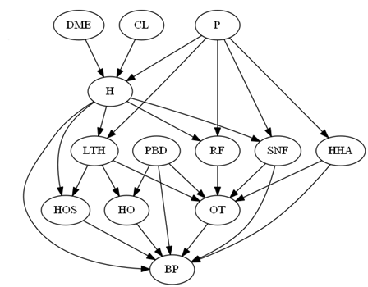
What are the parents in Markov blanket of RF?
Notes:
This is a network. Let us first familiarize ourselves with the concept of parents in the network. For each node, these are the nodes that precede it and are connected to it with a directed arc. So what are the parents in Markov blanket of RF?

Slide 23
Notes:
H and P are parents in the Markov blanket of RF. If one controls these variables, then de facto one controls the effect of any other preceding covariate on RF.

Slide 24
OT
Notes:
OT is the child in the Markov blanket of RF. If one controls this variable, then de facto one controls the effect of any other following variable on RF.

Slide 25
LTH
PBD
SNF
HHA
OT
Notes:
LTH, PBD, SNF and HHA are co-parents and a member of the Markov Blanket. .

Slide 26
If one controls the Markov Blanket then nothing else matters and affects RF
LTH
PBD
SNF
HHA
OT
Notes:
If one controls all members of the Markov Blanket then nothing else in the network matters and affects RF

Slide 27
Markov Blanket Makes the rest of Network Irrelevant Parents in Markov Blanket draw the network Markov Blanket is similar to Significance of variables in Regression

