Slide 1


Mediation Analysis
Teach One
George Mason University – HAP 823
03/02/2025
Jacob Copenheaver, Trinity Hua, Laxmi Prasanna Reddy Telkala

Slide 2
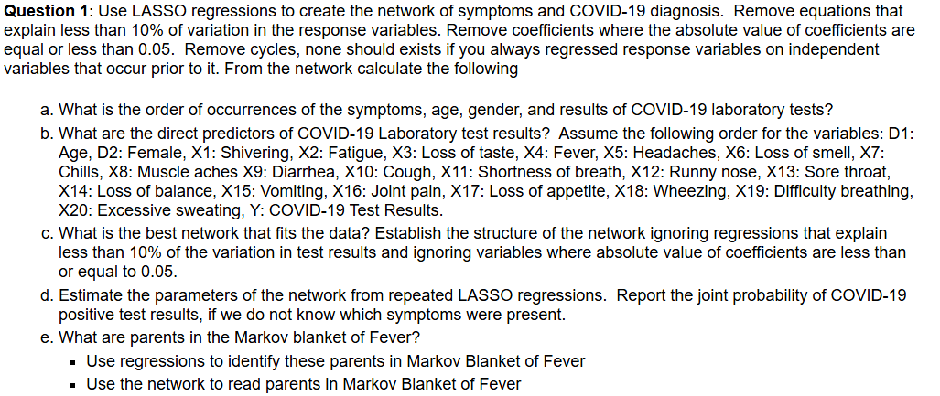
Question 1a – 1e

Slide 3
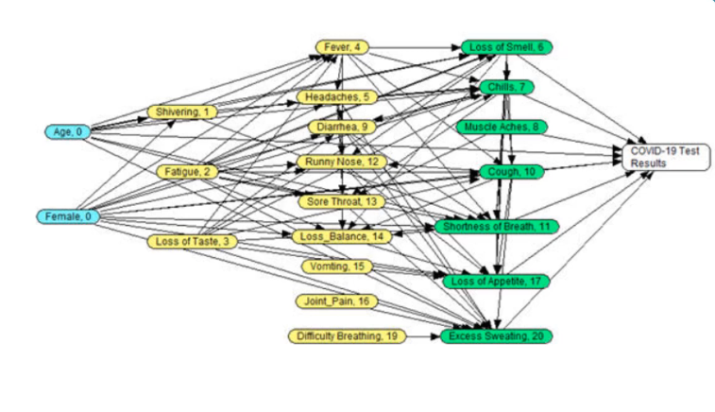
Q1a
Temporal order of the variables
Demographics
Symptoms
Outcome

Slide 4
Q1b
Order of steps
Preprocessing
Prepare data for analysis
LASSO regressions
Notes:
Question 1b is asking us to find the direct predictors of COVID19 laboratory test results, which is the outcome.
It provides us with an order in which the variables present themselves.
Direct predictors are anything in the regression that has a coefficient greater than 0.05
We also need to obtain the intercept and the mcfadden r2 values
There are 2 steps to complete this question. The first is to preprocess the data. This is to prepare the data for analysis.
The next step is to run the lasso regressions and obtain the information we need.

Slide 5
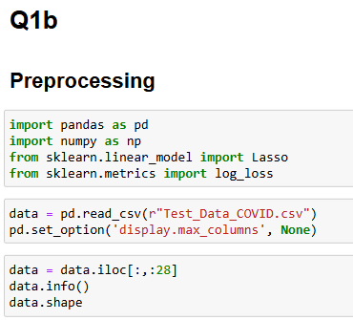
Q1b: Preprocessing
Notes:
We need to ensure that we have the correct libraries and data set imported as seen with the imports and the data = pd read csv line
To preprocess we need to check for null values, the datas shape and if any information in the dataset is not required to reduce noise
In our dataset there were columns that were not present in the variables listed in the question, therefore not in the temporal order of symptoms. These were removed.

Slide 6
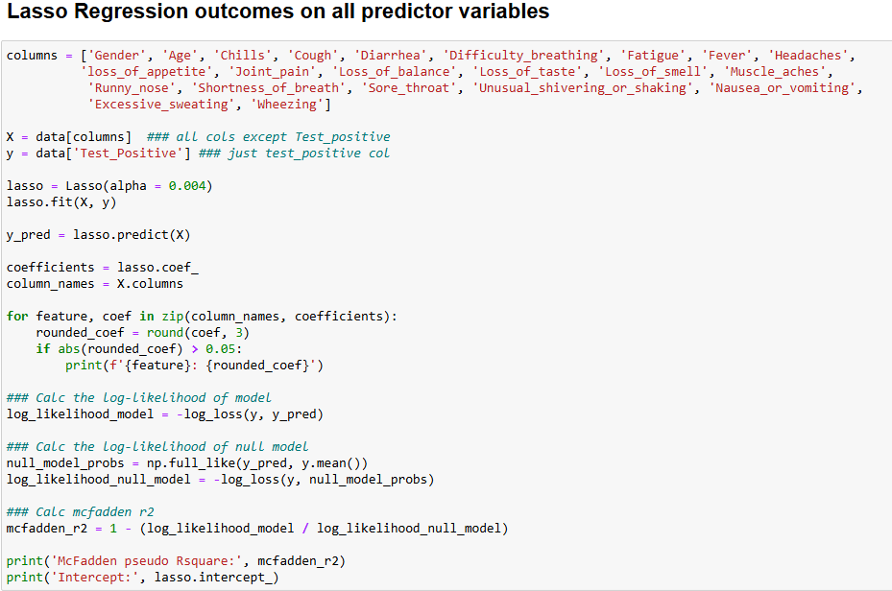
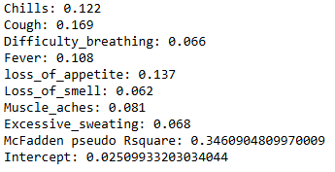
Q1b: LASSO regressions
Notes:
The next step is to perform lasso regression of the outcome variable (test result) with the preceding variables.
We start by identifying all the columns that are preceding by putting those into an array.
We make “X” be all the columns with the same name as those in the dataset and “y” be the test positive column
The alpha value for running these regression should be 0.004 and we need to fit our lasso regression to X and y
Y pred is defined as the prediction of lasso regression on y with X being the variable predicting it
In the for loop you can see that the coefficient are being rounded to 3 decimal places and they be checked to only show those that are relevant or greater than 0.05
When calculating the likelihoods of the models it is important to note that the mcfadden r2 value will be greater than 0.01

Slide 7
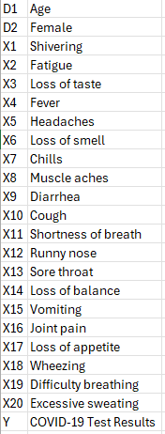
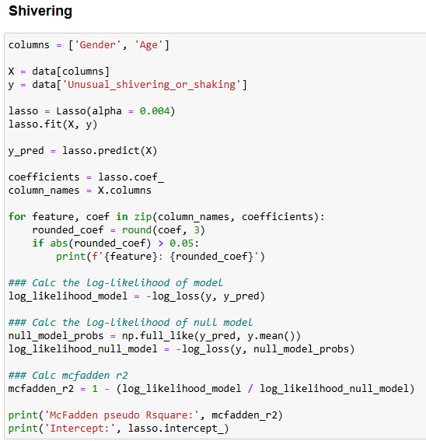

Q1c
Notes:
Question 1c is asking what is the best network that fits the data.
We needs to establish the structure of the network ignoring regressions that explain less than 10% of the variation in the test results and ignoring variables where absolute value of coefficients are less than or equal to 0.05
This is why we set up our 1st regression the way we did with the 0.05
Based on the previous question we know the order of the variables. We have to use this information to make a series of lasso regressions to determine if the previous predictors are significant predictors that need to be included in our best network. We must remember to remove the predictors that come after the variable that’s being predicted form our columns since they do not predict the variable that comes before it.
Provided is the order of variables as given previously. I provided one example of Shivering and the next slide will provide another example of excessive sweating.
As you can see in the code, the columns that remain are only gender and age. This is because the X1 is shivering therefore the only columns that could predict shivering are d1 and d2.
As we can see here, gender and age would not be significant predictors due to the mcfadden r2 value being less than the 0.05

Slide 8
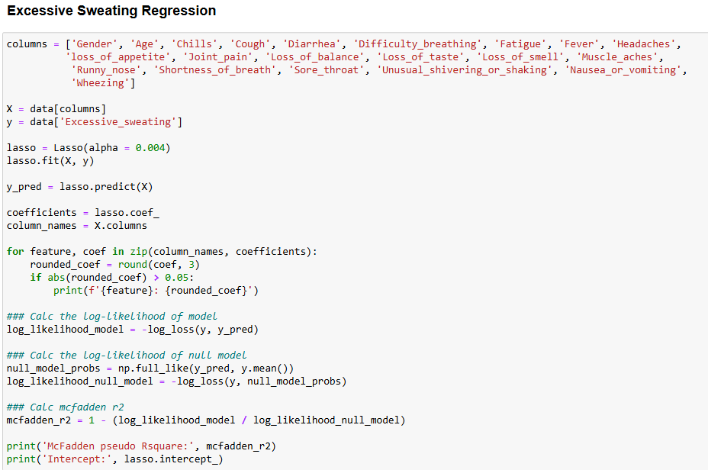
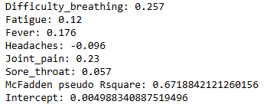
Q1c
Notes:
In this example of excessive sweating, the columns are just missing the excessive sweating column since excessive sweating is X20 and the last variable before the outcome variable Y.
This mcfadden r2 value is 0.672 therefore it would be significant.

Slide 9
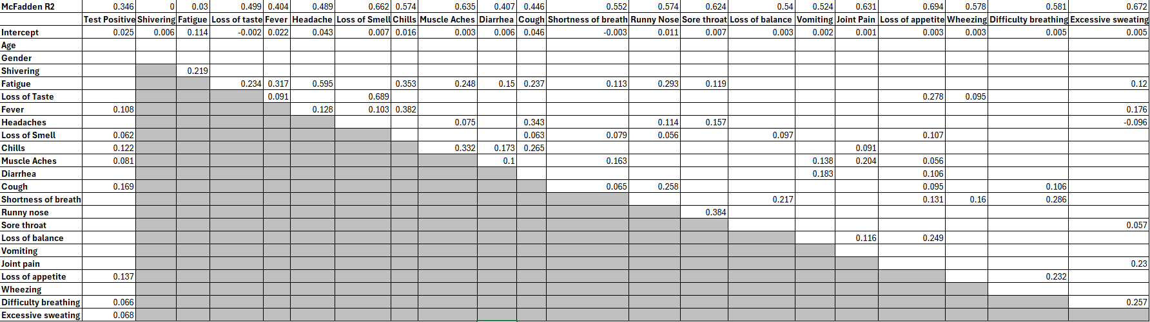
Q1c
Notes:
This is just all the coefficients produced by the regressions as well as the mcfadden r2 values and intercepts.

Slide 10
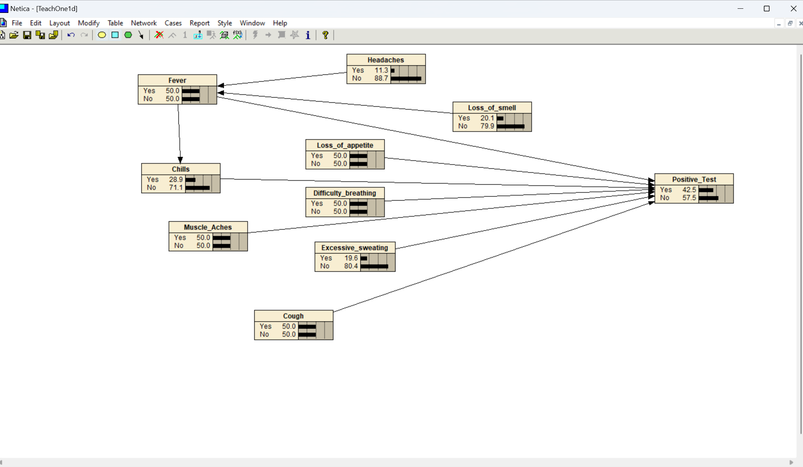
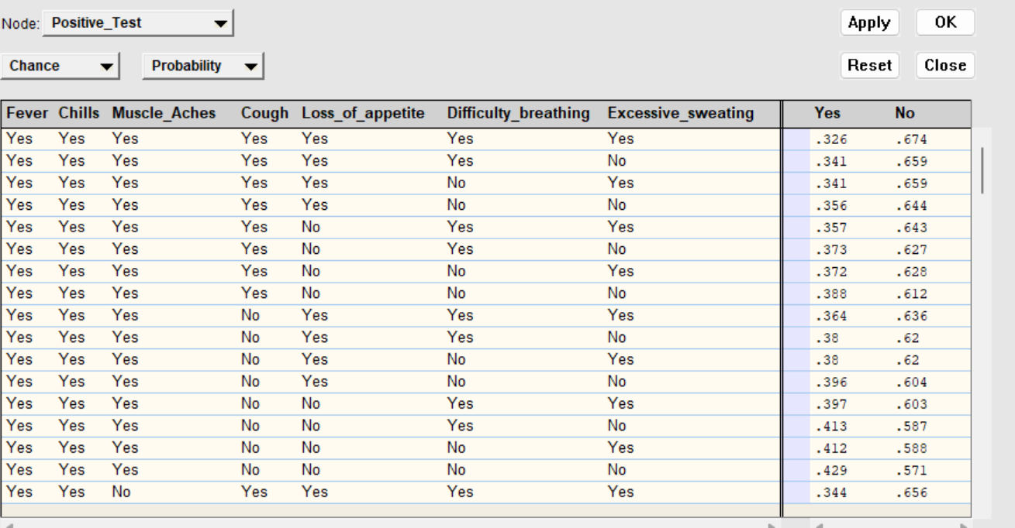
Q1d
Notes:
The best network is determined by:
Ignoring regressions that explain less than 10% of the variation in test results.
Removing coefficients with an absolute value ≤ 0.05 to filter out weak predictors.
Ensuring the temporal order of variables is maintained and that cycles are avoided (i.e., response variables must depend on prior variables only).
This network will be used to estimate the relationships among symptoms and test outcomes.

Slide 11
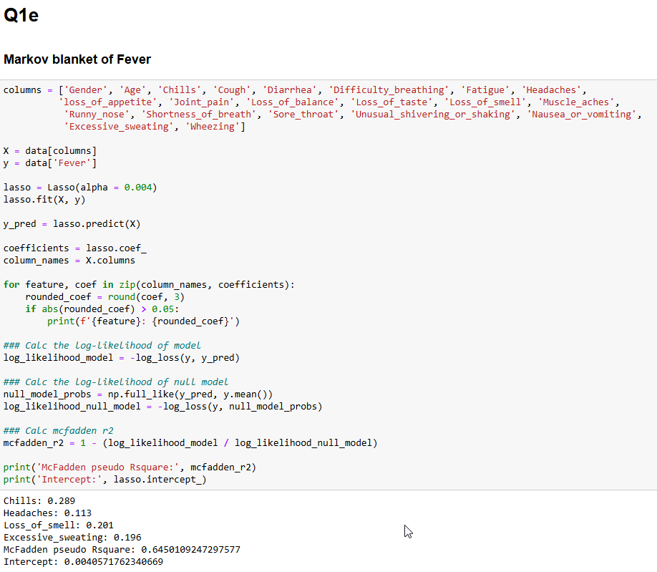
Q1e
Notes:
Question 1e is asking what are the parents in the Markov blanket of fever.
Use regressions to identify these parents in the Markov blanket of fever.
To approach this problem we need to run a regression on Fever. However since we are looking at the entire dataset to find the parents we ignore the temporal order in this case and have all columns besides test positive and fever be present in our X variable. Then the rest is the same regarding the regression.

Slide 12
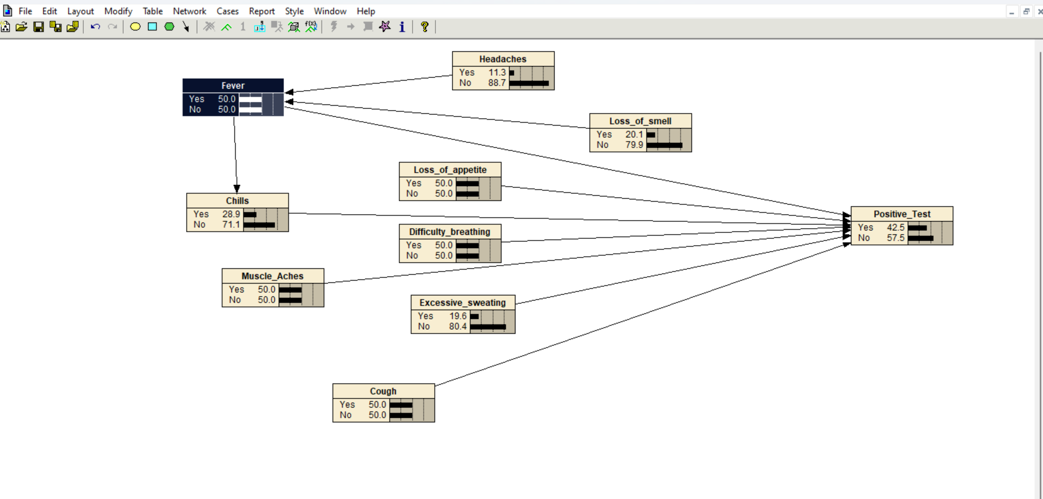
Q1e
Use the network to read parents in Markov Blanket of Fever
Notes:
After constructing the Bayesian network in Netica, the Markov blanket of Fever can be visually and computationally verified.
This involves:
Checking the parent-child relationships in the network.
Ensuring that the parents identified via regression (Chills, Headaches, Loss of Smell, and Excessive Sweating) are present.

Slide 13
THANK YOU!

