Slide 1
Network Modeling through LASSO Regression
Farrokh Alemi, Ph.D.
Notes:
These slides show you how to create a causal network through LASSO regressions

Slide 2
LASSO Regression:
Variables that make other variables irrelevant
Notes:
LASSO regression is a statistical technique that identifies a subset of variables that make other variables irrelevant in a prediction task.

Slide 3
LASSO Regression:
Identifies Markov blanket of regression’s response variable
Notes:
In network terminology, LASSO regression identifies Markov blanket of the response variable.

Slide 4
LASSO Regression
$$Response Y \sim β_{0}+\sum{β_{i}}X_{i}+λ\sum{{|β}_{i}|}$$
Penalty Parameter
Notes:
This shows a regression equation with Xs indicating the independent variables and Y indicating the response variable. In LASSO, the parameter lambda is called the penalty variable. It is multiplied by the sum of the absolute value of the parameters. When the value of lambda is large then more variables are forced to drop out of regression. The larger lambda the smaller the subset of features that will have a statistically significant relation to the response variable.

Slide 5
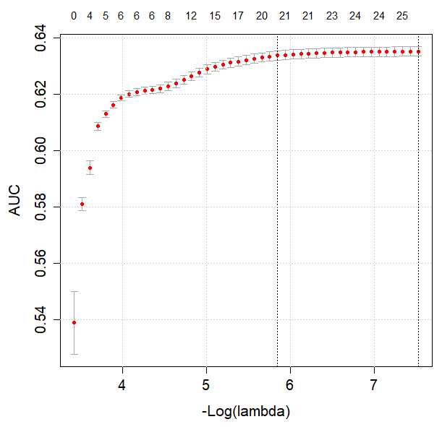
LASSO
Regression
$$Response Y \sim β_{0}+\sum{β_{i}}X_{i}+λ\sum{{|β}_{i}|}$$
Notes:
Here we see an example of how changes in lambda affects the cross validated accuracy of predictions, shown as AUC on the Y axis. The X axis shows minus log of lambda. Log of lambda is negative so minus log of lambda makes it a positive number. As lambda gets higher, we will have more accurate models and with fewer predictors in them. More accurate and more parsimonious. Early on, with minus log of lambda values less than 4, we see rapid improvements in accuracy. Around 5.8 improvements in accuracy get to be negligible. So we could choose this level as we will not lose much accuracy by choosing minus log of lambda of 5.8.

Slide 6
Causal Networks:
Parents in Markov blankets
Notes:
A causal network is a collection of nodes, where parents in Markov blanket of the node point to and are connected to the node.

Slide 7
Causal Network
Notes:
This graph shows a causal network. Variables are related by arcs. There are no cycles in the network. You can start from causes and see its effects.

Slide 8
Markov Blanket
Notes:
The Markov blanket of variable X6 is shown here inside the dashed line.

Slide 9
Markov Blanket
Parent
Parent
Notes:
This includes parents of X6 which are X2 and X3, the variables that immediately precede X6 and are connected to it.

Slide 10
Markov Blanket
Child
Child
Notes:
Markov blanket also includes children of X6, in this case X8 and X9.

Slide 11
Markov Blanket
Co-parents
Co-parents
Notes:
Finally Markov blanket includes co-parents. These are other parents of children of X6. In this network these are X5 and X7.

Slide 12
LASSO Regression on preceding variables identifies parents in Markov blanket
Notes:
The order and timing of occurrence of a variable identifies the parents in Markov blanket of a network. So doing a LASSO regression of a response variable on variables that precede it not only identifies the Markov blanket of the response variable but also a subset of variables within the Markov blanket, notably the parents within the Markov blanket. This is a crucial subset for construction of a network as if you know the parents in the Markov blanket of every variable in the network, then you have the entire network structure.

Slide 13
Order of Occurrence:
By Definition
By average time of occurrence
By time of measurement
Notes:
The order and timing of variables can be set by definition, e.g. date of birth occurs before any other event in the person’s life. It can be set by average time of occurrence, for example older people tend to have Alzheimer and younger people tend to have drug abuse. It can be done by when the variable was measured. For example, a diagnosis prior to treatment is comorbidity and a diagnosis after treatment is a complication. Comorbidities occur prior to complications.

Slide 14
An Example
Notes:
Let us go through an example

Slide 15
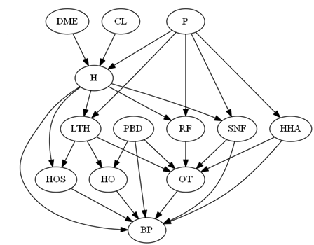
What are the parents in Markov blanket of RF?
Notes:
This is a network. Let us first familiarize ourselves with the concept of parents in the network. For each node, these are the nodes that precede it and are connected to it with a directed arc. So what are the parents in Markov blanket of RF?

Slide 16
Notes:
H and P are parents in the Markov blanket of RF. They are significantly related to RF, they occur prior to RF. If one controls these variables, then de facto one controls the effect of any other preceding covariate on RF.

Slide 17
$$RF\sim β_{0}+β_{1}^{∗}P+β_{2}^{∗}H+β_{3}CL+β_{4}DME+λ\sum{β_{i}}$$
All Variables that Precede RF
Notes:
LASSO regression can be used to detect the parents. This provides the equation of a LASSO regression of RF on all variables that occur prior to it. The parameter lambda in red is multiplied by some of the other parameters, so when lambda is large it drives the parameters to zero so that the product of lambda and the parameters becomes smaller.

Slide 18
$$RF\sim β_{0}+β_{1}^{∗}P+β_{2}^{∗}H+β_{3}CL+β_{4}DME+λ\sum{|β_{i}|}$$
Significant
Significant
Notes:
Only H and P will have a significant relationship with RF. DME and CL are correlated with RF but LASSO drops these variables, in part because of intercorrelation among the variables. H blocks the effect of these two variables on RF.

Slide 19
What is the equation that will identify parents to LTH?
Notes:
Let us try another example. What is the equation that will identify parents to LTH?

Slide 20
What is the equation that will identify parents to LTH?
$$LTH\sim β_{0}+β_{1}^{∗}P+β_{2}^{∗}H+β_{3}CL+β_{4}DME+λ\sum{{|β}_{i}|}$$
Significant
Significant
Notes:
The response variable is LTH. The independent variables are all the variables that occur before LTH, which is the same set of variables that occur before RF. We now expect that LASSO will identify P and H are significant. CL and DME are not significant.

Slide 21
Repeated LASSO Regression
Response Variable: Each Variable in Analysis
Independent Variables: All Variables Preceding Response
Notes:
The general process can now be described. Each node is selected as a response variable. Each node is LASSO regressed on all variables that precede it in time. The variables that remain statistically significant are the parents in Markov blanket of the response variable. This process identifies parents for all nodes in the network, de facto identifying the entire network.

Slide 22
LASSO Regression through glmnet
> STARD<-read.csv("/Users/Srilatha/Desktop/STARD.csv")
> data=subset(STARD, select=-c(1,2,4,5,6,7,8,9,10,11,13,14,15))
> colnames(data)
> x<-as.matrix(data[-35])
> y<-data[,35]
> cvfit=cv.glmnet(x,y)
> coef(cvfit, s="lambda.1se")
Notes:
Here is a code for doing LASSO regression using the package glmnet

Slide 23
LASSO Regression through glmnet
Read Data
> STARD<-read.csv("/Users/Srilatha/Desktop/STARD.csv")
> data=subset(STARD, select=-c(1,2,4,5,6,7,8,9,10,11,13,14,15))
> colnames(data)
> x<-as.matrix(data[-35])
> y<-data[,35]
> cvfit=cv.glmnet(x,y)
> coef(cvfit, s="lambda.1se")
Select Relevant Subset of Data
Notes:
First you read the data and drop variables that are not relevant to the analysis.

Slide 24
LASSO Regression through glmnet
> STARD<-read.csv("/Users/Srilatha/Desktop/STARD.csv")
> data=subset(STARD, select=-c(1,2,4,5,6,7,8,9,10,11,13,14,15))
> colnames(data)
> x<-as.matrix(data[-35])
> y<-data[,35]
> cvfit=cv.glmnet(x,y)
> coef(cvfit, s="lambda.1se")
Exclude response from independent variables

Slide 25
LASSO Regression through glmnet
> STARD<-read.csv("/Users/Srilatha/Desktop/STARD.csv")
> data=subset(STARD, select=-c(1,2,4,5,6,7,8,9,10,11,13,14,15))
> colnames(data)
> x<-as.matrix(data[-35])
> y<-data[,35]
> cvfit=cv.glmnet(x,y)
> coef(cvfit, s="lambda.min")
Set Response Variable

Slide 26
LASSO Regression through glmnet
> STARD<-read.csv("/Users/Srilatha/Desktop/STARD.csv")
> data=subset(STARD, select=-c(1,2,4,5,6,7,8,9,10,11,13,14,15))
> colnames(data)
> x<-as.matrix(data[-35])
> y<-data[,35]
> cvfit=cv.glmnet(x,y)
> coef(cvfit, s="lambda.1se")
Do Cross Validated LASSO Regression

Slide 27
LASSO Regression through glmnet
> STARD<-read.csv("/Users/Srilatha/Desktop/STARD.csv")
> data=subset(STARD, select=-c(1,2,4,5,6,7,8,9,10,11,13,14,15))
> colnames(data)
> x<-as.matrix(data[-35])
> y<-data[,35]
> cvfit=cv.glmnet(x,y)
> coef(cvfit, s="lambda.1se")
List Coefficients

Slide 28
Dropped Features
All Significant Variables Are Parents to the Response Variable: Citalopram
Sample Output
Dropped Features

Slide 29
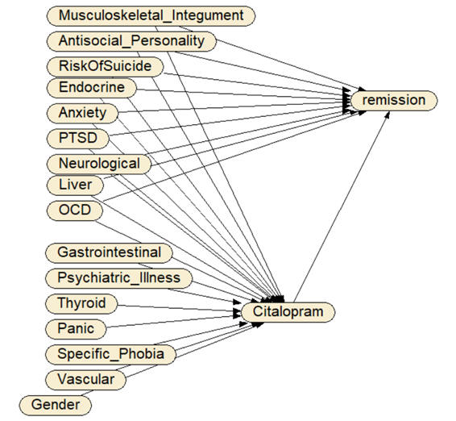
Network Model of Treatment & Outcome Regressions
Notes:
Here we see how two regressions were combined to create a single network model. The first regression had citalopram as response and baseline diseases as independent variables. The second regression had remission of symptoms as response, and citalopram and baseline comorbidities as independent variables. Once the structure of the network has been determined then parameters for the combined network are assessed by fitting the network to data using a software such as Netica.

Slide 30
Repeated LASSO Regression Identifies Entire Network Structure

