Slide 1
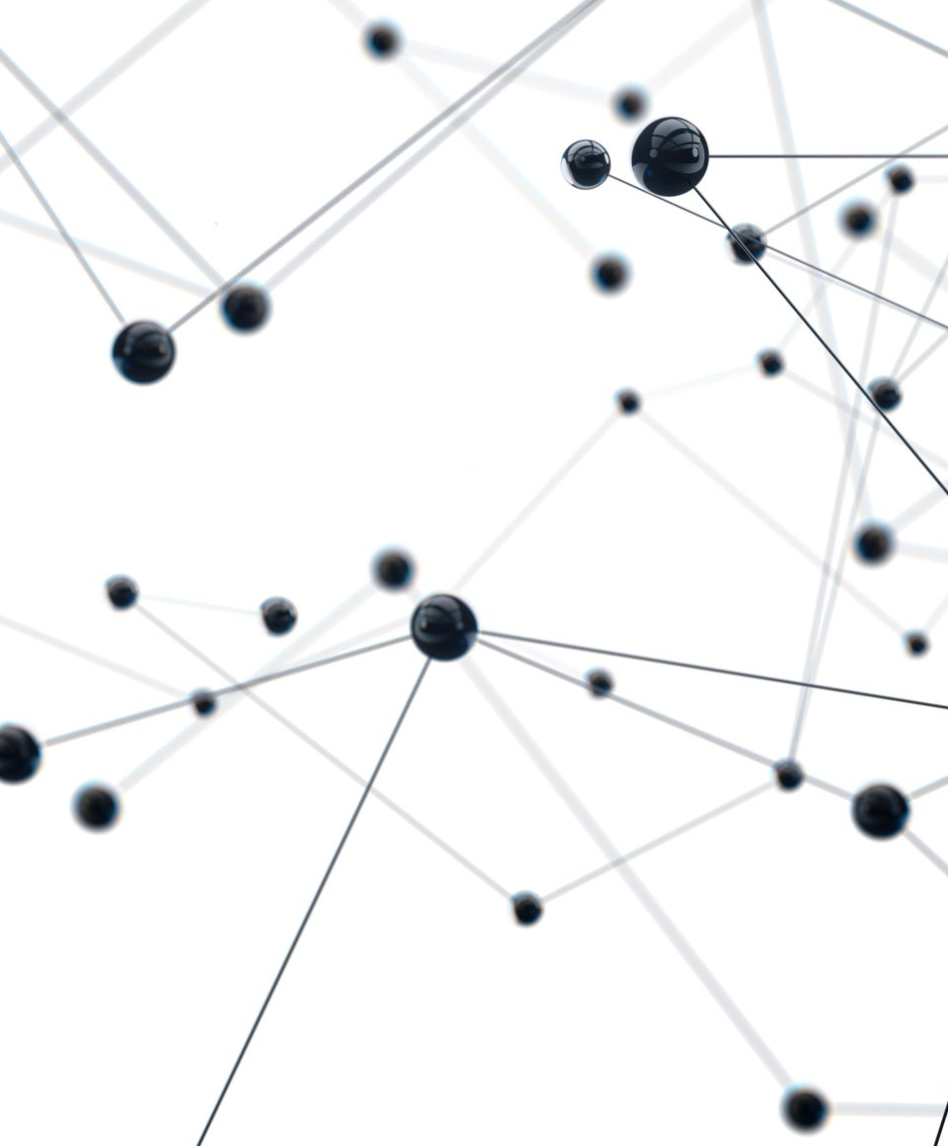
Causal Network LASSO Regression (Question 4)
Sai Vineela Ramineni
HAP 823
Dr. Farrokh Alemi
Prof. Abdul Hafeez

Slide 2
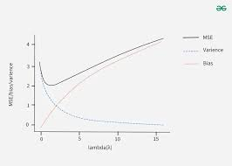
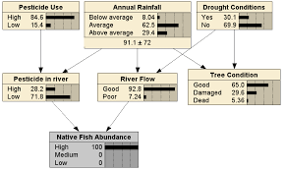
Introduction
Causal Networks: Graph-based models that represent cause-and-effect relationships, helping to analyze dependencies and infer causal impacts.
LASSO Regression: LASSO regression helps recover the original structure of a causal network by selecting the most relevant relationships from simulated data, reducing overfitting, and improving interpretability.
Bayesian Networks & Netica: Bayesian networks use probability distributions to model conditional dependencies between variables. Netica is a tool used to analyze these relationships and compute the causal impact of one variable on another.

Slide 3
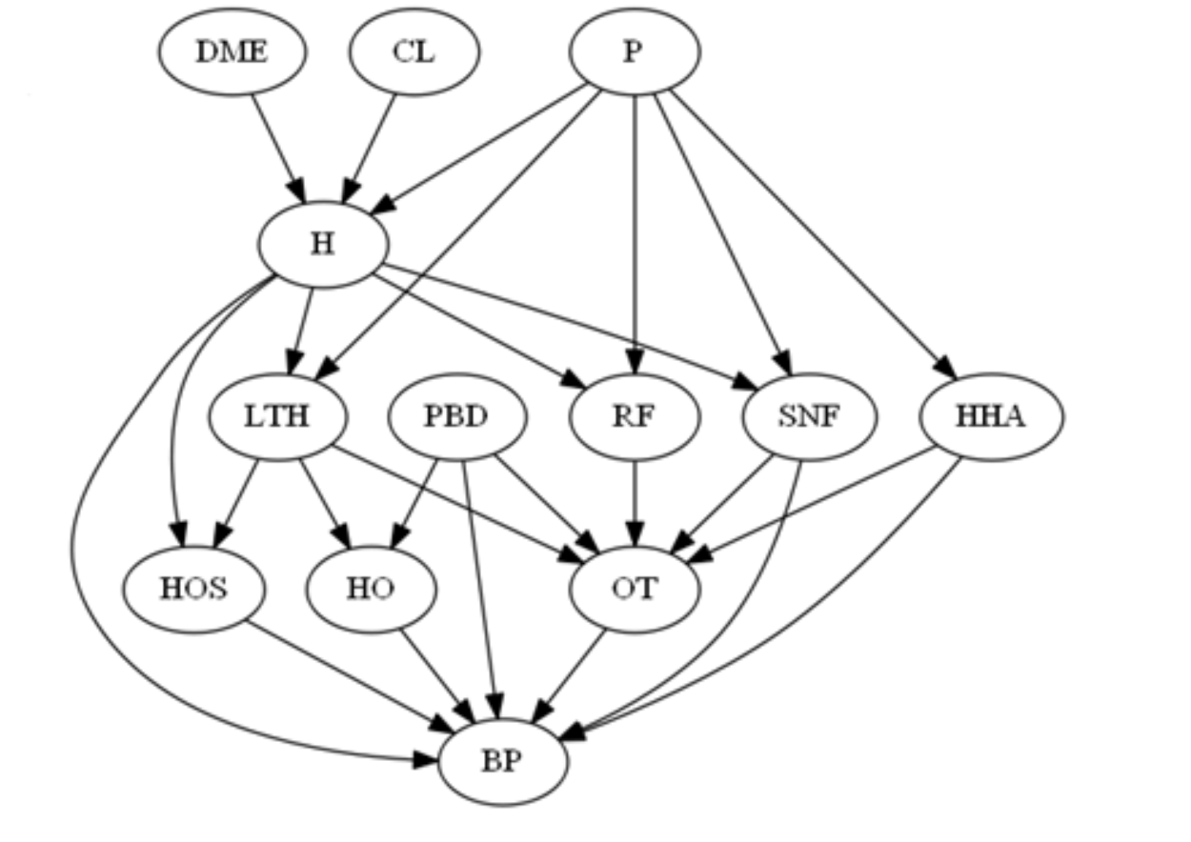
Question
4. The following graph was used to simulate data on bundling payment for total hip fracture treatment. Recover the original network from the data using LASSO regression and calculate the causal impact of H on BP using Netica.

Slide 4
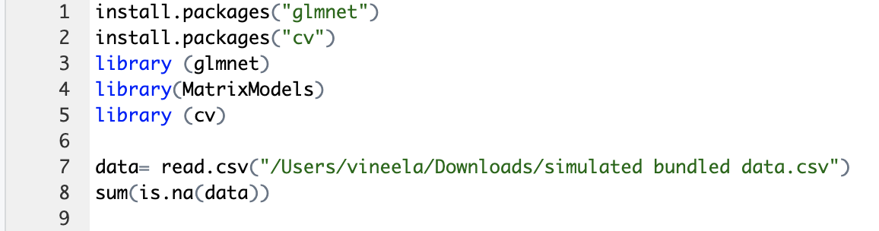
Code
Step 1: Installing the packages
  install.packages("glmnet")
  install.packages("cv")
  library (glmnet)
  library(MatrixModels)
  library (cv)
Step 2: Reading the data
data= read.csv("/Users/vineela/Downloads/simulated bundled data.csv")
sum(is.na(data))

Slide 5
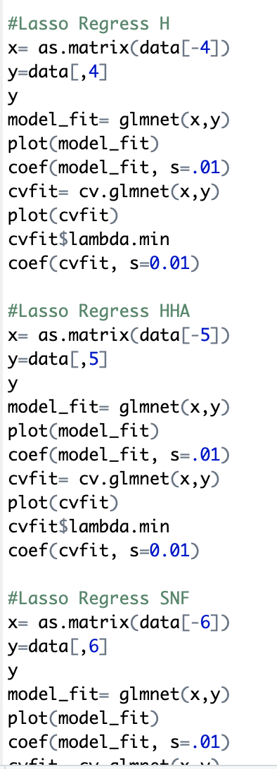
Step 3: LASSO regression for each target variable
  #Lasso Regress H
  x= as.matrix(data[-4])
  y=data[,4]
  y
  model_fit= glmnet(x,y)
  plot(model_fit)
  coef(model_fit, s=.01)
  cvfit= cv.glmnet(x,y)
  plot(cvfit)
  cvfit$lambda.min
  coef(cvfit, s=0.01)
Step 4: Do the same for other target variables
(excluding DME, CL, P)

Slide 6
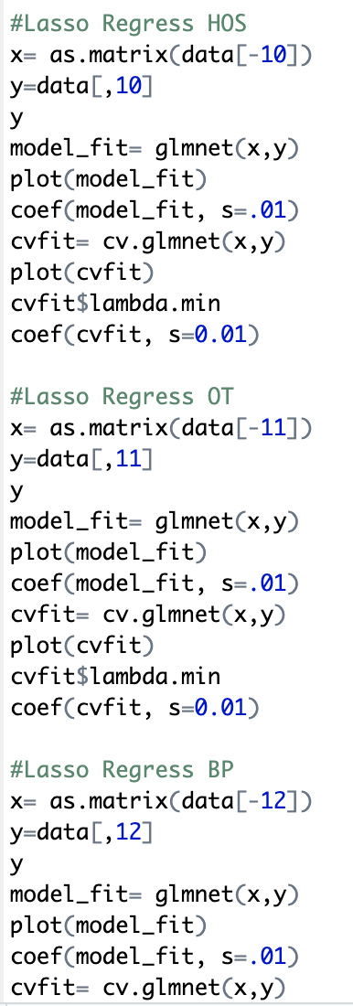
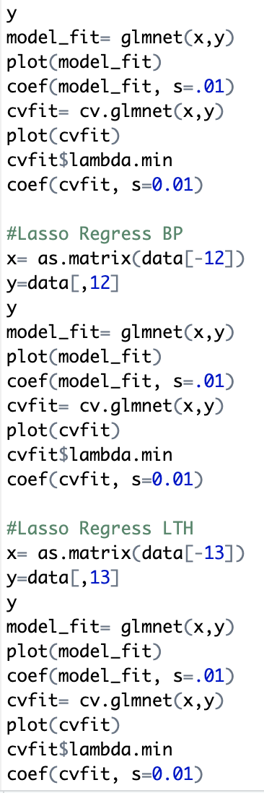
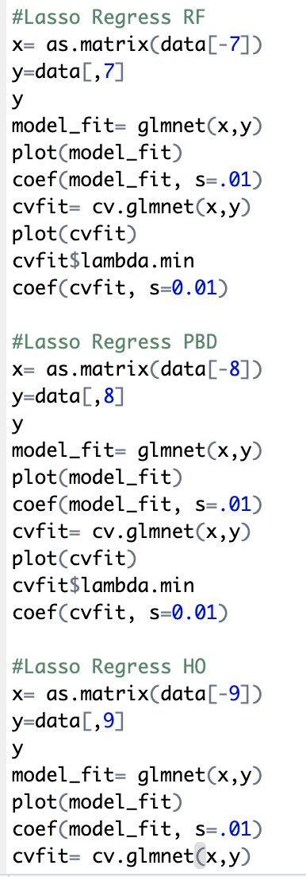

Slide 7
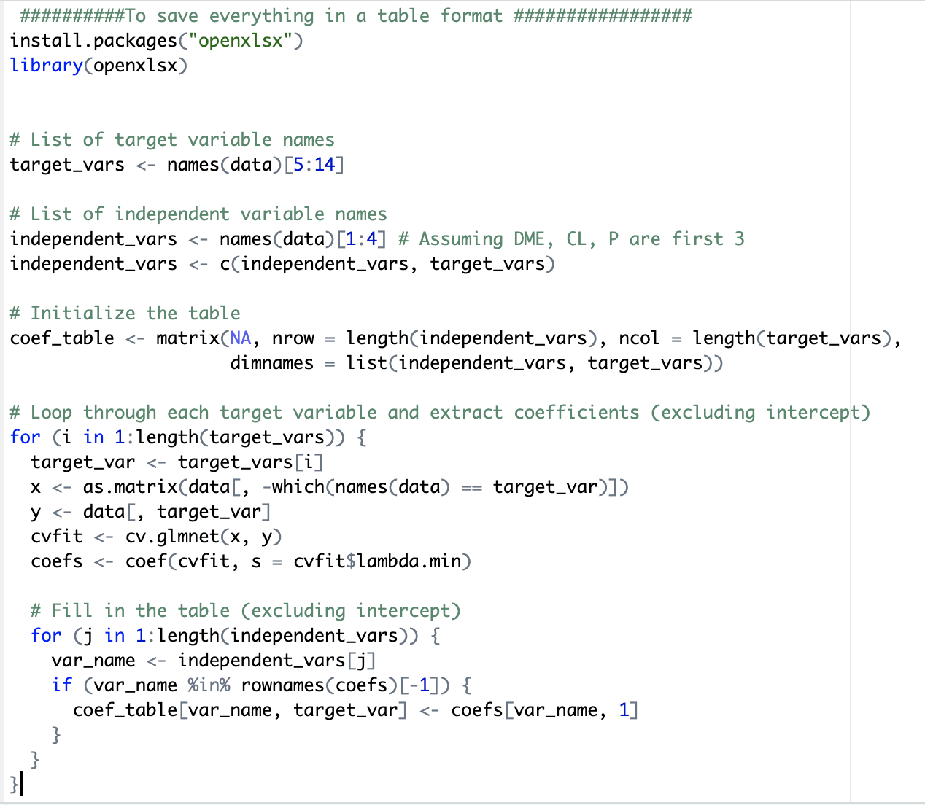
Step 5: Store coefficients in table format
  #Define target and independent variables
  install.packages("openxlsx")
  library(openxlsx)
  # List of target variable names
  target_vars <- names(data)[5:14]
  # List of independent variable names
  independent_vars <- names(data)[1:4] # Assuming DME, CL, P are first 3
  independent_vars <- c(independent_vars, target_vars)
Step 6: Loop through each target variable and run LASSO
# Initialize the table
coef_table <- matrix(NA, nrow = length(independent_vars), ncol = length(target_vars),
dimnames = list(independent_vars, target_vars))
# Loop through each target variable and extract coefficients (excluding intercept)
for (i in 1:length(target_vars)) {
target_var <- target_vars[i]
x <- as.matrix(data[, -which(names(data) == target_var)])
y <- data[, target_var]
cvfit <- cv.glmnet(x, y)
coefs <- coef(cvfit, s = cvfit$lambda.min)
# Fill in the table (excluding intercept)
for (j in 1:length(independent_vars)) {
var_name <- independent_vars[j]
if (var_name %in% rownames(coefs)[-1]) {
coef_table[var_name, target_var] <- coefs[var_name, 1]
}
}
}

Slide 8
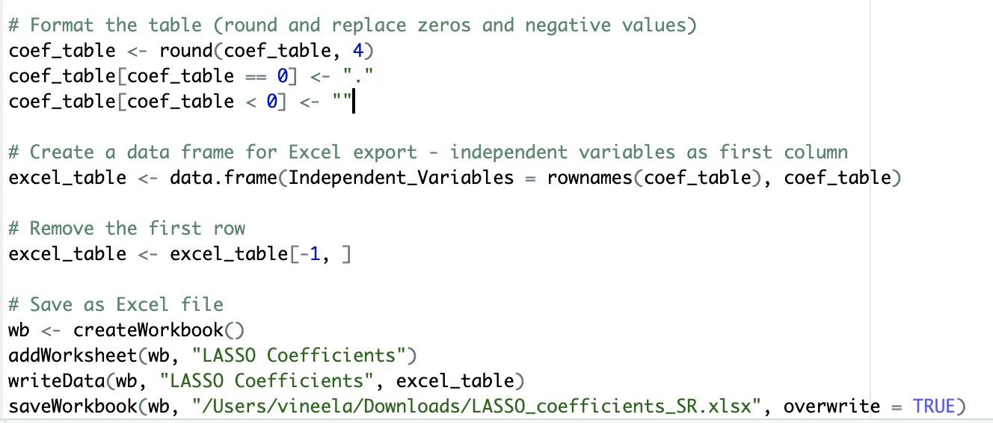
Step 7: Format the table and save the coefficients
table as Excel file
# Format the table (round and replace zeros and negative values)
coef_table <- round(coef_table, 4)
coef_table[coef_table == 0] <- "."
coef_table[coef_table < 0] <- ""
# Create a data frame for Excel export - independent variables as first column
excel_table <- data.frame(Independent_Variables = rownames(coef_table), coef_table)
# Remove the first row
excel_table <- excel_table[-1, ]
# Save as Excel file
wb <- createWorkbook()
addWorksheet(wb, "LASSO Coefficients")
writeData(wb, "LASSO Coefficients", excel_table)
saveWorkbook(wb, "/Users/vineela/Downloads/LASSO_coefficients.xlsx", overwrite = TRUE)

Slide 9
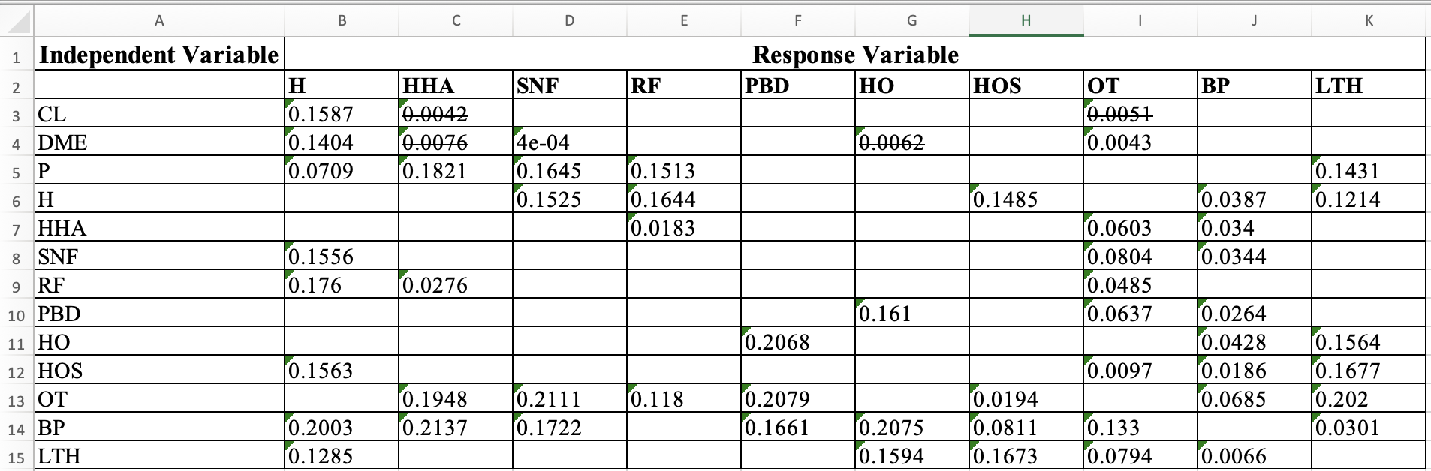
Results
*Edited for more readability and strike through the values that are <0.01

Slide 10
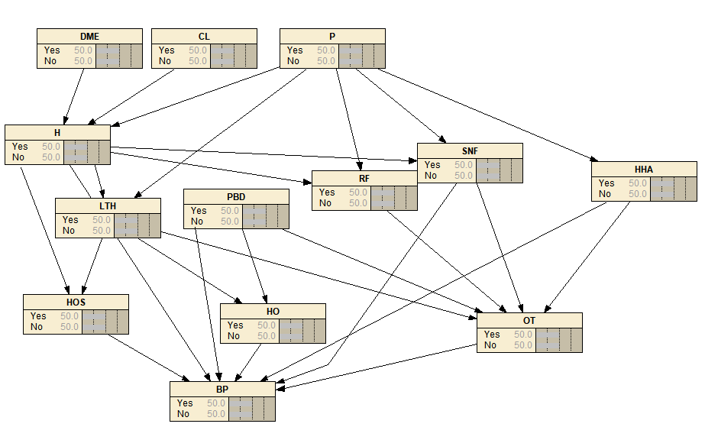
4.2: Casual impact of h on bp
- Change the datatype from CSV to txt for best results
Replace all the binary variables in
simulatedbundleddata.csv file to categorical variables (1=Yes, 0=No) (use CTRL+H to do find and replace all)
Create this network on netica by adding nodes and arrows
Your network should look like this!!!

Slide 11
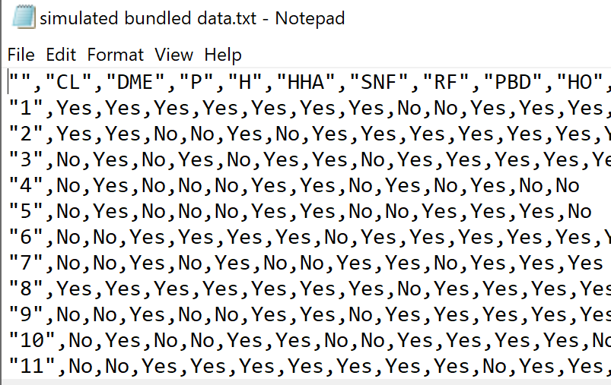
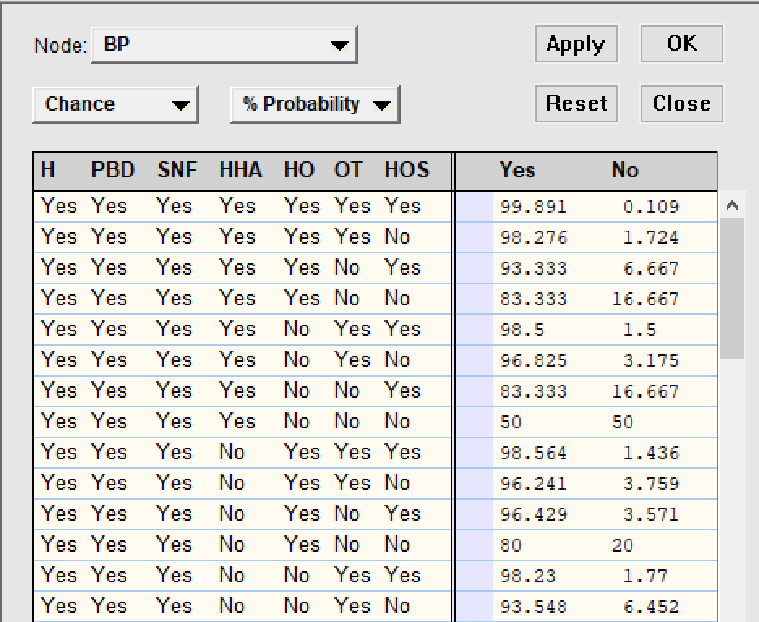
Uploading case files
  Cases -> Learn -> Incorp case file -> chose txt file (degree 1) -> compile net

Slide 12
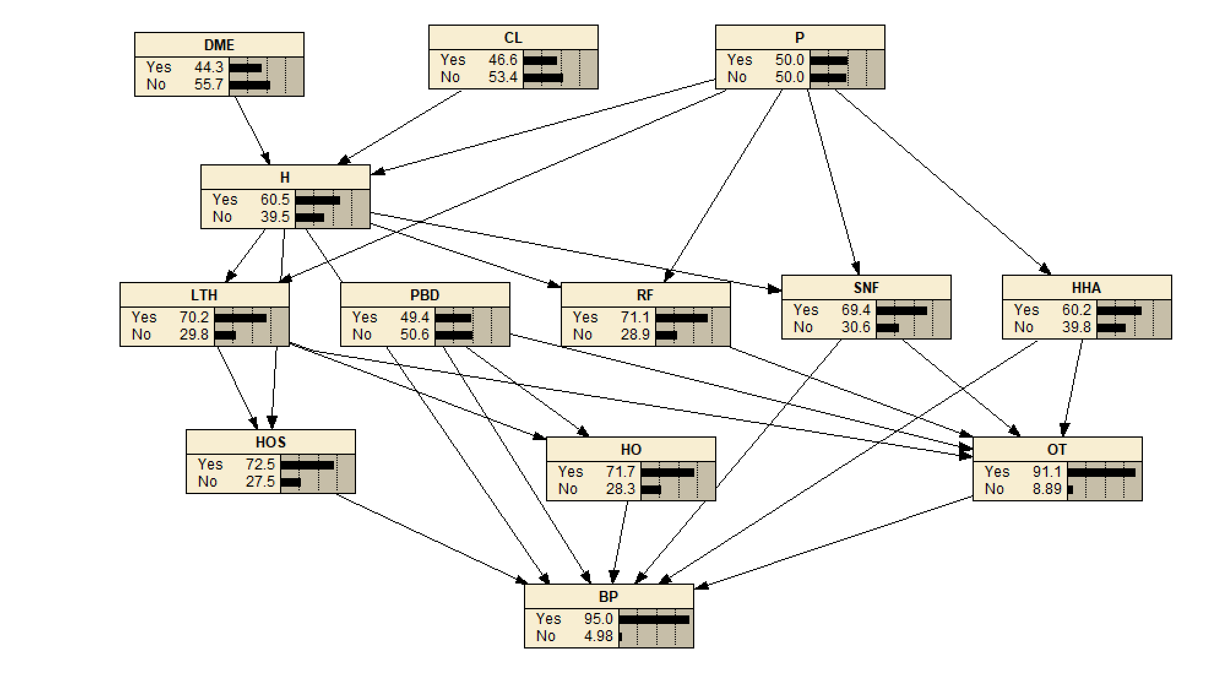
Netica network after uploading the case file

Slide 13
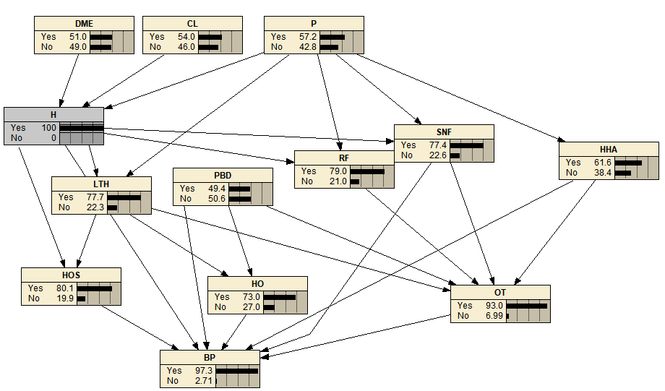
The casual impact of h on bp is 97.3%
Notes:
If H is a positive factor, the likelihood of BP occurring increases to 97.3%.

Slide 14
THANK YOU ☺

