Slide 1

regression NETWORKS HAP823 teach- ONE PRESENTATION
Disease Occurrence Order Analysis
POOJITHA KILARI
NITYA GARLAPALLY

Slide 2
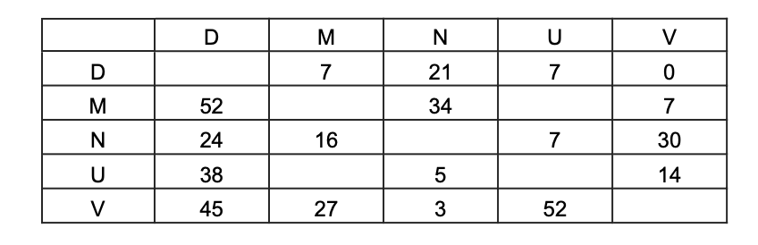
Disease Occurrence Order Analysis
The following data show for how many patients a disease occurs before another.
For example, for 21 patients, disease D occurs before disease N, and for 24 patients, the reverse order occurs.
There is no patient in our sample where both U and M have occurred in the same person.
Which of the following statements are correct?
- U occurs before M, when and if they both occur in the same patient
- M occurs before U, when and if they both occur in the same patient
- There is not sufficient information to know the temporal order of U and M

Slide 3
Plan for Analysis
Step 1: Print Data Values
Step 2: Replace Zeros with NaNs
Step 3: Create Point Difference DataFrame & Calculate Differences
Step 4: Calculate Average Point Differentials
Step 5: Determine Temporal Order (if possible)

Slide 4
Step 1:Printing Data Values
Step 1: Printing Data Values
data = {'D': {'M': 7, 'N': 21, 'U': 7, 'V': 0}, 'M': {'D': 52, 'N': 34, 'U': 0, 'V': 7}, 'N': {'D': 24, 'M': 16, 'U': 7, 'V': 30}, 'U': {'D': 38, 'M': 0, 'N': 5, 'V': 14}, 'V': {'D': 45, 'M': 27, 'N': 3, 'U': 52}}

Slide 5
Step 2: Replacing Zeros with NaNs
point_diff.replace(0, np.nan, inplace=True)
Step 3: Creating Point Difference DataFrame & Calculating Differences
for d1 in diseases: for d2 in diseases: if d1 == d2: point_diff.loc[d1, d2] = 0 elif d1 in data and d2 in data[d1] and d2 in data and d1 in data[d2]: diff = data[d1][d2] - data[d2][d1] point_diff.loc[d1, d2] = diff point_diff.loc[d2, d1] = -diff
Step 4: Calculating Average Point Differentials
avg_diff = point_diff.mean(axis=1)

Slide 6
Step 4: Calculating Average Point Differentials
avg_diff = point_diff.mean(axis=1)
for disease in diseases:
print(f"AVG OF POINT differentials FOR {disease}: {avg_diff[disease]}")
avg_diff = point_diff.mean(axis=1)
ranked_diff = avg_diff.sort_values().reset_index()
ranked_diff.columns = ['Disease', 'Avg. Point Differential']
ranked_diff.index = np.arange(1, len(ranked_diff) + 1)
print(ranked_diff)

Slide 7
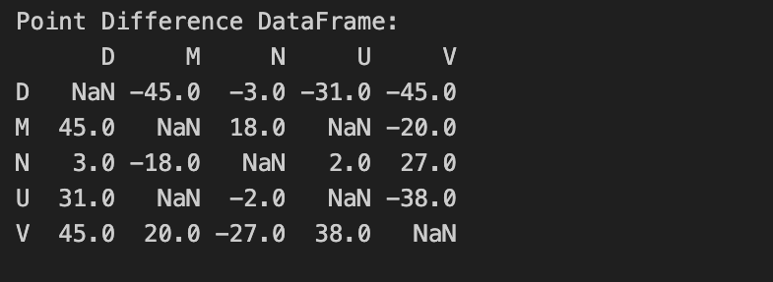
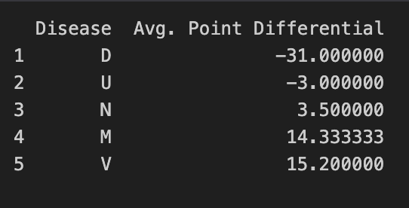
RESULTS

Slide 8

Conclusion
U occurs before M in the same patient, as U has an average point differential of -3.00 while M has an average point differential of 14.33.

Slide 9
THANKYOU

