Slide 1
Teach One: Logistic Regression
(QUESTION 5)
HAP 823 | Spring 2022
Jo-Vivian Yu

Slide 3
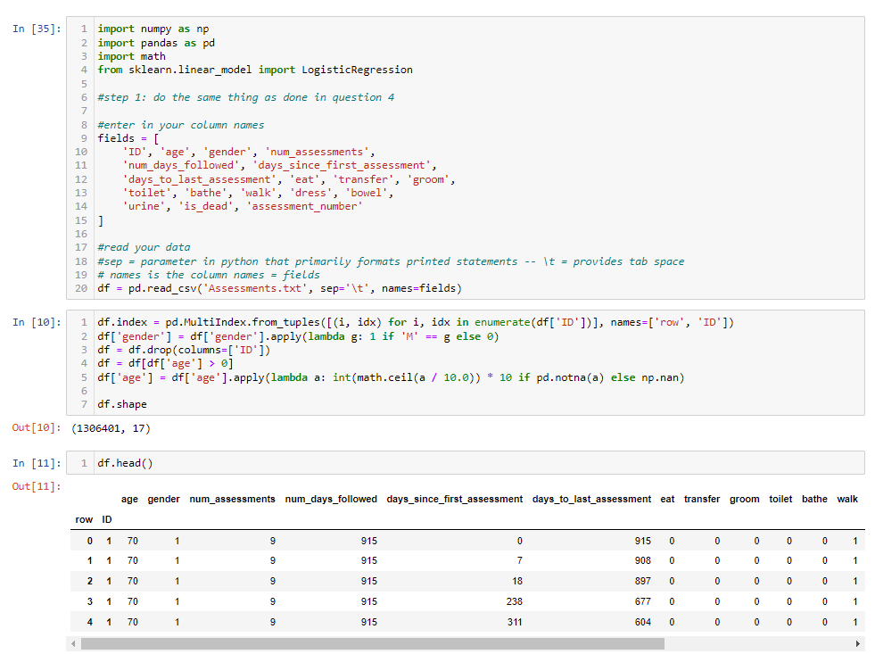

Slide 4
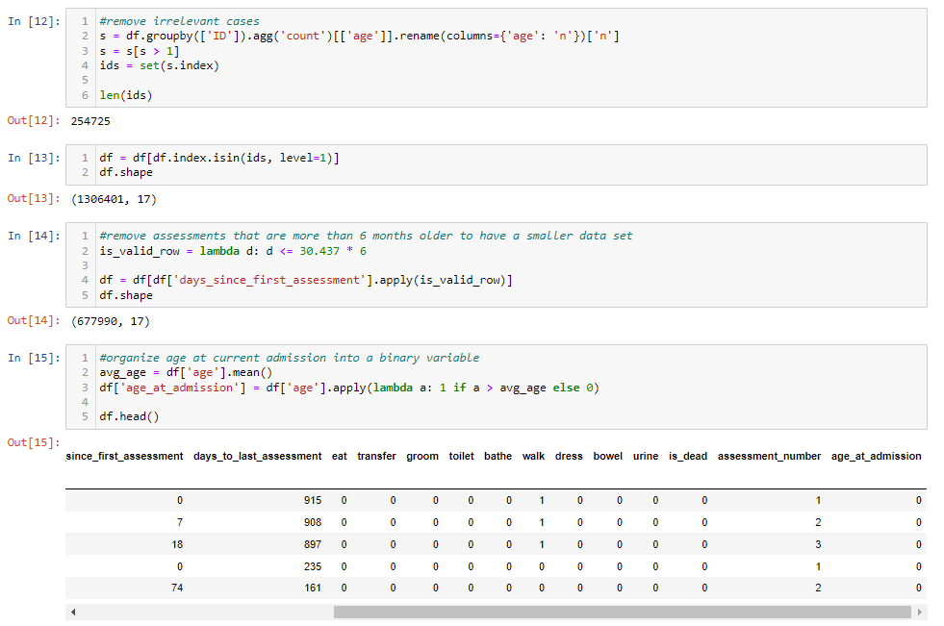
Notes:
Remove irrelevant cases such as cases with only one assessment
Remove assessments that older than six months
Binarize age at current admission

Slide 5
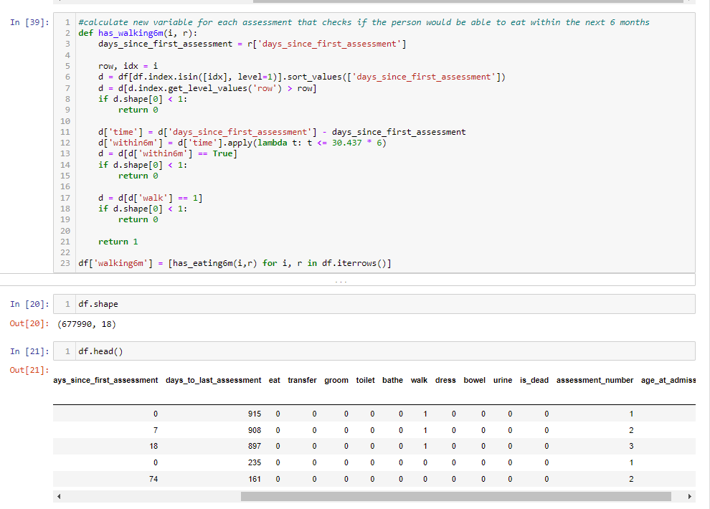

Slide 6
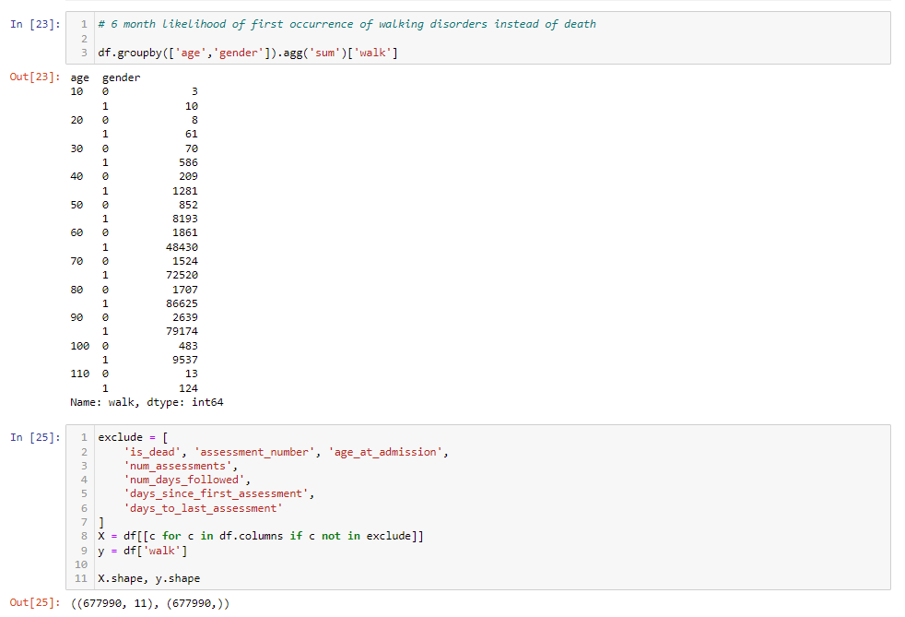

Slide 7
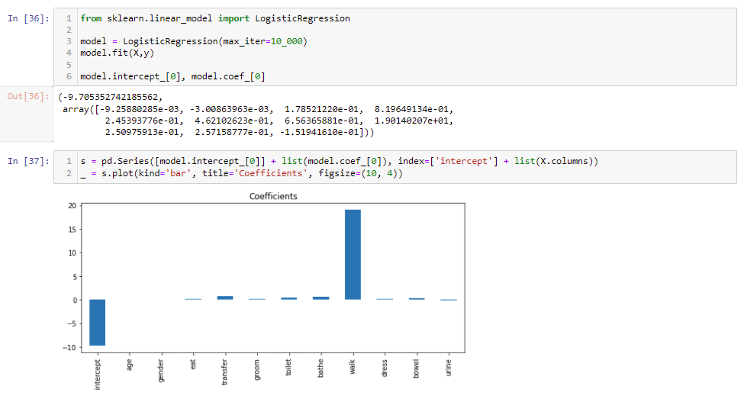

Slide 8
Thank you!

