Slide 1

Social Determinants of Diabetes
HAP823
George Mason University
Jieun Jang
Notes:
Hello everyone, my name is Jieun. This presentation was prepared as a part of HAP823 course taught by Dr. Alemi at George Mason University.

Slide 2

Social Determinants of Diabetes
Question 1:
The attached data show the percent of diabetes in different 2,228 counties within United States in 2010, 2011, and 2012 years. We want to understand if access to food stores affects diabetes. Create the network model, using data from repeated LASSO regressions. The first regression will be diabetes in 2012 on all 2011 variables. Other LASSO regressions will have as response/dependent variable the statistically significant variables in the previous regression regressed on all 2010 variables. Draw the network model using Netica. Stratify the parents in Markov blanket of diabetes in 2012; calculate the impact of access to quality food stores in 2011 on diabetes using stratified covariate balancing.
Notes:
In this presentation, I’m covering social determinants of diabetes and how to calculate the impact of access to quality food on diabetes using stratified covariate balancing. Repeated LASSO regression will be used to get the answer for question1. The first regression will be diabetes in 2012 on all the 2011 variables. And the statistically significant variables from the first regression will be used as the response variable of the second LASSO regression. We will carry out the regression on the 2011 variables. Afterwards, we are going to draw a network model utilizing Netica. Through this step-by-step process, we are able to analyze if quality food store access affects developing diabetes.

Slide 3
Social Determinants of Diabetes
S t e p 0 1
Download the provided data from the website (openonlinecourses.com/causalanalysis)
Notes:
For step 1, download the provided data from the Openonlinecourses.com website. Click the “Data” icon as you can see in this screen. Then CSV file will be saved on your computer.

Slide 4
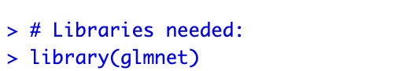
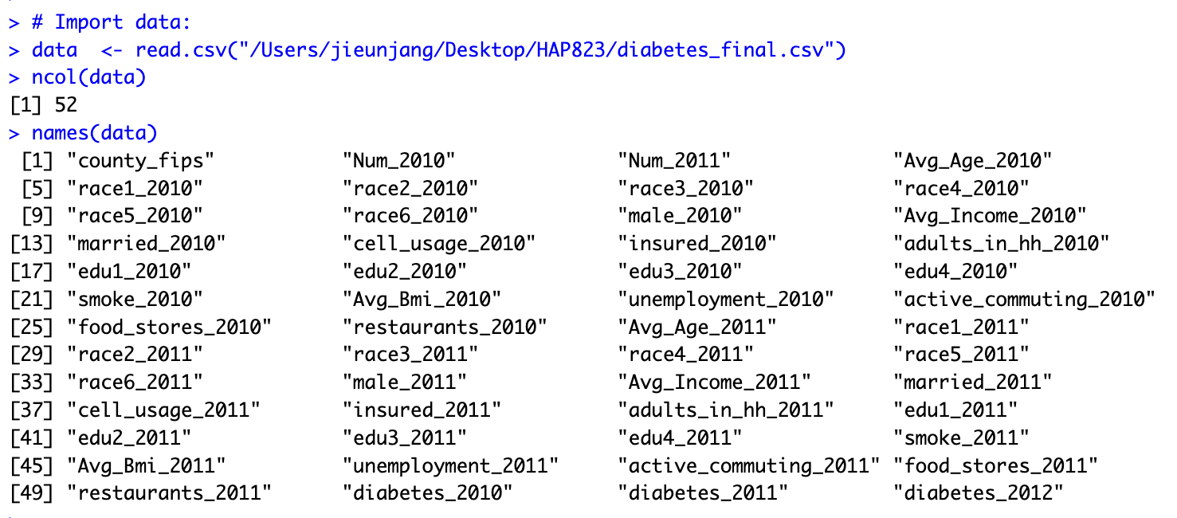
Social Determinants of Diabetes
S t e p 0 2
Import the data in R Studio and install libraries needed
Notes:
For step 2, import the downloaded CSV file into R Studio and install the needed libraries. For this analysis, LASSO regression will be used and it can be done using GLMnet. And after the file is imported, we can get the names of all columns using names() function and the number of columns using ncol() function respectively.

Slide 5
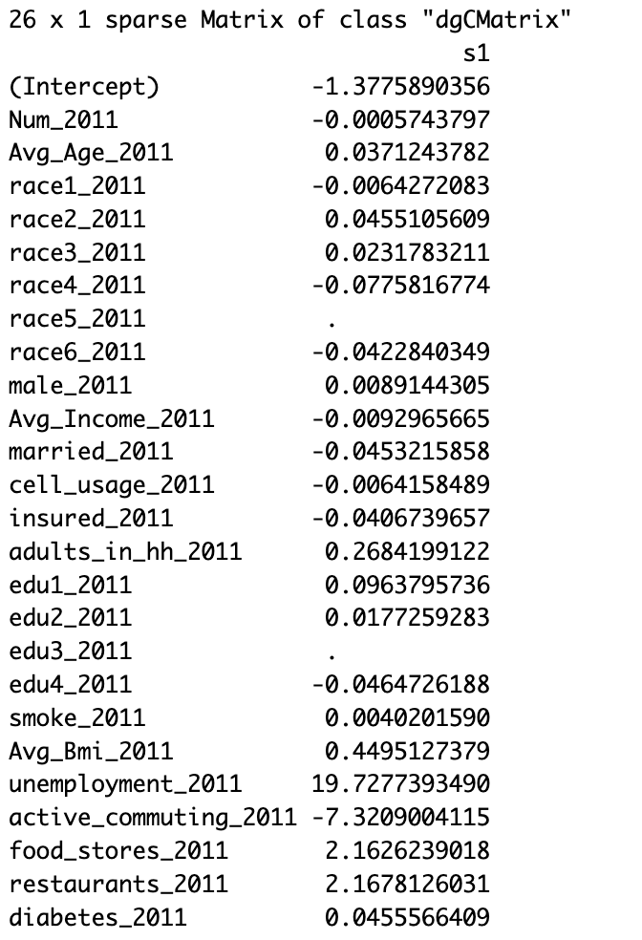
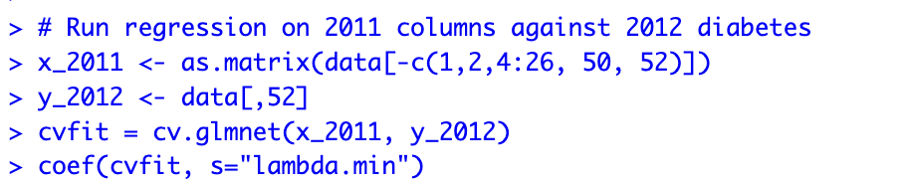
Social Determinants of Diabetes
S t e p 0 3
Implement regression on 2011 columns against diabetes_2012
Notes:
Step 3, we will carry out regression on the 2011 variables against the dependent variable diabetes 2012. X variables should be all 2011 columns. So we will remove column1, column2, columns 4 though 26, column 50, and column 52. The reason why we will remove column 52 is because it will be used as the dependent variable. And for the “cvfit”, the "cv" part means we want to use cross validation to obtain the optimal values for alpha and
“GLMnet” provides a variety of regularization methods, including LASSO and Ridge regularization. The first two parameters mean that we want to use x_2011 to predict y_2012. Finally, we can extract the coefficient of each covariate using “coef()” function with lambda.min.

Slide 6
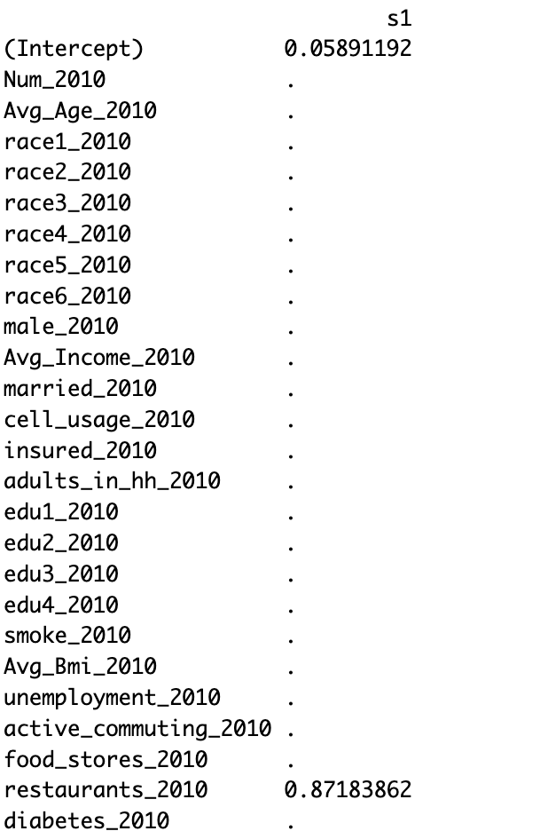
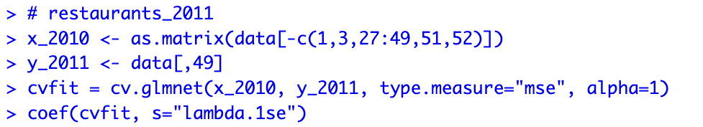
restaurants_2011
S t e p 0 4
Implement regression on 2010 columns against 2011 significant variables
Notes:
For step 4, the second LASSO regression will be carried out based on the statistically significant variables from the first regression, which are “restaurants_2011”, “unemployment_2011”, ” Avg_Bmi_2011”, “active_commuting_2011”, “food_stores_2011”, “adults_in_hh_2011”. In this step, 2010 variables will be selected as X variables. So we will eliminate column 1, column 3, column 27 through 49, column 51, and column52. And we will allocate each 2011 significant variable for LASSO regression repeatedly. In the “cvfit” part, “alpha=1” indicates that we are using LASSO regression. The result can be seen on the right side. Since we added a penalty term using LASSO, it shrinks the coefficients of some predictors towards zero and we found that there is a relationship between restaurants_2010 and reataurants_2011.

Slide 7
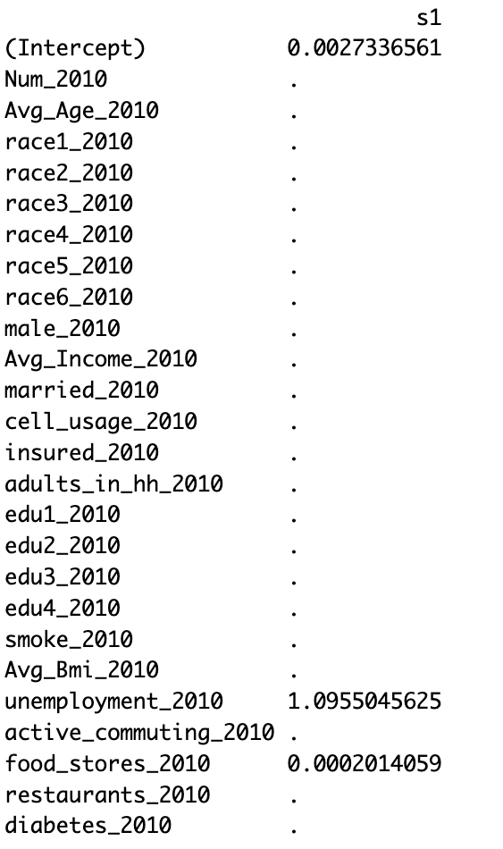
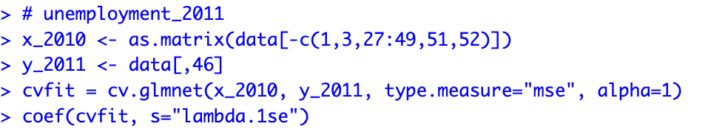
unemployment_2011
Notes:
Next, we are going to run the same LASSO regression for each different y variable. The y variables are from a previous regression that has statistically significant variables. This time “unemployment_2011” was assigned.

Slide 8
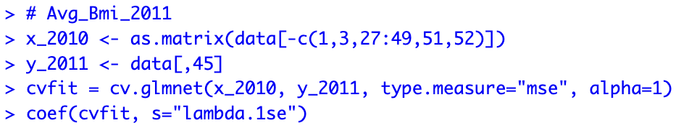
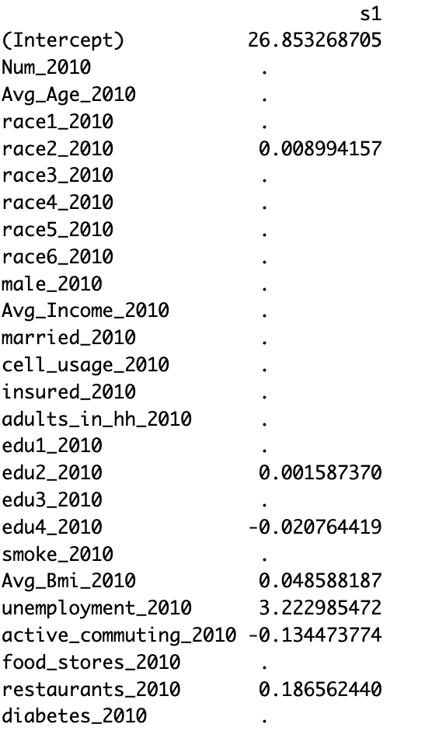
Avg_Bmi_2011

Slide 9
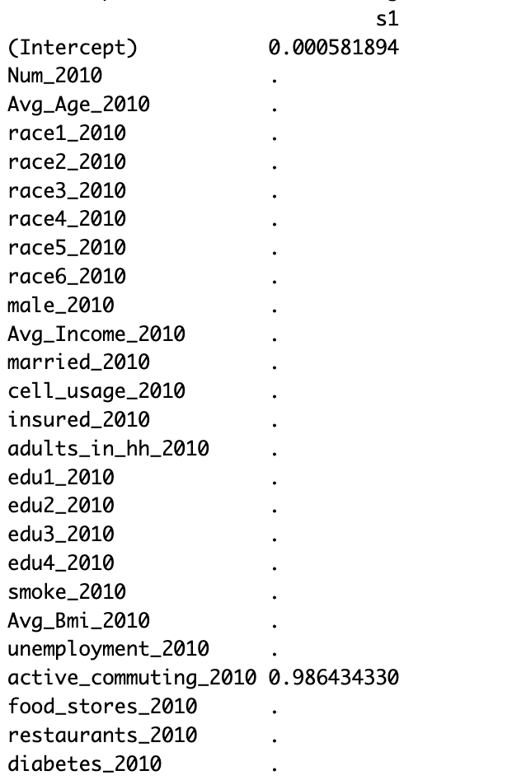
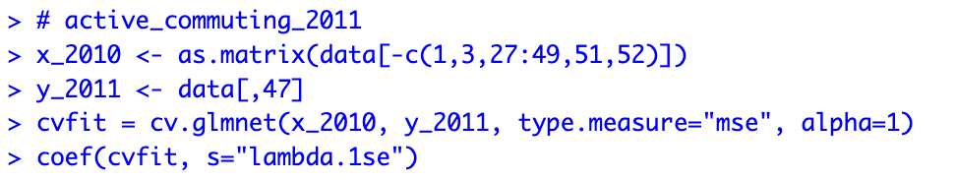
active_commuting_2011

Slide 10
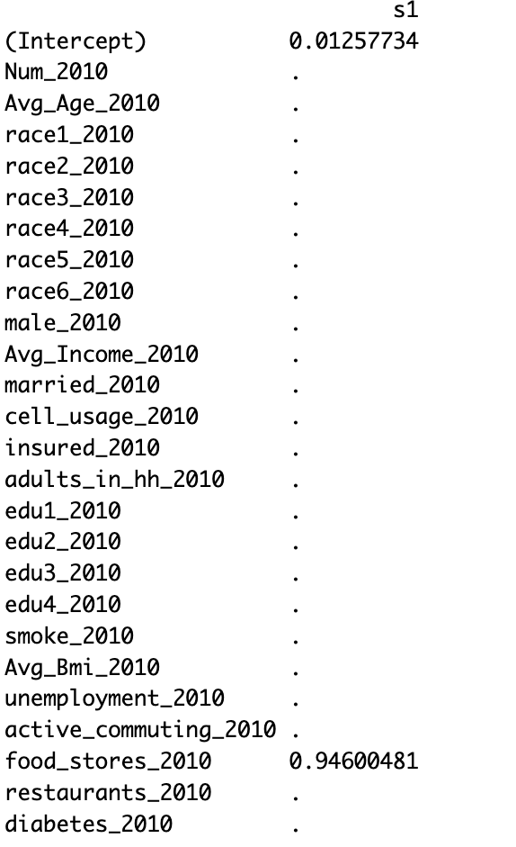
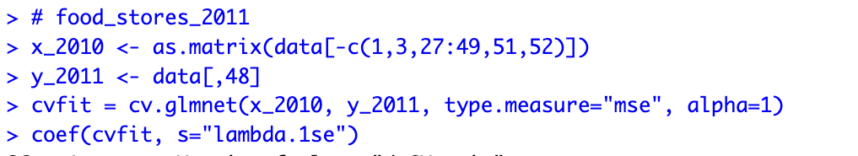
food_stores_2011

Slide 11
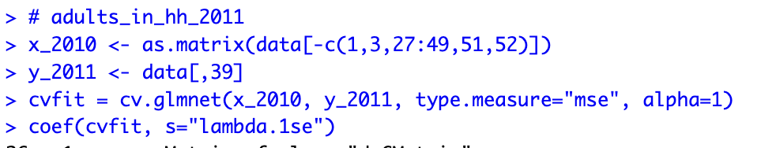
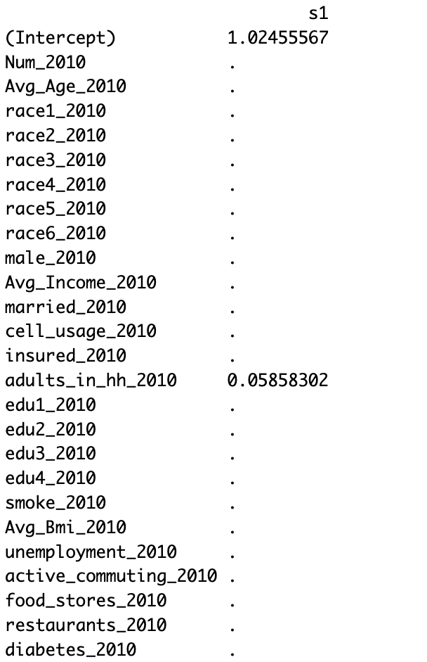
adults_in_hh_2011

Slide 12
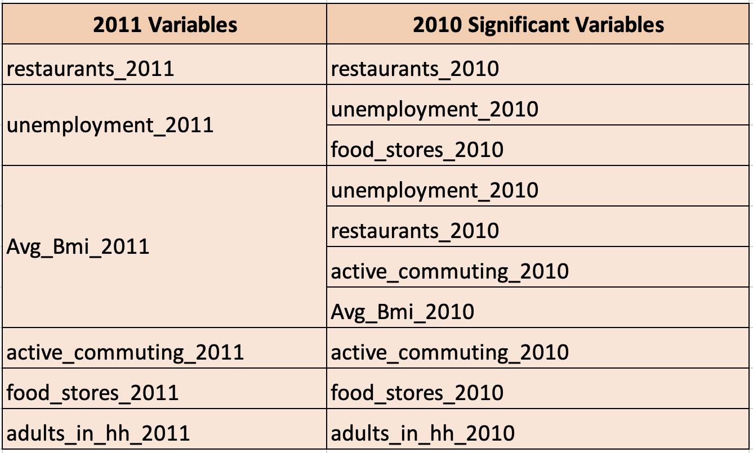
Social Determinants of Diabetes
Notes:
The results of the second regression can be summed up in this table.

Slide 13
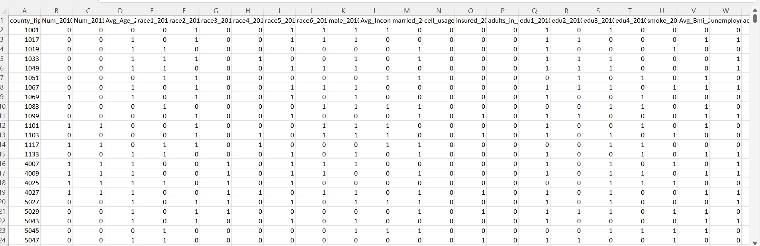
Social Determinants of Diabetes
S t e p 0 5
Turn data with numeric features into binary data and save as text file
Notes:
For step 5, Turn data with numeric features into binary data and save as text file. To change to binary data first calculate the average of each column and then if the value is greater than the average, assign 1, otherwise assign a zero.

Slide 14
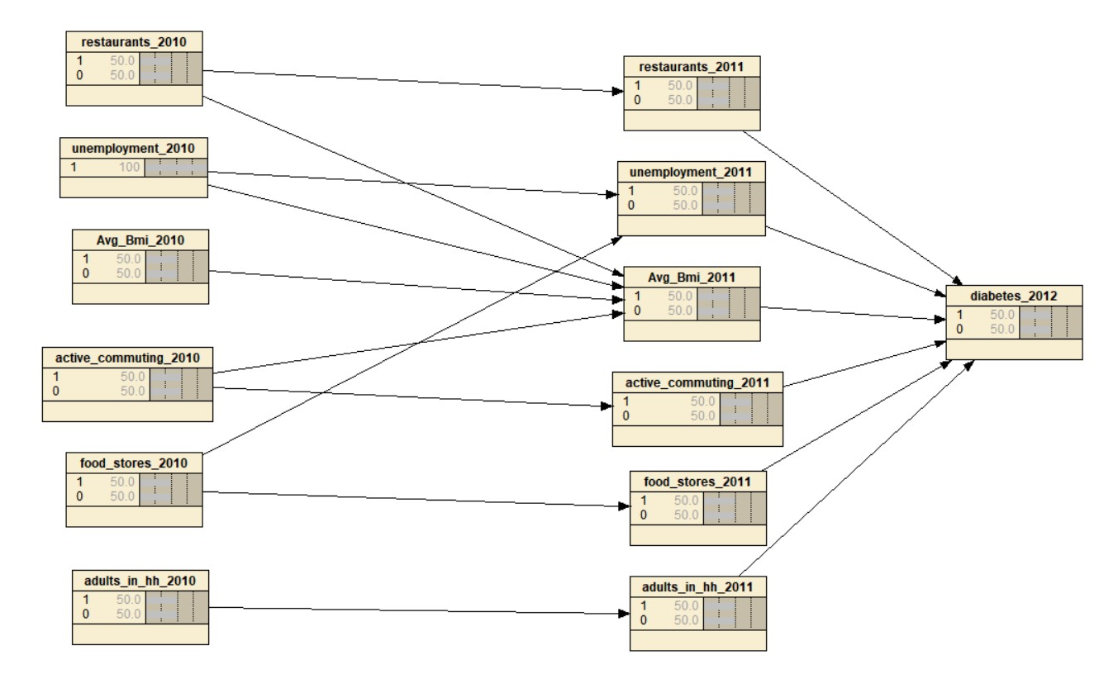
Social Determinants of Diabetes
S t e p 0 6
Draw the network model by creating nodes and arrows between any two nodes using Netica
Notes:
Step 6, Draw the network model by creating nodes and arrows between any two nodes using Netica.
To do that, first create node for each significant variables and add each node states of 0 and 1. After that, draw arrows to conncect nodes based on the regression’s results. and click “Cases” and go to ”Learn” and then “Incorporate Case File”. We will load the prepared binarized text file. Lastly, click lightening bolt to “Compile”.

Slide 15
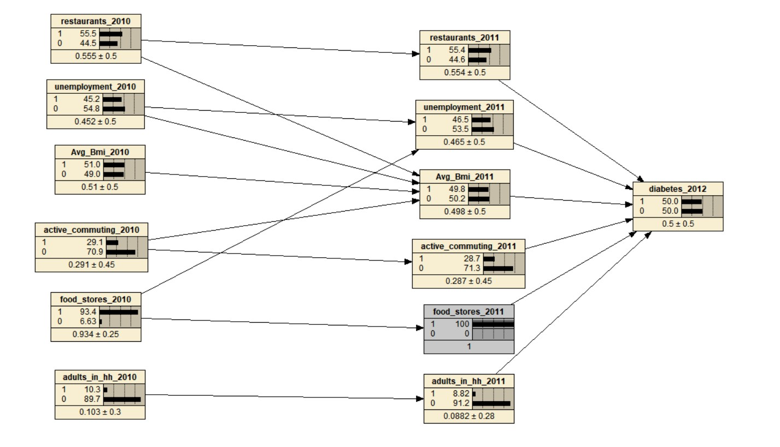
Social Determinants of Diabetes
S t e p 0 7
Find the percentage of diabetes_2012 when food_stores_2011 is “1”
Notes:
When food_stores_2011 is “1”, the percentage of diabetes_2012 is 50

Slide 16
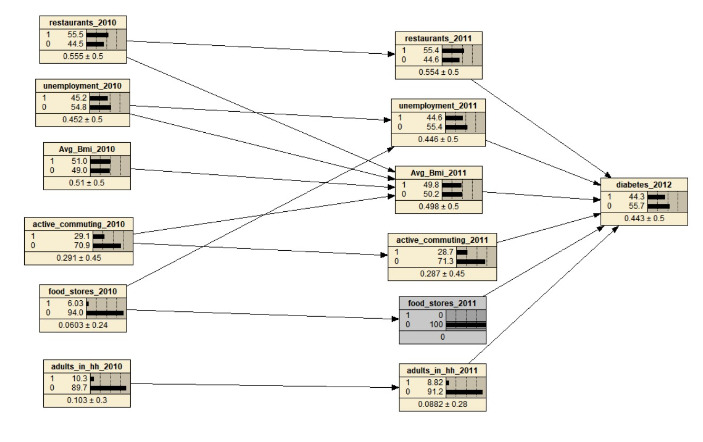
Social Determinants of Diabetes
S t e p 0 8
Find the percentage of diabetes_2012 when food_stores_2011 is “0”
Notes:
When food_stores_2011 is “0”, the percentage of diabetes_2012 is 44.3

Slide 17
Social Determinants of Diabetes
S t e p 0 9
Subtract the two values to get the answer
50.0 %
44.3 %
-------------
5.7%
The impact of access to quality food stores in 2011 on diabetes = 5.7%
Notes:
For step 9, subtract the two values then we can get the result which is 5.7%. In conclusion, the impact of access to quality food stores in 2011 on diabetes is 5.7%

