Slide 1
Order Matters
Farrokh Alemi, Ph.D.
Notes:
This presentation focusses why it is important to find out the order of events. It is presented by Dr. Alemi.

Slide 2
Temporal Order of Variables Can Affect Accuracy of Models

Slide 3
Temporal Order of Variables Can Affect Accuracy of Models
Why no statistics course covers order of events?

Slide 5
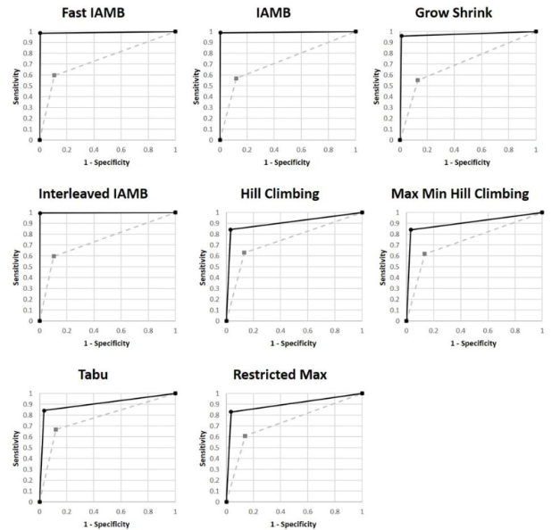
Notes:
(c) Strength of causal reasoning. In human judgment, causes have a bigger impact on the effects than the reverse. Zargoush and colleagues used this method to examine sequence among disabilities ^{[32]}.

Slide 6
Why does sequence of variables affect their association?

Slide 7
Reverse Causality
Disease
Death
Notes:
Reverse causality is a major problem in health care

Slide 8
Notes:
Reverse causality not only distorts the relationship but drops the percent of variation explained

Slide 9
Adding a variable on the pathway from model to outcome reduces the model’s accuracy
Notes:
Variables Natural Occurrences Can Be Used

Slide 10
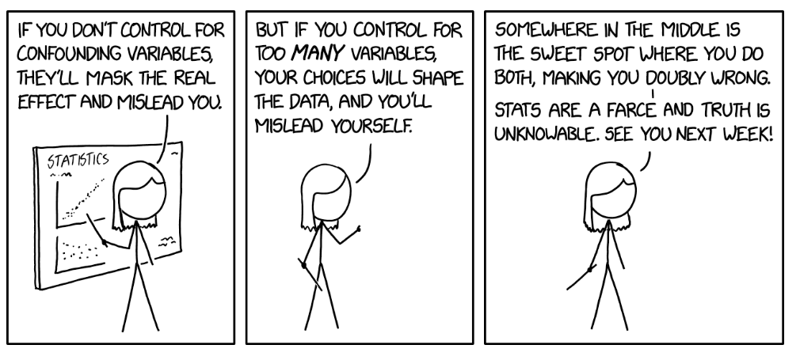

Slide 11
Sequence of Events Matter a Great Deal in Analyzing associations among these events

