Slide 1
Lasso regression
Chris Naso
George mason university
Hap 823

Slide 2
Overview
Question 1: LASSO regress COVID-19 test results on COVID-19 symptoms. Identify the relative weight of each symptom, pair of symptom, and triplet of symptoms. Clarify if clusters of symptoms are more accurate than individual symptoms. LASSO regress COVID-19 test results on its symptoms: Report a measure of goodness of fit and the coefficients for the regression.

Slide 3
Chat gpt lasso regression definition

Slide 4
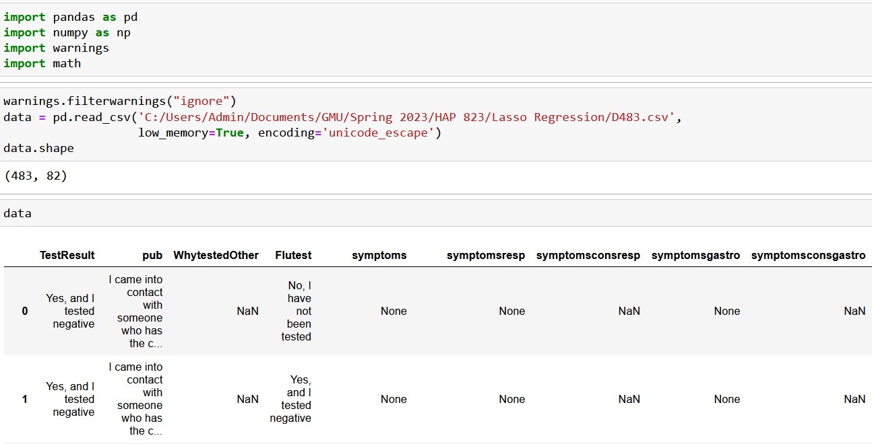
Import the data into python

Slide 5
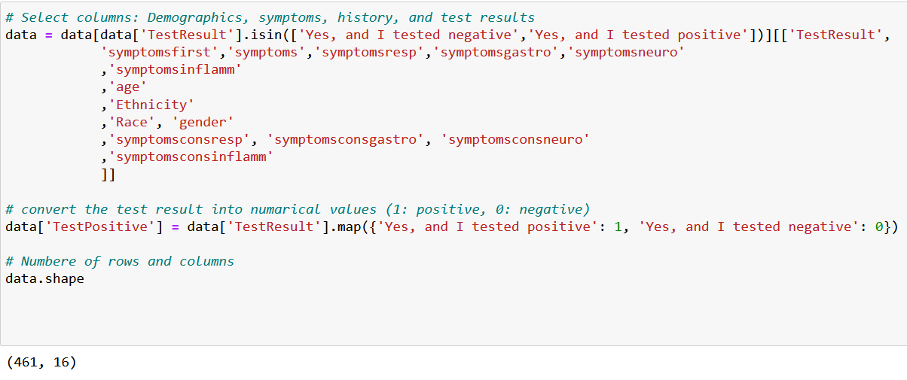
Binarizing outcome into numerical values

Slide 6
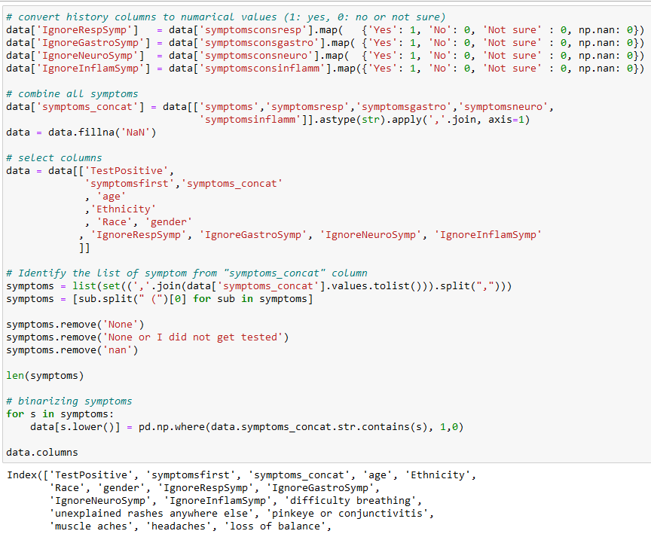
Binarizing variables into numerical values & Cleaning

Slide 7
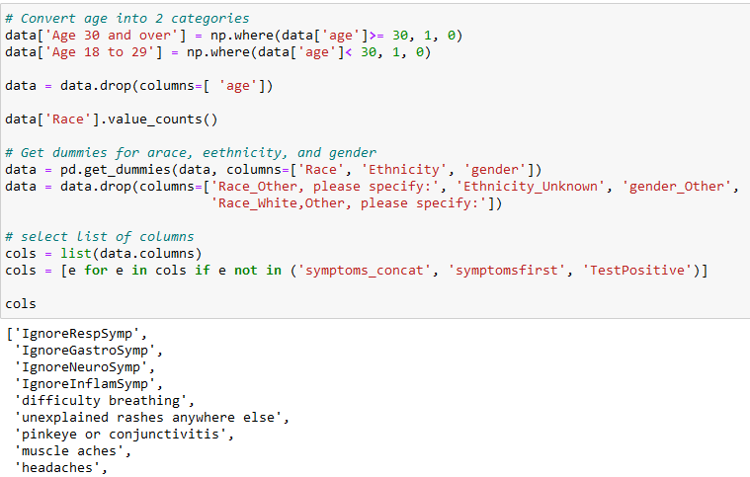
Binarizing variables into numerical values & Cleaning

Slide 8
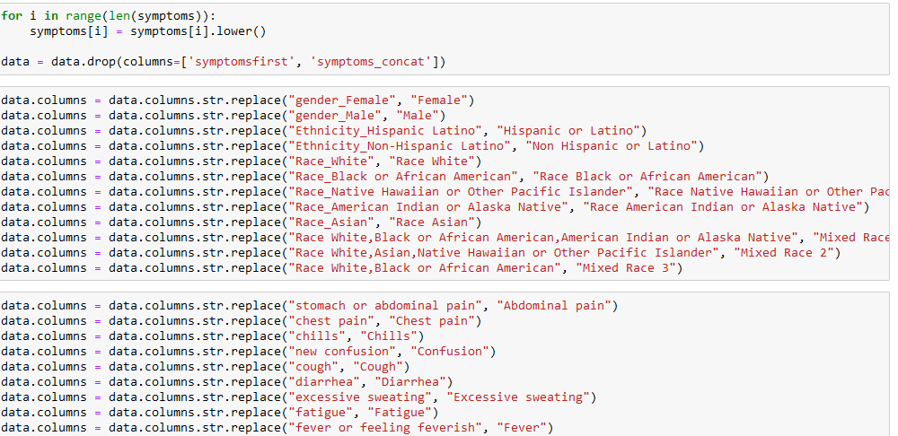
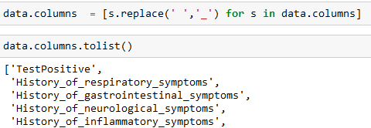
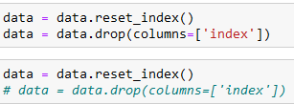
Binarizing variables into numerical values & Cleaning

Slide 9
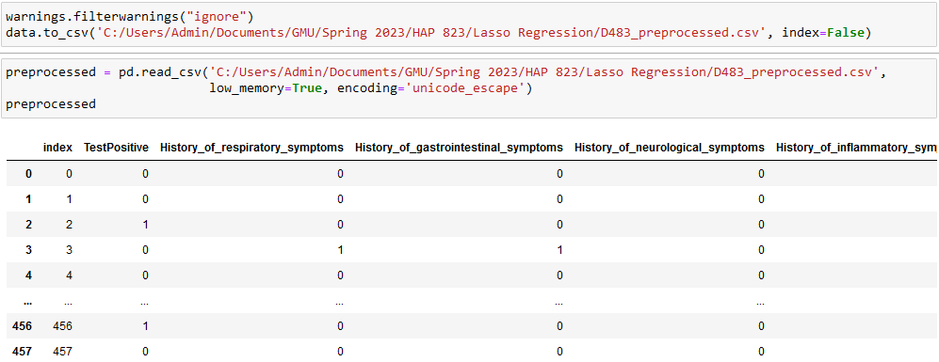
Copying cleaned data to new file

Slide 10
Creating x variables

Slide 11
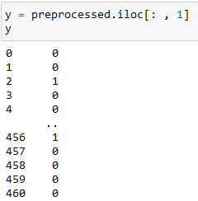
Creating Y variables

Slide 12
Capturing best performing alpha value for lasso regression

Slide 13
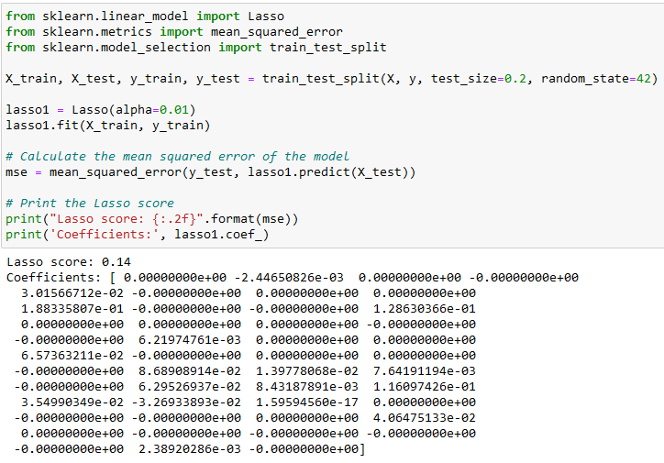
Individual variable model performance & coefficients

Slide 14
Individual variable model coefficient with variables and sorted

Slide 15
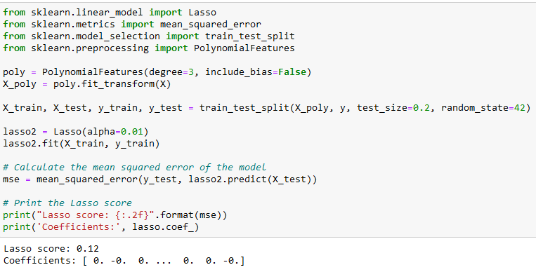
Pairwise and triplet variable model performance & coefficients

Slide 16
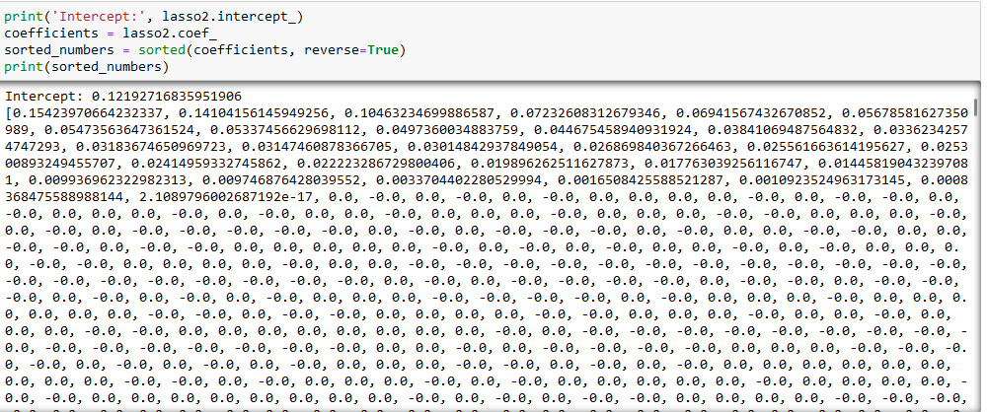
Pairwise and triplet variable coefficients sorted

