Slide 1
Grow Shrink Algorithm
Jee Vang, Ph.D.
Farrokh Alemi, Ph.D.
Notes:
This lecture shows how grow shrink algorithm discovers Markov blanket of variables. This presentation was prepared by Dr. Alemi and is based on slides prepared by Dr. Vang.

Slide 2
Hiton
Notes:
There are many methods to discovering the markov blanket of a variable.
Grow-Shrink (GS): D. Magaritis, Learning Bayesian Network Structure, Carnegie Mellon University, 2003.
HITON: C. Aliferis, I. Tsamardinos, and A. Statnikov, “HITON: A Novel Markov Blanket Algorithm for Optimal Variable Selection,” in AMIA Annu Symp Proceedings, 2003.
IAMB: I. Tsamardinos, C. Aliferis and A. Statnikov, “Time and space efficient discovery of Markov blankets and direct causal relations,” in Proceedings of the 9th ACM SIGKDD International Conference on Knowledge Discovery and Data Mining, 2003.
Tabu search (TS-MB): X. Bai, “Tabu search enhanced Markov blanket classifier for high dimensional data sets,” Carnegie Mellon University, 2005.
S-IAMB: Y. Zhang, H. Xu, Y. Huang, and G. Qian, “S-IAMB Algorithm for Markov Blanket Discovery,” Information Processing, Vol.2, pp. 379 – 382, 2009.
Many many more…

Slide 3
IAMB
Notes:
There are many methods to discovering the markov blanket of a variable.
Grow-Shrink (GS): D. Magaritis, Learning Bayesian Network Structure, Carnegie Mellon University, 2003.
HITON: C. Aliferis, I. Tsamardinos, and A. Statnikov, “HITON: A Novel Markov Blanket Algorithm for Optimal Variable Selection,” in AMIA Annu Symp Proceedings, 2003.
IAMB: I. Tsamardinos, C. Aliferis and A. Statnikov, “Time and space efficient discovery of Markov blankets and direct causal relations,” in Proceedings of the 9th ACM SIGKDD International Conference on Knowledge Discovery and Data Mining, 2003.
Tabu search (TS-MB): X. Bai, “Tabu search enhanced Markov blanket classifier for high dimensional data sets,” Carnegie Mellon University, 2005.
S-IAMB: Y. Zhang, H. Xu, Y. Huang, and G. Qian, “S-IAMB Algorithm for Markov Blanket Discovery,” Information Processing, Vol.2, pp. 379 – 382, 2009.
Many many more…

Slide 4
Tabu
Notes:
There are many methods to discovering the markov blanket of a variable.
Grow-Shrink (GS): D. Magaritis, Learning Bayesian Network Structure, Carnegie Mellon University, 2003.
HITON: C. Aliferis, I. Tsamardinos, and A. Statnikov, “HITON: A Novel Markov Blanket Algorithm for Optimal Variable Selection,” in AMIA Annu Symp Proceedings, 2003.
IAMB: I. Tsamardinos, C. Aliferis and A. Statnikov, “Time and space efficient discovery of Markov blankets and direct causal relations,” in Proceedings of the 9th ACM SIGKDD International Conference on Knowledge Discovery and Data Mining, 2003.
Tabu search (TS-MB): X. Bai, “Tabu search enhanced Markov blanket classifier for high dimensional data sets,” Carnegie Mellon University, 2005.
S-IAMB: Y. Zhang, H. Xu, Y. Huang, and G. Qian, “S-IAMB Algorithm for Markov Blanket Discovery,” Information Processing, Vol.2, pp. 379 – 382, 2009.
Many many more…

Slide 5
Many More
Notes:
There are many other approaches as well.
Grow-Shrink (GS): D. Magaritis, Learning Bayesian Network Structure, Carnegie Mellon University, 2003.
HITON: C. Aliferis, I. Tsamardinos, and A. Statnikov, “HITON: A Novel Markov Blanket Algorithm for Optimal Variable Selection,” in AMIA Annu Symp Proceedings, 2003.
IAMB: I. Tsamardinos, C. Aliferis and A. Statnikov, “Time and space efficient discovery of Markov blankets and direct causal relations,” in Proceedings of the 9th ACM SIGKDD International Conference on Knowledge Discovery and Data Mining, 2003.
Tabu search (TS-MB): X. Bai, “Tabu search enhanced Markov blanket classifier for high dimensional data sets,” Carnegie Mellon University, 2005.
S-IAMB: Y. Zhang, H. Xu, Y. Huang, and G. Qian, “S-IAMB Algorithm for Markov Blanket Discovery,” Information Processing, Vol.2, pp. 379 – 382, 2009.
Many many more…

Slide 6
Grow Shrink
Notes:
We focus on Grow Shrink, one of the earliest method proposed. The purpose of these slides is to give you an intuition on how grow shrink works.
Grow-Shrink (GS): D. Magaritis, Learning Bayesian Network Structure, Carnegie Mellon University, 2003.
HITON: C. Aliferis, I. Tsamardinos, and A. Statnikov, “HITON: A Novel Markov Blanket Algorithm for Optimal Variable Selection,” in AMIA Annu Symp Proceedings, 2003.
IAMB: I. Tsamardinos, C. Aliferis and A. Statnikov, “Time and space efficient discovery of Markov blankets and direct causal relations,” in Proceedings of the 9th ACM SIGKDD International Conference on Knowledge Discovery and Data Mining, 2003.
Tabu search (TS-MB): X. Bai, “Tabu search enhanced Markov blanket classifier for high dimensional data sets,” Carnegie Mellon University, 2005.
S-IAMB: Y. Zhang, H. Xu, Y. Huang, and G. Qian, “S-IAMB Algorithm for Markov Blanket Discovery,” Information Processing, Vol.2, pp. 379 – 382, 2009.
Many many more…

Slide 7
X1
X1=0 | X1=1
0.80 | 0.20
 | X2=0 | X2=1
X1=0 | 0.80 | 0.20
X1=1 | 0.20 | 0.80
X2
X3
X6
 | X3=0 | X3=1
X2=0 | 0.90 | 0.10
X2=1 | 0.10 | 0.90
X6=0 | X6=1
0.55 | 0.45
X4
X7
 | X7=0 | X7-1
X6=0 | 0.80 | 0.20
X6=1 | 0.10 | 0.90
 | X4=0 | X4=1
X3=0,X6=0 | 0.90 | 0.10
X3=0,X6=1 | 0.30 | 0.70
X3=1,X6=0 | 0.30 | 0.70
X3=1,X6=1 | 0.10 | 0.90
X5
 | X5=0 | X5=1
X4=0 | 0.90 | 0.10
X4=1 | 0.10 | 0.90
Notes:
Here is an example of a toy network that we can use to show you how grow shrink algorithm works. If we are discovering this network from the data, we do not know the structure of the network. We need to do certain tests on the data to discover the Markov blanket of each node. We assume that the data reflects the network structure without error, meaning that if two needs are connected in the network they are also dependent in the data; if two nodes are not connected or cannot be reached from each other then they are independent. We will do a series of independence tests to discover the network structure. Even though you see this network, once in the data you know only the test results and not the network structure. We hope to discover this network structure from the data. We will see if we can do so.

Slide 8


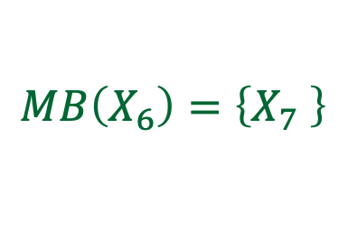




Markov blankets
$$MB\left(X_{1}\right)=\left\{X_{2}\right\}$$
X1
$$MB\left(X_{2}\right)=\left\{X_{2},X_{3}\right\}$$
X2
X3
X6
$$MB\left(X_{3}\right)=\left\{X_{2},X_{4},X_{6}\right\}$$
$$MB\left(X_{6}\right)=\left\{X_{7} \right\}$$
X4
$$MB\left(X_{4}\right)=\left\{X_{3},X_{6},X_{5}\right\}$$
X7
$$MB\left(X_{7}\right)=\left\{X_{6}\right\}$$
$$MB\left(X_{5}\right)=\left\{X_{4}\right\}$$
X5
Notes:
In a directed network, the Markov blanket of a variable $X_{i}$is defined as its parents, children, and co-parents of the variable. It is easy to read this from the graph.

Slide 9
Markov blankets
$$MB\left(X_{1}\right)=\left\{X_{2}\right\}$$
X1
$$MB\left(X_{2}\right)=\left\{X_{2},X_{3}\right\}$$
X2
X3
X6
$$MB\left(X_{3}\right)=\left\{X_{2},X_{4},X_{6}\right\}$$
$$MB\left(X_{6}\right)=\left\{X_{7} \right\}$$
X4
$$MB\left(X_{4}\right)=\left\{X_{3},X_{6},X_{5}\right\}$$
X7
$$MB\left(X_{7}\right)=\left\{X_{6}\right\}$$
$$MB\left(X_{5}\right)=\left\{X_{4}\right\}$$
X5
Notes:
For example, the Markov blanket of X3 (shown in green) is X2, X4 or X6. X2 is the parent to X3, X4 is the child of X3 and X6 and X3 are the co-parents of X4. The nodes shown in red represent the Markov blanket of X3. Lets see if grow shrink can discover these blankets.

Slide 10

Grow-Shrink (GS) algorithm
$$B_{i}←∅$$
While $∃Y∈U$ such that $¬I(X,Y|B_{i})$ //grow
$$B_{i}←B_{i}∪\{Y\}$$
While $∃Y∈B_{i}$such that $I(X,Y|B_{i}∖\{Y\})$ //shrink
$$B_{i}←B_{i}∖\{Y\}$$
return $B_{i}$
Notes:
Suppose we want to estimate the blanket for X. We conduct test of independence with any variable Y given the variables that are currently in the blanket. If Y and X are dependent, the Y is added to the blanket and the number of variables in the blanket grows. If Y is not dependent on X then it is not added to the blanket.

Slide 11

Grow-Shrink (GS) algorithm
$$B_{i}←∅$$
While $∃Y∈U$ such that $¬I(X,Y|B_{i})$ //grow
$$B_{i}←B_{i}∪\{Y\}$$
While $∃Y∈B_{i}$such that $I(X,Y|B_{i}∖\{Y\})$ //shrink
$$B_{i}←B_{i}∖\{Y\}$$
return $B_{i}$
Notes:
For the shrink phase, the variables currently in the blanket are tested again but this time with final list of variables in the blanket. Any variable that is independent of X conditional on variables in the blanket are dropped from the analysis. In the shrink phase some of the variables that are no longer dependent on X are dropped from the blanket.

Slide 12
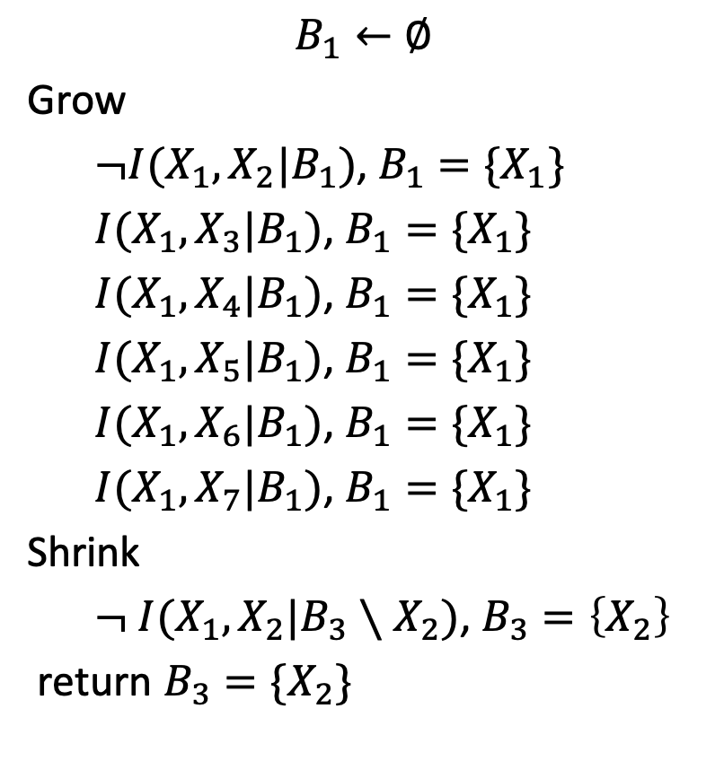
$$B_{1}←∅$$
Grow
$¬I(X_{1},X_{2}|B_{1})$, $B_{1}=\{X_{1}\}$
$I(X_{1},X_{3}|B_{1})$, $B_{1}=\{X_{1}\}$
$I(X_{1},X_{4}|B_{1})$, $B_{1}=\{X_{1}\}$
$I(X_{1},X_{5}|B_{1})$, $B_{1}=\{X_{1}\}$
$I(X_{1},X_{6}|B_{1})$, $B_{1}=\{X_{1}\}$
$I(X_{1},X_{7}|B_{1})$, $B_{1}=\{X_{1}\}$
Shrink
$¬ I(X_{1},X_{2}|B_{3}∖X_{2})$, $B_{3}=\left\{X_{2}\right\}$
return $B_{3}=\{X_{2}\}$
X1
X2
X3
X6
X4
X7
X5
Notes:
Lets see how the grow phase works. First we start with a no variables in the blanket. Then we test the dependence between X1 and all other variables. The grow phase adds X2 to blanket. The shrink phase cannot drop X2. So the blanket for X1 is X2.

Slide 13
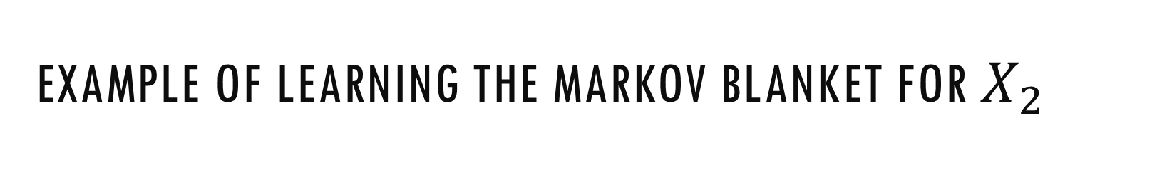
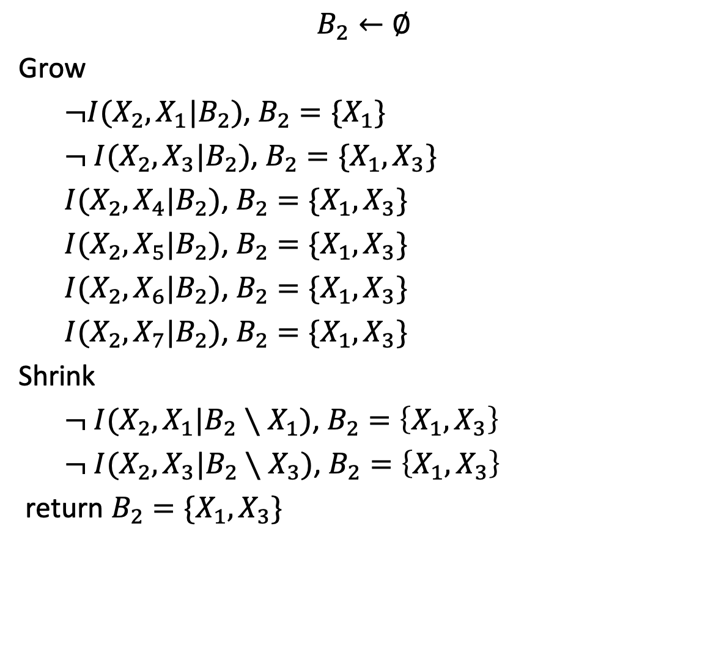
Example of learning the Markov blanket for $X_{2}$
$$B_{2}←∅$$
Grow
$¬I(X_{2},X_{1}|B_{2})$, $B_{2}=\{X_{1}\}$
$¬ I(X_{2},X_{3}|B_{2})$, $B_{2}=\{X_{1},X_{3}\}$
$I(X_{2},X_{4}|B_{2})$, $B_{2}=\{X_{1},X_{3}\}$
$I(X_{2},X_{5}|B_{2})$, $B_{2}=\{X_{1},X_{3}\}$
$I(X_{2},X_{6}|B_{2})$, $B_{2}=\{X_{1},X_{3}\}$
$I(X_{2},X_{7}|B_{2})$, $B_{2}=\{X_{1},X_{3}\}$
Shrink
$¬ I(X_{2},X_{1}|B_{2}∖X_{1})$, $B_{2}=\left\{X_{1},X_{3}\right\}$
$¬ I(X_{2},X_{3}|B_{2}∖X_{3})$, $B_{2}=\left\{X_{1},X_{3}\right\}$
return $B_{2}=\{X_{1},X_{3}\}$
X1
X2
X3
X6
X4
X7
X5
Notes:
When looking at X2, the grow phase adds X1 and X3, these are shown in red as these two are dependent on X2. The shrink phase does not drop anything. So the Markov blanket discovered for X2 is X1 and X3, which is correct. So far the algorithm has discovered all Markov blankets correctly.

Slide 14
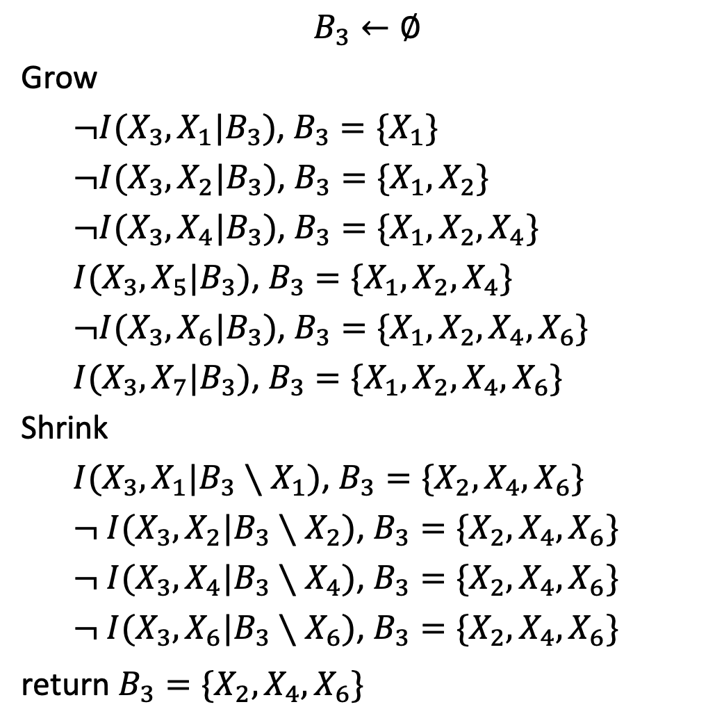
$$B_{3}←∅$$
Grow
$¬I(X_{3},X_{1}|B_{3})$, $B_{3}=\{X_{1}\}$
$¬I(X_{3},X_{2}|B_{3})$, $B_{3}=\{X_{1},X_{2}\}$
$¬I(X_{3},X_{4}|B_{3})$, $B_{3}=\{X_{1},X_{2},X_{4}\}$
$I(X_{3},X_{5}|B_{3})$, $B_{3}=\{X_{1},X_{2},X_{4}\}$
$¬I(X_{3},X_{6}|B_{3})$, $B_{3}=\{X_{1},X_{2},X_{4},X_{6}\}$
$I(X_{3},X_{7}|B_{3})$, $B_{3}=\{X_{1},X_{2},X_{4},X_{6}\}$
Shrink
$I(X_{3},X_{1}|B_{3}∖X_{1})$, $B_{3}=\{X_{2},X_{4},X_{6}\}$
$¬ I(X_{3},X_{2}|B_{3}∖X_{2})$, $B_{3}=\{X_{2},X_{4},X_{6}\}$
$¬ I(X_{3},X_{4}|B_{3}∖X_{4})$, $B_{3}=\{X_{2},X_{4},X_{6}\}$
$¬ I(X_{3},X_{6}|B_{3}∖X_{6})$, $B_{3}=\{X_{2},X_{4},X_{6}\}$
return $B_{3}=\{X_{2},X_{4},X_{6}\}$
X1
X2
X3
X6
X4
X7
X5
Notes:
When looking at X3, the grow phase adds X1, X2, X4, and X6. Note that because we are conditioning on X4, a collider node, X6 is going to be related to X3. So X6 is also picked up in the grow phase. The shrink phase drops X1 as now X2 is in the blanket and it blocks the relationship between X1 and X3. Meaning that conditional on X2, X1 is not related to X3. So the Markov blanket discovered for X3 is X2 and X4 and X6. Again, the algorithm has discovered the Markov blanket correctly.

Slide 15
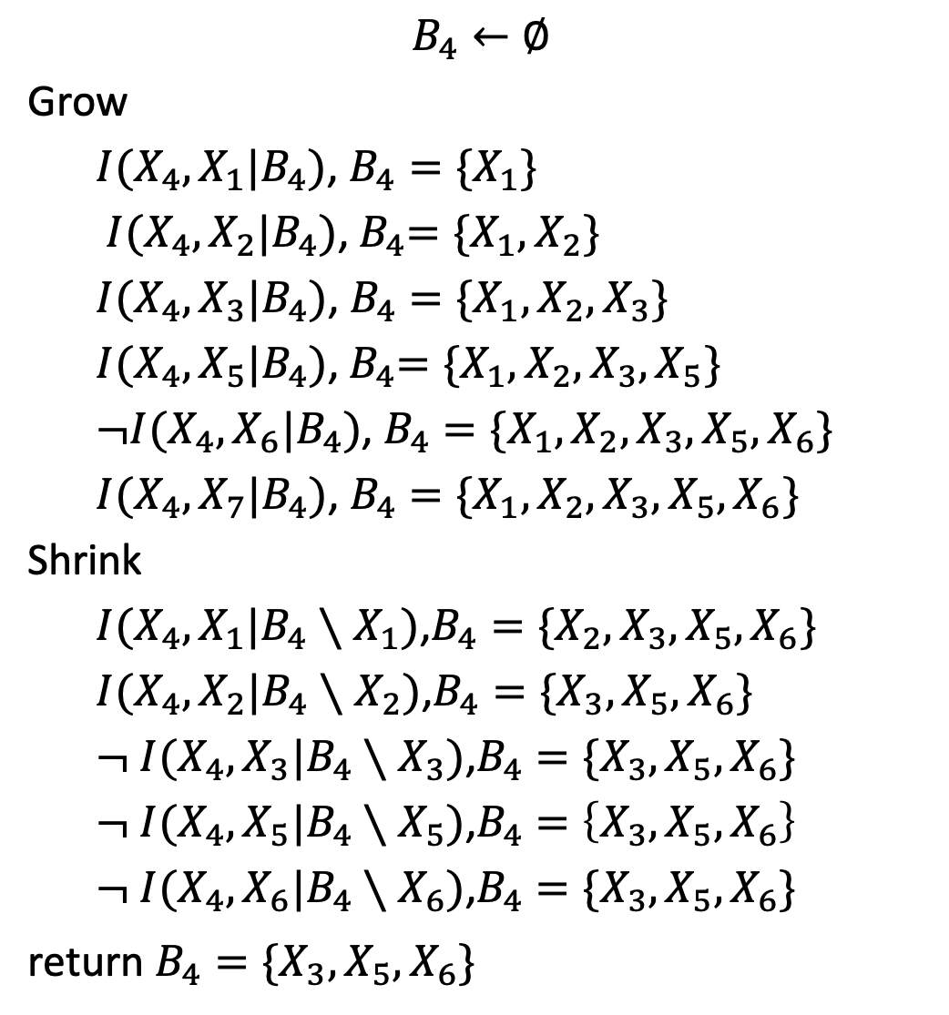
$$B_{4}←∅$$
Grow
$I(X_{4},X_{1}|B_{4})$, $B_{4}=\{X_{1}\}$
$I(X_{4},X_{2}|B_{4})$,${ B}_{4}=\{X_{1},X_{2}\}$
$I(X_{4},X_{3}|B_{4})$, $B_{4}=\{X_{1},X_{2},X_{3}\}$
$I(X_{4},X_{5}|B_{4})$,${ B}_{4}=\{X_{1},X_{2},X_{3},X_{5}\}$
$¬I(X_{4},X_{6}|B_{4})$, $B_{4}=\{X_{1},X_{2},X_{3},X_{5},X_{6}\}$
$I(X_{4},X_{7}|B_{4})$, $B_{4}=\{X_{1},X_{2},X_{3},{X_{5},X}_{6}\}$
Shrink
$I(X_{4},X_{1}|B_{4}∖X_{1})$,$B_{4}=\{X_{2},X_{3},{X_{5},X}_{6}\}$
$I(X_{4},X_{2}|B_{4}∖X_{2})$,$B_{4}=\{X_{3},{X_{5},X}_{6}\}$
$¬ I(X_{4},X_{3}|B_{4}∖X_{3})$,$B_{4}=\{X_{3},{X_{5},X}_{6}\}$
$¬ I(X_{4},X_{5}|B_{4}∖X_{5})$,$B_{4}=\left\{X_{3},{X_{5},X}_{6}\right\}$
$¬ I(X_{4},X_{6}|B_{4}∖X_{6})$,$B_{4}=\{X_{3},{X_{5},X}_{6}\}$
return $B_{4}=\{X_{3},X_{5},X_{6}\}$
X1
X2
X3
X6
X4
X7
X5
Notes:
The algorithm also works for node X4. It correctly identifies that the blanket of X4 includes X3, X5 and X6.

Slide 16
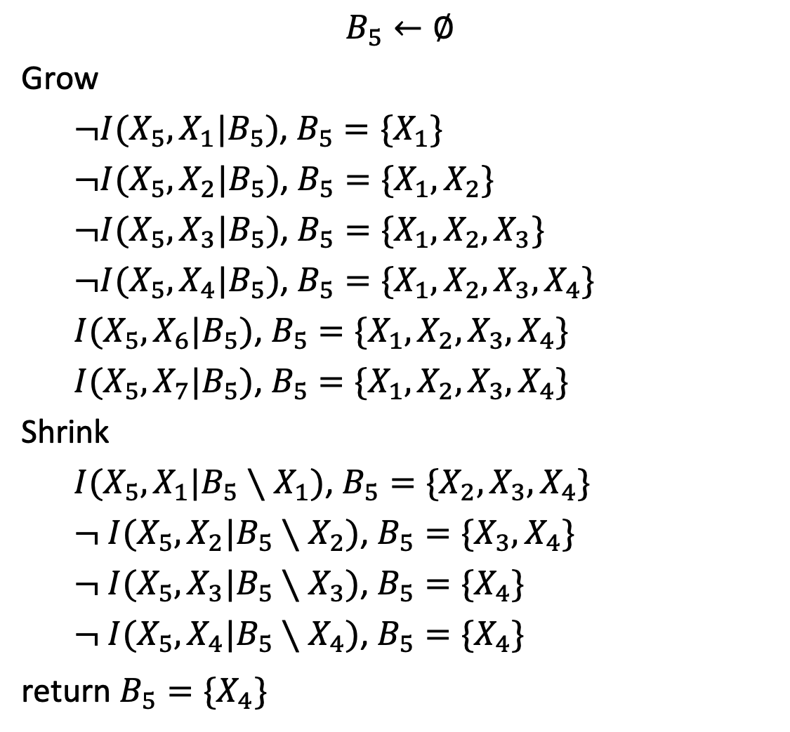
$$B_{5}←∅$$
Grow
$¬I(X_{5},X_{1}|B_{5})$, $B_{5}=\{X_{1}\}$
$¬I(X_{5},X_{2}|B_{5})$, $B_{5}=\{X_{1},X_{2}\}$
$¬I(X_{5},X_{3}|B_{5})$, $B_{5}=\{X_{1},X_{2},X_{3}\}$
$¬I(X_{5},X_{4}|B_{5})$, $B_{5}=\{X_{1},X_{2},X_{3},X_{4}\}$
$I(X_{5},X_{6}|B_{5})$, $B_{5}=\{X_{1},X_{2},X_{3},X_{4}\}$
$I(X_{5},X_{7}|B_{5})$, $B_{5}=\{X_{1},X_{2},X_{3},X_{4}\}$
Shrink
$I(X_{5},X_{1}|B_{5}∖X_{1})$, $B_{5}=\{X_{2},X_{3},X_{4}\}$
$¬ I(X_{5},X_{2}|B_{5}∖X_{2})$, $B_{5}=\{X_{3},X_{4}\}$
$¬ I(X_{5},X_{3}|B_{5}∖X_{3})$, $B_{5}=\{X_{4}\}$
$¬ I(X_{5},X_{4}|B_{5}∖X_{4})$, $B_{5}=\{X_{4}\}$
return $B_{5}=\{X_{4}\}$
X1
X2
X3
X6
X4
X7
X5
Notes:
The algorithm also works for node X5.

Slide 17
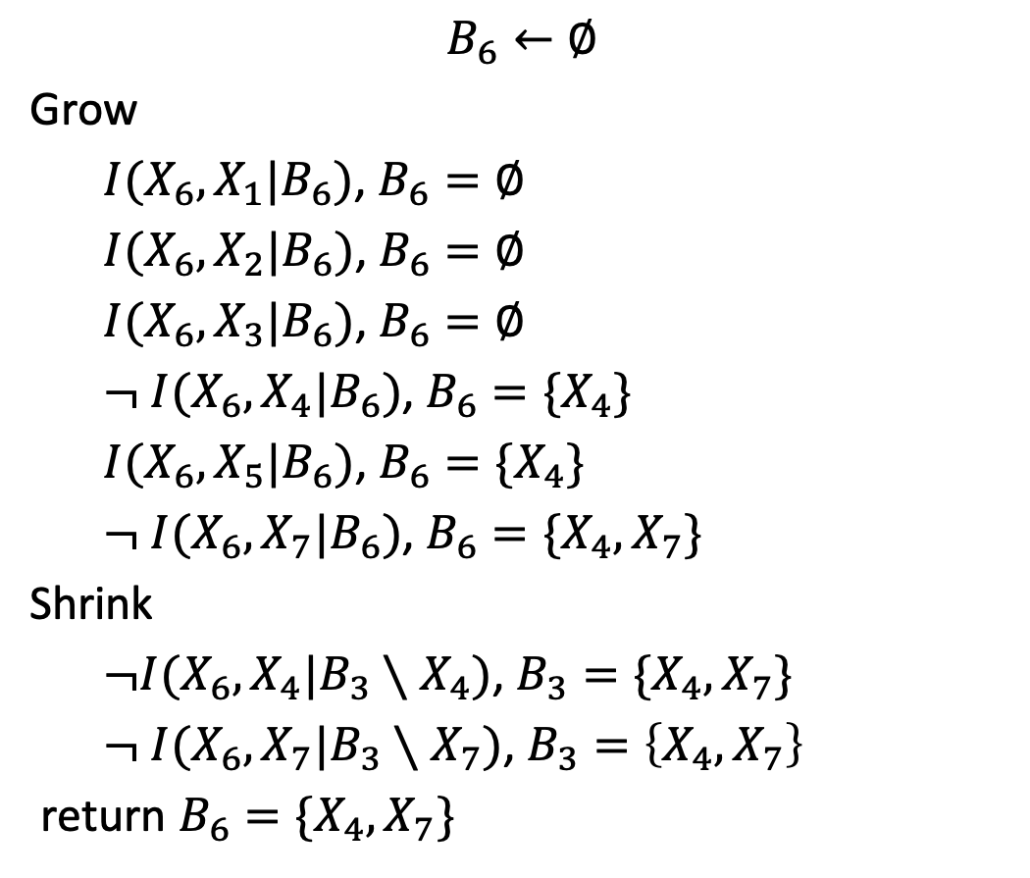
$$B_{6}←∅$$
Grow
$I(X_{6},X_{1}|B_{6})$, $B_{6}=∅$
$I(X_{6},X_{2}|B_{6})$, $B_{6}=∅$
$I(X_{6},X_{3}|B_{6})$, $B_{6}=∅$
$¬ I(X_{6},X_{4}|B_{6})$, $B_{6}=\{X_{4}\}$
$I(X_{6},X_{5}|B_{6})$, $B_{6}=\{X_{4}\}$
$¬ I(X_{6},X_{7}|B_{6})$, $B_{6}=\{X_{4},X_{7}\}$
Shrink
$¬I(X_{6},X_{4}|B_{3}∖X_{4})$, $B_{3}=\{X_{4},X_{7}\}$
$¬ I(X_{6},X_{7}|B_{3}∖X_{7})$, $B_{3}=\left\{X_{4},X_{7}\right\}$
return $B_{6}=\{X_{4},X_{7}\}$
X1
X2
X3
X6
X4
X7
X5
Notes:
The algorithm a makes a mistake in determining the Markov blanket of X6. It should have picked up X3 as a co-parent but it does not. In the grow phase, X4 is not in the blanket, no collider is created, so the algorithm thinks that X3 and X6 are not related. Later X4 comes into the blanket but by now it is too late and we have missed the opportunity to include X3.

Slide 18
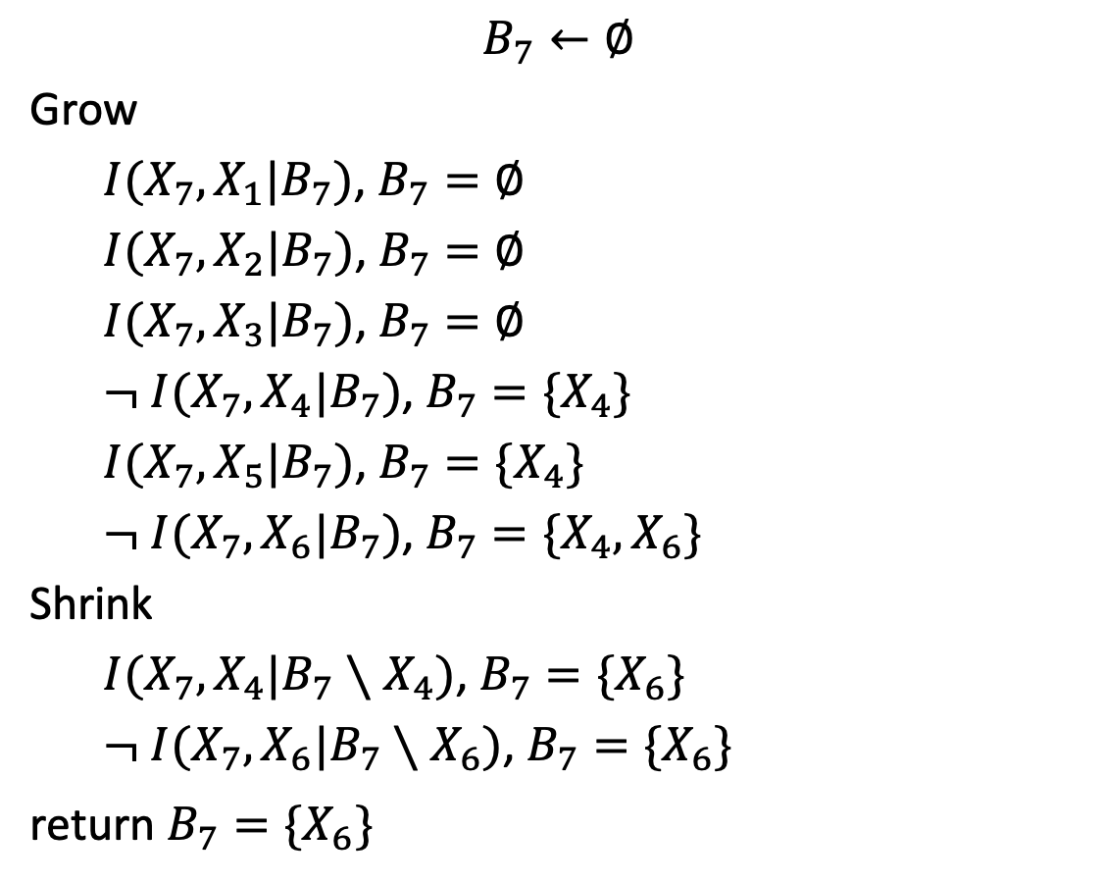
$$B_{7}←∅$$
Grow
$I(X_{7},X_{1}|B_{7})$, $B_{7}=∅$
$I(X_{7},X_{2}|B_{7})$, $B_{7}=∅$
$I(X_{7},X_{3}|B_{7})$, $B_{7}=∅$
$¬ I(X_{7},X_{4}|B_{7})$, $B_{7}=\{X_{4}\}$
$I(X_{7},X_{5}|B_{7})$, $B_{7}=\{X_{4}\}$
$¬ I(X_{7},X_{6}|B_{7})$, $B_{7}=\{X_{4},X_{6}\}$
Shrink
$I(X_{7},X_{4}|B_{7}∖X_{4})$, $B_{7}=\{X_{6}\}$
$¬ I(X_{7},X_{6}|B_{7}∖X_{6})$, $B_{7}=\{X_{6}\}$
return $B_{7}=\{X_{6}\}$
X1
X2
X3
X6
X4
X7
X5
Notes:
The algorithm correctly picks up the Markov blanket of X7.

Slide 19
Grow shrink algorithm works most of the time but can make errors
Notes:
Grow shrink algorithm works most of the time but occasionally it makes an error, specially when a collider is possible and the algorithm has not picked the variables in the right order to detect the collider.

