Slide 1
Mediation Analysis
Wednesday, October 05, 2016
Farrokh Alemi, PhD.
The lecture is based on Nguyen QC, Osypuk TL, Schmidt NM, Glymour MM, Tchetgen Tchetgen EJ. Practical guidance for conducting mediation analysis with multiple mediators using inverse odds ratio weighting. Am J Epidemiol. 2015 Mar 1;181(5):349-56.
Notes:
This lecture focuses on mediation analysis. It is based on work of Nguyen and colleagues.

Slide 2
Meditation Can Show Mechanism
1. Association
2. Sequence
3. Counterfactual
4. Mechanism
Notes:
Causal analysis of data requires us to specify four relationships between cause and effect: association between cause and effect, sequence of cause and effect, counterfactual or the absence of effect, when causes are absent, and finally a mechanism by which the effect occurs. Mediation analysis can verify a hypothesized mechanism. In this lecture we cover methods for testing if a variable mediates the effect of two other variables on each other.

Slide 3
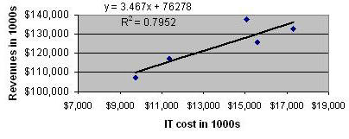
Return on IT Investment
Alemi F, Zargoush M, Oakes JL Jr, Edrees H. A Simple Method for Causal Analysis of Return on IT Investment. J Healthc Eng. 2011 Mar 1;2(1):43-54.
Notes:
For example, consider a situation where we want to know if investment in IT is associated with new revenues. A simple plot can show that the two variables are associated. All we know from this graph is IT cost and revenue are related to each other. We do not know why and how. These are two important questions that can radically change our interpretation of whether we should invest into more IT or not.

Slide 4
Why IT Cost Is Related to Revenue?
Invest in IT
Use IT
Earn More
More Revenue
Invest in IT
Use IT
Notes:
There are two interpretation of the association between IT investment and revenue. Increased IT investments could be leading to more revenue or the reverse more income may be associated with more money for new computers and gadgets. The first interpretation is productive and the second is counterproductive spending that is not related to earning more revenue. It is possible that IT drives the new income or the reverse the new income leads to more spending on IT. To answer which of these two are the cause of change we need to introduce a mediating variable such as use of IT into the analysis. If use of IT mediates the effect of cost of IT and revenue of the organization, then we have more support for IT investment is leading to increased revenue. Alternatively, if use of IT does not mediate the effect, then we have more support that IT spending increases when we have more money to spend. Mediation can settle this important distinction and help us understand the role that IT is playing in the organizations.

Slide 5
Direct & Indirect Effect
Exposure E
Mediator M
Outcome Y
Covariate C
Notes:
Suppose that we have a set of independent and identically distributed data are observed for n subjects with outcome Y, binary exposure E, and mediator M, which succeeds the exposure and precedes the outcome and through which the exposure has an impact on outcome. Also assume that C is the vector of pre-exposure covariates that confound the relationship between exposure, mediation and outcome.

Slide 6
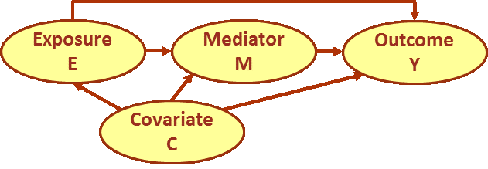
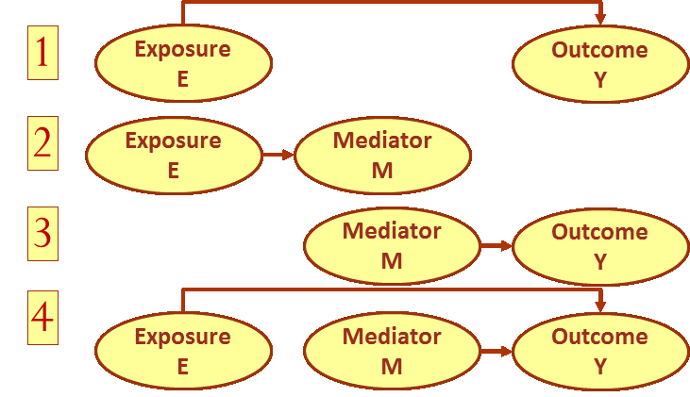
Baron and Kenny’s Approach
Notes:
In 1986, Baron and Kenny described how multiple regressions can be used to test if a variable is mediating the effect of two other variables. The problem was divided into 4 separate regression. The first was regression of Y on E, which measured total impact of E on Y. Then there was regression of M on E, which measures the relationship between mediator and exposure. Next was regression of Outcome on the mediator. Finally was regression of outcome on both mediator and exposure. The purpose of the first 3 regressions was to estimate the impact of single variables and the last regression estimates the impact of combined variables. Regression 1 and 4 can be compared to find if M is in fact the mediator. If M is the mediator, then in the effect of E on Y should disappear or be reduced when both variables are in the model.

Slide 7
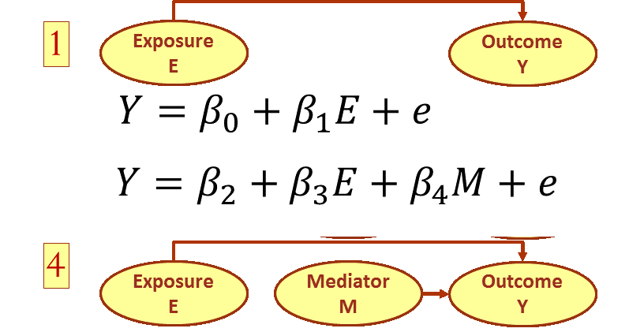
Baron and Kenny’s Approach

Slide 8
Baron and Kenny’s Approach
Notes:
Compared to the coefficient of exposure in the regression with and without mediator. If B1 is significant but B3 is not, then we have evidence for a mediator.

Slide 9
Assumptions
No unmeasured confounding
Confounding not affected by exposure
Notes:
We assume no unmeasured confounding of the effects of the 1) exposure on the mediator, 2) mediator on the outcome, or 3) exposure on the outcome, conditioning on pre-exposure confounders. We also assume that the confounding variables of the mediator-outcome relationship are not affected by the exposure.

Slide 10
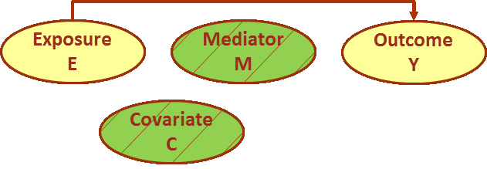
Other Approaches
1. Stratified Covariate Balancing
2. Inverse Odds Ratio Weights
Notes:
There are at least two ways to measure the direct impact of exposure. In both methods weights are estimated that remove the effect of covariates and mediators and the weighted impact of exposure on outcome is the estimate for the direct effect.

Slide 11
Inverse Odds Ratio Weights
Regress exposure on M & C
$$E=β_{0}+β_{1}M_{c=1}+{β_{2}M}_{c=2}+β_{3}C+e$$
Notes:
The inverse odds ratio weights starts with regressing the exposure on the mediator and the covariate set. Here the regression reflects the interaction of mediators and covariate variables so a different indicator variable is used for mediators when covariate is present and when it is absent.

Slide 12
Direct Effect of E on Y (IORW)
1. Regress exposure on M & C
2. Calculate weights to remove indirect paths
W$=\frac{1}{OR(E,M|C)}=\frac{1}{e^{{(β}_{1}{EM}_{1}+{β_{2}EM}_{2})/σ^{2}}}$
Notes:
Next step is to calculate the odds of combined exposure and mediation given the covariate. The Odds Ratio is the condition odds of observing the combination of E and M given the covariate. This odds ratio can be calculated from the earlier regression parameters and the standard deviation can be calculated through bootstrapping.

Slide 13
Direct Effect of E on Y (IORW)
1. Regress exposure on M & C
2. Calculate weights to remove indirect paths
3. Weighted regression of Y on E & C
Notes:
The last step is to use the weighted regression of outcome on E and C. The inverse odds ratio weights essentially balances the data so conditional on covariate there is no difference in the level of the mediator variable for exposed and not exposed patients.

Slide 14
Direct Effect of E on Y (SCB)
Stratify mediator at levels of covariate
Set mediator to be the level when E=0
Calculate weights to remove indirect effects
Calculate weighted impact of change in E on Y
Notes:
The second approach is to use the stratified covariate balancing. The stratified covariate balancing provides the weights for removing the effects of mediator and covariate through stratification so that the combination of exposure and mediator at different covariate levels are balanced. We can stratify on the mediator and the covariate, to break the indirect relationships between exposure and outcome. Then the direct impact of exposure on outcome is calculated as difference of average outcome at various levels of exposure.

Slide 15
Direct & Indirect Effects
Notes:
This lecture has shown how to measure direct and indirect unconfounded effects of one variable on another.

